Slide 1
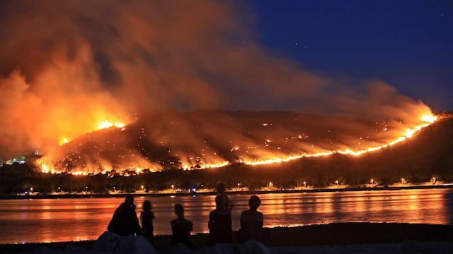



Representing sub-grid biomass burning processes in regional and global models
Jeffrey Pierce
Kim Sakamoto, Emily Ramnarine, Anna Hodshire
This study was supported by the U.S. National Science Foundation under Grant No. AGS-1559607, the U.S. National Oceanic and Atmospheric Administration under Grant No. NA17OAR430001, and the Joint Fire Science Program (JFSP) under Project 14-1-03-26.

Slide 2
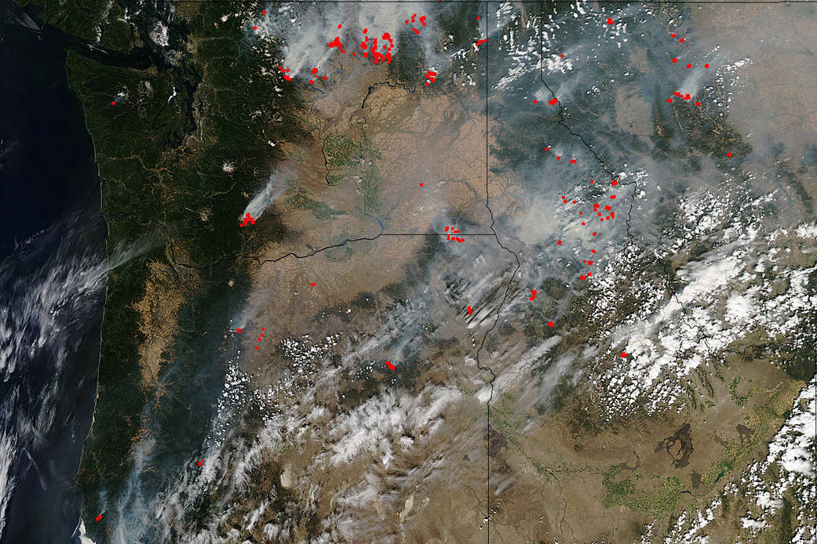
Smoke PM: complicated not just chemically… but spatially
NASA Aqua-MODIS, Pacific Northwest fires, Aug. 15, 2015.
NASA image courtesy Jeff Schmaltz, MODIS Rapid Response Team.

Slide 3
Direct effects
NASA Aqua-MODIS, Pacific Northwest fires, Aug. 15, 2015.
NASA image courtesy Jeff Schmaltz, MODIS Rapid Response Team.

Slide 4
Indirect effects
NASA Aqua-MODIS, Pacific Northwest fires, Aug. 15, 2015.
NASA image courtesy Jeff Schmaltz, MODIS Rapid Response Team.

Slide 5
Concentration gradients smaller than model gridboxes
Global-model gridbox
Regional-model gridbox
NASA Aqua-MODIS, Pacific Northwest fires, Aug. 15, 2015.
NASA image courtesy Jeff Schmaltz, MODIS Rapid Response Team.

Slide 6
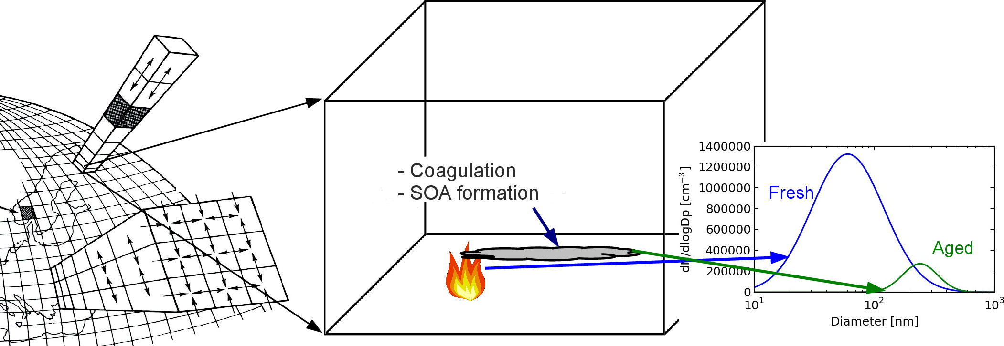
Sub-grid processes affect particle mass and size distribution
POA evaporation
SOA formation
Coagulation

Slide 7
Focus on coagulation
POA evaporation
SOA formation
Coagulation

Slide 8
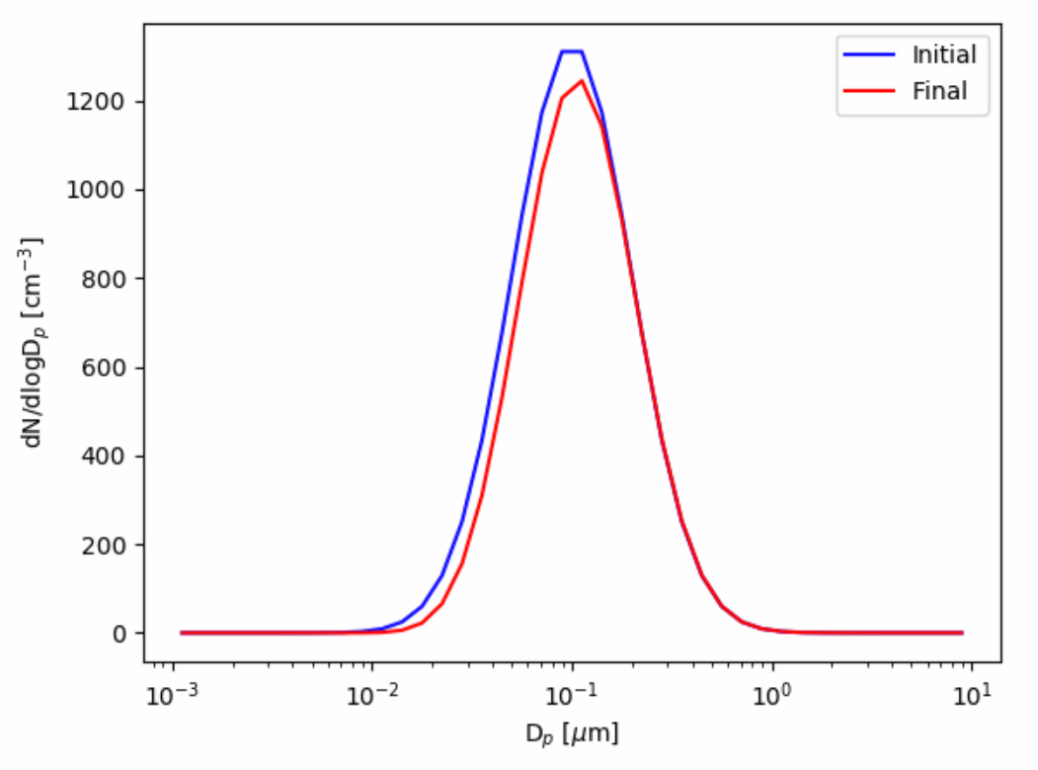
Coagulation:
(1) removes number
(2) increases median diameter (D_{pg})
(3) decreases modal width (σ_{g})
dN/dlogD_{p}
D_{p} (μm)
http://pierce.atmos.colostate.edu/apps/mphys

Slide 9
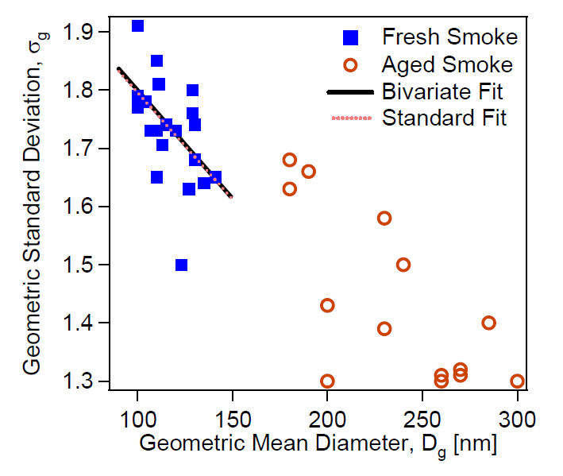
Biomass-burning particle distributions get larger and narrower with aging
Janhäll, S., et al.:, Atmos. Chem. Phys., 10, 1427-1439, 2010.

Slide 10
Biomass-burning particle distributions get larger and narrower with aging
Aging
Janhäll, S., et al.:, Atmos. Chem. Phys., 10, 1427-1439, 2010.

Slide 11
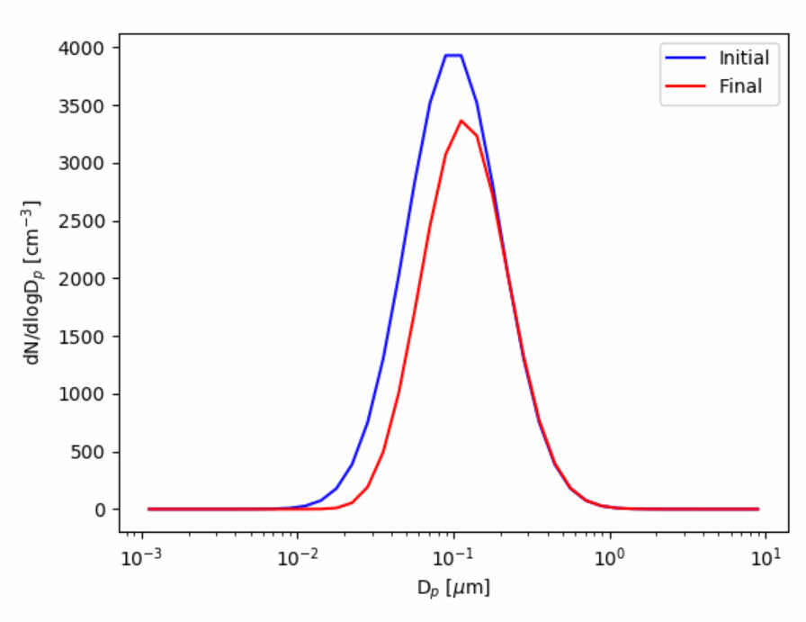
Higher number concentration causes more coagulation
3000 cm⁻³
1000 cm⁻³
dN/dlogD_{p}
dN/dlogD_{p}
D_{p} (μm)
D_{p} (μm)
http://pierce.atmos.colostate.edu/apps/mphys

Slide 12
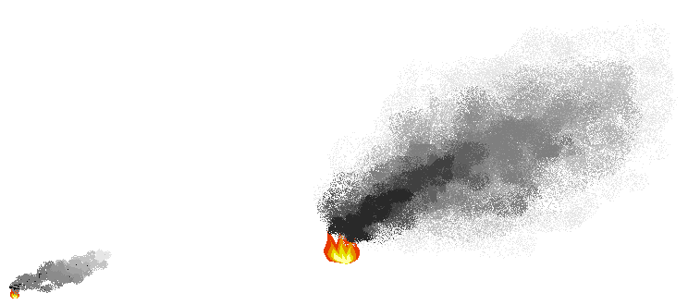
Less dilution (higher number concentration) causes more coagulation
3000 cm⁻³
1000 cm⁻³
dN/dlogD_{p}
dN/dlogD_{p}
dN/dlogD_{p}
Large Fire
D_{p} (μm)
Small Fire
Dilution happens more quickly
Dilution happens more slowly
D_{p} (μm)
Notes:
make analogy to campfire

Slide 13
So, how do we currently represent subgrid coagulation in models?
Global-model gridbox
Regional-model gridbox
NASA Aqua-MODIS, Pacific Northwest fires, Aug. 15, 2015.
NASA image courtesy Jeff Schmaltz, MODIS Rapid Response Team.

Slide 14
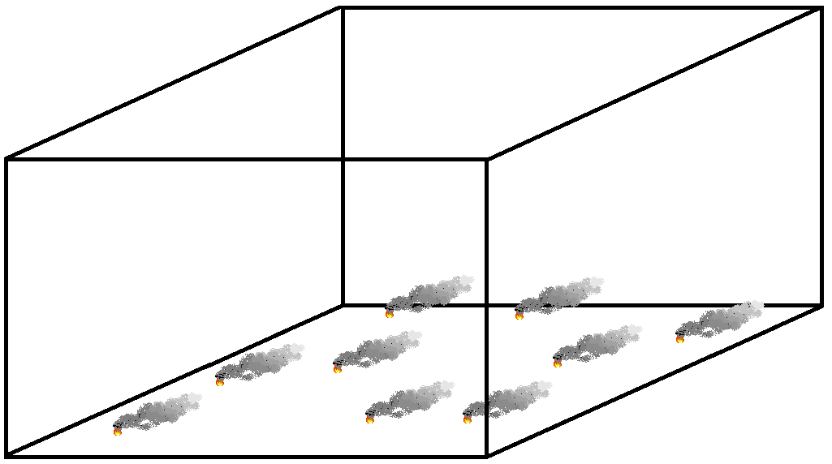
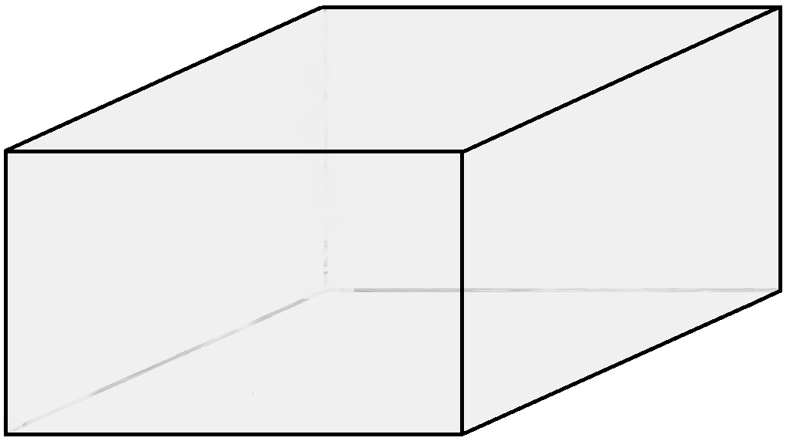
Instantaneous mixing through the full gridbox
dilutes the aerosol plume
Notes:
Normally, these models immediately spread the emissions from the smoke plumes into the entire gridbox, greatly diluting the smoke

Slide 15
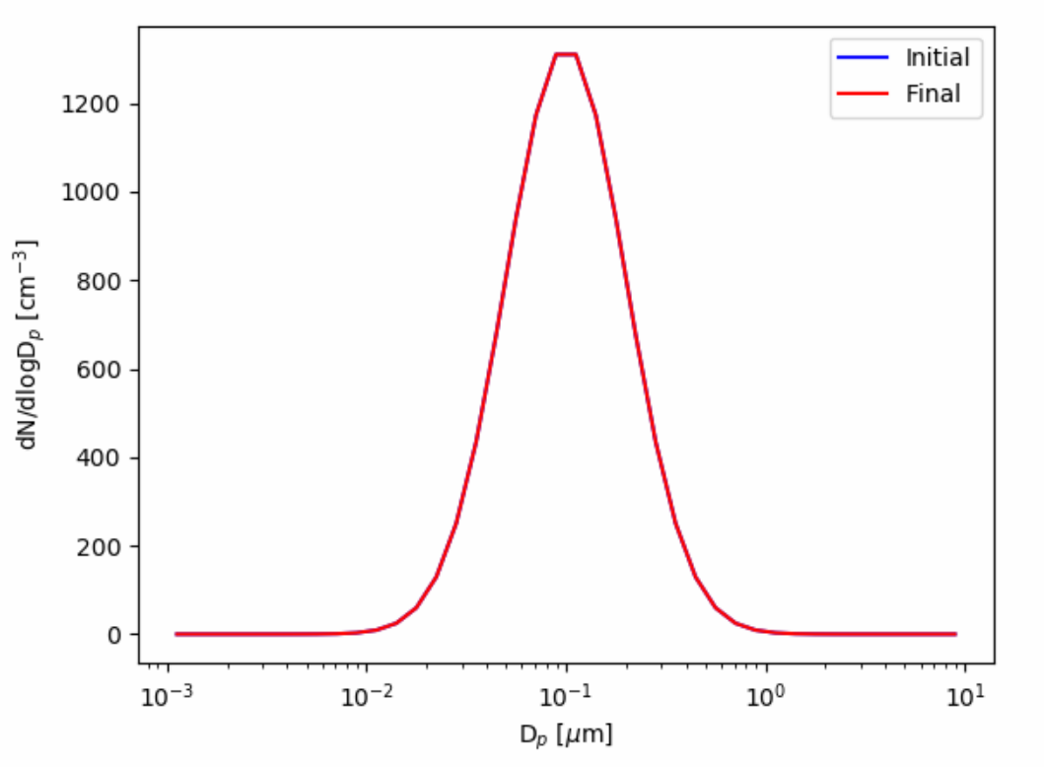
Inadequate aging due to instant dilution can change the predicted size distribution
High Concentration
dN/dlogD_{p}
Low Concentration
D_{p} (μm)
dN/dlogD_{p}
D_{p} (μm)
Notes:
More dilute emissions mean less coagulation overall (and no subgrid coagulation)

Slide 16
Inadequate aging due to instant dilution can change the predicted size distribution
High Concentration
dN/dlogD_{p}
Low Concentration
D_{p} (μm)
dN/dlogD_{p}
D_{p} (μm)
How can we improve this?
Notes:
More dilute emissions mean less coagulation overall (and no subgrid coagulation)

Slide 17
Two goals for this talk
Develop a parameterization of sub-grid coagulation for regional/global models
Estimate the impact of this sub-grid coagulation on direct and indirect radiative effects

Slide 18
Two goals for this talk
Develop a parameterization of sub-grid coagulation for regional/global models
Estimate the impact of this sub-grid coagulation on direct and indirect radiative effects

Slide 19
Instantaneous mixing through the full gridbox
dilutes the aerosol plume
Notes:
Normally, these models immediately spread the emissions from the smoke plumes into the entire gridbox, greatly diluting the smoke

Slide 20
Inadequate aging due to instant dilution can change the predicted size distribution
High Concentration
dN/dlogD_{p}
Low Concentration
D_{p} (μm)
dN/dlogD_{p}
D_{p} (μm)
Notes:
More dilute emissions mean less coagulation overall (and no subgrid coagulation)

Slide 21
With an in-plume coagulation parameterization, we can include the plume coagulation in the model
dN/dlogD_{p}
D_{p} (μm)
Notes:
What if instead of immediately diluting the plume, the model did the coagulation in the plume and then applied this size distribution to the full gridbox fire emissions

Slide 22
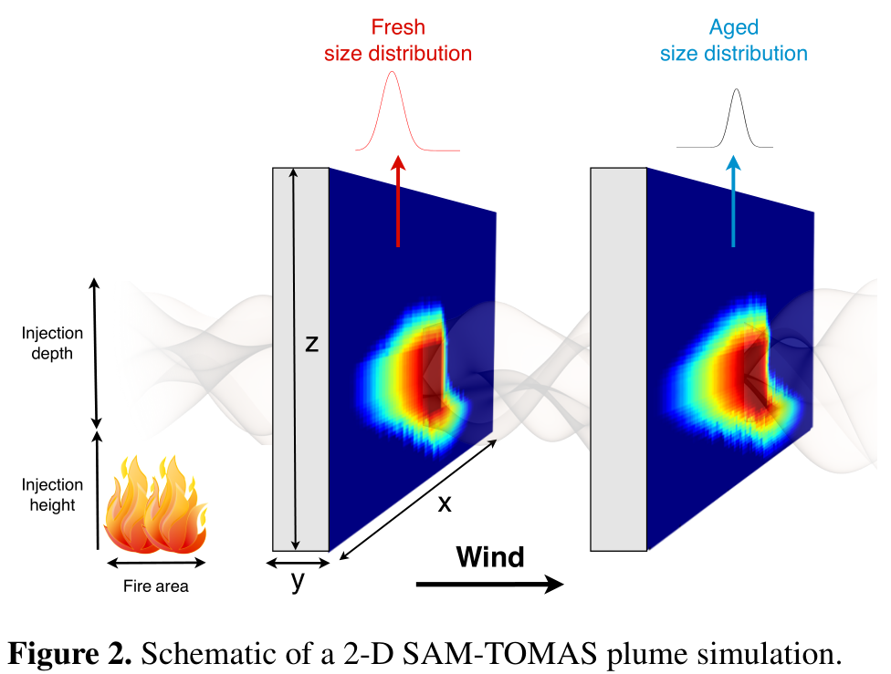
We used large eddy simulation with aerosol microphysics (SAM-TOMAS) to simulate many plumes
System for Atmospheric Modelling (SAM)
Large Eddy Simulation (LES)
2D wall moving with mean wind velocity
500 m resolution
Simulate dispersion in the first 100 km from fire
TOMAS aerosol microphysics
Coagulation only
Sakamoto, K. M., Laing, J. R., Stevens, R. G., Jaffe, D. A., and Pierce, J. R.: The evolution of biomass-burning aerosol size distributions due to coagulation: dependence on fire and meteorological details and parameterization, Atmos. Chem. Phys., 16, 7709-7724, doi:10.5194/acp-16-7709-2016, 2016.

Slide 23
We used large eddy simulation with aerosol microphysics (SAM-TOMAS) to simulate many plumes
Simulated 100 plumes varying:
Fire size
Emissions flux
Wind speed
Injection height/depth
Initial median diameter
Initial modal width
Sakamoto, K. M., Laing, J. R., Stevens, R. G., Jaffe, D. A., and Pierce, J. R.: The evolution of biomass-burning aerosol size distributions due to coagulation: dependence on fire and meteorological details and parameterization, Atmos. Chem. Phys., 16, 7709-7724, doi:10.5194/acp-16-7709-2016, 2016.

Slide 24
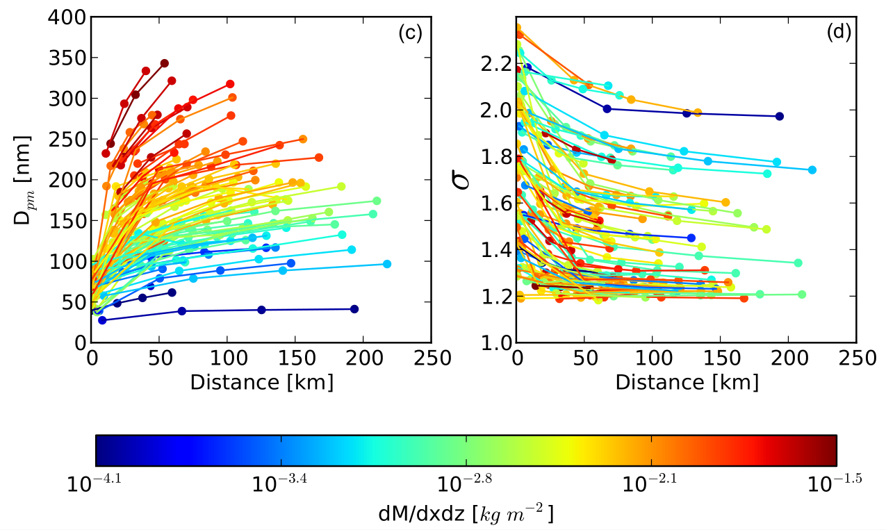
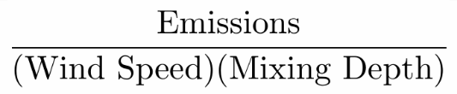
Diameter increases moving downwind
Sakamoto, K. M., Laing, J. R., Stevens, R. G., Jaffe, D. A., and Pierce, J. R.: The evolution of biomass-burning aerosol size distributions due to coagulation: dependence on fire and meteorological details and parameterization, Atmos. Chem. Phys., 16, 7709-7724, doi:10.5194/acp-16-7709-2016, 2016.
Notes:
Reminder of this graph

Slide 25
A proxy for mass concentration captures much of the model variability
Proxy for initial mass concentration
Sakamoto, K. M., Laing, J. R., Stevens, R. G., Jaffe, D. A., and Pierce, J. R.: The evolution of biomass-burning aerosol size distributions due to coagulation: dependence on fire and meteorological details and parameterization, Atmos. Chem. Phys., 16, 7709-7724, doi:10.5194/acp-16-7709-2016, 2016.
Notes:
Reminder of this graph

Slide 26
Modal width depends greatly on the initial value, but the mass concentration determines the rate of change
Proxy for initial mass concentration
Sakamoto, K. M., Laing, J. R., Stevens, R. G., Jaffe, D. A., and Pierce, J. R.: The evolution of biomass-burning aerosol size distributions due to coagulation: dependence on fire and meteorological details and parameterization, Atmos. Chem. Phys., 16, 7709-7724, doi:10.5194/acp-16-7709-2016, 2016.
Notes:
Reminder of this graph

Slide 27
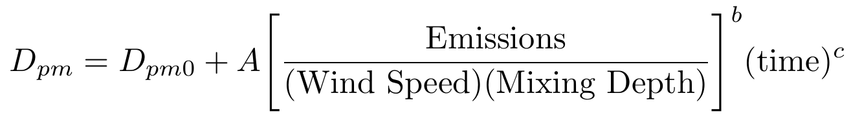
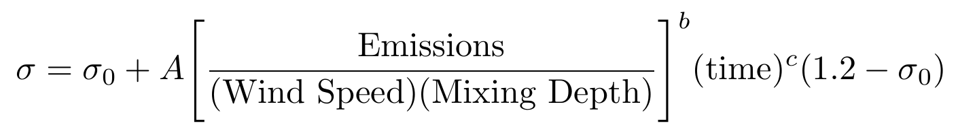
Parameterization fit to these simulations
Sakamoto, K. M., Laing, J. R., Stevens, R. G., Jaffe, D. A., and Pierce, J. R.: The evolution of biomass-burning aerosol size distributions due to coagulation: dependence on fire and meteorological details and parameterization, Atmos. Chem. Phys., 16, 7709-7724, doi:10.5194/acp-16-7709-2016, 2016.
Notes:
To be used for single fire
(fit A, b, and c to this plot)

Slide 28
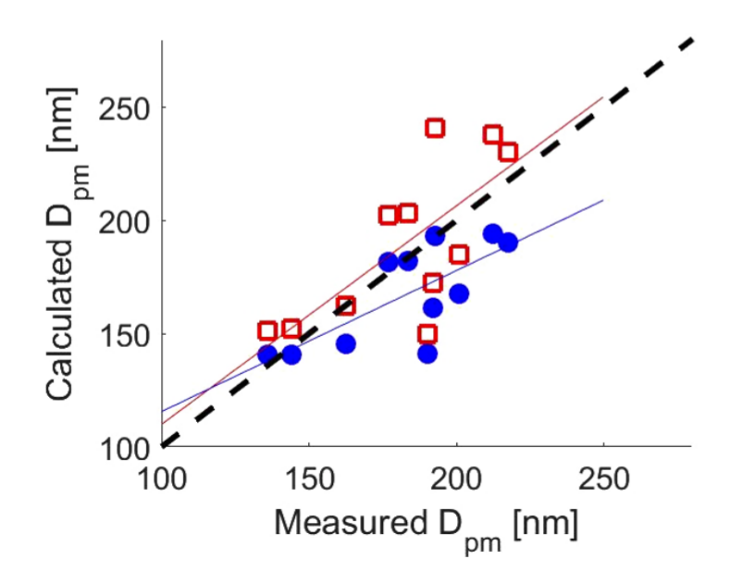
Tested the fits against aged biomass burning size measurements from Mt. Bachelor
Red: main parameterization
R² = 0.55
Blue: different fit
(not presented here)
Sakamoto, K. M., Laing, J. R., Stevens, R. G., Jaffe, D. A., and Pierce, J. R.: The evolution of biomass-burning aerosol size distributions due to coagulation: dependence on fire and meteorological details and parameterization, Atmos. Chem. Phys., 16, 7709-7724, doi:10.5194/acp-16-7709-2016, 2016.

Slide 29
Two goals for this talk
Develop a parameterization of sub-grid coagulation for regional/global models
Estimate the impact of this sub-grid coagulation on direct and indirect radiative effects

Slide 30
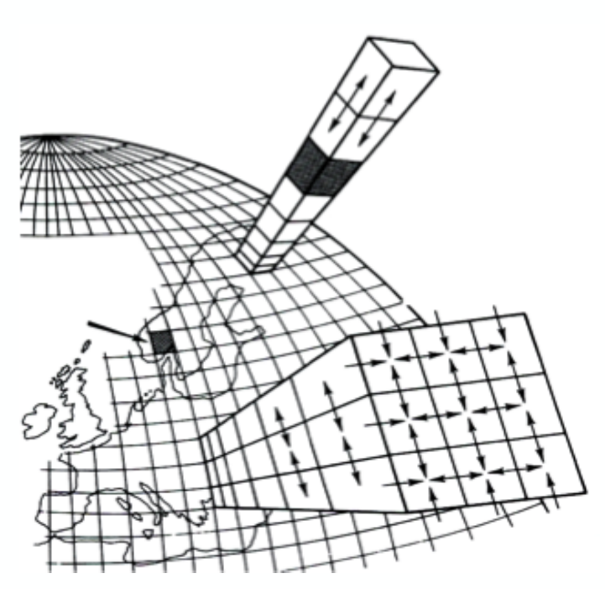
Estimate the global effects using
GEOS-Chem TOMAS
Chemical Transport Model
• 4x5° horizontal resolution
• 47 vertical layers
GEOS-5 meteorology
Fire emissions: GFED4 or FINN
TwO-Moment Aerosol Sectional (TOMAS) microphysics
• Tracks mass and number
• 15 size bins 3nm-10 μm
Direct effect and cloud-albedo indirect effects through RRTMG
TOMAS
Ramnarine, E., Kodros, J. K., Hodshire, A. L., Lonsdale, C. R., Alvarado, M. J., and Pierce, J. R.: Effects of Near-Source Coagulation of Biomass Burning Aerosols on Global Predictions of Aerosol Size Distributions and Implications for Aerosol Radiative Effects, Atmos. Chem. Phys., https://doi.org/10.5194/acp-2018-1084, 2019.

Slide 31
Test with and without subgrid coagulation
Chemical Transport Model
• 4x5° horizontal resolution
• 47 vertical layers
GEOS-5 meteorology
Fire emissions: GFED4 or FINN
TwO-Moment Aerosol Sectional (TOMAS) microphysics
• Tracks mass and number
• 15 size bins 3nm-10 μm
Direct effect and cloud-albedo indirect effects through RRTMG
TOMAS
Ramnarine, E., Kodros, J. K., Hodshire, A. L., Lonsdale, C. R., Alvarado, M. J., and Pierce, J. R., Effects of Near-Source Coagulation of Biomass Burning Aerosols on Global Predictions of Aerosol Size Distributions and Implications for Aerosol Radiative Effects, Atmos. Chem. Phys., https://doi.org/10.5194/acp-2018-1084, 2019.

Slide 32
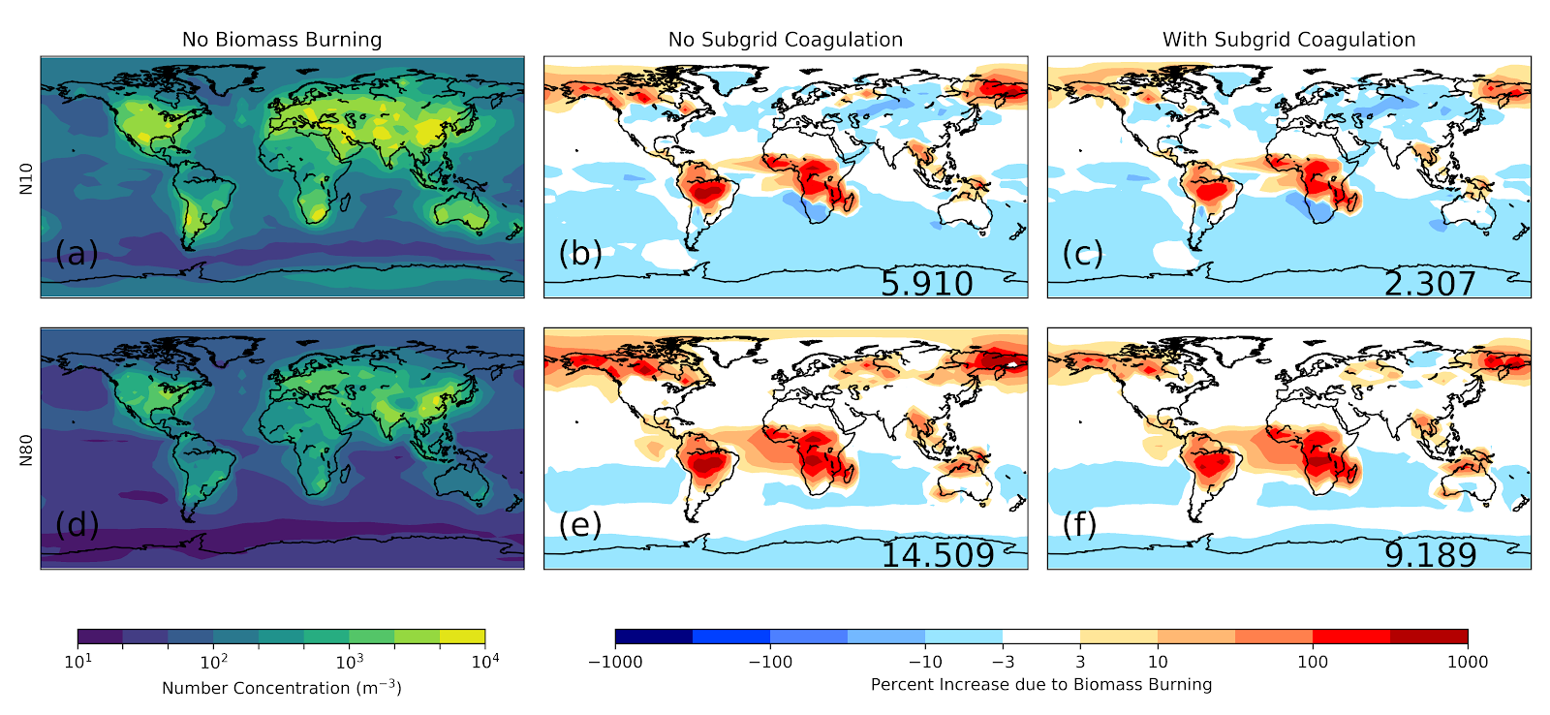
Global N10 (D_{p} > 10 nm) and N80 (D_{p} > 80 nm) without biomass burning
Surface concentrations w/o biomass burning
No sub-grid coag.
All BB emissions
D_{pg}=100 nm, σ_{g}=2.0
With sub-grid coagulation
N10
Global =
%
Global =
%
N80
Global =
%
Global =
%
Ramnarine, E., Kodros, J. K., Hodshire, A. L., Lonsdale, C. R., Alvarado, M. J., and Pierce, J. R., Effects of Near-Source Coagulation of Biomass Burning Aerosols on Global Predictions of Aerosol Size Distributions and Implications for Aerosol Radiative Effects, Atmos. Chem. Phys., https://doi.org/10.5194/acp-2018-1084, 2019.
Notes:
Now we are switching gears from emitted size distribution to ambient size distribution. On the left we have the number of particles per m2 above 10nm (top) and 80nm (bottom) without any biomass burning aerosols. This is for reference. On the right we can see the percent change in aerosol number concentration when we add in biomass burning aerosols. We can see that there is always an increase in the number of particles. Here we can see some key biomass burning regions and the areas downwind are most effected. On the right-hand figure we have the panel on the left that does not have subgrid coagulation and represents the model by default. On the right we have the same run but with subgrid coagulation added using the parameterization discussed. We can see that there is a general decrease in the number of particles when subgrid coagulation is added, especially in the Amazon and Congo regions. We can also see that a smilar change occurs in N10 as in N80.

Slide 33
Adding biomass burning increases CCN-sized particles (N80) by ~15%
Surface concentrations w/o biomass burning
No sub-grid coag.
All BB emissions
D_{pg}=100 nm, σ_{g}=2.0
With sub-grid coagulation
N10
Global =
%
Global =
%
N80
Global =
%
Global =
%
Ramnarine, E., Kodros, J. K., Hodshire, A. L., Lonsdale, C. R., Alvarado, M. J., and Pierce, J. R., Effects of Near-Source Coagulation of Biomass Burning Aerosols on Global Predictions of Aerosol Size Distributions and Implications for Aerosol Radiative Effects, Atmos. Chem. Phys., https://doi.org/10.5194/acp-2018-1084, 2019.
Notes:
Now we are switching gears from emitted size distribution to ambient size distribution. On the left we have the number of particles per m2 above 10nm (top) and 80nm (bottom) without any biomass burning aerosols. This is for reference. On the right we can see the percent change in aerosol number concentration when we add in biomass burning aerosols. We can see that there is always an increase in the number of particles. Here we can see some key biomass burning regions and the areas downwind are most effected. On the right-hand figure we have the panel on the left that does not have subgrid coagulation and represents the model by default. On the right we have the same run but with subgrid coagulation added using the parameterization discussed. We can see that there is a general decrease in the number of particles when subgrid coagulation is added, especially in the Amazon and Congo regions. We can also see that a smilar change occurs in N10 as in N80.

Slide 34
Subgrid coagulation reduces the impact of biomass burning on N10 and N80
Surface concentrations w/o biomass burning
No sub-grid coag.
All BB emissions
D_{pg}=100 nm, σ_{g}=2.0
With sub-grid coagulation
N10
Global =
%
Global =
%
N80
Global =
%
Global =
%
Ramnarine, E., Kodros, J. K., Hodshire, A. L., Lonsdale, C. R., Alvarado, M. J., and Pierce, J. R., Effects of Near-Source Coagulation of Biomass Burning Aerosols on Global Predictions of Aerosol Size Distributions and Implications for Aerosol Radiative Effects, Atmos. Chem. Phys., https://doi.org/10.5194/acp-2018-1084, 2019.
Notes:
Now we are switching gears from emitted size distribution to ambient size distribution. On the left we have the number of particles per m2 above 10nm (top) and 80nm (bottom) without any biomass burning aerosols. This is for reference. On the right we can see the percent change in aerosol number concentration when we add in biomass burning aerosols. We can see that there is always an increase in the number of particles. Here we can see some key biomass burning regions and the areas downwind are most effected. On the right-hand figure we have the panel on the left that does not have subgrid coagulation and represents the model by default. On the right we have the same run but with subgrid coagulation added using the parameterization discussed. We can see that there is a general decrease in the number of particles when subgrid coagulation is added, especially in the Amazon and Congo regions. We can also see that a smilar change occurs in N10 as in N80.

Slide 35
What do the size distributions look like in smoke-impacted regions?
Surface concentrations w/o biomass burning
No sub-grid coag.
All BB emissions
D_{pg}=100 nm, σ_{g}=2.0
With sub-grid coagulation
We will focus on two interesting grid boxes
N10
Global =
%
Global =
%
N80
Global =
%
Global =
%
Ramnarine, E., Kodros, J. K., Hodshire, A. L., Lonsdale, C. R., Alvarado, M. J., and Pierce, J. R., Effects of Near-Source Coagulation of Biomass Burning Aerosols on Global Predictions of Aerosol Size Distributions and Implications for Aerosol Radiative Effects, Atmos. Chem. Phys., https://doi.org/10.5194/acp-2018-1084, 2019.
Notes:
Now we are switching gears from emitted size distribution to ambient size distribution. On the left we have the number of particles per m2 above 10nm (top) and 80nm (bottom) without any biomass burning aerosols. This is for reference. On the right we can see the percent change in aerosol number concentration when we add in biomass burning aerosols. We can see that there is always an increase in the number of particles. Here we can see some key biomass burning regions and the areas downwind are most effected. On the right-hand figure we have the panel on the left that does not have subgrid coagulation and represents the model by default. On the right we have the same run but with subgrid coagulation added using the parameterization discussed. We can see that there is a general decrease in the number of particles when subgrid coagulation is added, especially in the Amazon and Congo regions. We can also see that a smilar change occurs in N10 as in N80.

Slide 36
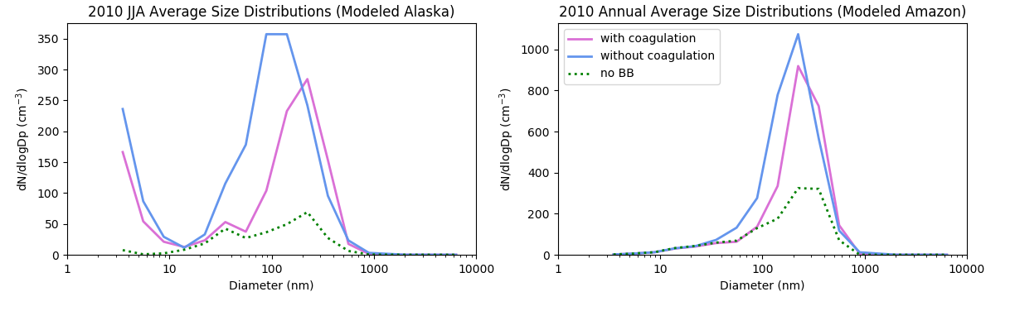
Sub-grid coagulation shifts size distribution in locations dominated by smoke
Alaska
Amazon
Ramnarine et al., 2019

Slide 37
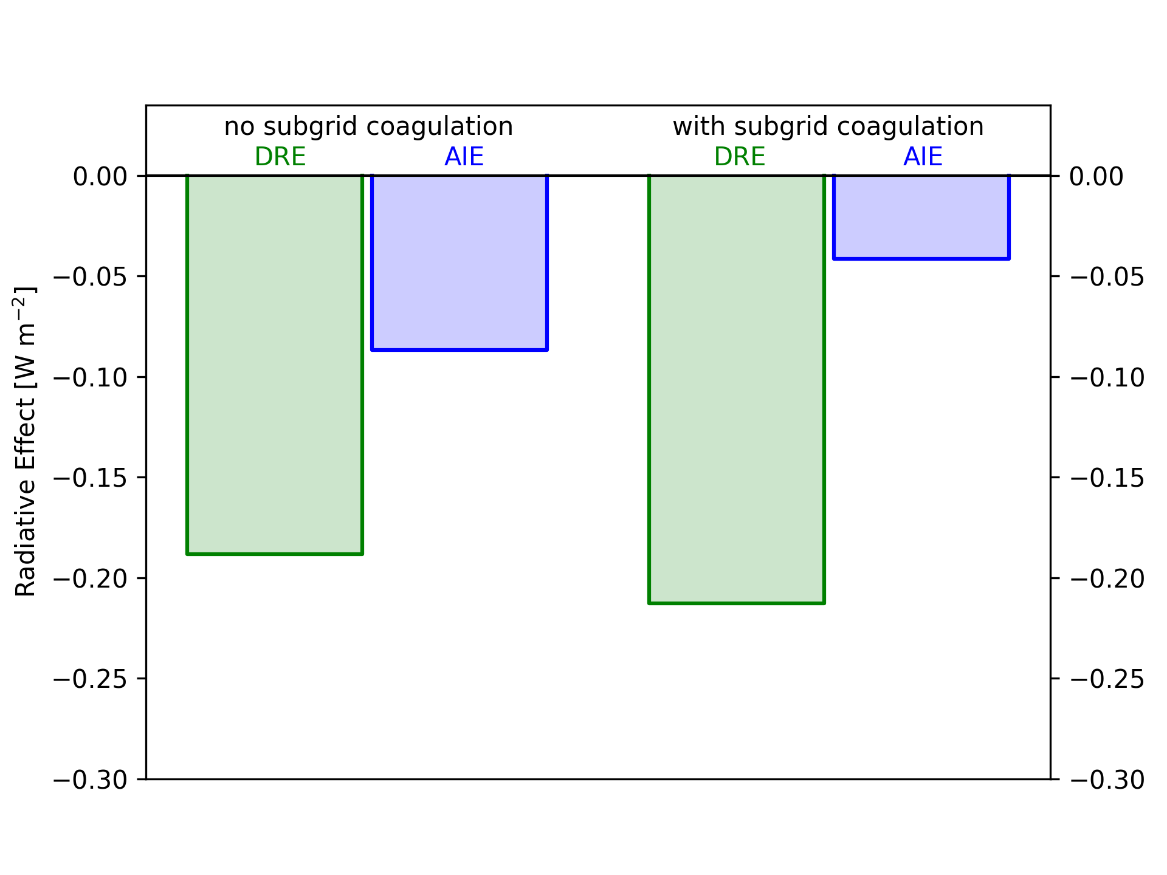
Biomass burning radiative effects:
Subgrid coag decreases AIE
Subgrid coag slightly increases DRE
Ramnarine et al., 2019

Slide 38
Primary organic aerosol (POA) evaporation vs. secondary organic aerosol (SOA) formation:
Net increase or decrease in PM_{2.5}?
POA evaporation
SOA formation
Coagulation

Slide 39

Organic aerosol is semivolatile:
Evaporates as smoke dilutes
Primary OA ratio to CO at emissions
OA
CO
Distance

Slide 40
Big fires vs. small fires… impacts dilution
NASA Aqua-MODIS, Pacific Northwest fires, Aug. 15, 2015.
NASA image courtesy Jeff Schmaltz, MODIS Rapid Response Team.

Slide 41
Big fires dilute more slowly… expect less evaporation?
Big fire
OA
CO
Small fire
Distance

Slide 42

Chemistry: Secondary Organic Aerosol (SOA) formation may increase mass
Dilution/evaporation + chemistry/condensation
OA
CO
Dilution/evaporation only
Distance

Slide 43
Evaporation vs. SOA formation…
What wins overall?
Big fire: Evap+SOA
Small fire: Evap+SOA
OA
CO
Big fire: Evaporation only
Small fire: Evaporation only
Distance

Slide 44

How to represent these processes in 3D models?
POA evaporation
SOA formation
Coagulation
Working towards this…
Anna Hodshire’s talk next!

Slide 45
Questions

Slide 46
Extras

Slide 47
Biomass burning contributes significantly to ambient aerosol number regardless of subgrid coagulation
Surface concentrations w/o biomass burning
No sub-grid coag.
All BB emissions
D_{pg}=100 nm, σ_{g}=2.0
With sub-grid coagulation
We will focus on two interesting grid boxes
N10
Global =
%
Global =
%
N80
Global =
%
Global =
%
Ramnarine, E., Kodros, J. K., Hodshire, A. L., Lonsdale, C. R., Alvarado, M. J., and Pierce, J. R., Effects of Near-Source Coagulation of Biomass Burning Aerosols on Global Predictions of Aerosol Size Distributions and Implications for Aerosol Radiative Effects, Atmos. Chem. Phys., https://doi.org/10.5194/acp-2018-1084, 2019.
Notes:
Now we are switching gears from emitted size distribution to ambient size distribution. On the left we have the number of particles per m2 above 10nm (top) and 80nm (bottom) without any biomass burning aerosols. This is for reference. On the right we can see the percent change in aerosol number concentration when we add in biomass burning aerosols. We can see that there is always an increase in the number of particles. Here we can see some key biomass burning regions and the areas downwind are most effected. On the right-hand figure we have the panel on the left that does not have subgrid coagulation and represents the model by default. On the right we have the same run but with subgrid coagulation added using the parameterization discussed. We can see that there is a general decrease in the number of particles when subgrid coagulation is added, especially in the Amazon and Congo regions. We can also see that a smilar change occurs in N10 as in N80.

Slide 48
Sub-grid coagulation shifts size distribution in locations dominated by smoke
Ramnarine et al., 2019

Slide 49
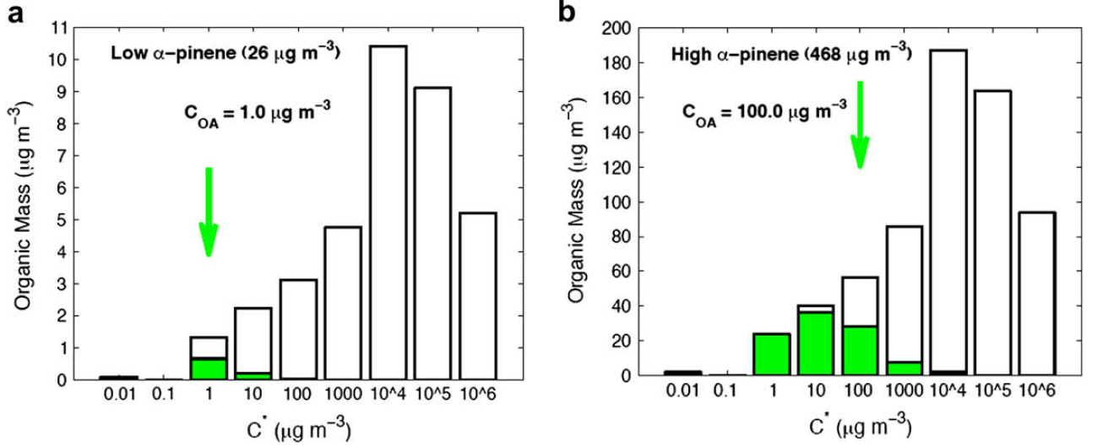
Gas-phase chemistry may shift mass to lower volatility, create SOA
Shift organic mass to lower volatility?

Slide 50
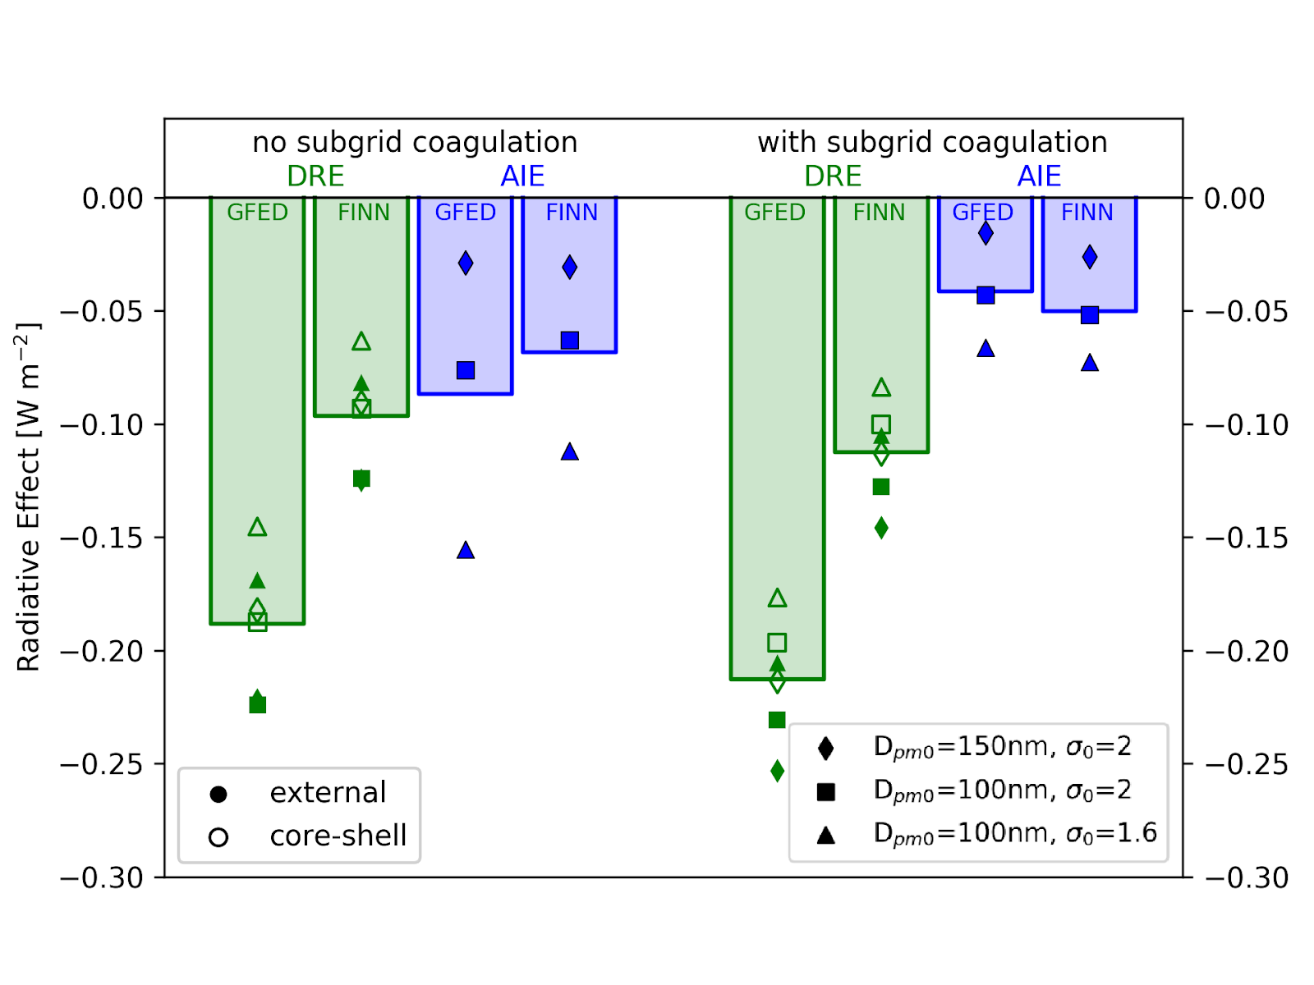
Qualitative results consistent across a wide range of sensitivity tests
Ramnarine et al., 2019

Slide 51
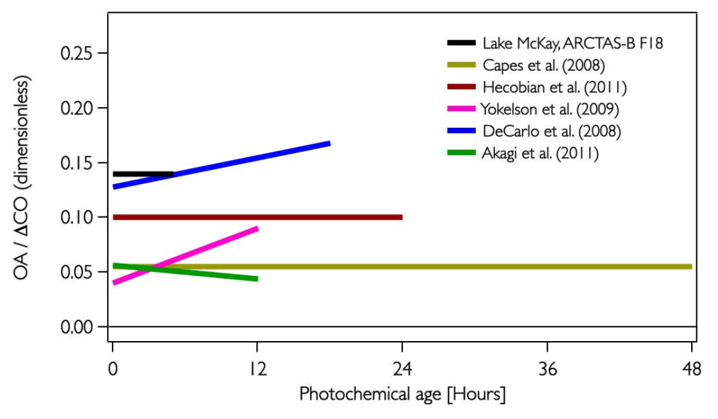
Observed plumes show variability in net OA production/evaporation
Cubison, M. J., et al.: Effects of aging on organic aerosol from open biomass burning smoke in aircraft and laboratory studies, Atmos. Chem. Phys., 11(23), 12049–12064, 2011.

Slide 52
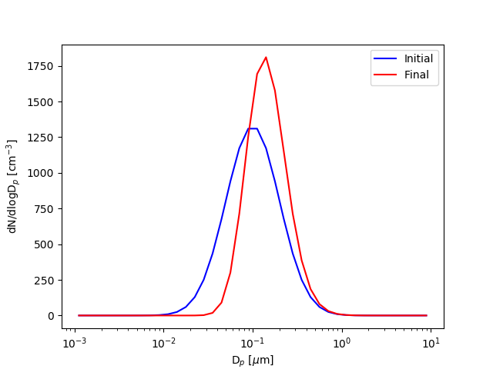
Condensation:
(1) conserves number
(2) increases median diameter (D_{pg})
(3) decreases modal width (σ_{g})

Slide 53
Biomass-burning particle distributions get larger and narrower with aging
Aging
Is this coagulation or SOA production?
BOTH should increase diameter and narrow distribution
Janhäll, S., et al.:, Atmos. Chem. Phys., 10, 1427-1439, 2010.

Slide 54
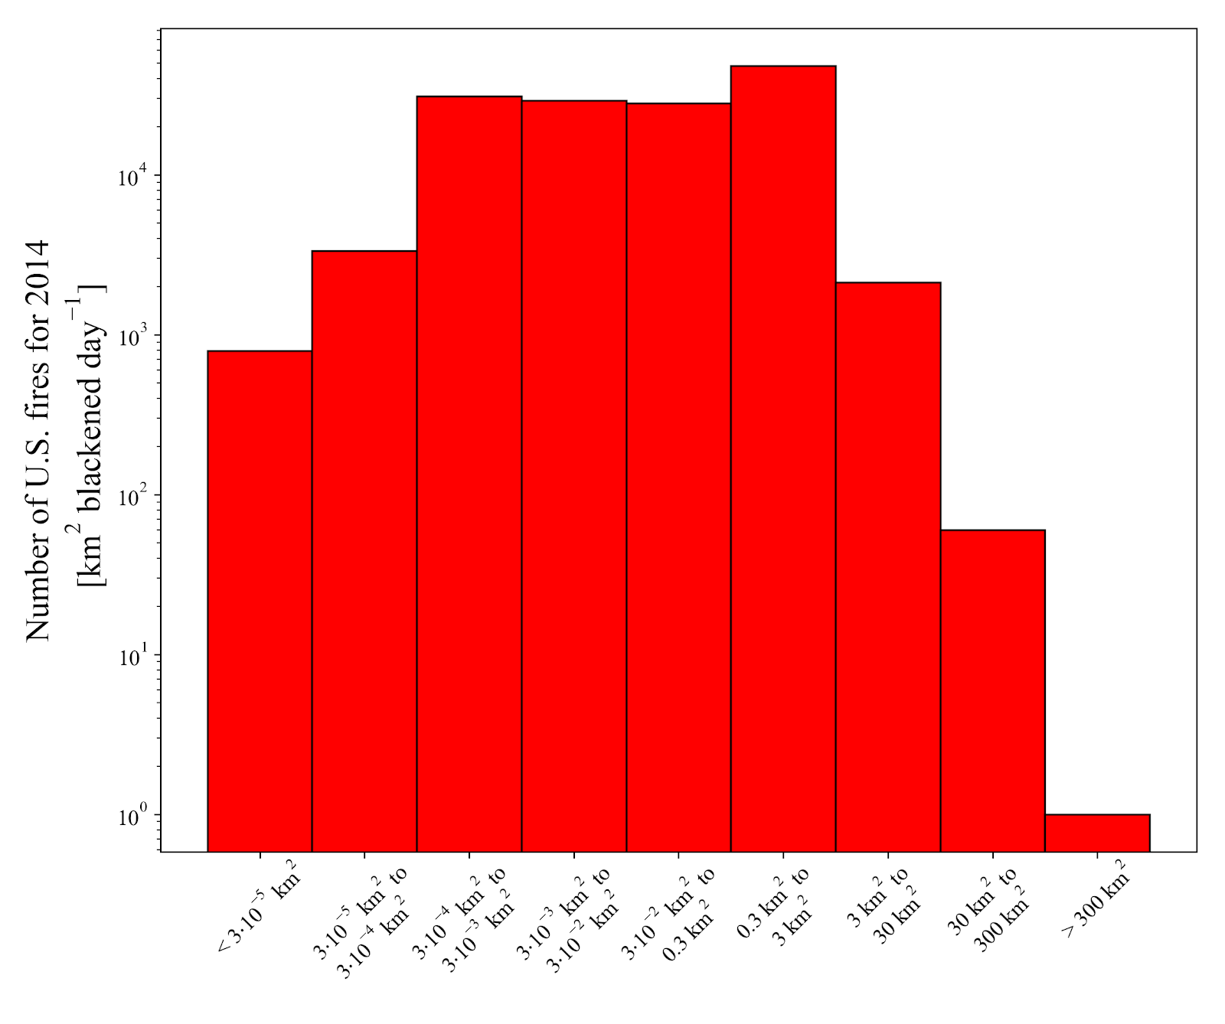
HUGE range in fire sizes
10⁴
10³
Number of fires in US in 2014
10²
10¹
10⁰
10⁻⁵ 10⁻⁴ 10⁻³ 10⁻² 10⁻¹ 10⁰ 10¹ 10² 10³
Fire area [km² blackened day⁻¹]
US Fires for 2014 from EPA NEI

Slide 55
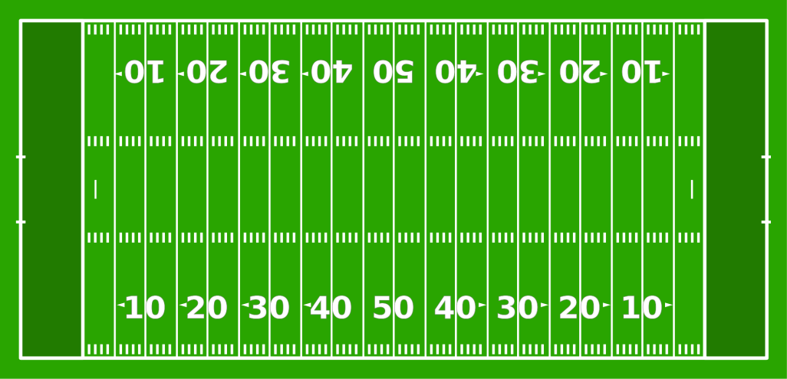
HUGE range in fire sizes
10⁴
10³
Number of fires in US in 2014
10²
10¹
10⁰
10⁻⁵ 10⁻⁴ 10⁻³ 10⁻² 10⁻¹ 10⁰ 10¹ 10² 10³
Fire area [km² blackened day⁻¹]
US Fires for 2014 from EPA NEI

Slide 56
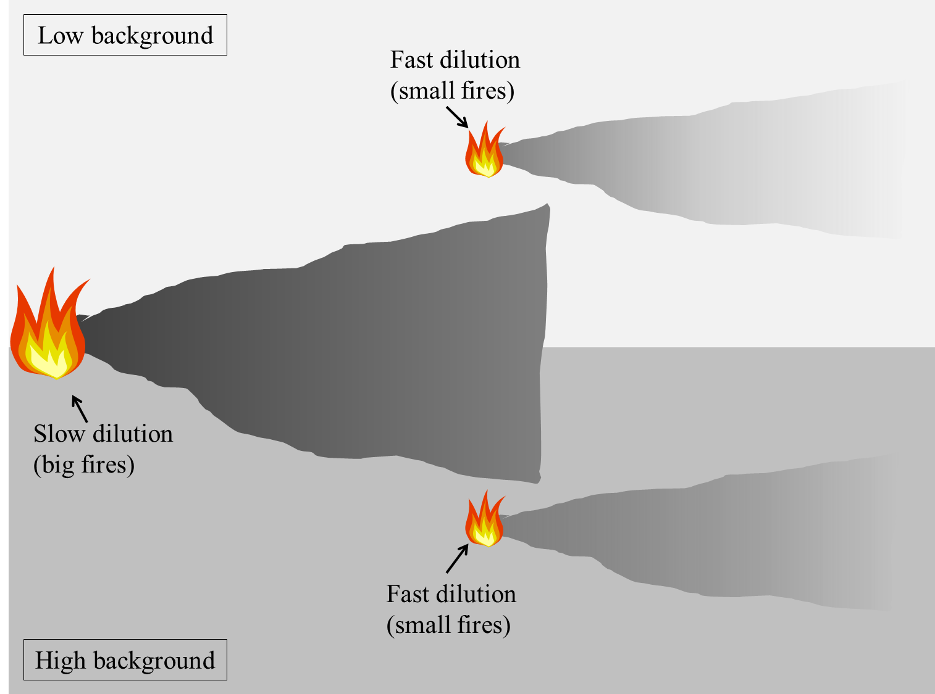
How do fire size, dilution rate, and background concentration matter?

Slide 57
How do fire size, dilution rate, and background concentration matter?
How do these factors impact:
aerosol mass?
size distribution?
CCN?
extinction?

Slide 58
Road map
Aging processes affect size distributions
  POA evaporation vs. SOA formation vs. coagulation?
  How much do fire size and background concentration matter?
The impact of in-plume coagulation on global radiative effects

Slide 59

Road map
Aging processes affect size distributions
  POA evaporation vs. SOA formation vs. coagulation?
  How much do fire size and background concentration matter?
The impact of in-plume coagulation on global radiative effects
Anna Hodshire

Slide 60

Investigating OA in expanding plumes
Plume volume expansion: Gaussian-dispersion framework
  Fire areas:
  1×10⁻⁴ (small prescribed fire) through 1×10² km² (large wildfires)
  Background OA concentrations: 0, 5, 20, 50 µg m⁻³
  Atmospheric stability class : D (neutral) (tested others, not shown)
  OA emissions mass flux: 5×10⁻⁶ kg m⁻² s⁻¹
Center line
2*σ_{y}
2*σ_{z}
Wind (U, m/s)
Q
4σ_{z}
x
4σ_{y}
Notes:
We apply a simple Gaussian-dispersion framework to represent plume volume expansion in our box model. We assume that the pollutants are uniformly distributed within a box with a crosswind width of y ± 2σy and height z ± 2σz (the thickness of the box in the wind direction is fixed at 1 m), so that the plume volume in the simulation is 4σy×4 σy×1 m3. We assume that the initial plume width (σy) is the same as the fire width (the square root of the fire area). The background is considered to be non-volatile OA with a fixed concentration of 5 µg m⁻³.
We perform sensitivity tests for fire areas of 1×10⁻⁴, 1×10⁻², 1 and 1×10² km² . The smallest fire size (1×10⁻⁴ km²) was selected to represent a prescribed fire and the larger fire sizes (1 and 1×10² km²) represent wildfire sources. For a fire size of 1 km², we also test the sensitivity to atmospheric stability class (A (unstable), D (neutral) and F (stable)) for mass fluxes of 2×10⁻⁸ and 5×10⁻⁶ kg m⁻² s⁻¹. The dispersion parameters used to estimate σ_{y} and σ_{z} for different Pasquill stability classes are taken from Klug (1969).

Slide 61
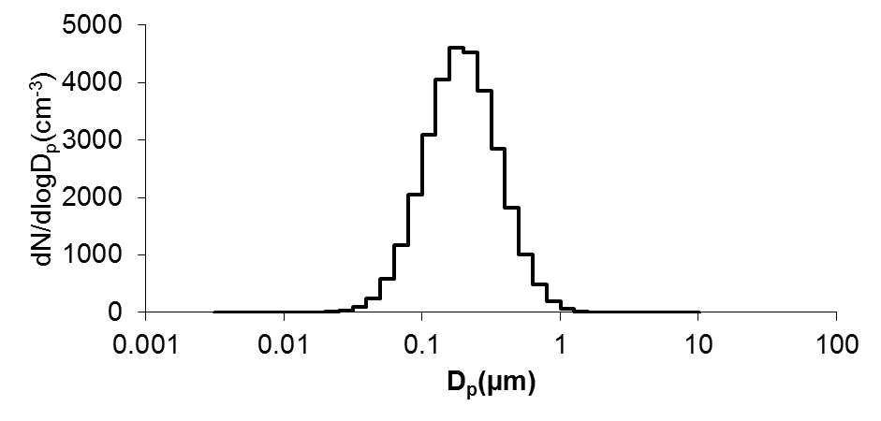
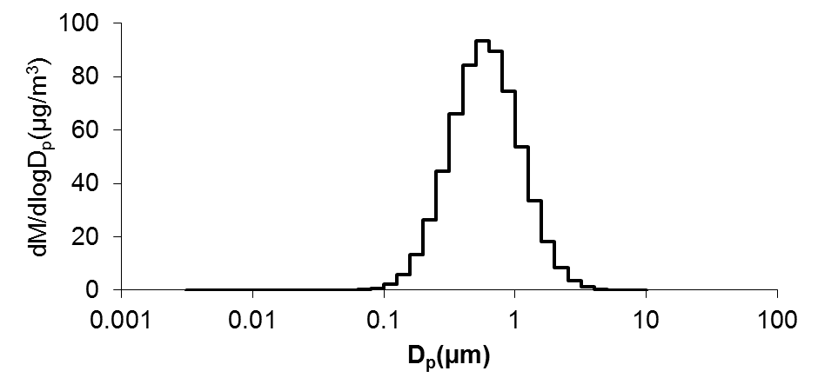
TwO-Moment Aerosol Sectional (TOMAS) microphysics
36 logarithmically spaced size, 3 nm to 10 µm
Smoke emissions: Single lognormal mode w/ D_{pm} = 160 nm, σ_{g} = 1.7
Number size distribution
Mass size distribution
Notes:
This slide lists the TOMAS model and other parameter setting for the base simulation

Slide 62
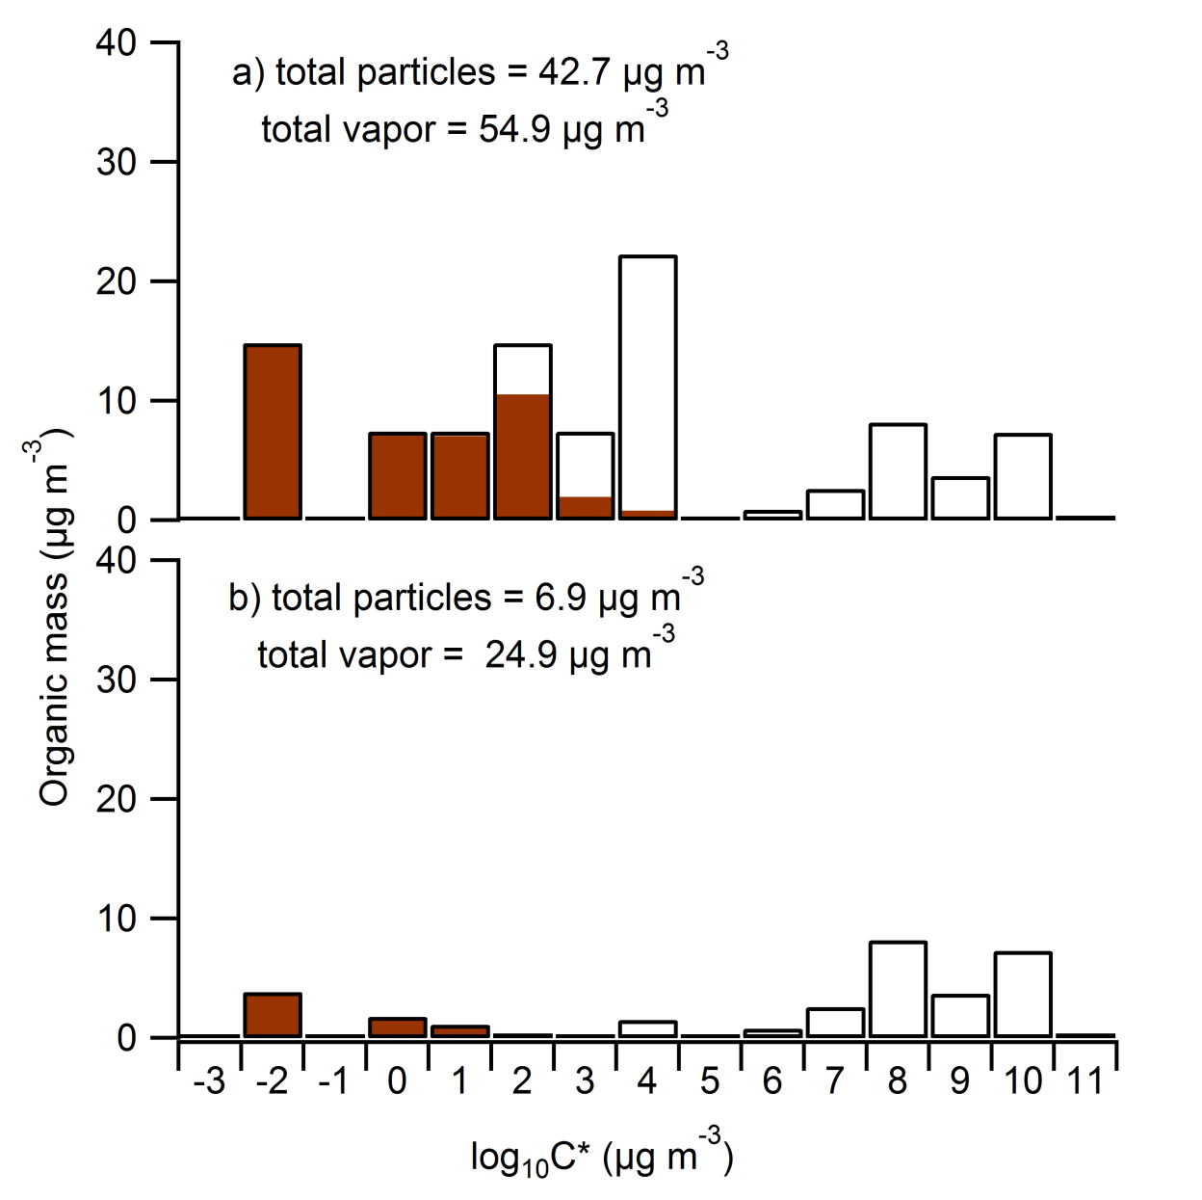
TwO-Moment Aerosol Sectional (TOMAS) microphysics
36 logarithmically spaced size, 3 nm to 10 µm
Smoke emissions: Single lognormal mode w/ D_{pm} = 160 nm, σ_{g} = 1.7
Black carbon, water and 15 lumped organics with logarithmically spaced Ci* (10⁻³ to 10⁴)
Number size distribution
Bian et al. (2017)
Mass size distribution
Based on FLAME-3
thermodenuder measurements
Based on FLAME-4
GC measurements
Notes:
This slide lists the TOMAS model and other parameter setting for the base simulation

Slide 63
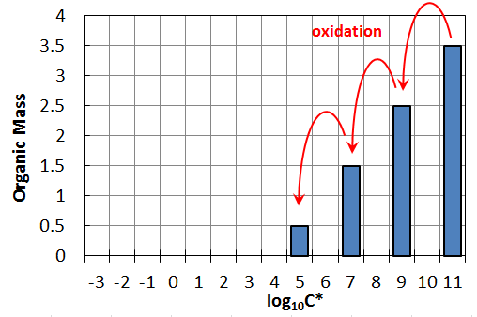
Simple gas-phase chemistry mechanism
(Jathar et al. 2014)
All functionalization, no fragmentation
Assumption 1: Fast chemistry (upper bound of SOA production)
  Rate constants based on aromatics
  4 volatility-bin drop per reaction
  OH = 1x10⁶ molec cm⁻³
Assumption 2: Slow chemistry (lower bound of SOA production)
  Rate constants based on alkanes
  2 volatility-bin drop per reaction
Notes:
The gas-phase organic chemistry matrix used in the model follows the study of Jathar et al. (2014). We assume that only functionalization occurs in the biomass-burning experiments, with the product organic vapors having volatilities that are either 2 or 4 volatility bins lower than the parent. a represents for the fast chemistry (4 volatility bins drop) and b for the slow chemistry (2 volatility bins drops).

Slide 64
How much do OA evap, SOA formation, and coagulation matter?
Sets of simulations
  Coag: On / Off
  SOA chemistry: On / Off
  (Dilution / evaporation on in every simulations)

Slide 65
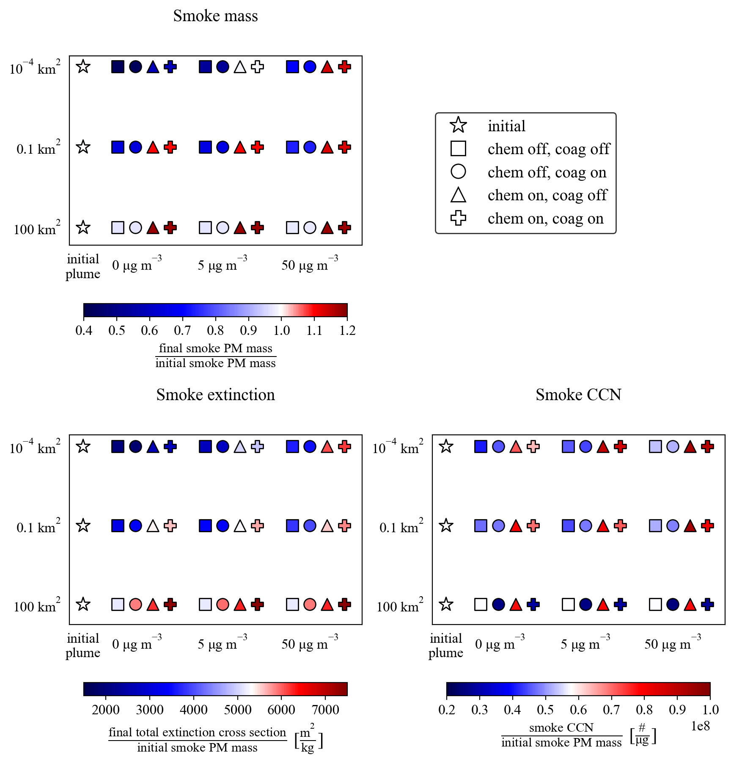
How much do OA evap, SOA formation, and coagulation matter?
Sets of simulations
  Coag: On / Off
  SOA chemistry: On / Off
  (Dilution / evaporation on in every simulations)

Slide 66
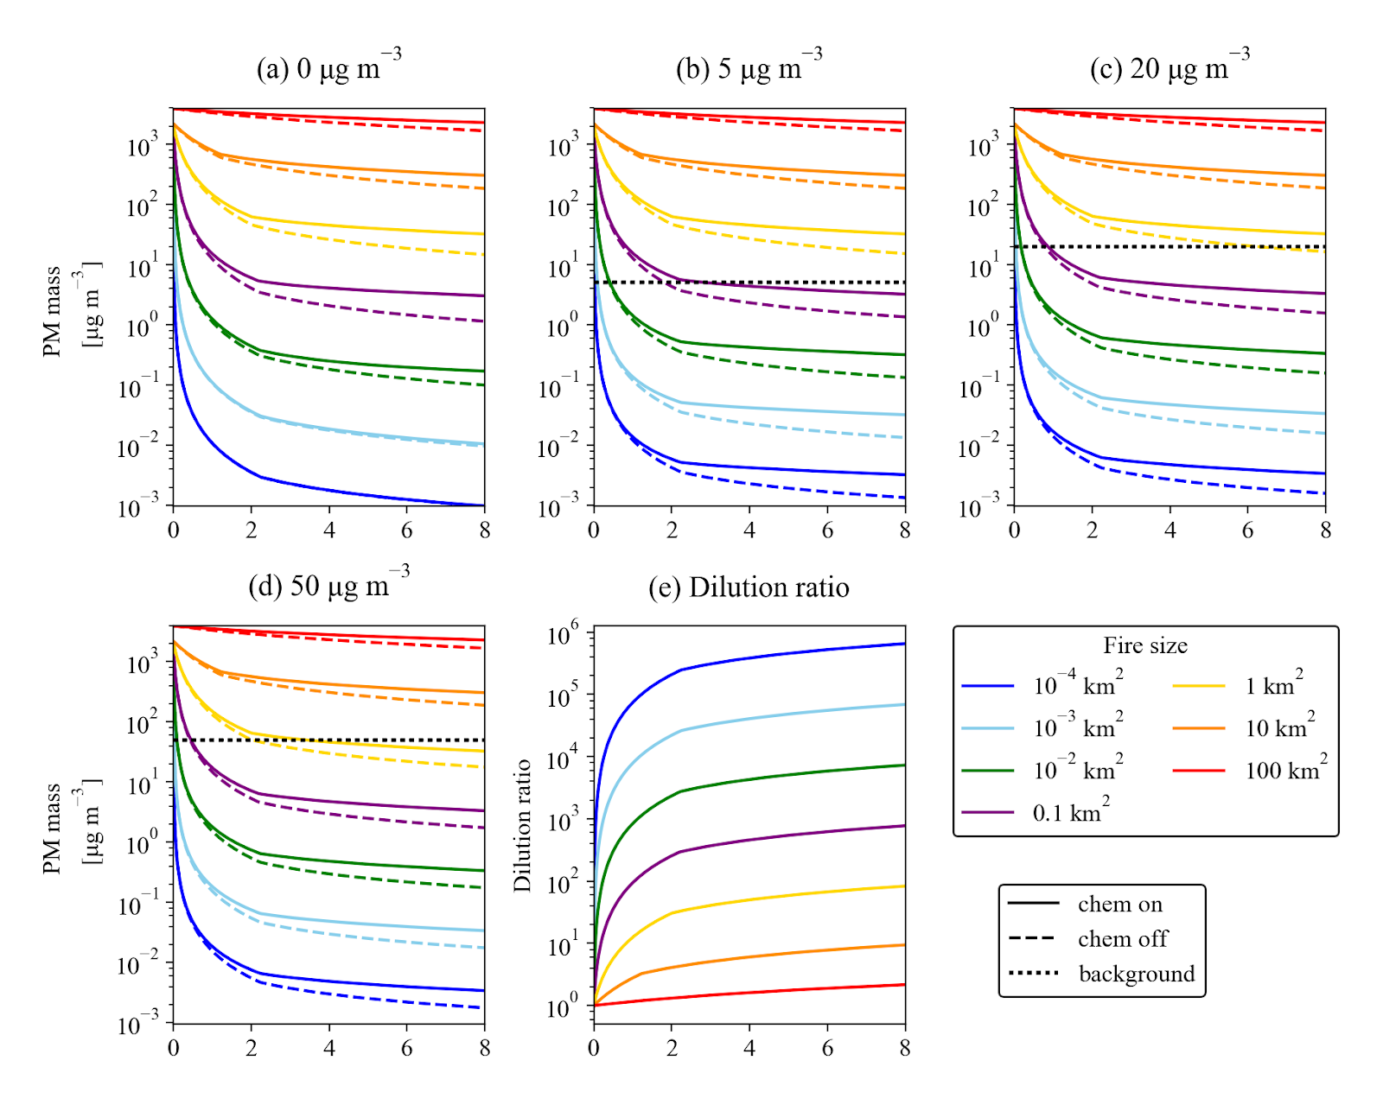
Dilution spans orders of magnitude depending on fire size
Dilution Ratio
Time [hr]

Slide 67
Dilution greatly influences smoke concentrations!
PM concentration with background of 0 μg m⁻³
Dilution Ratio
Time [hr]
Time [hr]

Slide 68

How does smoke mass age?
Fire size
Background concentration
after 4 hours

Slide 69
How does smoke mass age?
Fire size
Background concentration
after 4 hours

Slide 70
In absence of chemistry:
- Fires lose mass by OA evaporation
- Smaller fires evaporate more (more dilution)
- Polluted background slows evaporation
Fire size
Background concentration
after 4 hours

Slide 71
With chemistry:
- SOA production exceeds evaporation
(net OA production) for all but small fires in clean backgrounds
Fire size
Background concentration
after 4 hours

Slide 72
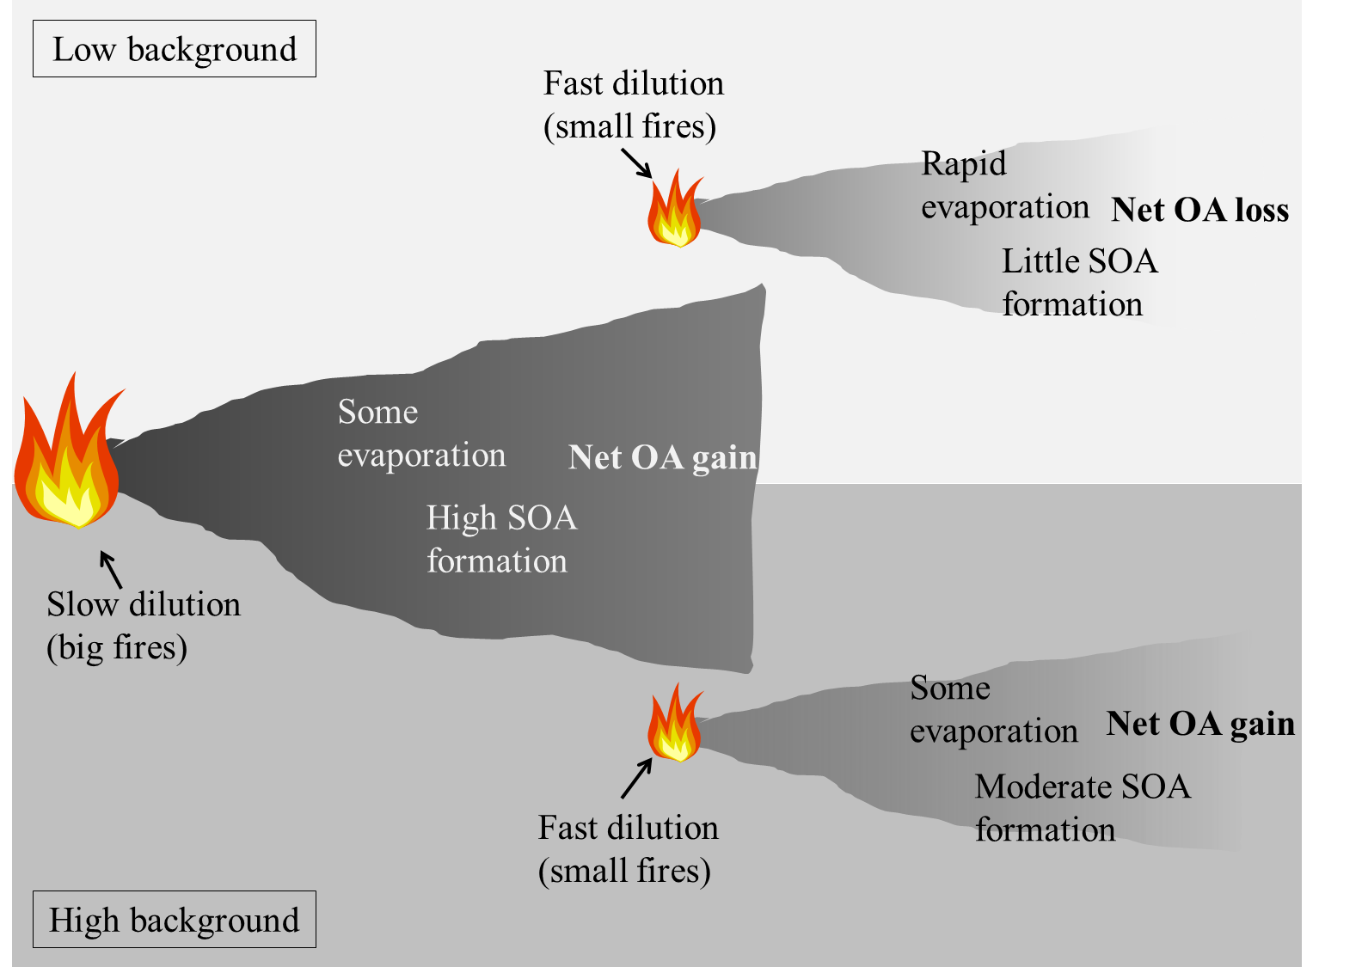
We expect fire size and background to matter…

Slide 73
What about shifts in the size distribution?
Aging
Janhäll, S., et al.:, Atmos. Chem. Phys., 10, 1427-1439, 2010.

Slide 74
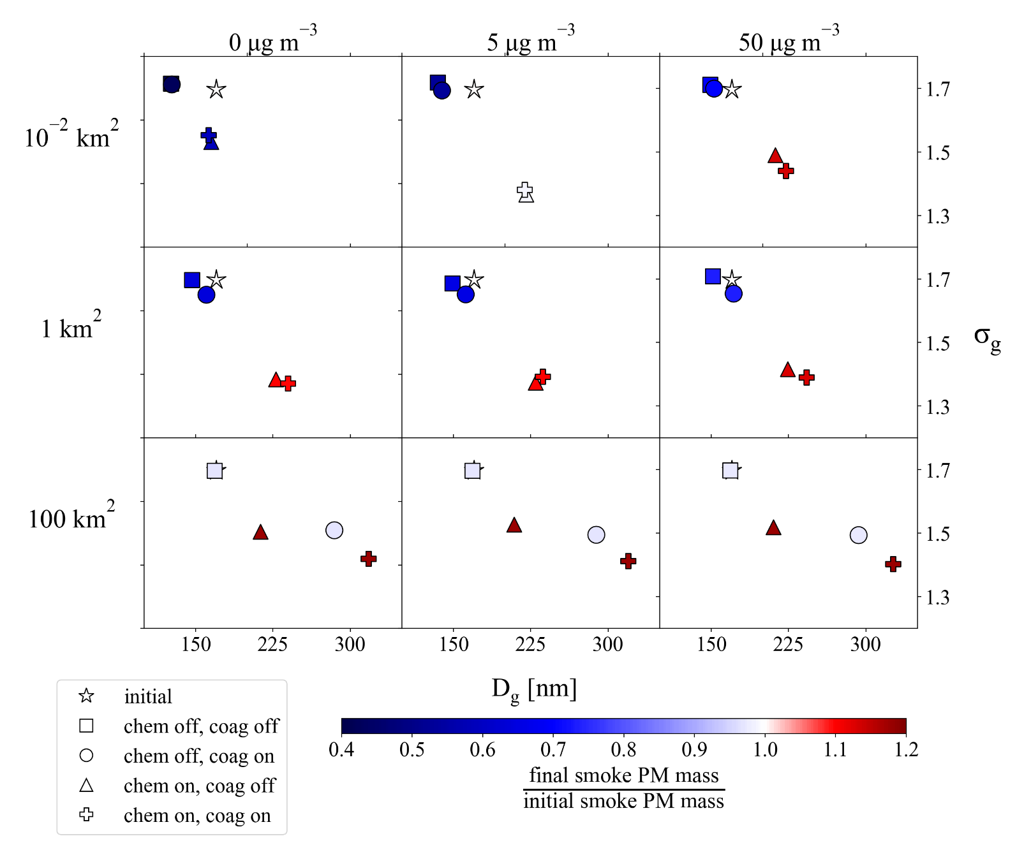
Size distribution changes for large fires
- Both SOA and coagulation make distribution larger and narrower
- Coagulation has slightly larger effect
100 km² fire, polluted background
after 4 hours

Slide 75
Size distribution changes:
- Coagulation makes distribution larger and smaller for large fires
- SOA production has similar effect
- Evaporation makes distribution smaller but not wider
after 4 hours

Slide 76
How do CCN(0.2%) change in the plume?
Fire size
Background concentration
after 4 hours

Slide 77
CCN(0.2%):
Dilution/Evap: decrease CCN (background OA slows evaporation)
Fire size
Background concentration
after 4 hours

Slide 78
CCN(0.2%):
Coagulation kills CCN for big fires
Fire size
Background concentration
after 4 hours

Slide 79
CCN(0.2%):
SOA increases CCN (growing ultrafine particles)
Fire size
Background concentration
after 4 hours

Slide 80
CCN(0.2%):
Overall: Coag death wins for big fires
SOA production wins for small fires
Fire size
Background concentration
after 4 hours

Slide 81
Extinction:
Similar to OA mass changes, but coagulation increase extinction for large fires
Fire size
Background concentration
after 4 hours

Slide 82
Mass again
Fire size
Background concentration
after 4 hours

Slide 83
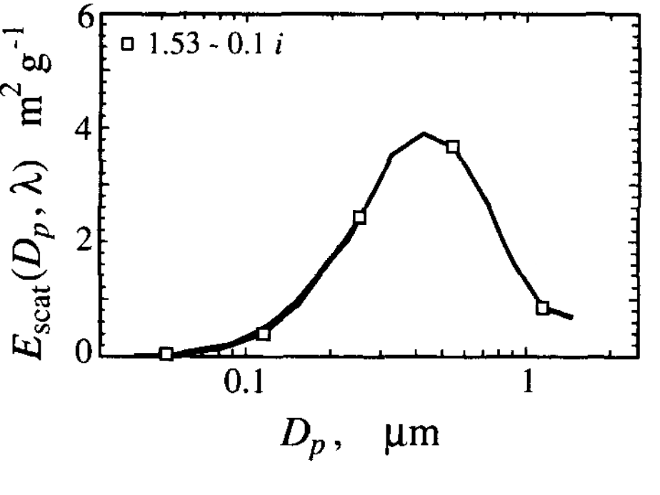
Coagulation pushes mass to sizes with higher mass-scattering efficiency

Slide 84
When do we expect processes to dominate?
Background concentration
Background concentration

Slide 85
Fires by number…
10⁴
10³
Number of fires in US in 2014
10²
10¹
10⁰
10⁻⁵ 10⁻⁴ 10⁻³ 10⁻² 10⁻¹ 10⁰ 10¹ 10² 10³
Fire area [km² blackened day⁻¹]
US Fires for 2014 from EPA NEI

Slide 86
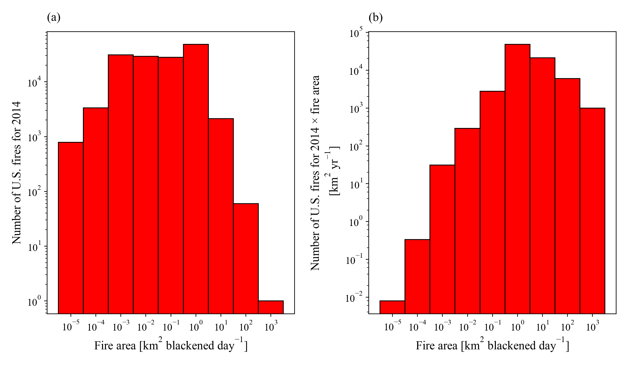
Fires by number… and weighted by area
Proxy for emissions
US Fires for 2014 from EPA NEI

Slide 87
Fires by number… and weighted by area
Proxy for emissions
Most field campaigns
US Fires for 2014 from EPA NEI

Slide 88
Two take-home points
Fire size and meteorological factors very important for plume aging.
Global/regional models can’t resolve plumes… need sub-grid representation.

Slide 89
The big caveat
Need to test both parts of results on measurements…
  (challenging to do)

Slide 90
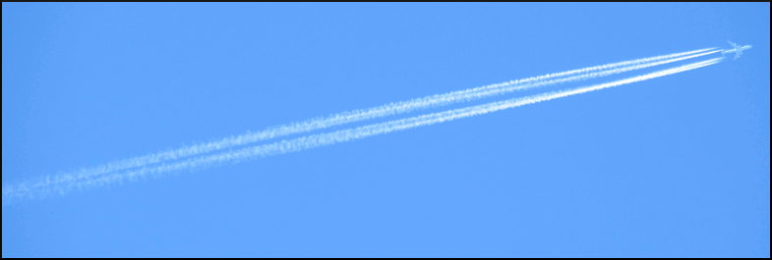
OA evaporates in diluting plumes:
Same phenomena as evaporating contrails
H₂O_{ice}
CO
Distance

Slide 91
Organic aerosol evaporation as smoke dilutes:
Like contrails… but a multi-species system
Low volatility
High volatility
Green: organics in aerosol phase
White: organics in gas phase
Donahue et al., Atmospheric organic particulate matter: From smoke to secondary organic aerosol, Atmos. Env., 2008

Slide 92
Organic aerosol evaporation as smoke dilutes:
Like contrails… but a multicomponent system
Dilute by factor of 18
OA reduced by factor of 100
Low volatility
High volatility
Low volatility
High volatility
Green: organics in aerosol phase
White: organics in gas phase
Donahue et al., Atmospheric organic particulate matter: From smoke to secondary organic aerosol, Atmos. Env., 2008

Slide 93
Organic aerosol is semivolatile:
Evaporates as smoke dilutes
Primary OA ratio to CO at emissions
OA
CO
Distance

