Slide 1

Predicted Ultrafine Particulate Matter Source Contribution across the Continental United States during Summer Time Air Pollution Events
Melissa A. Venecek, Xin Yu, Anikender Kumar, Yiting Li, and Michael J. Kleeman, University of California, , Department of Civil and Environmental Engineering, 1 Shields Ave, Davis CA 95616, USA. mjkleeman@ucdavis.edu, http://faculty.engineering.ucdavis.edu/kleeman/

Slide 2
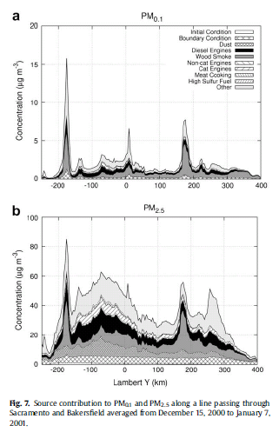
UFP Gradients are sharper than PM2.5 Gradients
The central site monitor strategy employed for PM2.5 will be difficult to use for UFP
Source: Ying, Q. Lu J., Kaduwela, A. and Kleeman, M.J. Modeling Air Quality during the California Regional PM10/PM2.5 Air Quality Study (CPRAQS) using the UCD/CIT Source Oriented Air Quality Model - Part III. Regional Source Apportionment of Secondary and Total Airborne PM2.5 and PM0.1. Atmospheric Environment, 43, pp419-430, 2009.

Slide 3
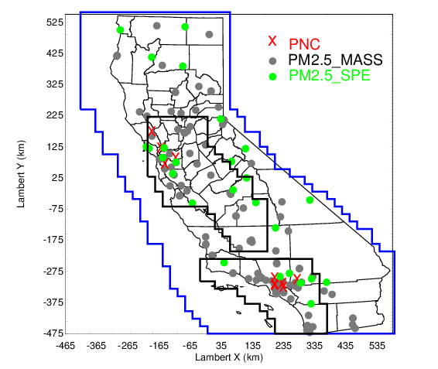
Regional Chemical Transport Models Used for UFP Exposure Estimates
Published Studies:
2019 J. Hu, B. Ostro, H. Zhang, Q. Ying, M.J. Kleeman. Using Chemical Transport Model Predictions To Improve Exposure Assessment of PM2.5 Constituents. Environmental Science and Technology Letters, accepted for publication.
2017 J. Hu, S. Jathar, H. Zhang, Q. Ying, S. Chen, C.D. Cappa, and M.J. Kleeman. Long-term particulate matter modeling for health effect studies in California – Part 2: Concentrations and sources of ultrafine organic aerosols. Atmospheric Chemistry and Physics, 17, 5379-5391, doi:10.5194/acp-17-5379-2017.
2015 J. Hu, H. Zhang, Q. Ying, S. Chen, F. Vandenberghe, and M.J. Kleeman. Long-term Particulate Matter Modeling for Health Effects Studies in California – Part I: Model Performance on Temporal and Spatial Variations. Atmospheric Chemistry and Physics, 15(6), pp3445-3461.
2014 J. Hu, H. Zhang, S. Chen, C. Wiedinmyer, F. Vandenberghe, Q. Ying, M.J. Kleeman. Predicting Primary PM2.5 and PM0.1 Trace Composition for Epidemiological Studies in California. Environmental Science and Technology, 48 (9), pp 4971–4979, doi 10.1021/es404809j.
2014 J. Hu, H. Zhang, S. Chen, Q. Ying, C. Wiedinmyer, F. Vandenberghe, and M.J. Kleeman. Identifying PM2.5 and PM0.1 Sources for Epidemiological Studies in California. Environmental Science and Technology, 48(9), pp 4980-4990.

Slide 4
Initial Epidemiological Results: Hazard ratios (HR) and 95% CI for IQRs of association of PM0.1 with Ischemic Heart Disease Mortality
Analysis also indicates that PM0.1 mass and each constituent and source provides better fit of the data than does corresponding PM2.5
Source:2015 B. Ostro, J. Hu, D. Goldberg, P. Reynolds, A. Hertz, L. Bernstein, and M.J. Kleeman. Long-term exposures to fine and ultrafine particles, species and sources: Results from the California Teachers Study Cohort. Environmental Health Perspectives, accepted for publication

Slide 5
Local vs. Regional UFP Source Contributions
0.24
Roads are an important source of UFP number, but there are other important sources on a regional scale.
Source: 2019 X. Yu, M. Venecek, A. Kumar, J. Hu, S. Tanrikulu, S. Soon, C. Tran, D. Fairley, and M.J. Kleeman. Regional Sources of Airborne Ultrafine Particle Number and Mass Concentrations in California. Atmospheric Chemistry and Physics, https://doi.org/10.5194/acp-2018-832.

Slide 6
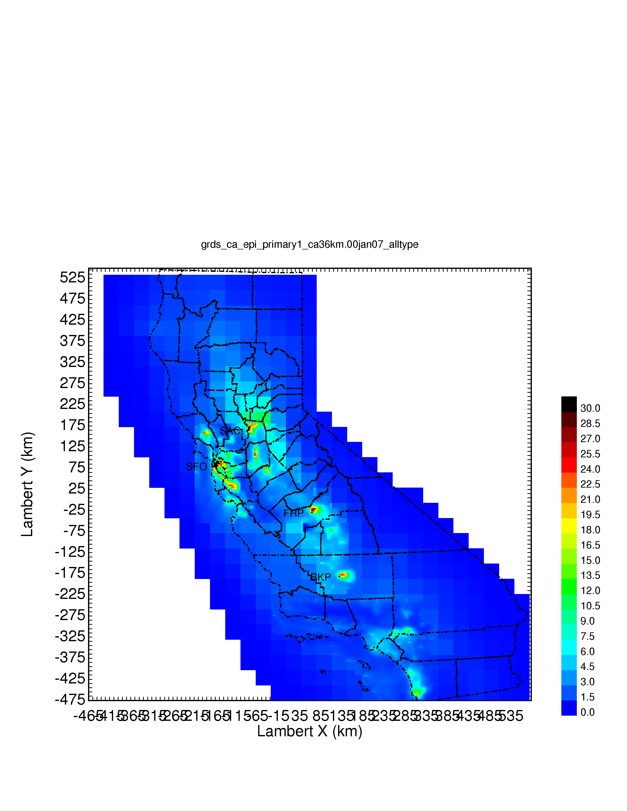
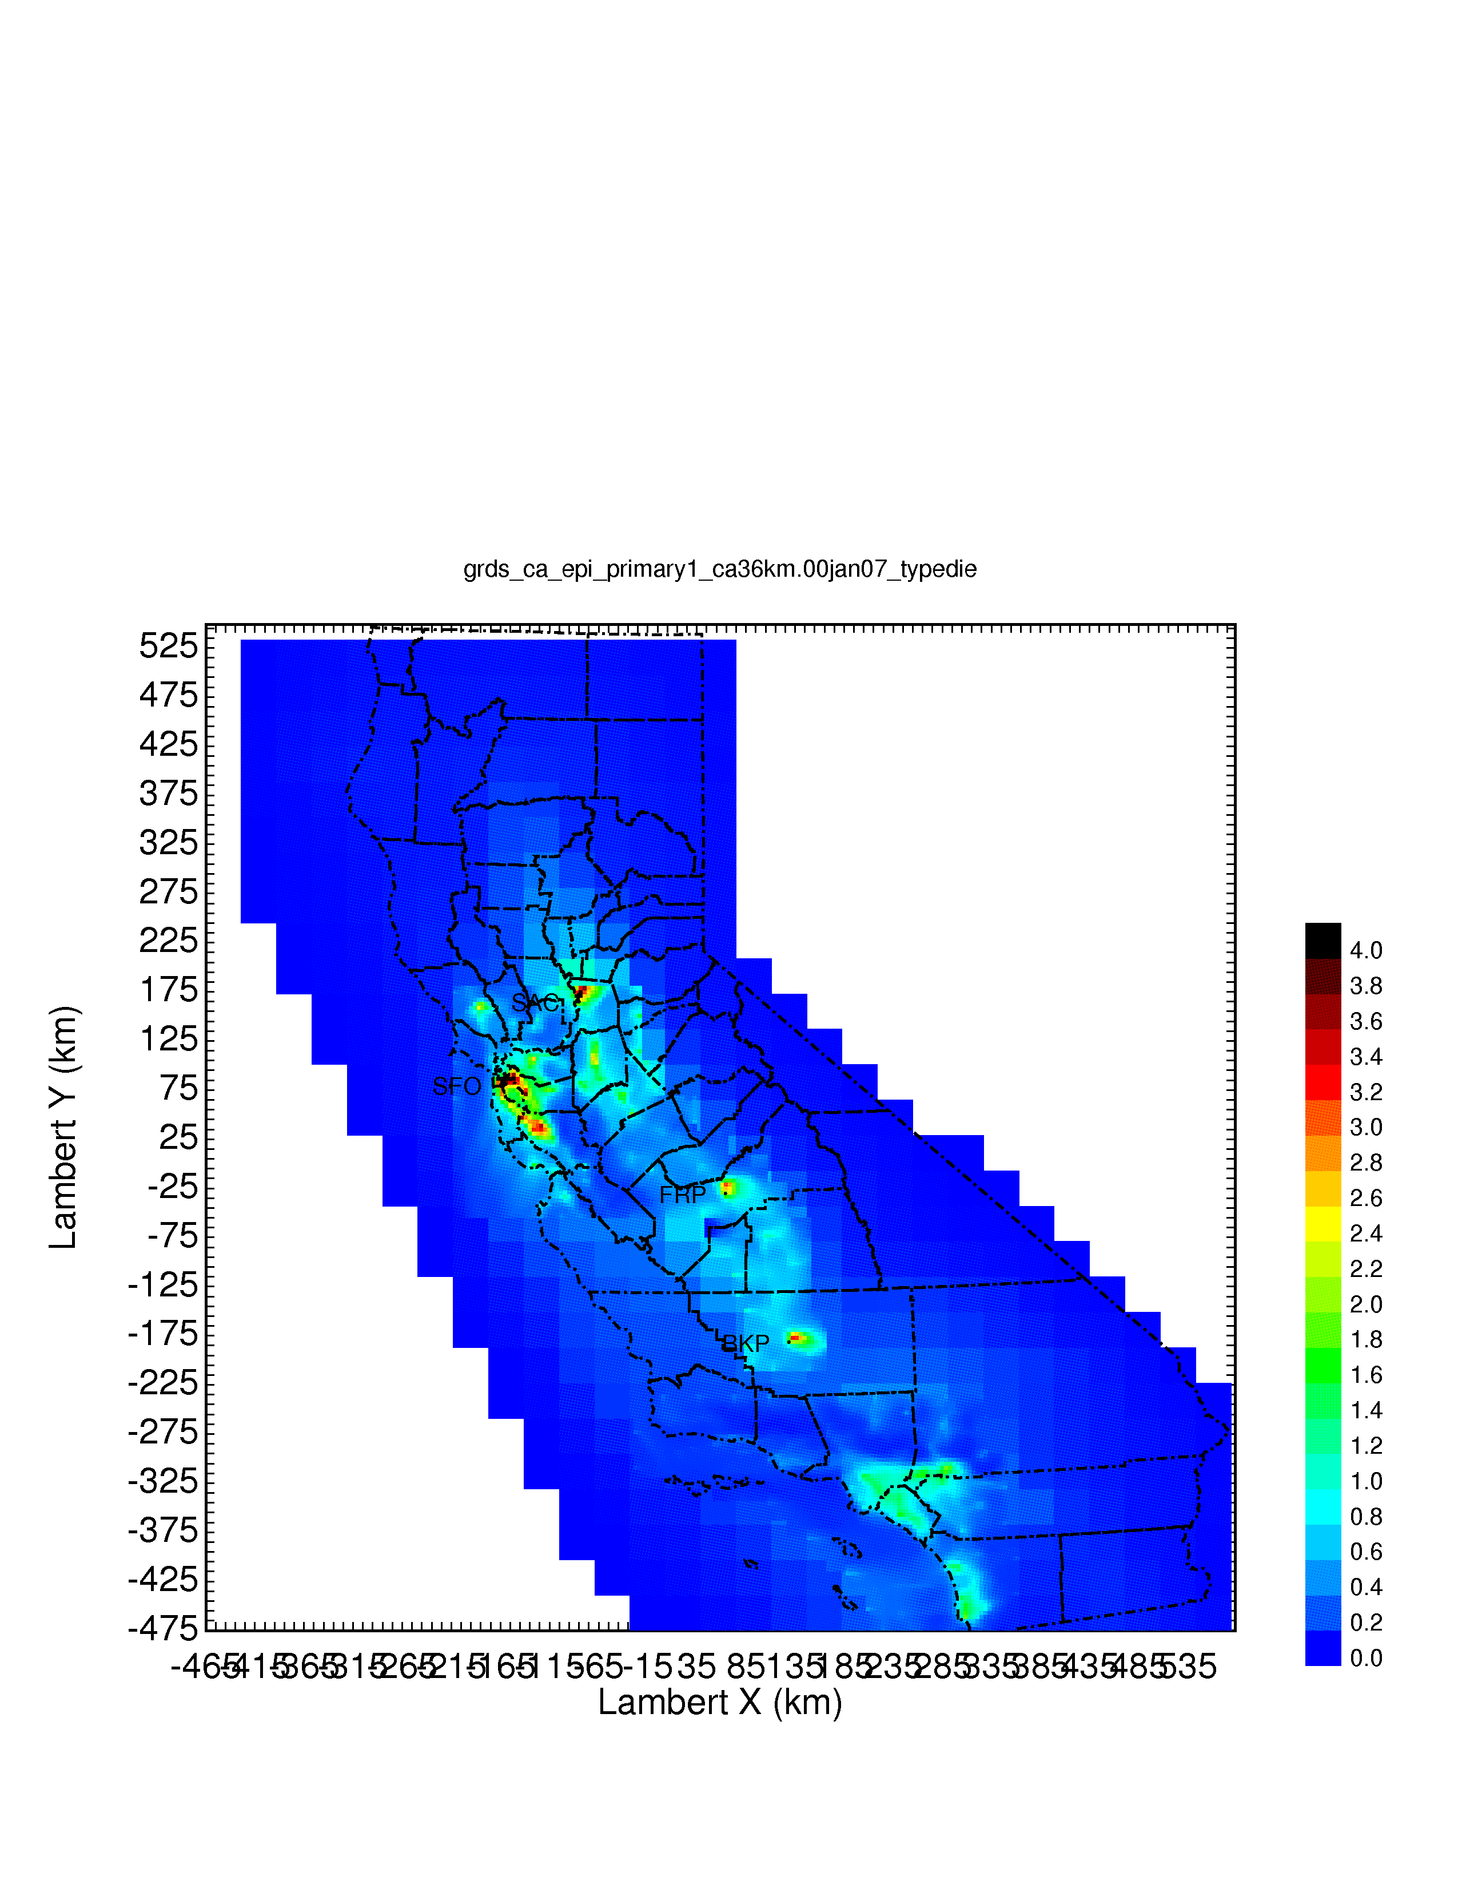

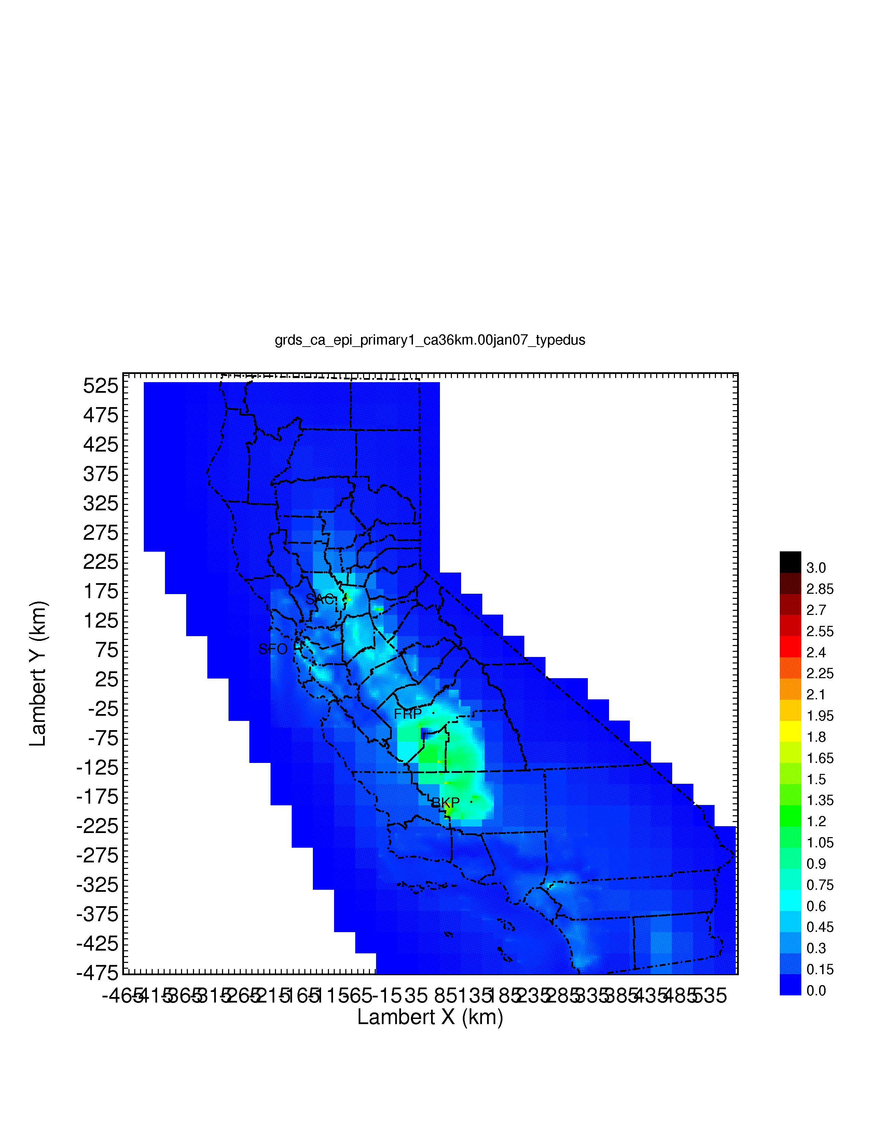
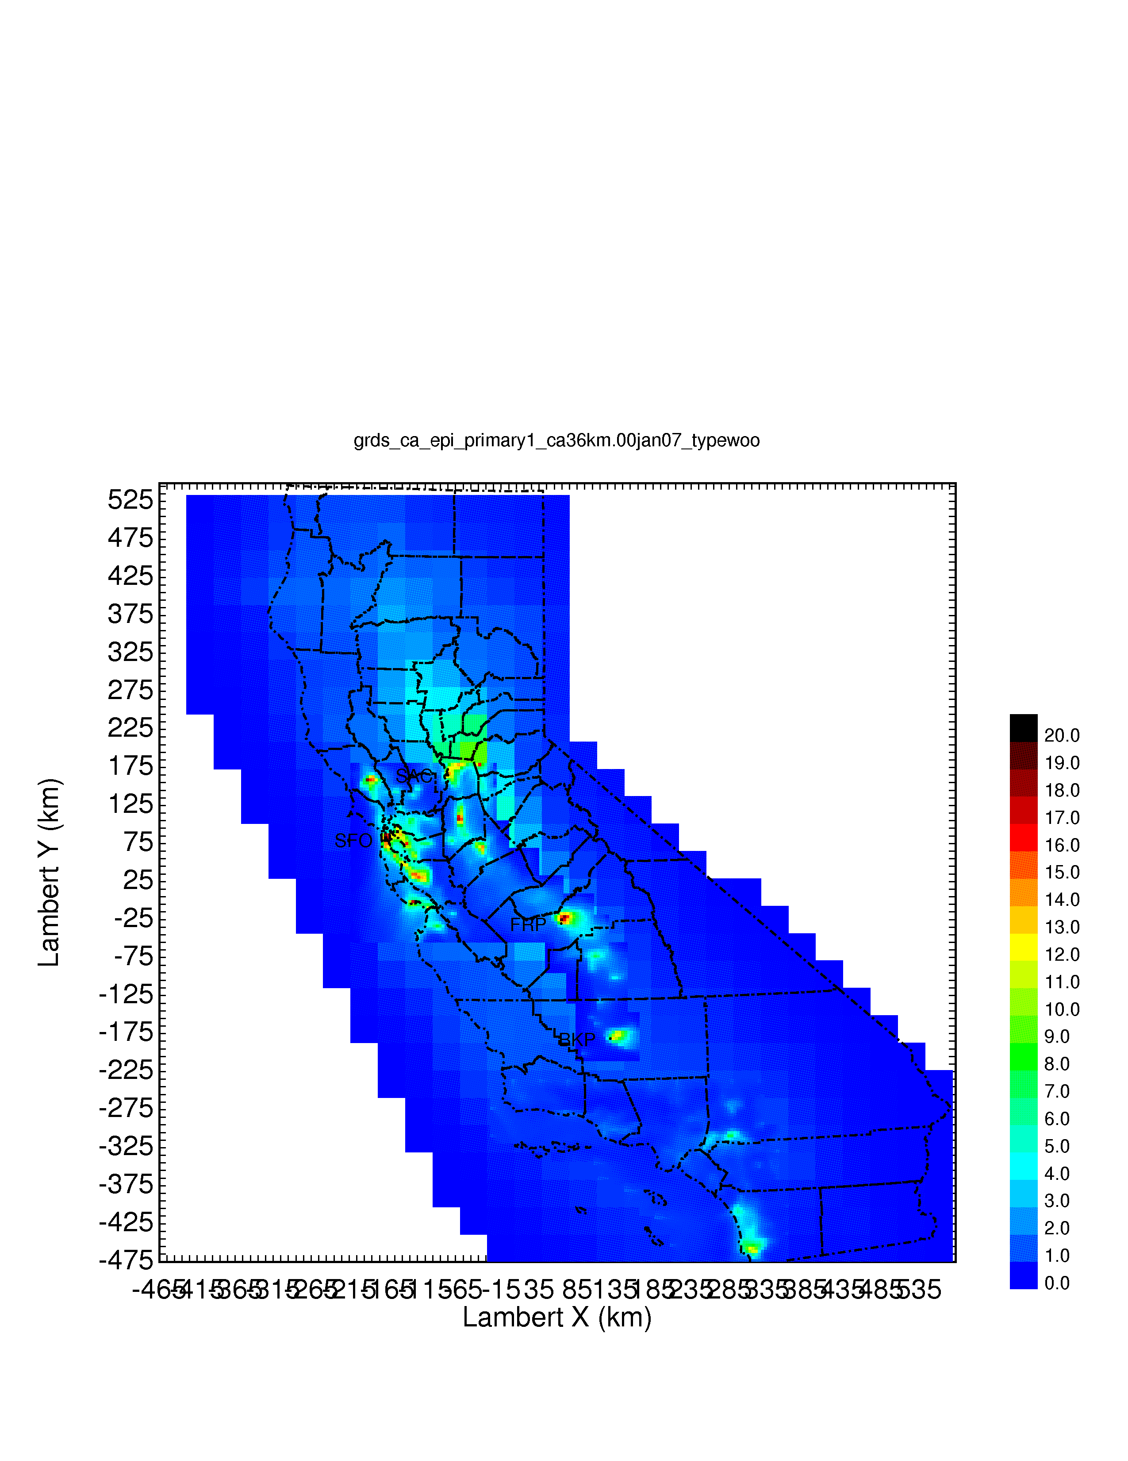
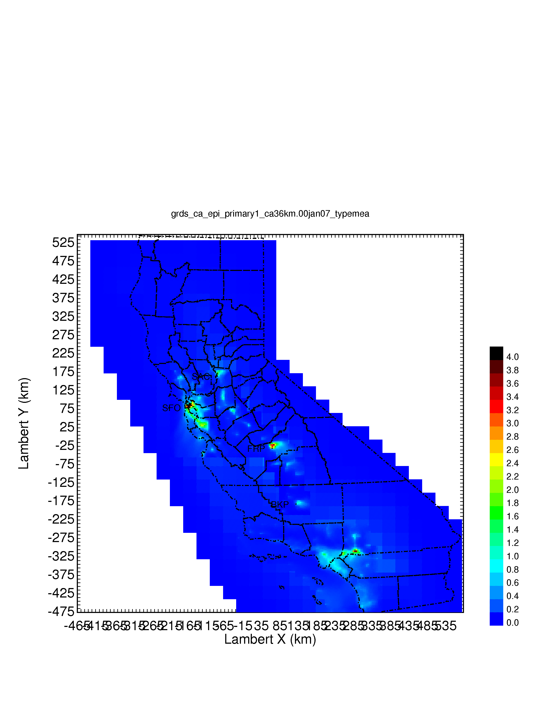
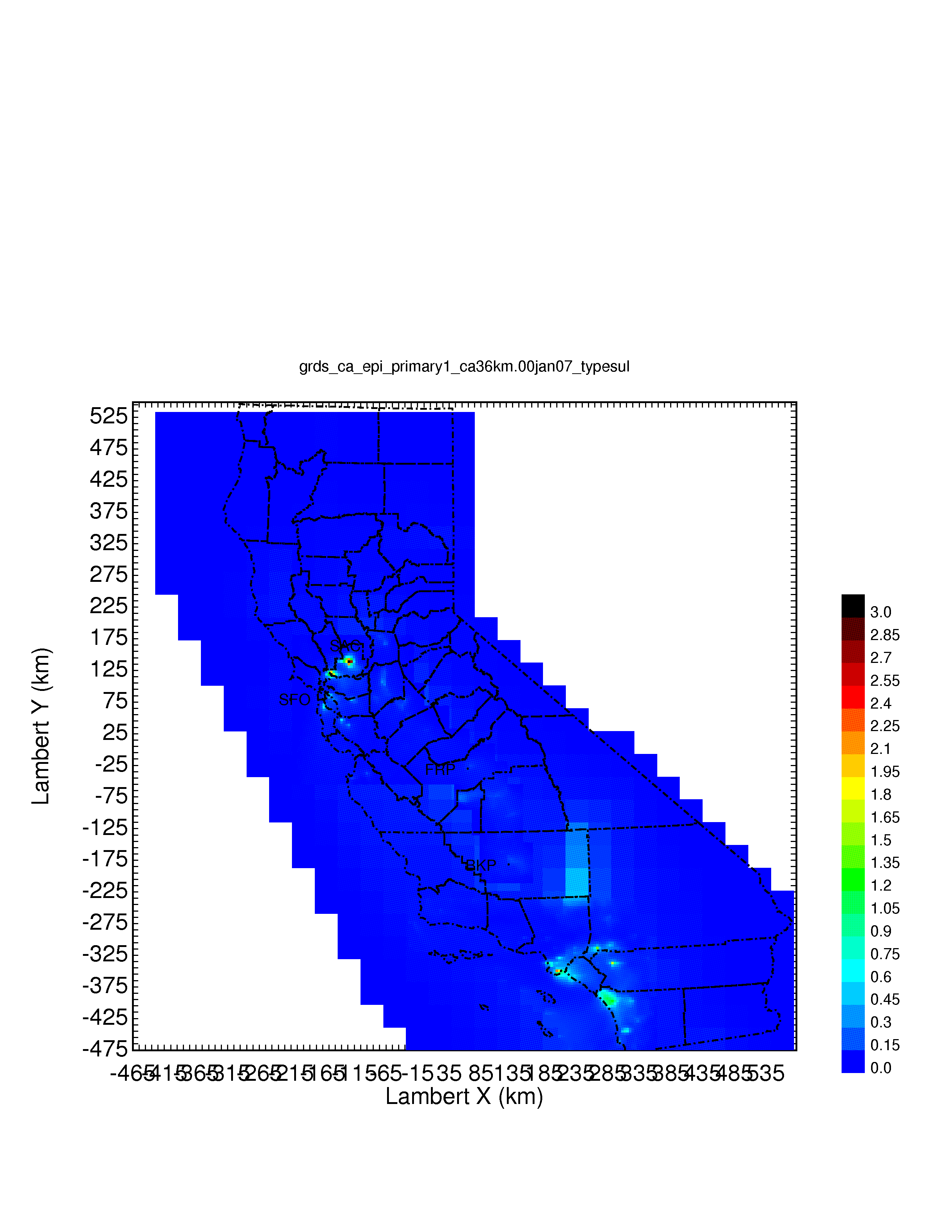
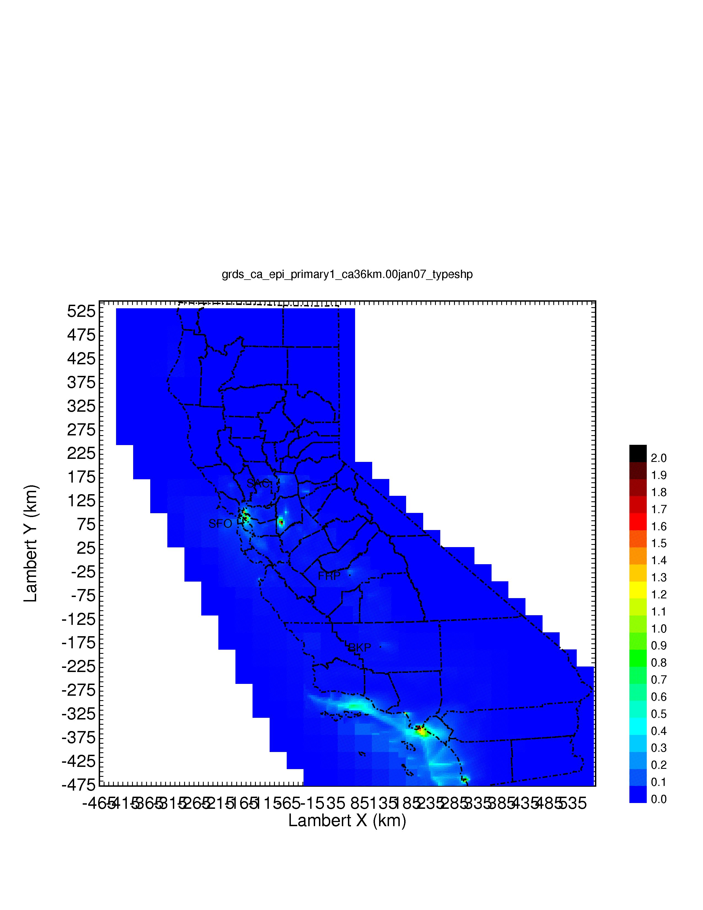
Regional Source Apportionment of UFP Mass
Download from faculty.engineering.ucdavis.edu/kleeman
PM0.1 Mass
Diesel Engines
Gasoline Engines
Dust
Wood Burning
Meat Cooking
High Sulfur Fuel
Shipping
Source: 2014 J. Hu, H. Zhang, S. Chen, Q. Ying, C. Wiedinmyer, F. Vandenberghe, and M.J. Kleeman. Identifying PM2.5 and PM0.1 Sources for Epidemiological Studies in California. Environmental Science and Technology, 48(9), pp 4980-4990.

Slide 7
PM_{0.1} Source Apportionment
Source: 2019 X. Yu, M. Venecek, A. Kumar, J. Hu, S. Tanrikulu, S. Soon, C. Tran, D. Fairley, and M.J. Kleeman. Regional Sources of Airborne Ultrafine Particle Number and Mass Concentrations in California. Atmospheric Chemistry and Physics, https://doi.org/10.5194/acp-2018-832.

Slide 8
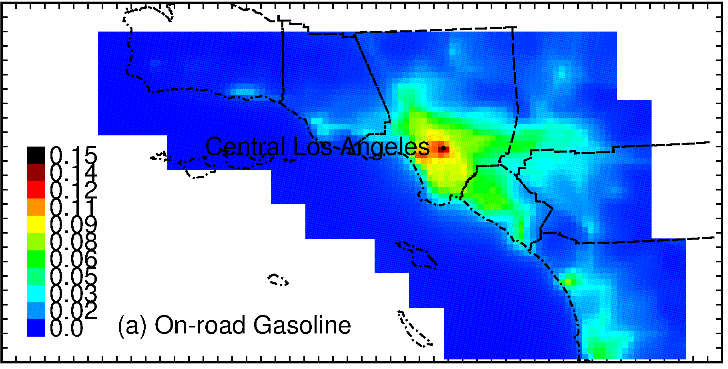
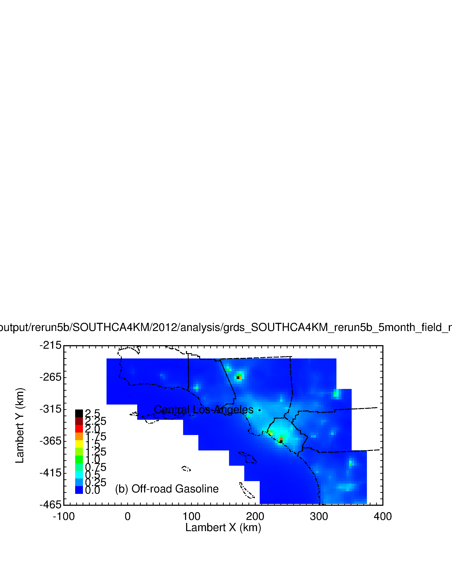
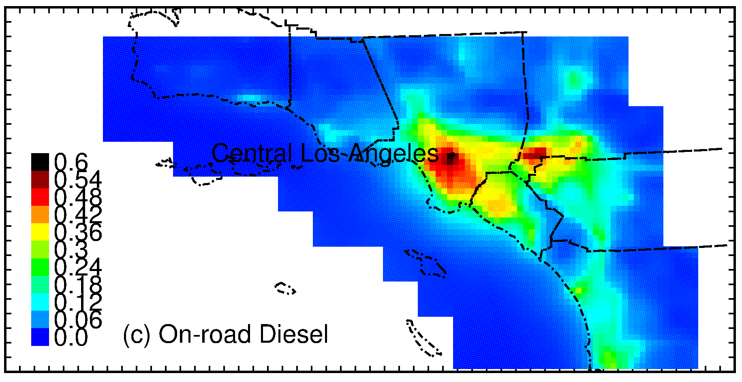

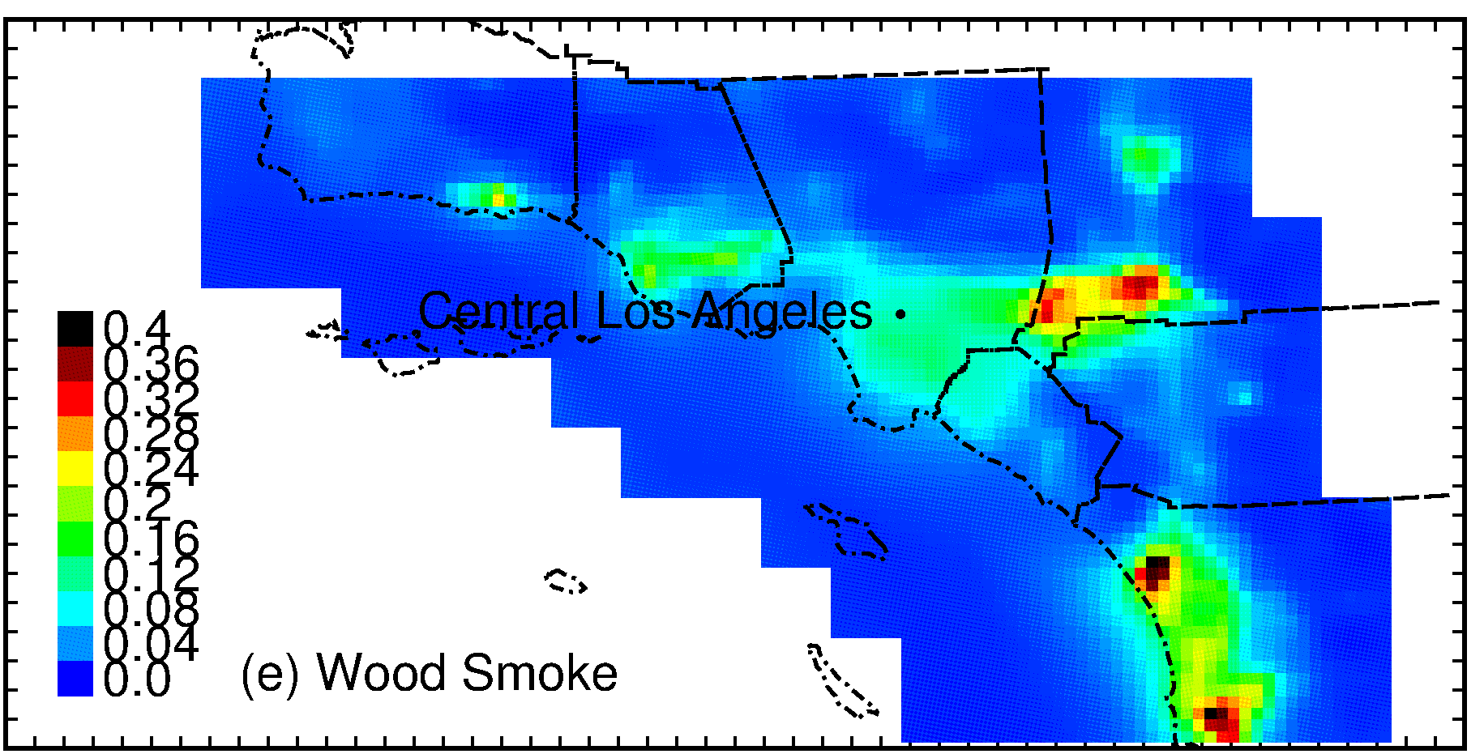
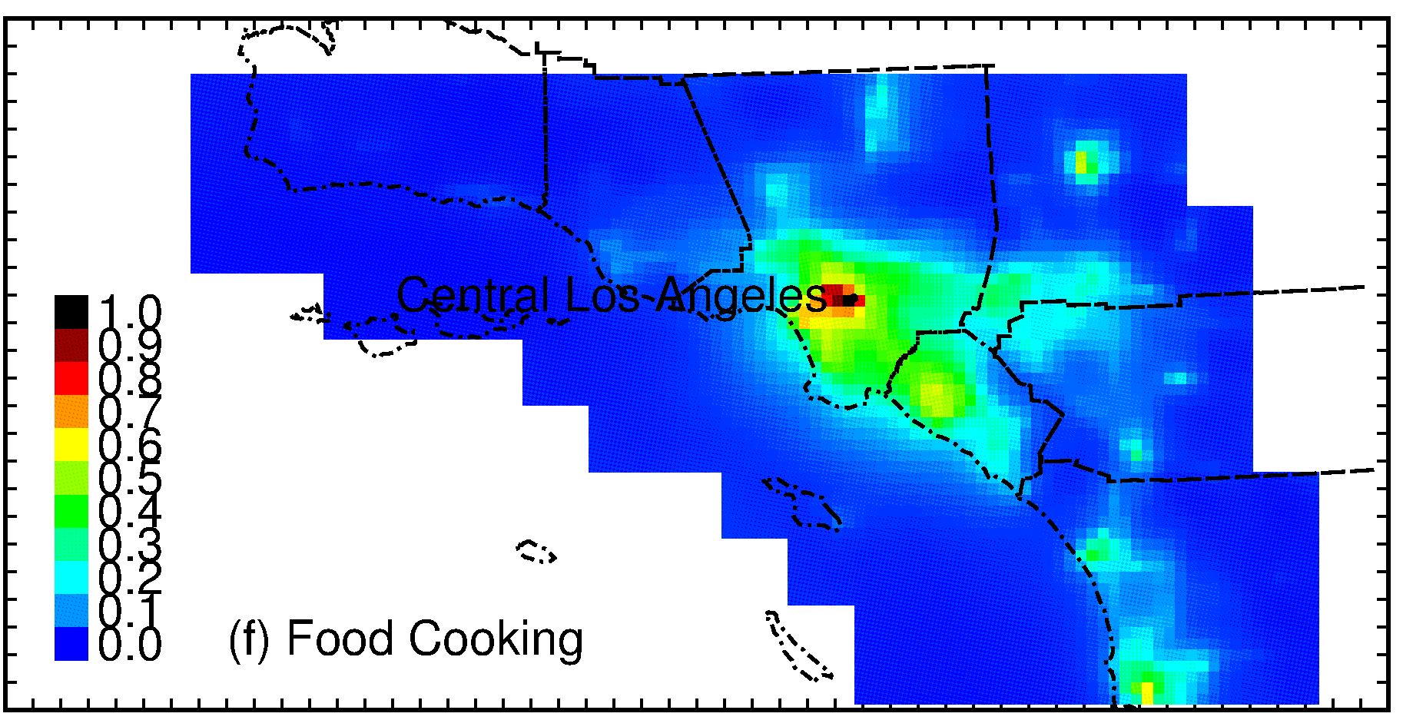
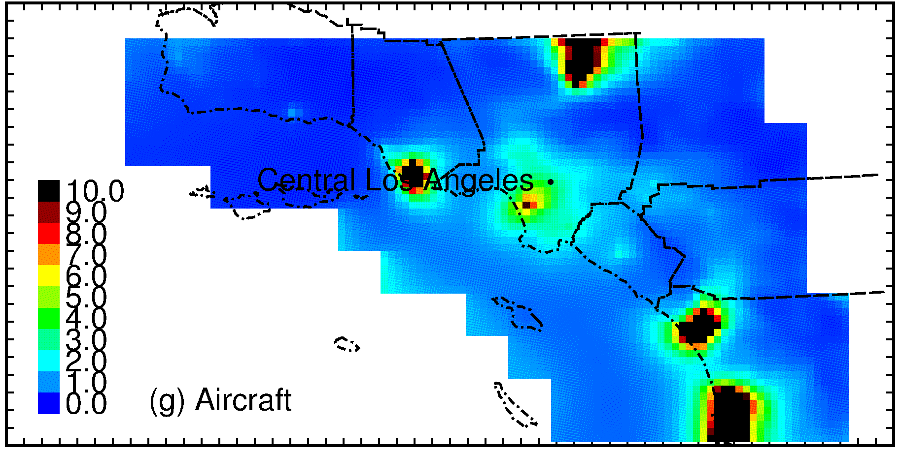


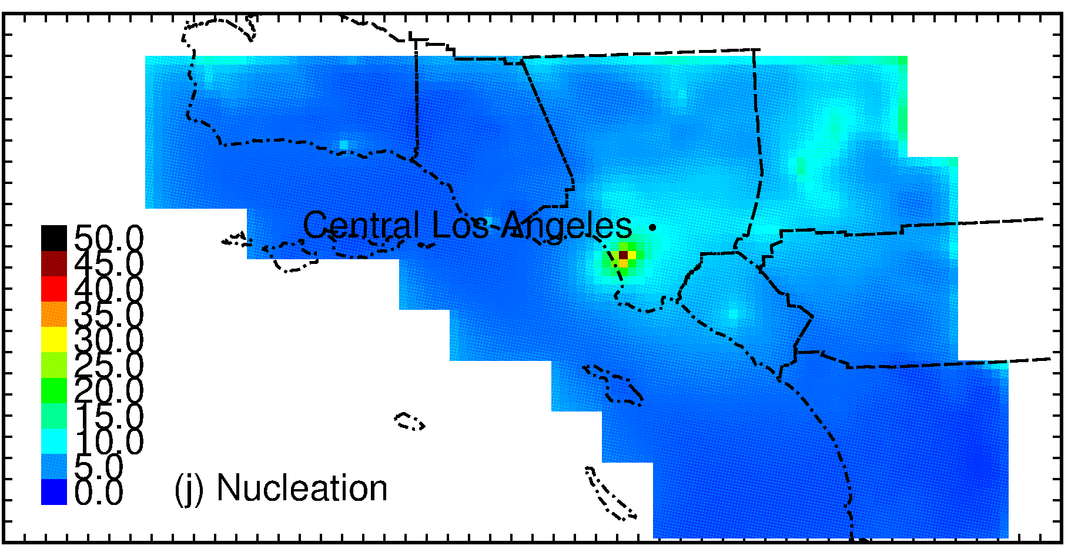
Southern California Regional Source Apportionment of N₇
Source: 2019 X. Yu, M. Venecek, A. Kumar, J. Hu, S. Tanrikulu, S. Soon, C. Tran, D. Fairley, and M.J. Kleeman. Regional Sources of Airborne Ultrafine Particle Number and Mass Concentrations in California. Atmospheric Chemistry and Physics, https://doi.org/10.5194/acp-2018-832.

Slide 9
Seasonal Variation of Nucleated Particles
Sources of H₂SO₄ have visible nucleation plumes downwind
Some airports characterize nucleated particles as primary emissions
Higher nucleation rates during colder months
Source: 2019 X. Yu, M. Venecek, A. Kumar, J. Hu, S. Tanrikulu, S. Soon, C. Tran, D. Fairley, and M.J. Kleeman. Regional Sources of Airborne Ultrafine Particle Number and Mass Concentrations in California. Atmospheric Chemistry and Physics, https://doi.org/10.5194/acp-2018-832.

Slide 10
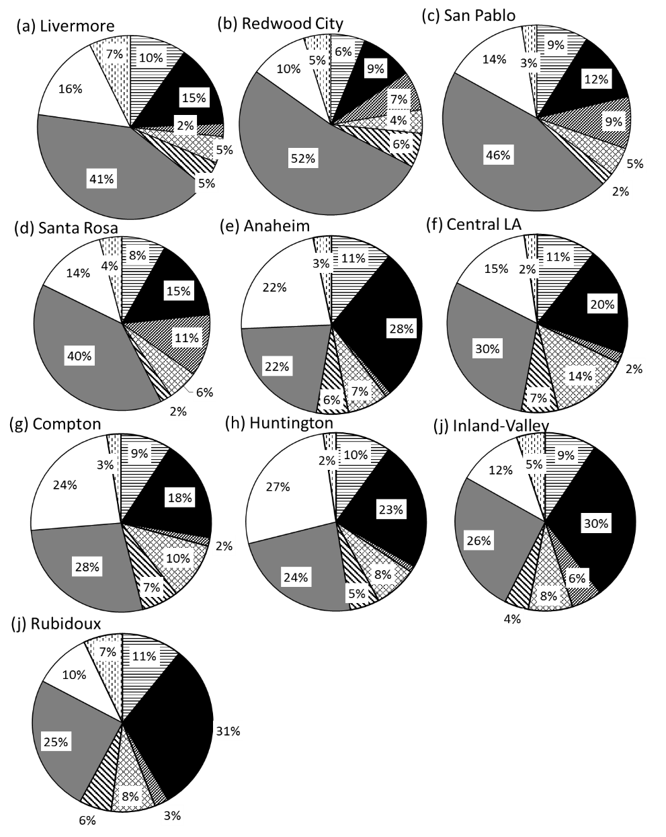

PM_{0.1} Source Contributions
Source: 2019 X. Yu, M. Venecek, A. Kumar, J. Hu, S. Tanrikulu, S. Soon, C. Tran, D. Fairley, and M.J. Kleeman. Regional Sources of Airborne Ultrafine Particle Number and Mass Concentrations in California. Atmospheric Chemistry and Physics, https://doi.org/10.5194/acp-2018-832.

Slide 11
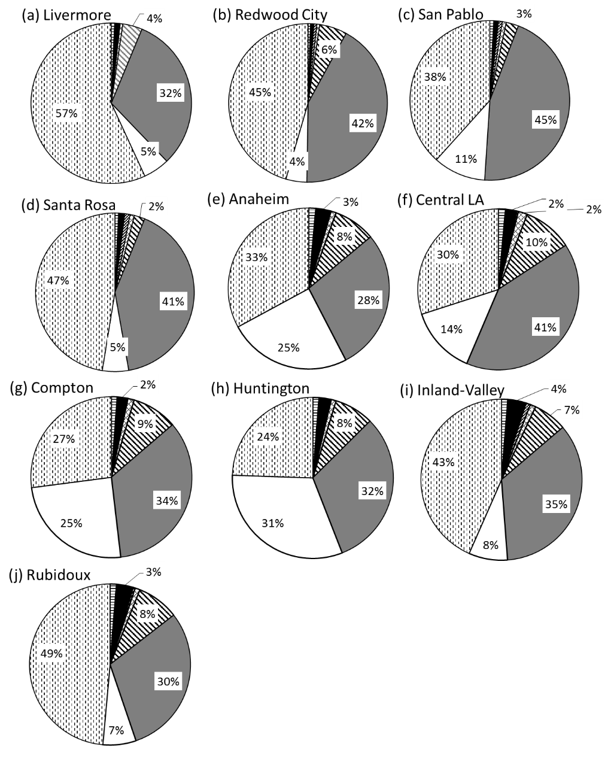

N₇ Source Contributions
Source: 2019 X. Yu, M. Venecek, A. Kumar, J. Hu, S. Tanrikulu, S. Soon, C. Tran, D. Fairley, and M.J. Kleeman. Regional Sources of Airborne Ultrafine Particle Number and Mass Concentrations in California. Atmospheric Chemistry and Physics, https://doi.org/10.5194/acp-2018-832.

Slide 12
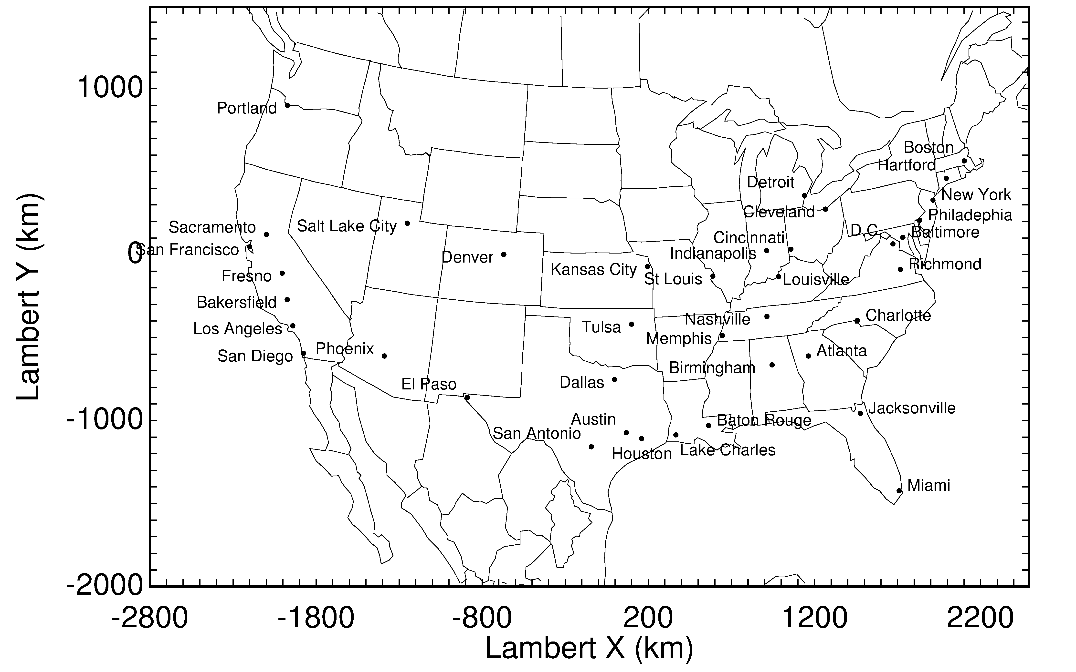
CONUS Analysis
Source: 2019 M.A. Venecek, X. Yu, M.J. Kleeman. Predicted ultrafine particulate matter source contributions across the continental United States during summer time air pollution events. Atmospheric Chemistry and Physics, 19, 9399–9412, 2019 https://doi.org/10.5194/acp-19-9399-2019.

Slide 13
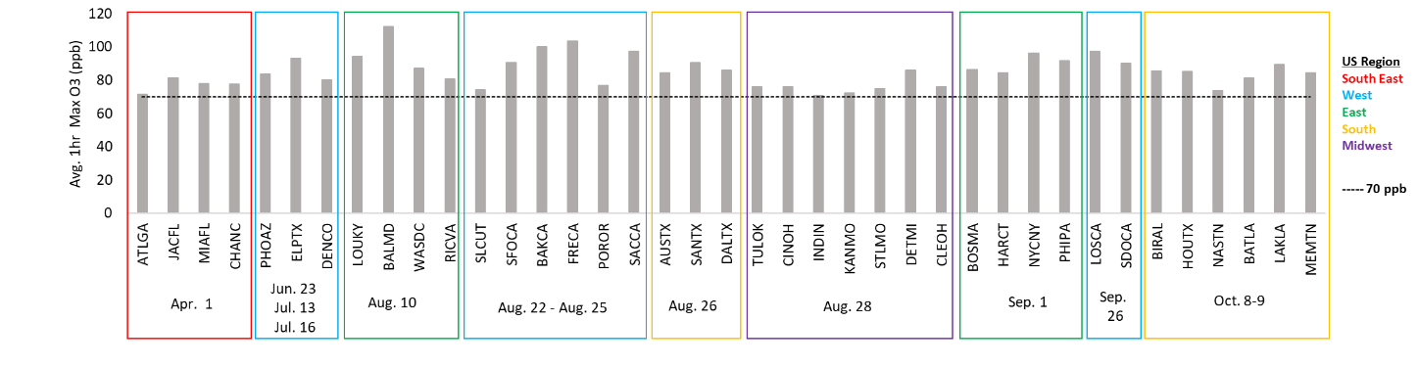
Representative Summer Photochemical Episodes in 2010
Source: 2019 M.A. Venecek, X. Yu, M.J. Kleeman. Predicted ultrafine particulate matter source contributions across the continental United States during summer time air pollution events. Atmospheric Chemistry and Physics, 19, 9399–9412, 2019 https://doi.org/10.5194/acp-19-9399-2019.

Slide 14
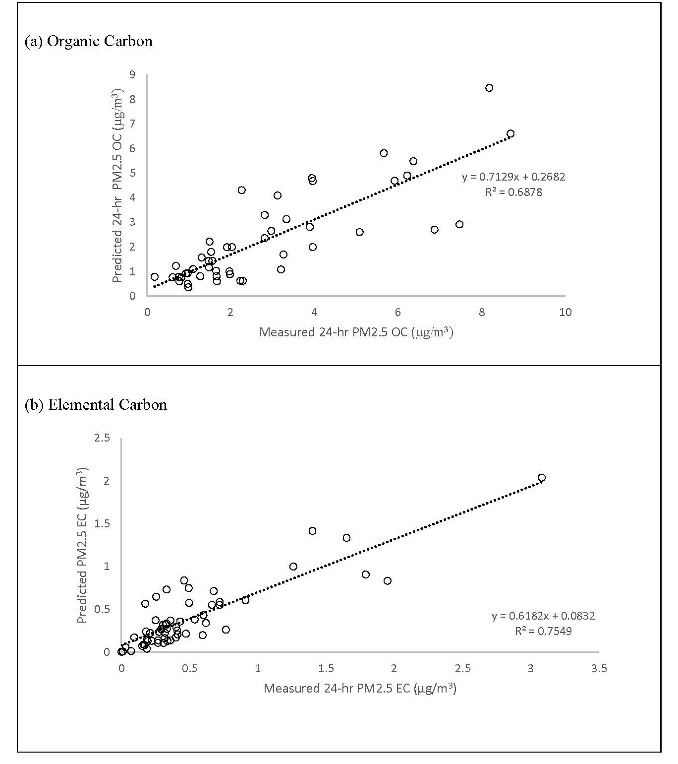
Model Performance

Slide 15
Source Contributions to PM_{2.5} and PM_{0.1}
Source: 2019 M.A. Venecek, X. Yu, M.J. Kleeman. Predicted ultrafine particulate matter source contributions across the continental United States during summer time air pollution events. Atmospheric Chemistry and Physics, 19, 9399–9412, 2019 https://doi.org/10.5194/acp-19-9399-2019.

Slide 16
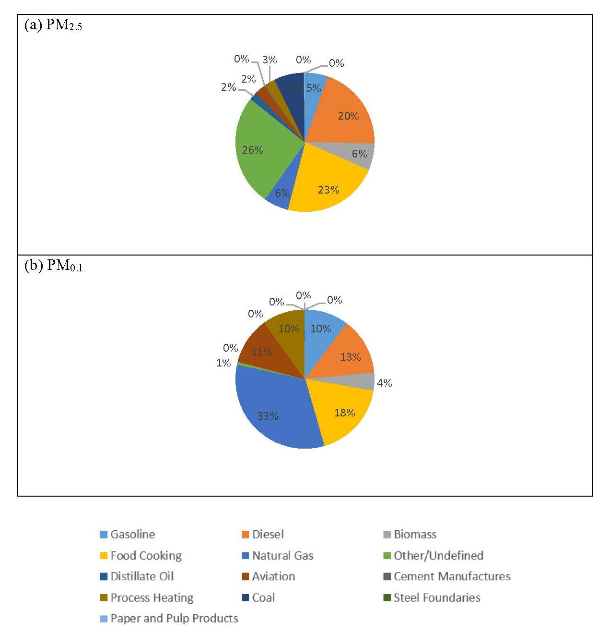
Population-Weighted Concentrations

Slide 17
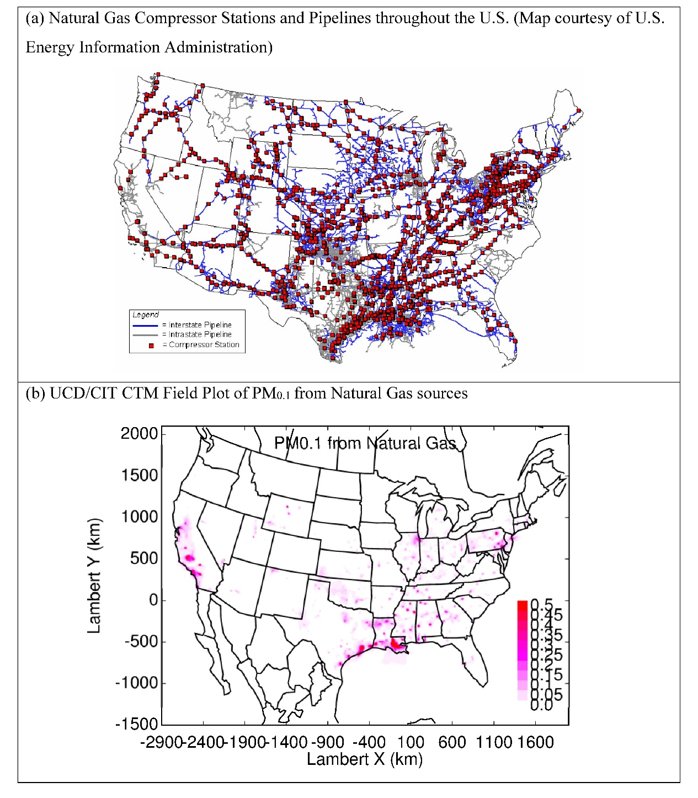
Natural Gas Compressor Stations vs. Natural Gas PM_{0.1}

Slide 18
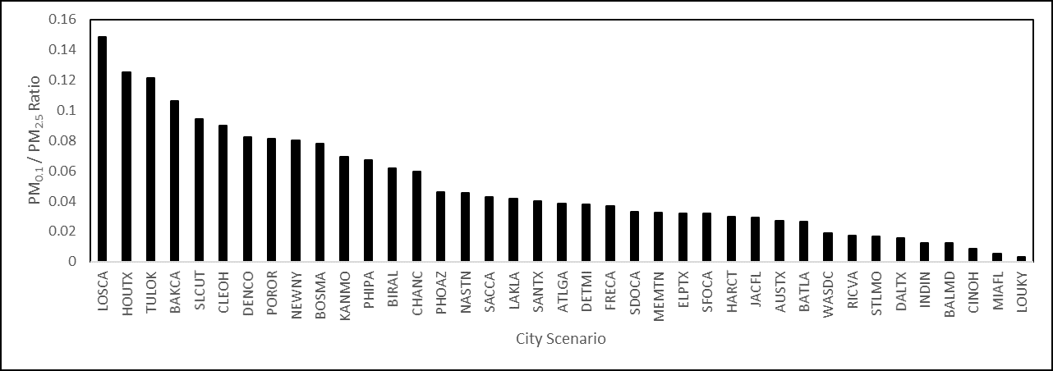
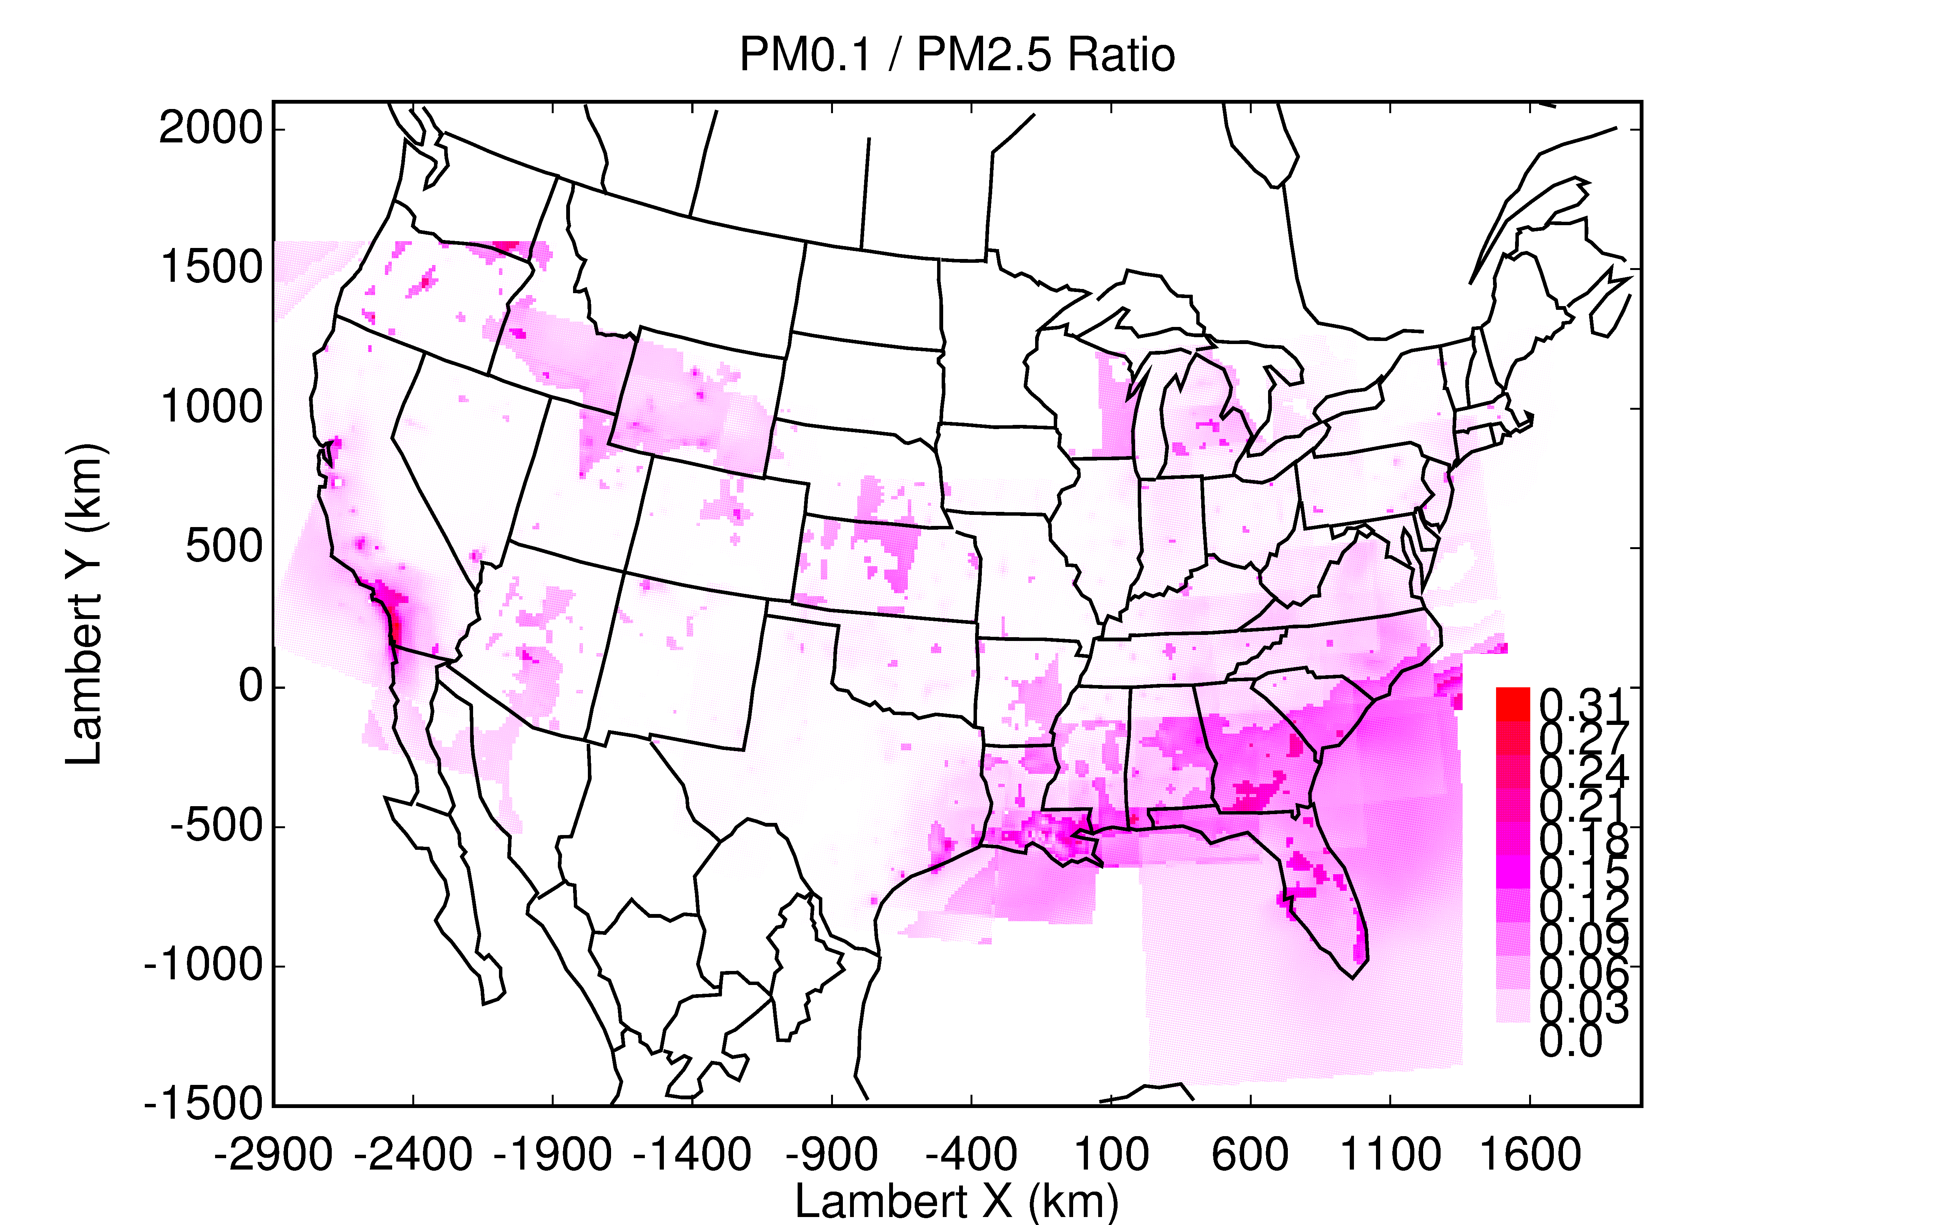
PM_{0.1}/PM_{2.5} Ratio

Slide 19
Conclusions
UFP epidemiology is difficult because of sharp spatial gradients
UFP mass, surface area, and number are different metrics that each have strengths and weaknesses
Initial epidemiology on UFP mass shows positive associations with Ischemic Heart Disease
  Exposure estimated using regional grid models
Natural gas combustion appears to be a major source of UFP
  Natural gas is a clean “transition fuel”, but it still has environmental costs

Slide 20
Future Work
Unique health effects associated with UFP metrics. Is there an effect distinct from PM2.5?
  Toxicology and Epidemiology
Continued improvements for exposure assessments including PM_{0.1} and N₇

Slide 21
Acknowledgements
CARB Project #14-314, BAAQMD Project #2013.218
Bart Ostro (UCD), Peggy Reynolds (UCSF), Debbie Goldberg (UCSF)
Mohammad H. Sowlat and Constantinos Sioutas – USC
Anabelle Lolinco and Alam Hasson – CSU Fresno
Saffet Tanrikulu, Steven Randall, Robert Boynton, Robert Graul, and David Beyer – BAAQMD
Lori Miyasato – CARB

