Slide 1

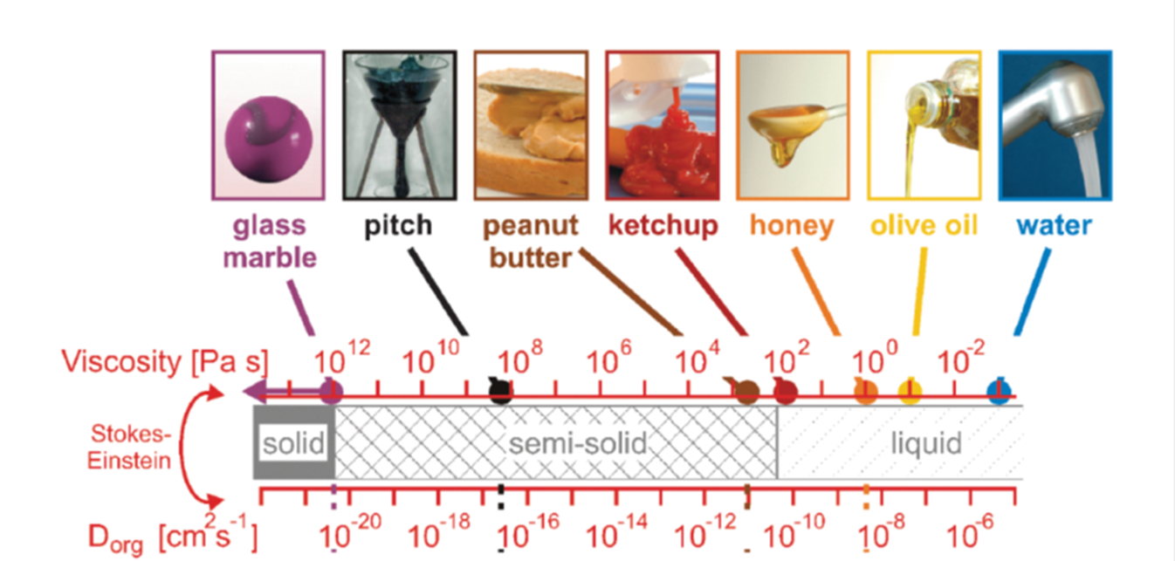
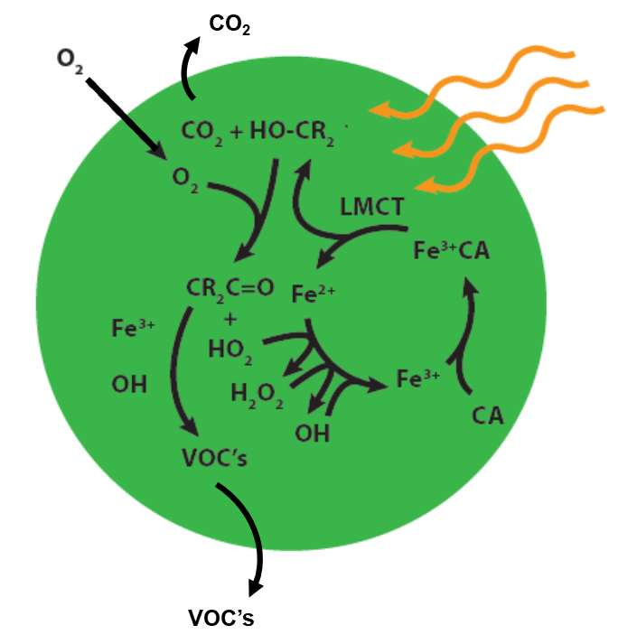
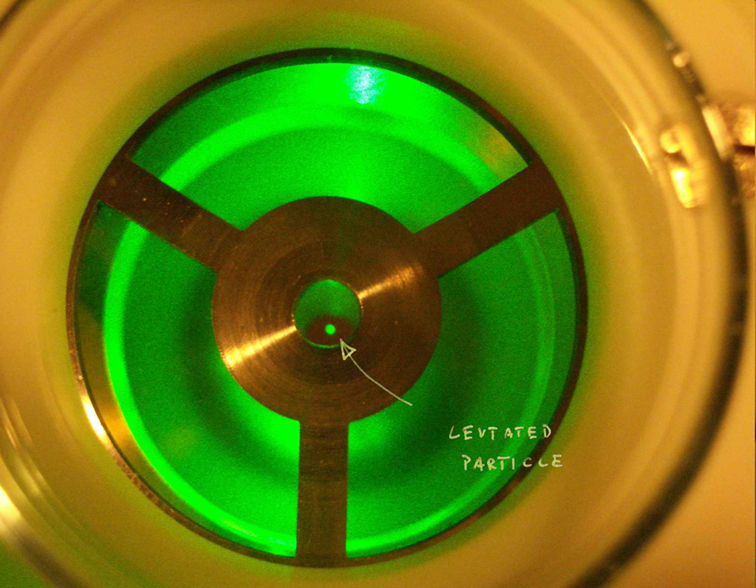
Photochemical reaction and diffusion (PRAD) model:
The influence of viscosity on photochemistry in single aerosol particles
Jing Dou,
Beiping Luo, Thomas Peter, Peter A. Alpert, Pablo Corral Arroyo, Markus Ammann, and Ulrich K. Krieger

Slide 2
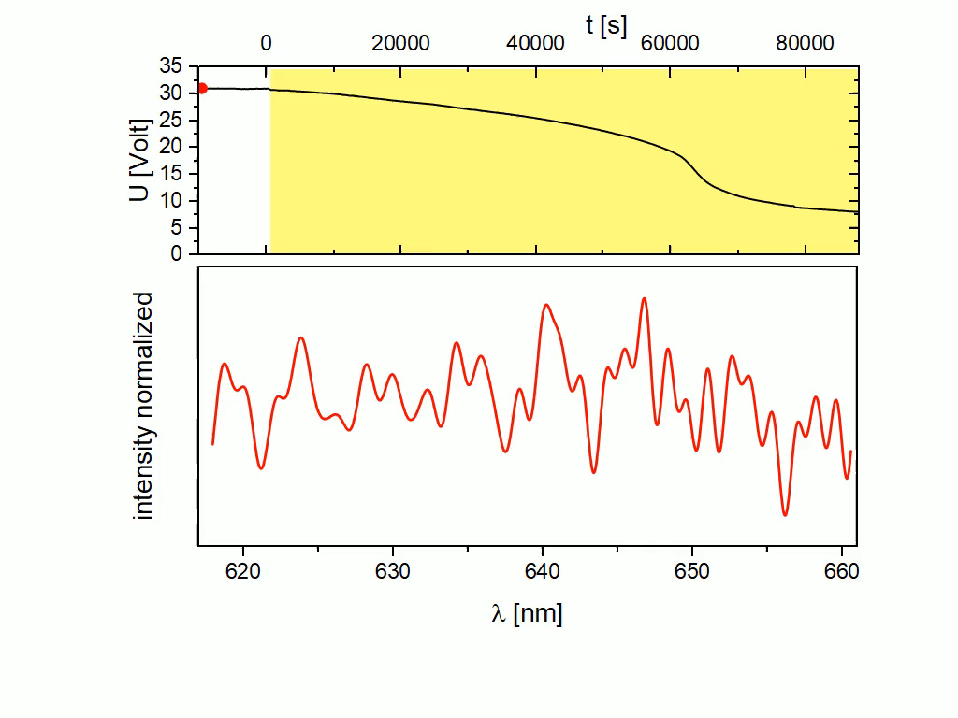
Observation: massive particle mass loss due to photochemsitry
375 nm
Fe^{III}-citrate
Citric acid
H₂O
Mie Resonance Spectrum
Notes:
Fe^{III}cit : CA = 0.05 (molar)

Slide 3
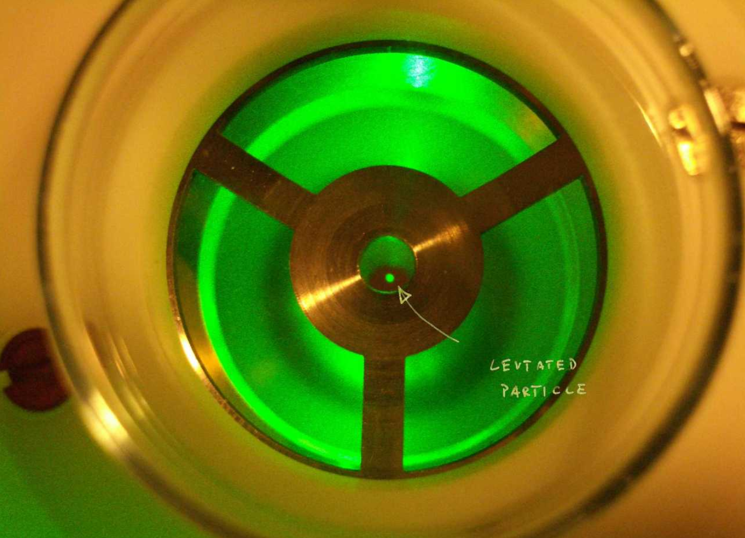
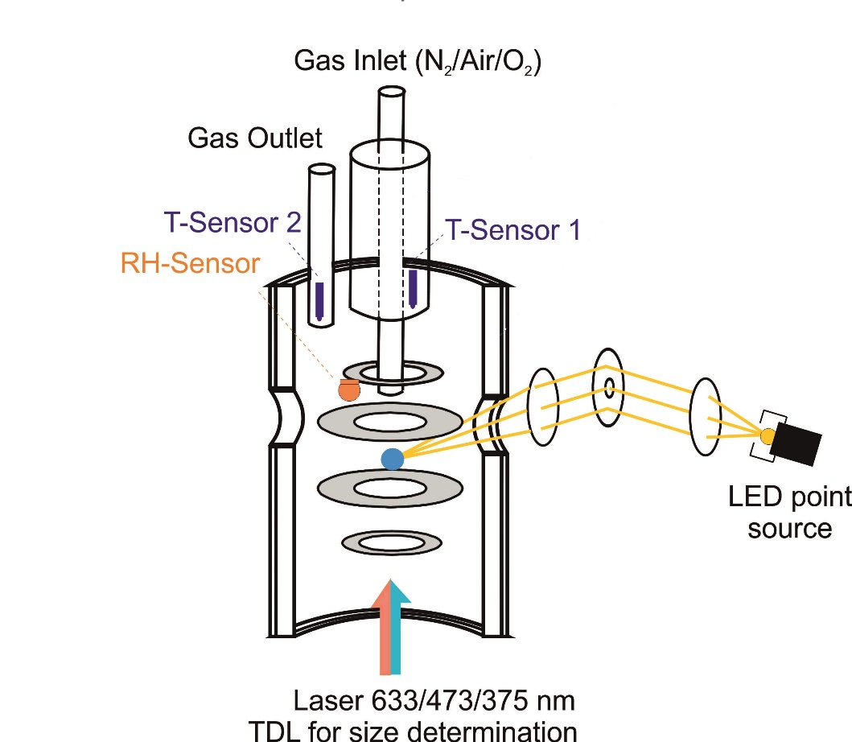


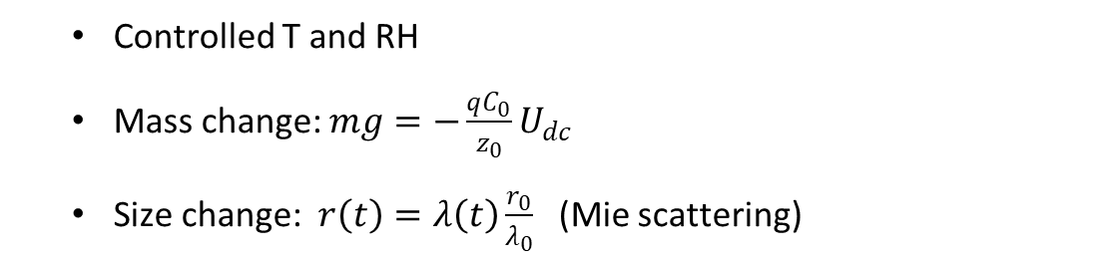
Setup — Electrodynamic balance (EDB)
  Controlled T and RH
  Mass change: $mg=−\frac{qC_{0}}{z_{0}}U_{dc}$
  Size change: $r\left(t\right)=λ\left(t\right)\frac{r_{0}}{λ_{0}}$ (Mie scattering)
$$qE$$
single, levitated particle
Fe^{III}-citrate
Citric acid
H₂O
laser beam
$m$g

Slide 4
Effect of RH
Fe^{III}-citrate
Citric acid
H₂O
Notes:
293 K

Slide 5
Iron(III)-citrate photochemistry scheme
CO₂
VOC’s

Slide 6
Photochemical Reaction And Diffusion (PRAD) model
Shell n
Shell n-1
[X]_{n}↔[Y]_{n}
In each shell:
chemical reactions
·
·
∙
[X]_{n-1}↔[Y]_{n-1}
Shell i+1
f_{n-1}
f_{n}
Shell i
[X]_{i+1}↔[Y]_{i+1}
Shell i-1
[X]_{i}↔[Y]_{i}
f_{i+1}
[X]_{i-1}↔[Y]_{i-1}
f_{n-2}
f_{i-1}
f_{i}

Slide 7
In each shell: chemical reactions
Number | Chemical reactions | Reaction rate coefficients
Photolysis and follow-up reactions
R1 | Fe^{III}(Cit) + hν → Fe²⁺ + OH-•C(CH₂COO)₂²⁻ + CO₂ | σ=1.0×10⁻¹⁹ cm² (cross section)
R2 | Fe^{III}(Cit)(OH)⁻ + hν → Fe²⁺ + OH-•C(CH₂COO)₂²⁻ + CO₂ + OH⁻ | σ=1.0×10⁻¹⁹ cm² (cross section)
R3 | •OOC-C(OH)(CH₂COO)₂²⁻ + O₂ → O=C(CH₂COO)₂²⁻ + H⁺+ O₂^{•-} + CO₂ | k=1.0×10⁶ M⁻¹ s⁻¹
O₂^{•-}/HO₂• and Fe²⁺/Fe³⁺ reactions
R4 | HO₂• + HO₂• → H₂O₂ + O₂ | k=8.3×10⁵ M⁻¹ s⁻¹
R5 | Fe²⁺ + O₂^{•-} (+ 2H⁺) → Fe³⁺ + H₂O₂ | k=1.0×10⁷ M⁻¹ s⁻¹
R6 | Fe²⁺ + HO₂• (+ H⁺) → Fe³⁺ + H₂O₂ | k=1.2×10⁶ M⁻¹ s⁻¹
R7 | Fe²⁺ + H₂O₂ → Fe³⁺ + •OH + OH⁻ (Fenton reaction) | k=76 M⁻¹ s⁻¹
R8 | Fe²⁺ + •OH → Fe^{III}(OH)²⁺ | k=4.3×10⁸ M⁻¹ s⁻¹
R9 | Fe^{II}(HCit) + O₂ → Fe^{III}(Cit) + HO₂• | K=3 M⁻¹ s⁻¹
Follow-up photo-active reactions
R10 | C₅ + hν → C₃ + 2CO₂ | σ=10⁻²¹ cm² (cross section)
R11 | C₄ + hν → C₃ + CO₂ | σ=10⁻²⁰ cm² (cross section)
R12 | C₅ + hν → C₂+ C₃ | σ=10⁻²² cm² (cross section)
R13 | C₄ + hν → C₂+ C₂ | σ=10⁻²¹ cm² (cross section)
R14 | C₅ + hν → C₄+ CO₂ | σ=10⁻²⁰ cm² (cross section)
CO₂
VOC’s
The photolysis products C₅ and C₄ are photo-chemically active.

Slide 8
Photochemical Reaction And Diffusion (PRAD) model
Shell n
Shell n-1
[X]_{n}↔[Y]_{n}
In each shell:
chemical reactions
equilibria
·
·
∙
[X]_{n-1}↔[Y]_{n-1}
Shell i+1
f_{n-1}
f_{n}
Shell i
[X]_{i+1}↔[Y]_{i+1}
Shell i-1
[X]_{i}↔[Y]_{i}
f_{i+1}
[X]_{i-1}↔[Y]_{i-1}
f_{n-2}
f_{i-1}
f_{i}

Slide 9
In each shell: equilibria
CO₂
Number | Equilibria | Equilibrium constants
E1 | H₂O ⇌ OH⁻+H⁺ | K=1×10⁻¹⁴ M
E2 | H₃Cit ⇌ H₂Cit⁻+H⁺ | K=7.5×10⁻⁴ M
E3 | H₂Cit⁻ ⇌ HCit²⁻ +H⁺ | K=1.7×10⁻⁵ M
E4 | HCit²⁻ ⇌ Cit³⁻+H⁺ | K=4.0×10⁻⁷ M
E5 | Fe³⁺ + Cit³⁻ ⇌ Fe^{III}(Cit) | K=1.58×10¹³ M⁻¹
E6 | Fe³⁺ + Cit³⁻ +H₂O ⇌ Fe^{III}(Cit)(OH)⁻ +H⁺ | K=8.35×10⁷ M⁻¹
E7 | Fe³⁺ + HCit²⁻ ⇌ Fe^{III}(HCit)⁺ | K=2.51×10⁷ M⁻¹
E8 | Fe²⁺ + HCit²⁻ ⇌ Fe^{II}(HCit) | K=1.935×10¹⁰ M⁻¹
E9 | Fe³⁺ + H₂O ⇌ Fe^{III}(OH)²⁺ +H⁺ | K=4.57×10⁻³ M
E10 | O₂^{•-} + H⁺ ⇌ HO₂• | K=6.32×10⁴ M⁻¹
E11 | Fe²⁺ + O=C(CH₂COO)₂²⁻ ⇌ Fe^{II}[O=C(CH₂COO)₂] | K=2×10³ M⁻¹
E12 | 2H⁺ + OH-•C(CH₂COO)₂²⁻ ⇌ OH-•C(CH₂COOH)₂ | K=1.5×10⁶ M⁻²
E13 | 2H⁺ + O=C(CH₂COO)₂²⁻ ⇌ O=C(CH₂COOH)₂ | K=1.5×10⁶ M⁻²
VOC’s
Tuning parameters

Slide 10
Photochemical Reaction And Diffusion (PRAD) model
In each shell:
chemical reactions
equilibria
Between shells:
diffusion
Shell n
Shell n-1
[X]_{n}↔[Y]_{n}
·
·
∙
[X]_{n-1}↔[Y]_{n-1}
Shell i+1
Shell i
[X]_{i+1}↔[Y]_{i+1}
Shell i-1
[X]_{i}↔[Y]_{i}
[X]_{i-1}↔[Y]_{i-1}

Slide 11
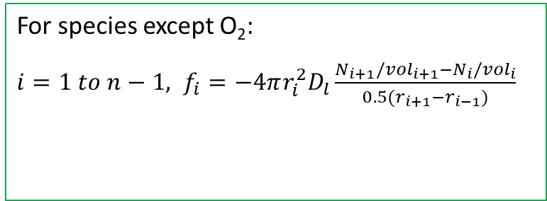
Photochemical Reaction And Diffusion (PRAD) model
Diffusion
For species except O₂:
$i=1 to n−1, f_{i}=−4πr_{i}^{2}D_{l}\frac{N_{i+1}/{vol}_{i+1}−N_{i}/{vol}_{i}}{0.5(r_{i+1}−r_{i−1})}$
Shell n
Shell n-1
[X]_{n}↔[Y]_{n}
·
·
∙
[X]_{n-1}↔[Y]_{n-1}
Shell i+1
f_{n-1}
Shell i
[X]_{i+1}↔[Y]_{i+1}
Shell i-1
[X]_{i}↔[Y]_{i}
f_{i+1}
[X]_{i-1}↔[Y]_{i-1}
f_{n-2}
f_{i-1}
f_{i}

Slide 12
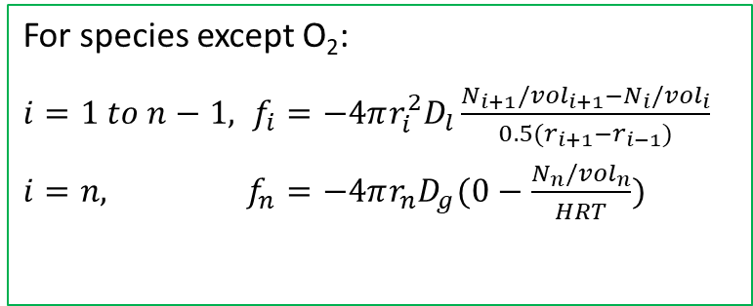
Photochemical Reaction And Diffusion (PRAD) model
Diffusion
For species except O₂:
$i=1 to n−1, f_{i}=−4πr_{i}^{2}D_{l}\frac{N_{i+1}/{vol}_{i+1}−N_{i}/{vol}_{i}}{0.5(r_{i+1}−r_{i−1})}$
$i=n, f_{n}=−4πr_{n}D_{g}(0−\frac{N_{n}/{vol}_{n}}{HRT})$
Shell n
Shell n-1
[X]_{n}↔[Y]_{n}
·
·
∙
[X]_{n-1}↔[Y]_{n-1}
Shell i+1
f_{n-1}
f_{n}
Shell i
[X]_{i+1}↔[Y]_{i+1}
Shell i-1
[X]_{i}↔[Y]_{i}
f_{i+1}
[X]_{i-1}↔[Y]_{i-1}
f_{n-2}
f_{i-1}
f_{i}

Slide 13
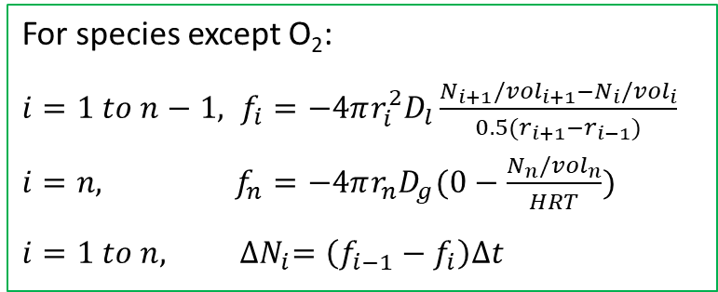
Photochemical Reaction And Diffusion (PRAD) model
Diffusion
For species except O₂:
$i=1 to n−1, f_{i}=−4πr_{i}^{2}D_{l}\frac{N_{i+1}/{vol}_{i+1}−N_{i}/{vol}_{i}}{0.5(r_{i+1}−r_{i−1})}$
$i=n, f_{n}=−4πr_{n}D_{g}(0−\frac{N_{n}/{vol}_{n}}{HRT})$
$$i=1 to n, {∆N}_{i}=\left(f_{i−1}−f_{i}\right)∆t$$
Shell n
Shell n-1
[X]_{n}↔[Y]_{n}
·
·
∙
[X]_{n-1}↔[Y]_{n-1}
Shell i+1
f_{n-1}
f_{n}
Shell i
[X]_{i+1}↔[Y]_{i+1}
Shell i-1
[X]_{i}↔[Y]_{i}
f_{i+1}
[X]_{i-1}↔[Y]_{i-1}
f_{n-2}
f_{i-1}
f_{i}

Slide 14
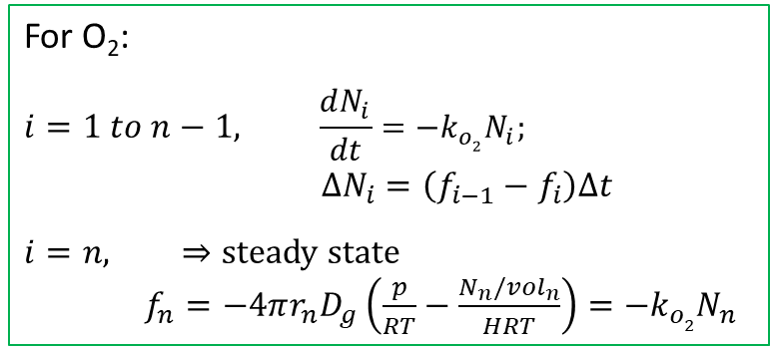
Photochemical Reaction And Diffusion (PRAD) model
Diffusion
For species except O₂:
$i=1 to n−1, f_{i}=−4πr_{i}^{2}D_{l}\frac{N_{i+1}/{vol}_{i+1}−N_{i}/{vol}_{i}}{0.5(r_{i+1}−r_{i−1})}$
$i=n, f_{n}=−4πr_{n}D_{g}(0−\frac{N_{n}/{vol}_{n}}{HRT})$
$$i=1 to n, {∆N}_{i}=\left(f_{i−1}−f_{i}\right)∆t$$
Shell n
Shell n-1
[X]_{n}↔[Y]_{n}
·
·
∙
[X]_{n-1}↔[Y]_{n-1}
Shell i+1
f_{n-1}
For O₂:
$$i=1 to n−1, \frac{dN_{i}}{dt}=−k_{o2}N_{i};$$
$∆N_{i}=\left(f_{i−1}−f_{i}\right)∆t$
$$i=n, ⇒steady state$$
$f_{n}=−4πr_{n}D_{g}\left(\frac{p}{RT}−\frac{N_{n}/{vol}_{n}}{HRT}\right)={−k}_{o2}N_{n}$
f_{n}
Shell i
[X]_{i+1}↔[Y]_{i+1}
Shell i-1
[X]_{i}↔[Y]_{i}
f_{i+1}
[X]_{i-1}↔[Y]_{i-1}
f_{n-2}
f_{i-1}
f_{i}
Notes:
$$N_{i}=N_{i}e^{−k_{o2}∆t}$$

Slide 15
Comparison between experiments and PRAD modelling
473 nm irradiation
4 W cm⁻²
T = 300 K

Slide 16
Comparison between experiments and PRAD modelling
473 nm irradiation
4 W cm⁻²
T = 300 K

Slide 17
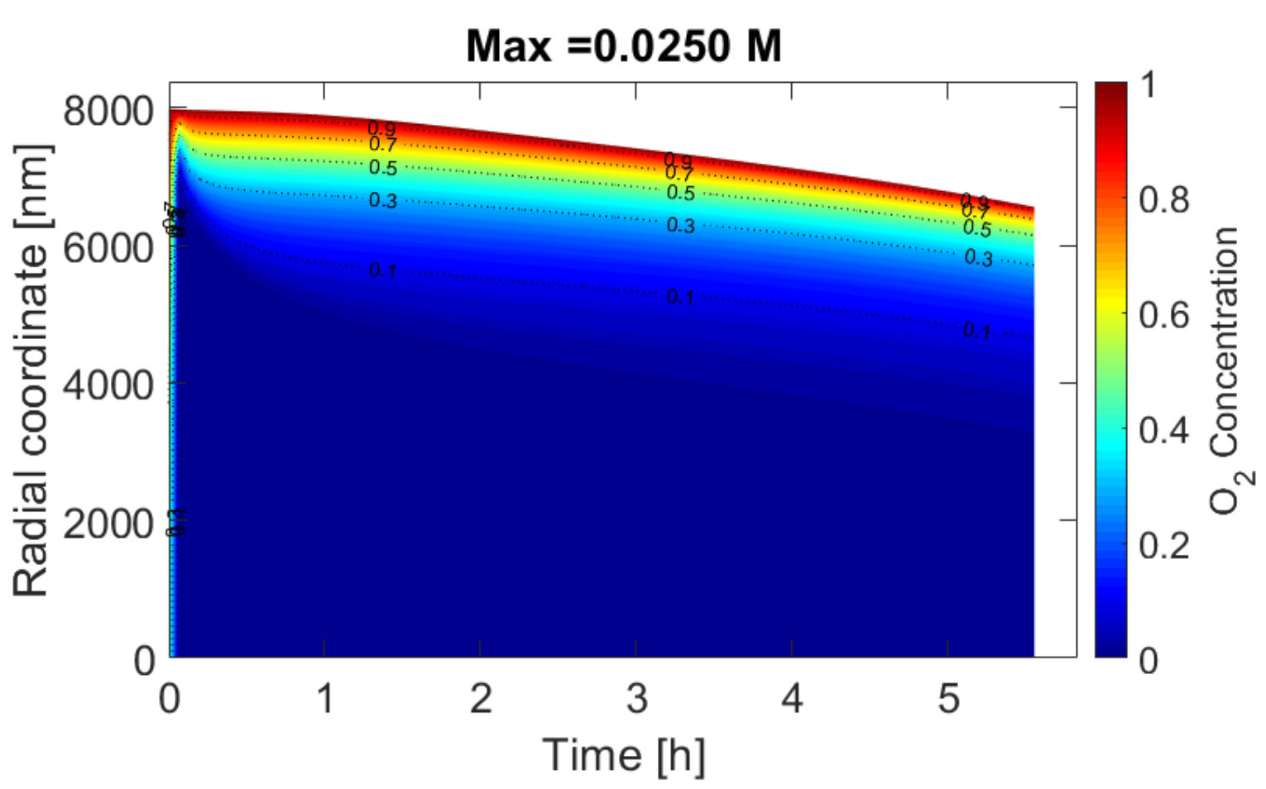
PRAD model results

Slide 18
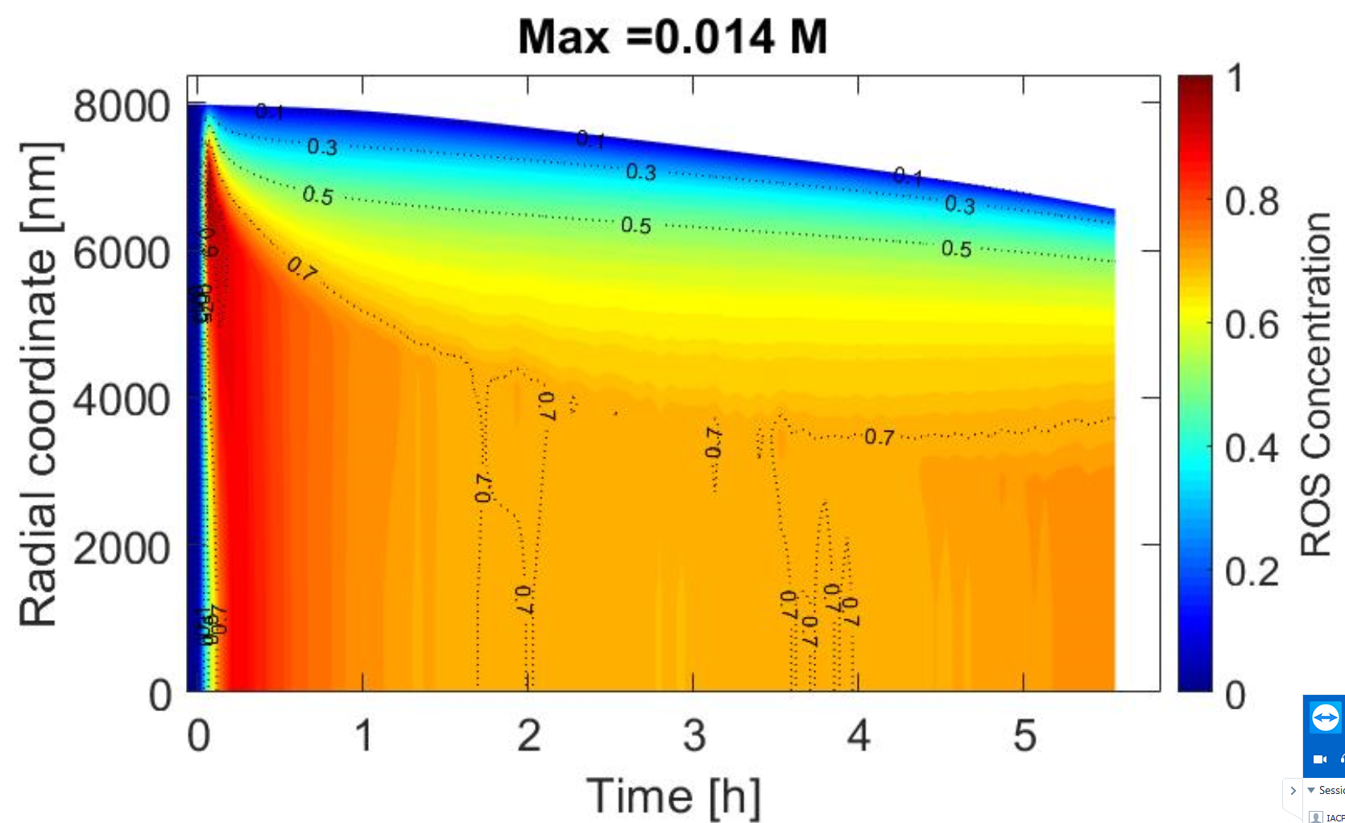
PRAD model results
O₂
ROS
Interior anoxic
With significant ROS species
Notes:
HO2 OH H2O2 O2

Slide 19
Summary & outlook
Massive mass loss upon irradiation
Degradation rate increases with time
Strong effect of viscosity on photochemical aging
Experimental
observations
Strong concentration gradients within particles
Interior of particle is anoxic with significant ROS concentrations
Modelling work ongoing to upscale / downscale to atmospheric conditions
Modelling simulations

Slide 20
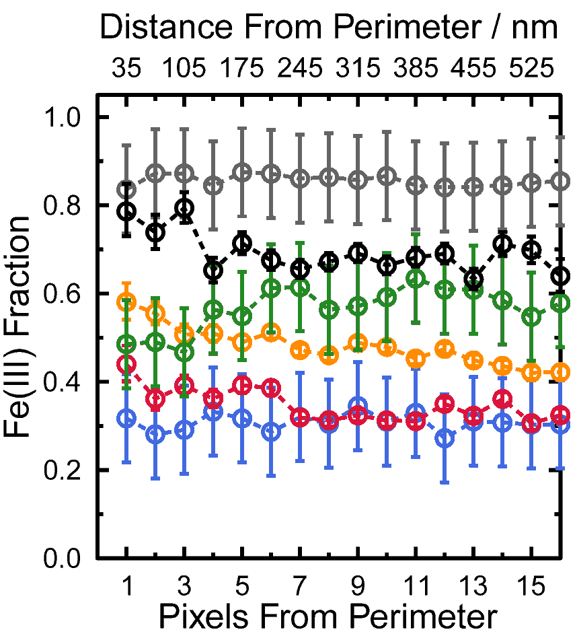
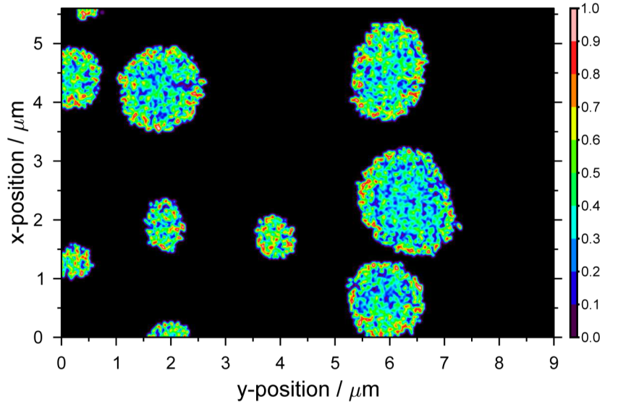
Following Fe(III) recovery in real time after irradiation stopped
2 min
Initial
107 min
67 min
24 min
10 min
2 min
UV LED
RH=60%, 3 W m⁻² at 370 nm 15 min lights on.
Notes:
Scanning transmission X-ray microscopy, Near Edge X-ray Absorption Fine Structure (NEXAFS)

Slide 21
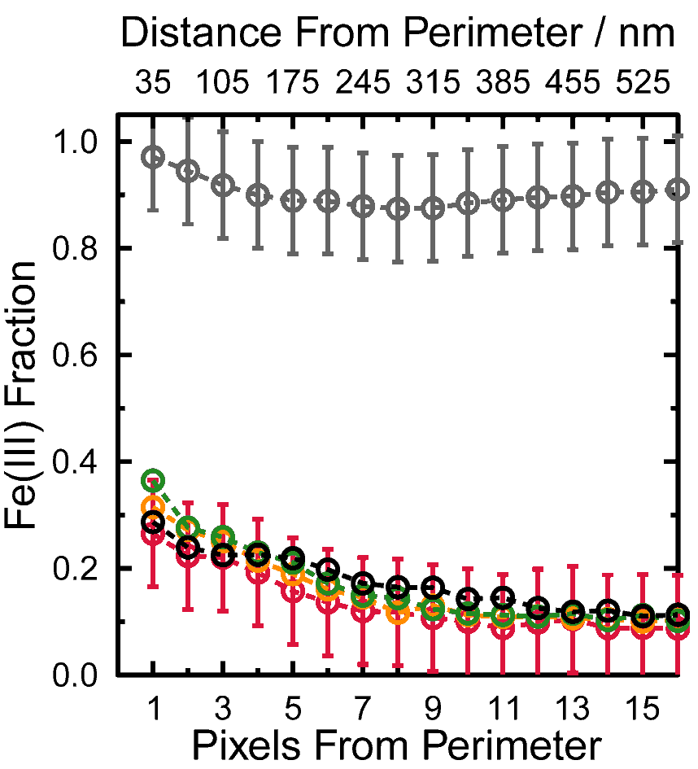
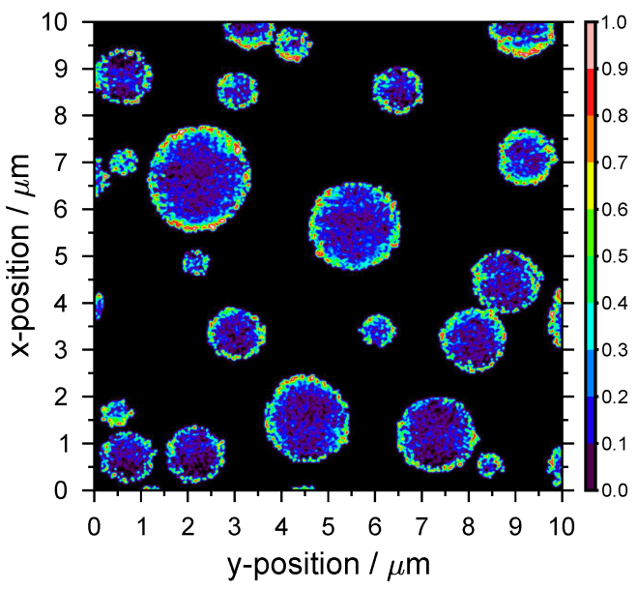
Following Fe(III) recovery in real time after irradiation stopped
13 min
Initial
102 min
62 min
34 min
13 min
UV LED
RH=40%, 3 W m⁻² at 370 nm 15 min lights on.

Slide 22
RH=46%, T=293 K

Slide 23
Photochemical Reaction And Diffusion (PRAD) model
Other assumptions:
  Water in the particle phase is in equilibrium with gas phase.
  Mass accommodation coefficients of all species are 1.
Shell n
Shell n-1
[X]_{n}↔[Y]_{n}
·
·
∙
[X]_{n-1}↔[Y]_{n-1}
Shell i+1
f_{n-1}
f_{n}
Shell i
[X]_{i+1}↔[Y]_{i+1}
Shell i-1
[X]_{i}↔[Y]_{i}
f_{i+1}
[X]_{i-1}↔[Y]_{i-1}
f_{n-2}
f_{i-1}
f_{i}

Slide 24
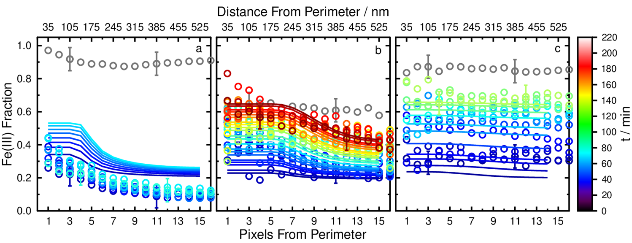
PRAD model STXM comparison
RH=40%
RH=50%
RH=60%

Slide 25
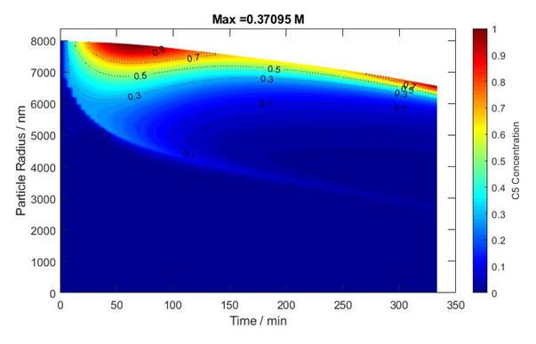
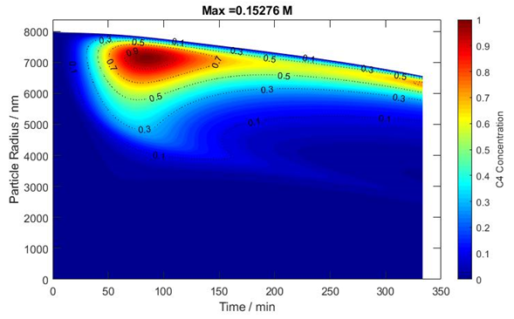
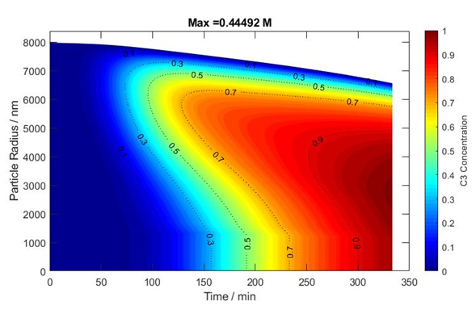
PRAD model results
C₅
C₄
C₃

Slide 26
Mie Resonance Spectrum or
“Whispering gallery modes”
Zardini et al. (2006)

Slide 27

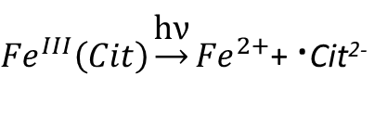
Iron(III)-citrate photochemical reaction scheme
CO₂
${Fe}^{III}\left(Cit\right)\underset{→}{\text{h}\text{ν}}{Fe}^{2+}$+ ·Cit²⁻
•Cit²⁻ → HO-•CR₂ ²⁻ + CO₂
HO-•CR₂ ²⁻ + O₂ → O=CR₂²⁻ + HO₂•
VOC’s, CO₂
2 HO₂• → H₂O₂ +O₂
H₂O₂ + Fe²⁺ → Fe³⁺ + •OH + OH⁻
Fe³⁺ + CA → ${Fe}^{III}\left(Cit\right)$
VOC’s
Notes:
LMCT: Ligand-to-metal-charge transfer which is an inner sphere electron transfer (i.e., the electron transfer occurs via a covalently bound bridging ligand) from the carboxylate group to the iron. Investigations using time resolved transient spectroscopy reported the formation of long
lived radical complexes, [FeII(OOC– R)]2+, with lifetimes of the order of a millisecond, followed by the dissociation to the organic radical R–COO and an FeII aquacomplex. R–COO will decarboxylate almost instantaneously
FeIII(Cit) + hν → Fe²⁺ + OH– C(CH2COO)2^{2–} + CO₂

Slide 28
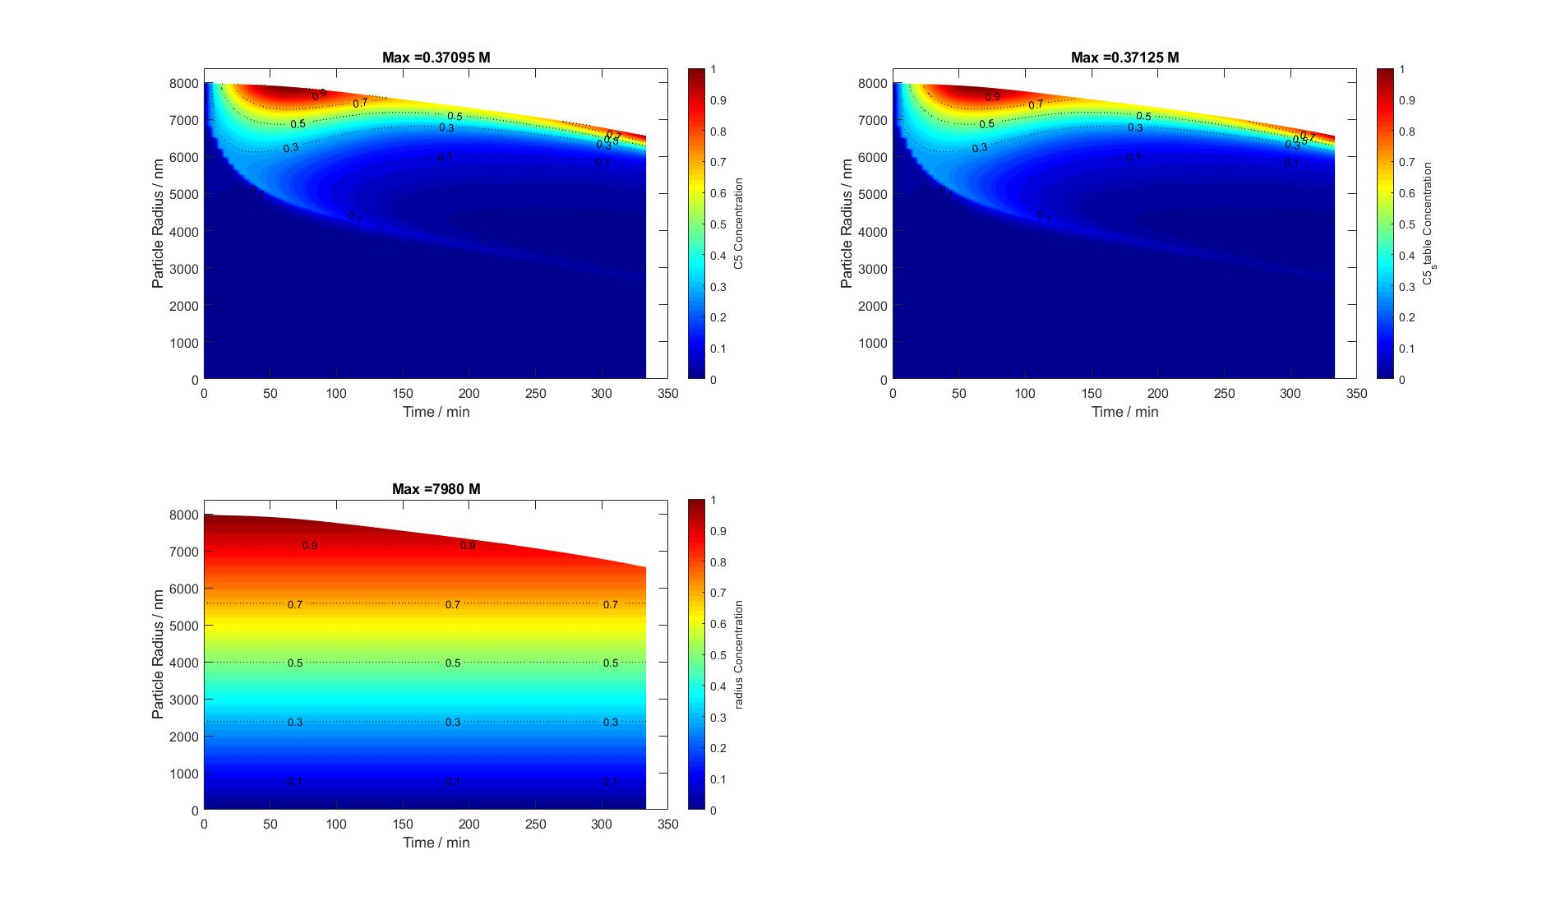
C

Slide 29
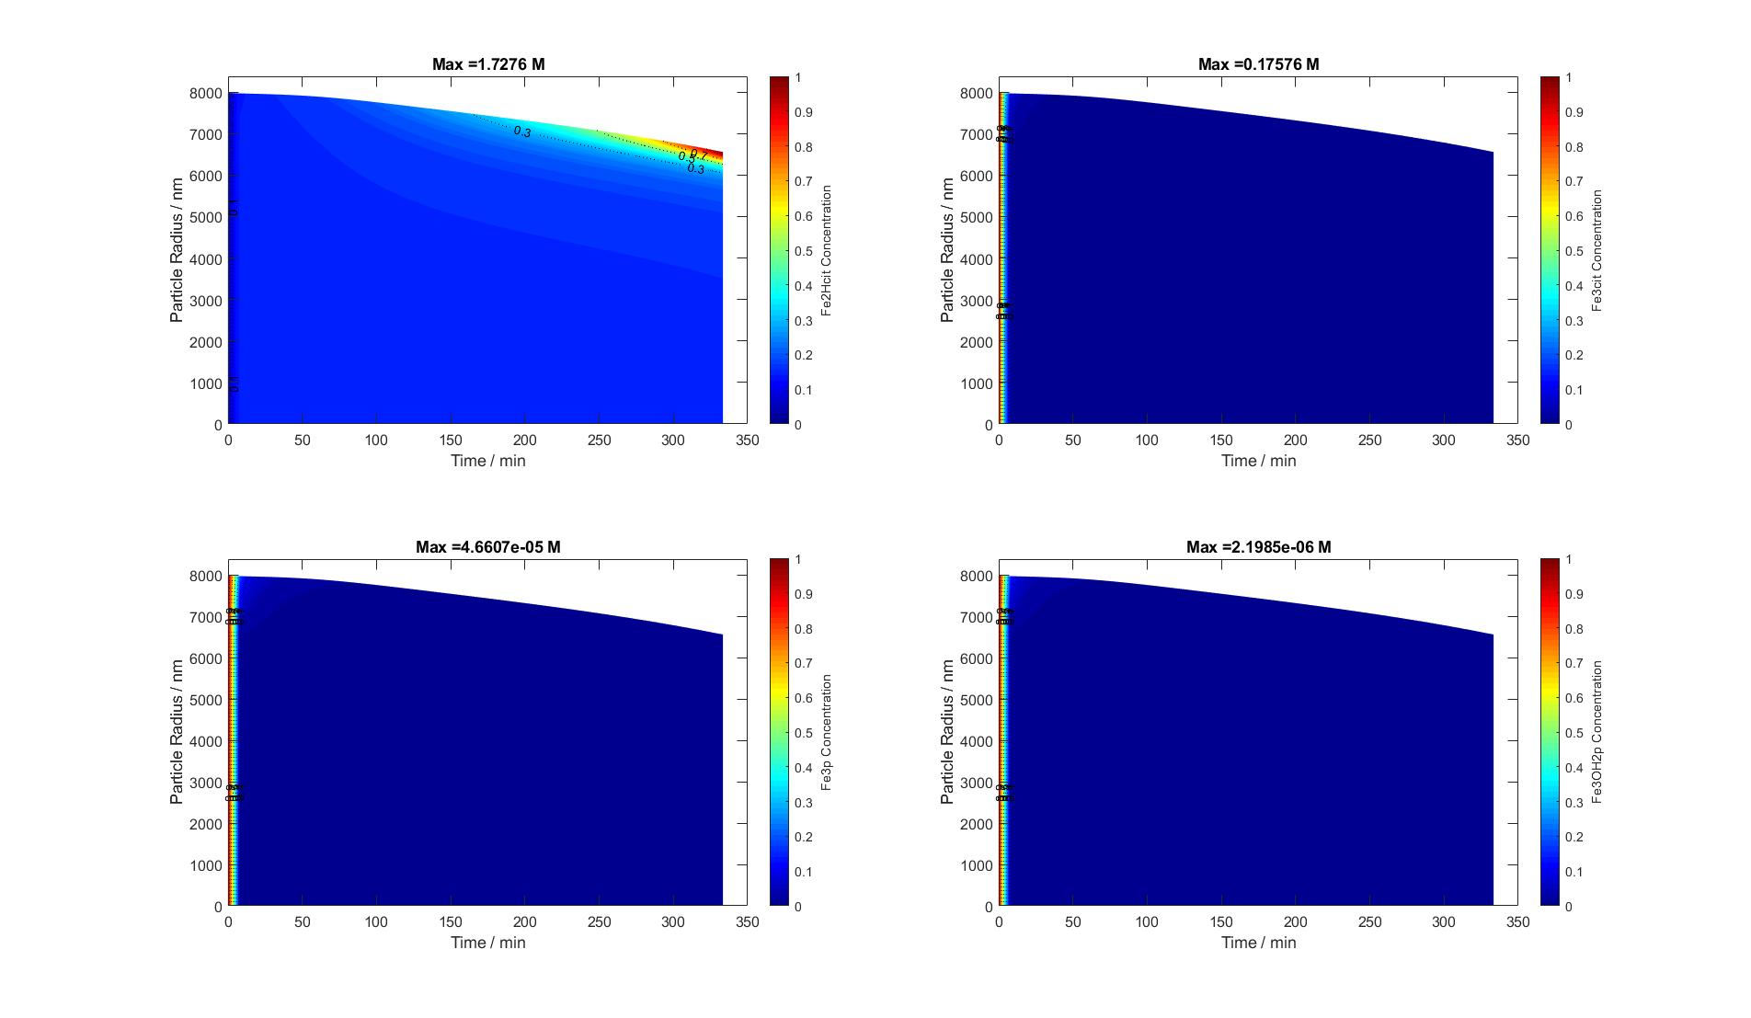
C

Slide 30
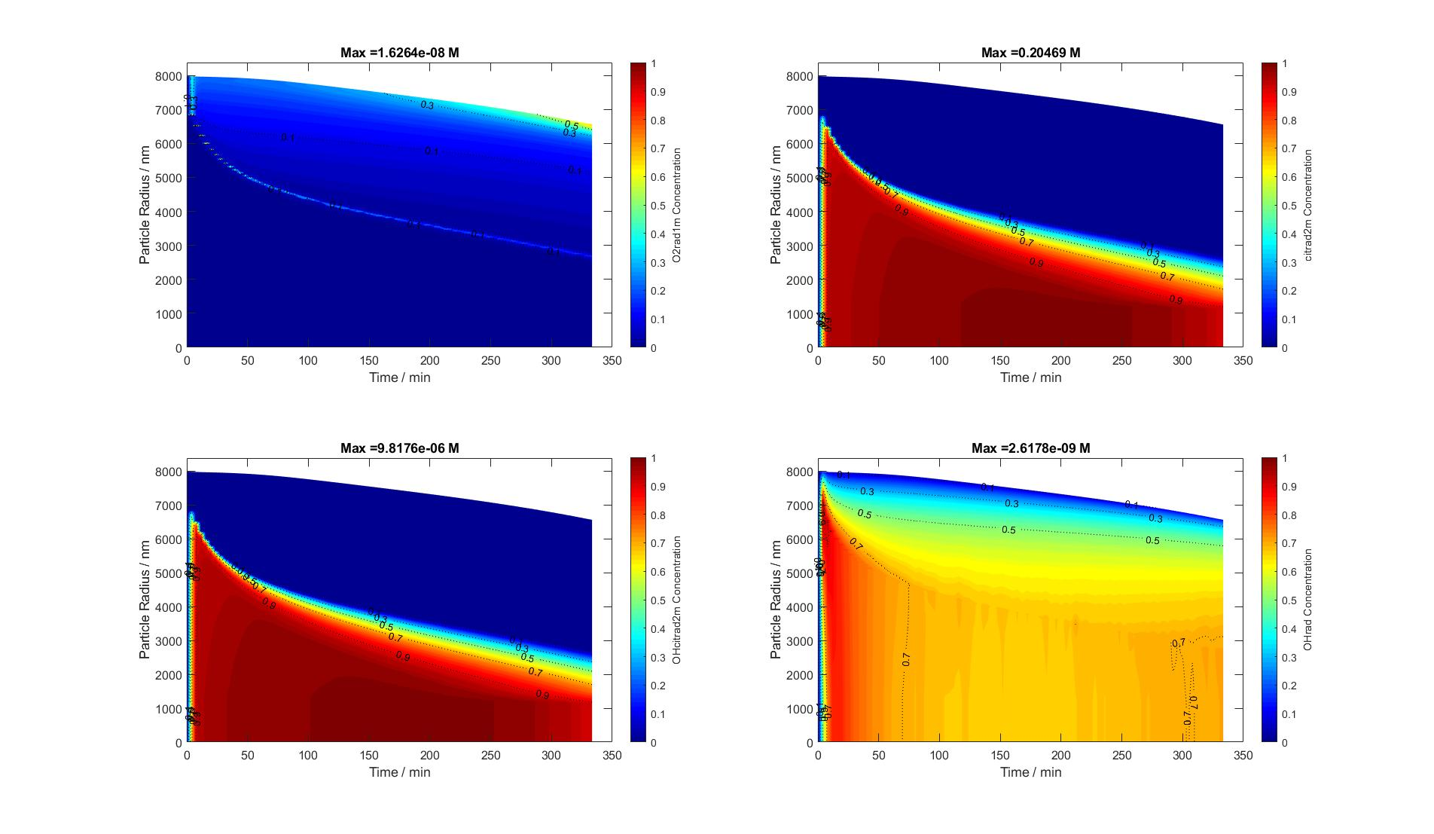
C

Slide 31

C

Slide 32

C

Slide 33
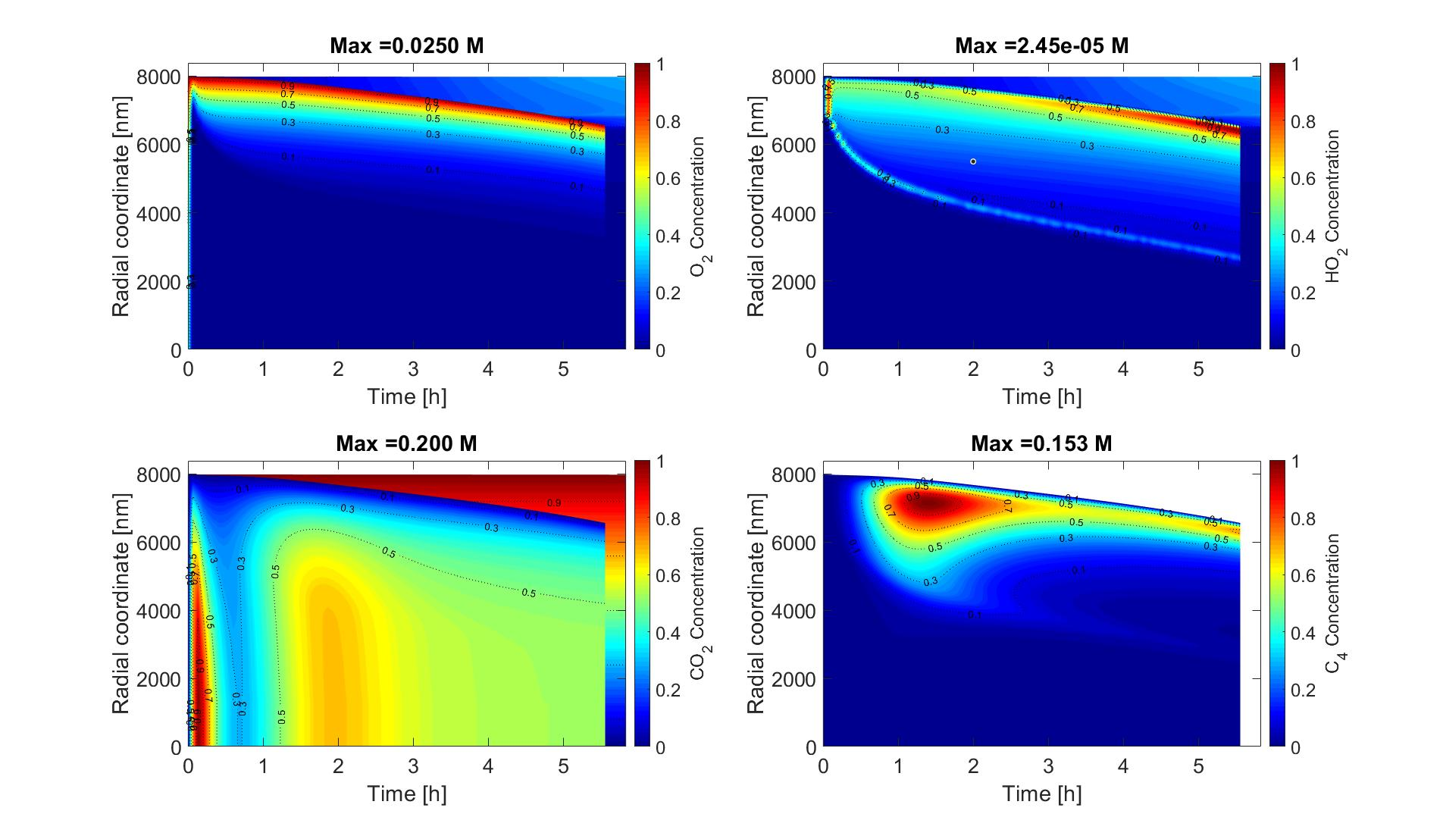
C

Slide 34
C

Slide 35
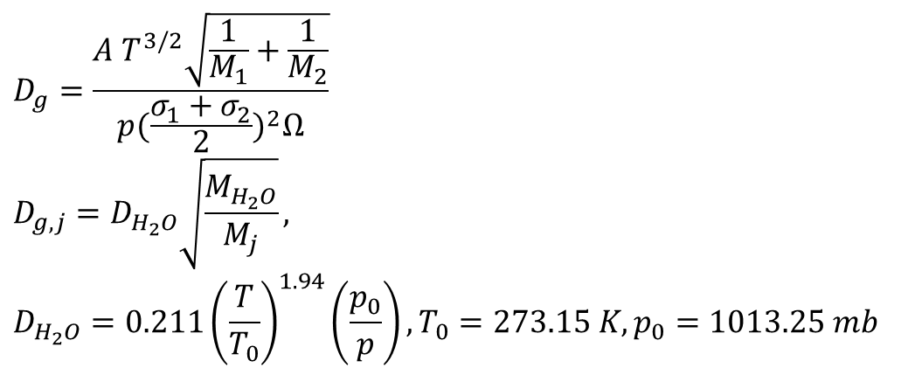
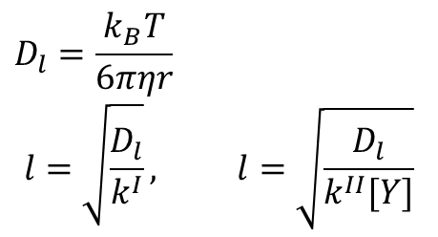
$$D_{l}=\frac{k_{B}T}{6πηr}$$
$$l=\sqrt{\frac{D_{l}}{k^{I}}}, l=\sqrt{\frac{D_{l}}{k^{II}[Y]}}$$
$$D_{g}=\frac{A T^{3/2}\sqrt{\frac{1}{M_{1}}+\frac{1}{M_{2}}}}{p{(\frac{σ_{1}+σ_{2}}{2})}^{2}Ω}$$
$$D_{g,j}=D_{H_{2}O}\sqrt{\frac{M_{H_{2}O}}{M_{j}}},$$
$$D_{H_{2}O}=0.211{\left(\frac{T}{T_{0}}\right)}^{1.94}\left(\frac{p_{0}}{p}\right),T_{0}=273.15 K,p_{0}=1013.25 mb$$

Slide 36
Species
Number | Name | Formula | D_{l}_factor | H₀ (M/atm) | Q
1 | water | H₂O | 1 | - | -
2,3,4 | citrate total, ferric (Fe^{III}) total, ferrous (Fe^{II}) total | - | - | - | -
5,6,7,8 | CA, dihydrogen citrate, hydrogen citrate, citrate | CA, H₂Cit⁻ , HCit²⁻, Cit³⁻ | 10⁻³ | 10⁴⁰ | 10000
9,10,14 |  | Fe^{III}(Cit)(OH)⁻, Fe^{III}(HCit)⁺, Fe^{III}(OH)²⁺ | 10⁻³
11,12 | ferrous citrate, ferric citrate | Fe^{II}(HCit), Fe^{III}(Cit) | 10⁻³
13,15 | ferric ion, ferrous ion | Fe³⁺, Fe²⁺ | 10⁻¹
16,17,19,22 | hydrogen ion, hydroxide ion, superoxide radical, hydroxyl radical | H⁺, OH⁻, O₂^{•-}, •OH | - | - | -
18 | hydroperoxyl radical | HO₂• | 1 | 4×10³ | 5900
20,21 |  | OH-•C(CH₂COO)₂²⁻, OH-•C(CH₂COOH)₂ | 10⁻² | 10⁴⁰ | 10000
23 | hydrogen peroxide | H₂O₂ | 0.8 | 8.3×10⁴ | 7400
24 | oxygen | O₂ | 1 | 1.3×10⁻³ | 1500
25 | carbon dioxide | CO₂ | 1 | 3.4×10⁻² | 2400
26 | acetone | CH₃COCH₃ | 10⁻² | 30 | 4600
27 |  | C₄ | 10⁻³ | 10⁵ | 6000
28 |  | O=C(CH₂COO)₂²⁻, O=C(CH₂COOH)₂ | 10⁻³ | 10⁴⁰ | 8000
29 | acetic acid | CH₃COOH | 10⁻¹ | 4.1×10³ | 6300
30 |  | Fe^{II}[O=C(CH₂COO)₂] | 10⁻² | 10⁴⁰ | 10000
31 |  | C₅ | 10⁻² | 10⁷ | 8000
32 |  | C₅_stable | 10⁻² | 5×10⁸ | 8000

Slide 37
Equilibria
Number | Equilibria | Equilibrium constants | References
E1 | H₂O ⇌ OH⁻+H⁺ | K=1×10⁻¹⁴ M
E2 | H₃Cit ⇌ H₂Cit⁻+H⁺ | K=7.5×10⁻⁴ M | Martell and Smith, 1982
E3 | H₂Cit⁻ ⇌ HCit²⁻ +H⁺ | K=1.7×10⁻⁵ M | Martell and Smith, 1982
E4 | HCit²⁻ ⇌ Cit³⁻+H⁺ | K=4.0×10⁻⁷ M | Martell and Smith, 1982
E5 | Fe³⁺ + Cit³⁻ ⇌ Fe^{III}(Cit) | K=1.58×10¹¹ M⁻¹ | Martell and Smith, 1982
E6 | Fe³⁺ + Cit³⁻ +H₂O ⇌ Fe^{III}(Cit)(OH)⁻ +H⁺ | K=3.16×10⁸ M⁻¹ | Martell and Smith, 1982
E7 | Fe³⁺ + HCit²⁻ ⇌ Fe^{III}(HCit)⁺ | K=5×10⁶ M⁻¹ | Martell and Smith, 1982
E8 | Fe²⁺ + HCit²⁻ ⇌ Fe^{II}(HCit) | K=794 M⁻¹ | Martell and Smith, 1982
E9 | Fe³⁺ + H₂O ⇌ Fe^{III}(OH)²⁺ +H⁺ | K=6.5×10⁻³ M | Smith and Martell, 1977
E10 | O₂^{•-} + H⁺ ⇌ HO₂• | K=6.3×10⁴ M⁻¹ | Bielski et al., 1985
E11 | Fe²⁺ + O=C(CH₂COO)₂²⁻ ⇌ Fe^{II}[O=C(CH₂COO)₂] | K=2×10² M⁻¹ | tuning parameter
E12 | 2H⁺ + OH-•C(CH₂COO)₂²⁻ ⇌ OH-•C(CH₂COOH)₂ | K=3×10² M⁻² | tuning parameter
E13 | 2H⁺ + O=C(CH₂COO)₂²⁻ ⇌ O=C(CH₂COOH)₂ | K=1.5×10² M⁻² | tuning parameter
Where Cit³⁻ represents citrate ion (OH)C(CH₂COO)₃³⁻.
Notes:
Acetonedicarboxylic acid (unstable)

Slide 38
Chemical reactions
Number | Chemical reactions | Reaction rate coefficients | References
Photolysis and follow-up reactions
R1 | Fe^{III}(Cit) + hν → Fe²⁺ + OH-•C(CH₂COO)₂²⁻ + CO₂ | σ=1.0×10⁻¹⁹ cm² (cross section) | Pozdnyakov et al., 2012
R2 | Fe^{III}(Cit)(OH)⁻ + hν → Fe²⁺ + OH-•C(CH₂COO)₂²⁻ + CO₂ + OH⁻ | σ=1.0×10⁻¹⁹ cm² (cross section) | Pozdnyakov et al., 2012
R3 | •OOC-C(OH)(CH₂COO)₂²⁻ + O₂ → O=C(CH₂COO)₂²⁻ + H⁺+ O₂^{•-} + CO₂ | k=1.0×10⁶ M⁻¹ s⁻¹ | Hug et al, 2001
R4 | •OOC-C(OH)(CH₂COO)₂²⁻ + O₂ → O=C(CH₂COO)₂²⁻ + H⁺+ O₂^{•-} + CO₂ | k=1.0×10⁶ M⁻¹ s⁻¹ | Hug et al, 2001
O₂^{•-}/HO₂• and Fe²⁺/Fe³⁺ reactions
R5 | HO₂• + HO₂• → H₂O₂ + O₂ | k=8.3×10⁵ M⁻¹ s⁻¹ | Bielski et al., 1985
R6 | Fe²⁺ + O₂^{•-} (+ 2H⁺) → Fe³⁺ + H₂O₂ | k=1.0×10⁷ M⁻¹ s⁻¹ | Rush and Bielski, 1985
R7 | Fe²⁺ + HO₂• (+ H⁺) → Fe³⁺ + H₂O₂ | k=1.2×10⁶ M⁻¹ s⁻¹ | Rush and Bielski, 1985
R8 | Fe²⁺ + H₂O₂ → Fe³⁺ + •OH + OH⁻ (Fenton reaction) | k=76 M⁻¹ s⁻¹ | Walling,1975
R9 | Fe²⁺ + •OH → Fe^{III}(OH)²⁺ | k=4.3×10⁸ M⁻¹ s⁻¹ | Christensen and Sehested, 1981
R10 | Fe^{II}(HCit) + O₂ ⇌ Fe^{III}(Cit) + HO₂• | K=3 M⁻¹ s⁻¹ | tuning parameter
Follow-up reactions ➔ products
R11,13,15 | C₅ + hν → (C₄ + CO₂) / (C₃ + 2CO₂) / (C₃ + C₂) | σ=2×10⁻²⁴ cm² (cross section) | tuning parameter
R12,14 | C₄ + hν → (C₃ + CO₂) / (2C₂) | σ=10⁻²⁰ cm² (cross section) | tuning parameter
R16 | C₅_stable fraction | 0.5 | tuning parameter
R17 | Radical self reaction | 0 | tuning parameter
Notes:
Acetonedicarboxylic acid (unstable)

