Slide 1
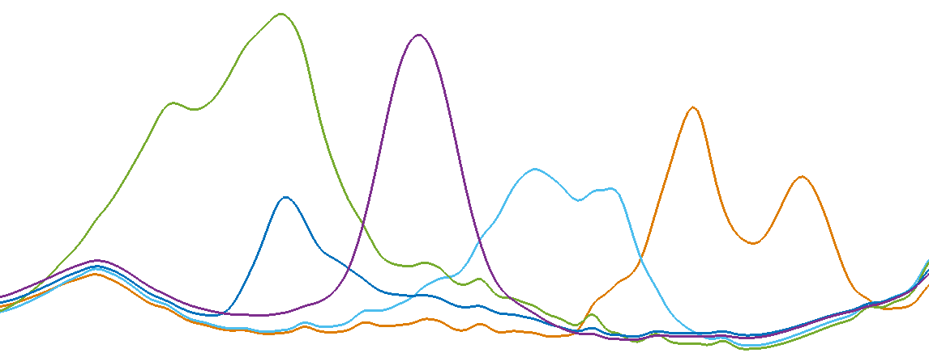
Trends in Organic Matter and Functional Groups from 2009 to 2016 in the Southeastern Aerosol Research and Characterization (SEARCH) Network
Ann M. Dillner, Air Quality Research Center, (AQRC) University of California Davis, Davis, CA,
Alexandra J. Boris, AQRC, University of California Davis, Davis, CA, currently at California Air Resources Board, Satoshi Takahama, Swiss Federal Institute of Technology, Lausanne, Switzerland,
Stephanie L. Shaw, Electric Power Research Institute, Palo Alto, CA,
Eric S. Edgerton, Atmospheric Research & Analysis, Inc., Cary, NC

Slide 2
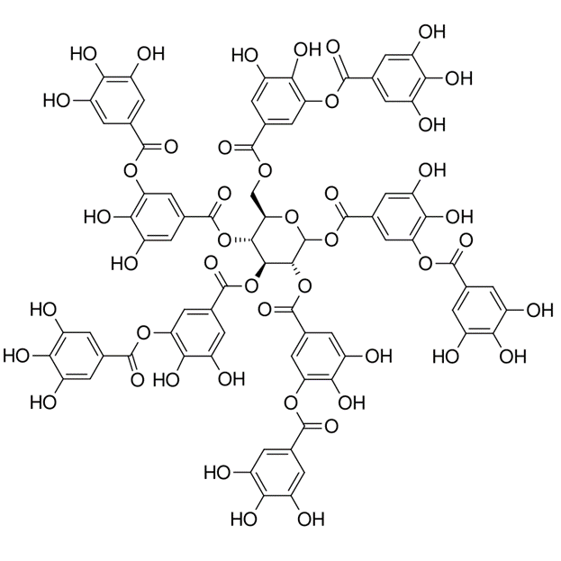
Motivation for measuring functional groups
Organic matter/mass (OM) is composed of
  Carbon
  Oxygen
  Hydrogen
  Sometimes sulfur and nitrogen or other elements
For filter samples, OM is typically estimated by
  Measuring OC (carbon) using thermal optical method
  Multipling by an OM/OC value (1.8 in IMPROVE/rural, 1.4 for urban)
Measurements and models have shown that OM/OC varies by region, season, sources and sample
FTIR measures functional groups (FGs)
  Useful for evaluating organic composition of aerosol
  Add FGs to estimate OM for each sample, OM = CH + COOH + COO⁺ + naCO + COH

Slide 3
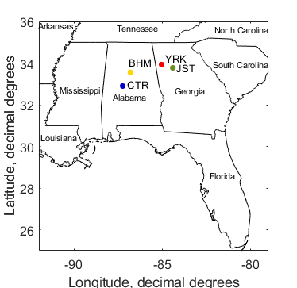
Functional group and OM measurements
SEARCH network
  Operated from 1999-2016
  Two urban/rural pairs of sites in southeast
    GA: Atlanta (JST; urban), Yorkville (YRK; rural)
    AL: Birmingham (BHM; urban), Centreville (CTR; rural)
  Collected a suite of filter samples as well as online methods
Functional group measurements
  FTIR analysis of routinely collected PTFE filters
  Samples from 2009-2016 (cold stored), ~5000 samples
  Developed calibrations to measure functional groups

Slide 4
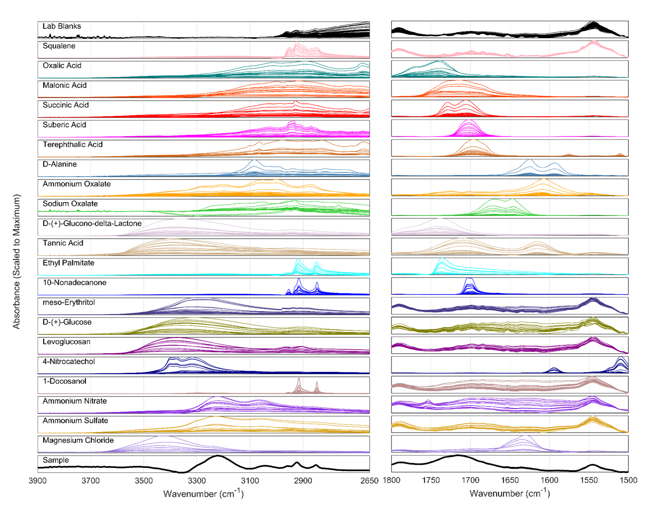
Representing atmospheric organic composition: suite of chemicals used for laboratory standards
Single compound standards of varying mass loadings
Varying C backbone lengths
Carboxylic acids (abundant or structure representative)
Carboxylates (oxalates)
Non-acid carbonyls (ketone)
Alcohols – tetrols, carbohydrates (glucose, levoglucosan), phenols
Multifunctional, humic-like compounds (tannic acid)
Inorganic interferents and water
Boris et al., 2019

Slide 5
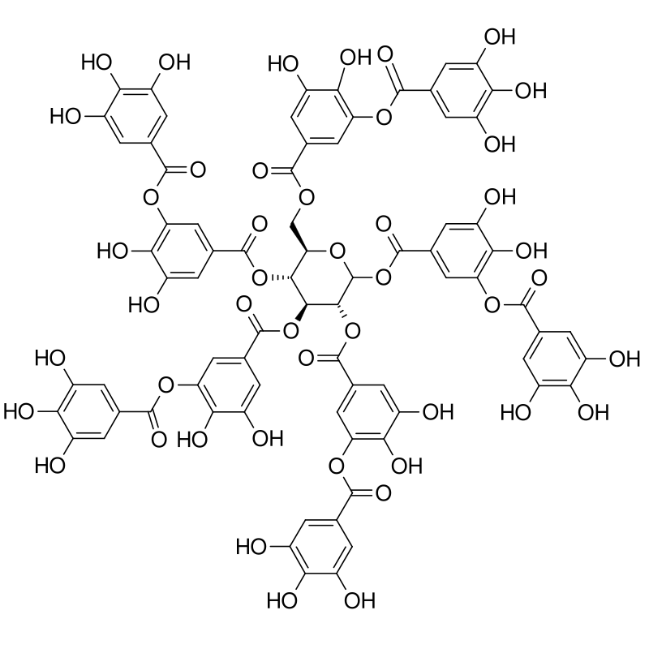
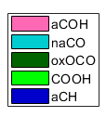
Functional Group Quantification Method
Alcohol
Calibration of FT-IR spectra to laboratory standards using multivariate regression (partial least squares, or PLS)
Measure five functional groups
Sum functional groups to calculate OM and OM/OC
Non-acid, non-oxalate carbonyl
Oxalate
Aliphatic C-H
Carboxylic acid
Boris et al., Atmos. Meas. Tech., 2019

Slide 6
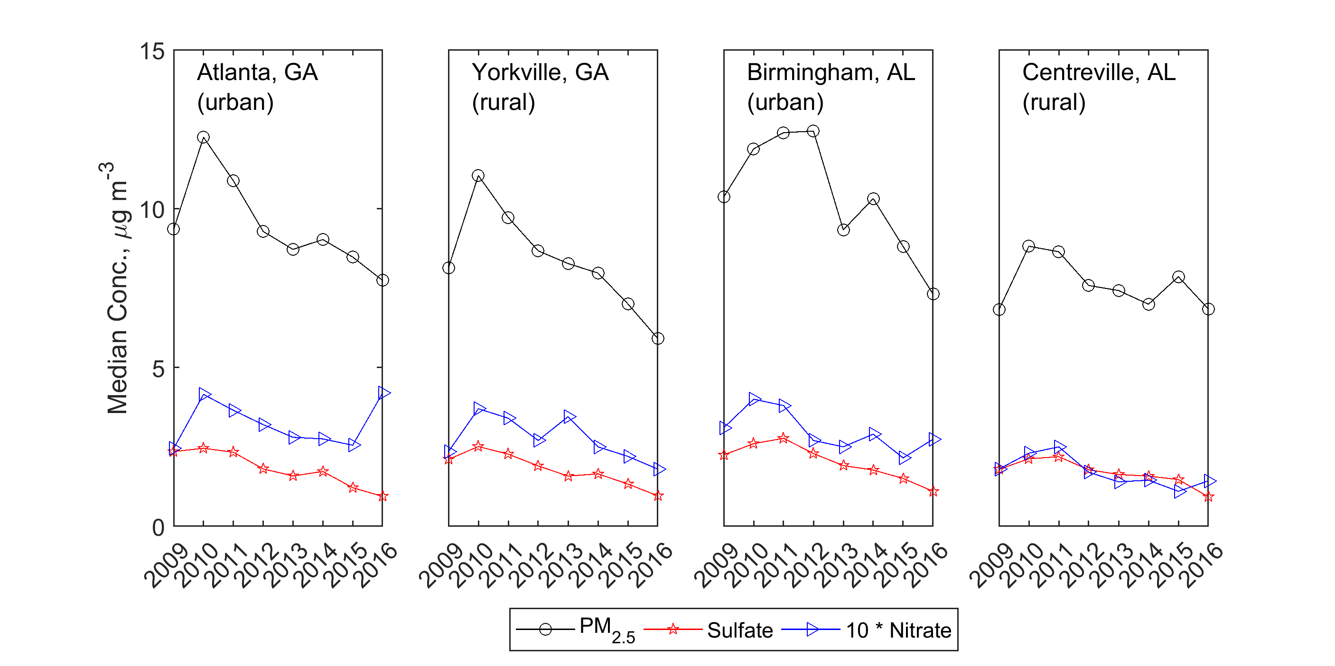
Annual medians at SEARCH sites during study

Slide 7
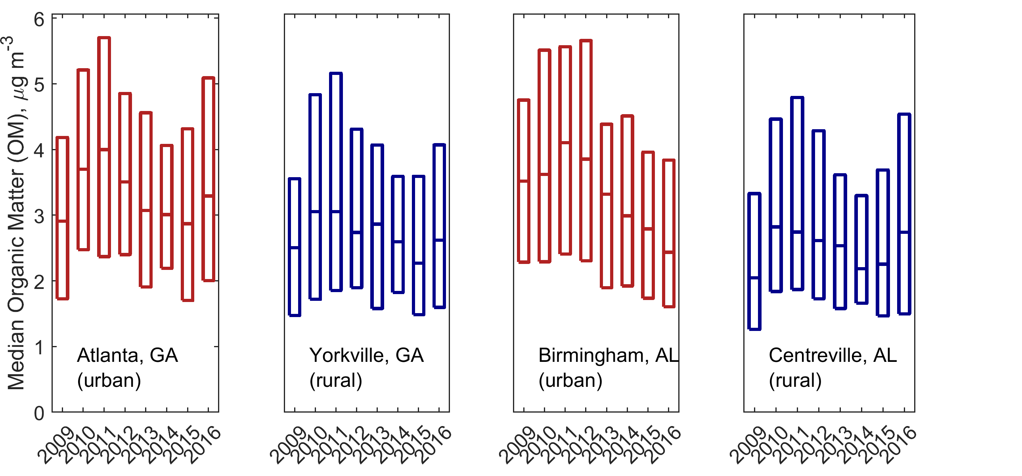
OM trends from 2009 to 2016
OM is slightly higher at urban sites
Increase 2009-2010/11
Overall decrease in OM concentrations
  -0.052±0.007 μg m⁻³ yr⁻¹ (Boris et al., in prep)
  OM decrease in SE 1991-2013 (Marais et al., 2017 Environ. Res. Lett.)
JST
YRK
BHM
CTR

Slide 8
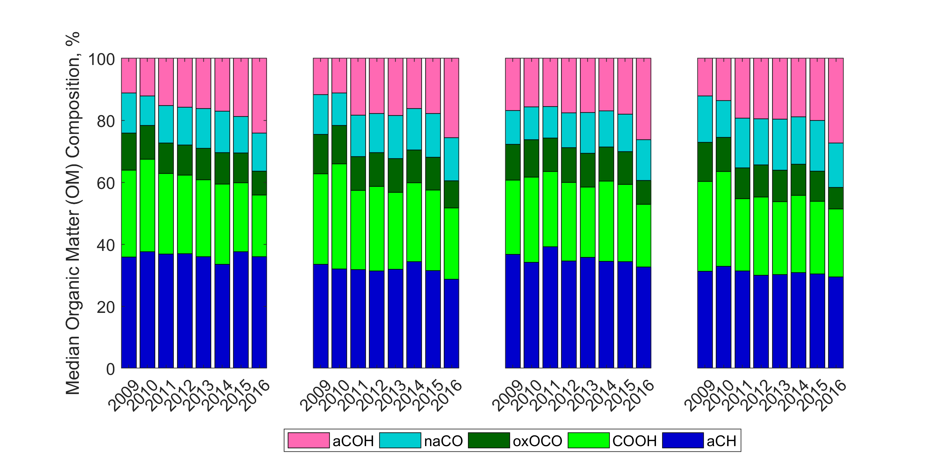
Composition changes from 2009 to 2016
aCOH significantly increasing over time period
COOH, oxOCO increasing to 2009-2010, then decreasing
  Parallels OM, PM2.5 trends
aCH mostly decreasing 2009-2016
Atlanta, GA
(urban)
Yorkville, GA
(rural)
Birmingham, AL
(urban)
Centreville, AL
(rural)

Slide 9
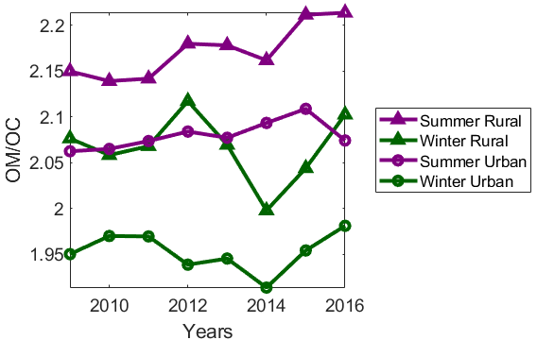
OM/OC variations by season, site over time (1/2)
Median OM/OC
  Seasonal values between 1.9 and 2.25
  Alternate method for OM/OC
    Multiple linear regression
    Coefficients obtained for SEARCH data set were not physically meaningful
    IMPROVE data (rural) in the SE 2009-2016
    Reg. coeff. = 1.85 to 2.1¹
OM/OC varies by season
  Summer higher than winter
  MLR over CONUS gives similar trend¹
OM/OC varies by urban vs. rural
  Rural higher than urban
¹Hand et al., Atmos. Env., 2019
Notes:
'OM/OC' 'All' 'All' 0.004 0.011
'OM/OC' 'CTR' 'All' 0.007 0.019
'OM/OC' 'YRK' 'All' 0.001 0.019
’OM/OC' 'JST' 'All' 0.004 0.019
'OM/OC' 'BHM' 'All' 0.00 0.02
'OM/OC' 'All' 'Winter' 0.00 0.02
'OM/OC' 'All' 'Spring' 0.00 0.02
'OM/OC' 'All' 'Summer' 0.01 0.02
'OM/OC' 'All' 'Autumn' 0.01 0.02

Slide 10
OM/OC variations by season, site over time (2/2)
FT-IR OM/OC shows no trends
Regression coefficient in SE using IMPROVE data
  Increasing from 2005 to 2014 and sharp decrease in 2015 and 2016¹
  Changes in reg. coeff. could be due to
    Atmospheric change
    Decrease in primary OC
    Analytical changes such that reg. coeff. may not be OM/OC¹
SEARCH
  OM/OC cannot be obtained from MLR or extended MLR approach (Simon et al., 2011)
    Insufficient data, other issues?
  FTIR provides an independent method for obtaining OM/OC
¹Hand et al., Atmos. Env., 2019
Notes:
'OM/OC' 'All' 'All' 0.004 0.011
'OM/OC' 'CTR' 'All' 0.007 0.019
'OM/OC' 'YRK' 'All' 0.001 0.019
’OM/OC' 'JST' 'All' 0.004 0.019
'OM/OC' 'BHM' 'All' 0.00 0.02
'OM/OC' 'All' 'Winter' 0.00 0.02
'OM/OC' 'All' 'Spring' 0.00 0.02
'OM/OC' 'All' 'Summer' 0.01 0.02
'OM/OC' 'All' 'Autumn' 0.01 0.02

Slide 11
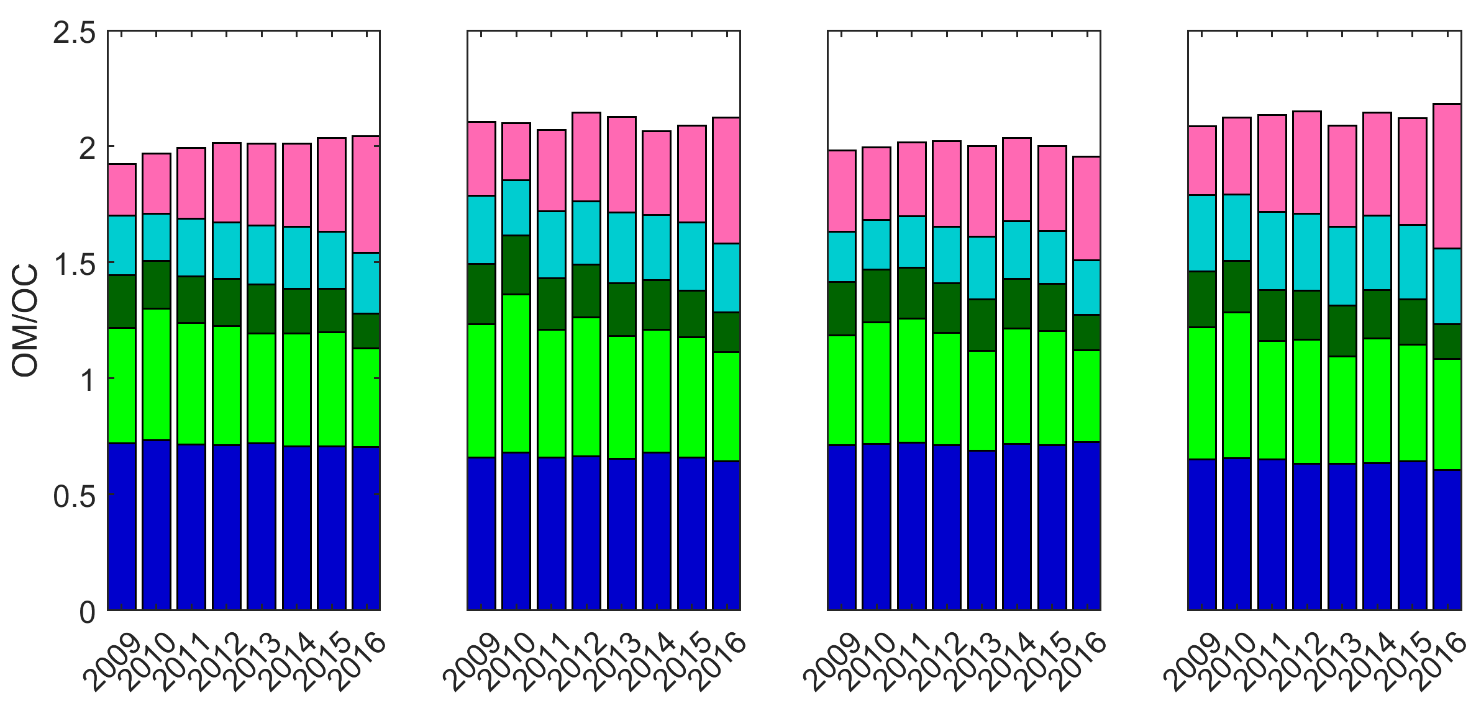
Composition changes in OM/OC
OM/OC is ~constant
  Functional group contribution not constant
  FGs offset each other
COOH
  Increasing 2009-2010, suggesting anthropogenic/economic activity
  Liu et al., 2011 suggests COOH as SOA from combustion sources
  Significantly decreasing after 2011
aCOH significantly increasing
  Also increasing in OM as OM decreases
Atlanta, GA
(urban)
Yorkville, GA
(rural)
Birmingham, AL
(urban)
Centreville, AL
(rural)

Slide 12
Conclusions
Functional groups enable more direct measurement of OM
  Annual concentrations decreased at all SEARCH sites from 2009-2016
Calculate OM/OC
  Independent method (not based on TOR or other routine measurements) for evaluating OM/OC
  FG OM/OC shows no trend over project period, in contrast to MLR method
Functional groups contributing to OM/OC change
  COOH decreasing – suggest decrease in anthropogenic activity
  aCOH increasing
Functional group data provides insights into compositional changes that may be useful for understanding changes in atmospheric chemistry

Slide 13
Acknowledgements
Funding for this project from EPRI (Agreement 10003745 and 10005355)
Laboratory analysis of SEARCH filters by Kelsey Seibert and a host of undergraduate students at UC Davis.

