Slide 1
SOA formation in a low NOx biogenic environment perturbed by an urban plume An explicit modeling study of the GoAmazon 2014/5 field campaign
IAMA 2019 December, 4th 2019
Camille Mouchel-Vallon, Sasha Madronich, Julia Lee-Taylor, Alma Hodzic
U.S. Department of Energy (DOE) ASR grant DE-SC0016331

Slide 2
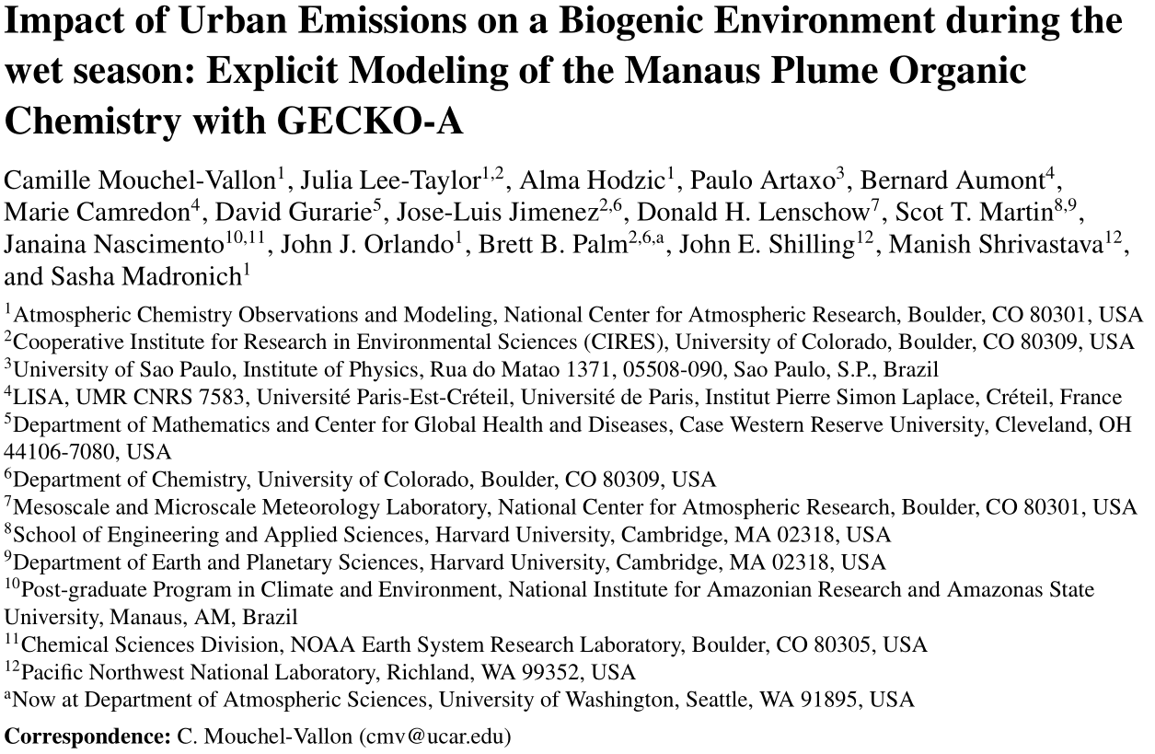
Atmos. Chem. Phys., Submitted

Slide 3
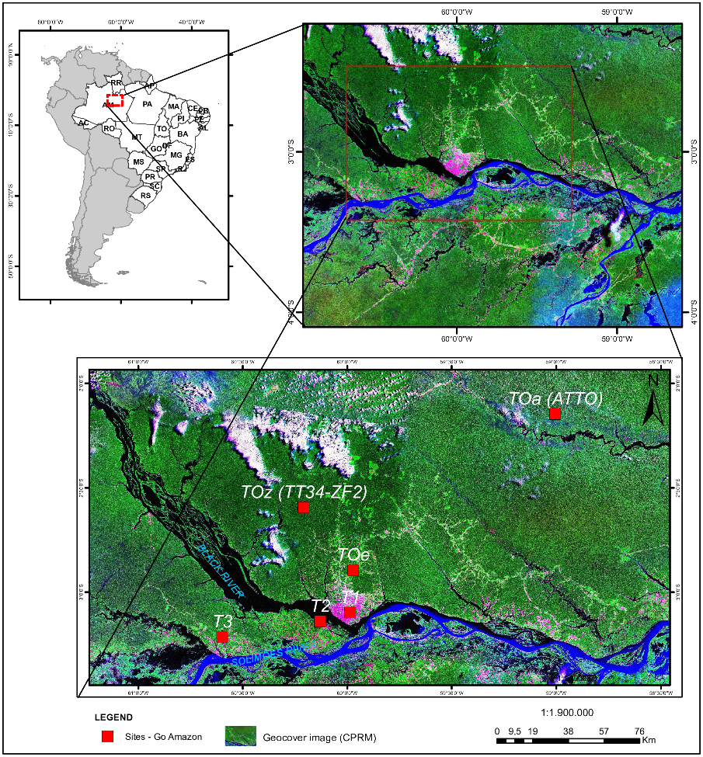
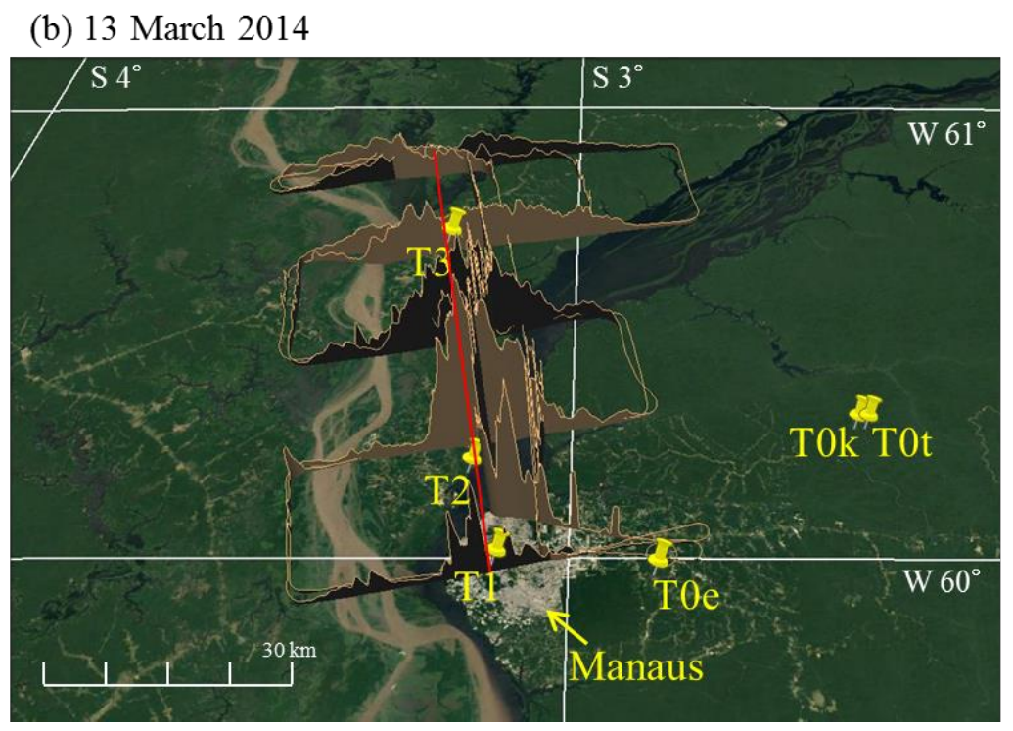
GoAmazon 2014/5
Manaus (Brazil), 2.1 million inhabitants, is situated in the middle of the Amazonian Rainforest.
Point source of anthropogenic pollution in a clean background.
Ideal place to study biogenic/anthropogenic
Manaus
T3 main ground instrumented site is alternately sampling background air and the Manaus outflow
+ Airborne measurements sampling the urban plume
Particle number concentrations
de Sá et al, 2017

Slide 4
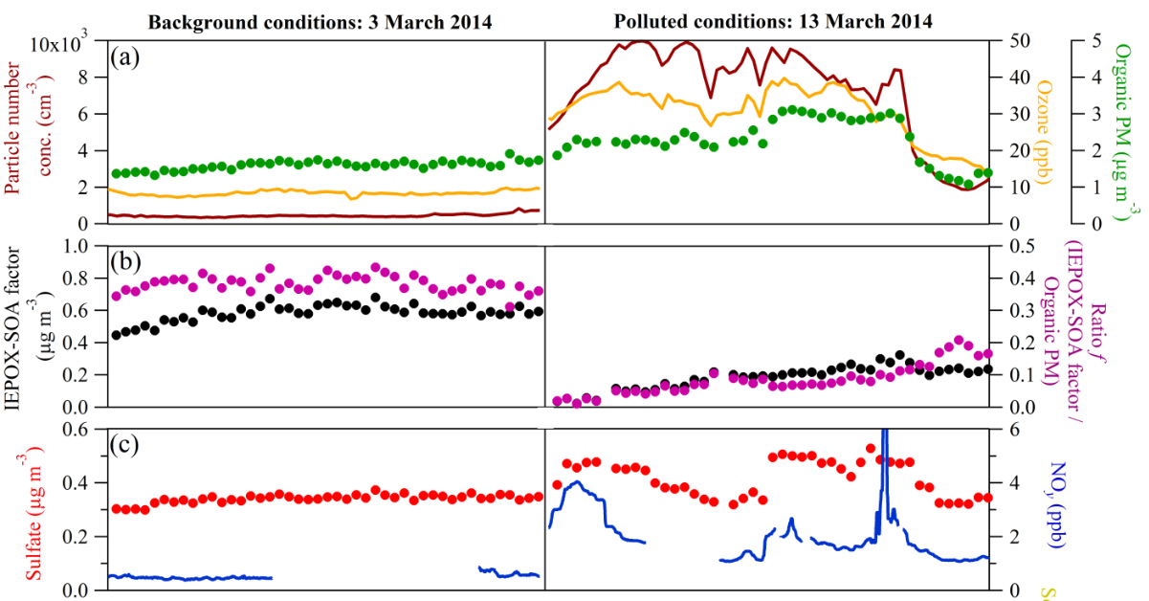
Interaction of clean air masses with urban plume
De Sá et al, 2017

Slide 5
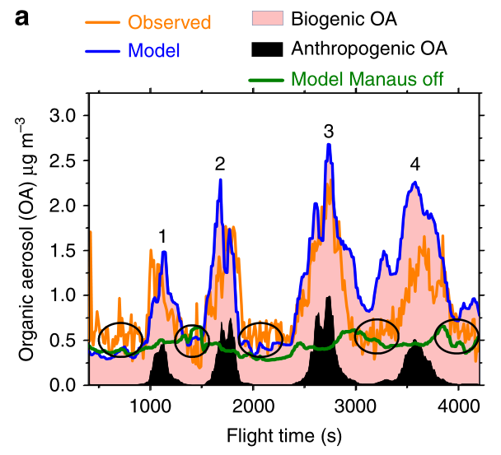
Interaction of clean air masses with urban plume
Shrivastava et al., 2019 (see talk on Thursday morning)
Modeling OA formation with WRF-Chem with a 4-bins VBS parameterization fitted on chamber experiments
Biogenic SOA formation is enhanced by higher oxidative capacity inside the urban plume

Slide 6
Can we reproduce the SOA enhancement with an explicit model?
Generator of Explicit Chemistry and Kinetics of Organics in the Atmosphere (GECKO-A, Aumont et al., 2005)
GECKO-A
Precursors
Computer program:
Automatically generates oxidation scheme (reactions, mass transfer between phases, …)
Explicit chemical schemes
+ properties
(Psat, H, ...)
Experimental data & structure activity relationships (SAR)
Protocol:
Identify oxidation pathways
Estimates missing data
→
k₁
Beginning
CH₃CH₂CH₃
+ OH
CH₃CH(OO.)CH₃
→
CH₃CH₂CH₃
+ OH
CH₃CH₂CH₂(OO.)
k₂
→
…..
...
CH₃CH(OO.)CH₃
+ NO
…..
→
…..
...
→
…..
...
CH₃CH₂CH₂(OO.)
+ NO
→
...
…..
…..
→
...
…..
CO₂ + H₂O
end

Slide 7
GECKO-A flowchart
New reaction products added to the stack
VOCn
VOC2
VOC1
Radical ?
no
yes
C-H ?
RO2 ?
OH reaction
Peroxy alkyl chemistry
RH + OH → RO₂
RO₂+NO → RO+NO₂
RO₂+NO → RONO₂
RO₂+NO₃ → RO+NO₂+O₂
RO₂+HO₂ → ROOH + O₂
RO₂+RO₂ → products
>C=C< + OH → >C(OH)C(O₂)<
O₃ reaction
>C=C< ?
>C=C< + O₃ → >C=O + Criegee
Criegee → products + OH
RCO3 ?
NO₃ reaction
Peroxy acyl chemistry
RCHO + NO₃ → R(O)OO
-CHO ?
RCO₃+NO → R+CO2+NO₂
RCO₃+NO₂ → RCO(OONO₂)
RCO₃+NO₃ → R+CO₂+NO₂+O₂
RCO₃+HO₂ → RCO(OOH) + O₂
RCO₃+HO₂ → RCO(OH) + O₃
RCO₃+RO₂ → products
>C=C< + NO₃ → >C(ONO₂)C(O₂)<
Photolysis
RCHO + hν → R + HCO
RONO₂ + hν → RO + NO₂
ROOH + hν → RO + OH
>C=O ?
-ONO₂ ?
-OOH ?
RO ?
-C(O)OONO₂ ?
Alcoxy chemistry
Thermal decomposition
>CH(O⋅)+O₂ → >C=O + HO₂
>CH(O⋅)C₂C(O.)< → >C(O⋅) C₂C(OH)<
>C(O⋅)-R → >C=O + R
RCO(OONO₂) → RCO(OO)+NO₂
Treat next species in the stack

Slide 8
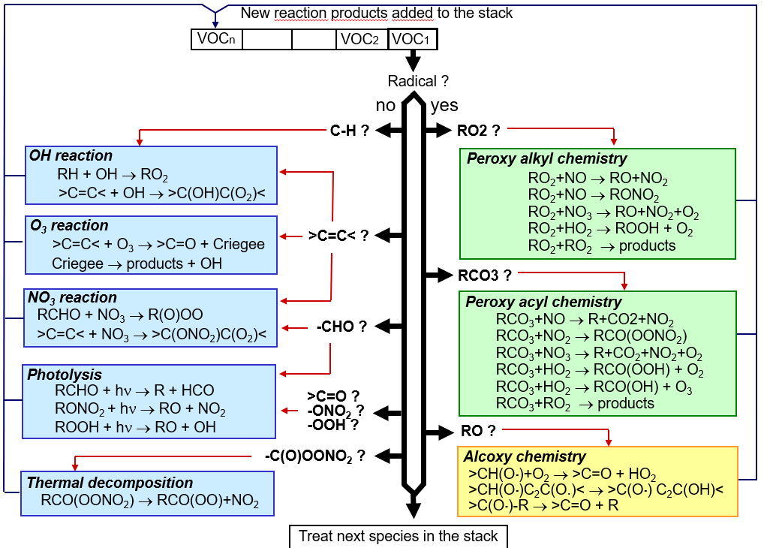
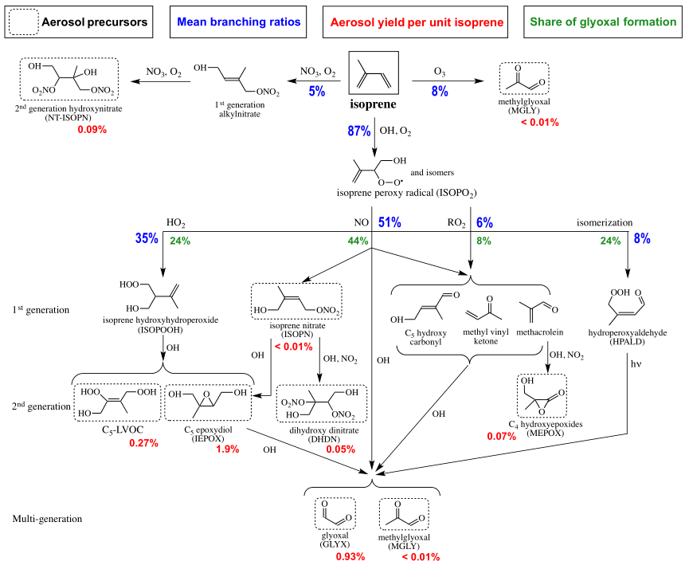
Can we reproduce the SOA enhancement with an explicit model?
Isoprene SOA heterogeneous formation from Marais et al. (2016)

Slide 9
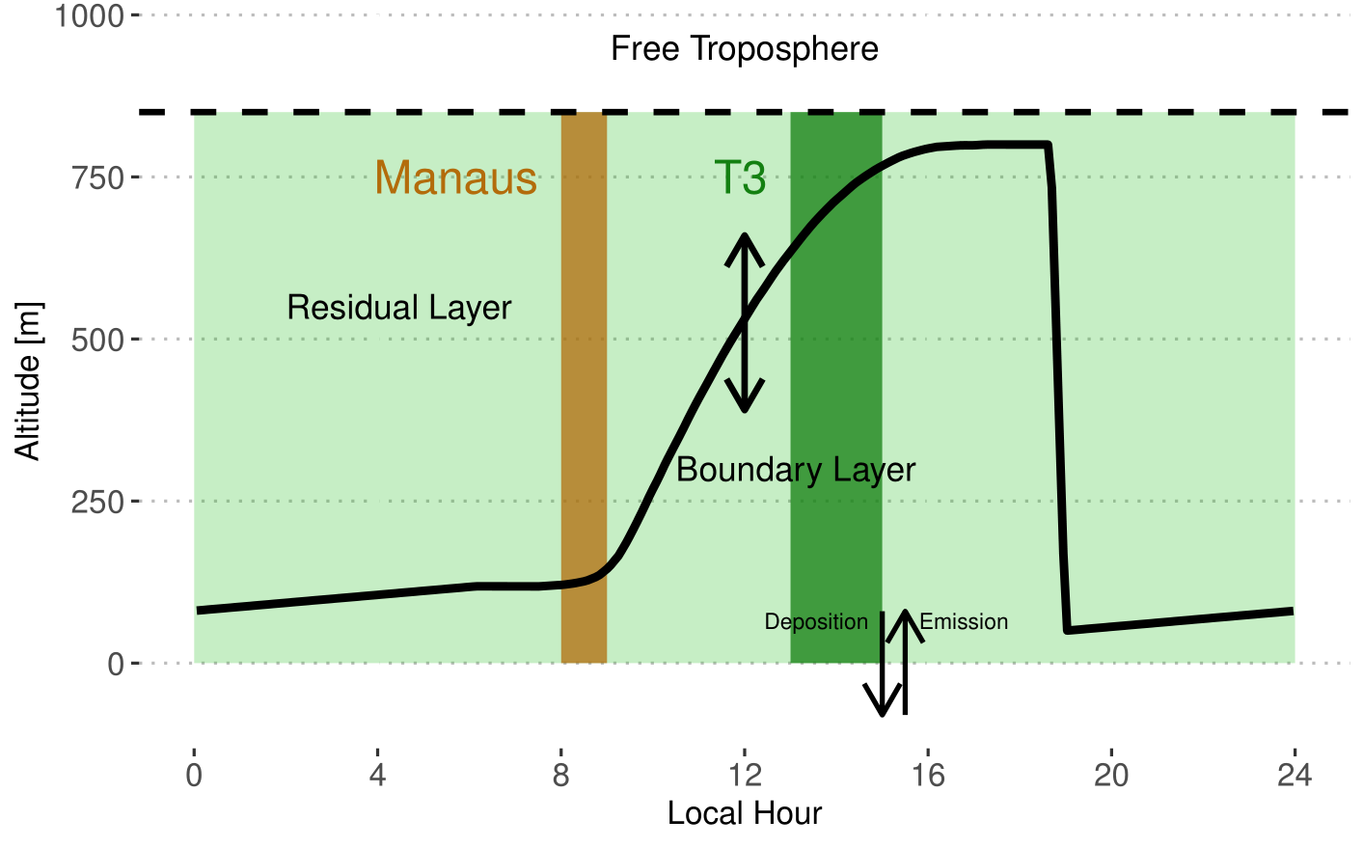
Boxmodel Setup

Slide 10
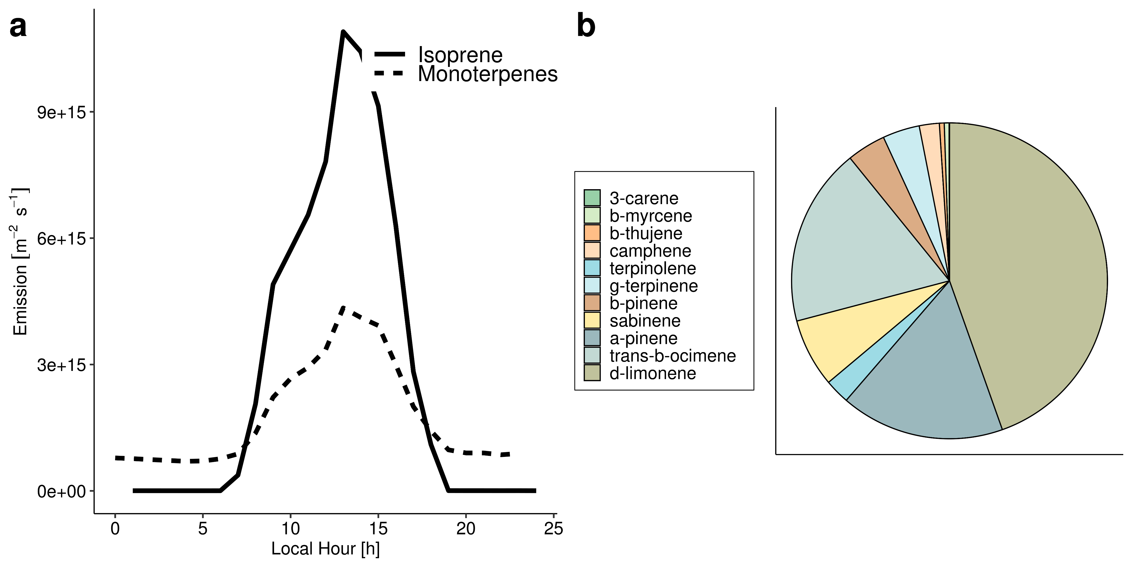
Estimating Emissions
Biogenic Emissions from MEGAN 2.1 (Guenther et al., 2012) and speciation fitted to Jardine et al. (2015)
65 organic precursors
16 million reactions, 4 million species
(400000 partitioning into the aerosol phase)
Anthropogenic Emissions based on Abou Rafee et al., (2017)

Slide 11
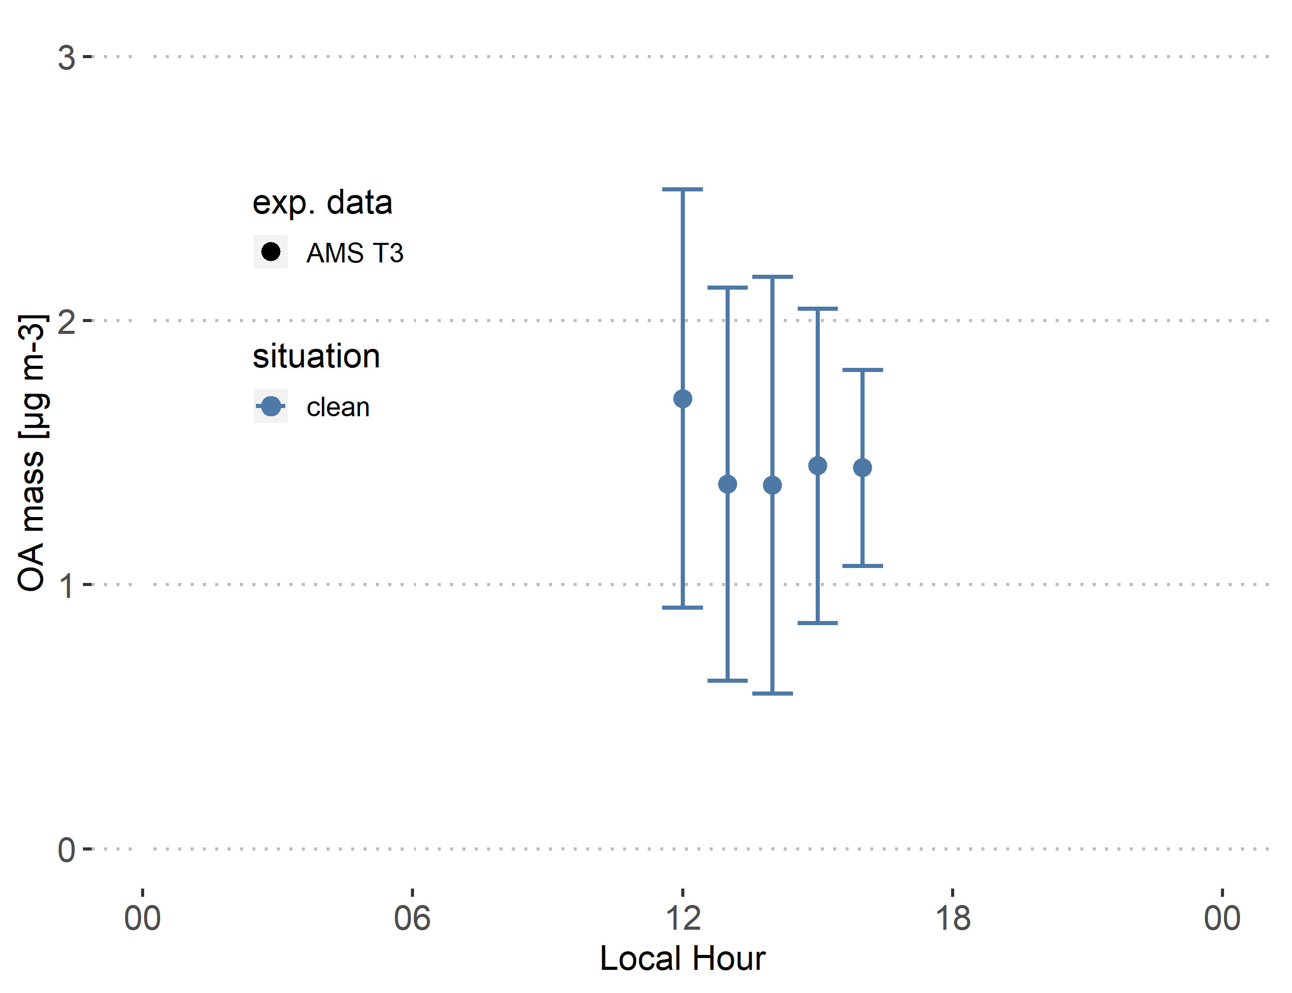
OA mass at T3 site

Slide 12
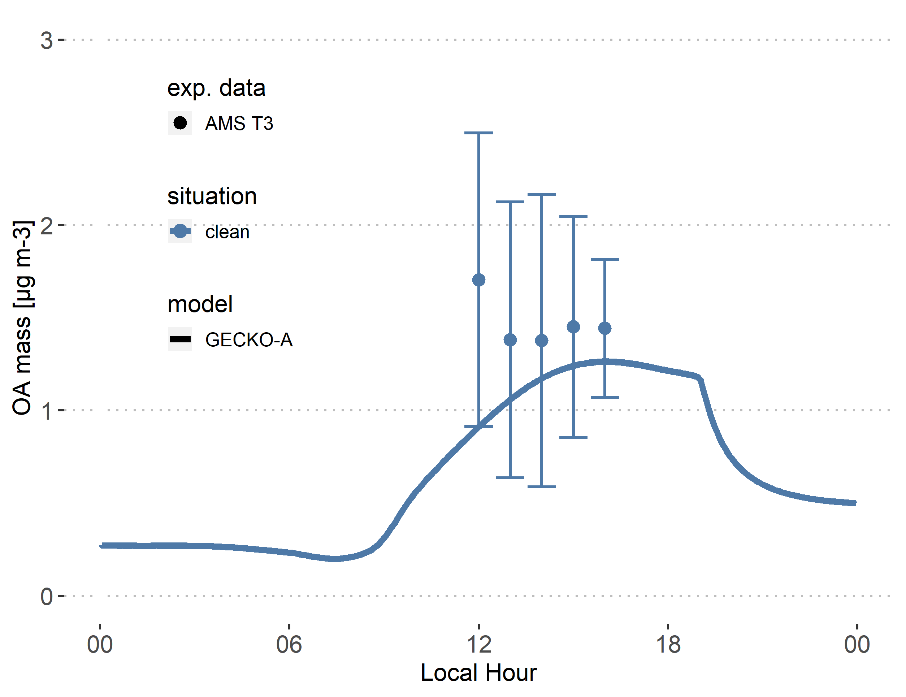
The Explicit model can reproduce background OA mass

Slide 13
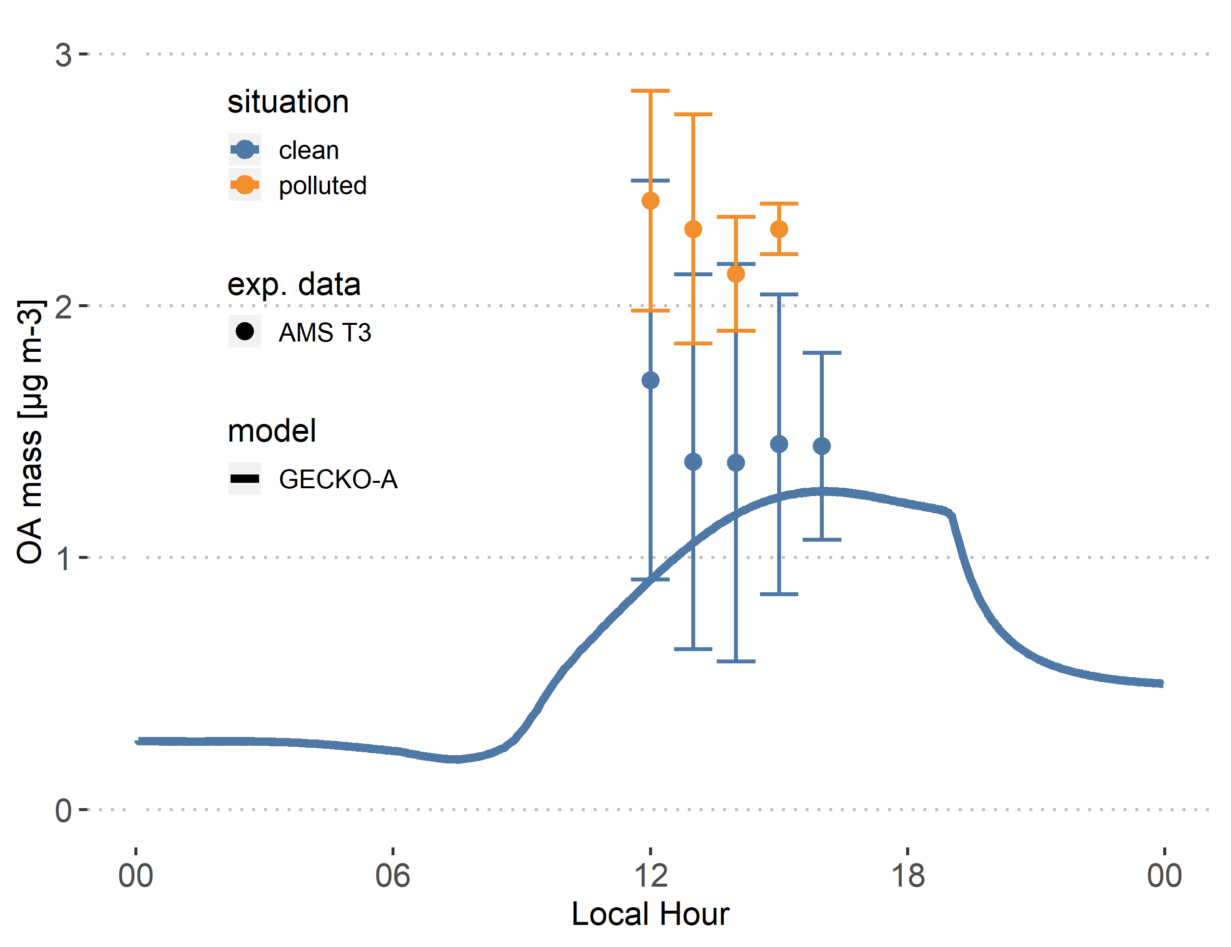
OA mass enhancement in the polluted plume

Slide 14
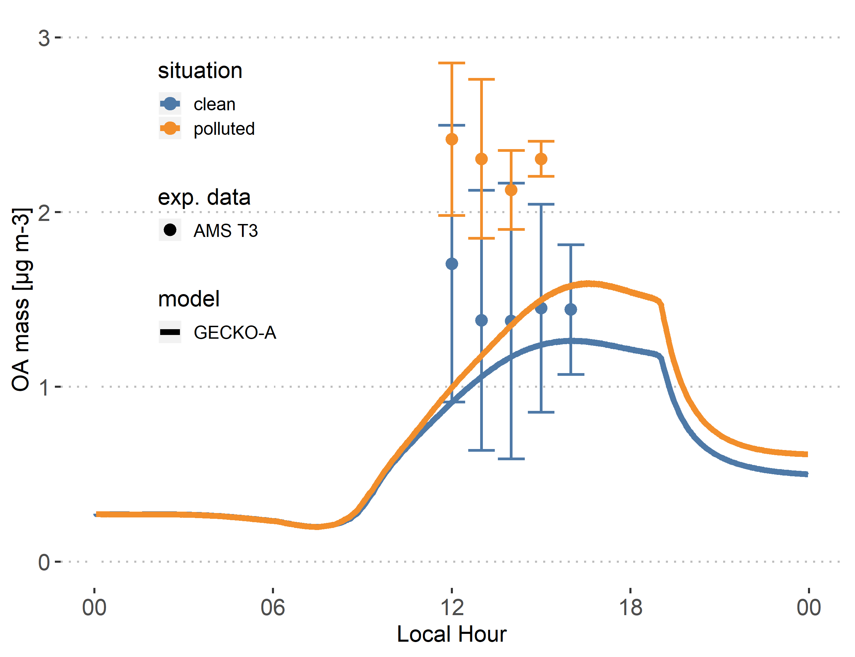
The explicit model does not reproduce the observed enhancement

Slide 15
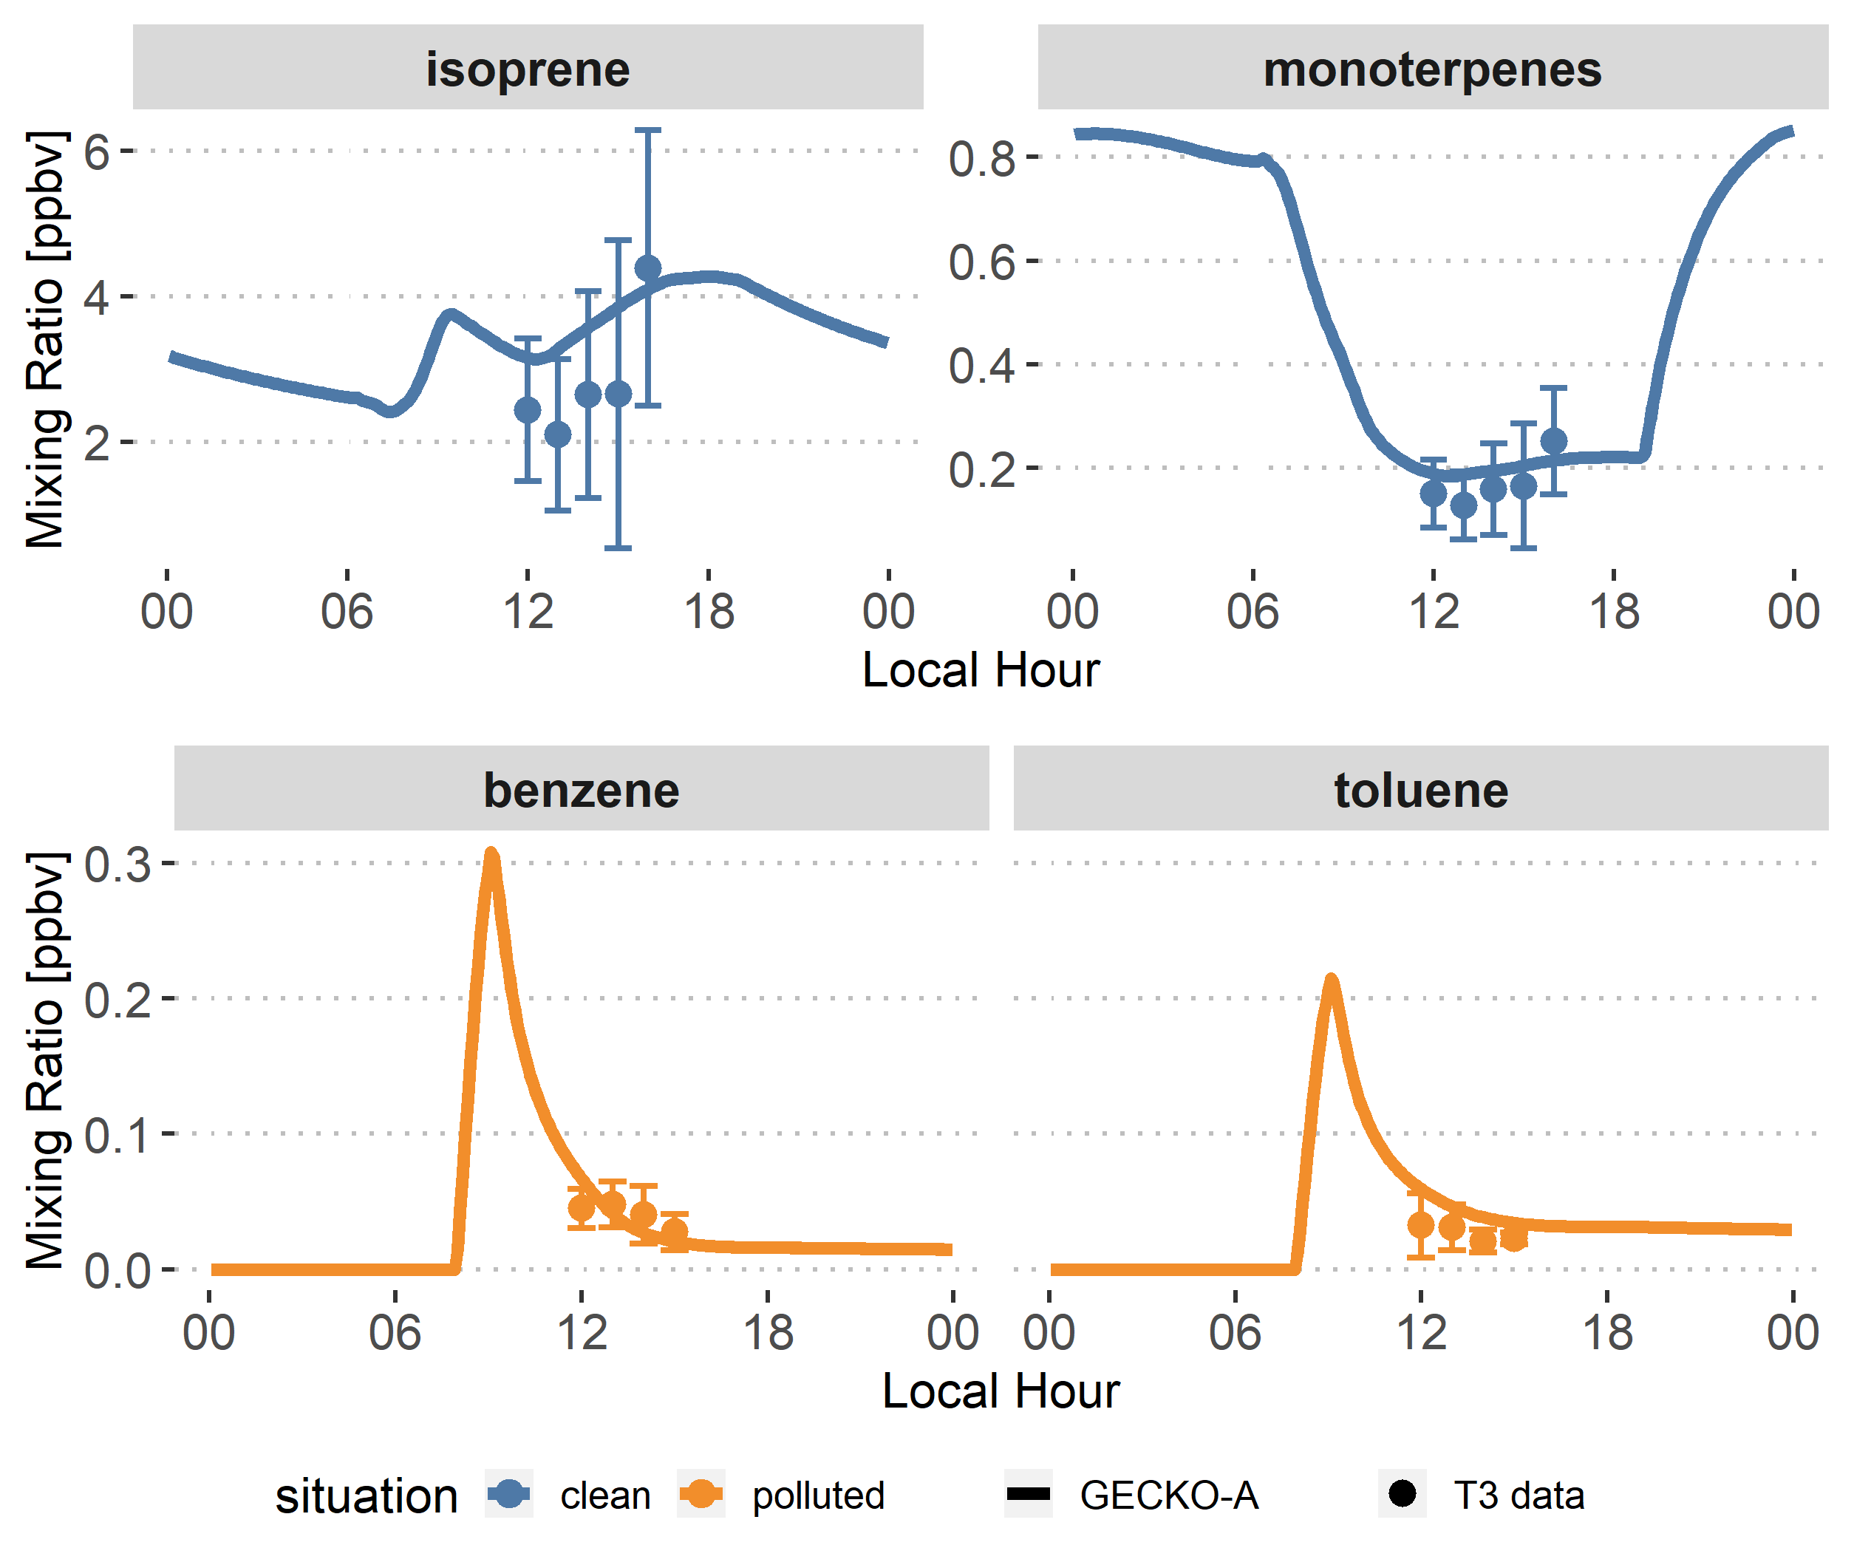
A problem with emissions and oxidants levels?

Slide 16
A problem with emissions and oxidants levels?

Slide 17
A problem with emissions and oxidants levels?
Notes:
VBS vs GECKO: means there is no problem with emissions or oxidants. Why is GECKO-A not sensitive to oxidants level

Slide 18
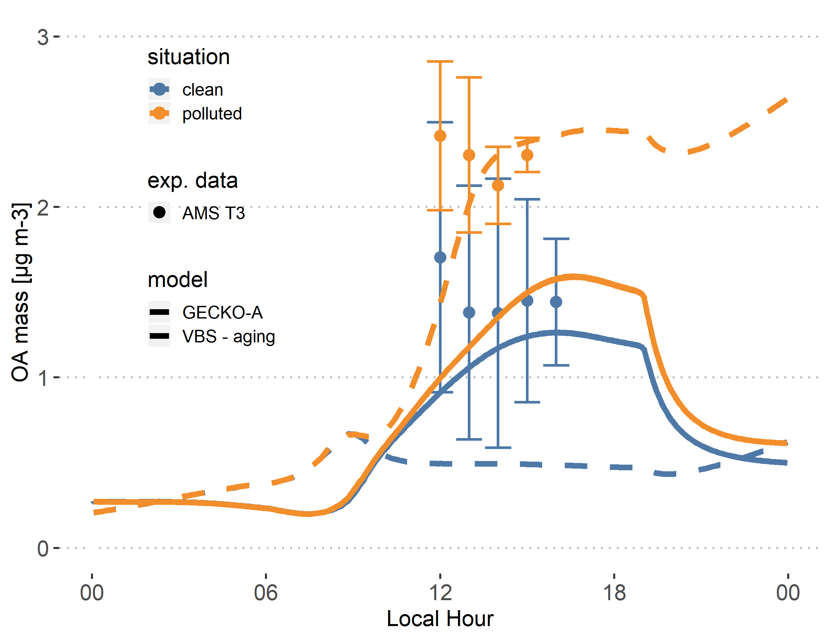
The VBS is more sensitive to oxidants levels
Notes:
VBS vs GECKO: means there is no problem with emissions or oxidants. Why is GECKO-A not sensitive to oxidants level

Slide 19
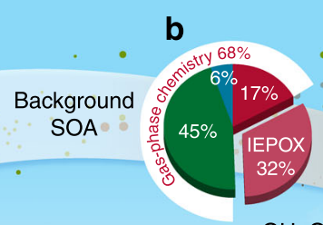
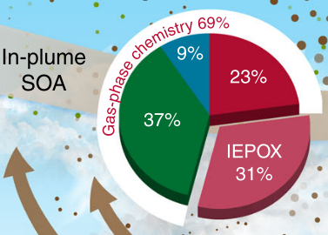
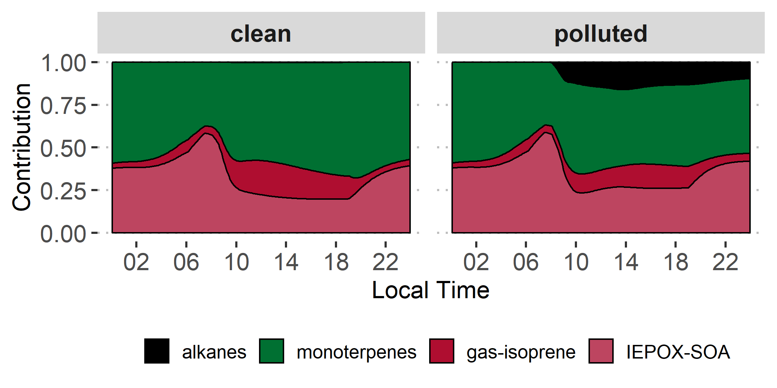
Contributions to SOA
Shrivastava et al., 2019
Similar contributions of monoterpenes and isoprene to biogenic SOA in VBS and GECKO-A

Slide 20
SOA aging

Slide 21
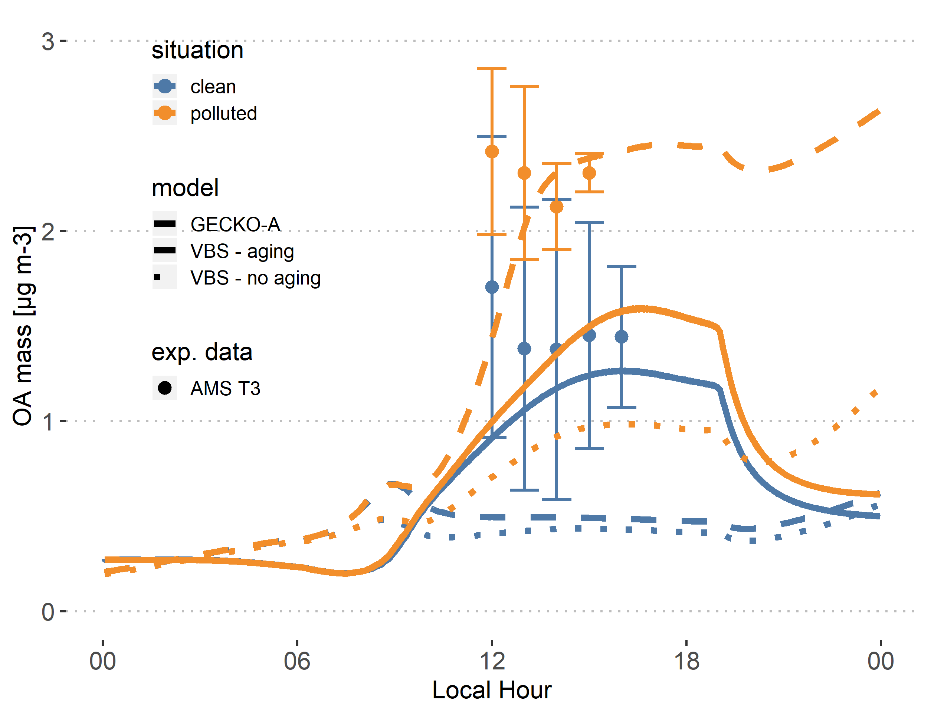
SOA aging

Slide 22
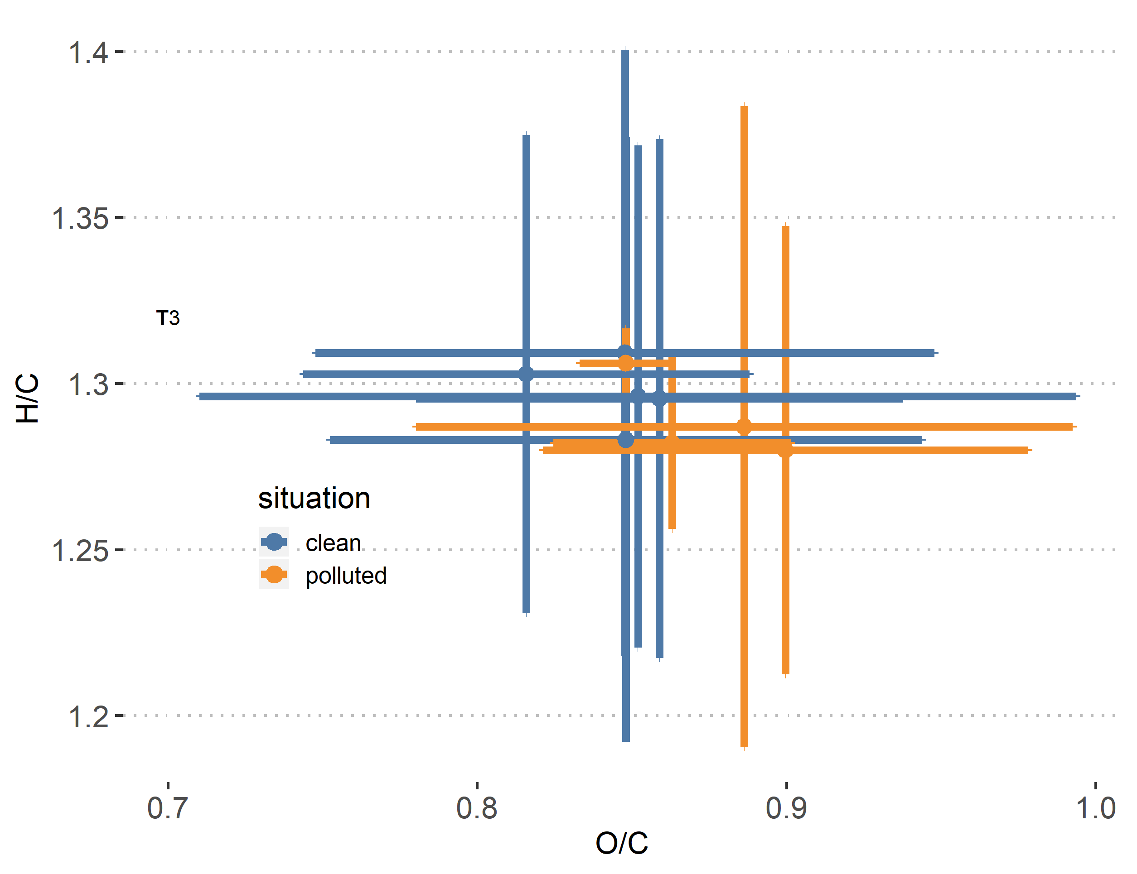
van Krevelen diagram
AMS measurements

Slide 23
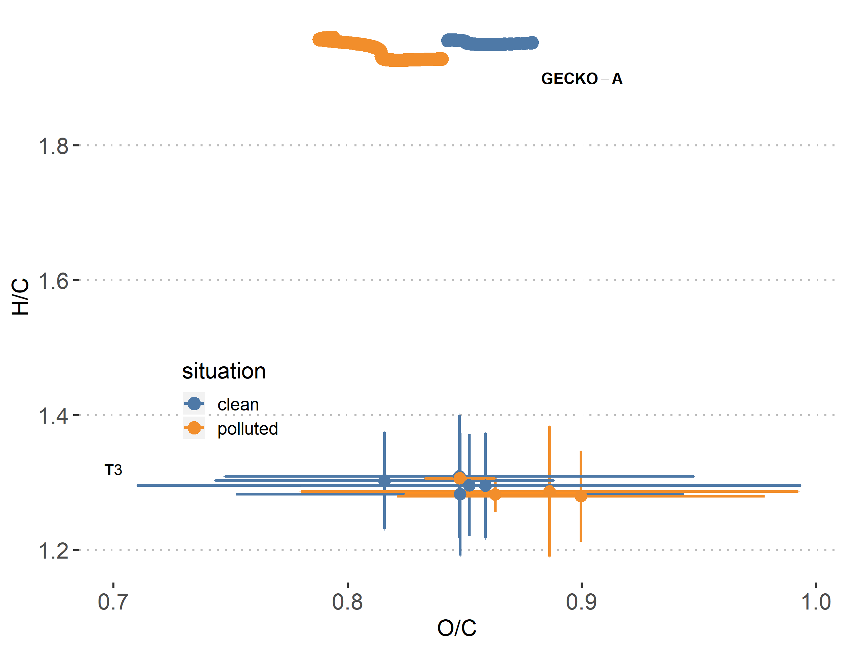
Missing Processes?
fragmentation
(gas/aerosol)
dimerization
(aerosol)
?

Slide 24
Conclusion
The explicit chemical mechanism in a boxmodel setup is able to reproduce realistic levels of primary organic compounds, NOx, OH and ozone.
It can reproduce background levels of organic aerosol, but is not able to reproduce the enhancement observed in the urban plume
The explicit approach is missing processes that are implicitly accounted for in the chamber-optimized VBS
These missing processes could involve dimerization and/or fragmentation
The processes contributing to SOA formation from biogenics are still poorly understood
https://doi.org/10.5194/acp-2019-1024

