Slide 1
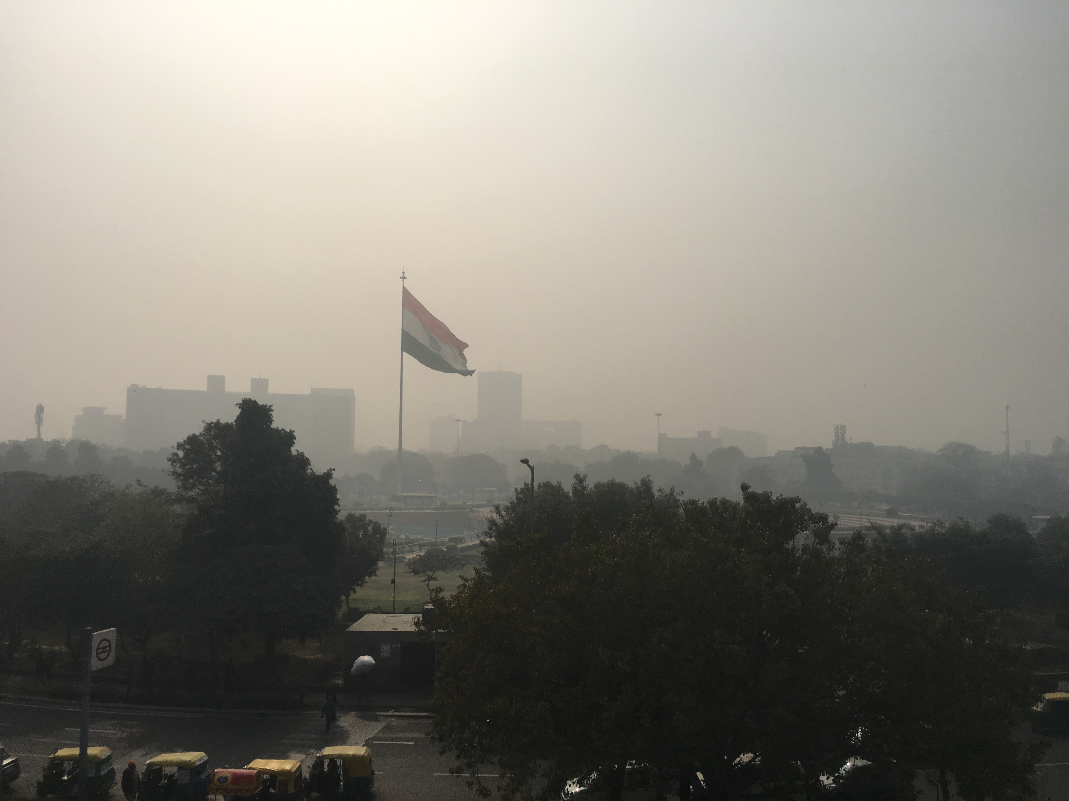
Inferring aerosol sources using multi-pollutant, low-cost air quality sensors
DAVID HAGAN, JESSE H. KROLL, SHAHZAD GANI, JOSH APTE, SAHIL BHANDARI, LEA HILDEBRANDT-RUIZ, KANAN PATEL, AND GAZALA HABIB
Notes:
Hi everyone

Slide 2
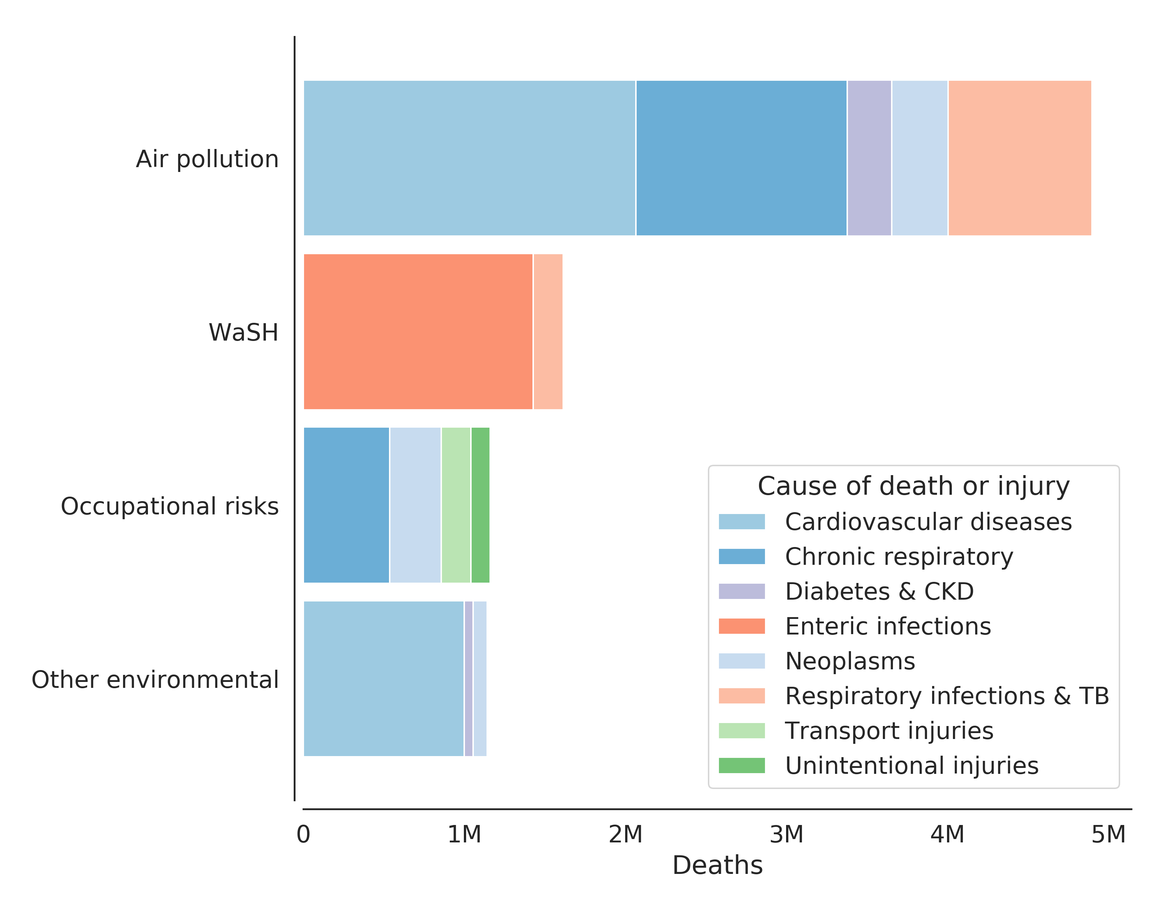
EXPOSURE TO AIR POLLUTION INCREASES MORBIDITY AND MORTALITY
Between 4.5M -8.9M deaths attributed to PM_{2.5} and O₃ pollution annually ^{[1, 2]}
Globally, more than $225B in labor is lost each year due to air pollution (2013)^{[3]}
Impacts are disproportionately felt by the young and elderly, especially in LMIC’s
[1]Burnett et al., 2018; [2] Cohen et al., 2017; [3] The World Bank, 2016
Notes:
Exposure to ambient air pollution is the leading environmental risk factor for the global burden of disease
It causes between 4.5 and 8.9 million deaths every year – that’s about 1 in 10 deaths globally each year (NEXT)
In addition, there is a huge economic hit
Globally, more than 225 B dollars is lost to air pollution via lost labor alone – it turns out it is pretty hard to contribute to the economy when you’re sick or dead (NEXT)
While a world-wide problem, these impacts disproportionally impact the young and elderly – especially in low and middle income countries

Slide 3
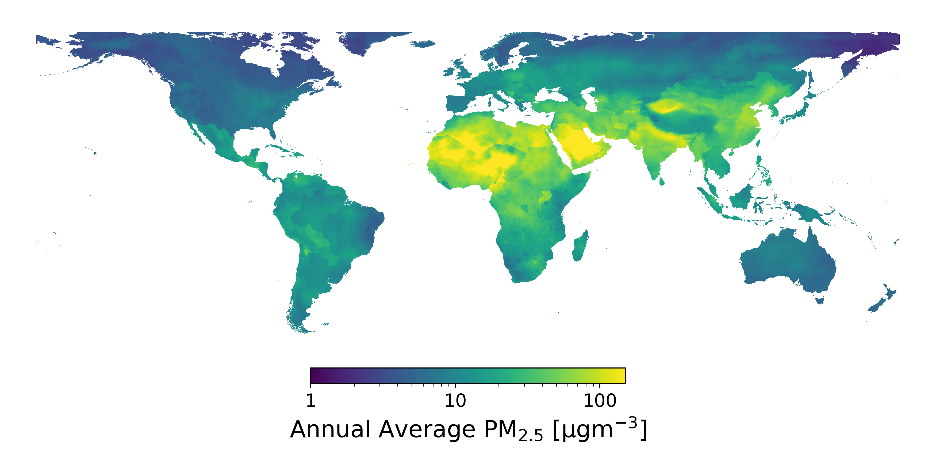
AMBIENT PM_{2.5} IS GLOBALLY HETEROGENEOUS
PM_{2.5} estimates from Shaddick, et al. ES&T (2018)
Notes:
Air pollution is spatially and temporally heterogeneous
Here, we show a global map, colored by the annual mean PM concentration
In the US, we’ve done a pretty good job at improving air quality, though much of the world still struggles
This is especially true in some of the world most dense population centers

Slide 4
AMBIENT PM_{2.5} IS GLOBALLY HETEROGENEOUS
95% of global population
PM_{2.5} estimates from Shaddick, et al. ES&T (2018)
Notes:
In fact, something like 95% of the global population lives in conditions the WHO considers unhealthy, where the PM2.5 concentration exceeds 10 ugm3

Slide 5
AMBIENT PM_{2.5} IS GLOBALLY HETEROGENEOUS
Global population-weighted PM_{2.5} concentrations have increased 18% since 2010.
PM_{2.5} estimates from Shaddick, et al. ES&T (2018)
Notes:
Unfortunately, the problem is getting worse
The population-weighted PM concentrations have increased nearly 20% over the past decade

Slide 6
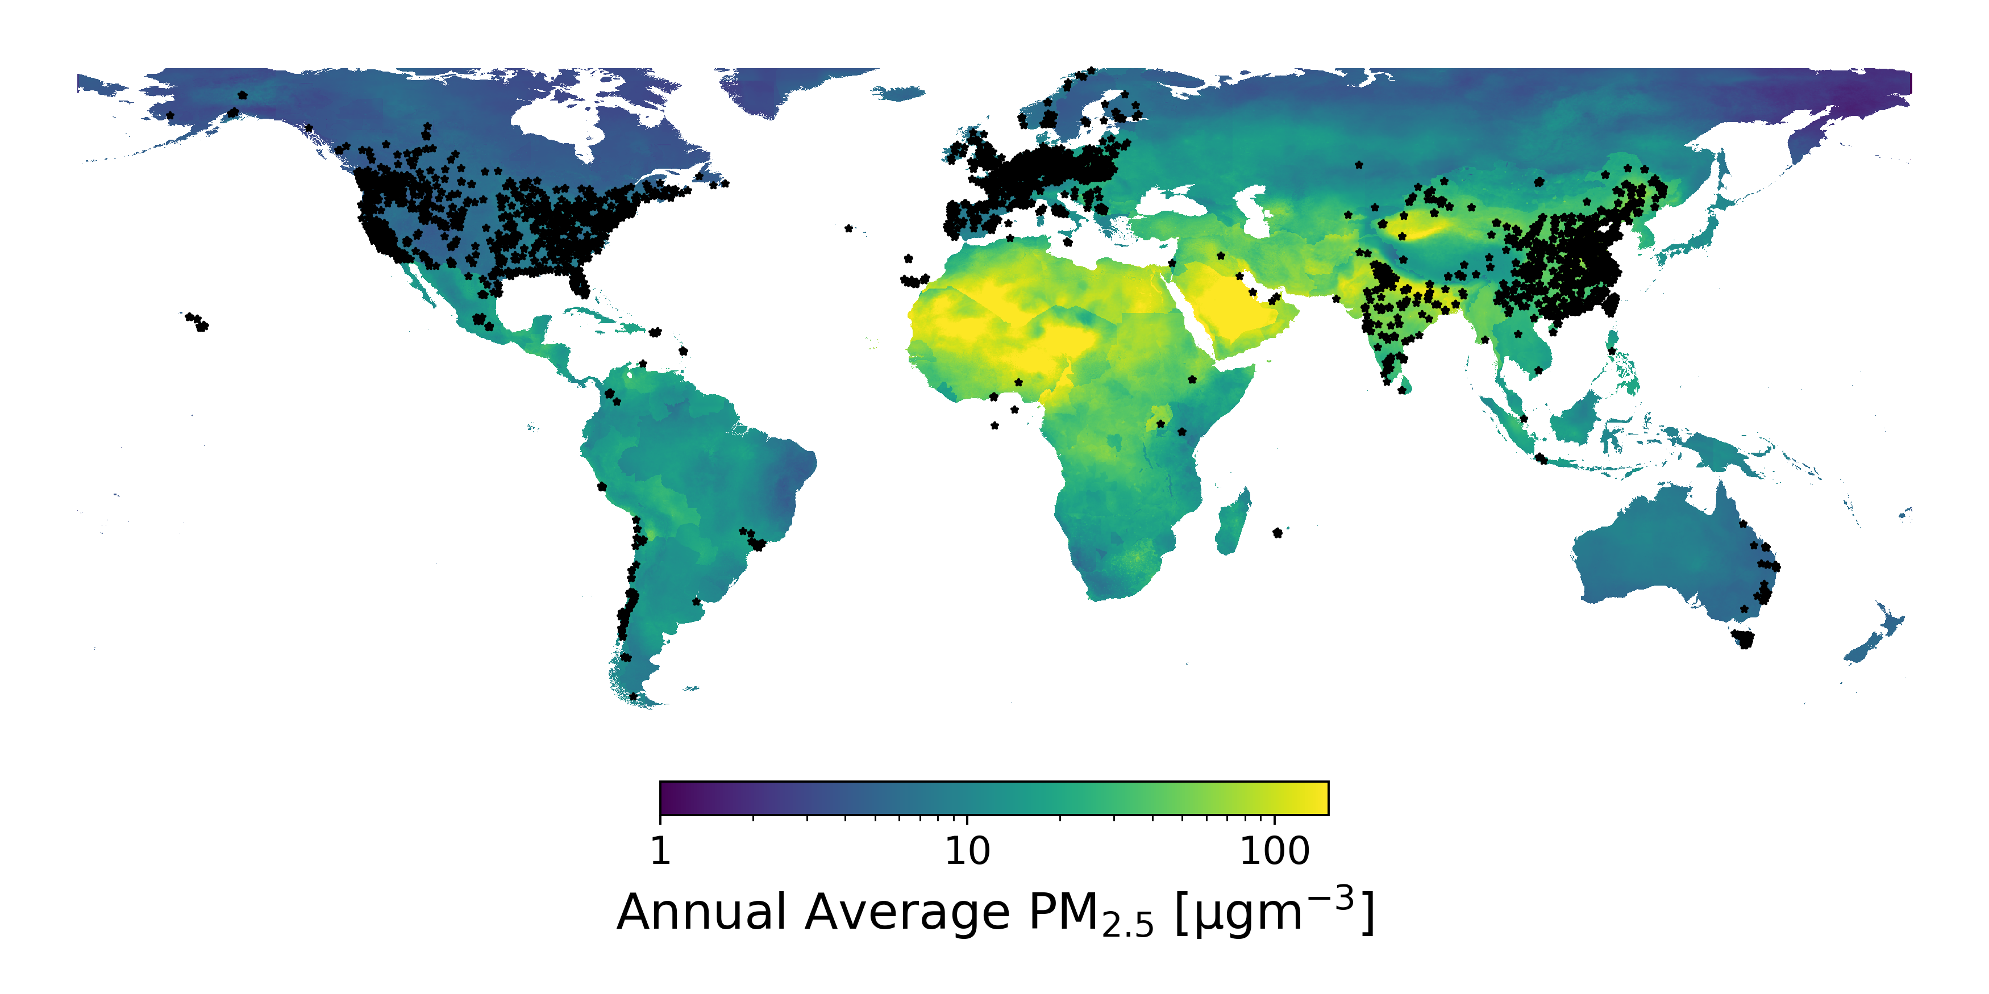
EXISTING MONITORING SOLUTIONS ARE EXPENSIVE AND SPARSE
PM_{2.5} estimates from Shaddick, et al. ES&T (2018); Sensor locations from OpenAQ
Notes:
One of the reasons we have been able to largely mitigate air pollution in the US is due to strong regulation, backed by an extensive government-operated AQ measurement network
Here, I’ve added a point for every one of these stations for which data is publicly available
As you can see, we do a very good job making measurements in the US and western Europe where the air is relatively clean, and a very poor job making measurements in the areas that need it the most

Slide 7
PORT OF OAKLAND
POLLUTION IMPACTS ARE HYPER-LOCAL
Air pollutants are highly heterogeneous in space
~4km
The spatial distribution is pollutant-specific
C_{amb} ~10 ppb
NO figure from Apte et al, 2017
Figure from Apte, et al. ES&T (2017)
Notes:
Not only is air pollution spatially distributed on a global scale, its highly variable on a hyper-local scale as well!
Here, we show the annual distribution of NO near the port of Oakland
Right here in the middle, we see the result for one of these government operated AQ stations and we can see that its not terribly representative of the areas just a few blocks away
Additionally, this same map for a different pollutant may look totally different
So, what do we do? How can we do a better job at understanding air pollution and fill in the measurement gaps both at this hyper-local as well as at the global scale?

Slide 8
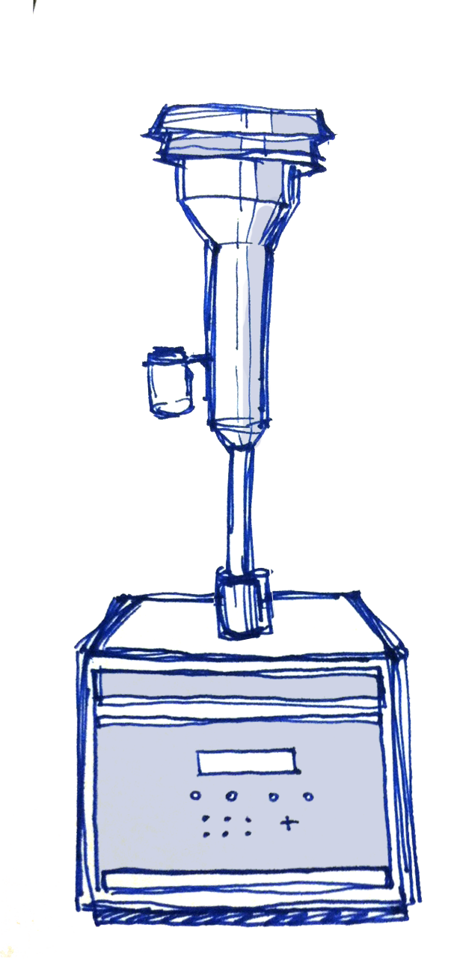
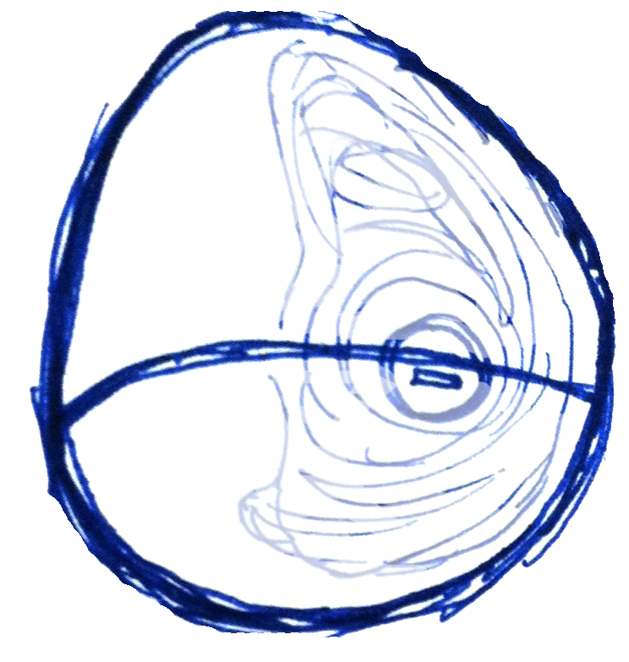
CURRENT LANDSCAPE OF AQ MONITORING
US EPA
certified
Consumer
Regulatory
$10
$1000
$10k
$100k
Less
expensive
More
expensive
100-1000x
50-100x
1-5x
Network
Size
Drawings by Jen Nguyen
Notes:
For the past several decades, AQ has been monitored using very accurate and reliable, but big expensive pieces of equipment. To set up and operate a single regulatory monitoring site, it will cost you about ¼ M in capital equipment plus another 100k/yr or so for labor and consumables
Over the past 5-10 years, consumer AQ sensors have really come into their own – mostly driven by the rise in cheap, accessible electronics and OEM sensors
Unfortunately, many of them are not much more than random number generators
For us, the quality of the data is absolutely paramount – we need to at least understand the error bar on the measurement in order for it to be useful

Slide 9
“…data of poor or unknown quality is less useful than no data since it can lead to wrong decisions.”
EMILY SNYDER
The Changing Paradigm of Air Pollution Monitoring, ES&T, 2013
To ensure the data we collect is impactful, we must understand sensor strengths and limitations.
Notes:
- As Emily Snyder so nicely put in her paper a few years ago, [read quote]

Slide 10
LOWER COST AQ SENSORS MAKE DISTRIBUTED MEASUREMENTS ECONOMICAL
US EPA
certified
Consumer
Regulatory
$10
$1000
$10k
$100k
Less
expensive
More
expensive
100-1000x
50-100x
1-5x
Network
Size
10-100x capital cost reduction provides new opportunities
Drawings by Jen Nguyen
Notes:
To bridge the gap between the super cheap, consumer grade sensors and the very expensive but accurate regulatory sensors, a new middle ground has appeared
The goal is to build moderately cheap sensors – still 10-100x cheaper than regulatory monitors – that work good enough to be used for quantitative measurements of AQ

Slide 11
1
Citizen science & community engagement
CURRENT AND POTENTIAL USES FOR LOW-COST AIR QUALITY SENSORS
2
Personal exposure assessment / epidemiology
3
Model and satellite data validation (i.e. ground-truth)
4
Understanding chemical composition and atmospheric chemistry
Notes:
So, who uses LCS and why? A vast majority of use cases at this point in time are really in the area of citizen science and community engagement, though they are beginning to be used quite a bit by folks doing personal exposure and human health assessments since they are so cheap, small, and user very little power. They’re also being used to build large, gridded networks which can be used for general AQ monitoring, fence-line monitoring, and hot spot detection.
Some folks on the academic side of things are beginning to use them to do things like constraining AOD/PM2.5 relationships, validating satellite measurements, and better constraining model outputs.
But one potential application that so far has gotten very little attention is the use of low cost sensors to learn about atmospheric chemistry - sources, transformations, and so forth, and that’s going to be the focus of our work here throughout the rest of the talk

Slide 12
OVERVIEW OF AIR QUALITY IN DELHI, INDIA
Population ~ 26M
Annual mean PM_{2.5} ~ 140 µgm⁻³
Hot summers with cool, wet winters
Unfavorable meteorology with shallow mixing heights (esp. winters)
Life expectancy impact ~1.5 years across India^{[1]}
Figure adapted from Gani, et al. ACP (2018); ^{[1]}Apte, et al. ES&T (2018)
Notes:
Delhi is the worlds most polluted megacity
The population is near 26M people and it experiences poor AQ year round, though as seen in this figure on the left, cooler months are particularly bad with PM1 loadings exceeding 200 ugm3!
The result is that across the country, people lose on average 1.5 years of life due to bad AQ

Slide 13
IIT-Delhi Campus
Not pictured (just outside window)
4 MIT MPAQS
O₃, NO₂, CO, SO₂, PM (0.38-17.5μm)
ACSM (NR-PM1)
SMPS (PSD, <= 560 nm)
Aethalometer (BC)
Inlet height ~ 20m
150m from major road
Photo provided by Shahzad Gani
Notes:
We were fortunate to work with a Texas-based group that had a nice lab setup at IIT-Delhi
The suite of instruments at our disposal include an Aethalometer for measuring BC, an SMPS for counting and sizing particles, and an ACSM for measuring the particle composition
These instruments represent truth as far as we’re concerned
Just outside the window were four of our multi-pollutant LCS that we will take a look at in a second (NEXT)
This site is located on the campus of IIT-Delhi, situated in South Delhi about 150m from a major arterial roadway

Slide 14
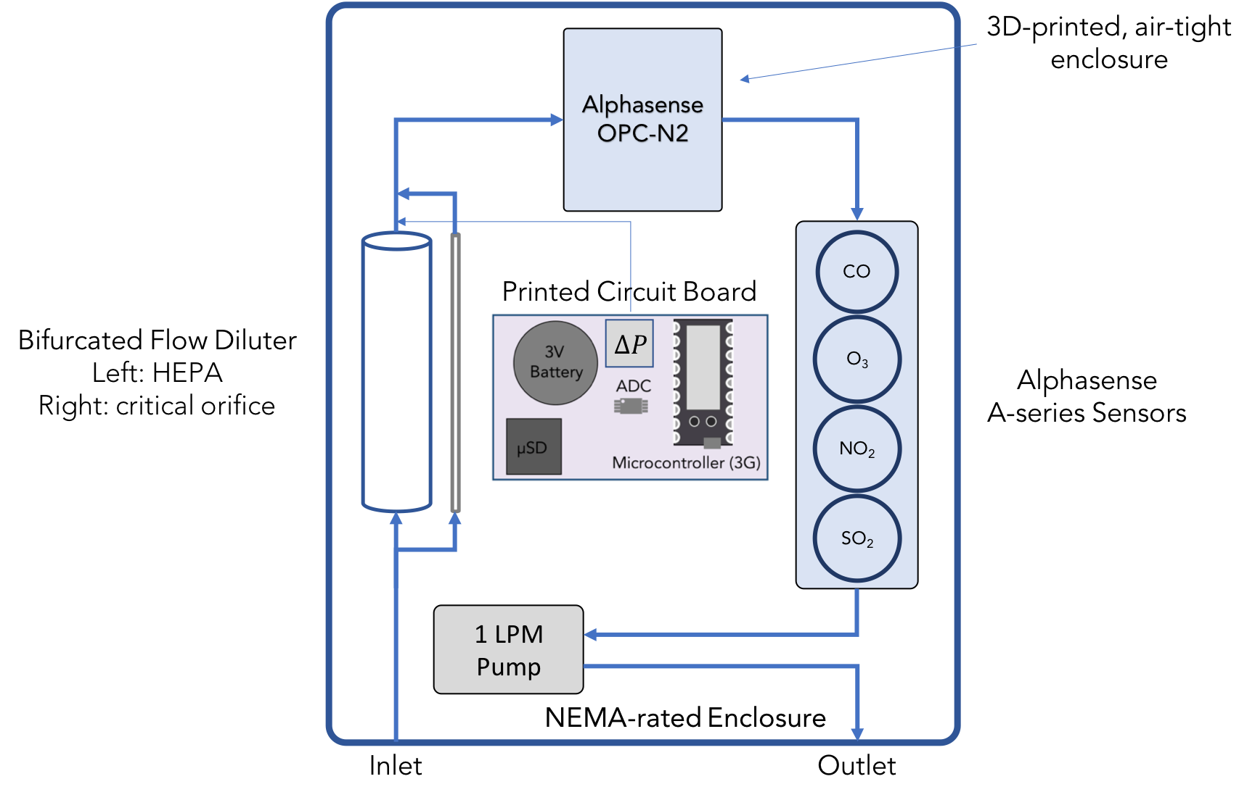
Multi-Pollutant Air Quality Sensor (MPAQS)
Material Cost (BOM) ~ $1250
Counts and sizes particles using a modified Alphasense OPC-N2 (380-17,500 nm, 658 nm laser)
Measures CO, NO, SO₂, O₃ using Alphasense A-series EC sensors
Data is stored locally on a µSD card (1 Hz) and pushed to a remote server every minute
Hagan, et al. ES&T Letters (2019)
Notes:
The sensor we used to make measurements is very similar to the one we used in Boston
The key difference between the two is that this version includes a bifurcated flow diluter to eliminate 90% of the incoming particles so that our instrument actually lasts longer than a few weeks
Each sensor measures SO2, CO, NO2, and O3 as well as particles using a LC OPC

Slide 15
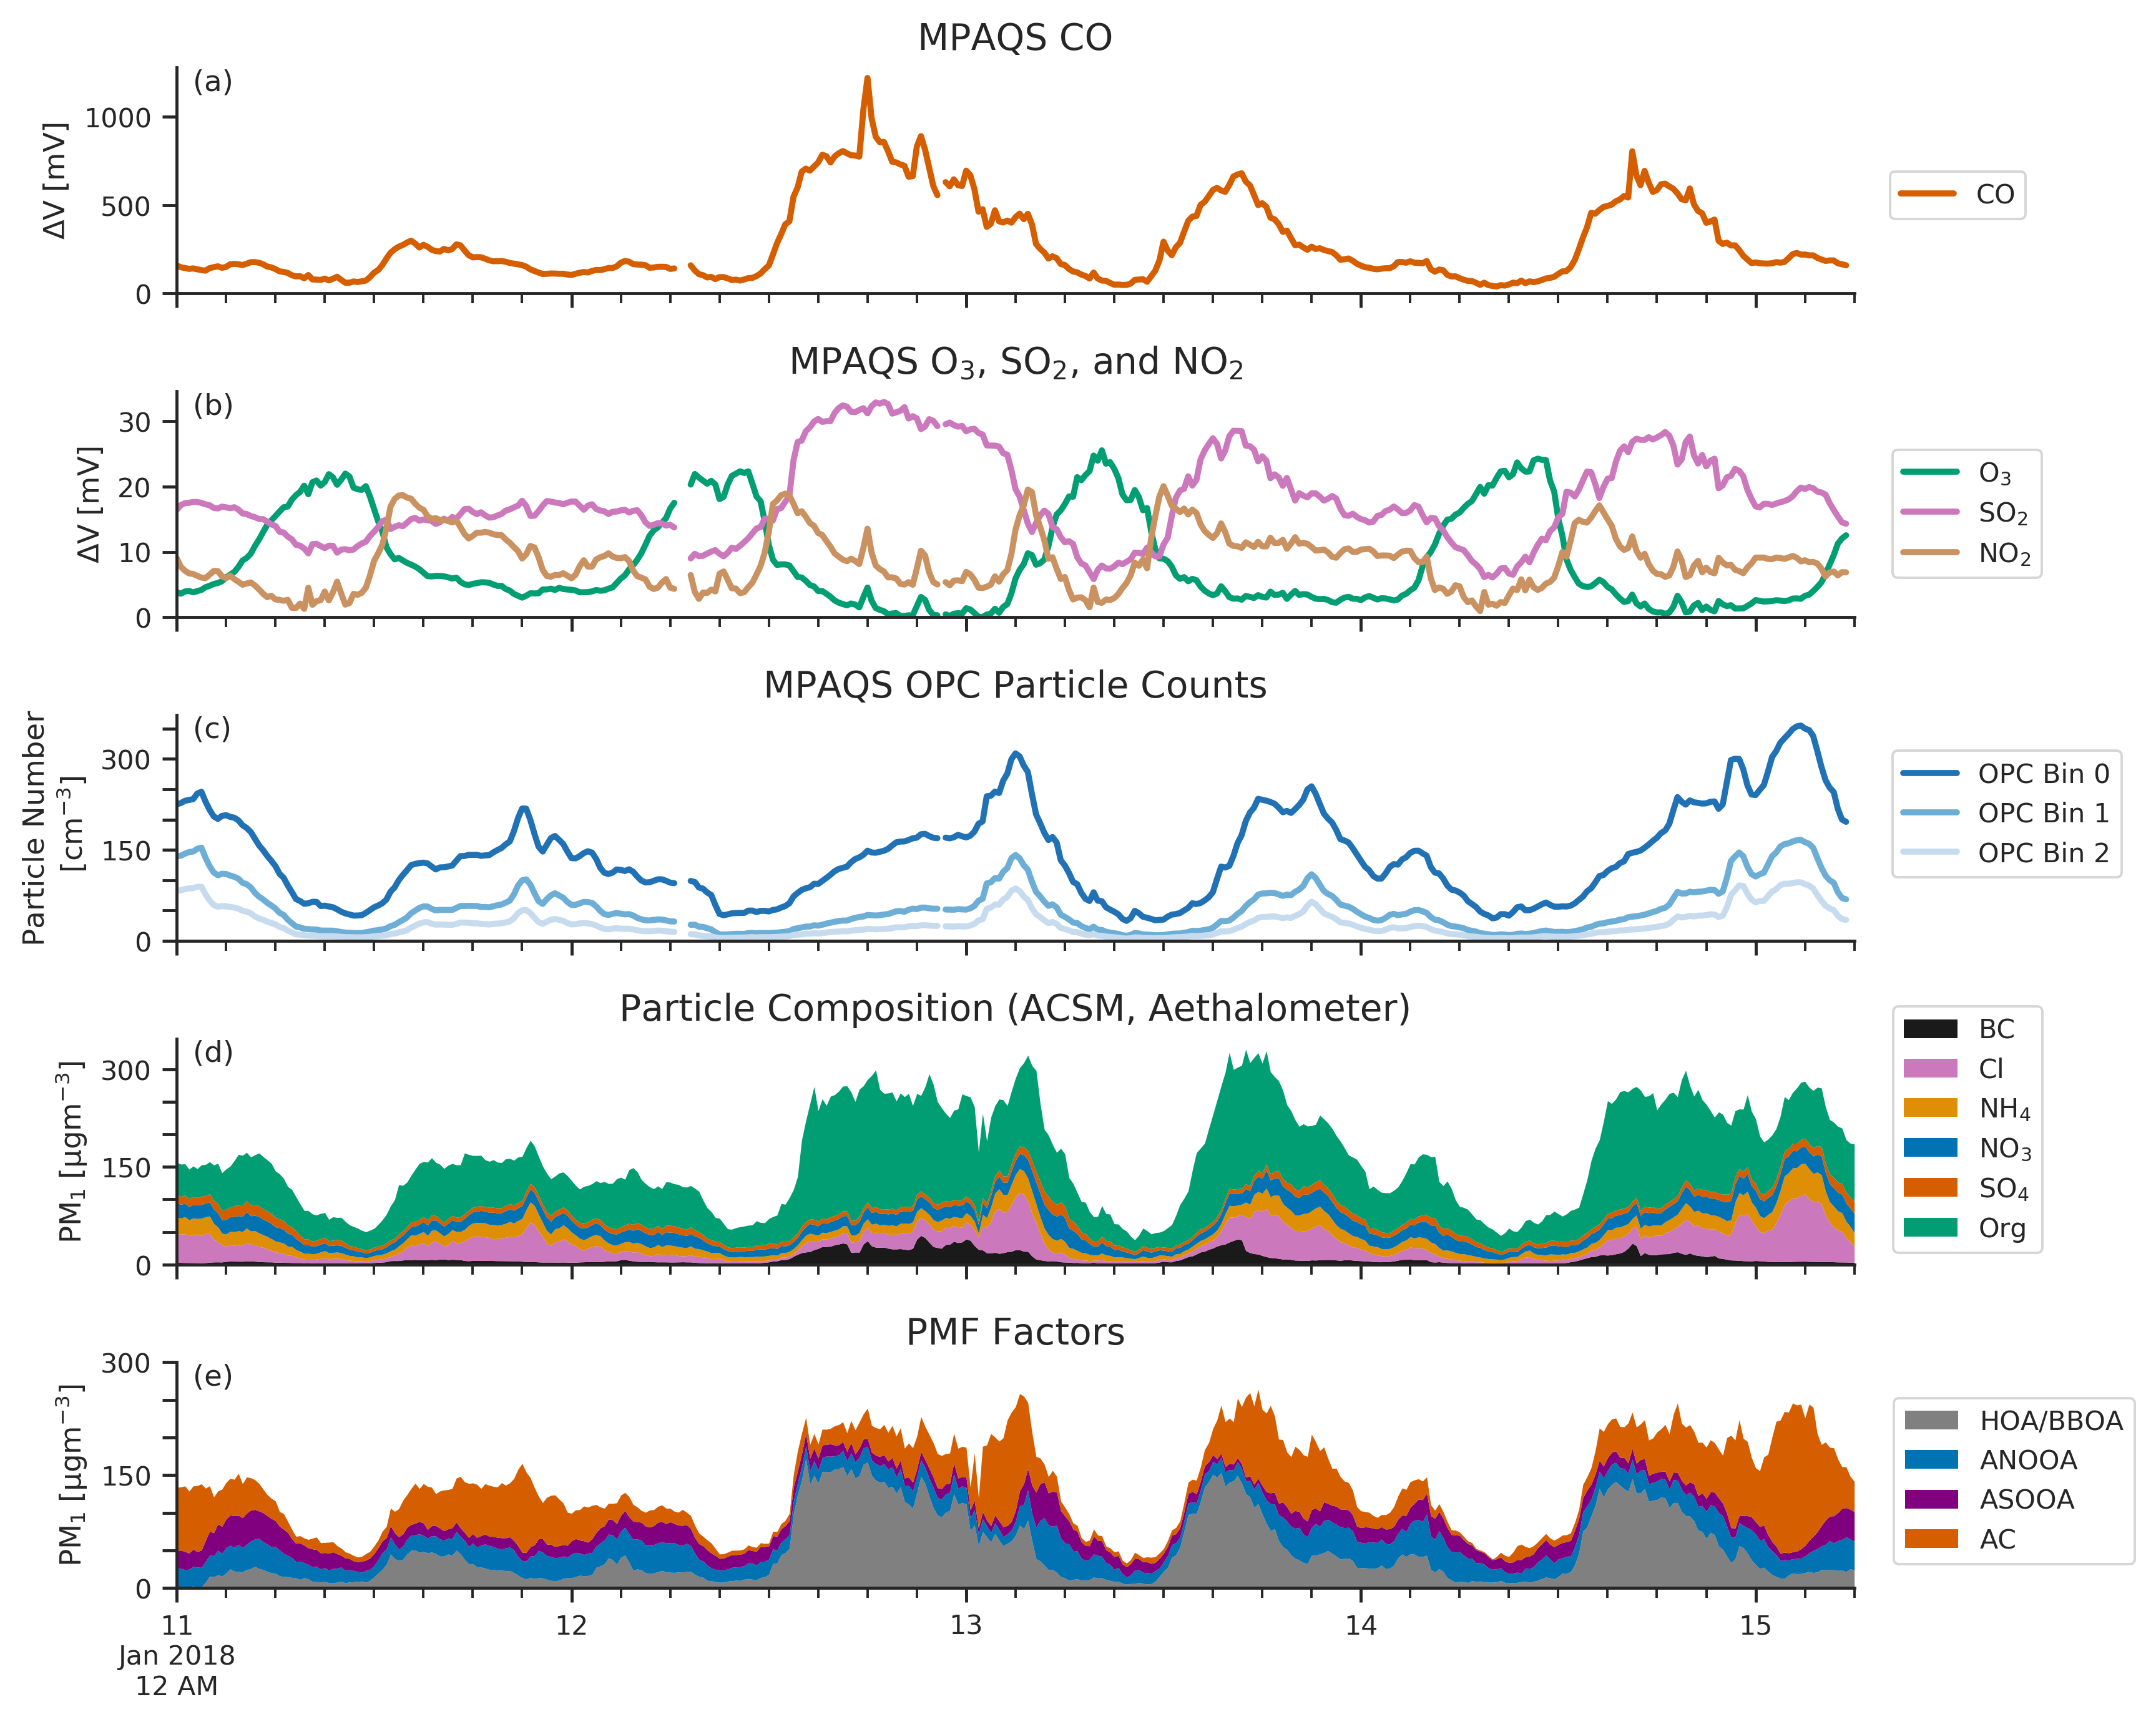
DELHI SUPERSITE
EVALUATION PERIOD
January 10th – February 16th, 2018
PM₁ = 142 ± 73 µgm⁻³
We want to find like signals – are there pollutants that appear together over and over?
Source Apportionment Analysis
By UT Austin
Hagan, et al. ES&T Letters (2019)
Notes:
Today we’re going to talk about a 6-week chunk of data taken last year – a few days of which is shown here on the right
The top two rows show the gas-phase data from the EC sensors and the 3rd row shows the OPC data, broken down by bin
Down below, we show the data from the reference kit, including the chemical composition and also the results of a factor analysis done using this chemical composition data
We see a few periods of elevated CO and SO2 data that appear to align with these green parts down below corresponding to the organic fraction of the PM1
Notice the OPC bins don’t necessarily line up with the total PM1 mass, but look like they correlate better with these pink and orange lines (NEXT)
Our goal is to search through this data and find signals that tend to appear in groups, indicating that they may be coming from the same place

Slide 16
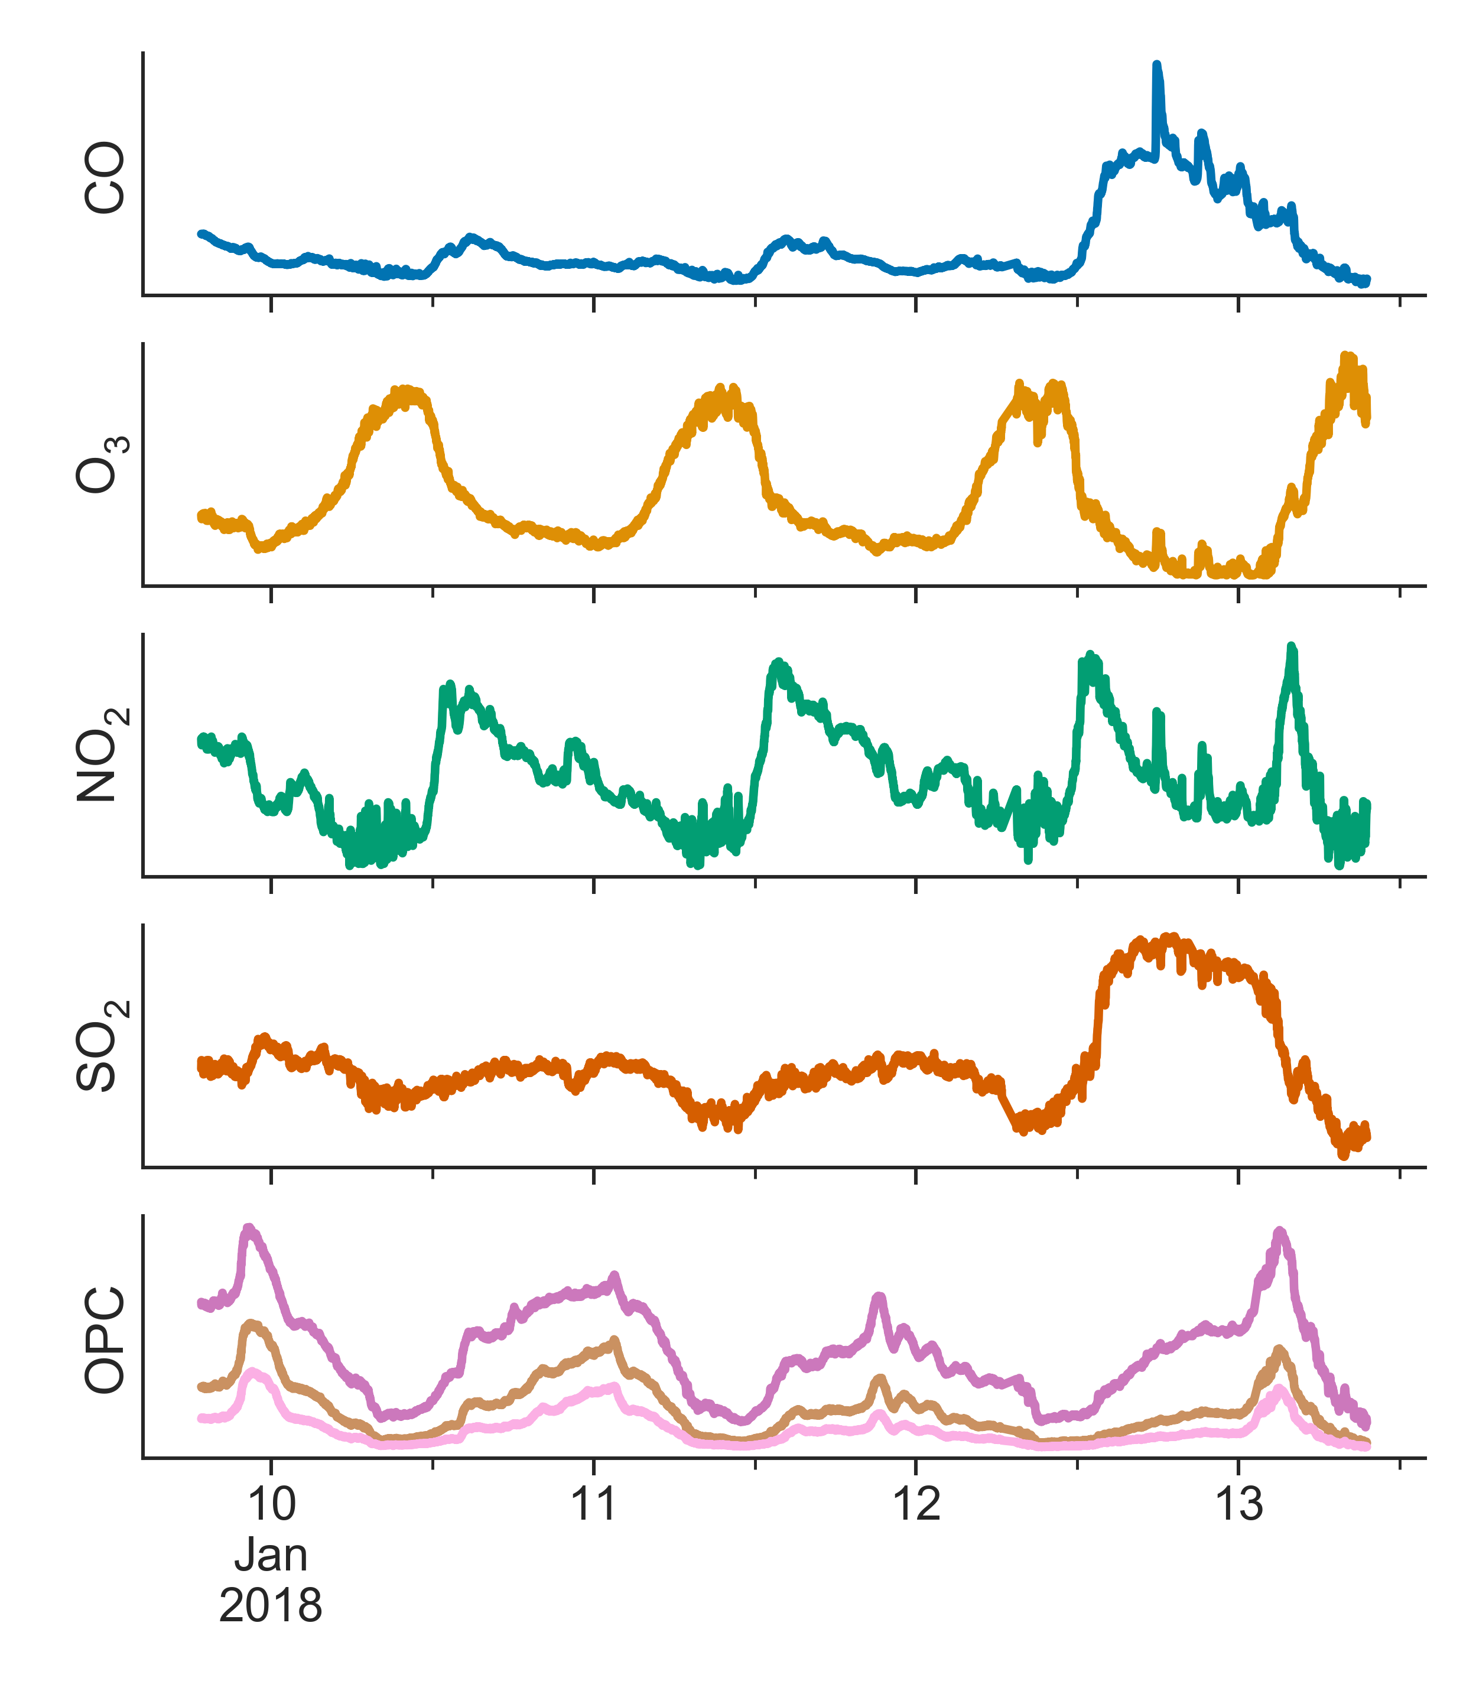
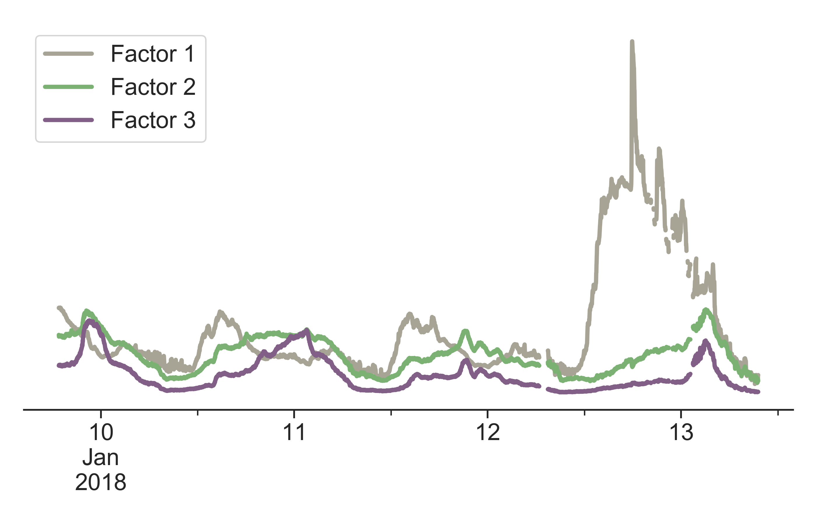
NON-NEGATIVE MATRIX FACTORIZATION (NMF) AS A TOOL FOR EXTRACTING SOURCE INFORMATION
NMF is an unsupervised learning technique that groups together like signals by covariance to provide physically interpretable factors.
NMF
Notes:
To do that, we use an algorithm called NMF, which is an unsupervised learning technique that groups together like signals by covariance
It’s somewhat similar to principal component analysis, with the requirement that all components must be >= 0 (NEXT)
Basically, we use both the gases and particles as inputs and use NMF to reduce the dataset into a set number of factors with fixed composition (NEXT)
Each factor is shown as a timeseries that represents that fixed ratio of the input pollutants

Slide 17
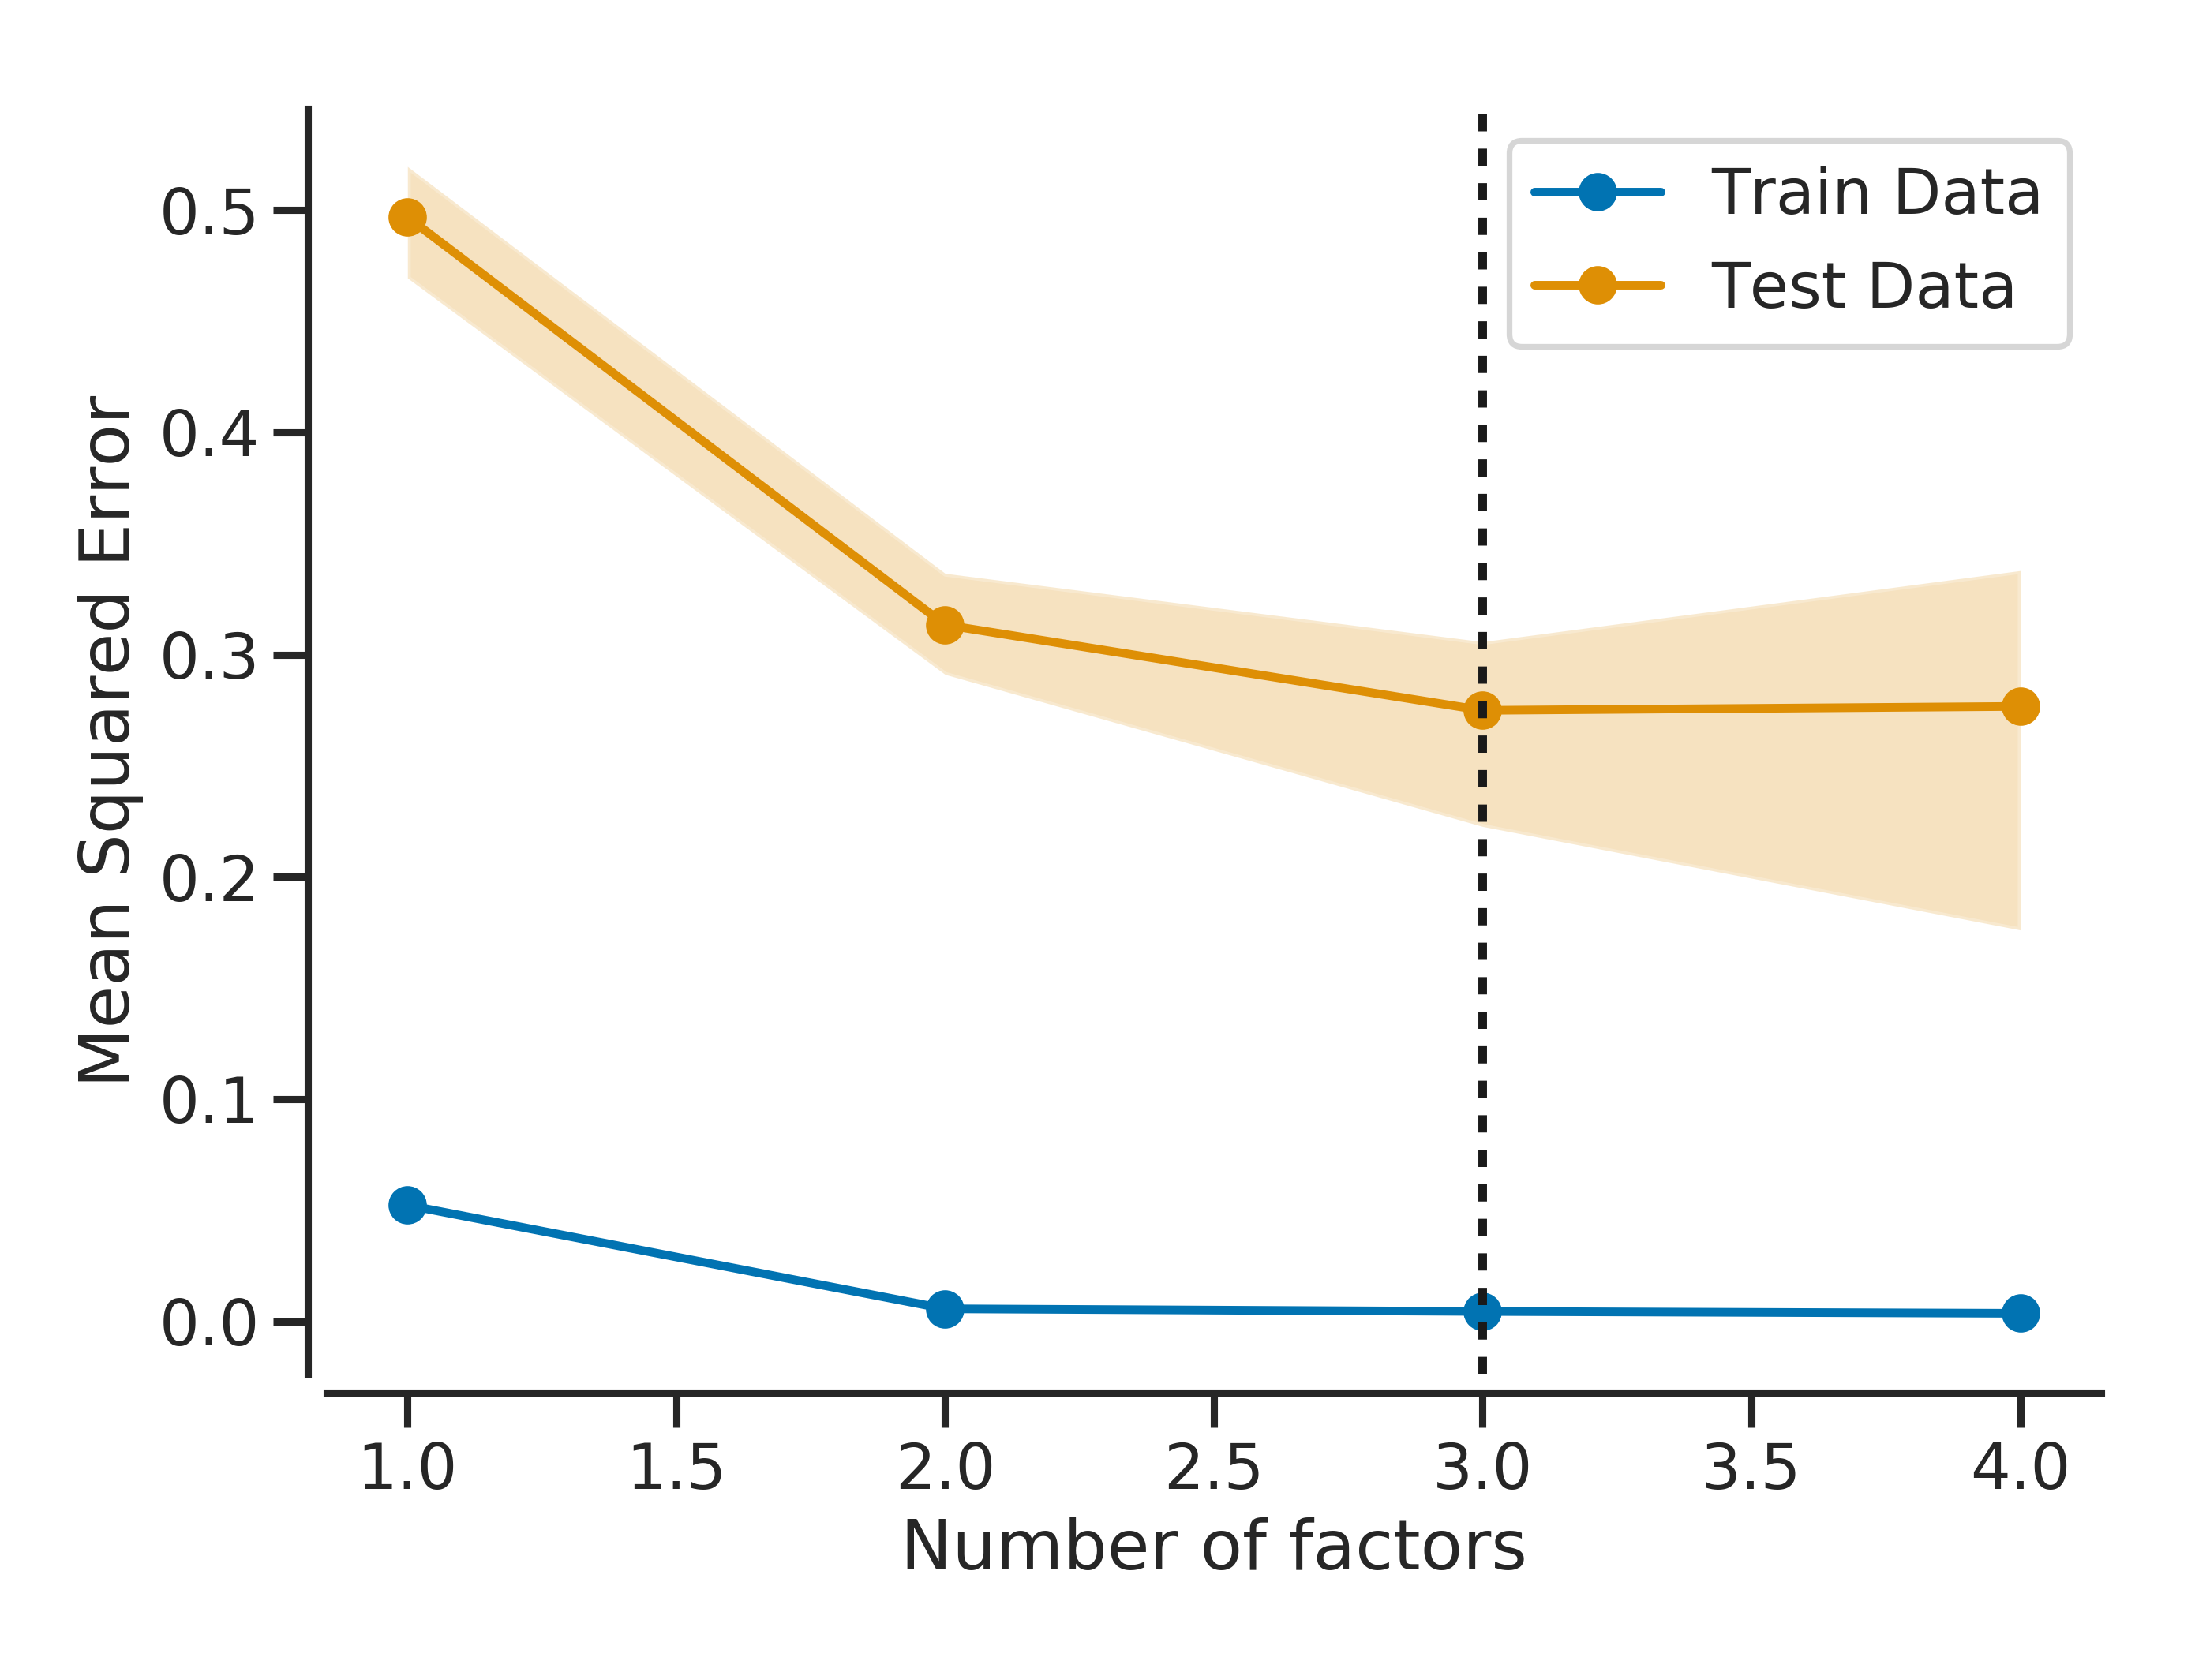
DETERMINING THE OPTIMAL RANK FOR FACTOR ANALYSIS METHODS VIA CROSS-VALIDATION
We use a speckled hold-out pattern to create test and training data sets
Training
Test

Slide 18
3-FACTOR NMF SOLUTION: FACTOR CONTRIBUTION
~95% of the CO signal
ends up in Factor 1
Factor 1 is dominated by CO with small contributions from Bin 0, SO₂, and NO₂
Factor 2 is mostly associated with OPC Bin2 0-2, O₃, and SO₂
Factor 3 is associated with the larger OPC bins (2, 1, 0 in order)
CO
dominated
Particle Factor 2
Particle Factor 1
Hagan, et al. ES&T Letters (2019)
Notes:
Here, we show the composition for each of the three factors we found (NEXT)
We see that nearly the entire CO signal, along with about 1/2 of the SO2 and NO2 end up in a single factor, with very little contribution from particles (NEXT)
We see this second factor is composed of the smaller particle bins as well as some gas-phase contribution (NEXT)
We see the third factor is just the larger particles
It appears this first factor is likely indicative of combustion and the reason we don’t see particles is not because they don’t exist, but because they’re too small Likewise, it appears the two particle factors are likely non-combustion particles, possibly secondary organic aerosol or more regional, larger particles that don’t necessarily have an associated gas signature
While its great that we can hypothesize these sources using just our LCS, we did have about $1/2M worth of equipment sitting in the lab, so we might as well double check

Slide 19
CORRELATION OF NMF FACTORS (LCS) TIME SERIES AGREE WELL WITH THE REFERENCE INSTRUMENTS
r²
MPAQS (LCS) NMF Factors
SMPS
ACSM
Aeth
Hagan, et al. ES&T Letters (2019)
Notes:
Here, we correlate the factors we got via the factor analysis of our LCS data (shown on the y axis) with key aerosol parameters from the research-grade instruments including the physical properties (number and mass), as well as the composition (shown on the x axis) grouped by the instrument the data came from.
The colors and numbers in each of these boxes is indicative of the correlation coefficient between the two results. A few things really stand out:
Our CO-dominated factor correlates strongly with the total number of particles as well as the org and BC fractions of PM1, all of which we associate with combustion
Factors 2/3 notably don’t correlate with these parameters but do correlate well with secondary inorganic species (ammonium, sulfate, nitrate, and chloride) which we would expect to appear in the accumulation mode which our particle counter is able to see
Due to the limits of our OPC, we cannot see particles below 380 nm – which means we’re missing most of the combustion-related particles

Slide 20
CORRELATION OF NMF FACTORS (LCS) TIME SERIES AGREE WELL WITH THE REFERENCE INSTRUMENTS
R²
CO-dominated
Factor 1 is correlated with primary OA (even more so than total OA)
Factors 2&3 capture secondary aerosols – SOA is very weakly correlated
Particle
Factor 1
Low Cost Sensors
Particle
Factor 2
We are able to (roughly) separate primary versus secondary aerosol using NMF with LCS
HOA/BBOA
ANOOA
ASOOA
AC
Reference Instruments
Hagan, et al. ES&T Letters (2019)
Notes:
When we compare our results, shown here on the y axis to those obtained using a much more established technique and equipment, shown on the x axis, we see promising results
Each of these boxes is colored by the correlation coefficient, which is also what the white number in each box is (NEXT)
Our CO/combustion factor agrees quite well with the Hydrocarbon and Biomass burning factor from the reference instruments (NEXT)
2nd and 3rd factors correlate well with Ammonium Chloride and secondary components
We can’t say for sure what the source of the 2nd and 3rd factors are, but they are statistically different and an area to keep researching (NEXT)
What this all shows, is that we can, at least roughly, separate primary from secondary sources of PM pollution using just the LCS despite being unable to see the smallest particles

Slide 21
CONCLUSIONS- INFERRING AEROSOL TYPES AND SOURCES
USING LOW-COST SENSORS
LCS are ‘blind’ to smallest (< 380 nm) primary combustion particles $→$ we can leverage the gas-phase measurements (esp. CO, SO₂, NO₂) to infer when combustion is present
Multi-pollutant low-cost sensor measurements (gas-phase pollutants, PM size distributions) can be used to provide information on aerosol types and sources
New algorithmic approaches (ex. NMF) are needed (and should be further validated) to improve the utility of LCS
Next $→$ Can we merge networked sensor data with regional (and sub-regional) models to better understand pollutant exposure and transport within urban megacities?
Notes:
4 lines

