Slide 1




A predictive group-contribution model for the viscosity of aqueous organic aerosol
Andreas Zuend¹, Natalie Gervasi¹, & David Topping²
¹ Department of Atmospheric and Oceanic Sciences, McGill University, QC, Canada
² School of Earth, Atmospheric and Environmental Science, University of Manchester, Manchester, U.K.
International Aerosol Modeling Algorithms Conference 2019

Slide 2
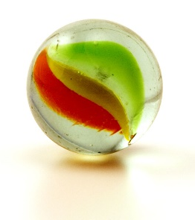
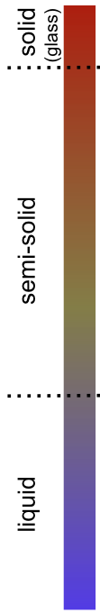
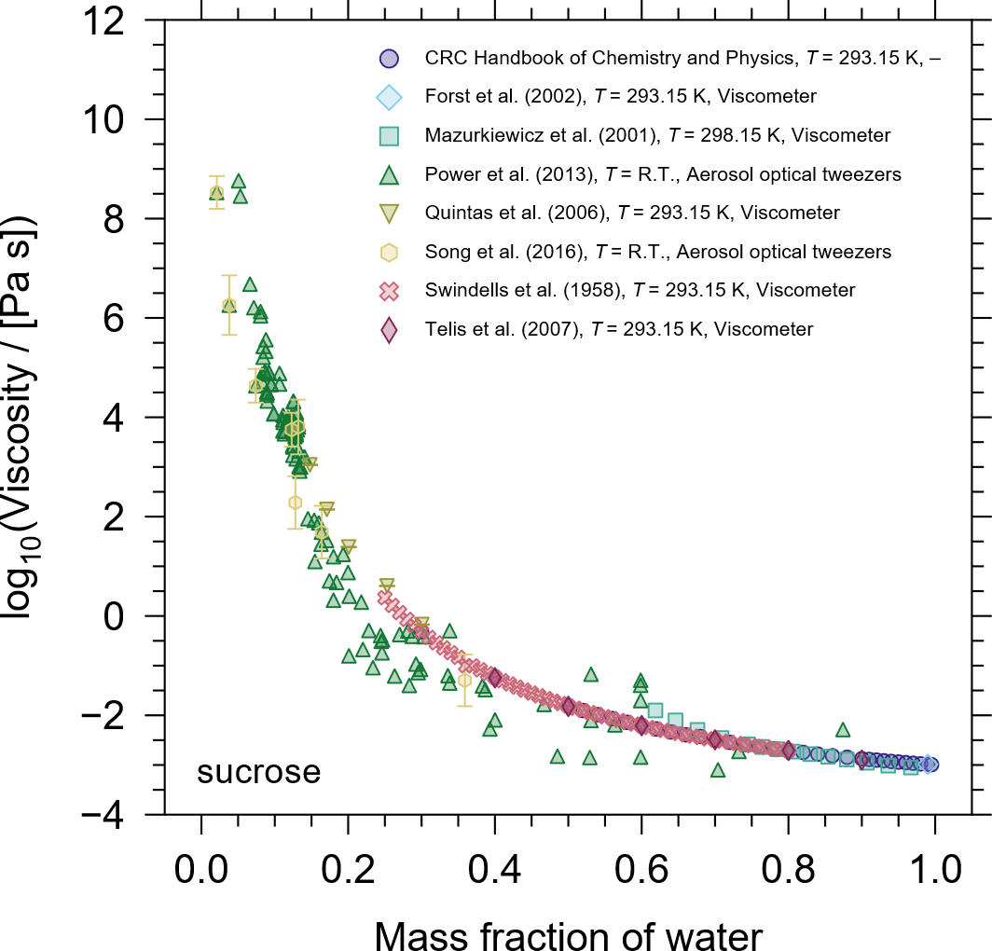
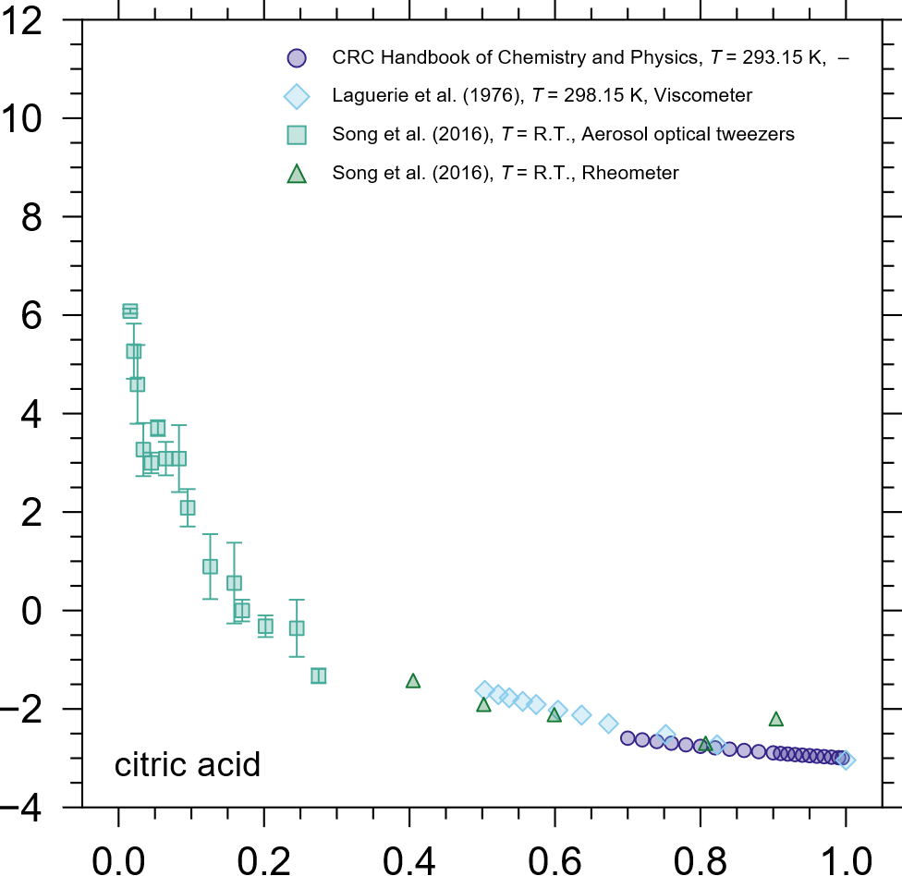
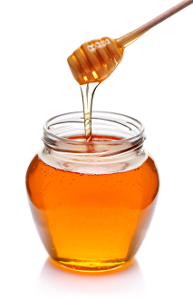
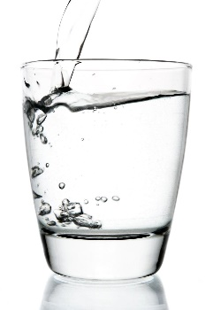
Motivation – Mixture viscosity depends on water content
Mass fraction of water
Mass fraction of water
[Gervasi et al., 2019, ACPD]

Slide 3
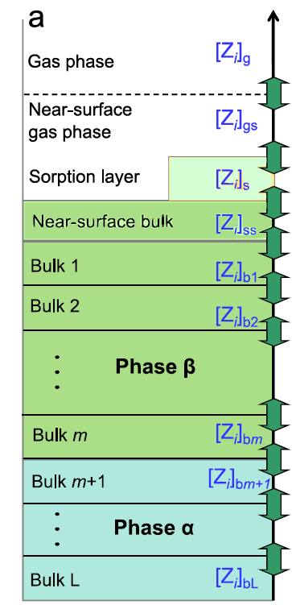

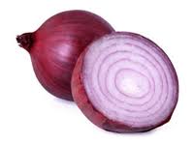
Motivation – Particle phase viscosity may affect mass transfer
Effects of mass transfer limitations in semi-solid or amorphous solid phases.
Impact on interpretation / modeling / measurements
Is equilibrium reached within the time period of interest?
In the atmosphere, depending on T, RH
During sample processing (e.g. drying)
and within instruments (e.g. HTDMA)
KM-GAP:
Kinetic Multilayer Gas–Aerosol Partitioning model. (Shiraiwa et al.)

Slide 4
Design of a predictive viscosity model
Our design goals:
Target organic-rich aerosol phases
Aim for reasonable performance in the semi-solid to glassy viscosity range
(~ 10¹ to 10¹² Pa s dynamic viscosity)
Capture the effects of temperature and water content
Assumptions & features:
Newtonian fluid (assuming no shear-stress dependence)
Thermodynamics-based, local-composition group-contribution model
(for dealing with many & unknown compounds)
→ similar to UNIFAC / AIOMFAC models for activity coefficients
→ computationally cheap
Based on GC-UNIMOD (Cao et al. 1993) model
→ modified because of weaknesses of Cao et al. model at high viscosity
[Gervasi et al., 2019, ACPD]

Slide 5
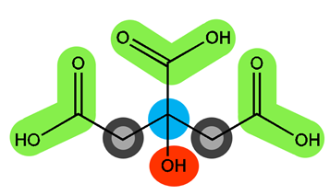
GC-UNIMOD vs. AIOMFAC-VISC mixture viscosity models
Common group-contribution approach:
Accounting for: shape (vol., surface area) & inter-group forces
GC-UNIMOD (Cao et al., 1993):
AIOMFAC-VISC
(UNIFAC combinatorial activity)
with
with
k, m = (sub)groups of molecule i
[Cao et al., 1993, Ind. Eng. Chem. Res.]
[Gervasi et al., 2019, ACPD]

Slide 6
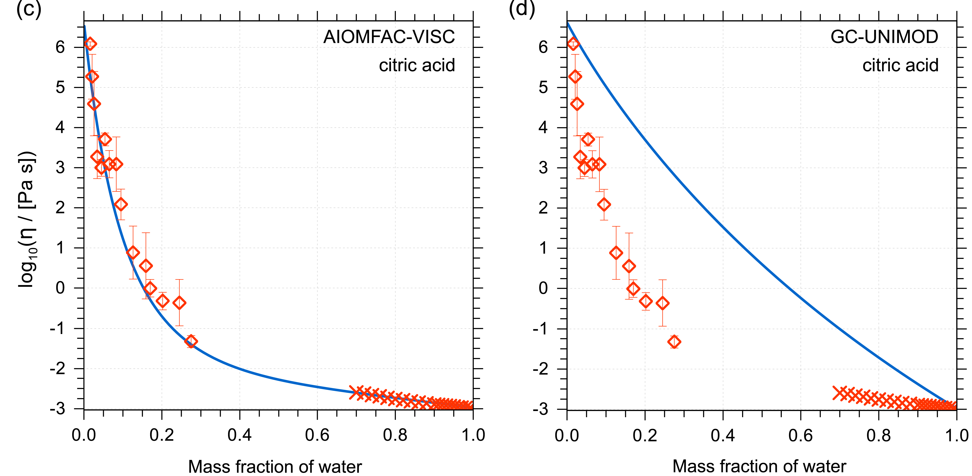
GC-UNIMOD vs. AIOMFAC-VISC mixture viscosity predictions
Binary water + citric acid mixtures at 293 K
Here: main prediction differences due to difference in combinatorial mixture viscosity contribution
[Gervasi et al., 2019, ACPD]

Slide 7
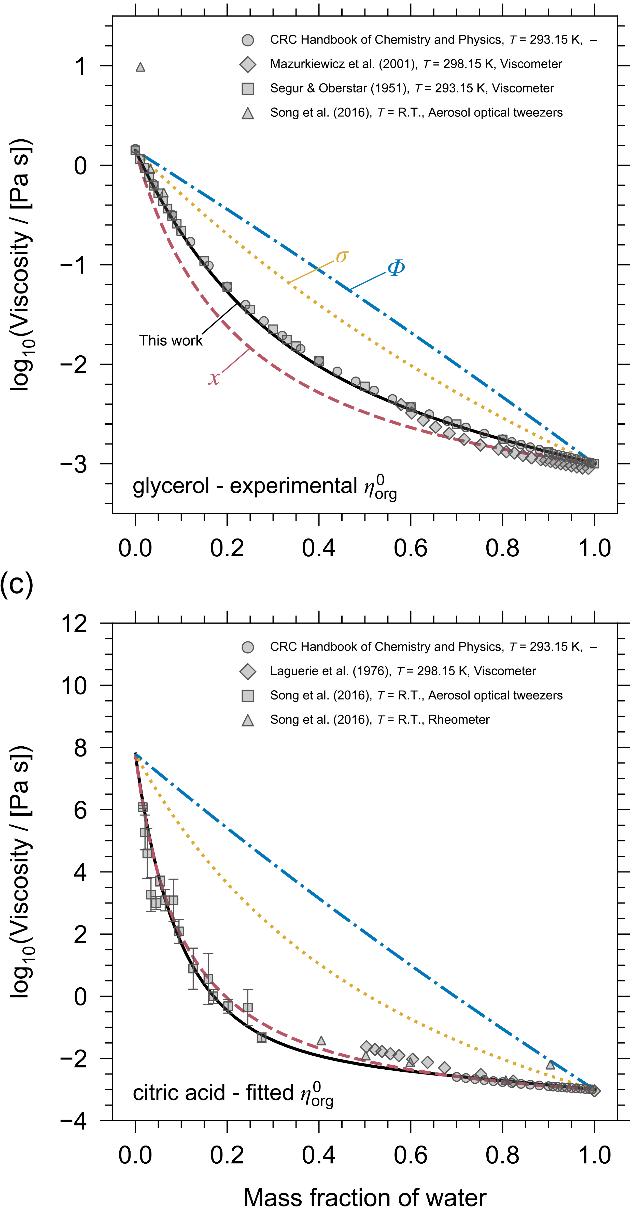
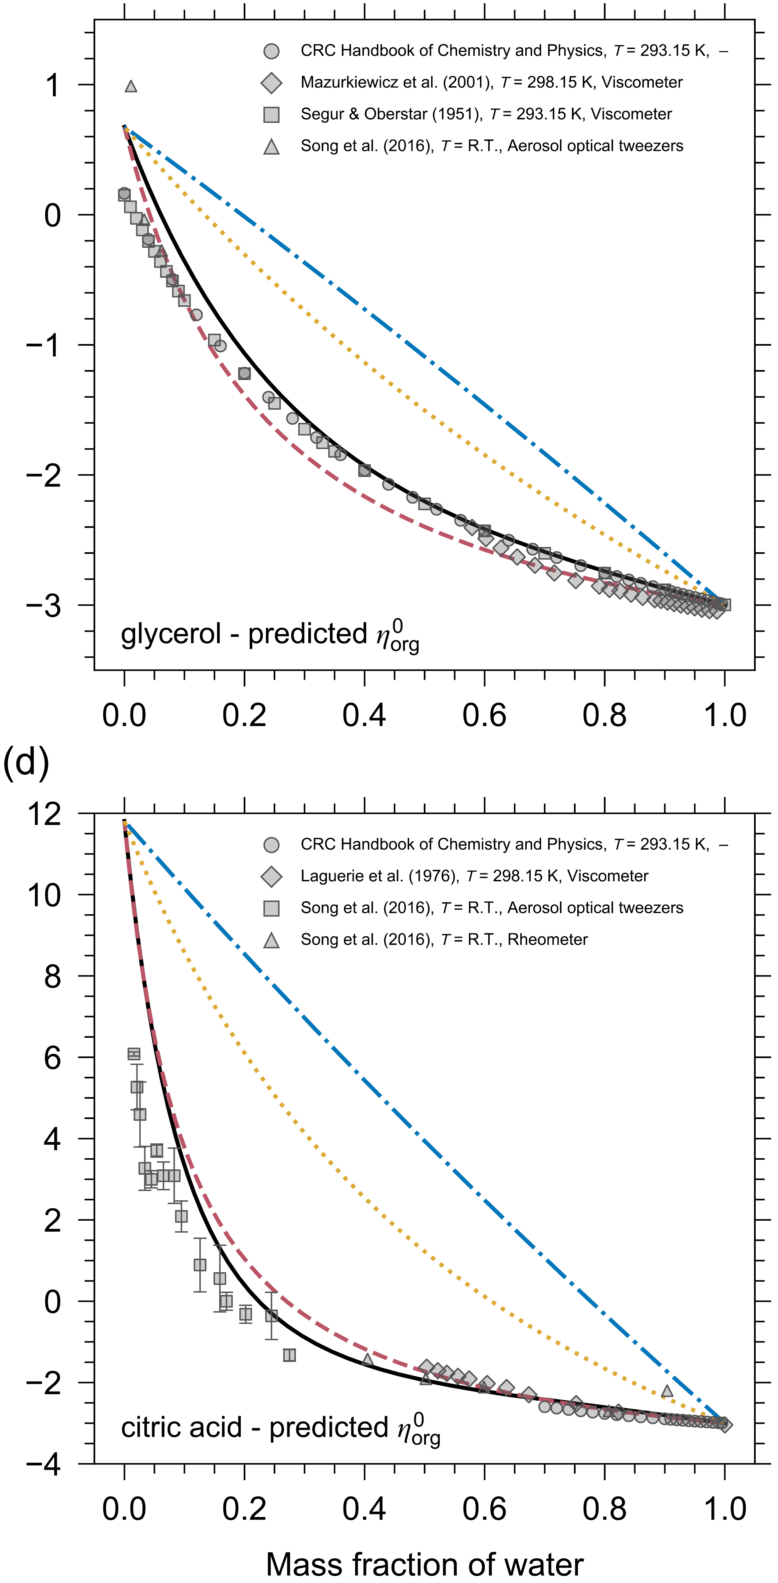
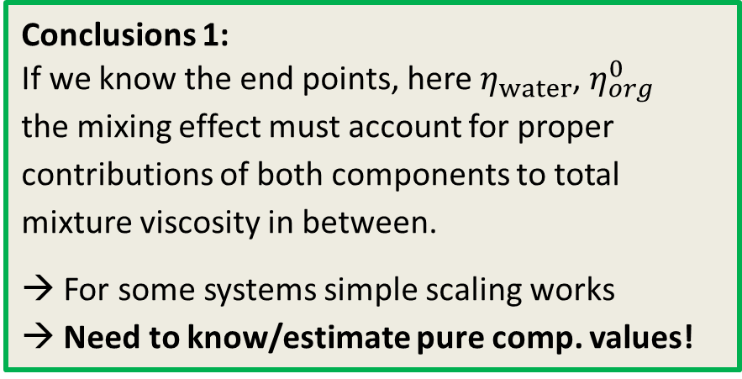



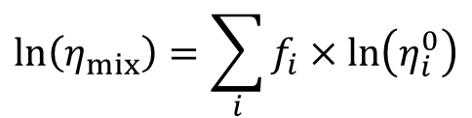
Comparison to simple mixing rules
Linear mixing of log[pure comp. viscosity]
full AIOMFAC-VISC prediction
$$\ln\left(η_{mix}\right)=\sum_{i}{f_{i}×\ln\left(η_{i}^{0}\right)}$$
$f_{i}$= surface area fraction (σ_{i})
or
$f_{i}$= volume fraction (Ф_{i})
or
$f_{i}$= mole fraction (x_{i})
Conclusions 1:
If we know the end points, here $η_{water}$, $η_{org}^{0}$
the mixing effect must account for proper contributions of both components to total mixture viscosity in between.
→ For some systems simple scaling works
→ Need to know/estimate pure comp. values!
[Gervasi et al., 2019, ACPD]

Slide 8
Comparison to simple mixing rules
Linear mixing of log[pure comp. viscosity]
full AIOMFAC-VISC prediction
$$\ln\left(η_{mix}\right)=\sum_{i}{f_{i}×\ln\left(η_{i}^{0}\right)}$$
$f_{i}$= surface area fraction (σ_{i})
or
$f_{i}$= volume fraction (Ф_{i})
or
$f_{i}$= mole fraction (x_{i})
Conclusions 2:
The combinatorial activity is a combination of mole fraction, surface area and volume contribution scaling…
[Gervasi et al., 2019, ACPD]

Slide 9
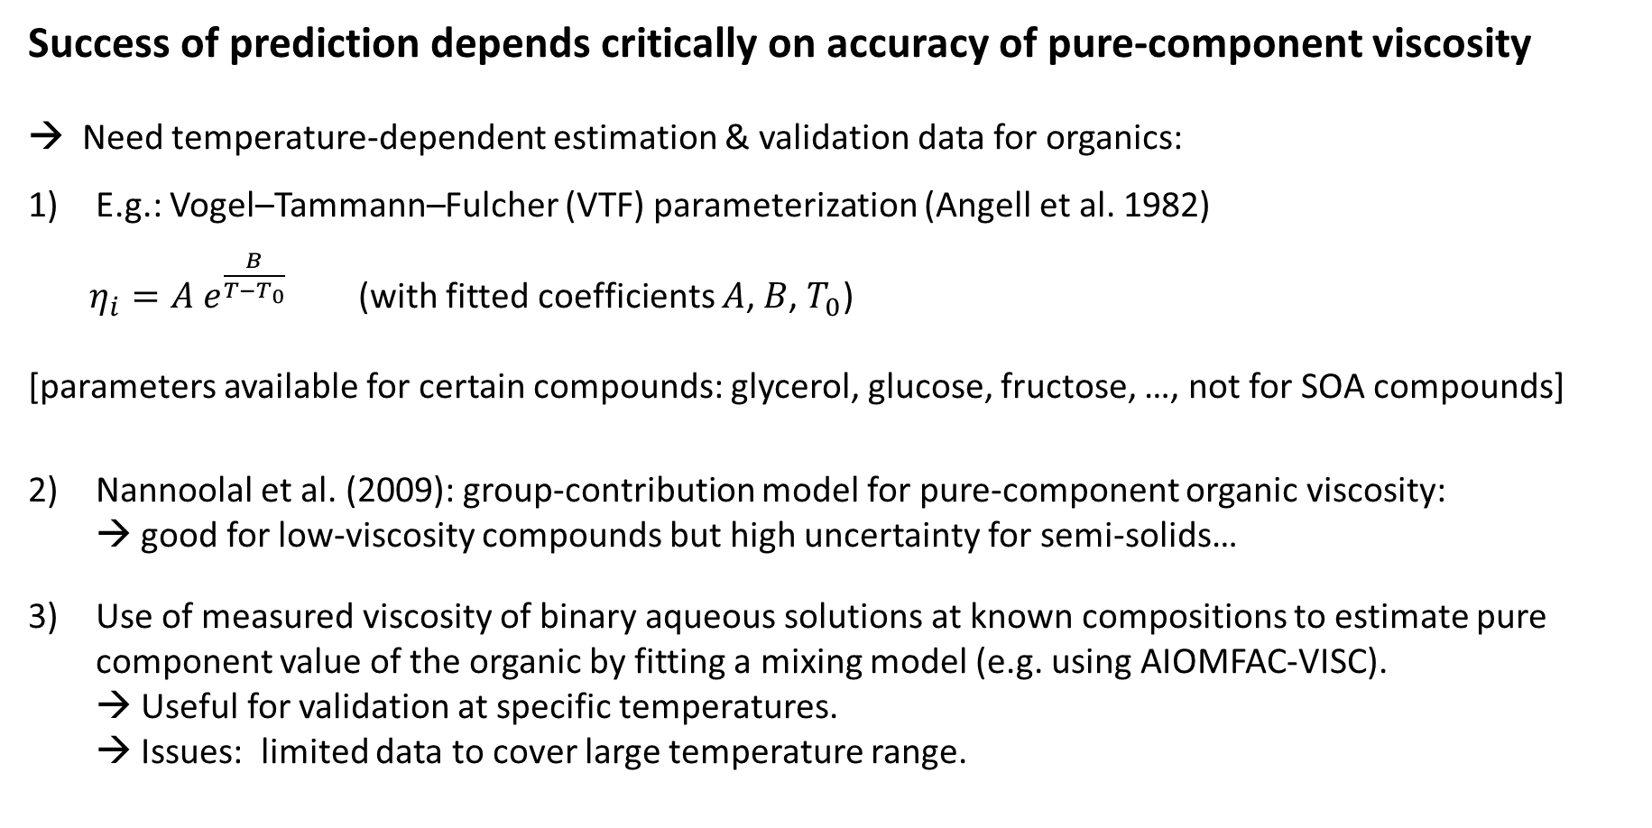
Estimating T-dependent pure-component viscosity (1)
Success of prediction depends critically on accuracy of pure-component viscosity
→ Need temperature-dependent estimation & validation data for organics:
E.g.: Vogel–Tammann–Fulcher (VTF) parameterization (Angell et al. 1982)
$η_{i}=A e^{\frac{B}{T−T_{0}}}$ (with fitted coefficients $A$, $B$, $T_{0}$)
[parameters available for certain compounds: glycerol, glucose, fructose, …, not for SOA compounds]
Nannoolal et al. (2009): group-contribution model for pure-component organic viscosity:
→ good for low-viscosity compounds but high uncertainty for semi-solids…
Use of measured viscosity of binary aqueous solutions at known compositions to estimate pure component value of the organic by fitting a mixing model (e.g. using AIOMFAC-VISC).
→ Useful for validation at specific temperatures.
→ Issues: limited data to cover large temperature range.

Slide 10
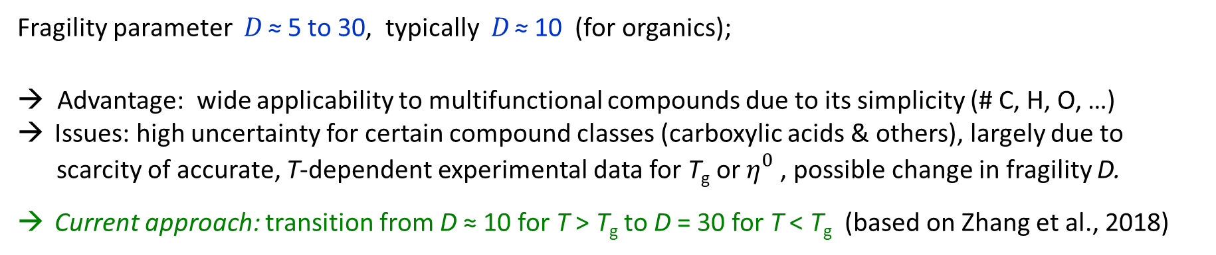
Estimating T-dependent pure-component viscosity (2)
Estimation using glass transition temperature prediction by DeRieux et al. (2018), Angell (1991):
Fragility parameter D ≈ 5 to 30, typically D ≈ 10 (for organics);
→ Advantage: wide applicability to multifunctional compounds due to its simplicity (# C, H, O, …)
Issues: high uncertainty for certain compound classes (carboxylic acids & others), largely due to scarcity of accurate, T-dependent experimental data for T_{g} or $η_{}^{0}$, possible change in fragility D.
Current approach: transition from D ≈ 10 for T > T_{g} to D = 30 for T < T_{g} (based on Zhang et al., 2018)
[DeRieux et al., 2018]

Slide 11
Mixture viscosity model framework
Alternatively: use pure-comp. viscosity from experiments or calculated by different approach
(future improvements)
[Gervasi et al., 2019, ACPD]

Slide 12
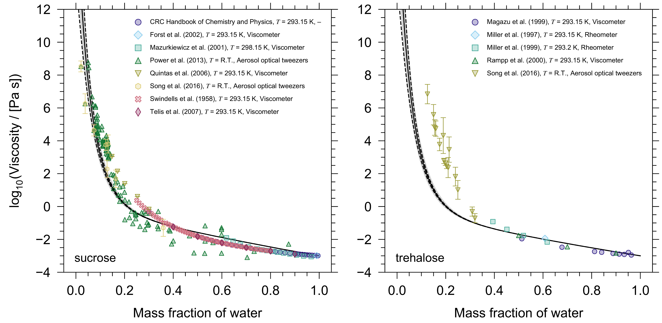
Results 1: predictions for binary systems
C₁₂H₂₂O₁₁
C₁₂H₂₂O₁₁
[Gervasi et al., 2019, ACPD]

Slide 13
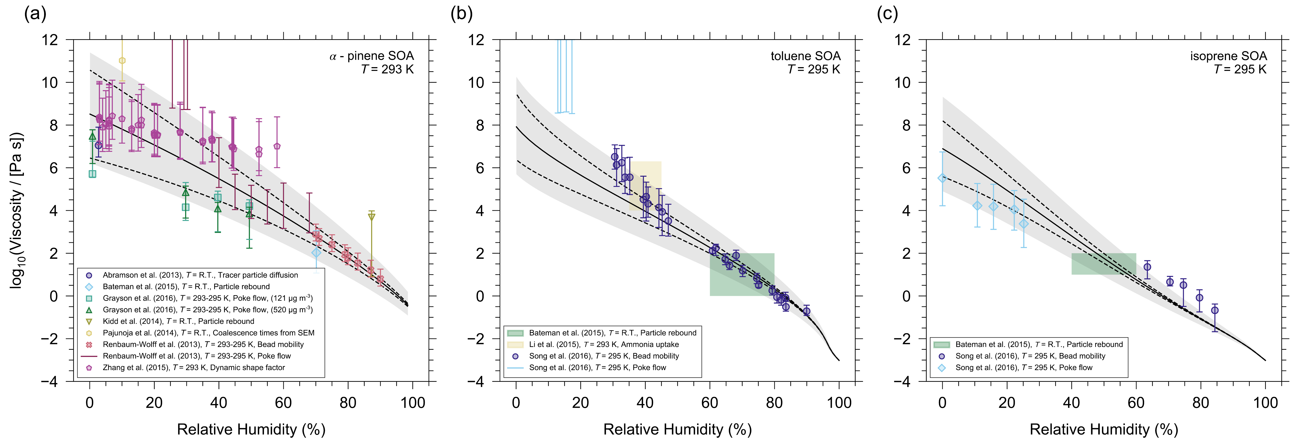
Results 2: predictions for multicomponent SOA systems
5 % uncertainty in T_{g} of pure components
±2 % uncertainty in mass fraction of water
Using MCM-derived SOA model components and AIOMFAC-based gas–particle partitioning
[Gervasi et al., 2019, ACPD]

Slide 14
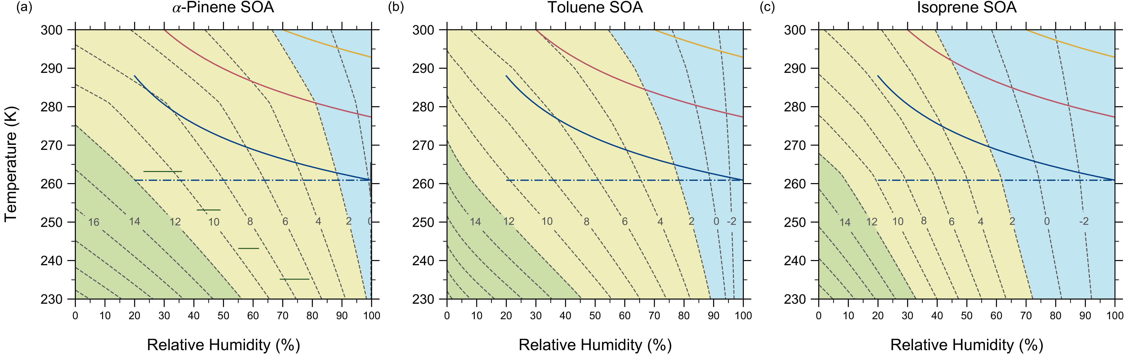
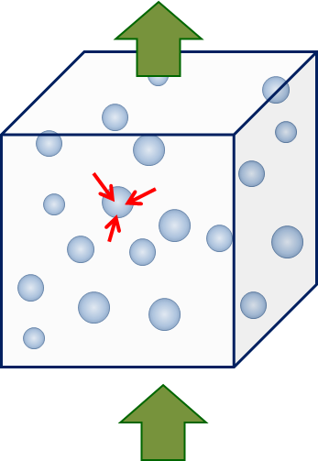

Results 3: T vs. RH effect in adiabatically rising air parcel
$$\log_{10}\left(\frac{η_{mix}}{[Pa s]}\right)$$
[Gervasi et al., 2019, ACPD]

Slide 15

Summary & Conclusions
AIOMFAC-VISC: mixing model for (aqueous) organic aerosol viscosity prediction.
Mixing model works well for many systems when pure component viscosities are well constrained.
Improvements in pure component viscosity prediction methods and underlying experimental data base identified as important for overall model improvements in future.
Applications in combination with thermodynamic equilibrium predictions of aerosol phase composition.
Future applications: implementation into kinetic mass transfer models (viscosity-related diffusivity predictions).
Run it online: https://aiomfac.lab.mcgill.ca

Slide 16


Acknowledgements
Funding Support
Natural Sciences and Engineering Research Council of Canada
(NSERC)
Fonds de recherche du Québec – Nature et technologies (FRQNT)
References
AIOMFAC-VISC
Gervasi, Topping & Zuend (2019): A predictive group-contribution model for the viscosity of aqueous organic aerosol, Atmos. Chem. Phys. Discuss., in review.
https://aiomfac.lab.mcgill.ca
Contact
Andi Zuend: andreas.zuend@mcgill.ca

Slide 18
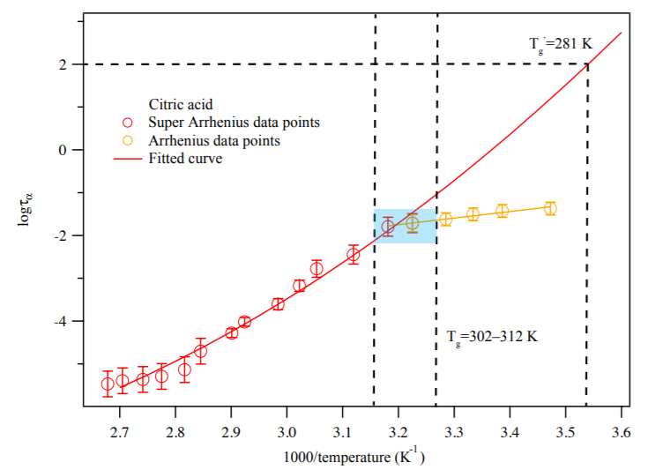

Estimating T-dependent pure-component viscosity (3)
  Novikov and Sokolov (2003), Mallamace et al. (2010) & others:
  experimental evidence for fragile-to-strong crossover (FTC) in glass formers within T_{g} < T_{FTC} < T_{melting}
  Zhang et al. (2018): Broadband dielectric spectroscopy of organic thin films
Relaxation time = 100 s
Which T_{g} temperature?
Differential Scanning Calorimetry w/ a cooling rate of 10 K/min:
Relaxation time
D ≈ 30
D < 30
[Zhang et al., 2018]

