Slide 1


IAMA Conference, UC Davis
12/4/2019
Impacts of phase state on
multiphase reactivity and partitioning of secondary organic aerosols
Manabu Shiraiwa
Department of Chemistry
University of California, Irvine
m.shiraiwa@uci.edu

Slide 2
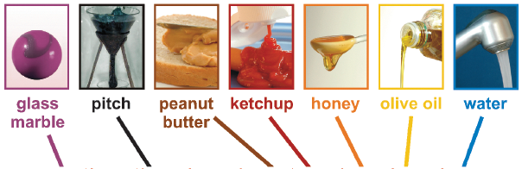
SOA can adopt semi-solid state (highly viscous or glassy)
Zobrist, 2008; Virtanen 2010; Vaden 2011; Perraud 2012; Bones2012; Cappa & Wilson 2012; Wang, Knopf 2012; Kuwata & Martin, 2012; Renbaum-Wolff 2013; Zhou 2013; Wang, Laskin 2015; Davies 2015; Hosny 2016; Rothfuss & Petters 2017; Reid 2018; Zaveri 2018; Zhang 2018; Slade 2019
& many more…
solid
semi-solid
liquid
glass
rubber
gel
oil
water
1 yr
1 s
Characteristic Time: τ_{diff} = d_{p}² / (4 π² D_{b})
Shiraiwa et al., PNAS 2011; Koop et al., PCCP, 2011

Slide 3
Atmospheric Implications
Shiraiwa et al., Nature Commun., 2017

Slide 4
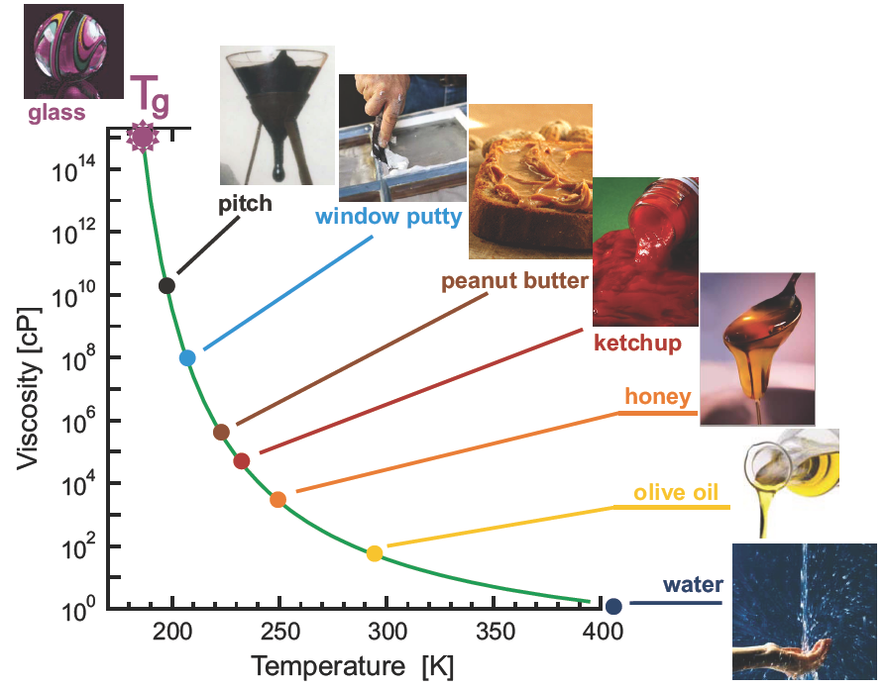
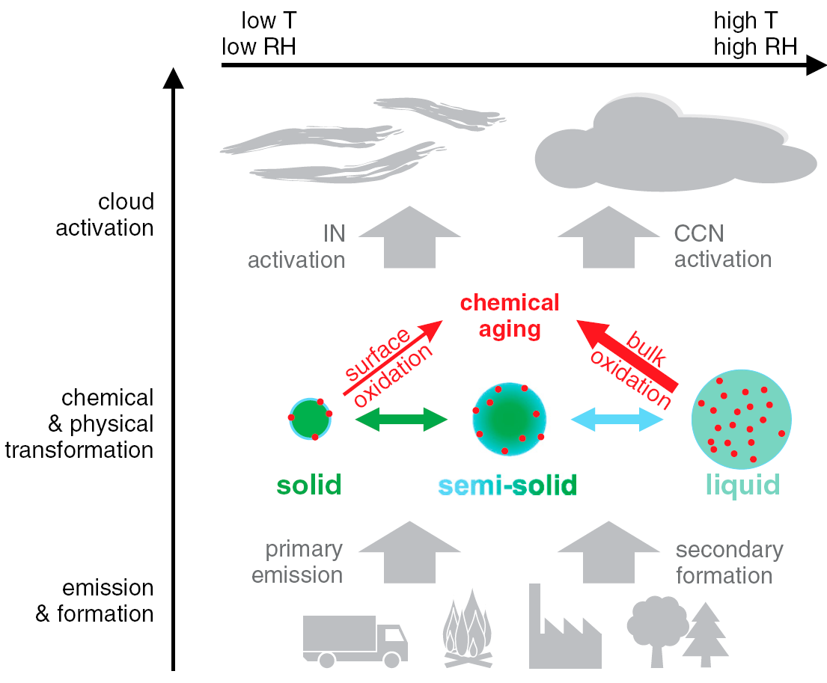
Prediction method: Glass Transition Temperature (T_{g})
T_{g}
Koop et al., PCCP, 2011
T_{ambient}<T_{g}
T_{ambient}>=T_{g}

Slide 5
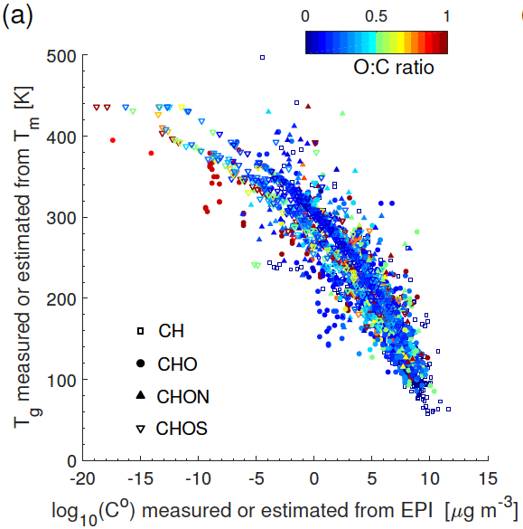

Parameterization of T_{g} by Elemental Composition
Shiraiwa, Li et al., Nature Commun., 2017; DeRieux, Li et al., Atmos. Chem. Phys., 2018
T_{g} =A+BlogC₀+ClogC₀²+D (O:C) logC₀
Li et al., to be submitted

Slide 6


Viscosity Estimation using HR-MS data of diesel SOA
HR-MS by Sergey Nizkorodov & Alex Laskin
Viscosity by the Allan Bertram group
Molecular composition
Prediction of T_{g} of each species
Gordon-Taylor equation to estimate T_{g} of dry SOA
Estimation of T_{g} of SOA with water by considering hygroscopic growth (κ = 0.2), the Gordon-Taylor rule (k_{GT} = 2.5)
Estimation of viscosity using the Angell plot of viscosity vs. T_{g}/T
Song et al., ACP, 2019

Slide 7
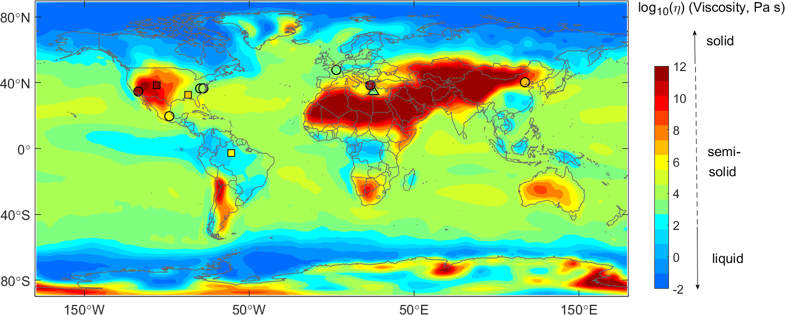
Global distribution of SOA Viscosity
Global model EMAC-ORACLE (Tsimpidi et al.): VBS with Tg/viscosity prediction method
Shiraiwa et al., Nature Commun., 2017
Consistent with field observations:
Liquid in Amazon (Bateman et al., 2015), Beijing (Liu et al., 2017)
Semisolid in Chile, Mexico, California (O’Brien et al., 2014)
Solid in Finland (Virtanen et al., 2010)
Stark et al., 2017
Li et al., to be submitted

Slide 8
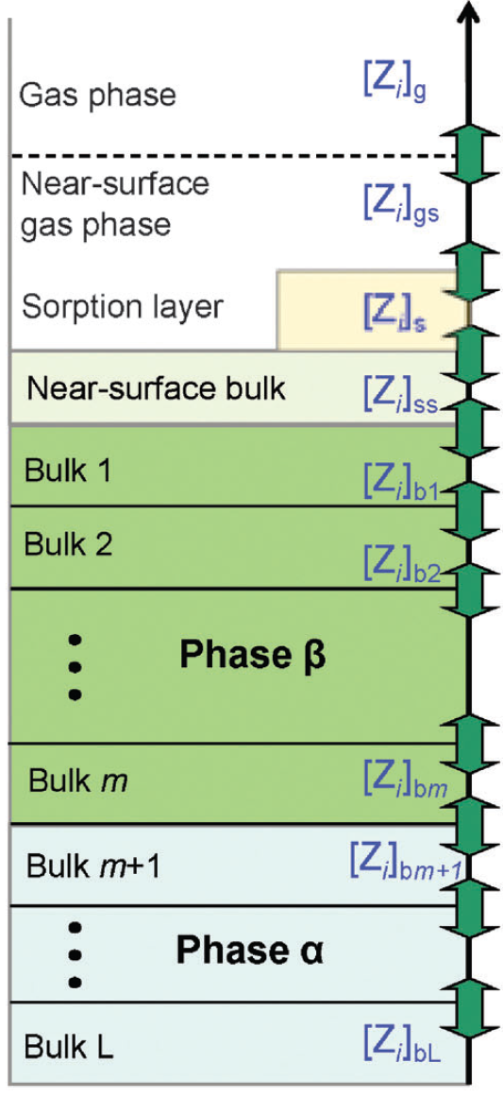
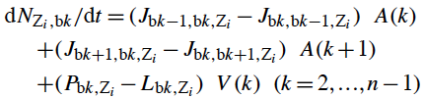


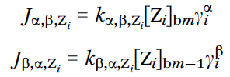
Kinetic multi-layer model (KM-GAP)
Coupled mass balance & rate equations
for every species & every layer
Component activity coefficients & mole fractions at equilibrium given by AIOMFAC (Zuend et al., 2012)
KM-GAP - Kinetic Multi-Layer Model of Gas-Particle Interactions:
surface & bulk transport & reaction for transient conditions & multiple species
Shiraiwa et al., ACP, 2010; 2012; PCCP, 2013

Slide 9
Kinetic Modeling (KM-GAP) of SOA Partitioning
τ_{eq} of LVOCs into highly viscous particles could be shorter compared to SVOCs
Li & Shiraiwa, ACP, 2019

Slide 10
Impacts of Volatility & Viscosity on SOA Partitioning
condensation in the closed system
evaporation in the open system
e.g., Liu et al., PNAS, 2016
Strong dependence of τ_{eq} on volatility & viscosity and different behaviors for condensation vs. evaporation and open vs. closed systems.
Li & Shiraiwa, ACP, 2019

Slide 11
Equilibration timescales under low temperatures
τ_{eq} is mostly on the order of seconds or minutes in the boundary layer, but it can be longer than hours or days in the free troposphere
Li & Shiraiwa, ACP, 2019

Slide 12
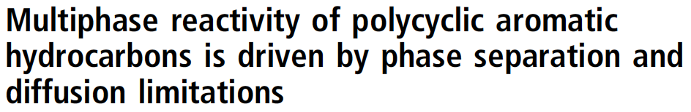
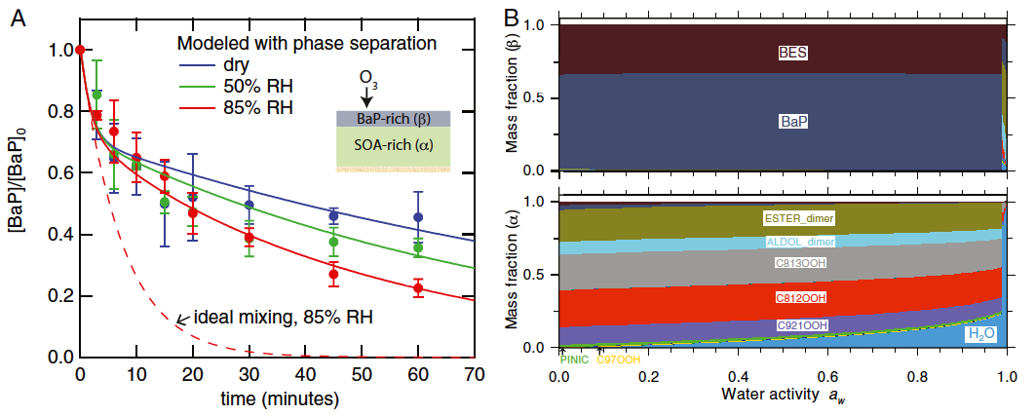
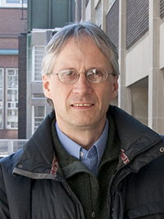

Zhou, Hwang, Lakey, Zuend, Abbatt & Shiraiwa, PNAS, 2019

Slide 13

Ozonolysis of PAH in oil
O₃
O₃
surface crust formation limits bulk diffusion
bulk diffusion
Thermodynamic model (AIOMFAC; A. Zuend) reveals that BaP is miscible in oil, but ozonolysis products of BaP would be phase separated.
Zhou, Hwang, Lakey, Zuend, Abbatt & Shiraiwa, PNAS, 2019

Slide 14
Amine Uptake by
AS-sucrose Particles
Exp. by Chak Chan
AIOMFAC (A. Zuend) predicts phase separation at RH < 94%
DMA uptake is limited by diffusion of DMA and AS through a viscous sucrose-rich shell at lower RH
DeRieux et al., ACS ESC, 2019

Slide 15
Organic Nitrate Partitioning in ⍺-pinene SOA
A plasticizing effect upon ON incorporation
A crusting effect upon desorption causing decreases in diffusion coefficients in the upper layers.
Vander Wall, …, Shiraiwa, Finlayson-Pitts, ESPI, 2018

Slide 16
Summary and Conclusions
We developed a method to predict glass transition temperatures and viscosity of SOA based on molecular composition, O:C and vapor pressures.
Equilibration timescales of SOA partitioning can be very short under low T, requiring kinetic treatments of SOA processes in aerosol models.
Multiphase reactivity and gas uptake are controlled by the interplay of phase separation and kinetic limitations of bulk diffusion.
Shiraiwa, Li et al., Nat Commun., 2017; DeRieux, Li et al., ACP, 2018
Li et al., to be submitted.
Li & Shiraiwa, ACP, 2019
Zhou, Hwang et al., PNAS, 2019; DeRieux et al., ACS-ESC, 2019
Vander Wall et al., ESPI, 2018

Slide 17



Acknowledgements
NSF-AGS
Department of Energy
Alfred P. Sloan Foundation
Postdoc:
Ying Li
Pascale Lakey
Ting Fang
Tommaso Galeazzo
Student:
Wing-Sy DeRieux
Brian Hwang
Jinlai Wei
Collaborators: Andi Zuend (McGill), Sergey Nizkorodov, Jim Smith, Barbara Finlayson-Pitts (UCI) , Jos Lelieveld, Ulrich Pöschl (MPI), Thomas Koop (Bielefeld), Jon Abbatt (Toronto), Alex Laskin (Purdue), Allan Bertram (UBC), Chak Chan (HK City U.)

Slide 19
Fractional Stokes-Einstein Equation
Stokes-Einstein
Erin Evoy et al., ACP, 2019
Fractional SE
D = (1 / η)^{ξ}
ξ = 0.93
Bulk diffusion timescale
(200 nm particle)

Slide 20
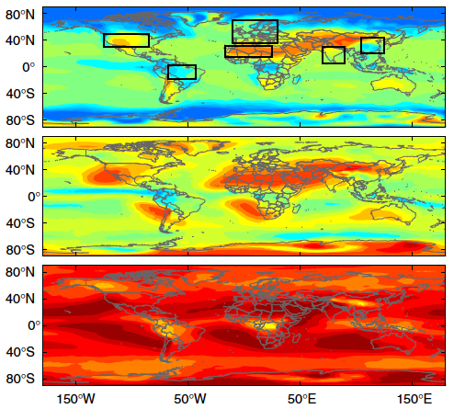
Phase state of SOA in the global atmosphere
Tg prediction method combined with a global model EMAC-ORACLE
Surface
850 hPa
Consistent with field observations:
Liquid in Amazon (Bateman et al., 2015), Beijing (Liu et al., 2017)
Semisolid in Chile, Mexico, California (O’Brien et al., GRL, 2014)
Solid in Finland (Virtanen et al., Nature, 2010)
500 hPa
Shiraiwa et al., Nature Commun., 2017

Slide 21
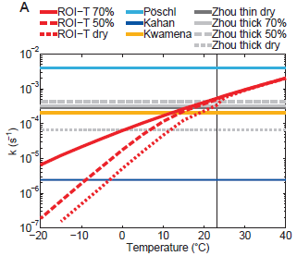
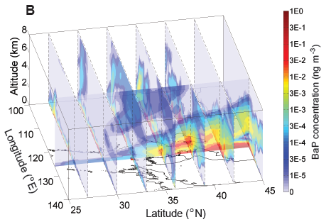
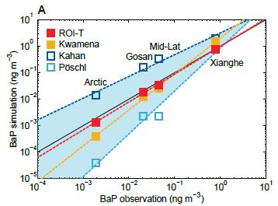
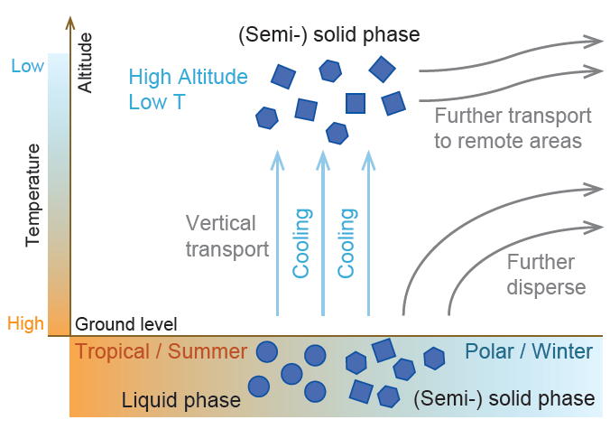
Long-range Transport of PAH
WRF-Chem
Mu, Shiraiwa et al., Science Adv., 2018

