Slide 1
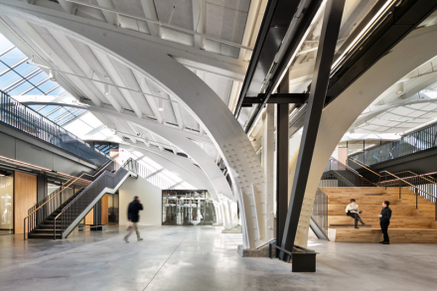
Modelling indoor ultrafine particle dynamics
International Aerosol Modeling Algorithms Conference
Dec. 5, 2019
UC Davis
\
Donghyun Rim, Ph.D.
James L. Henderson Jr. Memorial Assistant Professor
Department of Architectural Engineering
Penn State University

Slide 2
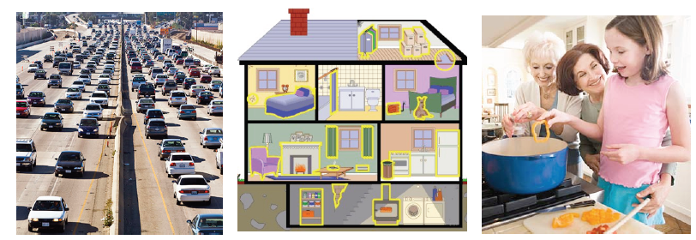
Indoor ultrafine particles (UFP)
UFP sources – time varying exposure
Outdoor
Mobile source emissions (diesel and automobile exhaust),
Natural nucleation bursts (gas-to-particle conversion)
Indoor
Combustion (gas stove, vented gas dryer, candle)
Electric motors (power tools, blenders, hair dryers)
High temperature process (release of SVOCs from heated surfaces)
Chemical reaction (ozone reaction with terpene)
Source: Nazaroff & EPA

Slide 3
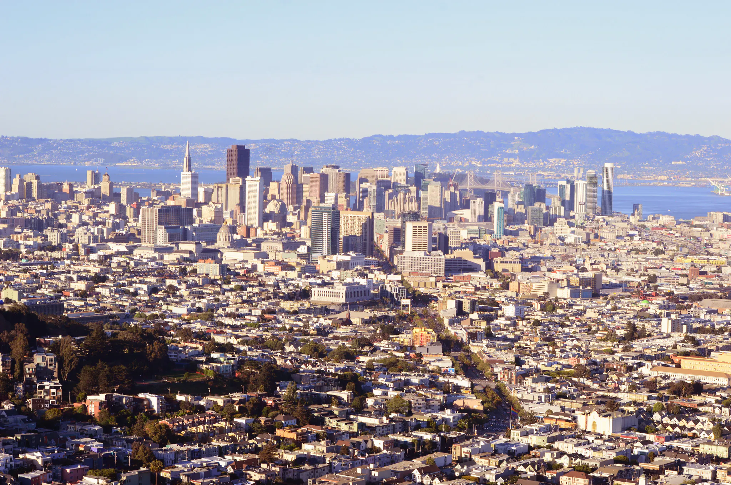
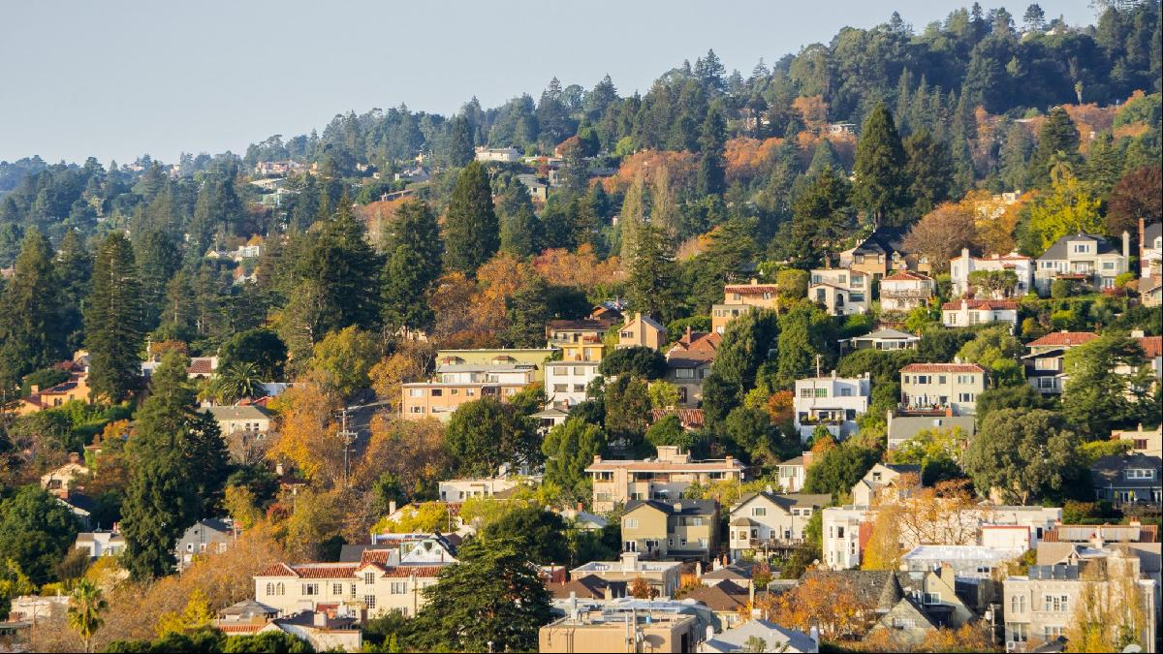
UFP characteristics
Health effects
- Oxidative stress-induced DNA damage (Ceretti, et al. 2014, Braun et al., 2007)
- Neurological diseases (Volk et al. 2014, Allen et al. 2014)
Dynamic characteristics
- Size-dependent behaviors: deposition, penetration, emission (Rim et al. 2016)
- Concentration metrics: mass vs. surface area vs. number
Measurements are valuable, but very limited….
http://cweawaternews.org/sf-bay-water-board-unveils-nutrient-requirements/
https://propertylistings.ft.com/propertynews/california/5863-five-reasons-to-live-in-berkeley-california.html

Slide 4
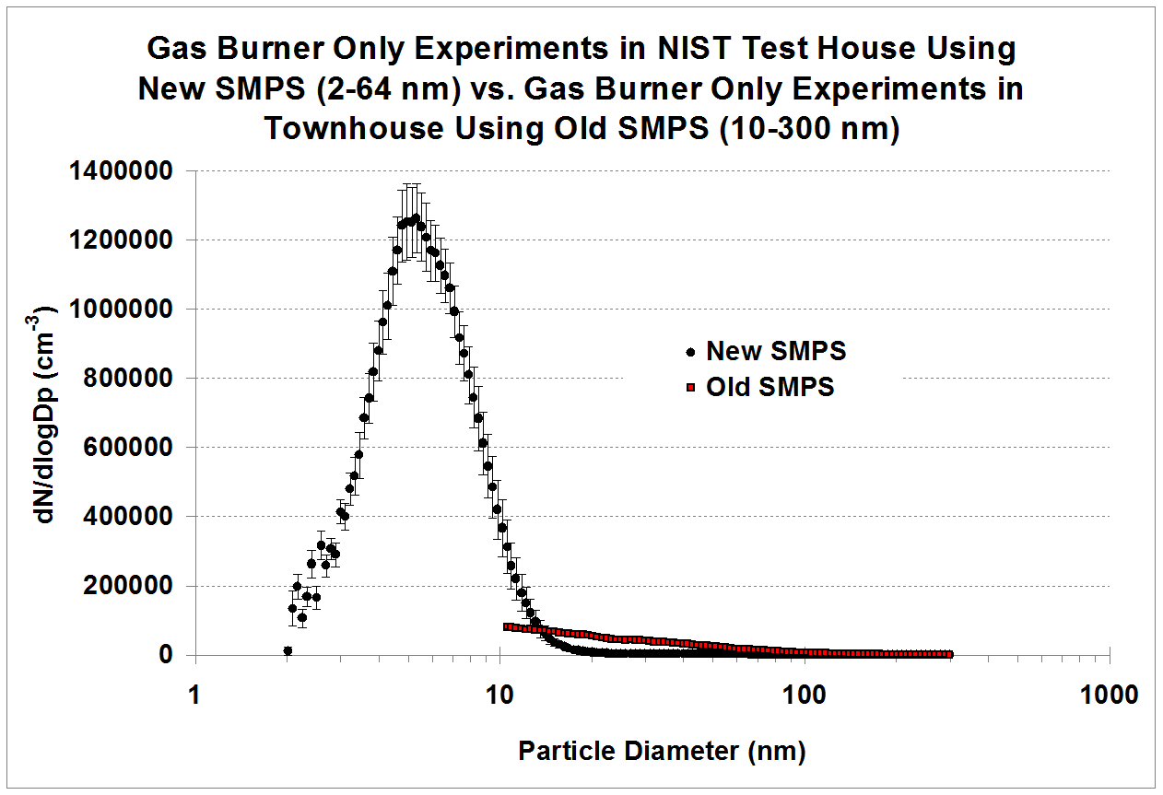
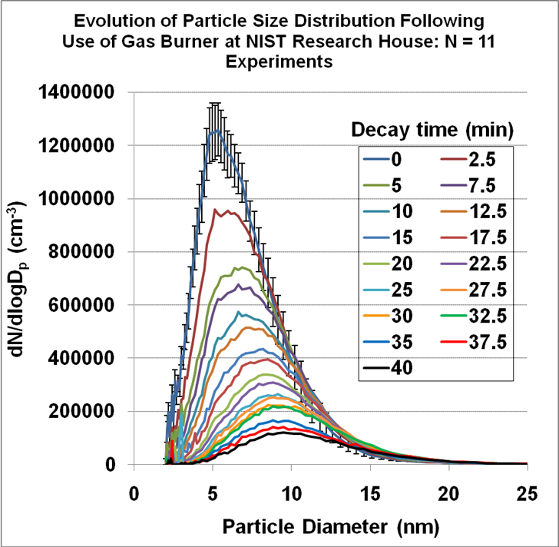
Episodic indoor events
high correlation with toxicity (Cauda et al., 2012)
cardiovascular health risk (Meier et al. 2014)
reactivity and inflammatory response (Schmid and Stoeger, 2016)
Wallace et al.. (2008).. Environmental Science & Technology, 42(23), 8641-8647.
High UFP emission due to combustion
Majority of particles < 10 nm
Indoor personal exposure to UFP
Coagulation
koreajoongangdaily.joins.com

Slide 5
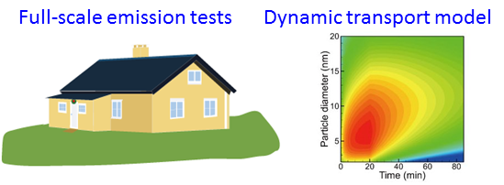
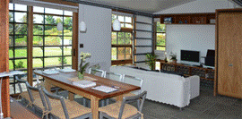
Objectives
Establish framework for an indoor aerosol dynamic model that estimates size-resolved behavior due to
Particle deposition
Coagulation
Ventilation
Nucleation
Condensation/evaporation
Consider indoor activities and building operating conditions

Slide 6
Methods
Use experimental datasets published in the literature
Emission Source | Monitoring duration (min) | Total number concentration at the start of decay (cm⁻³) | Measured particle size range (nm) | Air exchange rate (mean±SD, h⁻¹)
Candle | 73 | 1,100,000 | 2.33 - 63.8 | 0.04 ± 0.01
Gas stove | 178 | 305,000 | 2.17 - 63.8 | 0.14 ± 0.05
Clothes dryer | 85 | 72,000 | 9.83 - 400 | 0.36 ± 0.16
Toast | 75 | 67,000 | 10.57 - 400 | 0.34 ± 0.07
Broiled fish | 145 | 258,000 | 10.57 - 400 | 0.59 ± 0.04
Incense | 155 | 21,000 | 10.57 - 30 | 0.50 ± 0.03
Wallace, L., Jeong, S.G. and Rim, D., Dynamic behavior of indoor ultrafine particles (2.3‐64 nm) due to burning candles in a residence. Indoor Air, 2019 In Press.
Rim, D., Choi, J.I. and Wallace, L.A., Size-resolved source emission rates of indoor ultrafine particles considering coagulation. Environmental science & technology, 2016, 50(18), pp.10031-10038.
Rim, D.; Green, M.; Wallace, L.; Persily, A.; Choi, J. I. Evolution of Ultrafine Particle Size Distributions Following Indoor Episodic Releases: Relative Importance of Coagulation, Deposition and Ventilation. Aerosol. Sci. Tech. 2011, 46 (5), 494-503.
Wallace, L. A. Indoor sources of ultrafine and accumulation mode particles: size distributions size-resolved concentrations and source strengths. Aerosol. Sci. Tech. 2006, 40, 348-360.

Slide 7
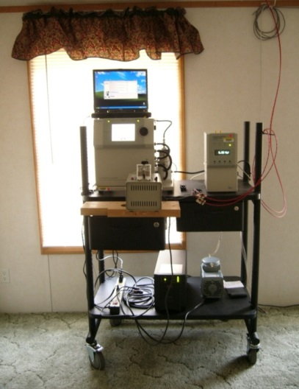
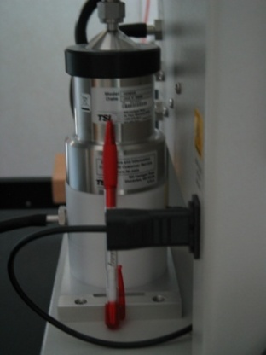
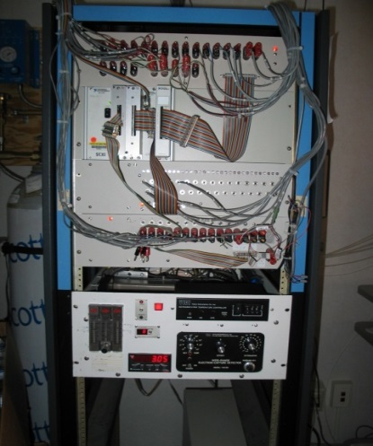
Measurements data in the literature
Measurements of indoor particles and ventilation
Scanning Mobility Particle Sizer (SMPS) System
Nano-DMA
GC-ECD
(Gas Chromatography with Electron Capture Detector) to estimate the air change rates continuously
Wallace, L., Jeong, S.G. and Rim, D., Dynamic behavior of indoor ultrafine particles (2.3‐64 nm) due to burning candles in a residence. Indoor Air, 2019 In Press.
Rim, D., Choi, J.I. and Wallace, L.A., Size-resolved source emission rates of indoor ultrafine particles considering coagulation. Environmental science & technology, 2016, 50(18), pp.10031-10038.
Rim, D.; Green, M.; Wallace, L.; Persily, A.; Choi, J. I. Evolution of Ultrafine Particle Size Distributions Following Indoor Episodic Releases: Relative Importance of Coagulation, Deposition and Ventilation. Aerosol. Sci. Tech. 2011, 46 (5), 494-503.
Wallace, L. A. Indoor sources of ultrafine and accumulation mode particles: size distributions size-resolved concentrations and source strengths. Aerosol. Sci. Tech. 2006, 40, 348-360.

Slide 8
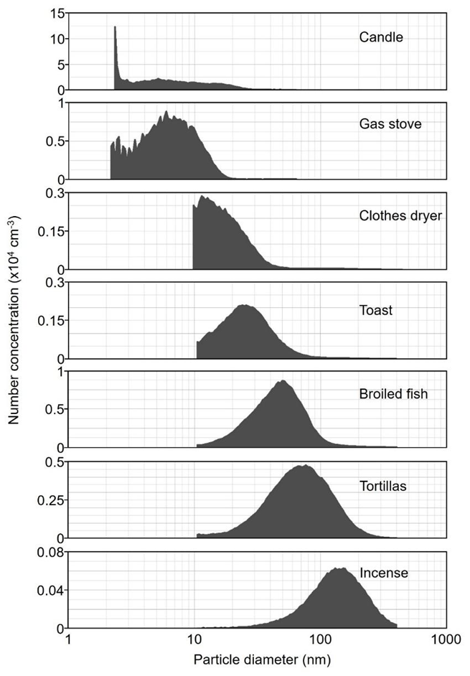
Particle size distributions
Log-normal distribution fitting
$$n_{j}=\frac{N_{T}∆d_{j}}{d_{j}\sqrt{2π}lnσ_{G}}exp\left[−\frac{\ln^{2}\left(d_{j}/{\overline{G}}_{D}\right)}{2\ln^{2}σ_{G}}\right]$$

Slide 9
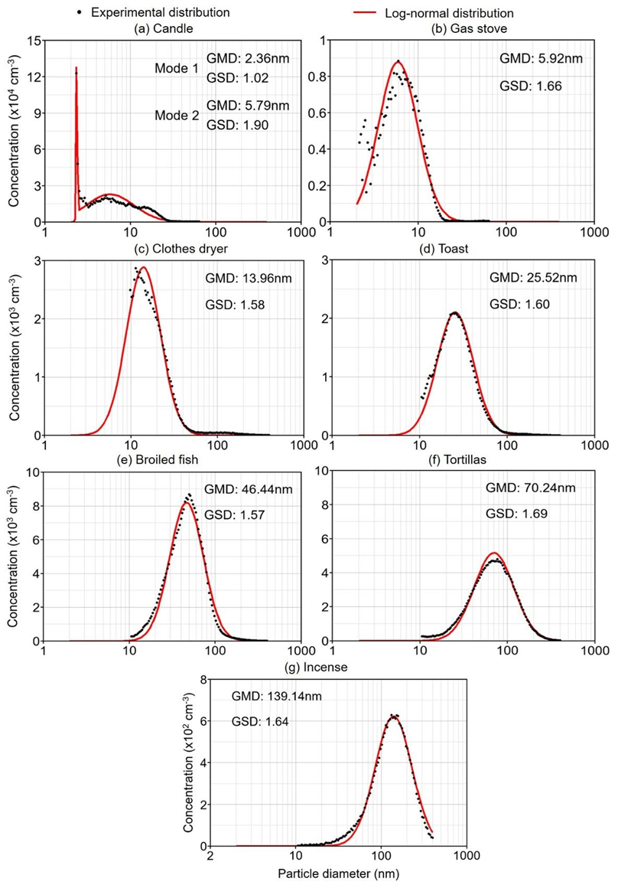
I. Log-normal distribution fitting
$$n_{j}=\frac{N_{T}∆d_{j}}{d_{j}\sqrt{2π}lnσ_{G}}exp\left[−\frac{\ln^{2}\left(d_{j}/{\overline{G}}_{D}\right)}{2\ln^{2}σ_{G}}\right]$$
II. Size and concentration dynamics
1. Ventilation - measured
1st order loss
2. Particle deposition - modeled
1st order loss
3. Coagulation - modeled
2nd order loss & gain

Slide 10
Material balance model
$$\frac{dC\left(v,t\right)}{dt}=\frac{1}{2}\int_{0}^{v}{β_{v−\overline{v},\overline{v}}C(v−\overline{v}},t)C\left(\overline{v},t\right)d\overline{v}−C\left(v,t\right)\int_{0}^{∞}{β_{v,\overline{v}}C\left(\overline{v},t\right)d\overline{v }}+PaC_{o}\left(v,t\right)$$
$−\left(k+a\right)C\left(v,t\right)+S(v,t)/V$
Coagulation Gain
Coagulation Loss Outdoor infiltration
Losses (Deposition+ Ventilation)
Source emission
C$(v,t)$[m⁻³]: the particle number concentration for particle volumes [m³] between $v$ and $v+dv$ at time t [s];
$v−\overline{v}$ and $\overline{v}$: volumes of two coagulating particles;
v: volume of newly coagulated particle;
β: the coagulation kernel (collision kernel);
a: air change rate [h⁻¹]; k: particle deposition rate [h⁻¹];
$V$: an involved volume (the whole house or master bedroom) [m³];
S$\left(v,t\right)$: particle size-resolved emission rate [h⁻¹] between $v$ and $v+dv$ at time t.

Slide 11
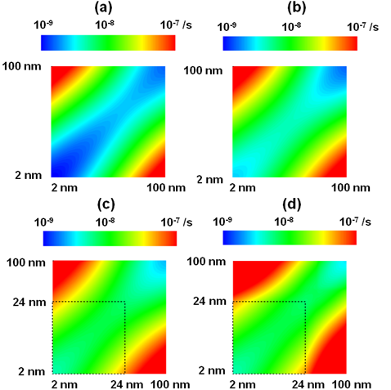
Size-resolved coagulation kernel
Brownian +
Fuch correction
Brownian+ van der Waals with 20k_{B}T
Brownian+ van der Waals with 200k_{B}T
Brownian+ van der Waals with 200k_{B}T + fractal 24nm
Rim, D., Green, M., Wallace, L., Persily, A., & Choi, J. I. (2012). Evolution of ultrafine particle size distributions following indoor episodic releases: relative importance of coagulation, deposition and ventilation. Aerosol Science and Technology, 46(5), 494-503.

Slide 12
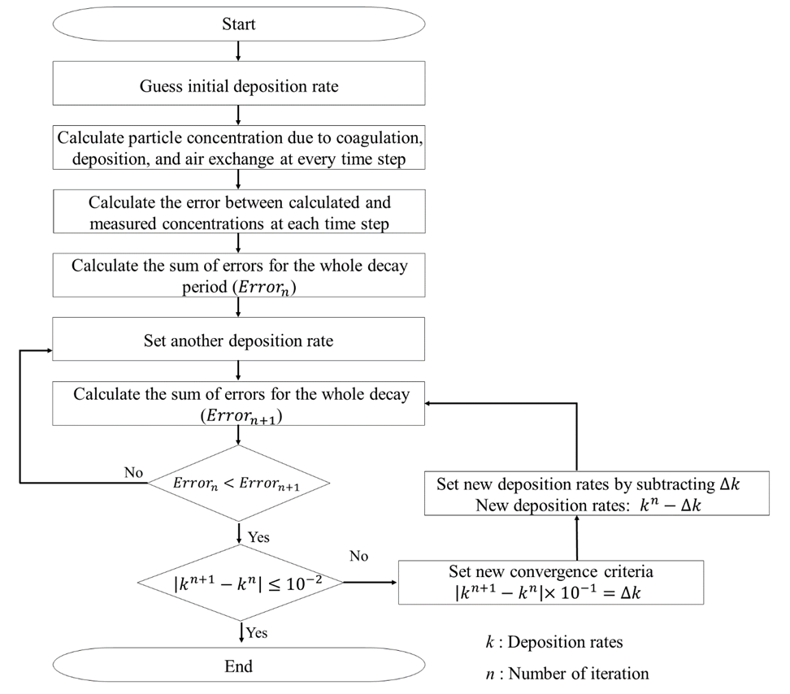
Iterative algorithm
To find size-resolved deposition rates
Wallace, L., Jeong, S. G., & Rim, D. (2019). Dynamic behavior of indoor ultrafine particles (2.3‐64 nm) due to burning candles in a residence. Indoor Air. 29:1018–1027

Slide 13
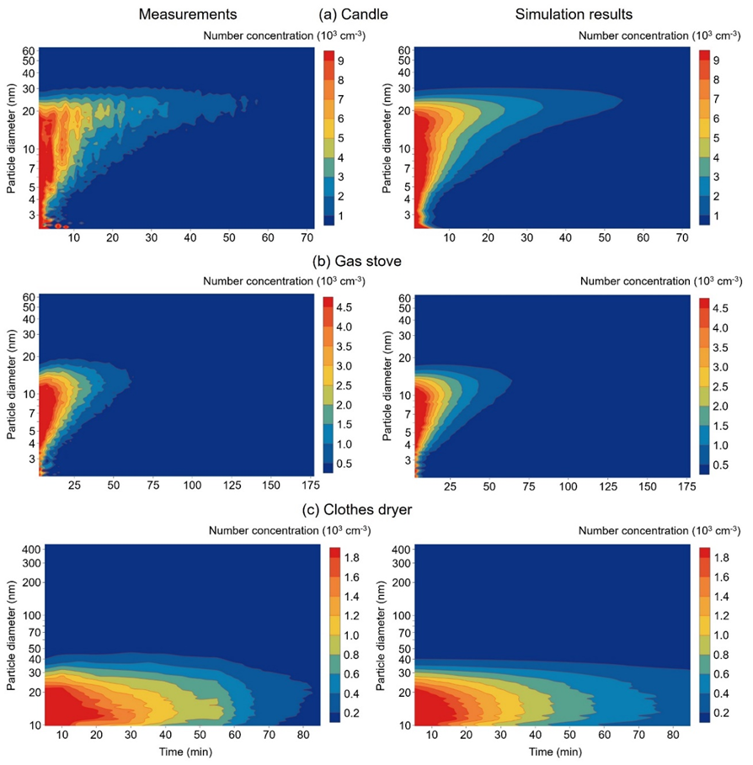
Results: concentration time-series

Slide 14
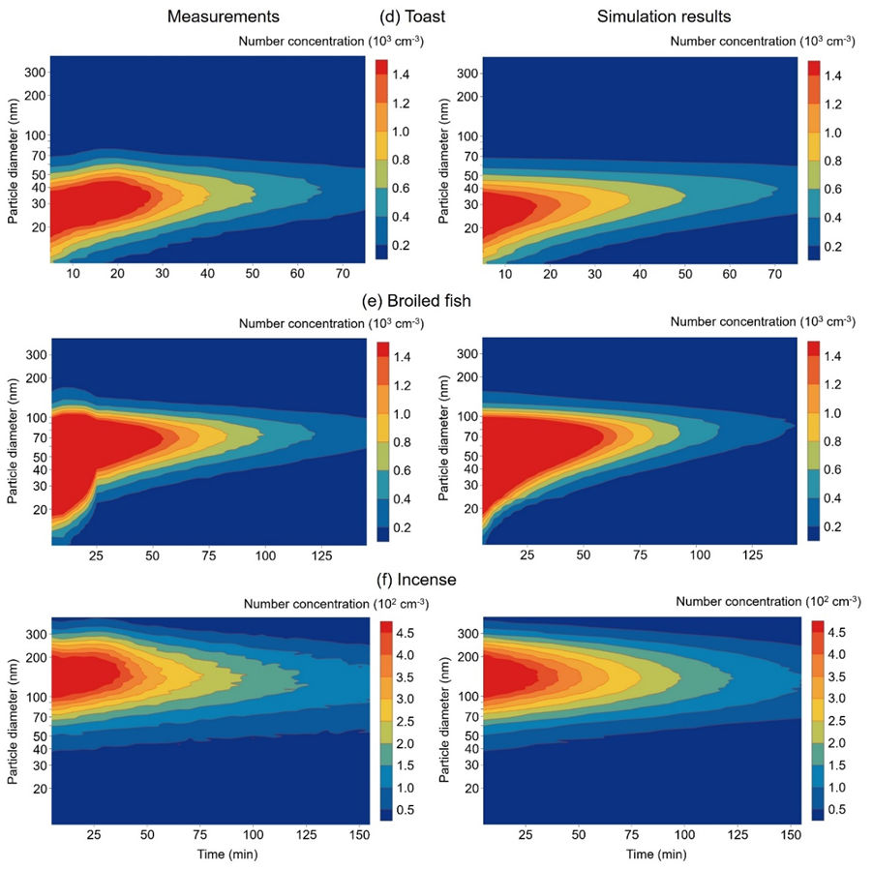
Results: concentration time-series

Slide 15
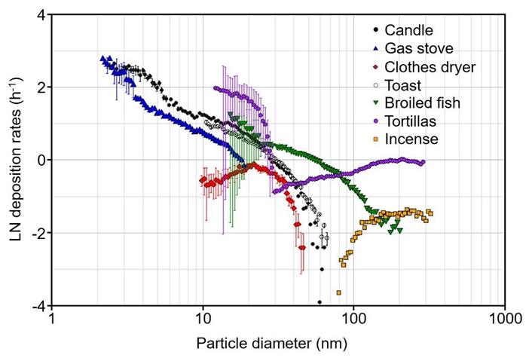
Results: size-resolved deposition rates

Slide 16
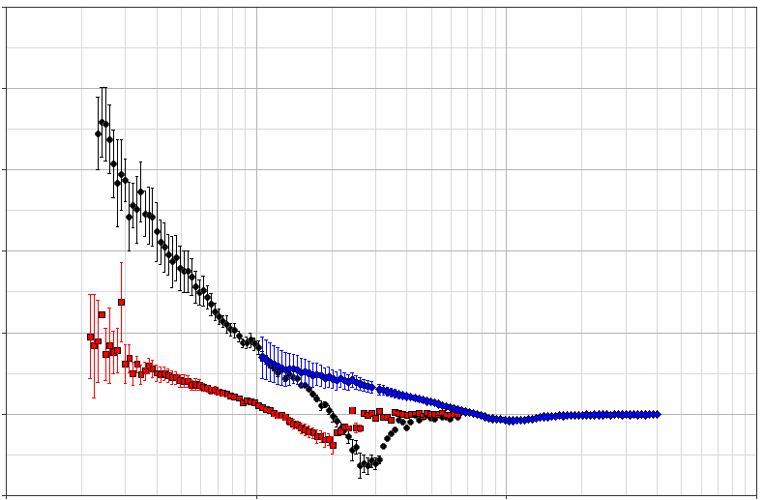
Results: coagulation losses
25
Candle
20
Gas stove
Broiled fish
15
10
Coagulation loss rates (h⁻¹)
5
0
-5
1
10
100
1000
Particle diameter (nm)

Slide 17
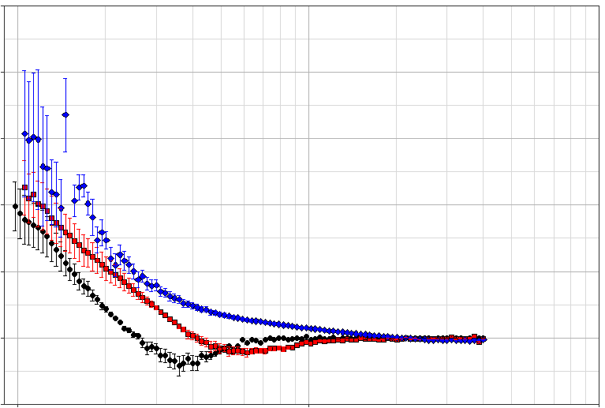
Results: coagulation losses
2.5
Clothes dryer
2.0
Toast
Incense
1.5
1.0
Coagulation loss rates (h⁻¹)
0.5
0
-0.5
10
100
1000
Particle diameter (nm)

Slide 18
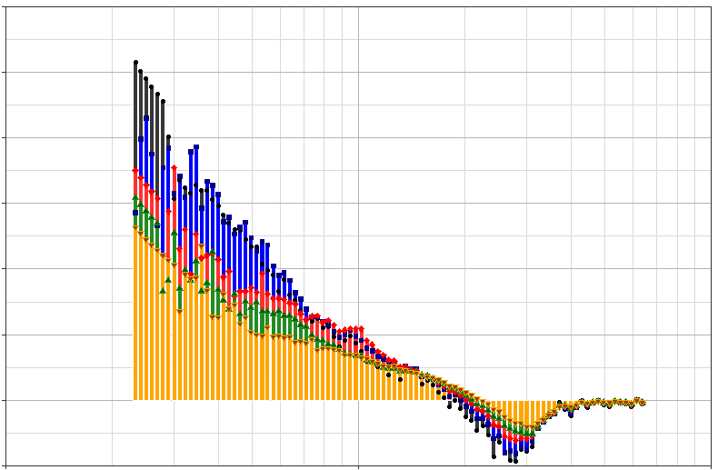
Coagulation rates over time (gas stove)
30
1min
25
3min
5min
20
7min
10min
15
Coagulation loss rates (h⁻¹)
10
5
0
-5
1
10
100
Particle diameter (nm)

Slide 19
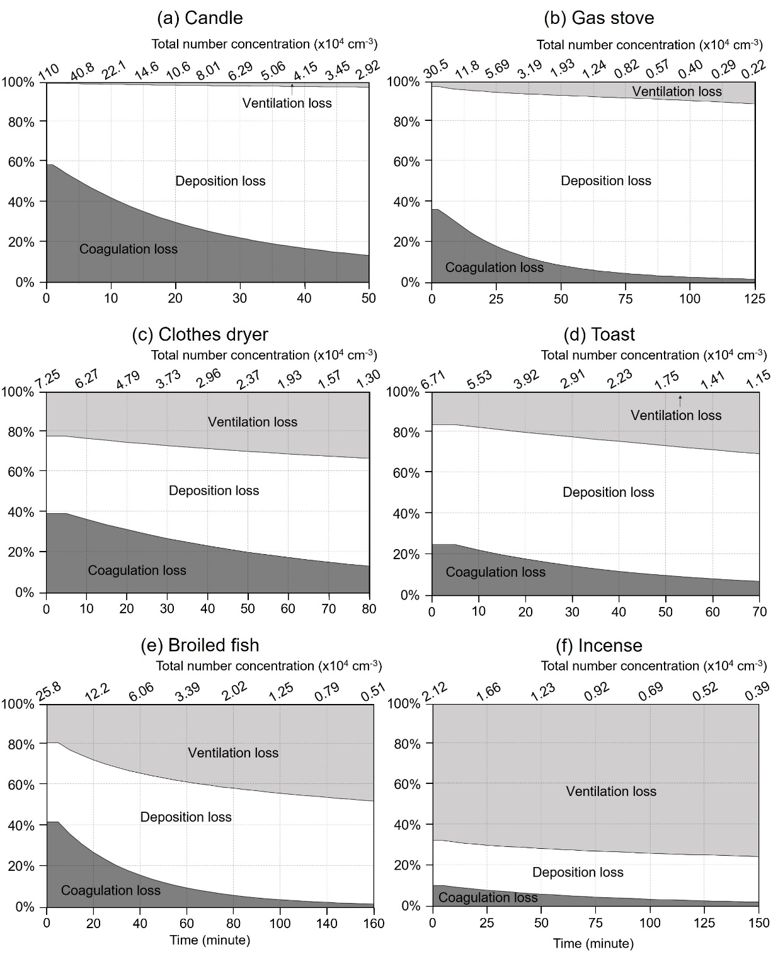
Relative contributions 1) coagulation 2) deposition 3) ventilation
Wallace, L., Jeong, S. G., & Rim, D. (2019). Dynamic behavior of indoor ultrafine particles (2.3‐64 nm) due to burning candles in a residence. Indoor Air. 29:1018–1027

Slide 20
Concluding remarks
Indoor particle concentrations are log-normally distributed in size.
Coagulation and deposition is a key aerosol process for indoor aerosol concentration change and particle size distribution shift.
Coagulation can have pronounced effect during the initial decay period when the particle size is smaller at high concentrations,
Relative contributions of coagulation, deposition, and ventilation vary a function of particle size, source emission activities, and indoor conditions
Modeling can give insights into size-resolved indoor particle dynamics and exposure considering emission activities and building operating conditions.
Notes:
In buildings…there are couple of ways to control indoor particles..
One of them is ventilation…
http://cbe.berkeley.edu/underfloorair/techoverview.htm we can engineer indoor climate….good news & bad news..)
- Building environmental (HVAC) systems (
Air quality - Comfort - Productivity (Wyon, Wargocki

Slide 21
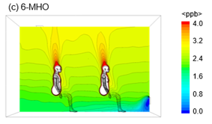
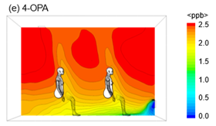
Near-human ozone and isoprene distribution
Lakey et al. (2019) The impact of clothing on ozone and squalene ozonolysis products in indoor environments. Communications Chemistry 2(1), 56.
Notes:
In buildings…there are couple of ways to control indoor particles..
One of them is ventilation…
http://cbe.berkeley.edu/underfloorair/techoverview.htm we can engineer indoor climate….good news & bad news..)
- Building environmental (HVAC) systems (
Air quality - Comfort - Productivity (Wyon, Wargocki

Slide 22
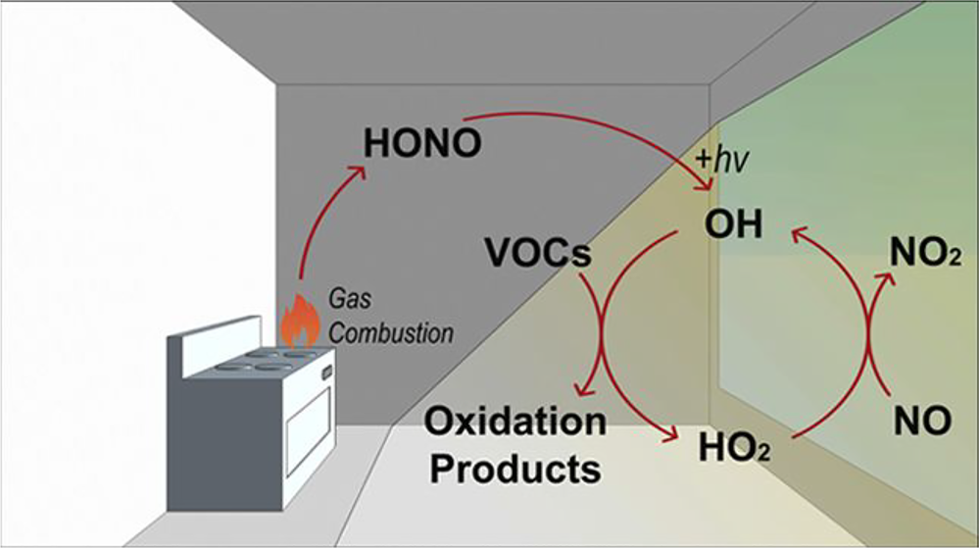
Indoor chemistry: OH⁻ distributions
Fluorescent tubes CFL
0 1×10⁻⁶ 2×10⁻⁶ 3×10⁻⁶ 4 ×10⁻⁶ 5×10⁻⁶
(ppb)
window
Won, Y., Waring, M. S., & Rim, D. (2019). Understanding the spatial heterogeneity of indoor OH and HO2 due to photolysis of HONO using Computational Fluid Dynamics (CFD) simulation Environ. Sci. Tech. in press
Notes:
In buildings…there are couple of ways to control indoor particles..
One of them is ventilation…
http://cbe.berkeley.edu/underfloorair/techoverview.htm we can engineer indoor climate….good news & bad news..)
- Building environmental (HVAC) systems (
Air quality - Comfort - Productivity (Wyon, Wargocki

Slide 23
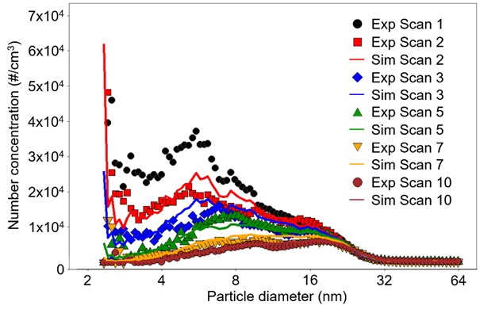
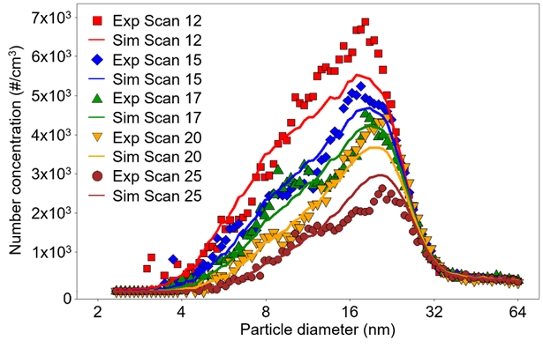
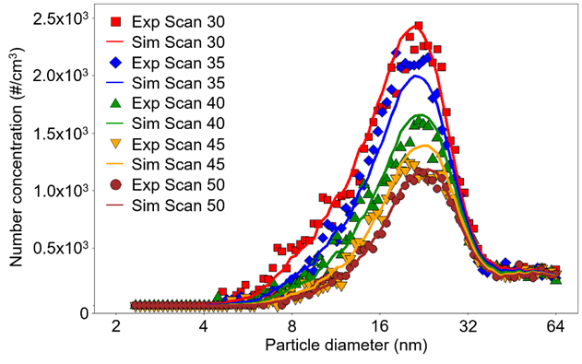
Back up: measurements vs. model (candle)

Slide 24
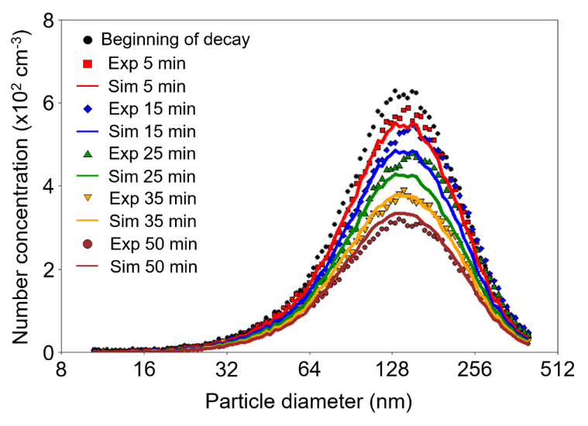
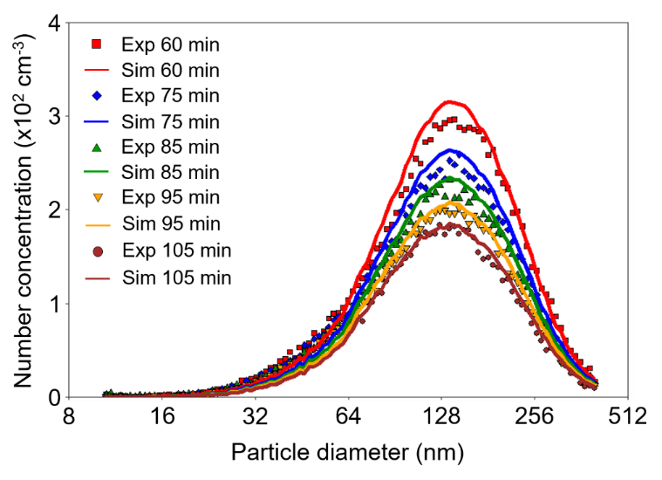
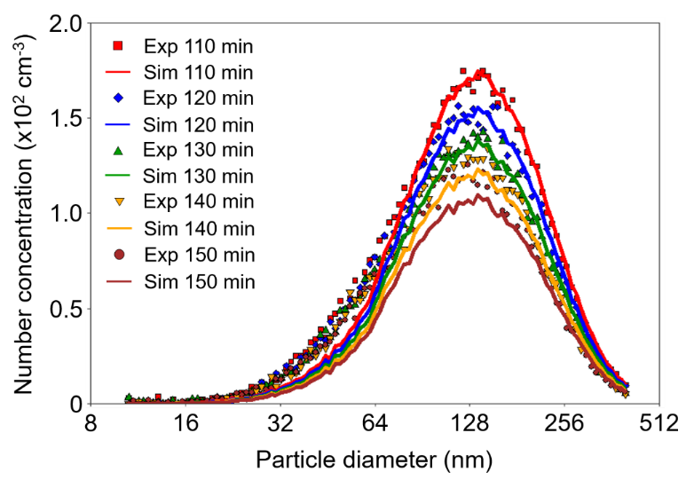
Back up: incense

Slide 25
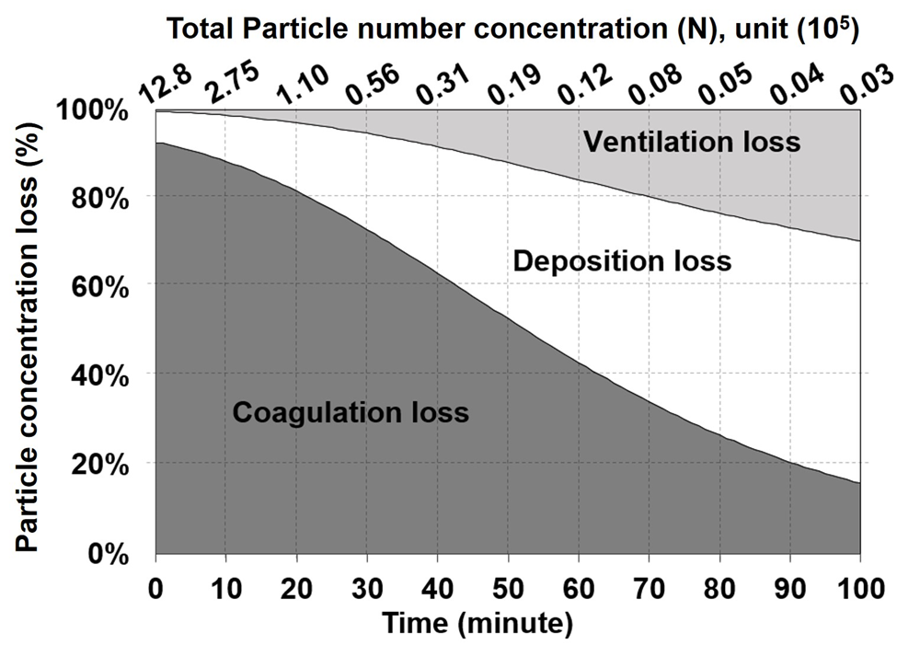
Back up
LN deposition rate – 3 monotonic data (Using corrected deposition)

Slide 26
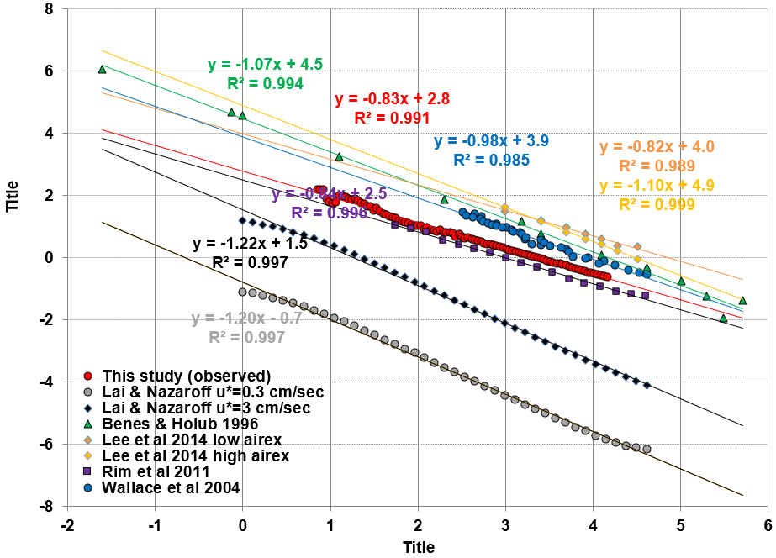
Back up: deposition rates
Ln (deposition rate)
Ln (particle diameter)

