Slide 1
Beyond traffic and biogenics: Importance of cooking and volatile chemical products in the urban atmosphere
Albert Presto
Dept. of Mechanical Engineering
Center for Atmospheric Particle Studies

Slide 2




Acknowledgments
Postdocs
Collaborators
PhD students
Funding Sources

Slide 3
Three main points
Cooking and traffic sources generate spikes of fresh emissions and contribute to urban PM enhancement
Secondary PM is also enhanced in urban centers
VCPs are an important contributor to excess urban SOA

Slide 4
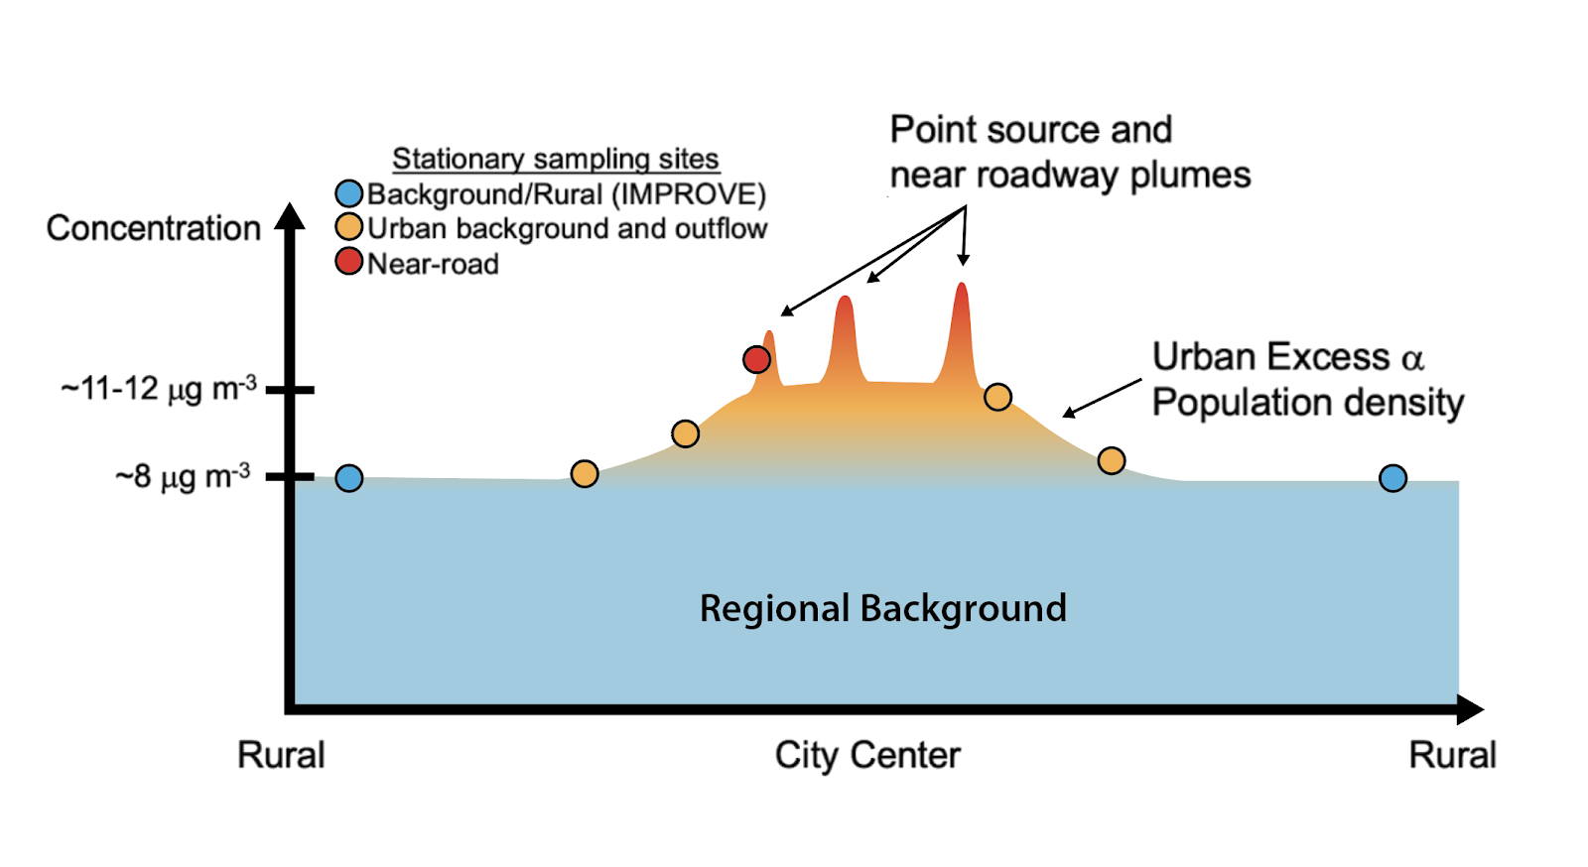
Adapted from Lenschow et al, 2001

Slide 5
Adapted from Lenschow et al, 2001

Slide 6
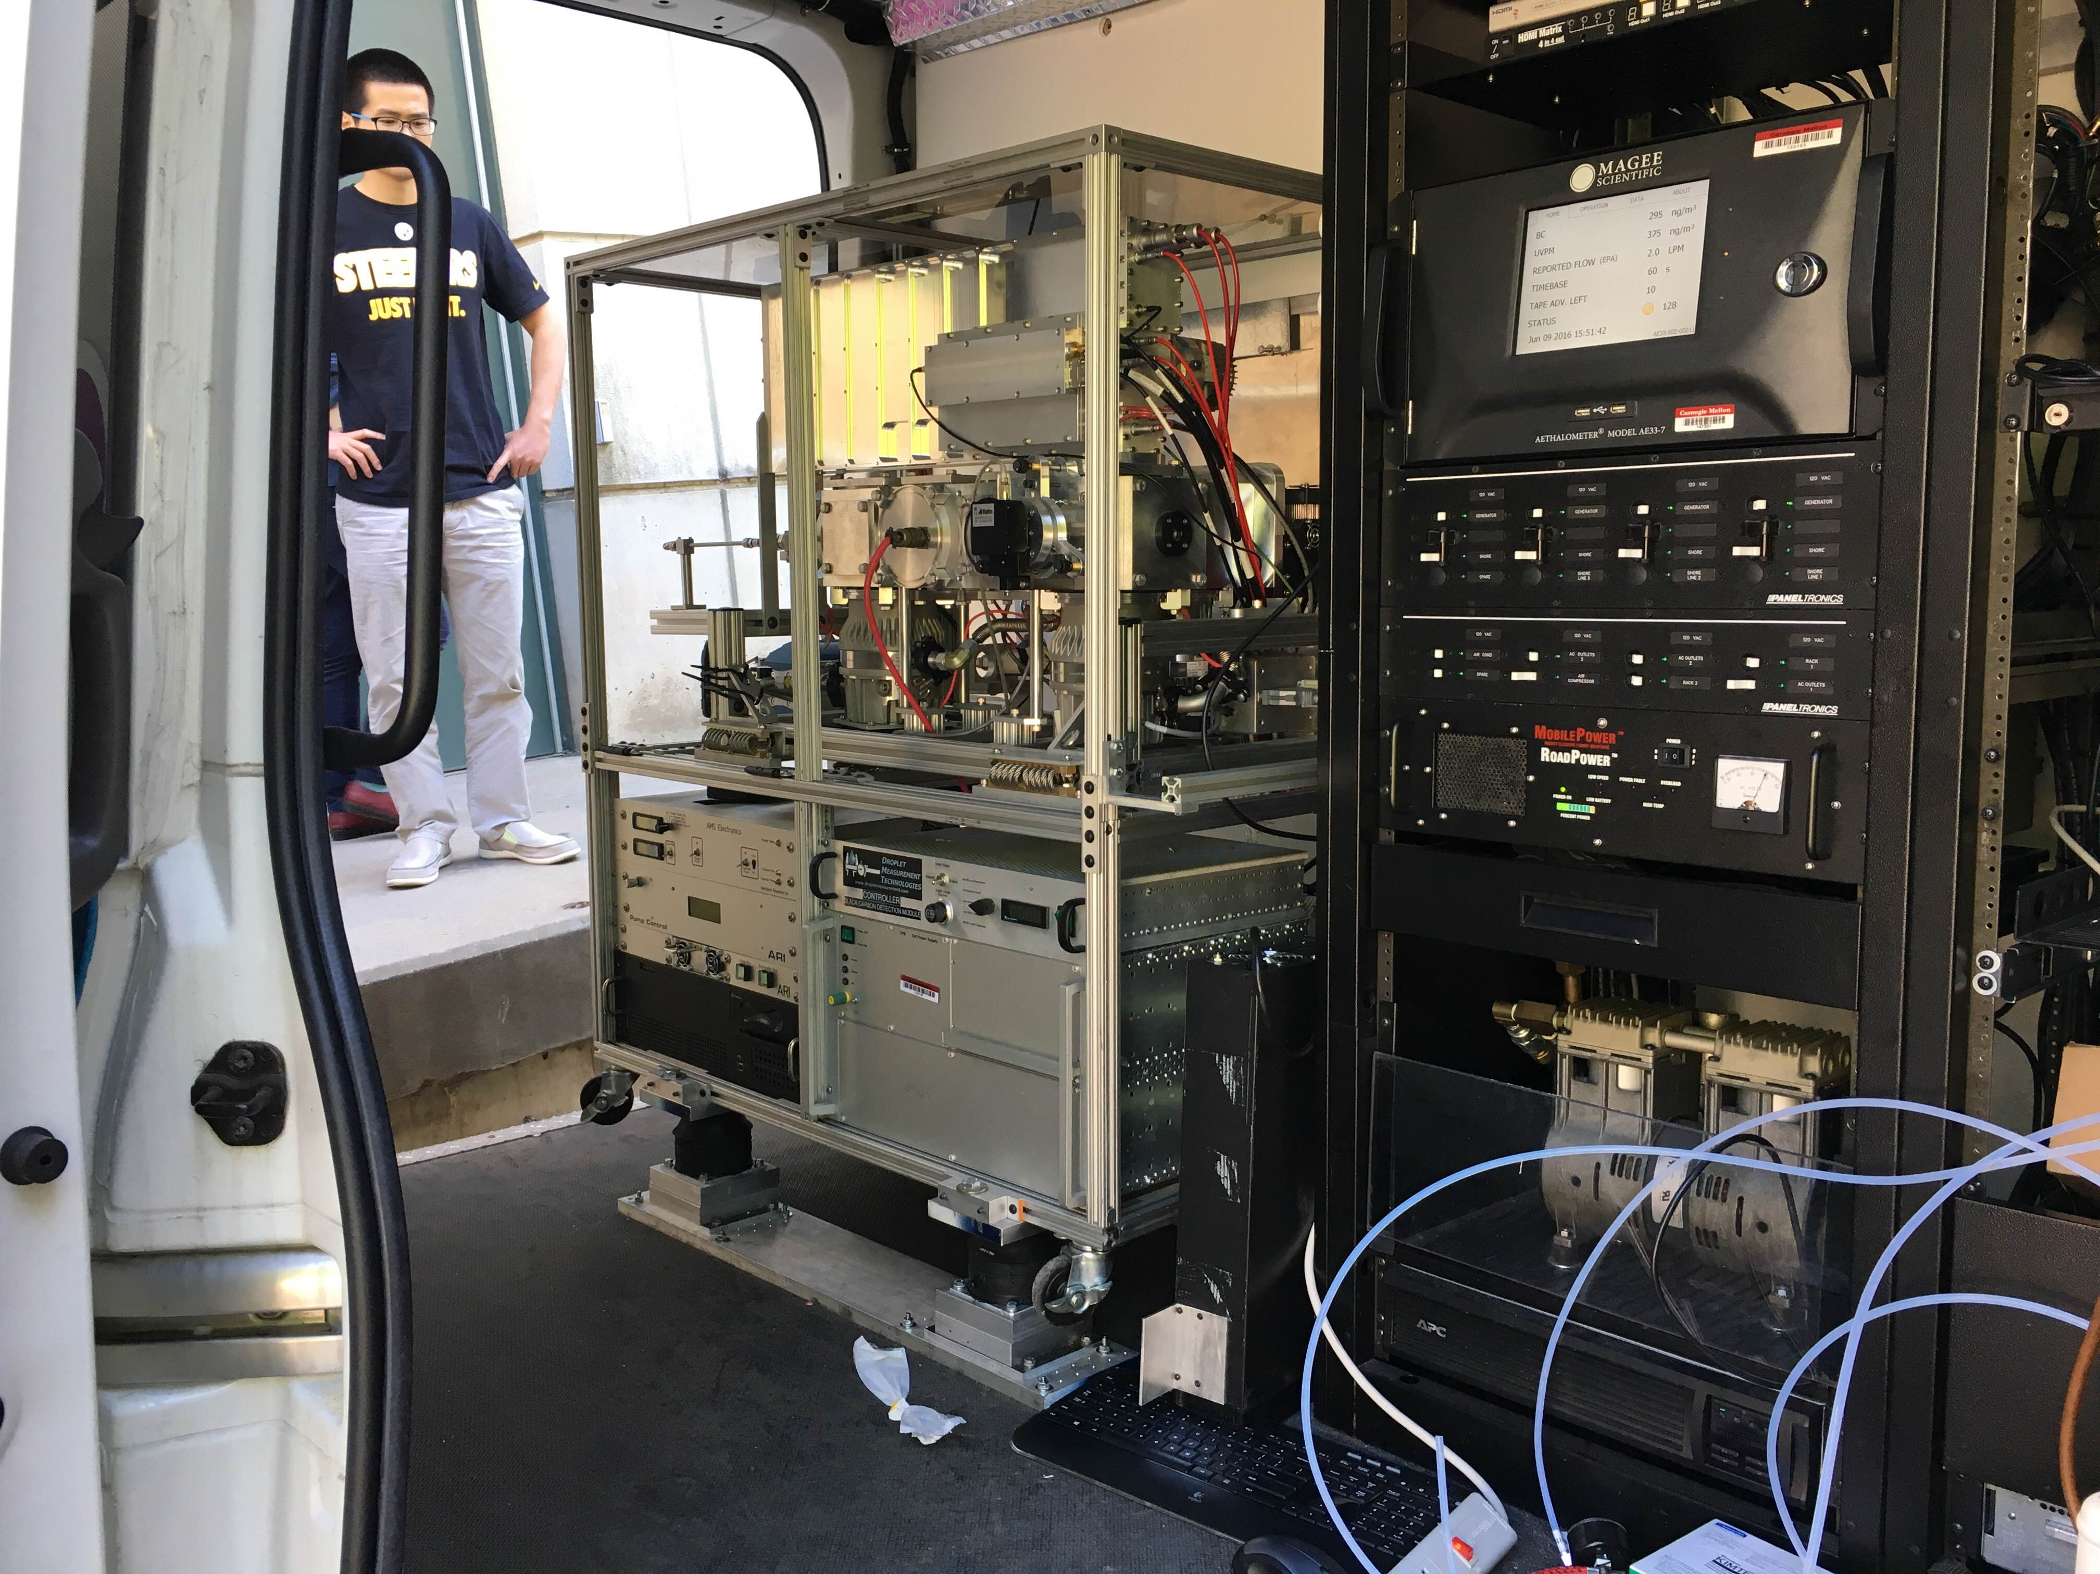
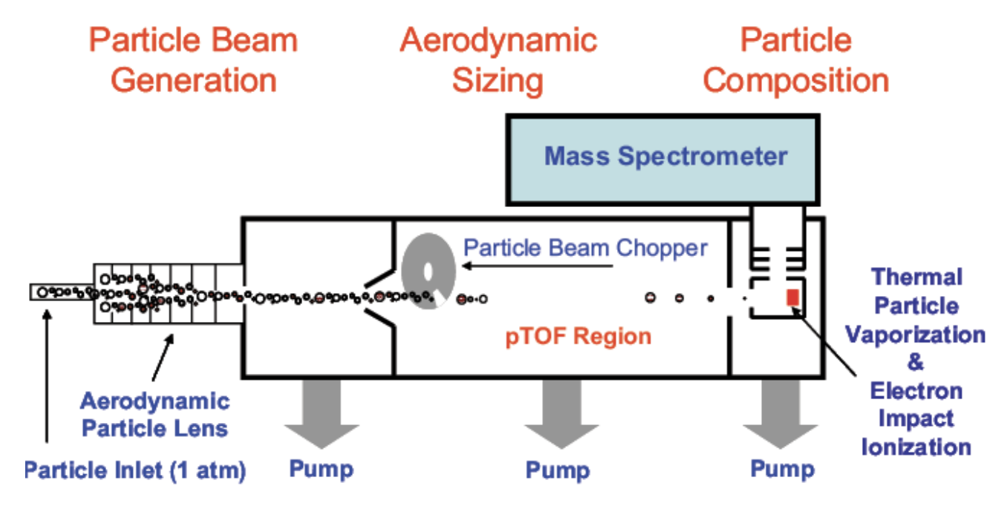
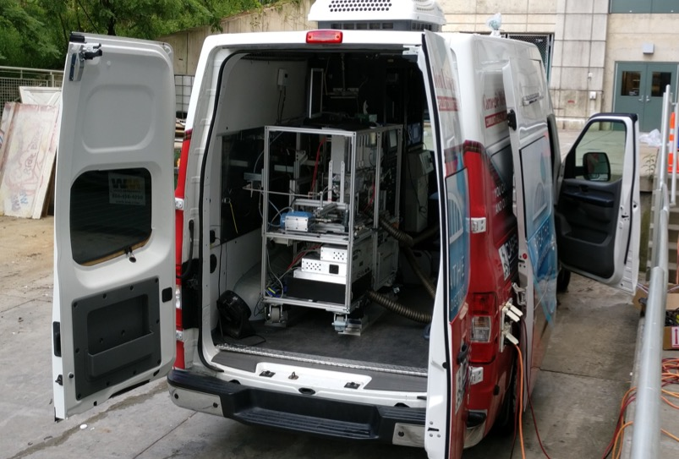
Mobile sampling with an Aerosol Mass Spectrometer (AMS)

Slide 7
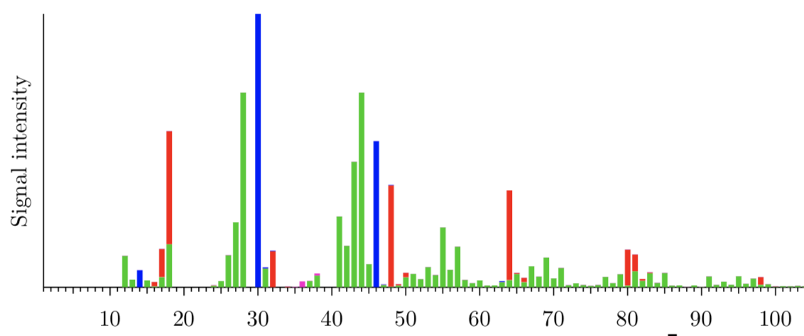
AMS: Composition
Sulfate
Nitrate
Ammonium
Organics
Signal Intensity
Mass to charge ratio (m/z)

Slide 8
Adapted from Lenschow et al, 2001

Slide 9
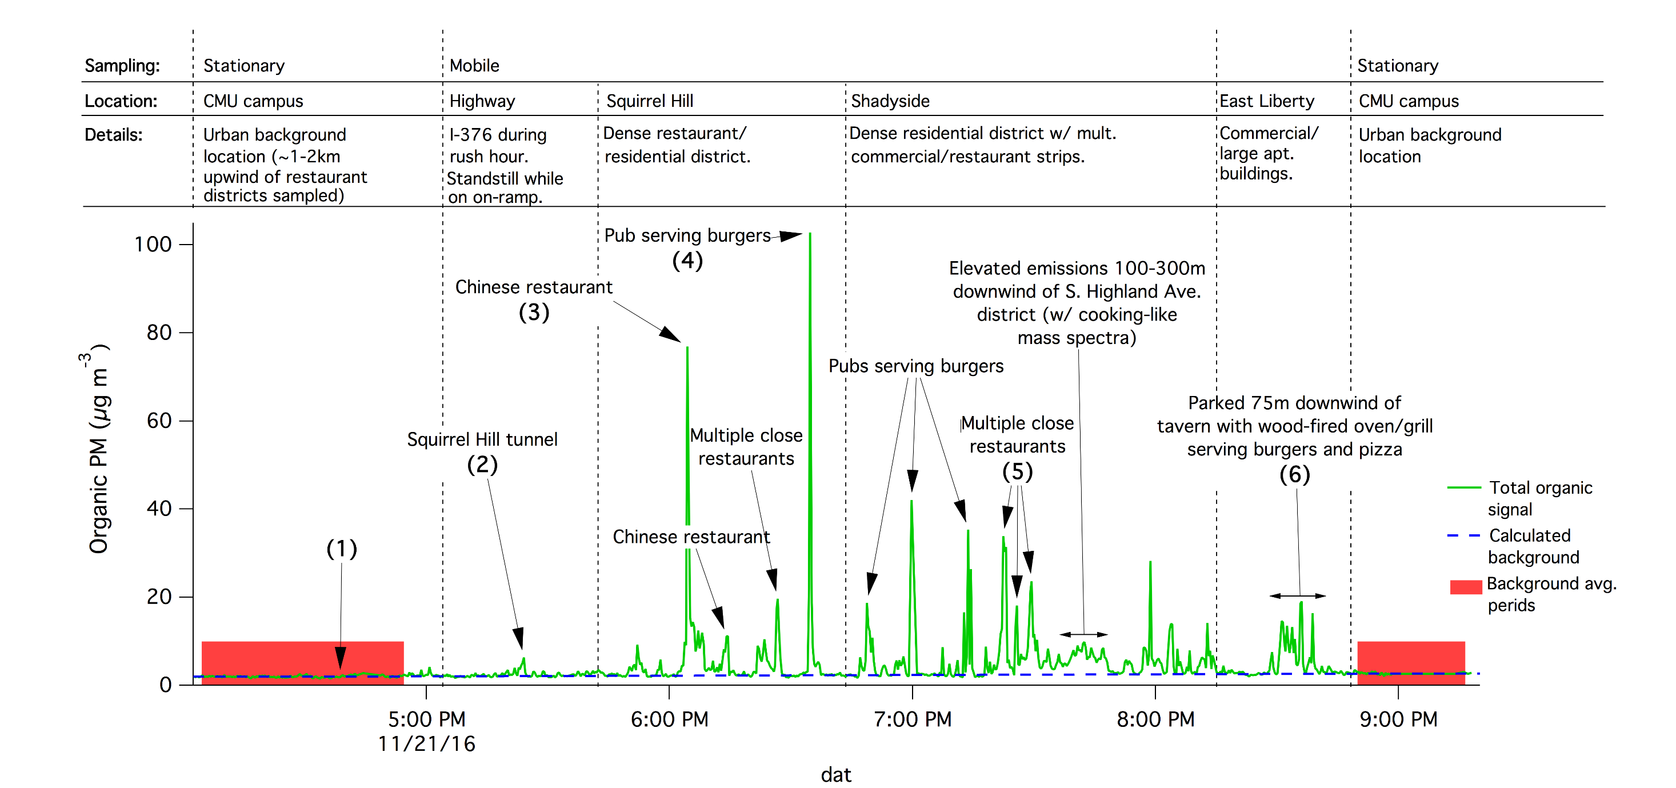
Plumes are generated by traffic and cooking
CMU campus
Background averaging period
ΔOA = Total OA - Background
Robinson et al, ES&T, 2018

Slide 10
Plumes are generated by traffic and cooking
CMU campus
Highway
Background averaging period
Tunnel
ΔOA = Total OA - Background
Robinson et al, ES&T, 2018

Slide 11
Cooking plumes are more frequent and larger
CMU campus
Highway
Background averaging period
Tunnel
ΔOA = Total OA - Background
Robinson et al, ES&T, 2018

Slide 12
Cooking plumes are more frequent and larger
CMU campus
Highway
Background averaging period
Tunnel
ΔOA = Total OA - Background
Robinson et al, ES&T, 2018

Slide 13
Cooking plumes are more frequent and larger
CMU campus
Highway
CMU campus
Background averaging period
Tunnel
Background averaging period
ΔOA = Total OA - Background
Robinson et al, ES&T, 2018

Slide 14
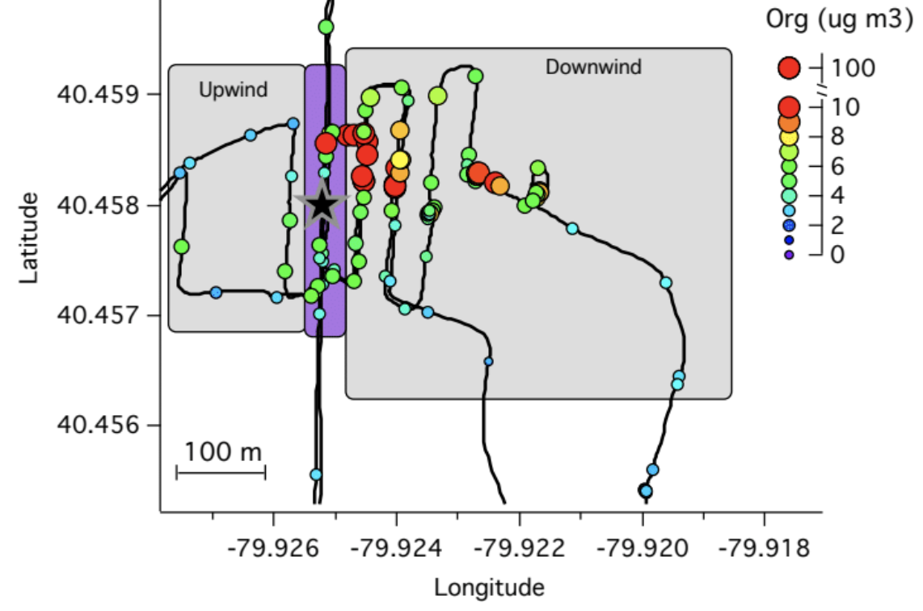
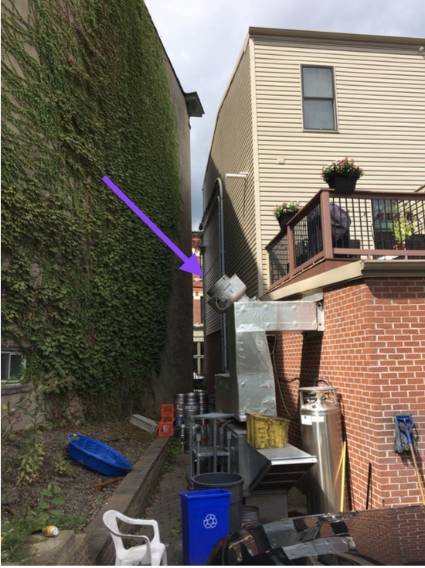
Cooking sources generate large plumes
Restaurant row
Wind
200 m

Slide 15
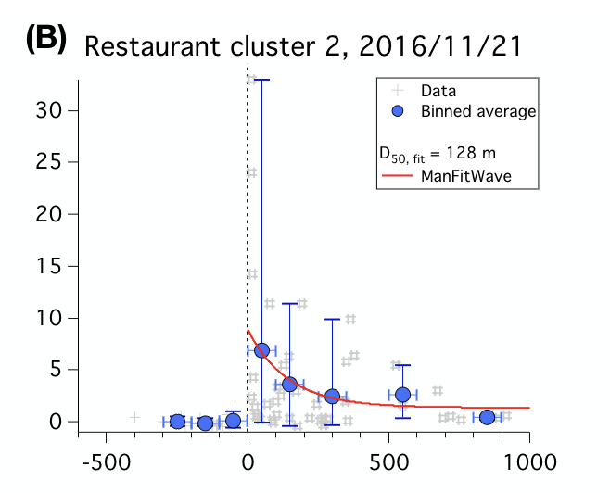
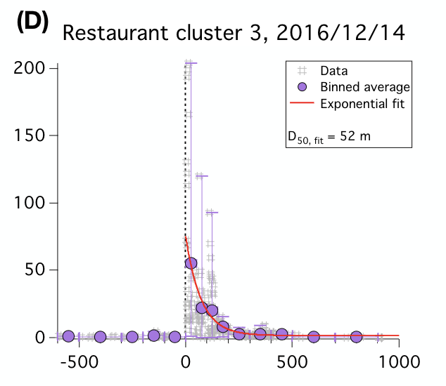
Restaurant plumes extend 50-300 m down wind
μg m⁻³
μg m⁻³
Distance (m)
Distance (m)
Robinson et al, ES&T, 2018

Slide 16
How variable is cooking OA composition?

Slide 17
How variable is cooking OA composition?

Slide 18
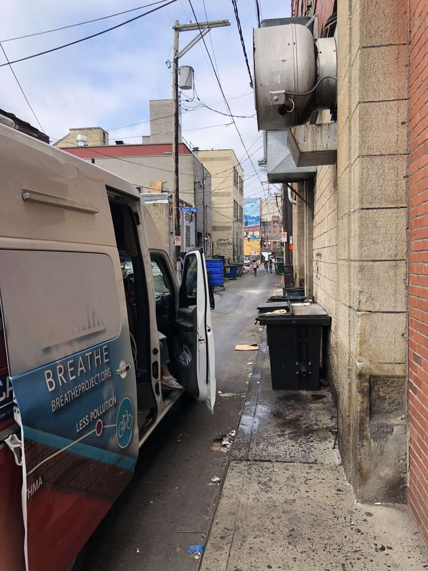
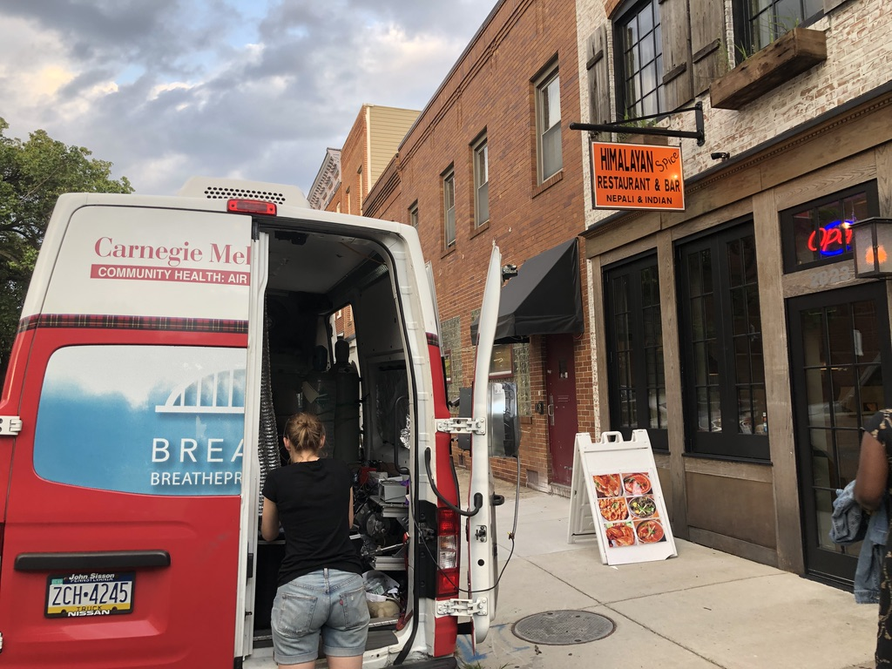
How variable is cooking OA composition?

Slide 19
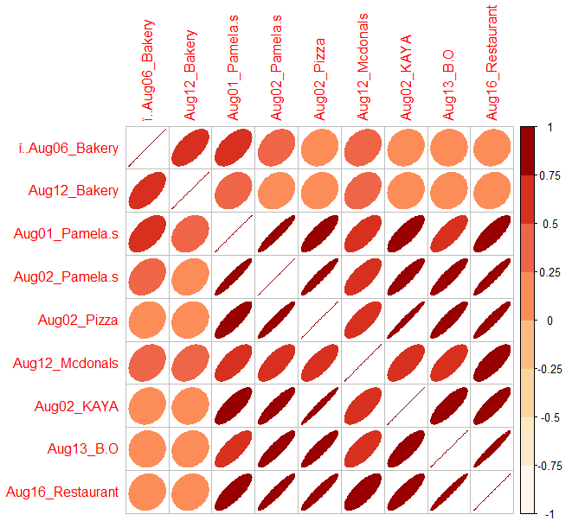
Cooking MS are consistent from one day to another
Aug 1 Pamela’s
Aug 2 Pamela’s
R
1
0.55
0.31
0.15
0.27
0.16
0.04
0.09
0.61
1
0.28
0.22
0.16
0.34
0.13
0.15
0.15
Aug 1 Pamela’s
0.55
0.28
1
0.94
0.83
0.67
0.79
0.75
0.8
Aug 2 Pamela’s
0.31
0.22
0.94
1
0.94
0.71
0.89
0.89
0.94
0.15
0.16
0.83
0.94
1
0.73
0.98
0.9
0.93
0.27
0.34
0.67
0.71
0.73
1
0.68
0.71
0.75
0.16
0.13
0.79
0.89
0.98
0.68
1
0.81
0.85
0.04
0.15
0.75
0.89
0.9
0.71
1
0.81
0.97
0.09
0.15
0.8
0.94
0.93
0.75
0.85
0.97
1
Kim et al, in prep

Slide 20
R > 0.7 across 6 different restaurant types
Aug 1 Pamela’s
Golden Arches
Aug 2 Pamela’s
BBQ
Steak house
Pizza
Caribbean
R
1
0.55
0.31
0.15
0.27
0.16
0.04
0.09
0.61
1
0.28
0.22
0.16
0.34
0.13
0.15
0.15
Aug 1 Pamela’s
0.55
0.28
1
0.94
0.83
0.67
0.79
0.75
0.8
Aug 2 Pamela’s
0.31
0.22
0.94
1
0.94
0.71
0.89
0.89
0.94
Pizza
0.15
0.16
0.83
0.94
1
0.73
0.98
0.9
0.93
Golden Arches
0.27
0.34
0.67
0.71
0.73
1
0.68
0.71
0.75
Caribbean
0.16
0.13
0.79
0.89
0.98
0.68
1
0.81
0.85
Steak house
0.04
0.15
0.75
0.89
0.9
0.71
1
0.81
0.97
BBQ
0.09
0.15
0.8
0.94
0.93
0.75
0.85
0.97
1

Slide 21
But some cooking sources may be overlooked
Aug 1 Pamela’s
Golden Arches
Aug 12 bakery
Aug 2 Pamela’s
BBQ
Steak house
Aug 6 bakery
Pizza
Caribbean
R
1
0.55
0.31
0.15
0.27
0.16
0.04
0.09
Aug 6 bakery
0.61
1
0.28
0.22
0.16
0.34
0.13
0.15
0.15
Aug 1 Pamela’s
0.55
0.28
1
0.94
0.83
0.67
0.79
0.75
0.8
Aug 2 Pamela’s
0.31
0.22
0.94
1
0.94
0.71
0.89
0.89
0.94
Pizza
0.15
0.16
0.83
0.94
1
0.73
0.98
0.9
0.93
Golden Arches
0.27
0.34
0.67
0.71
0.73
1
0.68
0.71
0.75
Caribbean
0.16
0.13
0.79
0.89
0.98
0.68
1
0.81
0.85
Steak house
0.04
0.15
0.75
0.89
0.9
0.71
1
0.81
0.97
BBQ
0.09
0.15
0.8
0.94
0.93
0.75
0.85
0.97
1

Slide 22
Adapted from Lenschow et al, 2001

Slide 23
The urban excess is composed of fresh emissions and secondary PM

Slide 24
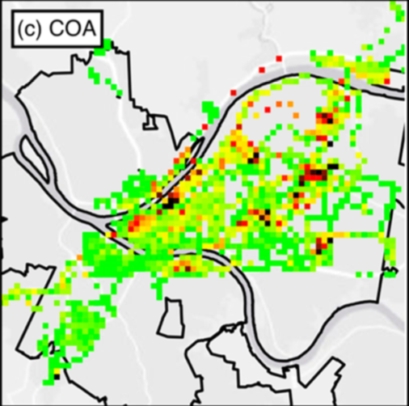
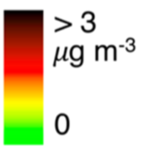
Pittsburgh: Cooking OA has neighborhood-scale enhancements
Gu et al, ES&T, 2018

Slide 25
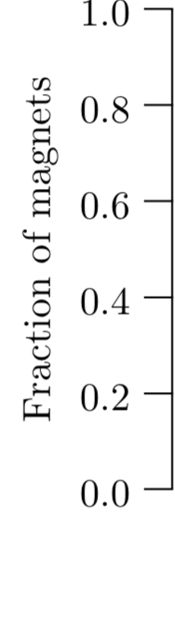
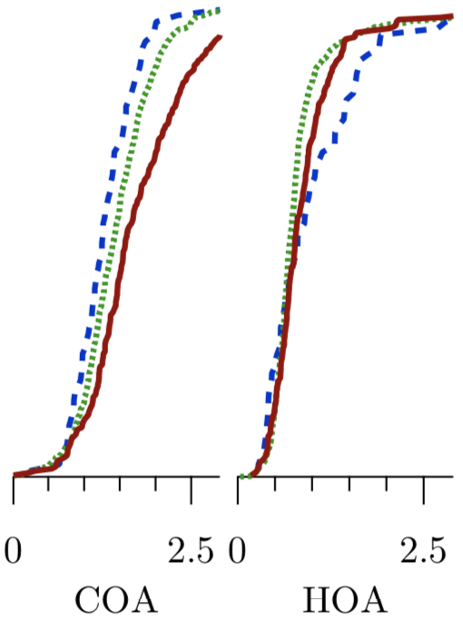
Oakland: HOA and COA variations driven by sources
Port
Residential
Downtown
Fraction of Grid Cells
Shah et al, ACP, 2018

Slide 26
Oakland: HOA and COA variations driven by sources
Port
Residential
Downtown
Fraction of Grid Cells
Shah et al, ACP, 2018

Slide 27
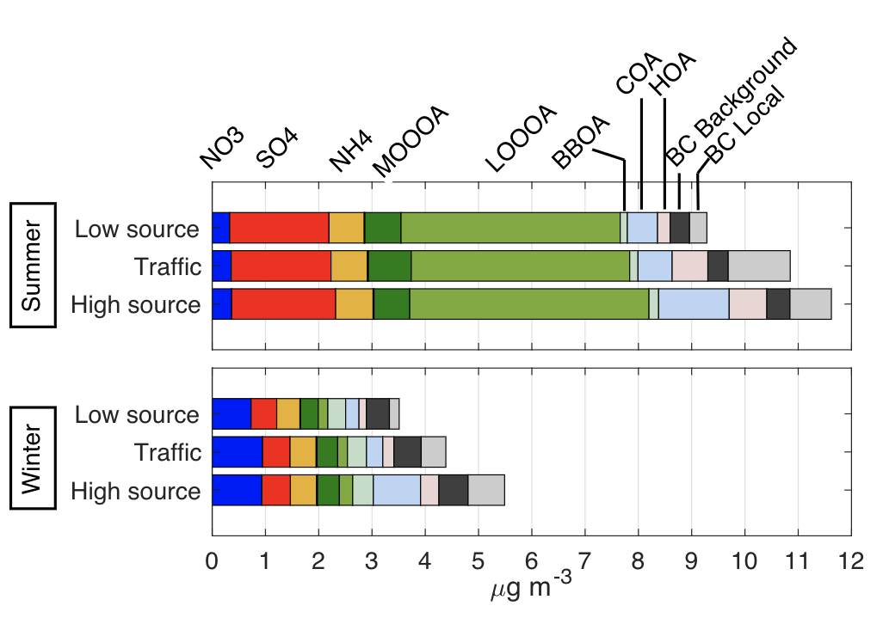
Restaurant and traffic lead to an increase of 2 𝜇g m⁻³ to PM₁ concentration in Pittsburgh
Pittsburgh SOA
+ 0.6
μgm⁻³
7.7
μgm⁻³
High Source Areas
Low
Source
Areas
μg m⁻³
Higher SOA downtown in Oakland and Baltimore too
Gu et al, ES&T, 2018
Notes:
0.7 ug m3, 11% increase
1.2 ug m3, 19% increase

Slide 28
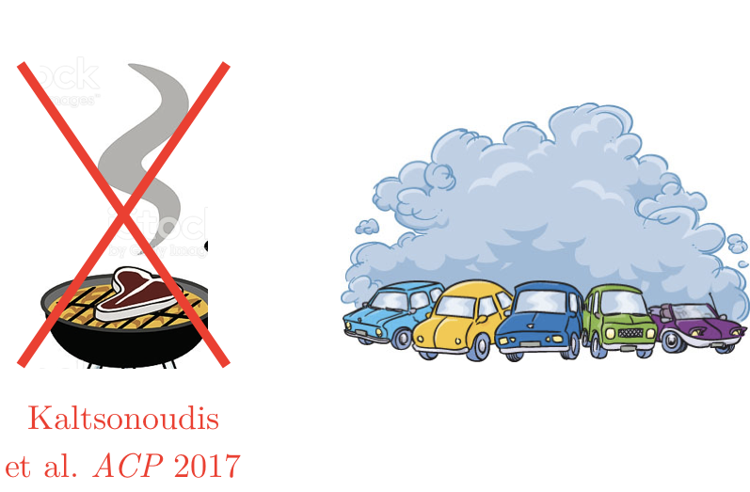
Are there more SOA precursors downtown?

Slide 29
Are there more SOA precursors downtown?

Slide 30
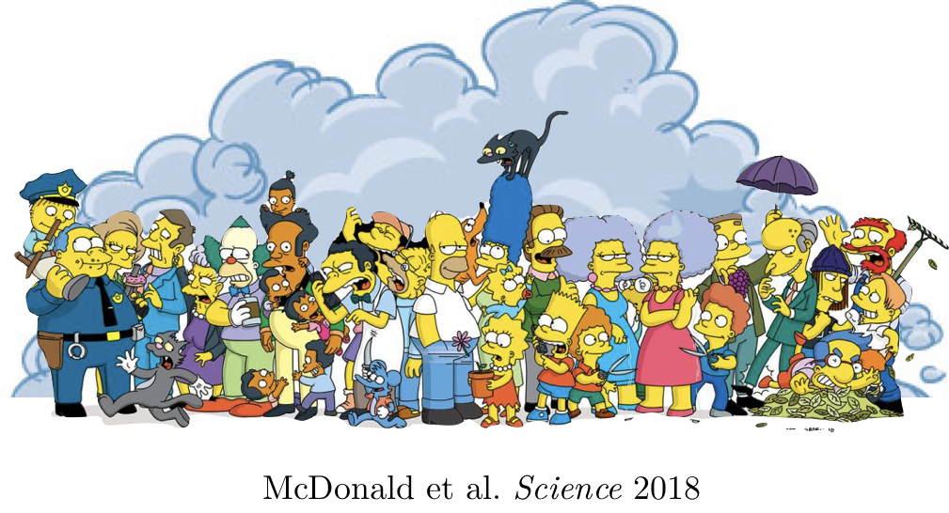
Are there more SOA precursors downtown?

Slide 31
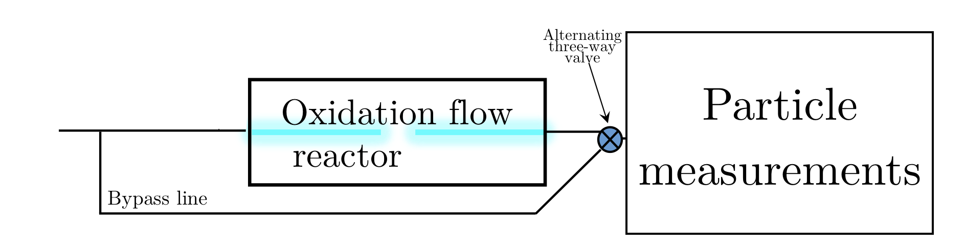

Slide 32
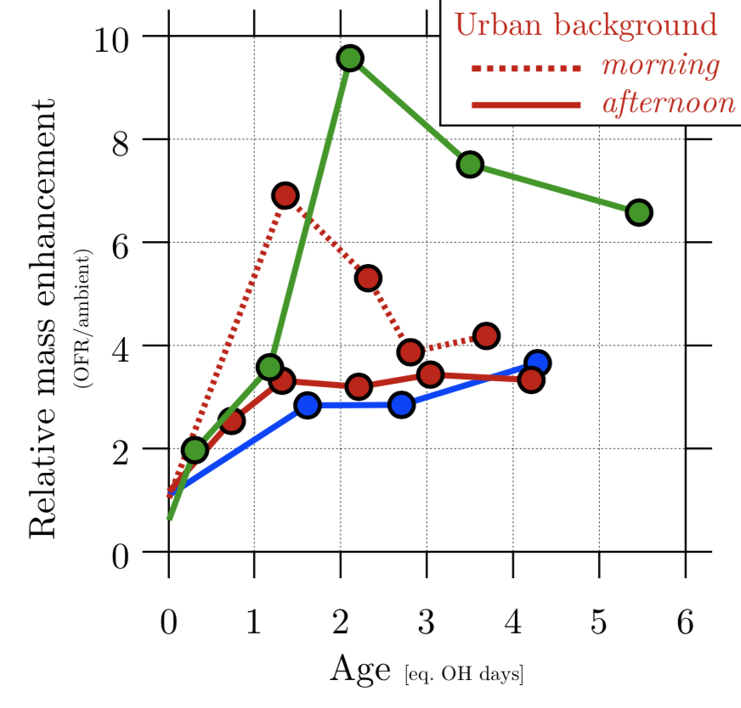
We observe excess SOA in downtown areas
Downtown
Urban background
Industrial area
Shah et al, submitted

Slide 33
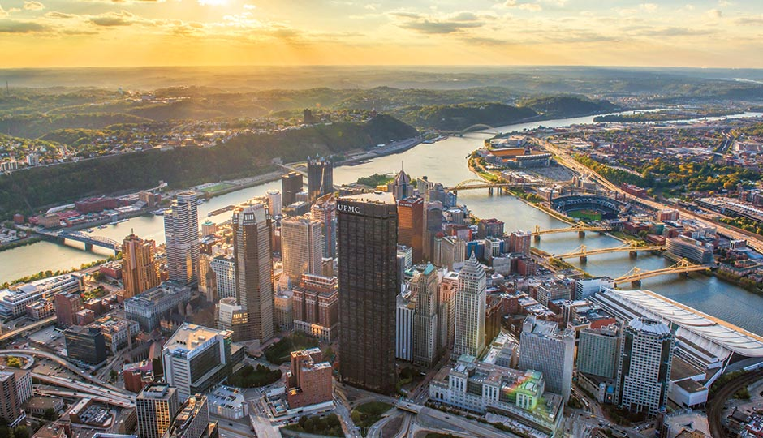
We observe excess SOA in downtown areas
Downtown
Urban background
Industrial area
Shah et al, submitted

Slide 34

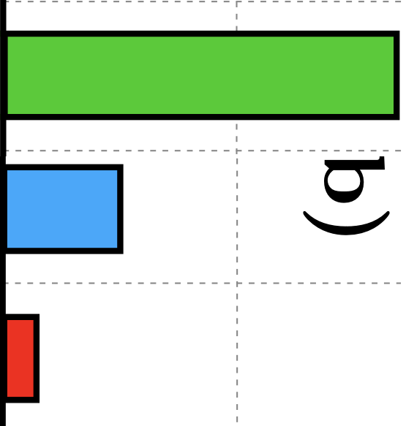

Unexplained SOA in morning-time
Morning downtown
Unexplained SOA
likely from non-combustion sources
b/c siloxanes and monoterpenes also higher in these environments
Morning urban lo-rise
Afternoon urban lo-rise
SOA predicted from biogenic and vehicular sources

Slide 35
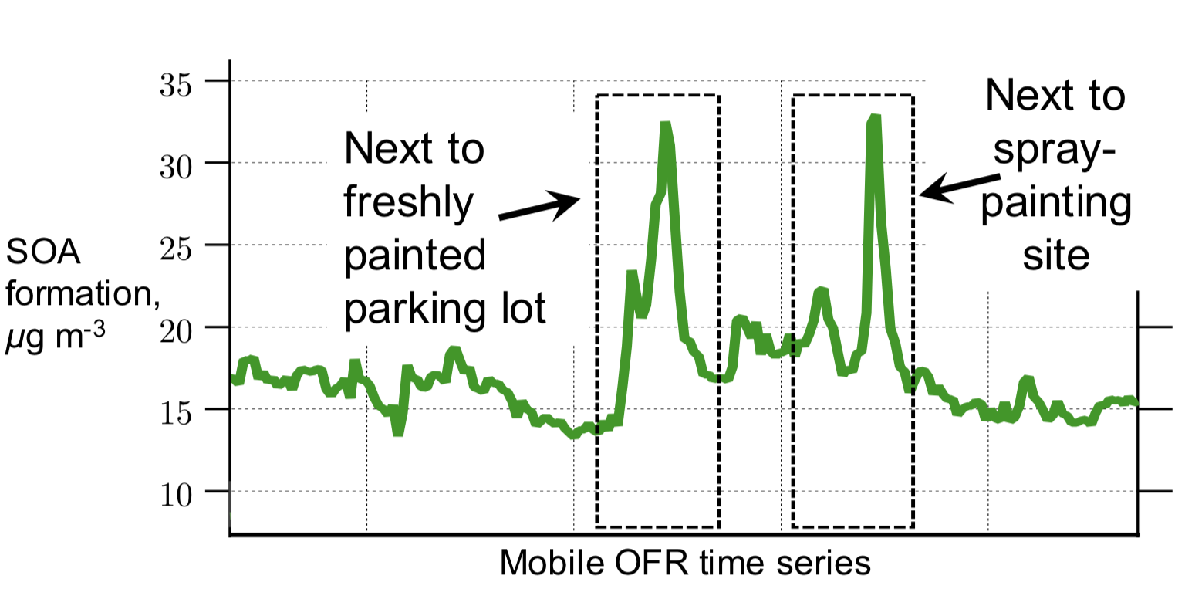
Evidence of VCP SOA from mobile OFR sampling

Slide 36
Three main points
Cooking and traffic sources generate spikes of fresh emissions and contribute to urban PM enhancement
  Cooking plumes are more frequent and larger
  Neighborhood-scale concentrations are also elevated
Secondary PM is also enhanced in urban centers
  Additional SOA observed in city centers
VCPs are an important contributor to excess urban SOA
  We can only explain half of observed SOA with vehicles and biogenics

Slide 38
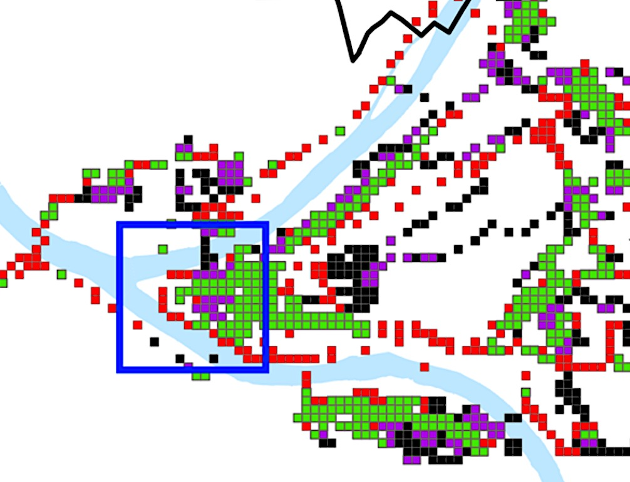
We sampled in Pittsburgh and Oakland
8 km
Restaurant-rich
Traffic-rich
Both
Background
Downtown Pittsburgh
Robinson et al.
Env Sci Tech. 2018

Slide 39
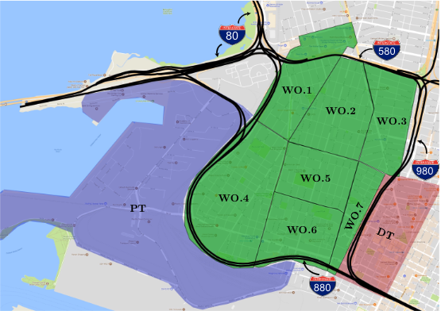
We sampled in Pittsburgh and Oakland
8 km
5 km
Restaurant-rich
Traffic-rich
Both
Port
West Oakland
Downtown
Downtown Pittsburgh
Shah et al.
Atmos. Chem. Phys. 2018
Robinson et al.
Env Sci Tech. 2018

Slide 40
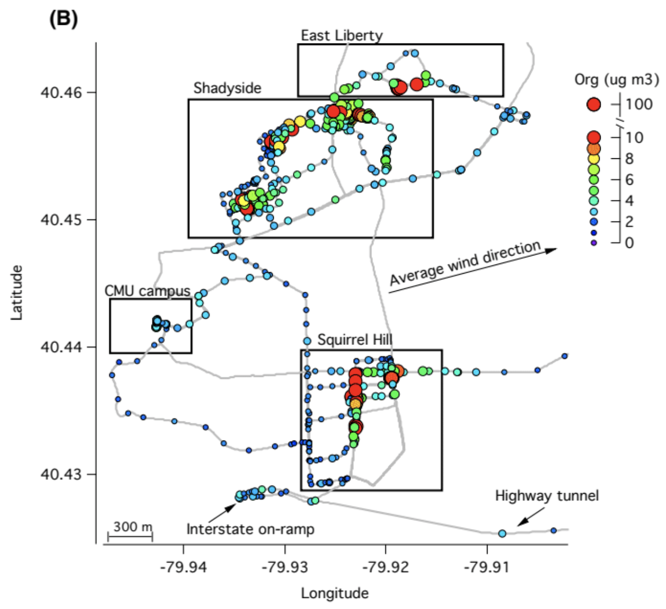
Cooking hotspots and plumes
Hot spots associated with cooking
Little enhancement on highway
Robinson et al, ES&T, 2018

Slide 41
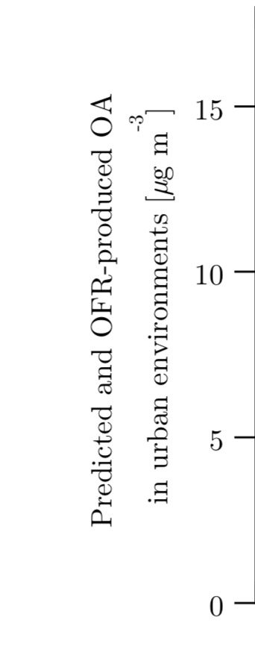
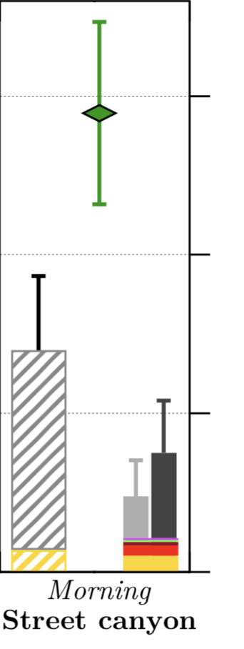
We can only explain ~half of the observed downtown SOA
Measured
Shah et al, submitted

Slide 42

We can only explain ~half of the observed downtown SOA
Measured
Harlem
Shah et al, submitted

