Slide 1



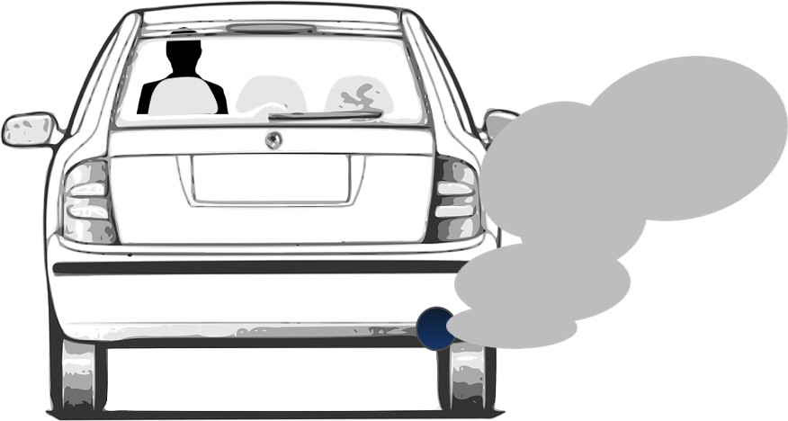


Modeling Impacts on Secondary Organic Aerosol Formation from Volatile Chemical Products
Brian McDonald, Georgios Gkatzelis, Matthew Coggon, Stuart McKeen, Jessica Gilman, Carsten Warneke, Jeff Peischl, Kenneth Aikin, Michael Trainer
Acknowledgments: CIRES Innovative Research Proposal grant
International Aerosol Modeling Algorithms Conference (Dec. 6, 2019)

Slide 2
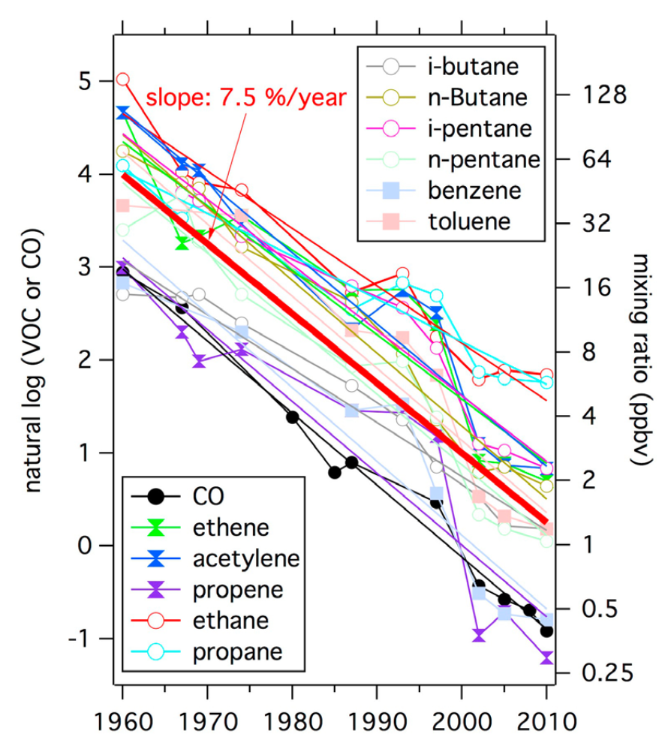
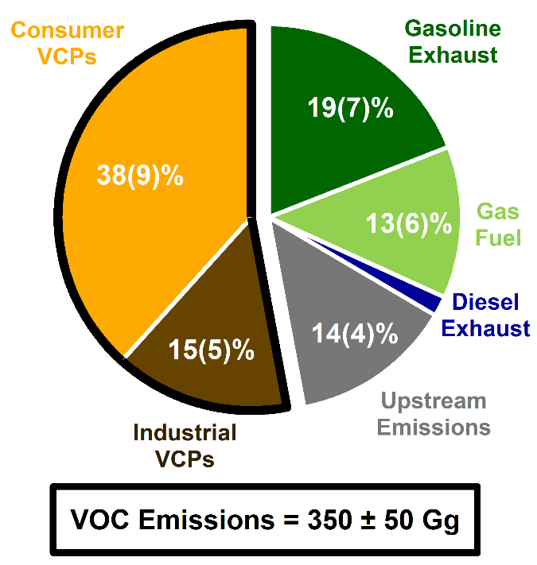
Long-Term Decreases in Motor Vehicle Emissions of VOCs
ln (VOC or CO)
mixing ratio (ppb)
Warneke et al. (J. Geophys. Res. 2018)
McDonald et al. (Science 2018)

Slide 3
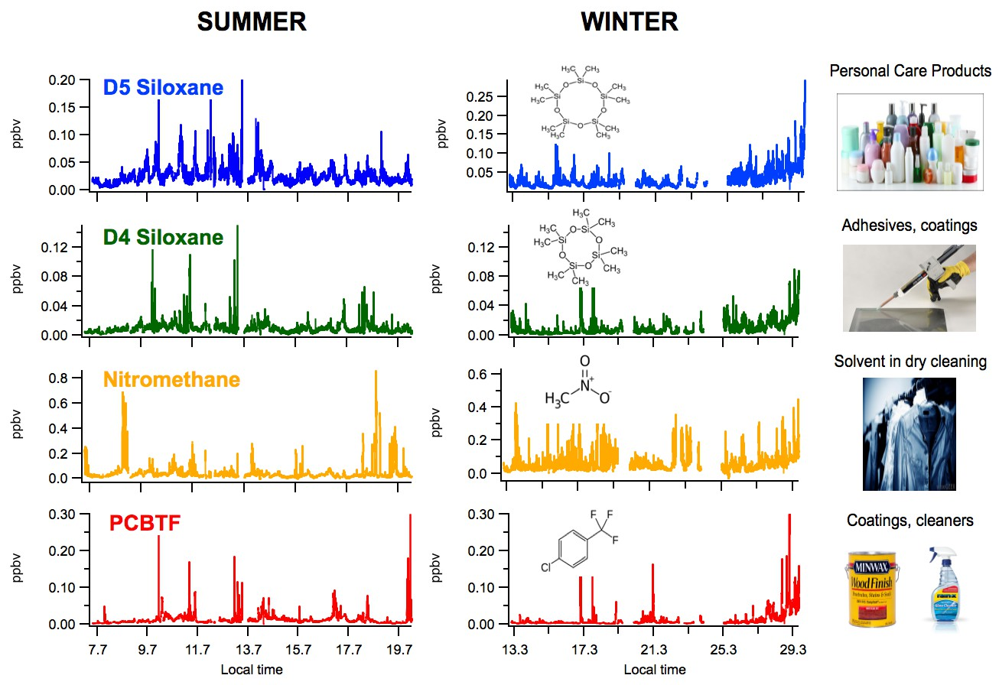
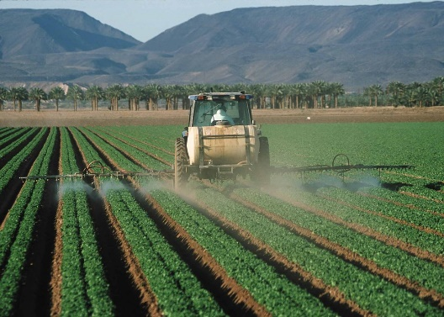
Research Objectives
  How ubiquitous are VCP emissions?
      Identify chemical tracers for VCPs
      Perform source apportionment of VOCs across cities
  Assess VCP contributions to SOA using chemical transport model
Define VCPs as coatings, inks, adhesives, personal care products,
cleaning agents, pesticides [McDonald et al., Science 2018]

Slide 4
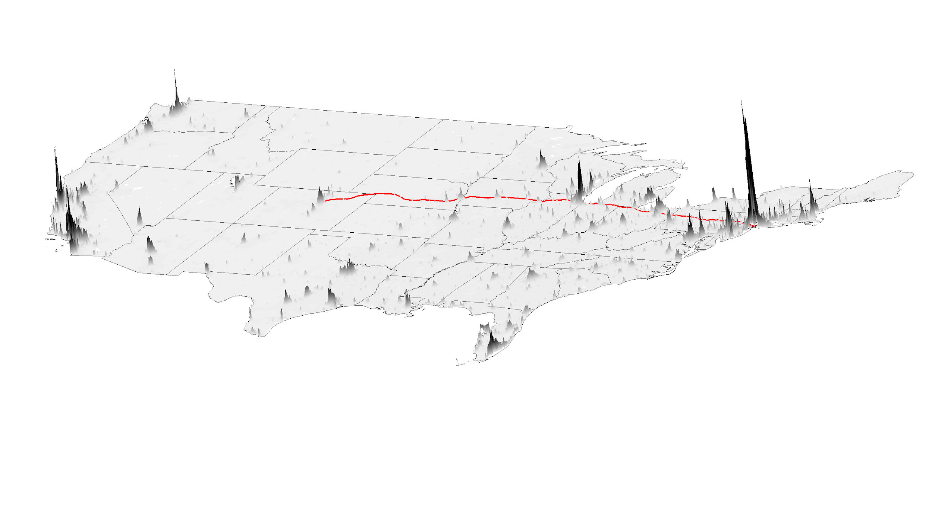
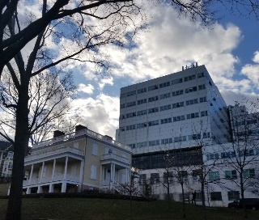
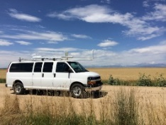
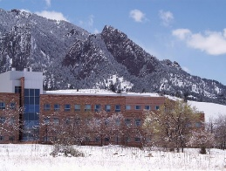
NOAA Ground and Mobile Laboratory VOC Measurements in 2018
WIN/SUM 2018
Denver
SUM 2018
NYC
Chicago
WIN 2018
Pittsburgh
PTR-ToF-MS
Population density ranges from ~200 to ~30,000 ppl / km²
Notes:
Advertise this with a NOAA symbol, Point CALNEX to LA and point to NY-ICE

Slide 5
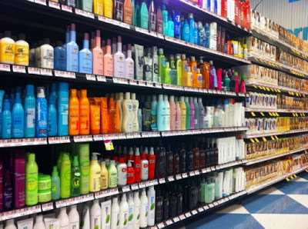
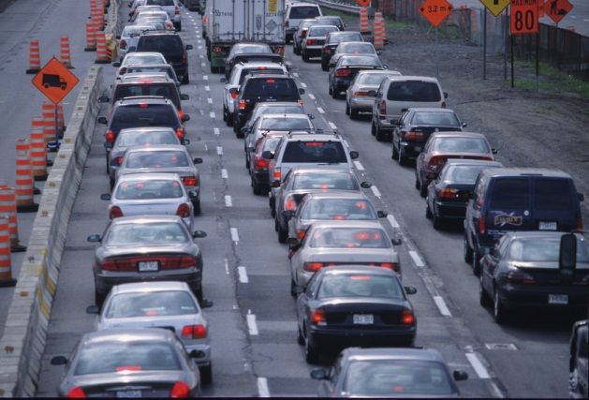
Identifying Chemical Tracers for VCP Sources
Hypothesis: If a chemical is a marker for VCP emissions, then its ambient ratio relative to benzene will increase with population density.
Benzene removed from VCPs
Per capita use of VCPs scales with population
Benzene primarily found in gasoline
Per capita driving decreases with increasing pop. density

Slide 6
Personal Care Emissions Enhanced Relative to Traffic in Denser Cities
Georgios Gkatzelis (NOAA)
Cites included: New York, Chicago, Pittsburgh, Denver
Coggon et al. (in preparation)

Slide 7
Chemical Markers Identified for Other VCP Source Sectors
Coggon et al. (in preparation)

Slide 8
VCPs are Ubiquitous in Urban Environments (even in tunnels)
Separation of tailpipe exhaust emissions from VCPs is challenging
Gkatzelis et al. (in preparation)

Slide 9
Constrain On-Road Tailpipe Exhaust Emissions Profile
Criteria to extract tailpipe emissions:
High BTEX conc.
Low conc. of VCP tracers
Gkatzelis et al. (in preparation)

Slide 10
Perform Constrained-PMF Analysis with 4 Factor Solution
Gkatzelis et al. (in preparation)

Slide 11
PMF Analysis of Ground Site Data Useful for Inventory Evaluation
Tailpipe dominated by road traffic
Off-road gasoline major tailpipe source
Gkatzelis et al. (in preparation)

Slide 12
VCPs Account for 50 – 80% of the AVOC Emissions
VOC reactivity and SOA yields of VCPs comparable to mobile sources
Gkatzelis et al. (in preparation)

Slide 13
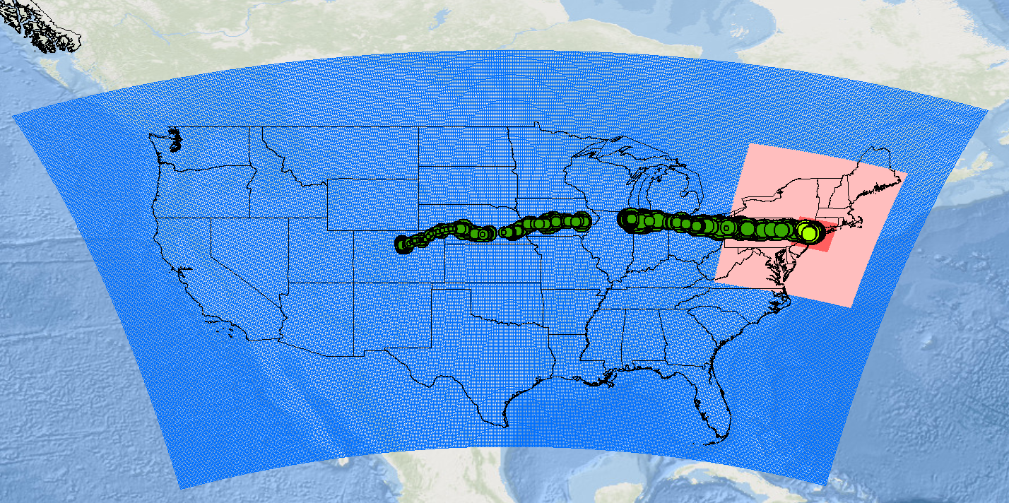
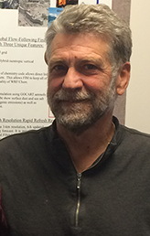
WRF-Chem Setup for Modeling Ozone and SOA during Summer 2018
Weather Research Forecasting with Chemistry Model (WRF-Chem)
D1: 12 km x 12 km
D2: 4 km x 4 km
Model SOA with 4-bin VBS scheme (Ahmadov et al., JGR 2012)
…but IVOCs missing and modeled as HC8
Stuart McKeen
(NOAA)
Updated mobile source NO_{x} (McDonald et al., ES&T 2018), power plant NO_{x} (CEMS), and anthropogenic VOC emissions (McDonald et al., Science 2018).

Slide 14
High Ozone during July Heat Wave Enhanced by AVOCs
BVOC + NO_{x} only
BVOC + NO_{x} + AVOC
∑(Unhealthy)
~ 24 million ppl

Slide 15
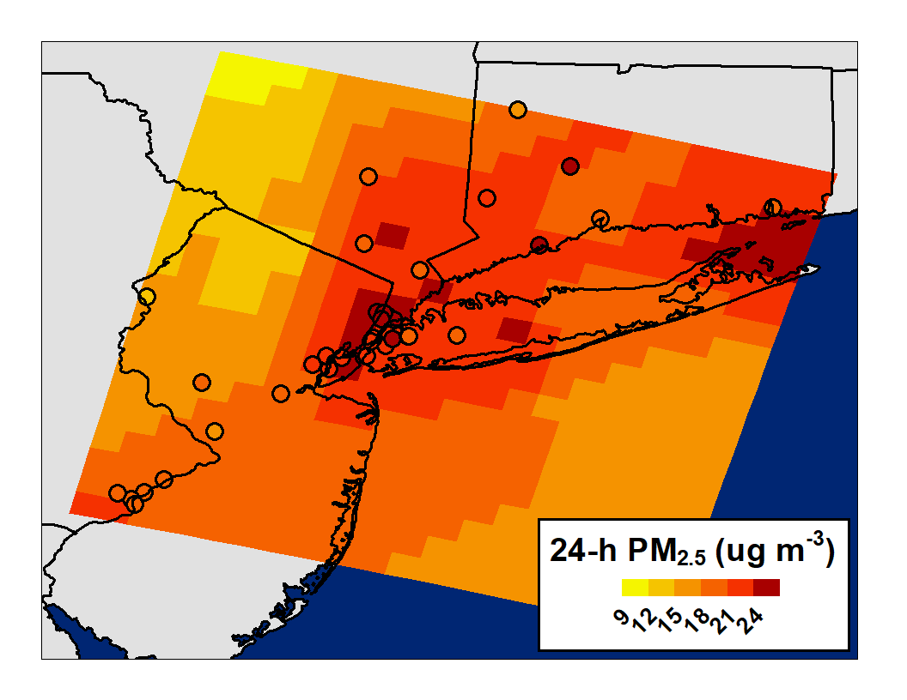
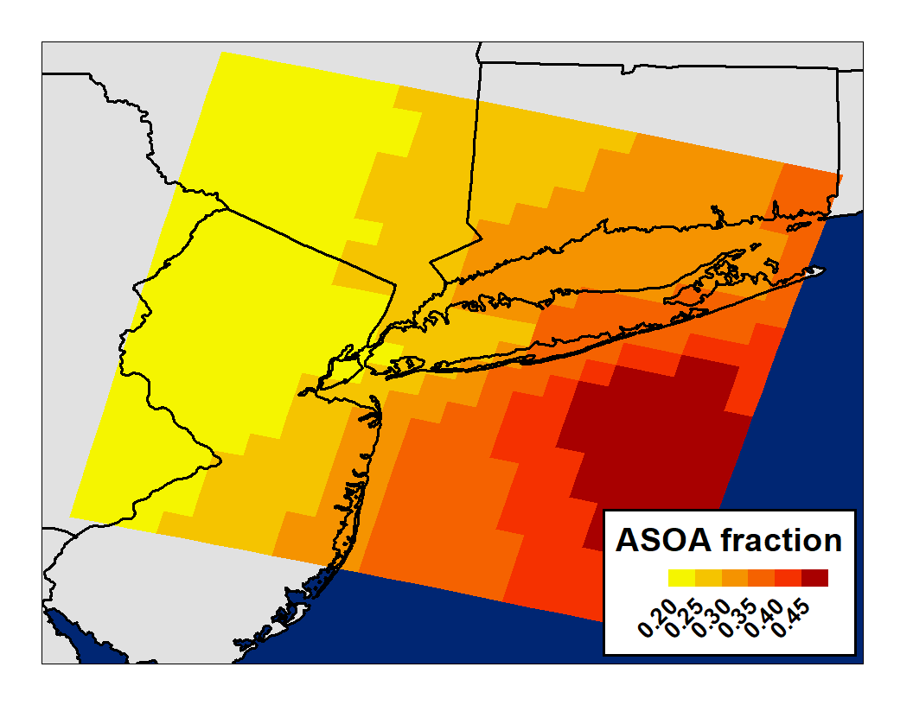
Anthropogenic SOA significant fraction of PM_{2.5} Mass
Urban = 21 μg m⁻³, max = 28 μg m⁻³
Urban = 27%, max = 47%
max
min
NYC
Bias = +0.6 μg m⁻³, r = 0.67
VCP SOA ~1 μg m⁻³, but not accounting for IVOCs or heterogeneous chemistry…

Slide 16
Summary
  Identified several tracers for VCPs in urban atmosphere using PTR-ToF-MS → VOC source apportionment in PMF analysis
  Across four US cities with population density spanning 2 orders of magnitude, VCPs are 50-80% of the anthropogenic VOC emissions
  Preliminary WRF-Chem modeling suggest VCPs can contribute to SOA, but likely under-accounted without representation of IVOCs

