Slide 1
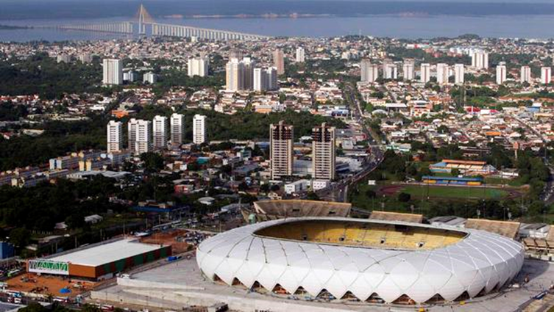
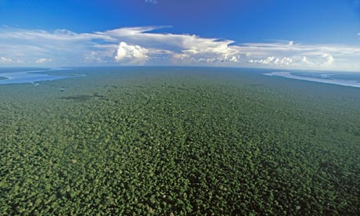
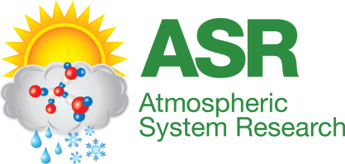
Manish Shrivastava
Notes:
In this talk I am going to tell you a story. It is about secondary organic aerosols that are formed in one of the most pristine forests of the Earth, the Amazon. And most interestingly, how Manaus, a city of 2 million people in the heart of the forest greatly increases this natural process of biogenic SOA fomration. I want to acknowledge all my co-authors, many of whom performed measurements over the forest during the 2014 Green Ocean Amazon field campaign and also US Department of Energy for funding,

Slide 2
How do anthropogenic activities affect biogenic SOA formation?
Anthropogenically controlled SOA: biogenic SOA that would not be formed in absence of anthropogenic activities
To understand anthropogenically controlled SOA, we need a baseline of biogenic SOA formation in absence of any influence of anthropogenic emissions
Most terrestrial locations on Earth have already been perturbed by anthropogenic activities: Pristine baseline is hard to find
Ideally, we need to go back in time under preindustrial conditions to fully unravel how anthropogenic activities have influenced biogenic SOA formation since that time
What if we can visit an atmosphere so pristine it is like preindustrial times in terms of atmospheric chemistry?
A story of time-travel riding an aircraft over a pristine tropical rainforest: The Amazon
Notes:
The Amazon is known as green ocean since vast areas of this rainforest remain untouched by human activities. The forest naturally makes SOA by oxidation of organic gases emitted by trees, particles that sustain several atmospheric and biospheric processes. But pollution from cities alter atmospheric chemistry of SOA in the forest. The question we need to answer is how do anthropogenic activities change the formation of biogenic SOA?
We define anthropogenically controlled SOA as biogenic SOA that would not be formed in the absence of anthropogenic activities

Slide 3
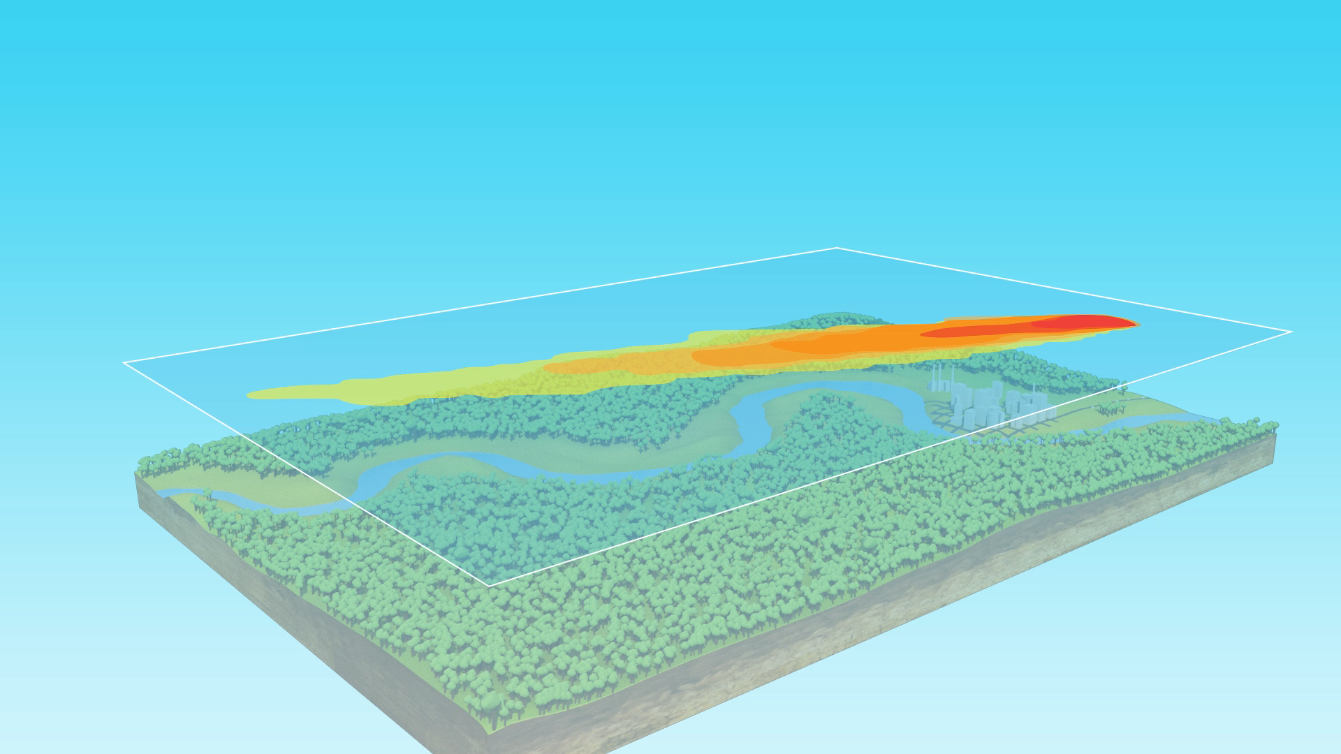
A snapshot during GoAmazon2014/5: DOE G-1 aircraft transecting pristine Amazonian forest and the urban plume

Slide 4
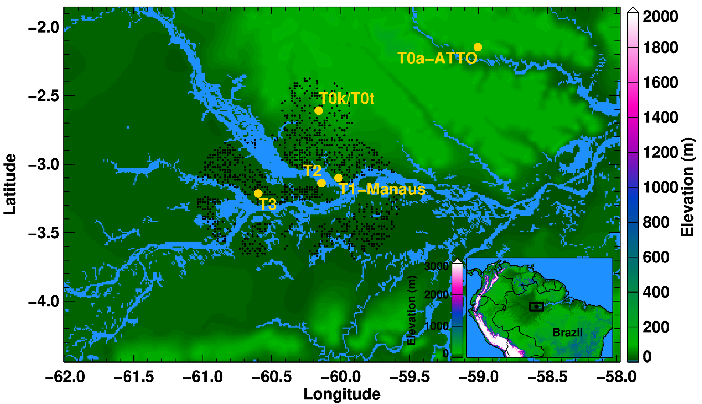
Amazon as a unique natural laboratory for understanding anthropogenic enhancement of biogenic SOA
Amazon as a natural laboratory
WRF-Chem nested domain (2 km grid spacing)
DOE GoAmazon 2014/5
10 km-grid spacing outer domain (1000×1500 km) and 2 km-grid (300×400km) inner domain
Biogenic emissions from CLM land model coupled to MEGAN
Boundary conditions: NCEP CFS reanalysis and quasi-global WRF-Chem for aerosols/trace gases
Notes:
A Google Earth Image of the area. Arrows are aircraft flight transects as it transects the plume. Transect 1 is closest to the city center the other transects are spaced 24 km equally and transect 4 is farthest downwind.Model configuration I used had nested grids. A 10 km grid spacing outer domain and high resolution 2 km grid spacing inner domain. The high resolution domain explicitly resolves features in emissions, chemistry and cloud convection as you will see. It also accounts for spatial heterogeneities. For example, in a global model grid most of my inner domain will just be represented in 2-4 grids so many of the features I see will not be resolved.

Slide 5
Amazon: One of the most challenging regions for modeling SOA
Scarcity of high-resolution emissions relevant for atmospheric chemistry
Atmospheric chemistry is much more sensitive to low levels of natural emissions (e.g. from soils) compared to other polluted regions
Complex meteorology, convection and clouds
Added new Amazon-relevant SOA parameterizations in WRF-Chem
  Gas-phase chemistry using the volatility basis set: Based on fits to chamber measurements
  Multiphase (gas and aqueous phase) chemistry of isoprene epoydiols (IEPOX) using simpleGamma module coupled to MOSAIC inorganic module
WRF-Chem run at much higher resolution (2 km grid spacing) than global models (~200 km grids) to explicitly resolve features in clouds, chemistry and emissions

Slide 6
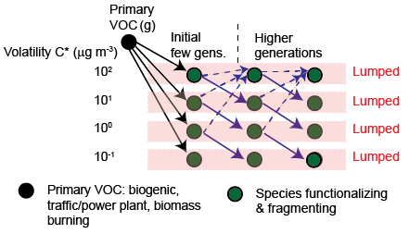




Included both biogenic and anthropogenic SOA formation based on chamber studies
A volatility basis-set approach (VBS) for SOA to represent multigenerational gas-phase chemistry
VBS fits derived from chamber measurements at low OA loadings: Include low volatility species implicitly
VBS approach: Lumps 1000’s of SOA compounds by their volatilities
Initial VBS yields determined by fitting chamber SOA measurements to a 4-product VBS (C*=0.1, 1, 10, 100 μg m⁻³)
Yields vary by VOC type, oxidant type and NO_{x} regimes
Further aging results in both functionalization and fragmentation of VBS species
Notes:
SOA is a complex mixture of thousands of oxidation products. I parameterized multigenerational oxidation of SOA using a volatility basis set approach that lumps oxidation products of SOA into a discrete set of volatility bins and tracks distribution of their mass across these bins as the mixture ages in the atmosphere. For this study, I determined initial distribution of mass by fitting to selected chamber measurements for biogenic SOA at low loadings to represent the Amazon. It was critical to choose yields from chamber measurements that went to 1 ug/m3 or less to represent typical wet season SOA yields in the Amazon. I also included further aging of this organic mixture including both gas-phase functionalization and fragmentation reactions. I assumed probability of fragmentation was Nox dependent.

Slide 7
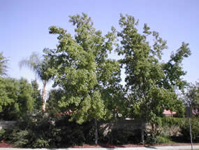
New SOA treatments included in WRF-Chem: Multiphase (gas and aqueous particle-phase IEPOX chemistry)
Mechanistic model of multi-phase isoprene chemistry
OH, NO_{x} mediated
Particle sulfate,
acidity, particle water
Isoprene
IEPOX(gas)
SOA
IEPOX(aq)
(sulfate, acidity)
Under humid conditions
(Woo and McNeil, 2015)
Sulfate, nitrate, acidity needed for IEPOX chemistry are calculated online by MOSAIC code in WRF-Chem (Zaveri et al. 2008)
Added a constraint that only 40% of IEPOX-SOA stays in particle-phase based on GoAmazon2014/5 measurements (Isaacman-VanWertz et al. 2016)

Slide 8
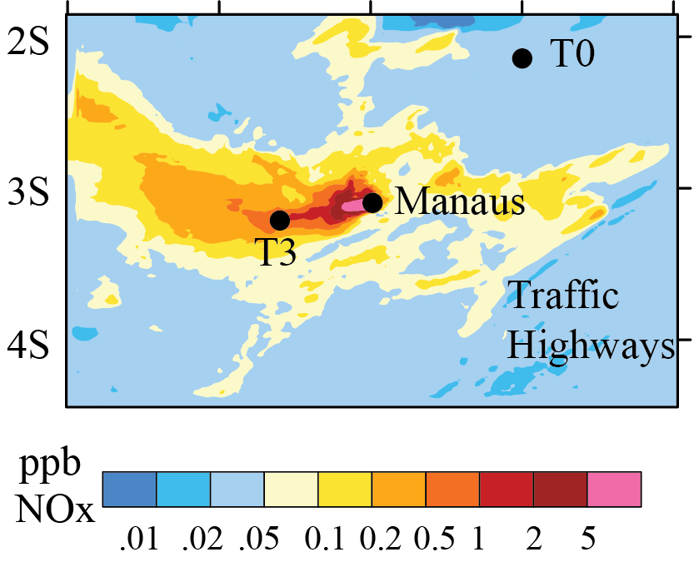
Results: Aircraft measurements and WRF-Chem show large increase in NO_{y} within plume
WRF-Chem NO_{x}
0.02 to 0.05 ppb NO from soil emissions
Shrivastava et al. 2019, Nature Communications
Included soil NO emissions observed for tropical forests: Critical modeling step to explain background
More than an order of magnitude increase in NO_{y} within plume. Traffic highways are visible too!!
Notes:
Orange represents Observations from the DOE G-1 aircraft as it traverses the plume are in orange. Default model simulation that follows aircraft flight trackes is in blue. I also ran a sensitivity test where I had forest biogenic emissions on but turned off urban emissions from Manaus to contrast what the model would predict when there was no Manaus shown in green. The green represents model predictions of the unperturbed Amazon background. A critical modeling step was I had to included soil NO emissions in the model based on measurements in the tropical forest. Without these emissions, the model could not reproduce oxidants and also relative reaction rates of isoprene peroxy radicals with HO2 compared to NO. This relative reaction was found to be 1 in the Amazon based on a study in PNAS published by Scot Martin’s group.
Another important finding from this figure is both model and measurements show that urban plume increased Noy by 1-2 orders of magnitude. This sharp constrast between plume and background is what makes the Amazon so unique and is hard to find at other locations like the United States. The figure on the right is a high resolution map from WRF-Chem shpwing how fossil fuels within Manaus increase Nox. In addition to emissions from power plants and oil refinery in the heart of the city, you also see The filaments you see in yellow are actually traffic highways. Again we can only see this is a high resolution model. But the model is also very expensive to run computationally.

Slide 9
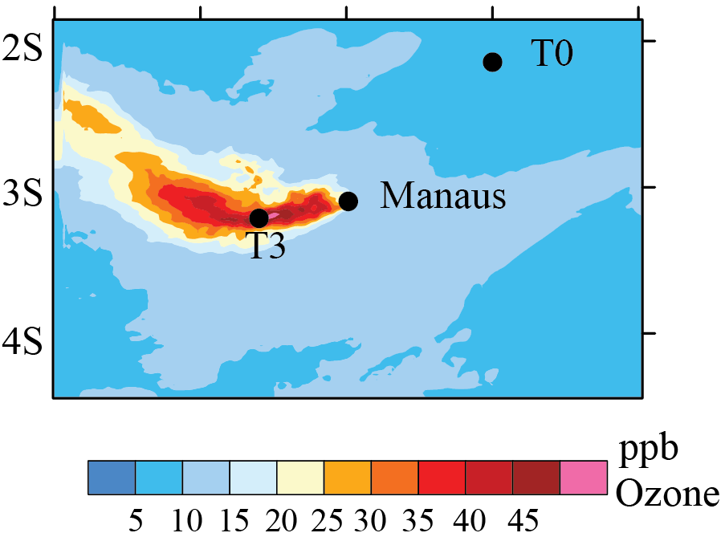
Both model and measurements show ozone increases in the Manaus plume
WRF-Chem Ozone
Shrivastava et al. 2019, Nature Communications
Observations show ozone increases by a factor of 2 to 3 in-plume
Model also clearly demonstrates higher ozone in the plume
Notes:
The Amazon is Nox limited with respect to ozone formation. So ozone is also substantially enhanced by a factor of 2-3 in plume. Model also demonstrates this higher ozone in plume although it ovepredicts maximum ozone formation,

Slide 10
WRF-Chem results: NO_{x} causes strong increase of oxidants in the urban plume
Both biogenic and Manaus emissions on
Manaus emissions off
Biogenic emissions on
Shrivastava et al. 2019, Nature Communications
Notes:
Here I am showing you maps of Nox and oxidants from two different model simulations. The top panels are default model where all emissions are on. The bottom panels is a sensitivity simulations where biogenic emissions from the forest are on, but urban emissions are turned off. The large increase of Nox and oxidants in the top panels in regions influenced by Manaus plume are clearly visible and strikingly contrast compared to bottom panels.

Slide 11
Strong enhancement in natural biogenic SOA formation in-plume
Shrivastava et al. 2019, Nature Communications
In the pristine background Amazon, biogenic SOA formation is low: NO_{x} and oxidant-limited
Soil NO_{x} emissions drive oxidant cycling and biogenic SOA formation in the background
Manaus NO_{x} emissions substantially increase biogenic SOA formation by 60-400%
Notes:
Although model simulates both anthropogenic and biogenic SOA, here I am showing just the biogenic SOA component of total organic aerosol simulated by the model. Compared to the simulation with urban emissions off, model with these emissions on shows strong enhancement in biogenic SOA in plume influenced locations.

Slide 12
Model simulations agree with organic aerosols measured by Aerosol Mass Spectrometer onboard G1 aircraft: March 13
Farthest downwind
Model plume shifted
Close to city
Shrivastava et al. 2019, Nature Communications
Model captures the rise and fall of organic aerosols as the aircraft moves in and out of plume
Model-measurements differ farther downwind from city due to differences in plume dispersion
Notes:
Now I am showing how the model compares with observations of organic aerosols measured by the Aerosol Mass Spectrometer onboard the G1 aircraft. Transect 1 is closest to the city center the other transects are spaced 24 km equally and transect 4 is farthest downwind. The model in blue reproduces the observed organic aerosol. But the model measurement differences are more farther downwiond due to differences in plume location and dispersion. The CO plot on the right also indicates a shift in model plume compared to measurements. The sensitivity simulation in green represents the background OA that matches with measurements when the aircraft moves out of the plume.

Slide 13
Observed and model simulated average organic aerosol enhancements
Shrivastava et al. 2019, Nature Communications
Model predicts biogenic SOA dominates organic aerosol mass both within and outside plumes
Simulated anthropogenic POA+SOA is significant only within plume and contributes ~20% to OA
Notes:
This is the same plot as in previous slided. But it shows the make of organic aerosol predicted by the model. Black shaded area is anthropogenic organic aerosol that comprises both primary and SOA from anthropogenic organic vapors. Anthropogenic SOA is significant only within the plume and makes 20% of organic aerosol measured by AMS. But the rest 80% is still biogenic SOA shown by the pink shaded regions. In the background almost 100% of the organic aerosol is biogenic SOA. The bars represent measured average increases in organic aerosol in the plume compared to background while the blue dots represent model predicted enhancements, Again, the model agrees with measurements for first 3 transects but deviates for the last transect due to plume shifts.

Slide 14
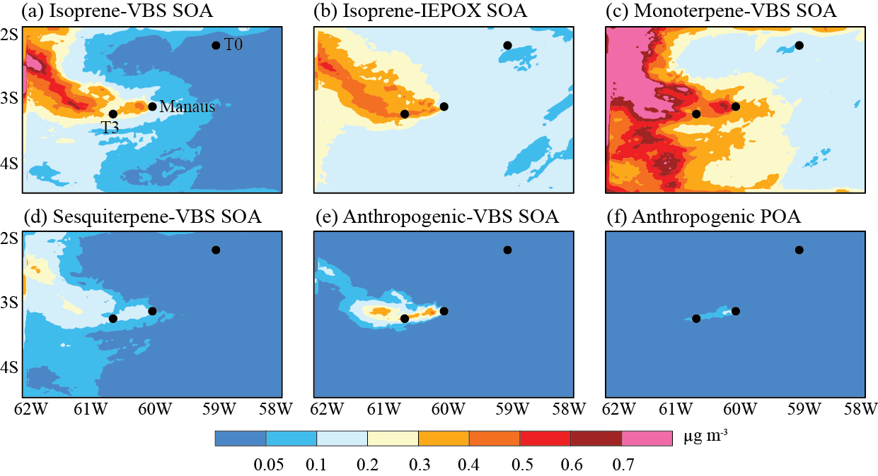
Simulated organic aerosol components

Slide 15
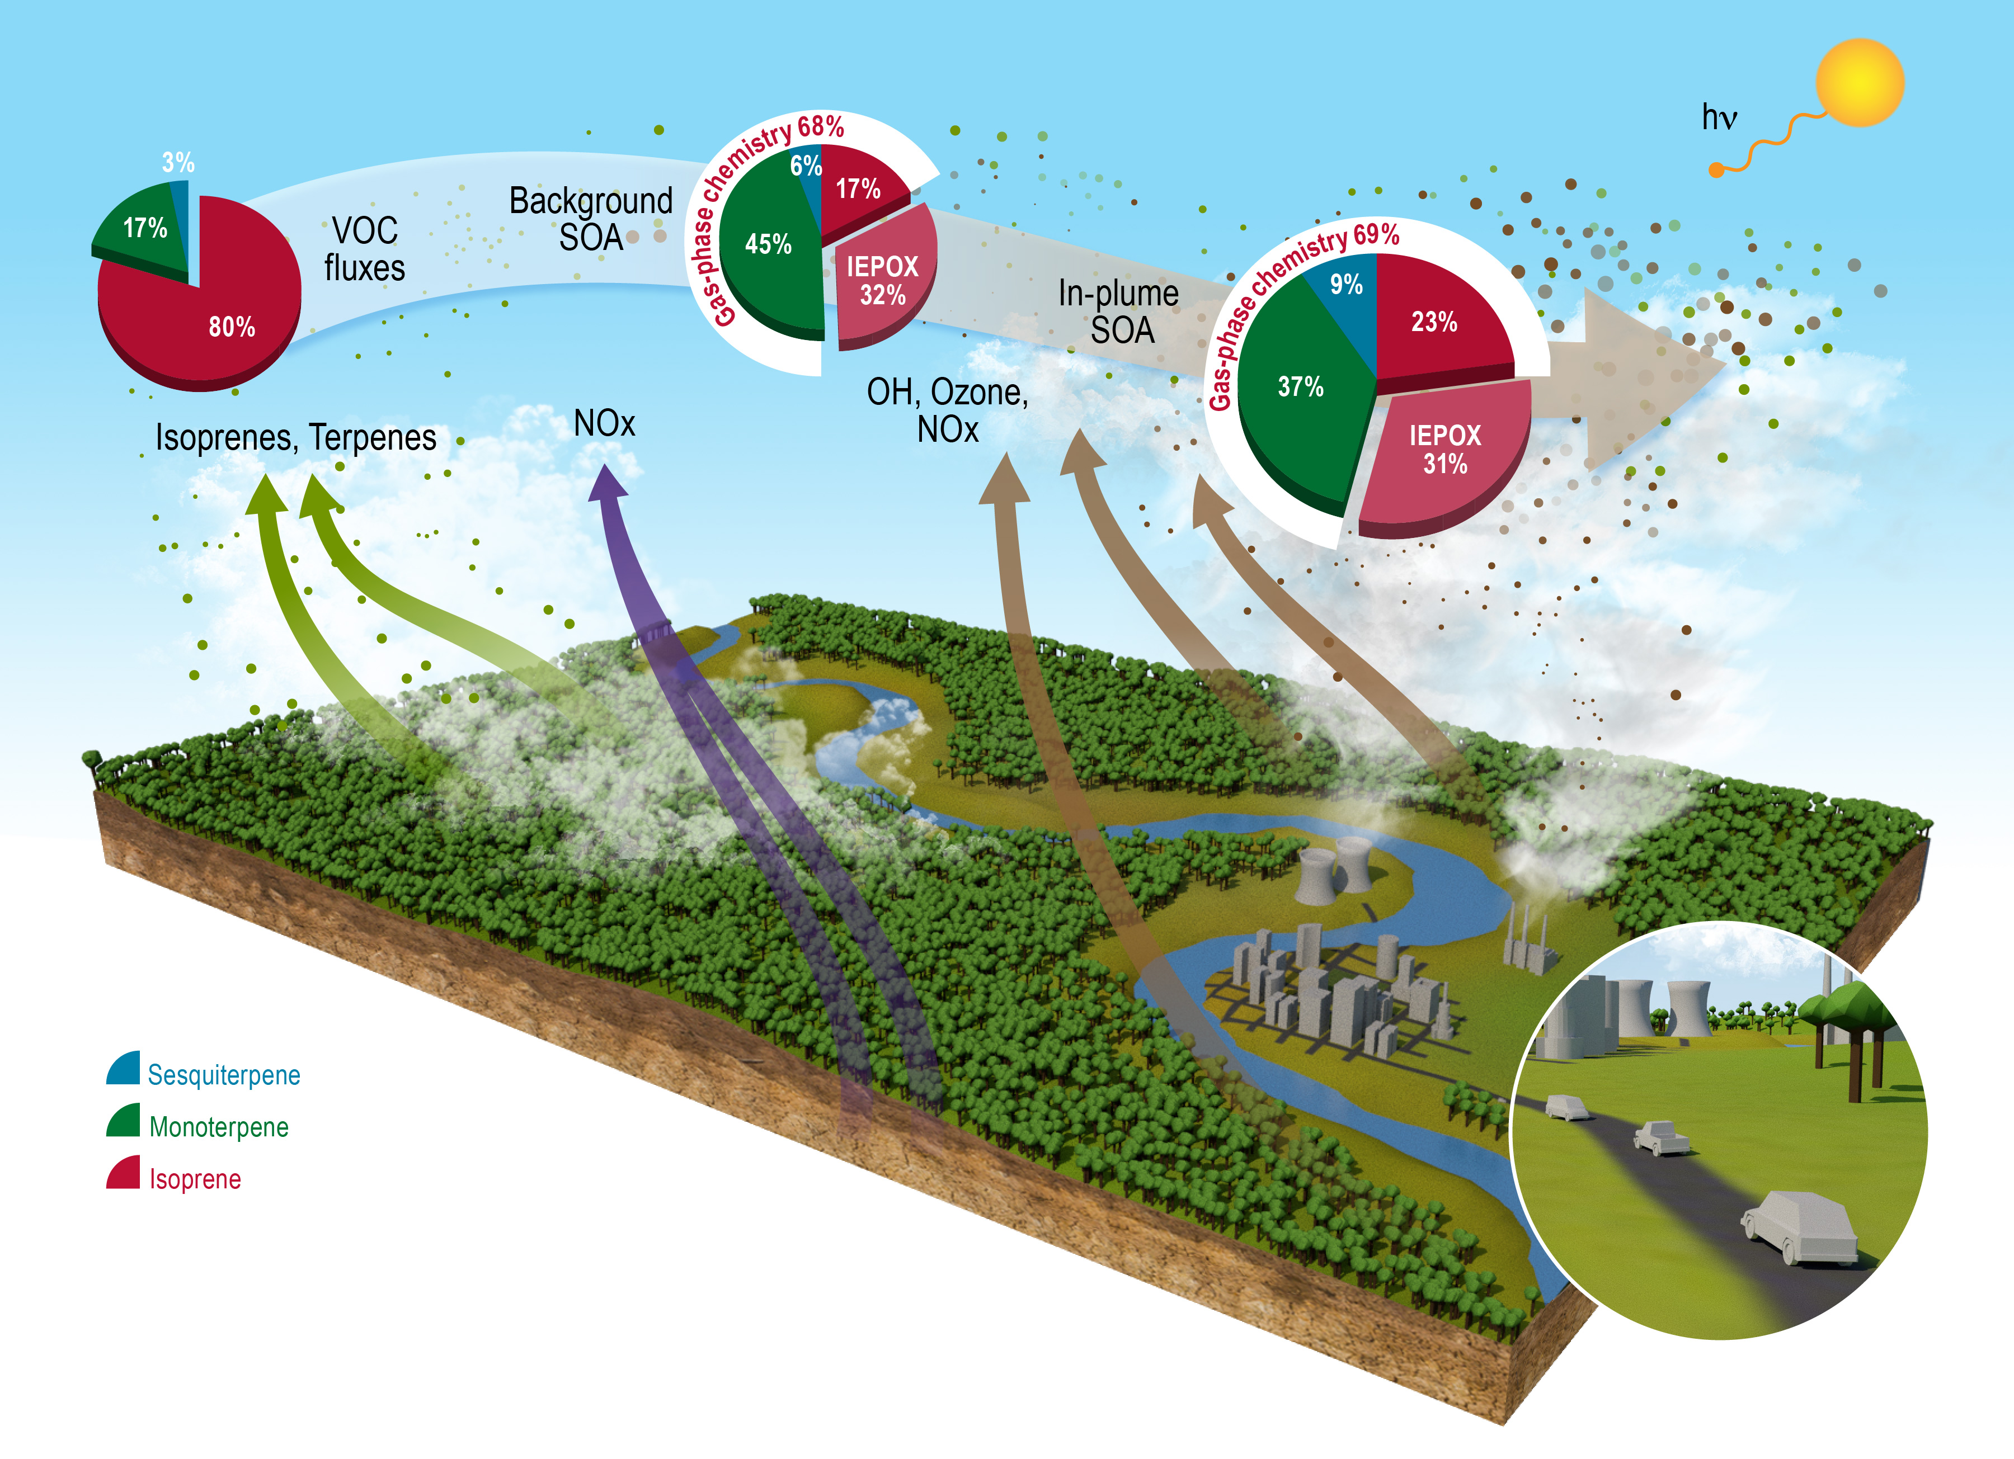
Summary: Anthropogenic NOx greatly enhances oxidation of biogenic VOCs and SOA formation
Shrivastava et al. 2019, Nature Communications
Pure gas-phase chemistry comprises 70% of biogenic SOA over the Amazon
Monoterpenes contribute 37-45% to biogenic SOA within isoprene dominated Amazon
Multiphase IEPOX chemistry represents another 30%: Likely an upper bound

Slide 16
Summary: Anthropogenic NO_{x} greatly enhances oxidation of biogenic VOCs and enhances SOA formation
SOA formation increases by 60-400% in Manaus plume as NO_{x} increases from 50 ppt (background) to 1 ppb (in-plume)
In the United States, NO_{x} controlled biogenic SOA has been reported to be ~20% (Carlton et al. 2010)
Amazonian in-plume NO_{x} of 1 ppb is background NO_{x} in other regions like USA!!!
Model shows that biogenic SOA comprises 80% of total OA in the plume, 20% is anthropogenic OA
Model shows that pure gas-phase chemistry comprises 70% of biogenic SOA over the Amazon
Reactive uptake of isoprene epoxydiols on aqueous particles is the other 30% of biogenic SOA

Slide 17
Future work
Developing IEPOX-SOA formulations to include self-limiting effects of organic coatings, semi-volatile tetrols and their oligomers based on chamber measurements
Investigating SOA formation within aqueous aerosols and cloud droplets
Including new monoterpene SOA formulations and assessing impacts for new particle formation and growth
Modeling dry season of GoAmazon focusing on biomass burning SOA formation
Other projects: SOA formation during HI-SCALE field campaign in Central Oklahoma, global-scale modeling of SOA within DOE’s new E3SM model

Slide 18
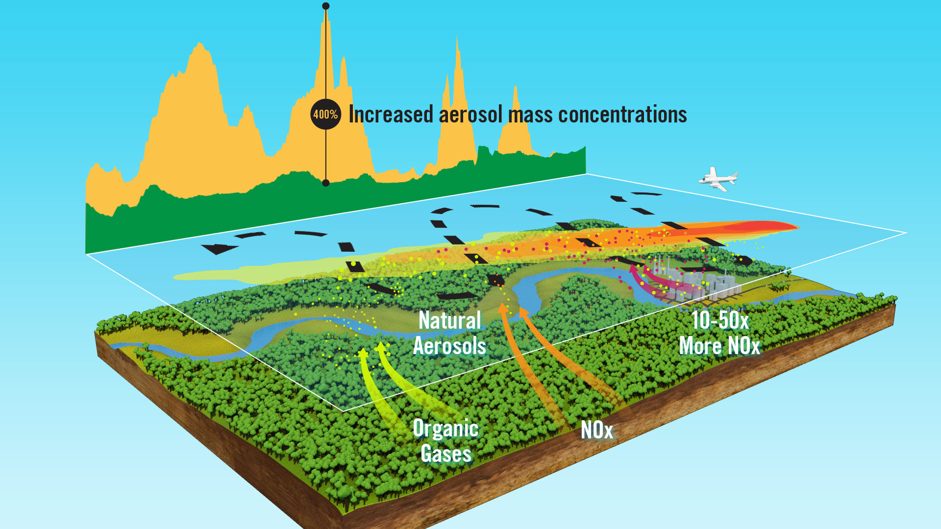
GoAmazon measurements March 13, 2014: G1 aircraft travels between pristine and polluted conditions
NO_{x} background in Amazon is 20-50 ppt, 1-2 orders of magnitude lower than other continental regions like USA!
Notes:
The forest emits volatile organic gases like isoprene, monoterpenes and sesquiterpenes. It also emits Nox from soil at sub- parts per billion levels. In comparison the urban area emits 10 to 50 times more Nox mainly from burning fossil fuels. We now see an aircraft as it zigzags across the urban plume at the center and samples both pristine air and polluted air comcomitantly. We see periodic rise and fall of organic aerosols as the aircraft intersects the plume in transeverse patterns. Over the past several years since the GoAmazon field campaign took place, I have been developing high resolution model treatments within the WRF-Chem model to see if the model can predict what the observations saw.

Slide 19
Simulated anthropogenic OA agrees with AMS HOA factor
WRF-Chem anthropogenic SOA+POA agrees with AMS HOA factor
HOA factor could have contributions from both primary and secondary anthropogenic SOA near source

