Slide 1
Projecting PM_{2.5} concentration fields to correspond to just meeting National Ambient Air Quality Standards
International Aerosol Modeling Algorithms (IAMA) Conference
4-6 December 2019, UC-Davis, CA
James Kelly¹, Carey Jang¹, Brian Timin¹, Brett Gantt¹, Adam Reff¹, Yun Zhu², Shicheng Long², and Adel Hanna³
¹U.S. Environmental Protection Agency, Office of Air Quality Planning & Standards, NC USA
²College of Environment and Energy, South China University of Technology, Guangzhou Higher Education Mega Center, Guangzhou, China
³Institute for the Environment, University of North Carolina at Chapel Hill, NC, 27517, USA
The views expressed in this presentation are those of the authors and do not necessarily represent the views or policies of the U.S. Environmental Protection Agency

Slide 2
Background
During periodic reviews of PM National Ambient Air Quality Standards (NAAQS), health risks associated with the existing and potential alternative PM_{2.5} standards are assessed
To inform these risk assessments, monitored PM_{2.5} concentrations are adjusted to concentrations that “just meet” the PM_{2.5} NAAQS
Statistical projection methods have been used previously due to the computational expense of photochemical grid models (PGMs)
Recent advances in exposure modeling have increased interest in using PGMs to project PM_{2.5} concentrations for risk assessments
Here we demonstrate an efficient method to use air quality modeling to project monitored and gridded PM_{2.5} concentration fields to correspond to just meeting NAAQS

Slide 3
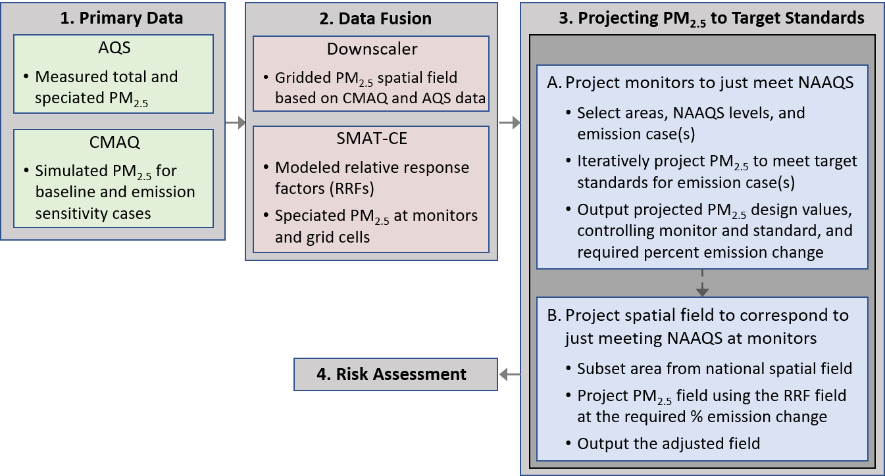
Primary Steps in Approach
Develop observationally-constrained baseline concentrations at monitors and on gridded spatial field
Simulate the response of PM_{2.5} for select emission changes, and interpolate the PM_{2.5} response across a range of emission changes
Iteratively project monitored PM_{2.5} to identify the emission level where the NAAQS are just met, and project the gridded PM_{2.5} field accordingly

Slide 4
Step 1: Characterizing Baseline Concentrations
PM_{2.5} was characterized at monitors using 2014-2016 observations
PM_{2.5} was modeled on a national gridded domain for the 2015 period using CMAQv5.2.1
Gridded concentration fields were developed using monitored and modeled PM_{2.5} according to three approaches
VNA (Voronoi Neighbor Averaging): interpolation of monitor data
eVNA (extended-VNA): interpolation of monitoring data that has been scaled by CMAQ gradients between the monitor and target grid cell
Downscaler: Bayesian statistical model that regresses CMAQ modeling on monitoring data and makes predictions using a CMAQ input field

Slide 5
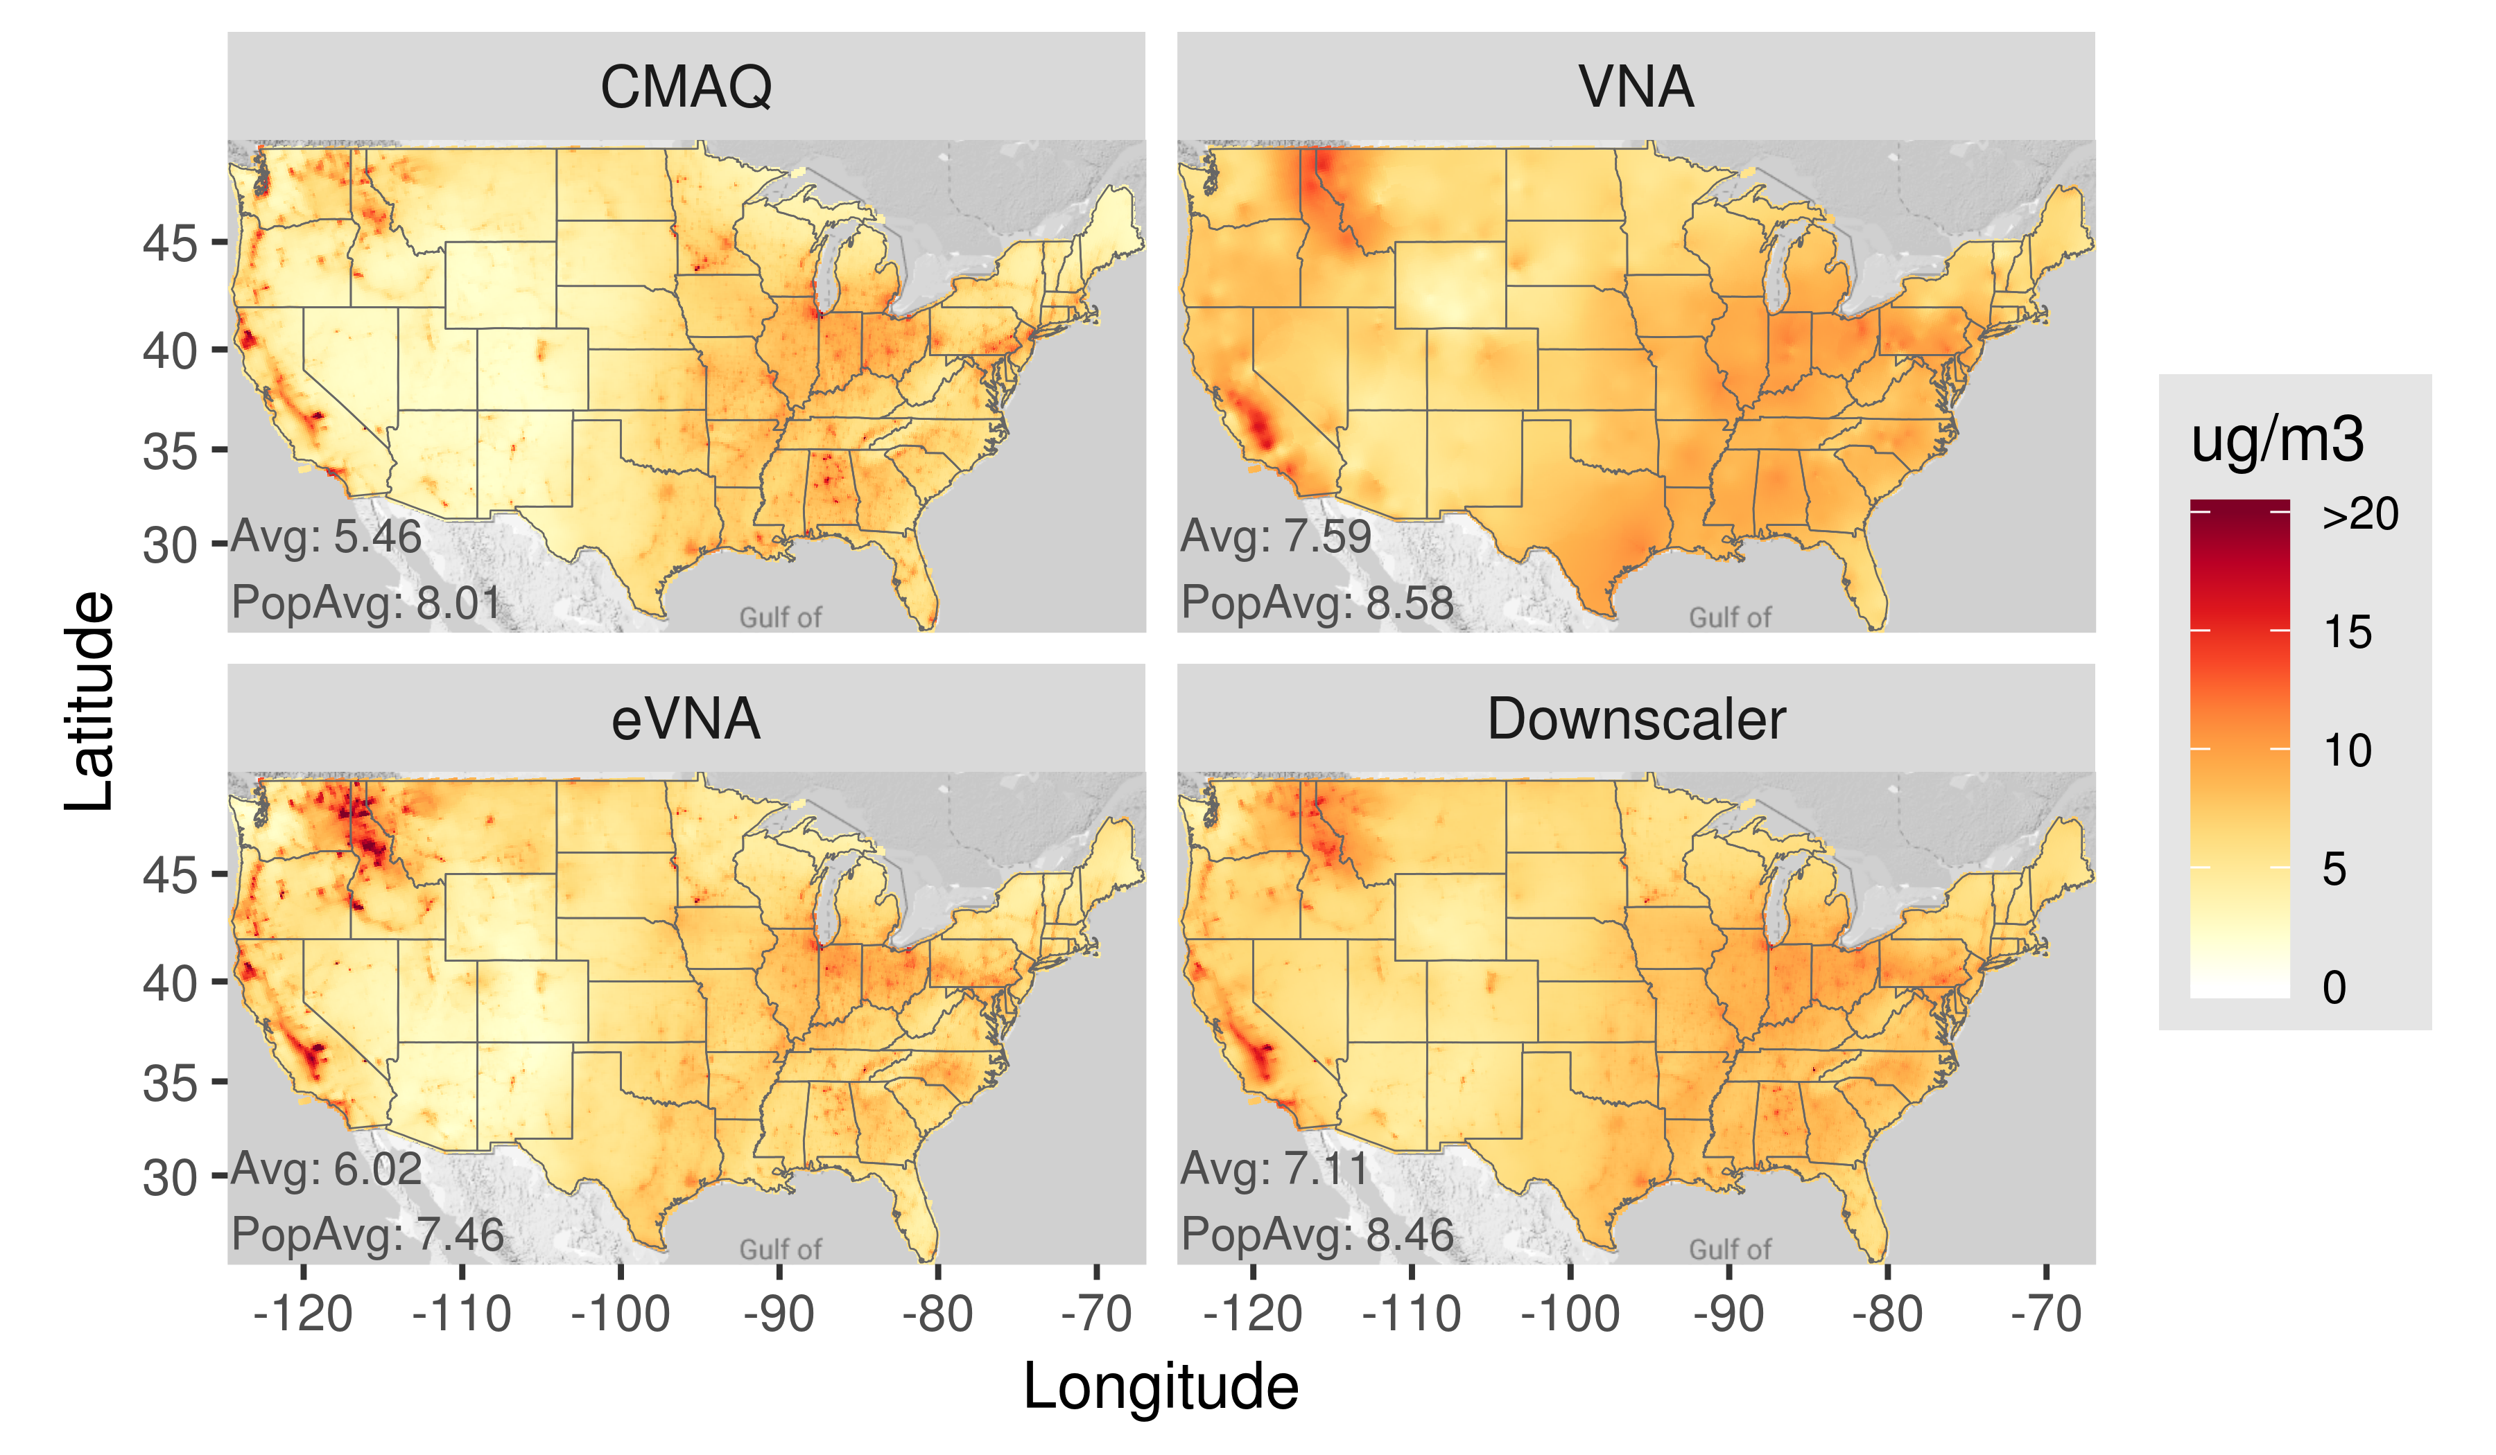
Baseline PM_{2.5} Concentration Fields
Annual PM_{2.5} concentrations are broadly consistent among methods
VNA and Downscaler fields tend to be smoother than eVNA and CMAQ fields
Ten-fold cross-validation was performed to evaluate the methods

Slide 6
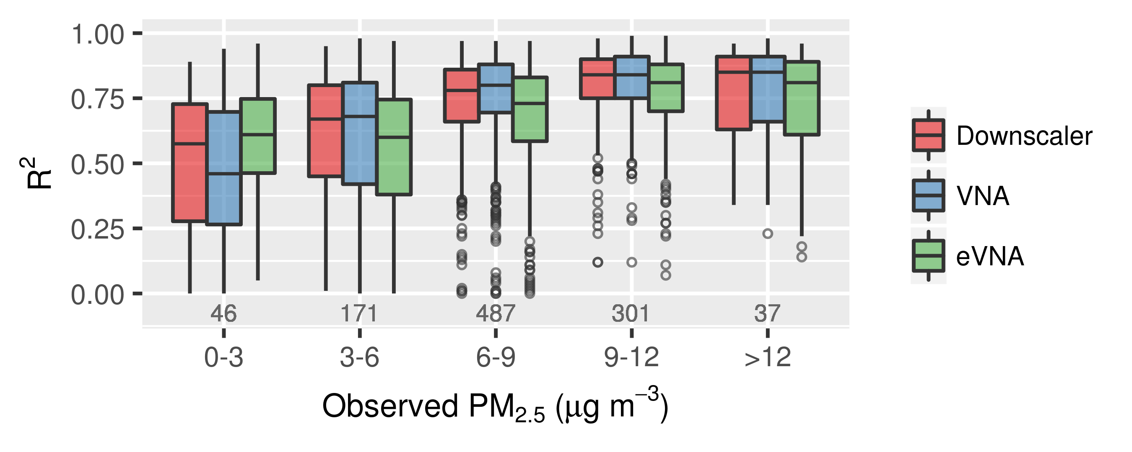
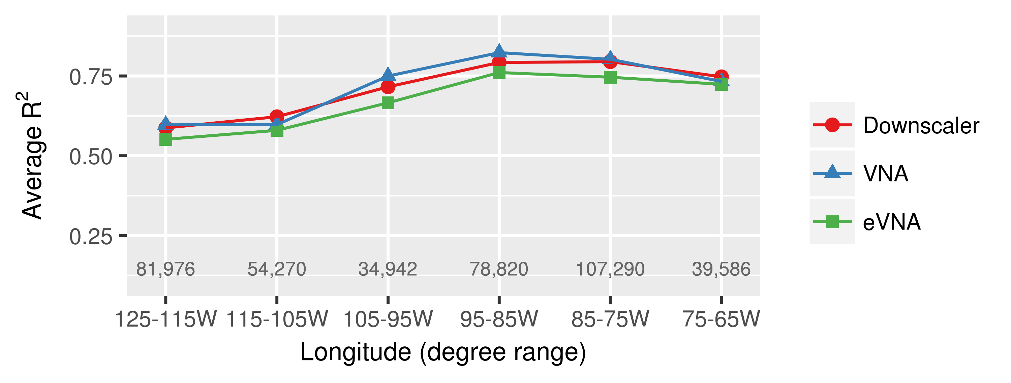
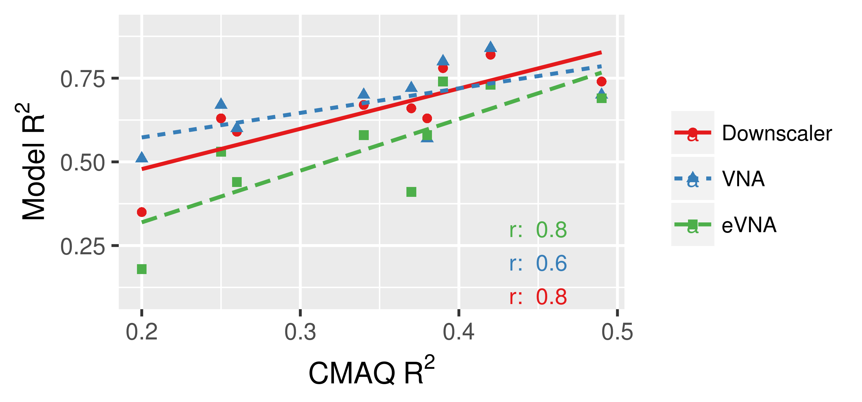
Model Evaluation using Withheld Observations
R² Increases with PM_{2.5} Concentration
R² is Higher in the Eastern U.S.
West
East
R² Increases with CMAQ Performance
R² Decreases with Distance to Nearest Monitor
Kelly et al. (2019) Atmospheric Environment: X, https://doi.org/10.1016/j.aeaoa.2019.100019

Slide 7
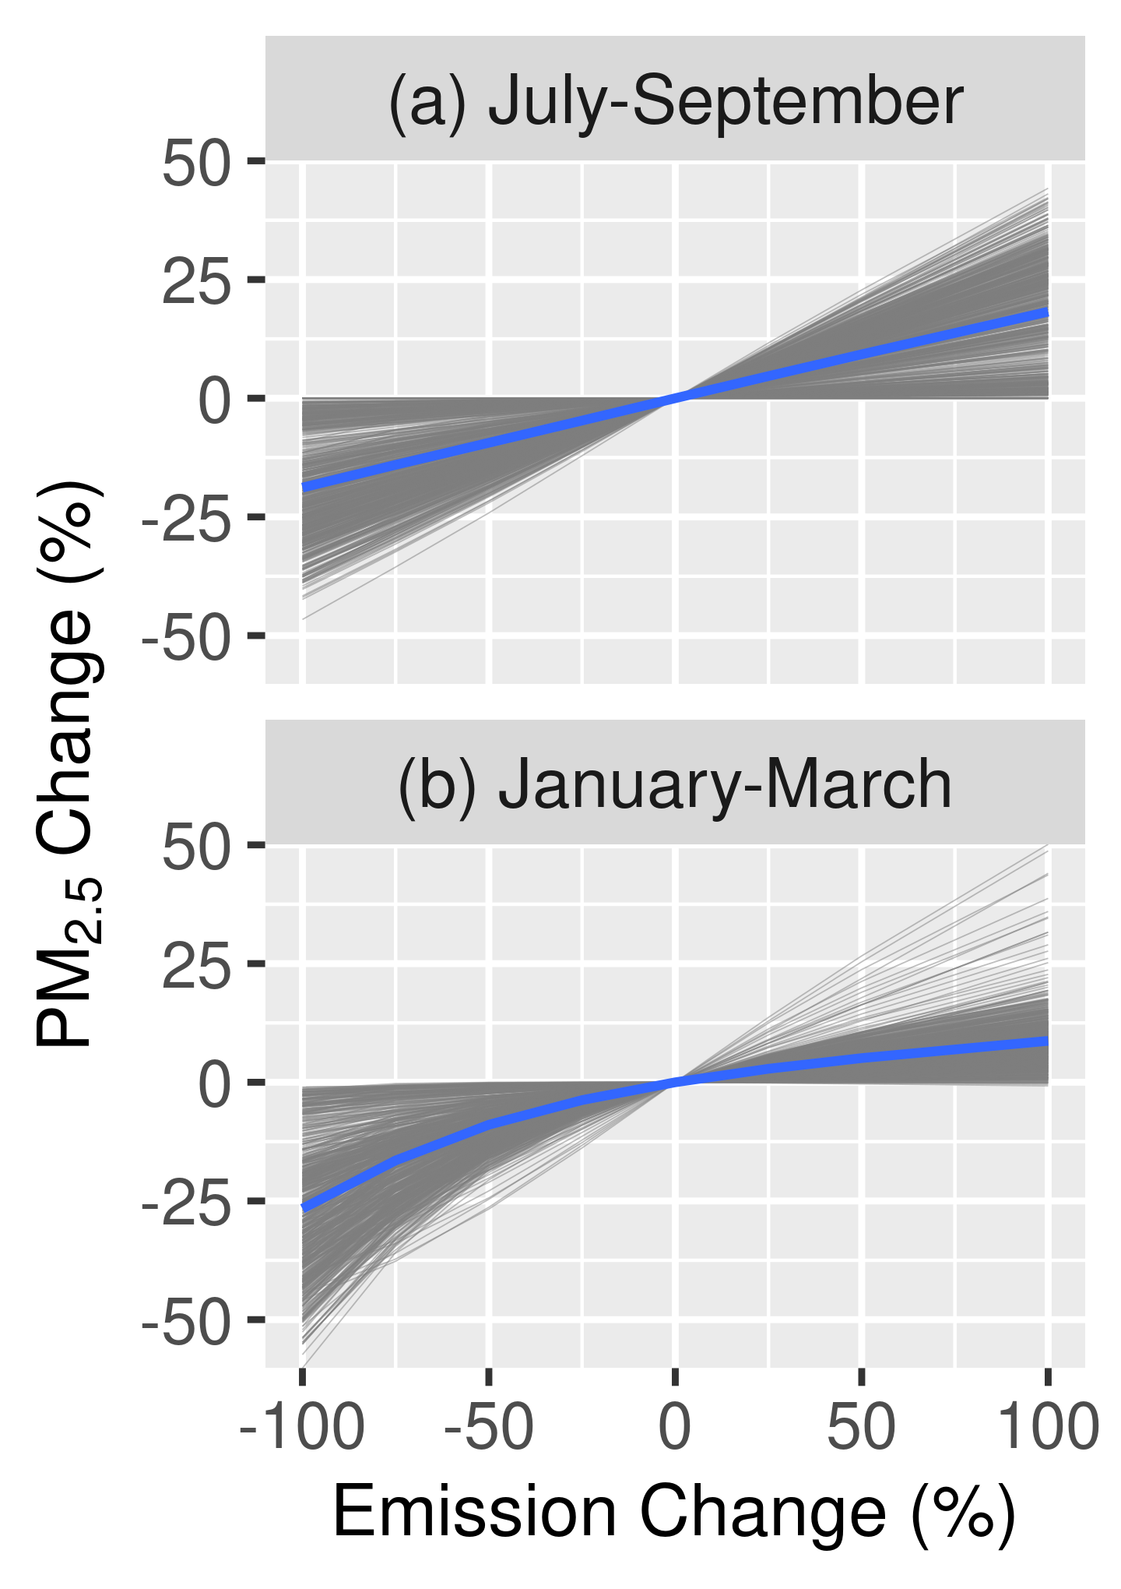
Step 2: Estimating the Response of PM_{2.5} to Emissions
Simulations were conducted with percent changes in U.S. anthropogenic emissions relative to the 2015 baseline
NOx and SO₂: -100%, -75%, -50%, -25%, +25%, +50%, +75%
Primary PM₂₅: -50% and +50%
Relative response factors (RRFs) were developed using the CMAQ baseline and sensitivity simulations
Species RRF: ${RRF}_{spc}=\frac{{PM}_{spc,control}}{{PM}_{spc,base}}$
Total PM_{2.5} RRF: ${RRF}_{Tot, PM2.5}=\frac{\sum{{RRF}_{spc}{PM}_{spc}}}{\sum{{PM}_{spc}}}$
NO_{x} and SO₂ Response

Slide 8
Spatial Field of PM_{2.5} Responsiveness
Spatial fields of response factors allow gridded PM_{2.5} fields to be projected according to the percent emission change needed for the monitors in the area to just meet the standard
Kelly et al. (2019) Atmospheric Environment: X, https://doi.org/10.1016/j.aeaoa.2019.100019

Slide 9
Step 3: Projecting Monitored and Gridded Fields of PM_{2.5}
First, concentrations at monitors are iteratively projected to estimate the emission changes needed to just meet standards at monitoring sites
Second, spatial PM_{2.5} fields are projected to correspond to just meeting NAAQS at monitor

Slide 10
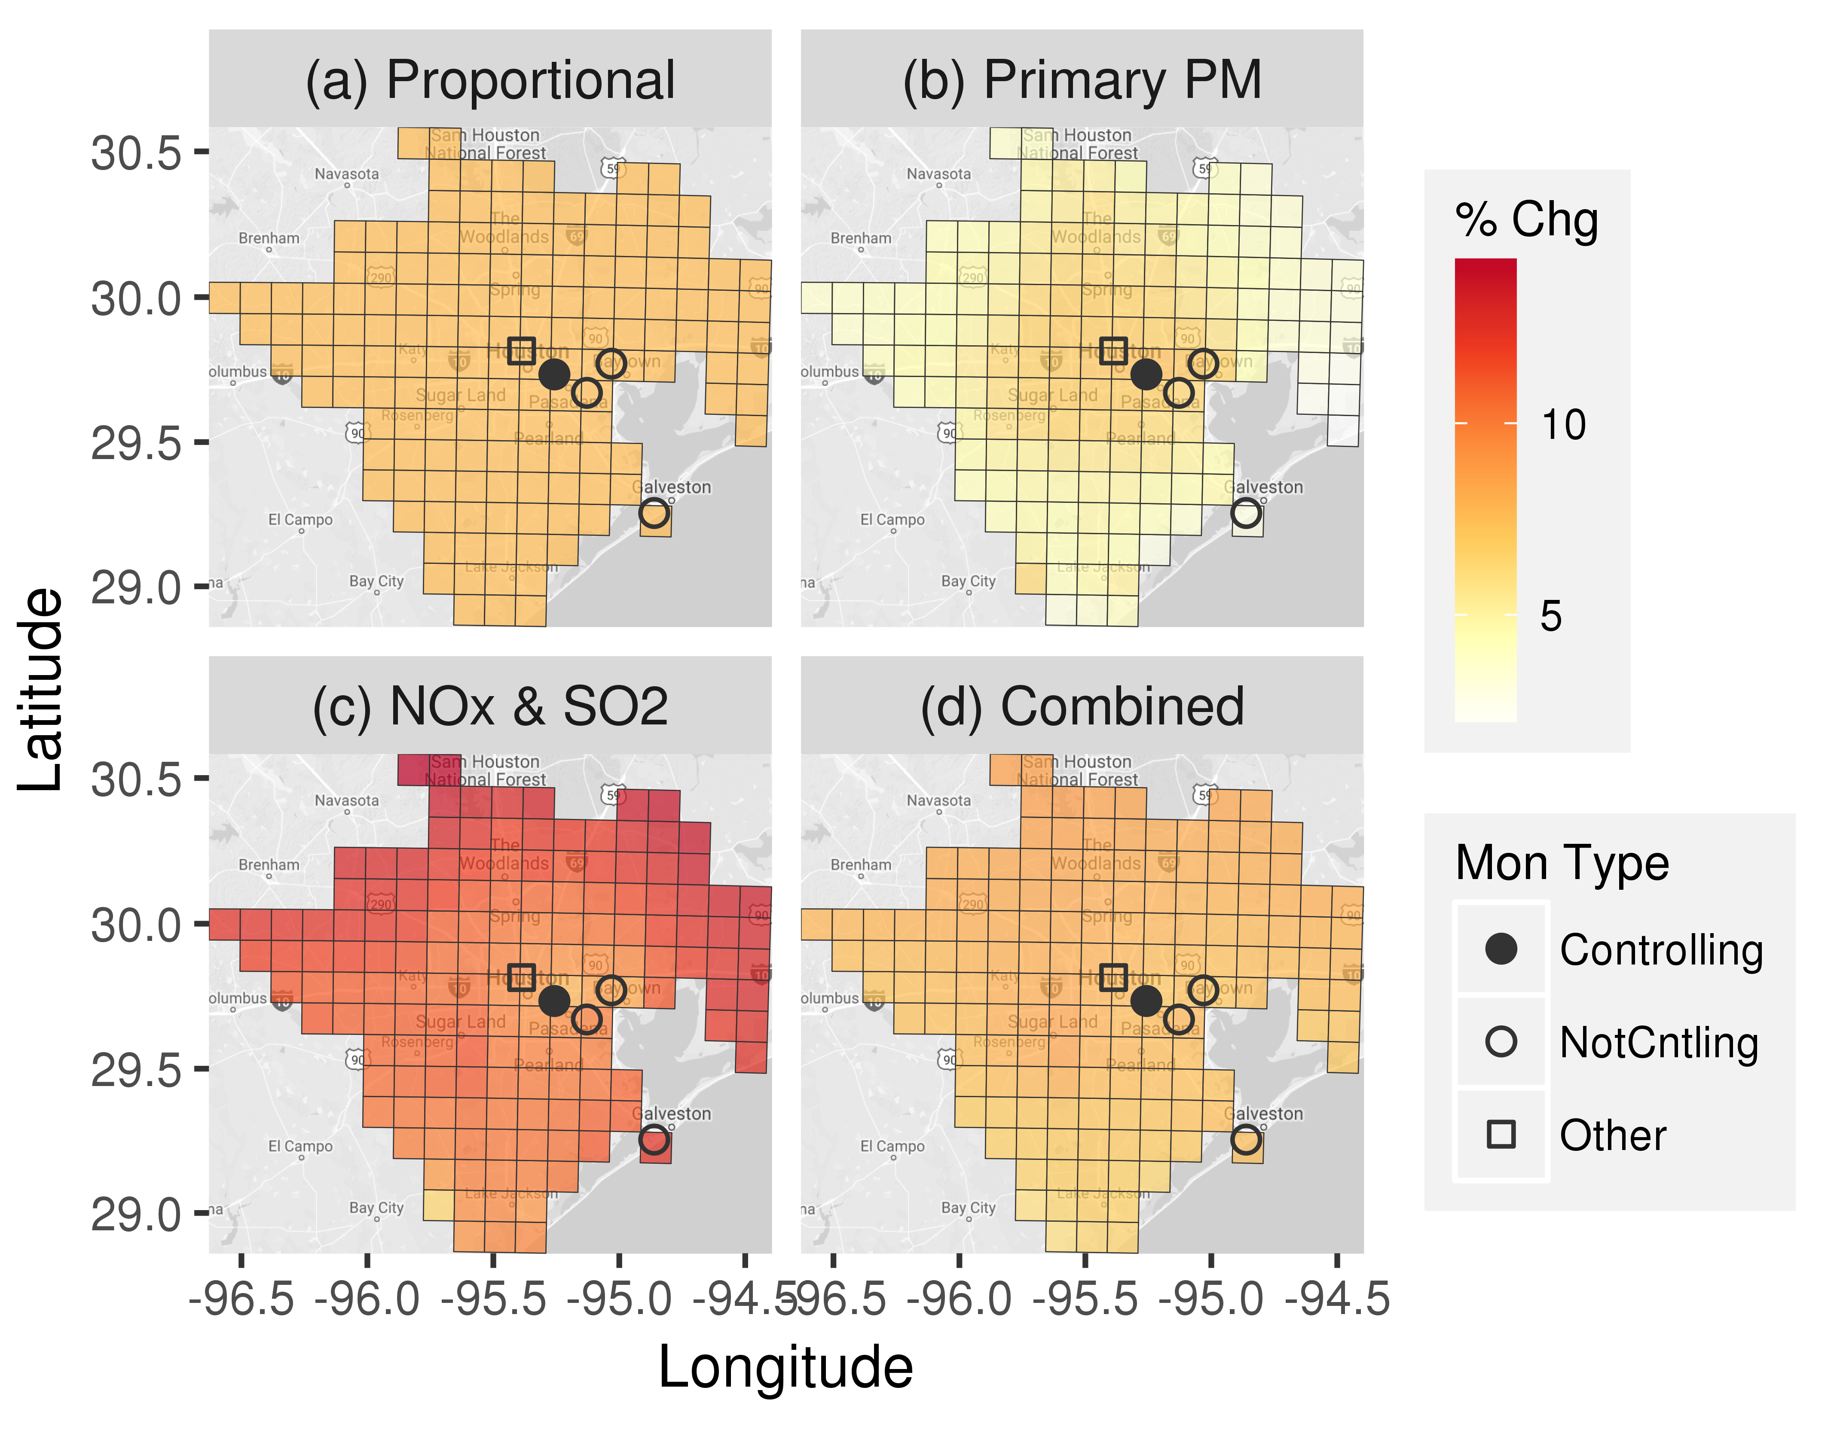
Percent Change in PM_{2.5} to Just Meet NAAQS
Proportional adjustment yields a uniform 7% increase in PM_{2.5} based on controlling monitor in Houston, TX
Primary PM_{2.5} emission increases yield relatively large PM_{2.5} increases in the urban core and smaller increases elsewhere
NOx and SO₂ emission increases yield relatively large PM_{2.5} increases outside of the urban core
Combined* primary PM_{2.5} and NOx and SO₂ emission increases yield PM_{2.5} increases similar to proportional projection
The air quality modeling approach provides realistic spatial response patterns for PM_{2.5} projection
Map data
©2018 Google, INEGI
*’Combined’ indicates that 50% of exceedance increment was resolved with primary PM_{2.5} and 50% with NOx and SO₂ emission reductions
Kelly et al. (2019) Atmospheric Environment: X, https://doi.org/10.1016/j.aeaoa.2019.100019

Slide 11
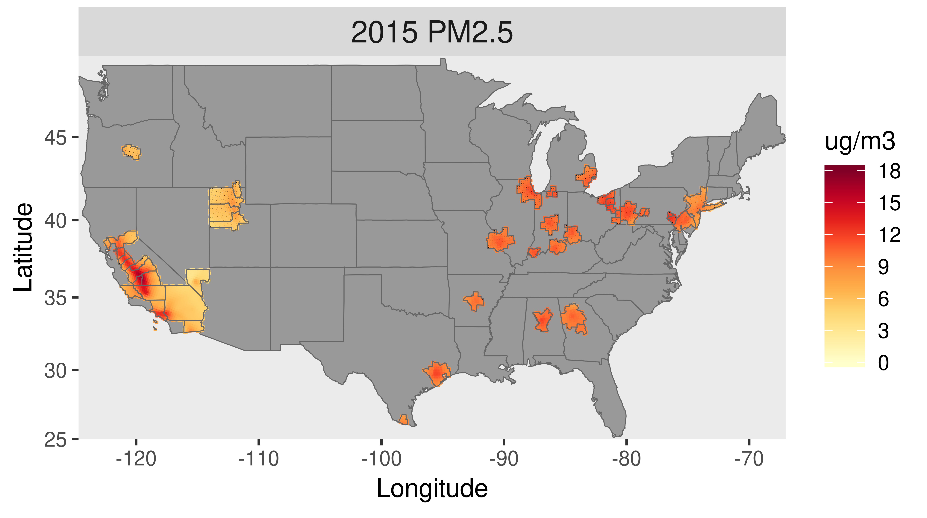
National-Scale Application
47 CBSAs (core-based statistical areas) were selected to provide national coverage with focus on areas with relatively high PM_{2.5}
Baseline 2015 concentrations (figure) were then projected to correspond with just meeting the existing NAAQS and an alternative case

Slide 12
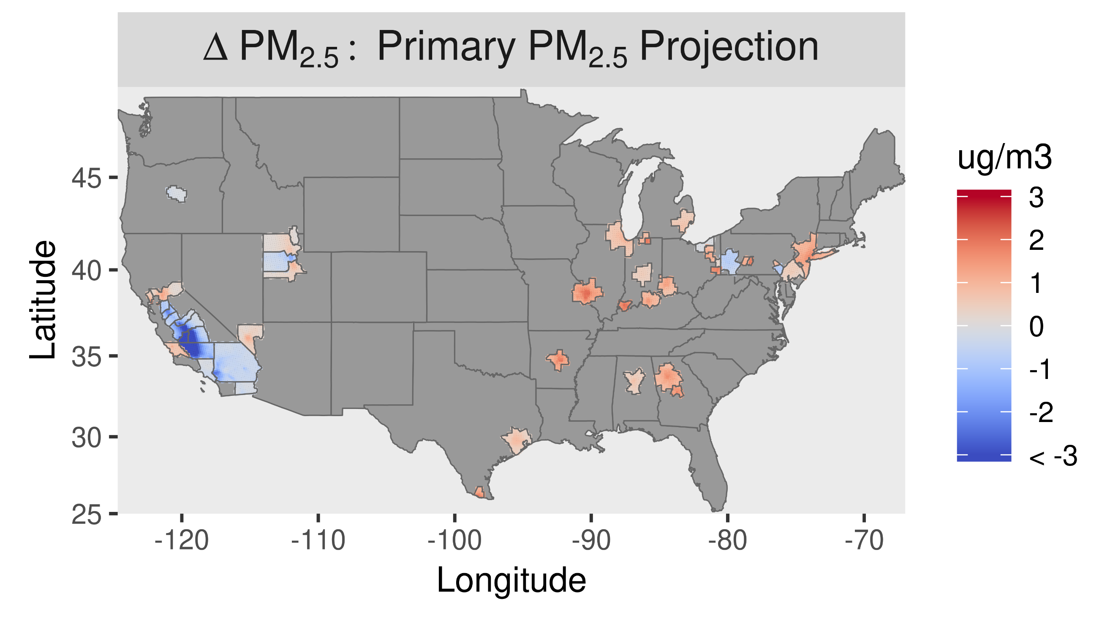
ΔPM_{2.5} (12/35* – 2015)
Difference in PM_{2.5} is shown between just meeting the existing standards and the 2015 baseline for the primary PM projection method
Positive increments occur in areas with baseline PM_{2.5} below the standards; negative increments occur in areas with PM_{2.5} above the standards
*Annual NAAQS: 12 μg m⁻³; Daily NAAQS: 35 μg m⁻³

Slide 13
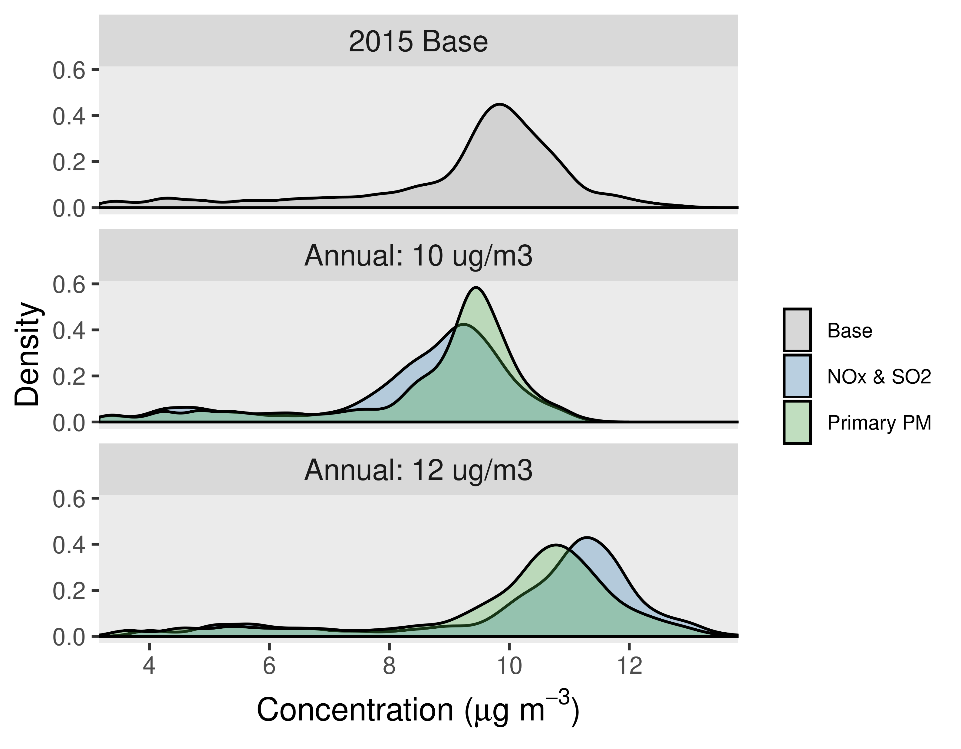
Shifts in PM_{2.5} Distributions with Standard Level
Distributions of PM_{2.5} are shown for the 2015 baseline and projected cases for the 30 CBSAs where the annual standard is controlling
Shifts in PM_{2.5} distributions associated with standard level are qualitatively similar for different emission cases, with some differences due to different spatial response patterns

Slide 14
Summary
Projecting gridded concentration fields to correspond to just meeting PM_{2.5} NAAQS using air quality models is computationally challenging
Here, a method is developed to efficiently project PM_{2.5} fields to just meet NAAQS according to realistic spatial response patterns based on air quality modeling for multiple emission cases
The method is demonstrated for a national-scale application with projections based on primary PM_{2.5} and NOx and SO₂ emission cases
Future work will explore the potential for more advanced response-surface models to inform risk assessments as well as a broader range of air quality applications

