Slide 1
The effectiveness of the “Air Pollution Prevention and Control Action Plan” on the air quality and human health during 2013-2017 in China
Jia Xing, Shuxiao Wang, Dian Ding, Jiming Hao (Tsinghua University)
Carey Jang, James Kelly (US EPA/OAQPS)
Yun Zhu (South China University of Technology)
International Aerosol Modeling Algorithms Conference, Dec 6, 2019, UC Davis

Slide 2
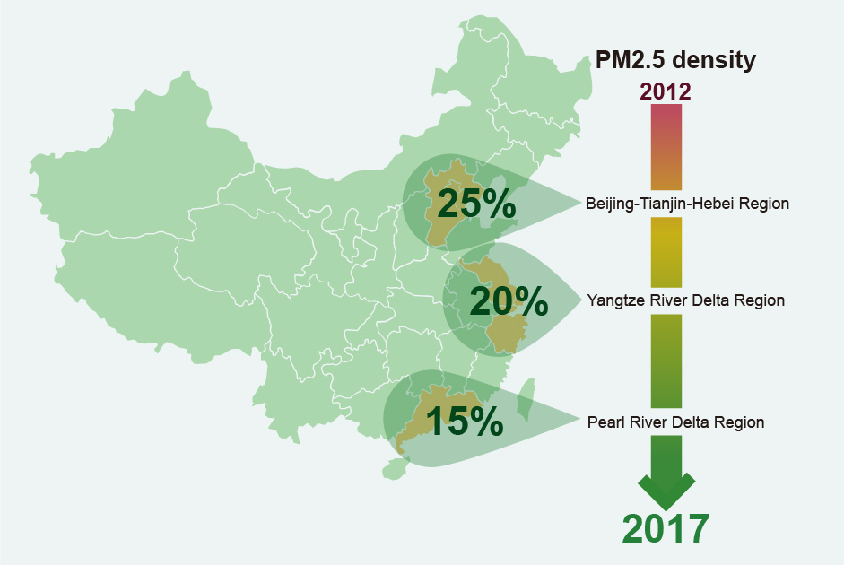
Background about PM_{2.5} control in China
China’s air quality management has shifted from targeting “Emissions Reduction” (Technology-based) to targeting “Air Quality” (Risk-based)
Ambient air quality standards (GB 3095-2012): sets limits on PM_{2.5} concentration
Air Pollution Prevention and Control Action Plan: sets PM_{2.5} reduction target
What was planed
What has happened
BTH: Beijing-Tianjin-Hebei
40%
23%
Key questions: What are the health benefits of the action plan during 2013-2017？

Slide 3
Anthropogenic emission reduction during 2013-2017
Controls on Power plants is effective in reducing SO₂ and NO_{x}
Primary PM reduction in industrial sectors is also important
 | SO₂ | NOx | PM_{2.5}
China | 33% | 25% | 30%
BTH | 44% | 28% | 41%
YRD | 45% | 32% | 30%
Guangdong | 37% | 20% | 18%
Sichuan-chongqing | 46% | 15% | 35%
How much percentage of the decreased PM_{2.5} is attributed to emission reductions?

Slide 4
Investigation with CMAQ and ABaCAS system
Simulation scenarios (CMAQv5.2)
 | Meteorology (WRFv3.8) | Biogenic emission (MEGANv2.04) | Anthropogenic emission
① | 2013 | 2013 | 2013
② | 2017 | 2017 | 2013
③ | 2017 | 2017 | 2017
Meteorology
Anthropogenic emission reduction
Data fusion (SMAT-CE)
Air quality monitoring data (2013, 2017)
Population growth
Health impact assessment (BenMAP-CE)
Air quality | Population | Incidence rates
①-② / ①-③ | 2013 | 2013
 | 2016 | 2013
 | 2013 | 2016
Mortality decreases
Contribution of the “Air Pollution Prevention and Control Action Plan” on PM_{2.5} reduction and related health effects

Slide 5
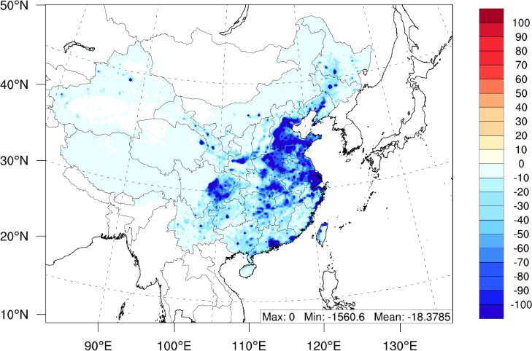
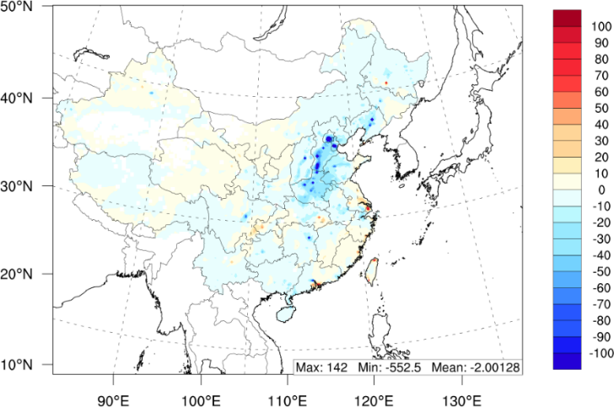
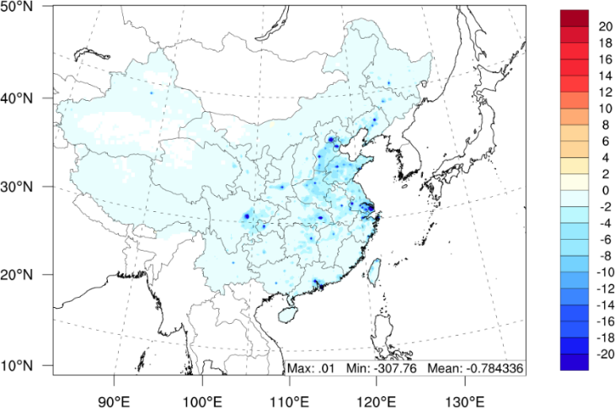
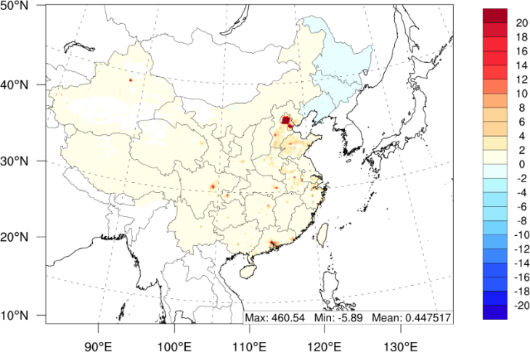
Premature deaths attribute to the change of four factors
Anthropogenic emission
Meteorology
The change of meteorology also contributes 28% of the decreased PM_{2.5} in BTH
Mortality rates
Population
The emission reduction is the dominant factor for the decrease of PM_{2.5} concentration and PM_{2.5}-related premature deaths

Slide 6
Premature deaths attributed to PM_{2.5} (2013-2017)
2013
2017
2013 - 2017
Premature deaths attribute to ambient PM_{2.5} in 2017 is 1102 thousands cases per year, decreased by 287 thousands (21%) from 2013.
Ding et al., EHP, 2019: Estimated Contributions of Emissions Controls, Meteorological Factors, Population Growth, and Changes in Baseline Mortality to Reductions in Ambient PM2.5 and PM2.5-Related Mortality in China, 2013–2017

Slide 7
Background about the increase of O₃ in China
What was expected
What was unexpected
PM_{2.5}
MDA8-O₃
25%
20%
90th percentiles in maximum daily average 8-h O₃
Many factors can contribute to such increase of O₃:
Meteorological variation
Emission changes
Reduced particle surface (heterogeneous reactions involving oxidants)
Aerosol direct/indirect effects on solar radiation and atmospheric dynamics
Key questions: What is the major driven factor for the increased O₃?

Slide 8
Anthropogenic emission reduction during 2013-2017
 | SO₂ | NOx | PM_{2.5} | VOC
China | 33% | 25% | 30% | 4%
BTH | 44% | 28% | 41% | 12%
YRD | 45% | 32% | 30% | 4%
Guangdong | 37% | 20% | 18% | -2%
Sichuan-chongqing | 46% | 15% | 35% | 12%
Is such increased O₃ related to the less/no controls on VOC?

Slide 9
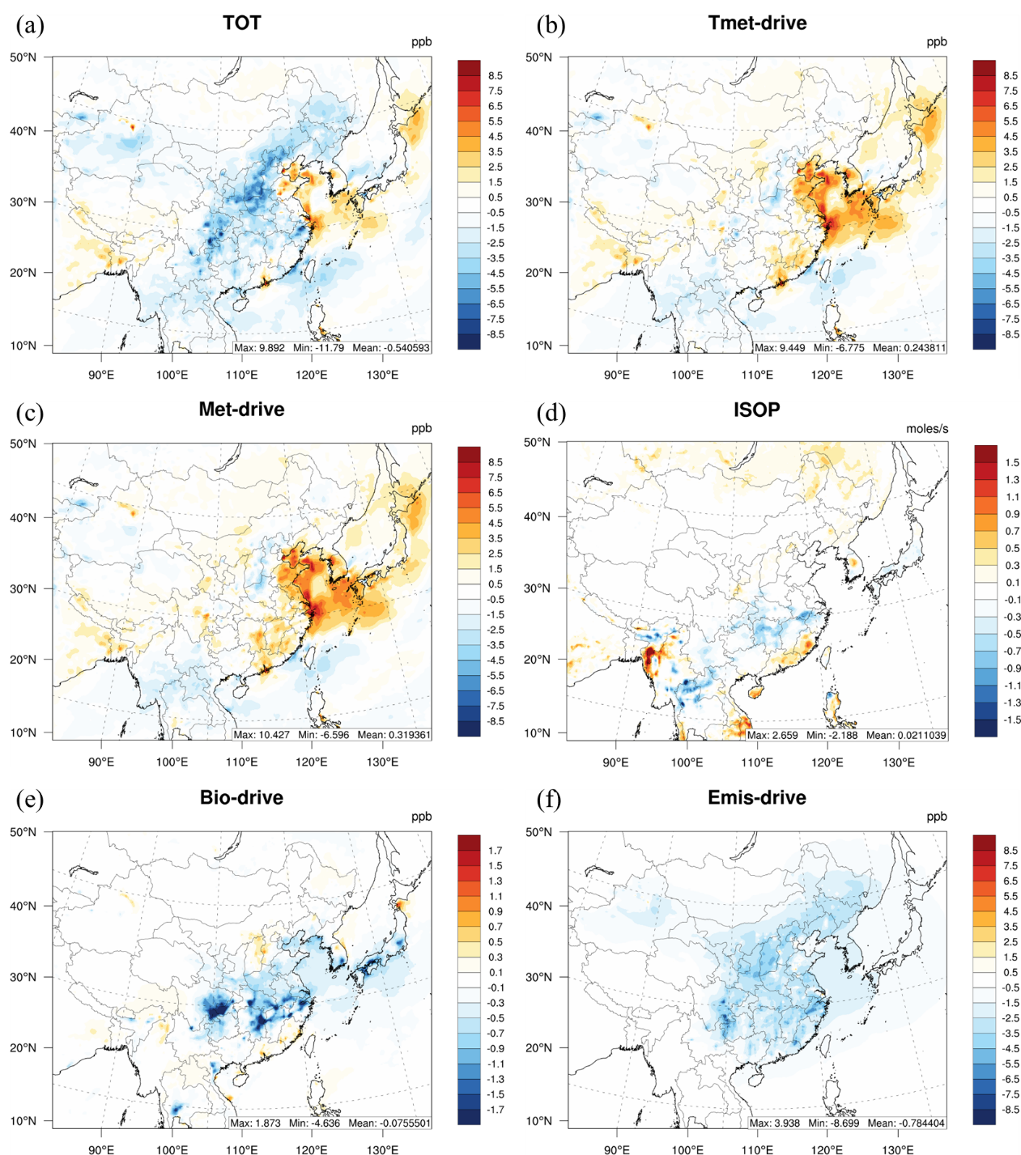
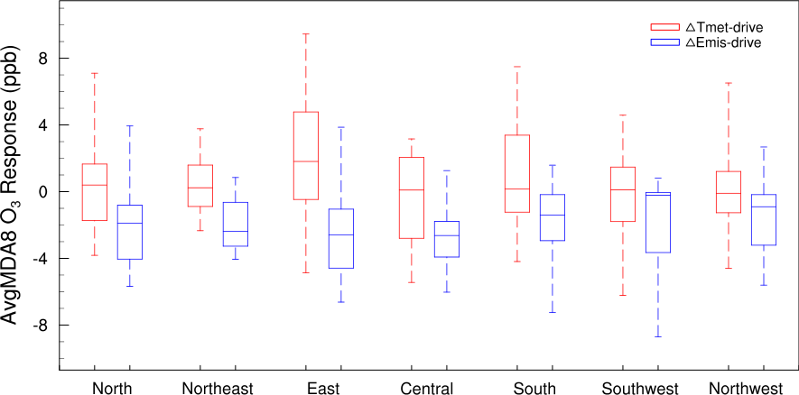
Contribution of emission and meteorology to MDA8 O₃
The effects of ΔEmis-Drive compensated ΔTmet-drive, suggesting that the emission reduction are important to prevent the increase of O₃
Higher temperature and stronger SW-radiation in 2017 enhances O₃ formation

Slide 10
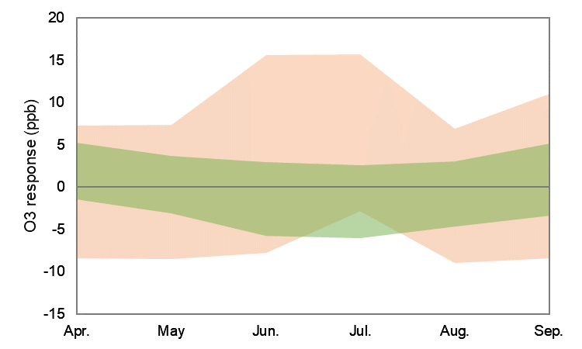
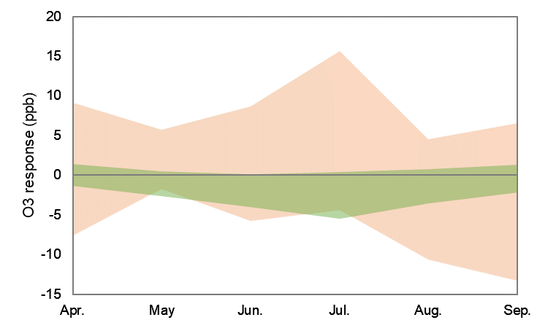
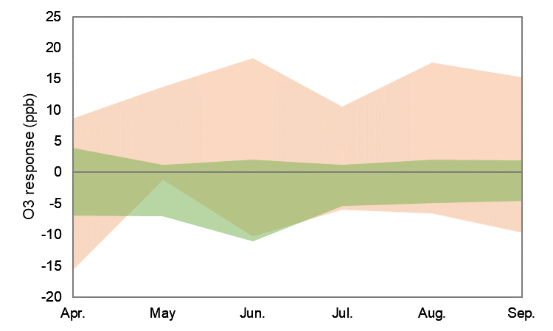
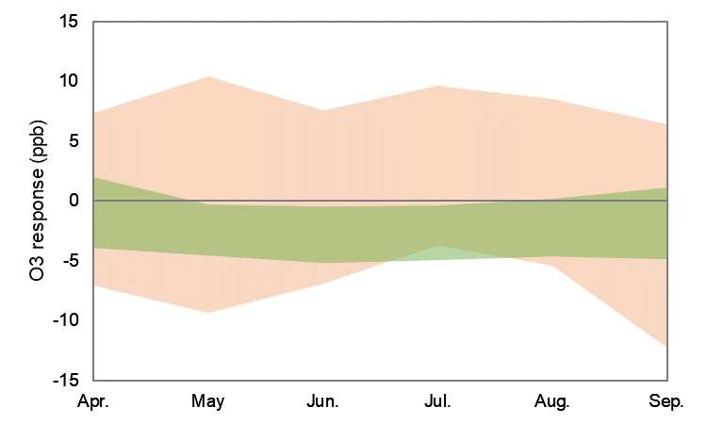
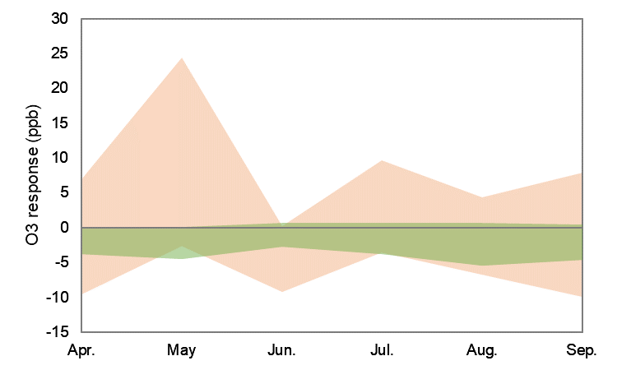
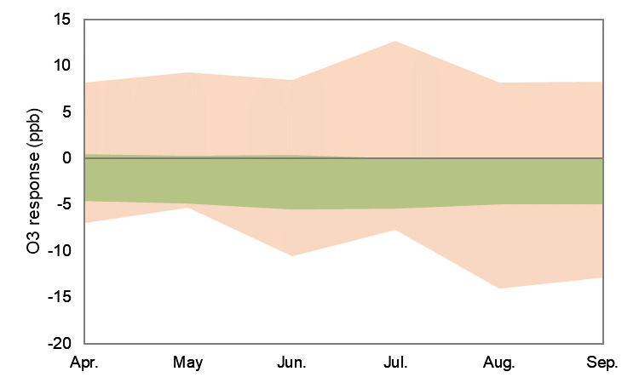
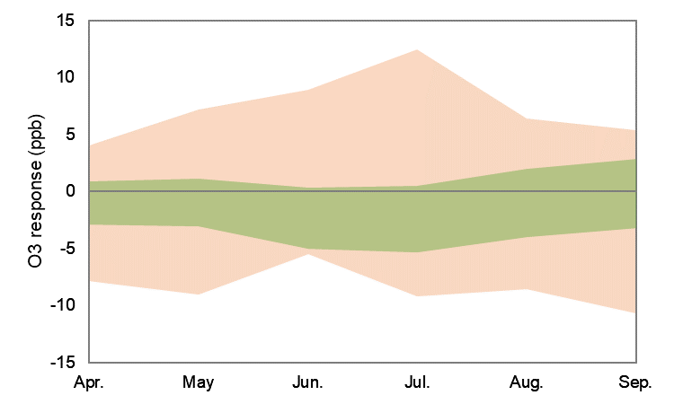
Contribution of emission and meteorology to MDA8 O₃
Tmet-drive
Emis-drive
North
Northeast
East
Central
South
Southwest
Northwest
ΔEmis-drive also varies significantly
largest benefit for O₃ reduction occurs in June and July
smallest benefit or even dis-benefit in April and September

Slide 11
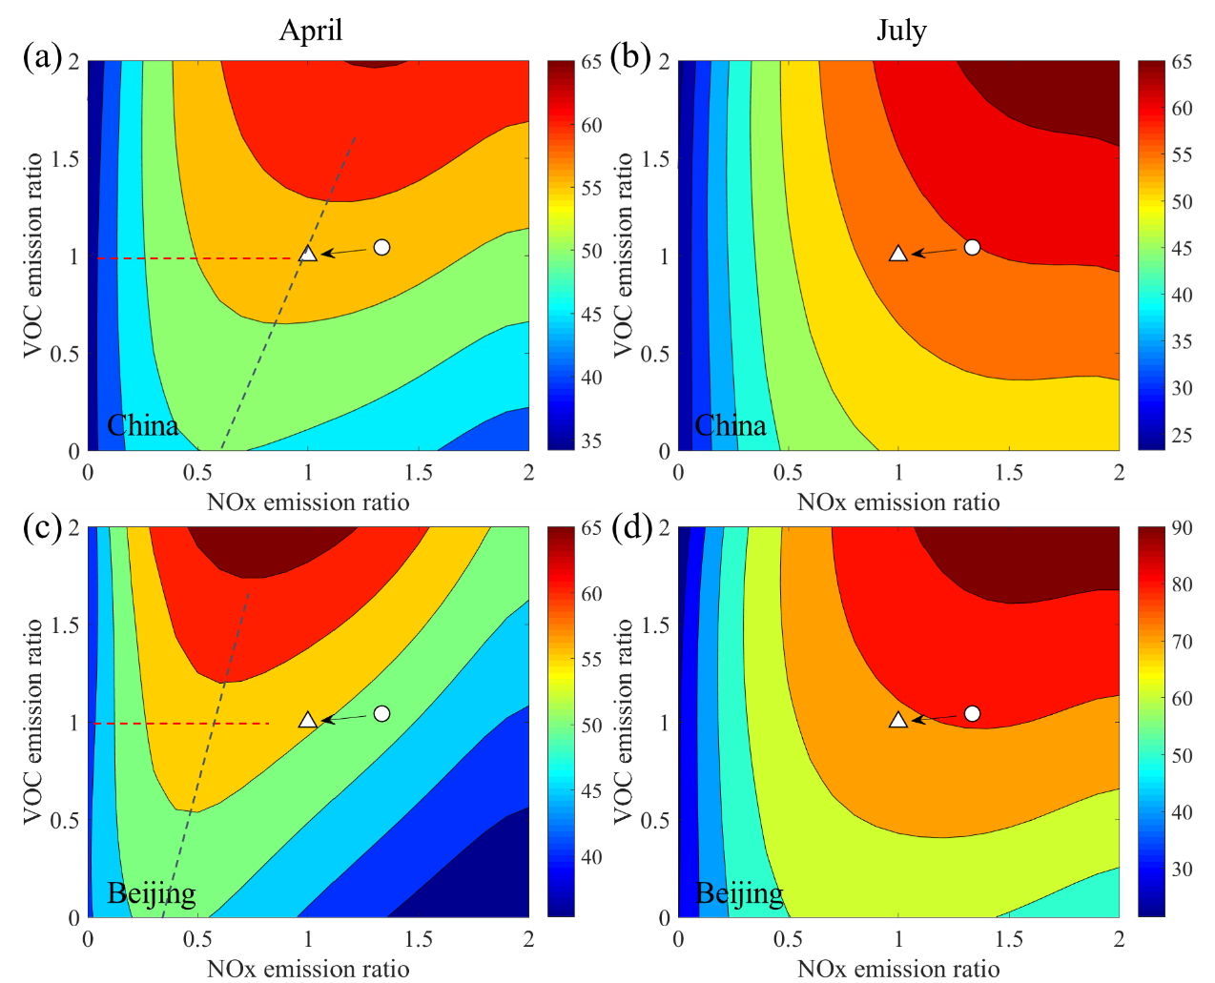
Investigate the O₃ response to NOx/VOC with RSM
Strong spatial and seasonal characteristics of O₃ chemistry
NOx-limited
China
(regional)
2013
2013
2017
2017
Beijing
(urban)
VOC-limited
2017
2013
2013
2017
VOC-limited
NOx-limited
Ding et al., FESE, 2019: Impacts of emissions and meteorological changes on China’s ozone pollution in the warm seasons of 2013 and 2017

Slide 12
What we learn from the Action Plan (2013-2017)?
It is effective for reducing PM_{2.5}, but much less effective for reducing O₃
Challenges:
How to further reduce PM_{2.5} to meet the national ambient air quality standard (NAAQS: 35 µg m⁻³), particularly in BTH?
How to reduce PM_{2.5} and O₃ simultaneously?

Slide 13
Design the optimal control pathway with LE-CO
The least-cost control strategy optimization (LE-CO) module
Cost
Response
Constraint
ICET：estimate cumulative control cost functions for each emission source;
RSM：quantify the relationship between concentration and emission reduction ratio
LECO: with certain environmental target, the optimized control ratio for each emission source can be calculated according to the minimal cost

Slide 14
Design the optimal control pathway (pollutants)
S1: only control PM_{2.5}
S2: control both O₃ and PM_{2.5}
Optimal control pathway to achieve NAAQS:
S1: NOx( -5%), SO2(-75%), VOC(-25%), PM(-85%), NH3(-65%)
S2: NOx(-75%), SO2(-75%), VOC(-55%), PM(-85%), NH3(-5%)
NH₃ emission controls can be a cost-efficient strategy to reduce PM_{2.5}, but not for O₃
Substantial reduction on NOx and VOC is critical for simultaneous control on PM_{2.5} and O₃
Xing et al., JEM, 2019: Least-cost control strategy optimization for air quality attainment of Beijing–Tianjin–Hebei region in China

Slide 15
Design the optimal control pathway (seasonal)
Control effectiveness with different NO_{x} and VOC ratios in reducing population-weighted PM_{2.5} and O₃ concentrations
In January, both PM_{2.5} and O₃ requires simultaneous VOC control to prevent the limitation of NO_{x} controls
In July, NO_{x} control was critical because the VOC controls had little effect on either O₃ or PM_{2.5}
Xing et al., ACP, 2019: Development and application of observable response indicators for design of an effective ozone and fine-particle pollution control strategy in China

Slide 16
Source apportionment from regional emissions
CM: local chemistry formed by transported precursors
TP: direct transport of the pollutant from the source area to the receptor area
PM_{2.5} (Winter)
O₃ (Summer)
Clean
Polluted
Clean
Polluted
PM_{2.5}
O₃
Contribution by regional emissions increases during the heavy pollution episodes
Xing et al., ES&T, 2017: Quantifying Nonlinear Multiregional Contributions to Ozone and Fine Particles Using an Updated Response Surface Modeling Technique

Slide 17
Design the optimal control pathway (spatial)
the same level of reductions should be conducted across the whole BTH region to achieve more aggressive targets
PM_{2.5}
O₃
local reduction has priorities for attaining moderate targets
(L:R = 1:1): the same reduction rate is applied in local and regional sources;
(L:R = 1:0.75): regional reduction rate is 75% of the local reduction rate;
(L:R = 1:0.5): regional reduction rate is half of the local reduction rate;
(L:R = 0.5:1): regional reduction rate is twice the local reduction rate;
(L:R = 1:0): only local reductions are considered)

Slide 18


Thank you very much!
Jia Xing
Associate Professor
School of Environment, Tsinghua University
Beijing, China, 10084
Email: xingjia@tsinghua.edu.cn

