Slide 1

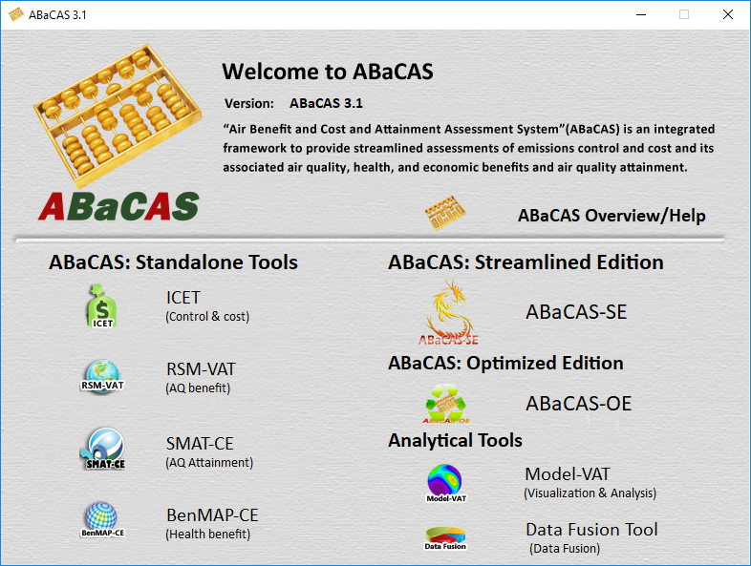

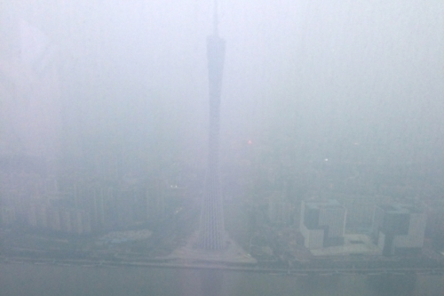


Development and Applications of Air Benefit and Cost and Attainment Assessment System (ABaCAS)
Air Pollution
(PM2.5 & O3)
ABaCAS
Cost/Benefit & Attainment
Emissions Control & Cost
Health & Economic
Benefit
AQ
Benefit & Attainment
Science
Policy
Actions
Carey Jang, Ph.D.
Office of Air Quality Planning & Standards
U.S. EPA, 12/6/2019

Slide 2
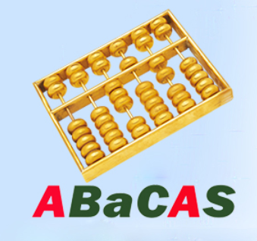
Outline
Air Benefit & Cost and Attainment Assessment System:
  “ABaCAS ”: An integrated assessment model developed by a team of international scientists; key components including:
    “ICET”: Control Cost Estimate Tool
    “RSM/CMAQ”: Air Quality Assessment Tool
    “SMAT-CE”: Attainment Assessment Tool
    “BenMAP-CE”: Health & Economic Benefit Tool
    “LE-CO”: Least Cost Optimizer Tool (prototype)
Evolution & Recent Development:
  1. ABaCAS Prototype (2016): Cost/Benefit & Attainment Assessment
  2. ABaCAS 1.x (2017): Connected under One Integrated Platform
  3. ABaCAS 2.x (2018): ABaCAS Streamlined Edition (ABaCAS-SE)
  4. ABaCAS 3.x (2019): ABaCAS Optimized Edition (ABaCAS-OE)
  5. ABaCAS 4.x (2020): Develop New Tool (FAST-CE) & Enhance RSM-VAT

Slide 3




ABaCAS
Prototype
ABaCAS 1.x
ABaCAS 2.x
ABaCAS 3.x
Four Key Tools:
Cost estimate
AQ Benefit
AQ Attainment
Health Benefit
Integrated
Platform
Integrated cost/benefit assessment
International applications
ABaCAS website
ABaCAS training & User’s Guides
Streamlined Edition
“ABaCAS-SE”
Streamlined cost/benefit assessment
China & USA pilot cases
Model-VAT Visual Tool
Data Fusion Tool
Optimized Edition
“ABaCAS-OE”
Optimized (least-cost) control strategy
Least Cost Optimizer “LE-CO”
Polynomial Functions “pf-RSM” and “i-RSM”
ICET
ICET
RSM-VAT
SMAT-CE
BenMAP-CE
2015
2016
2017
2018
2019

Slide 4
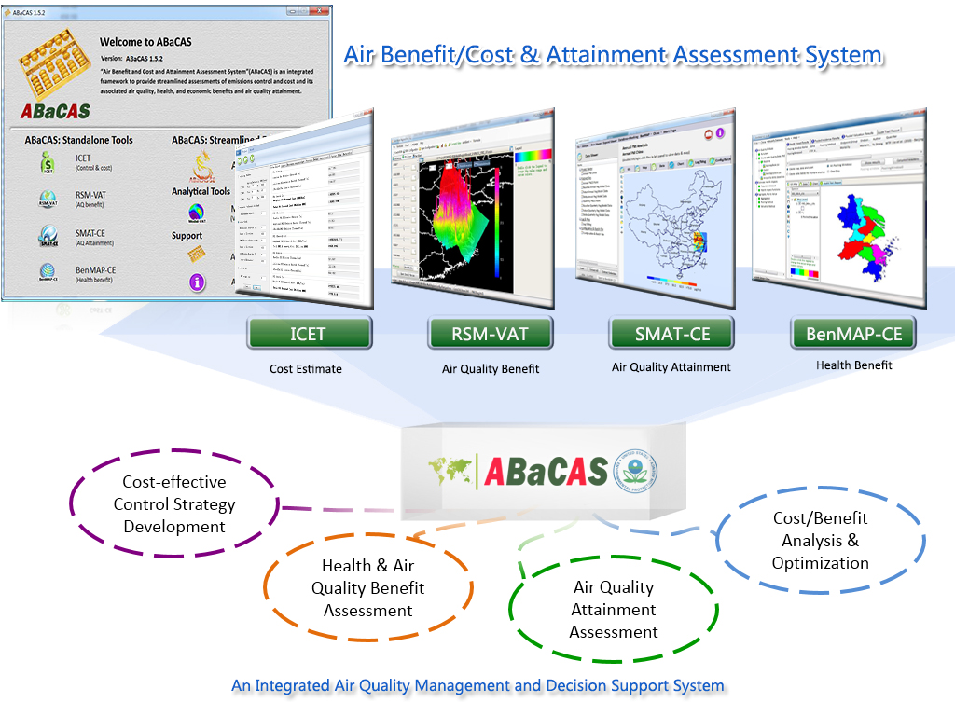
ABaCAS : Air Benefit and Cost & Attainment Assessment System
Integrated AQ Decision Support System (http://www.abacas-dss.com)
“ABaCAS 1.0”
2016
Integrated
Cost/Benefit
& Attainment
Assessment
Control
& Cost
Estimate
Real-time
Air Quality
Benefit
Air Quality
Attainment
Assessment
Health &
Economic
Benefit

Slide 5
“ABaCAS”: Air Benefit and Cost & Attainment Assessment System
An integrated AQ Decision Support System (v. 3.x)
Developed for “Scientists” and “Policy Makers”
5

Slide 6
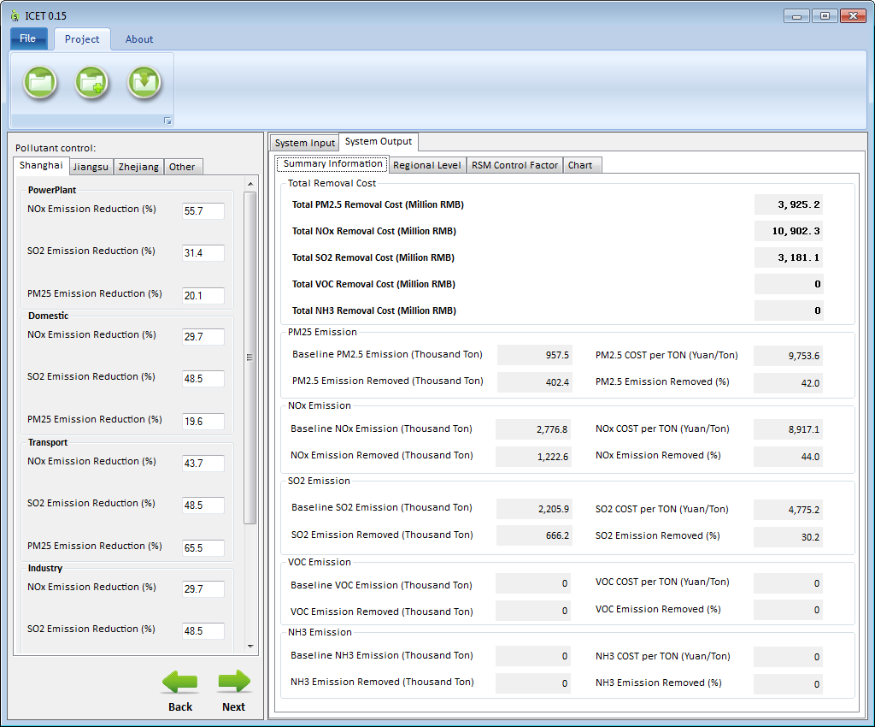
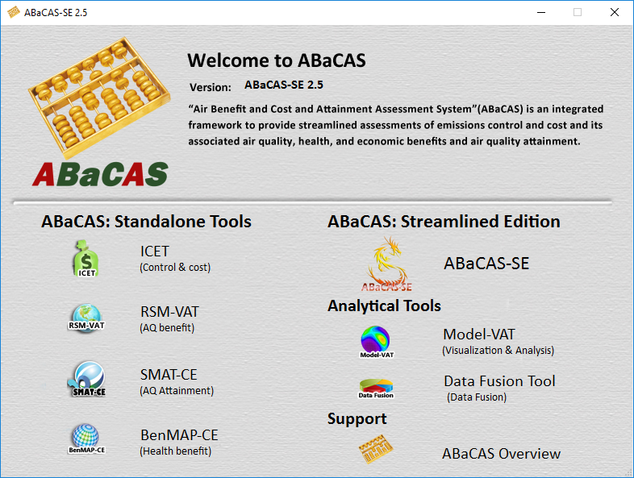
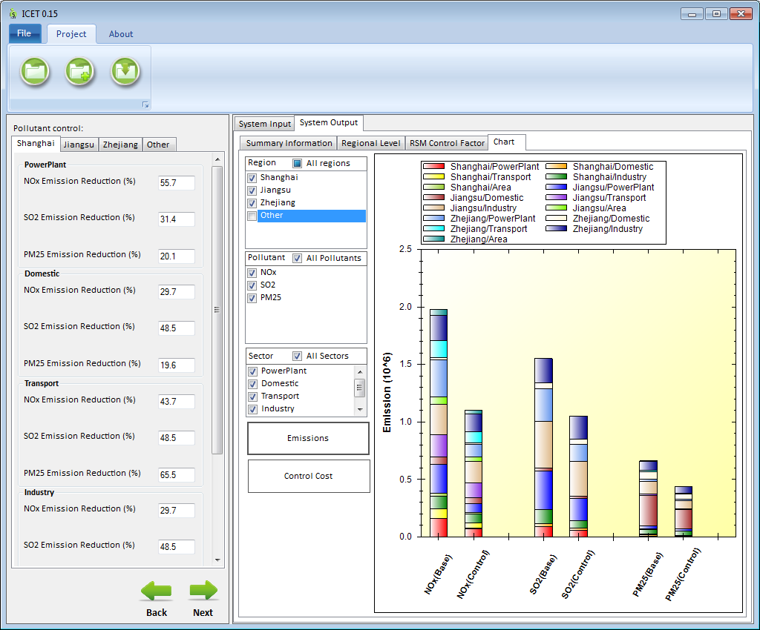
ICET: International Control cost Estimate Tool
ICET
(International Emissions Control Cost Interface Tool)
Provide Control Cost Analysis and Estimate : A flexible & modular control & cost estimate tool to give an estimate of control cost and link to RSM/CMAQ & BenMAP-CE for control cost/benefit assessment
Notes:
Comment: This is an important slide, but needs to be improved. Consider to use animations to highlight the key features & differences

Slide 7
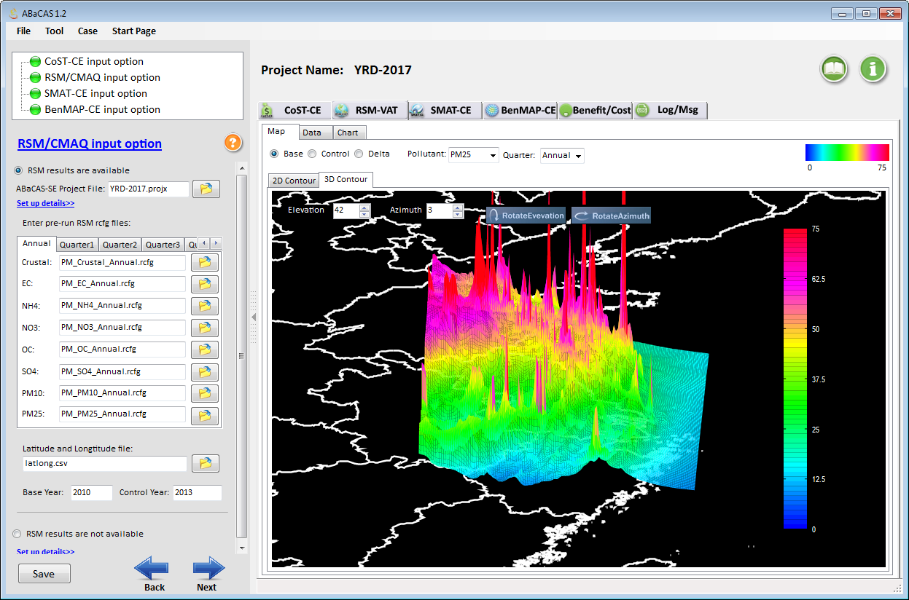
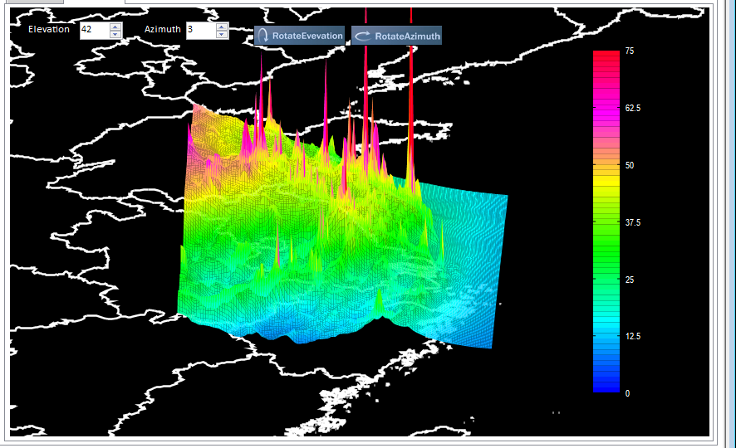
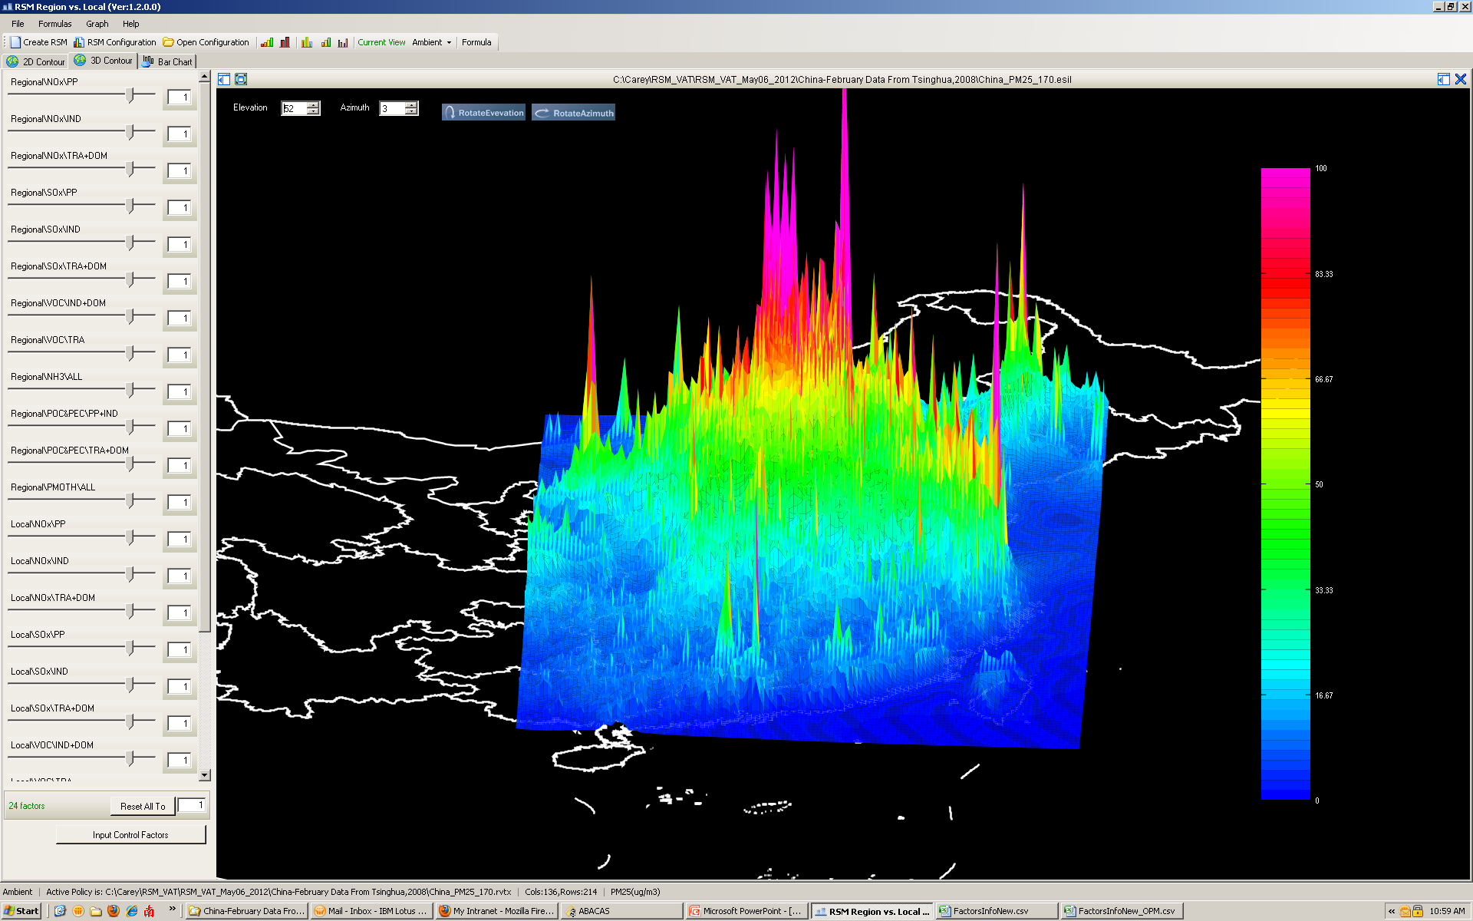
RSM: Response Surface Model
RSM/CMAQ
Base
Control
RSM-VAT:
(RSM Visualization &
Analysis Tool)
Provide Real-time AQ Response of Emissions Control:
A cutting-edge tool developed by USEPA & ABaCAS team to provide real-time response of AQ concentrations to changes in emission sources
Notes:
Comment: This is an important slide, but needs to be improved. Consider to use animations to highlight the key features & differences

Slide 8
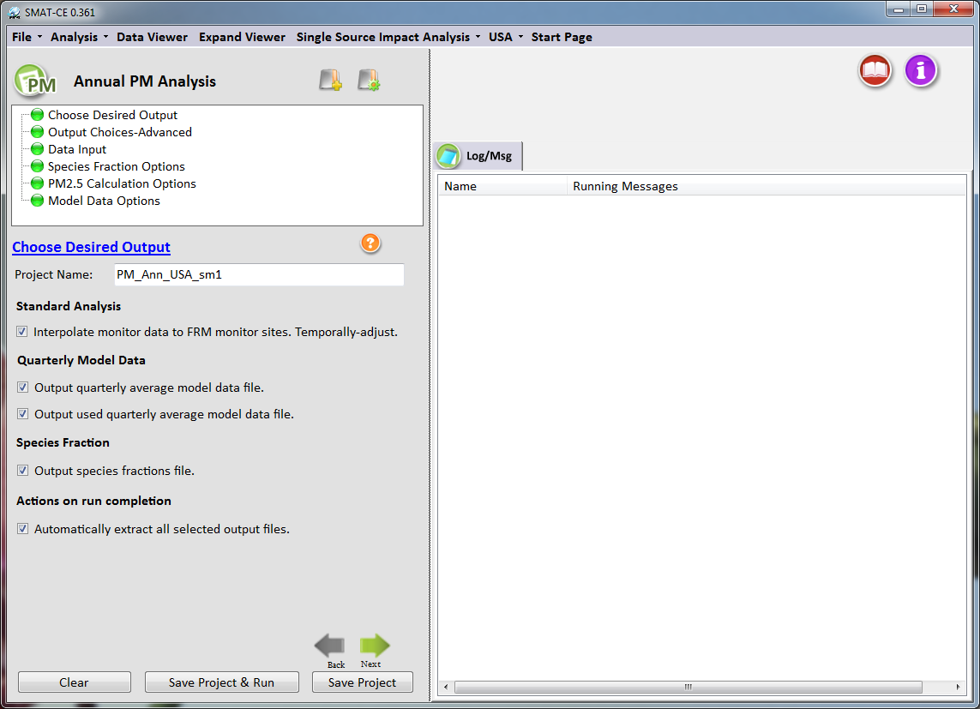
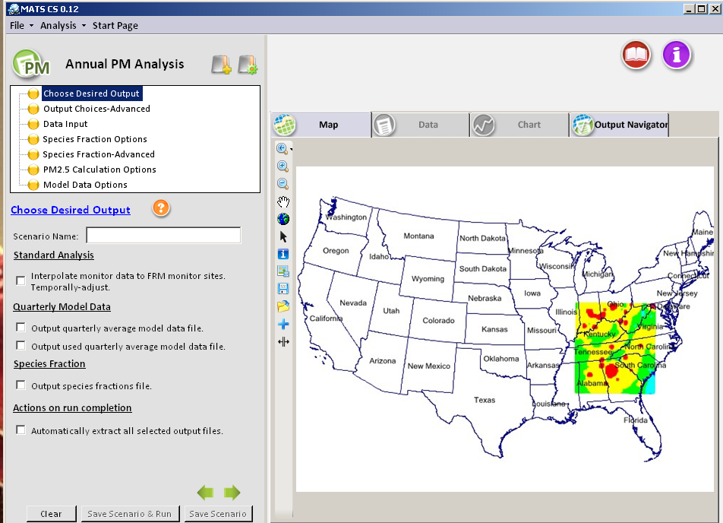
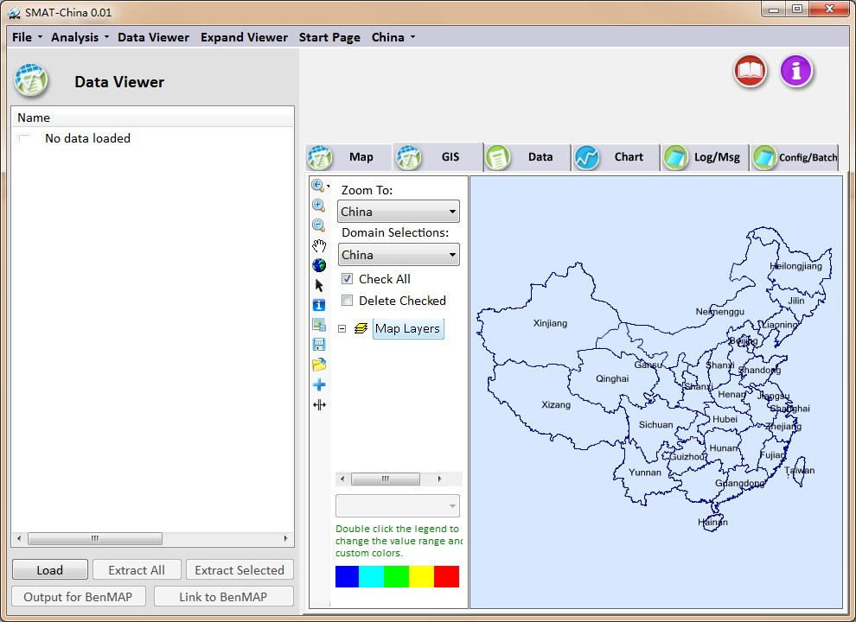
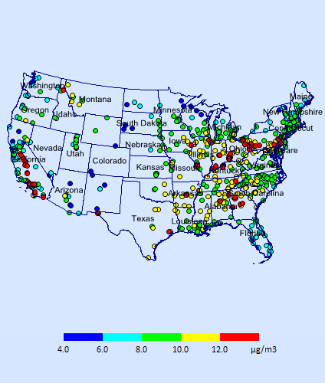
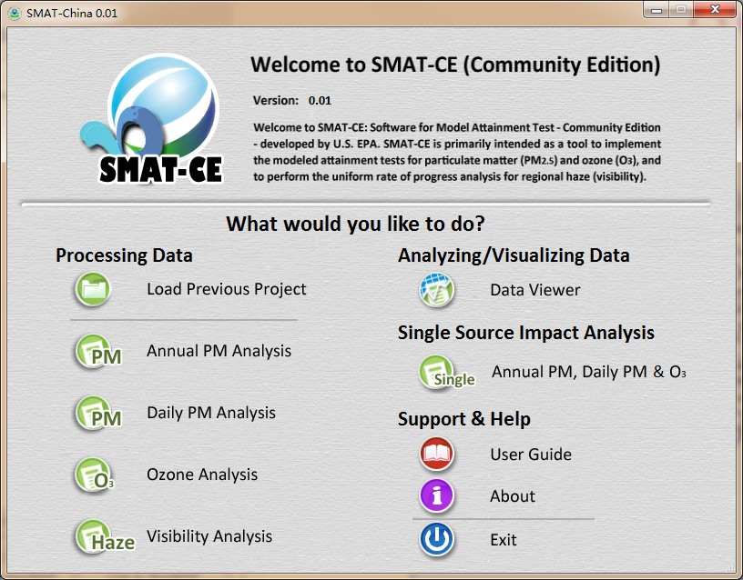
SMAT-CE: Software for Model Attainment Test
(Community Edition)
SMAT-CE
(Community Edition)
Developed by EPA and “ABaCAS” team to perform attainment assessment for EPA’s national rules and SIPs on PM2.5, O3 & Visibility
“SMAT-Asia” has been developed for customized Asian applications
Notes:
Comment: This is an important slide, but needs to be improved. Consider to use animations to highlight the key features & differences

Slide 9
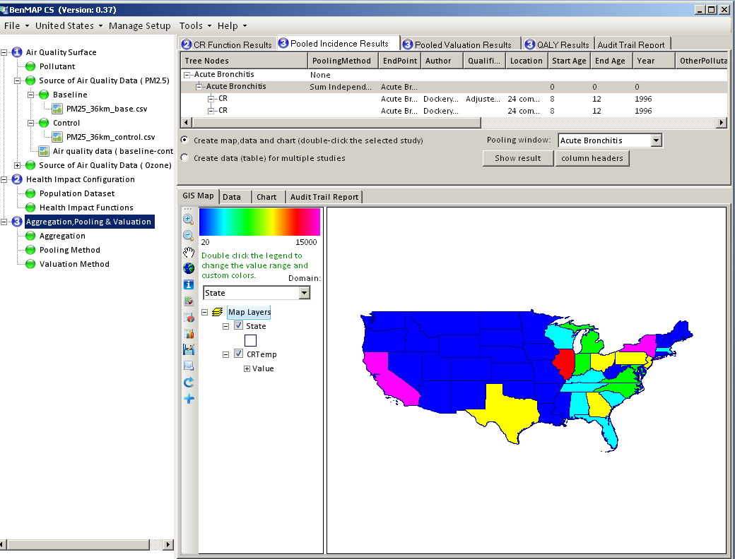
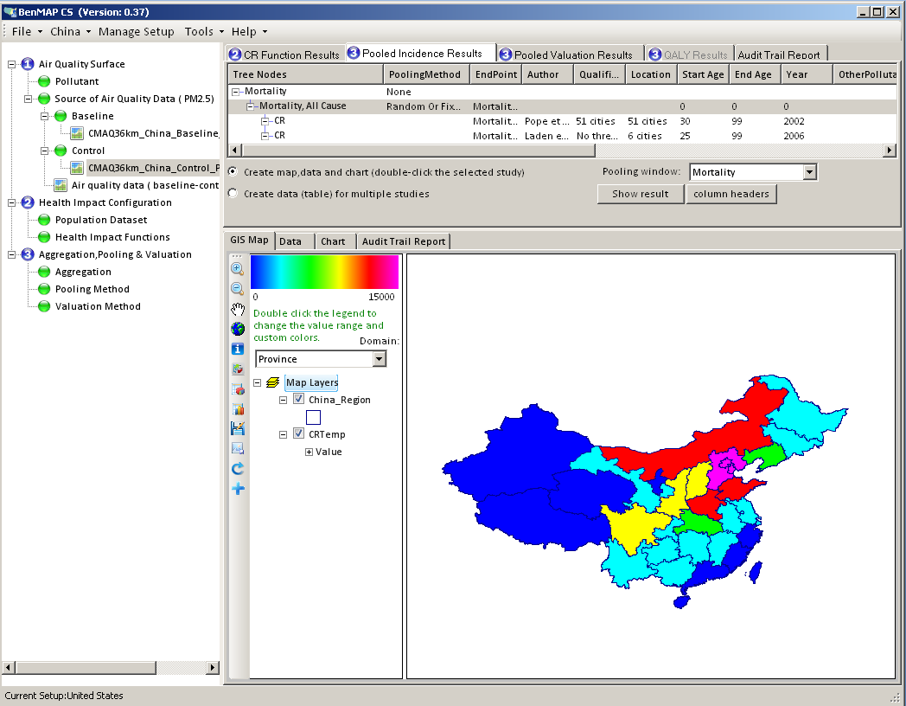
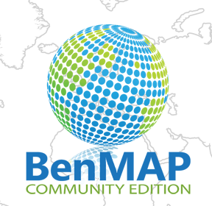
BenMAP-CE: Environmental Benefit Mapping & Analysis (Community Edition)
BenMAP-CE
BenMAP-CE
(Community Edition to
Replace Legacy BenMAP)
Provide Health Impacts & Economic Benefits Estimate:
Developed by EPA and “ABaCAS” team to estimate health & environmental impacts and economic benefits occurring changes in air quality
Notes:
Comment: This is an important slide, but needs to be improved. Consider to use animations to highlight the key features & differences

Slide 10
“ABaCAS-SE” and “ABaCAS-OE”
An integrated AQ Decision Support System (v. 3.x)
Developed for “Scientists” and “Policy Makers”
10

Slide 11

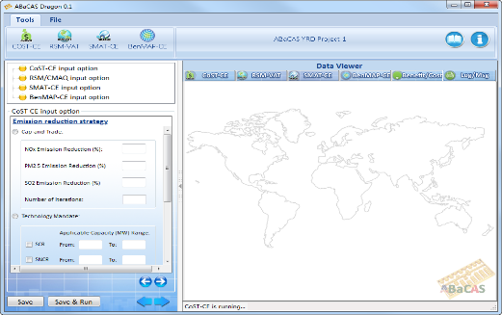

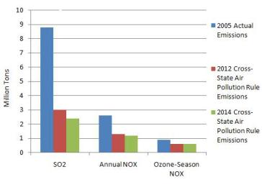
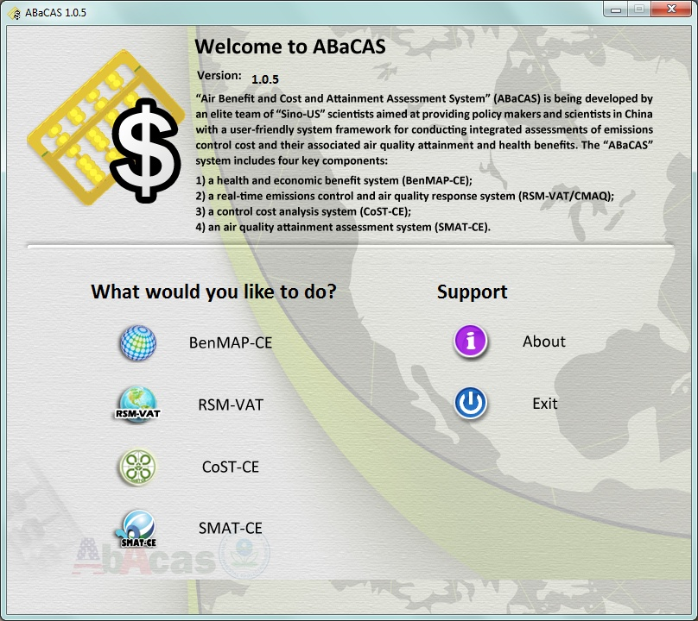
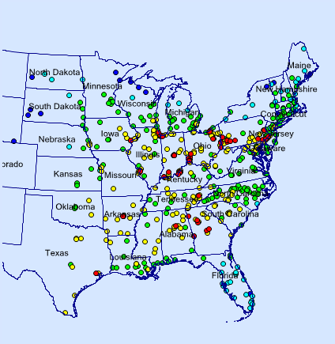
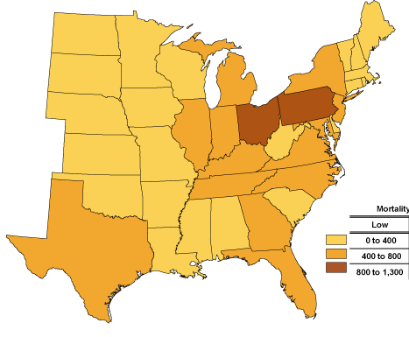
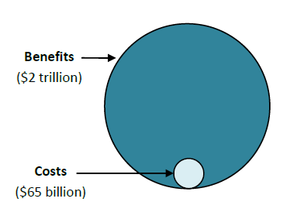
“ABaCAS-SE”:
(Streamlined Edition”, 2017)
Control Policy Scenarios
Control Strategy
A
Control Strategy
B
Control Strategy
C
……………
ABaCAS-SE
ABaCAS-SE Master Script
Cost estimate ($$)
ICET
ICET script
ICET
AQ Benefit (ug/m³)
RSM-VAT
RSM-VAT script
> 12 ug/m³ (non-attainment)
SMAT-CE
SMAT-CE script
Attainment (DVs)
BenMAP-CE
BenMAP-CE script
BenMAP-CE
Health Benefit ($$)
Benefit/Cost = ~20
Streamlined Assessment
Benefit ($$)/Cost ($$)
Notes:
spatial field: A Spatial Field refers to air pollution estimates made at the center of each grid cell in a specified modeling domain. For example, MATS might calculate ozone design values for each grid cell in the modeling domain. Several types of Spatial Fields can be calculated for ozone and PM.
利用环境监测数据、模型数据（主要是CMAQ模拟的结果）作为模型输入，并利用优化的数理统计技术对大气复合污染状况进行模拟，实现对环境空气质量标准的达标评估。其中包括point estimate和spatial field estimate。

Slide 12
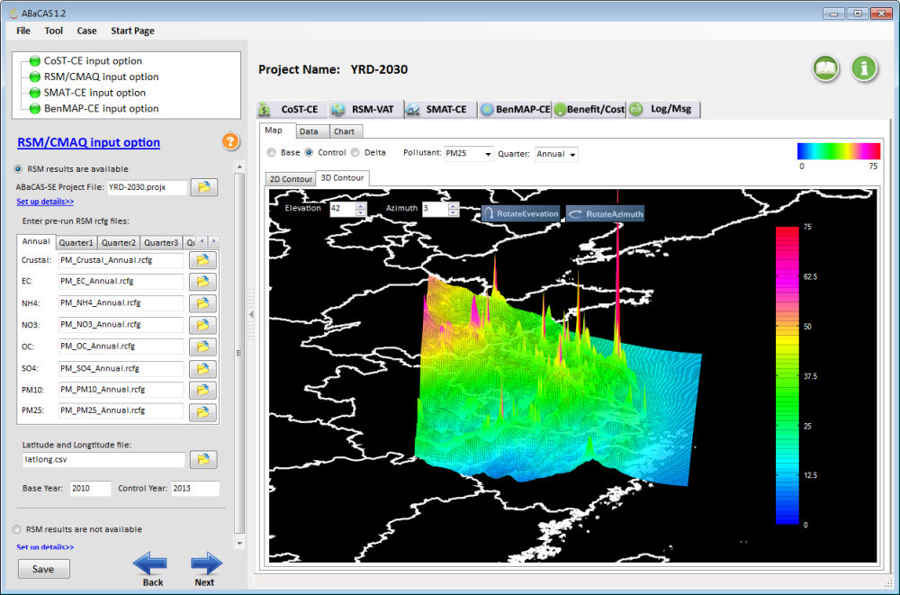
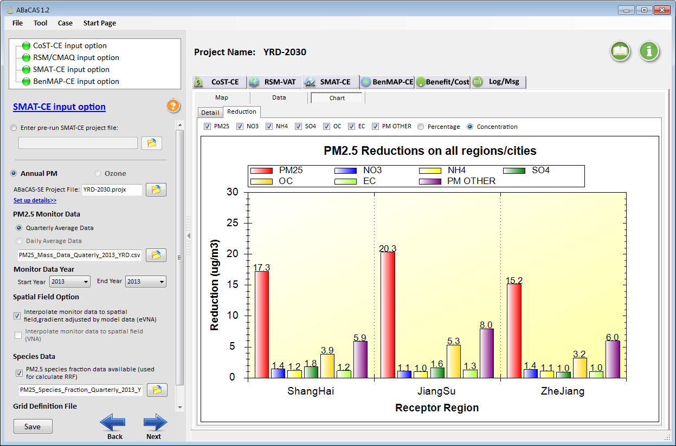
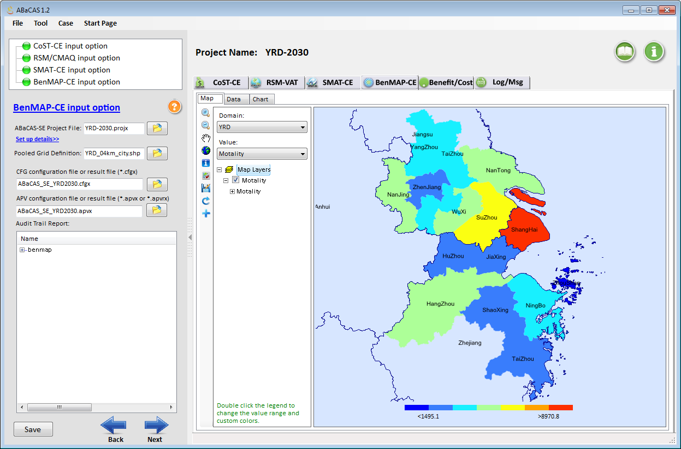
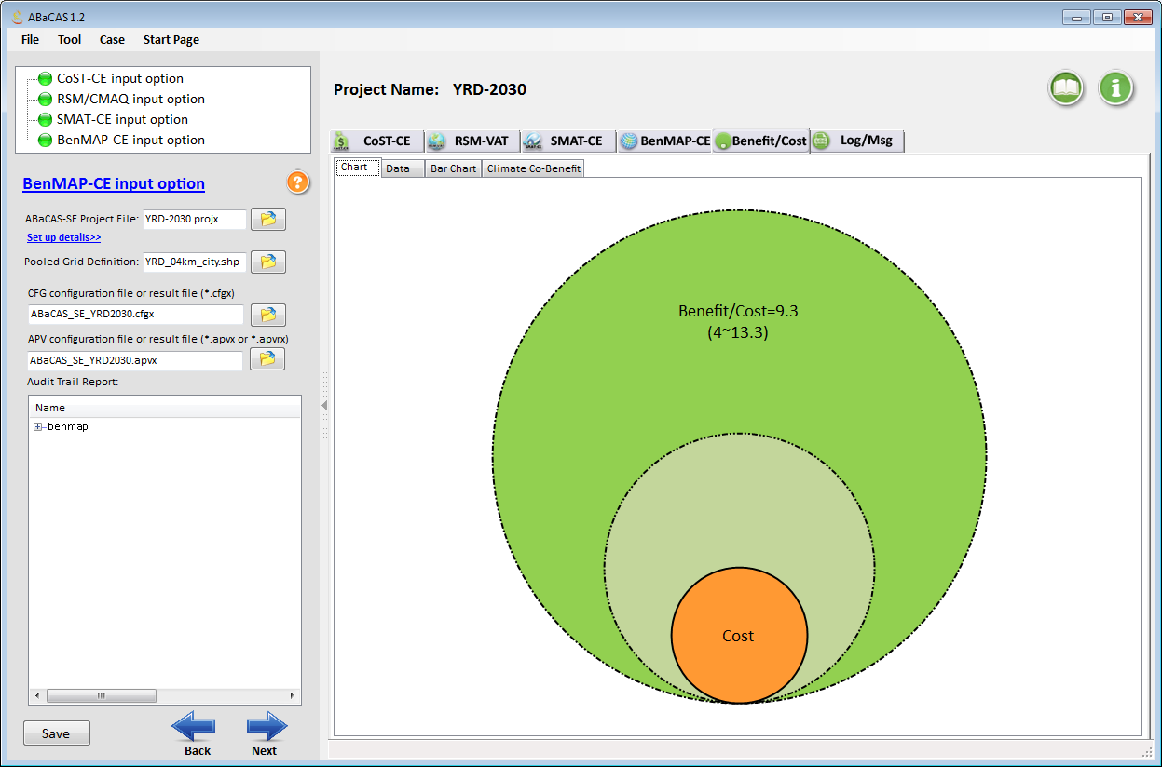
China YRD “2030” PM2.5 Case
RSM/CMAQ
(5~10 minutes to run)
SMAT-CE
BenMAP-CE
Benefit/Cost
Benefit/Cost =~ 9.3

Slide 13
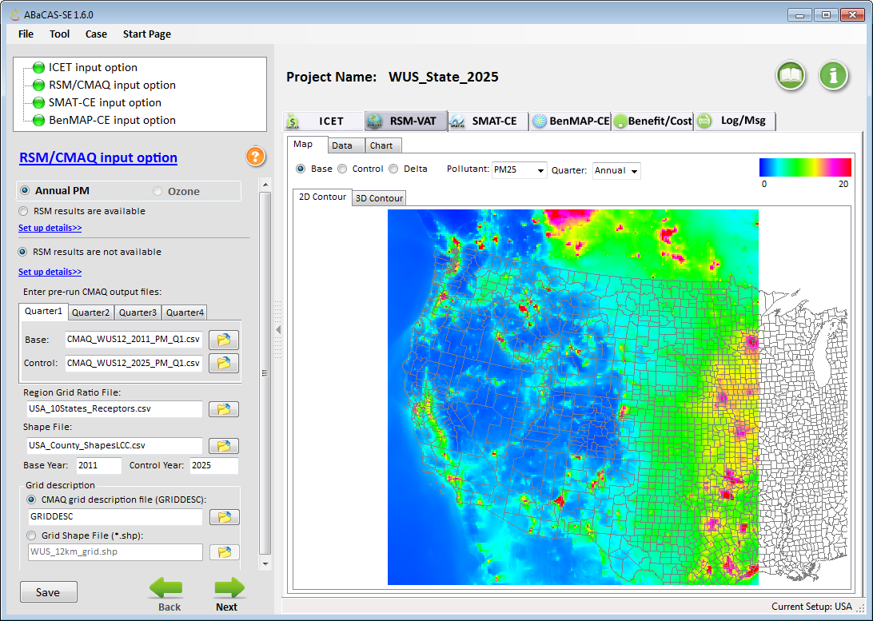
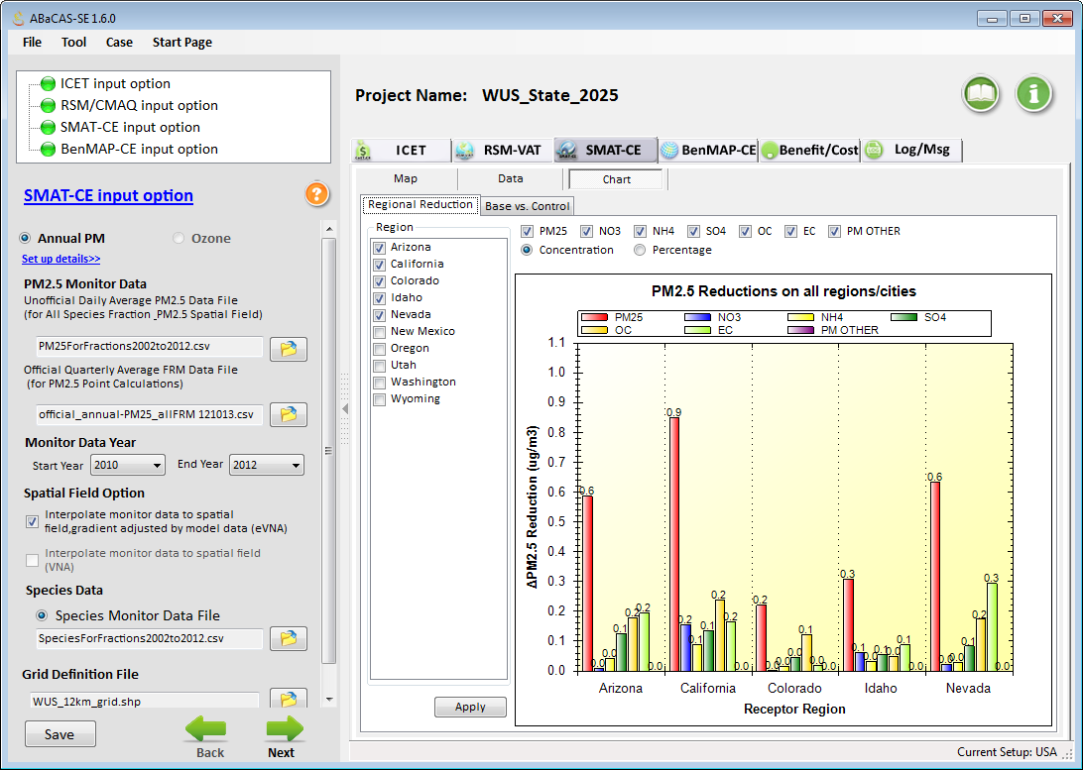
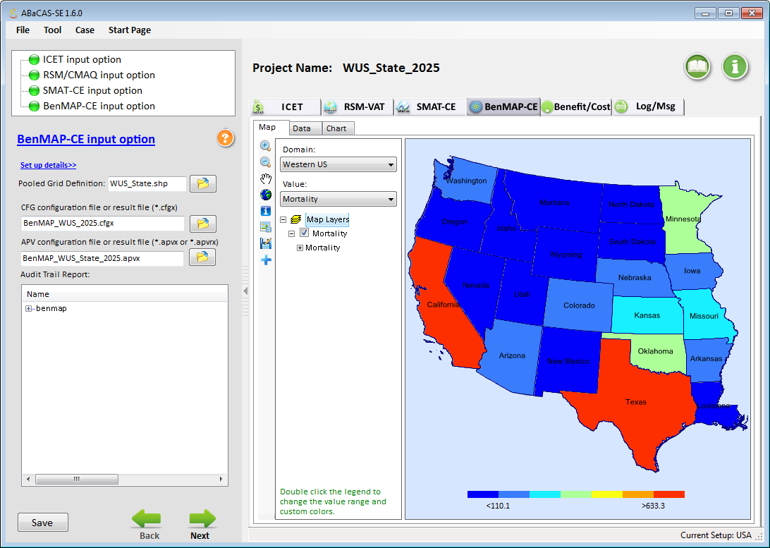
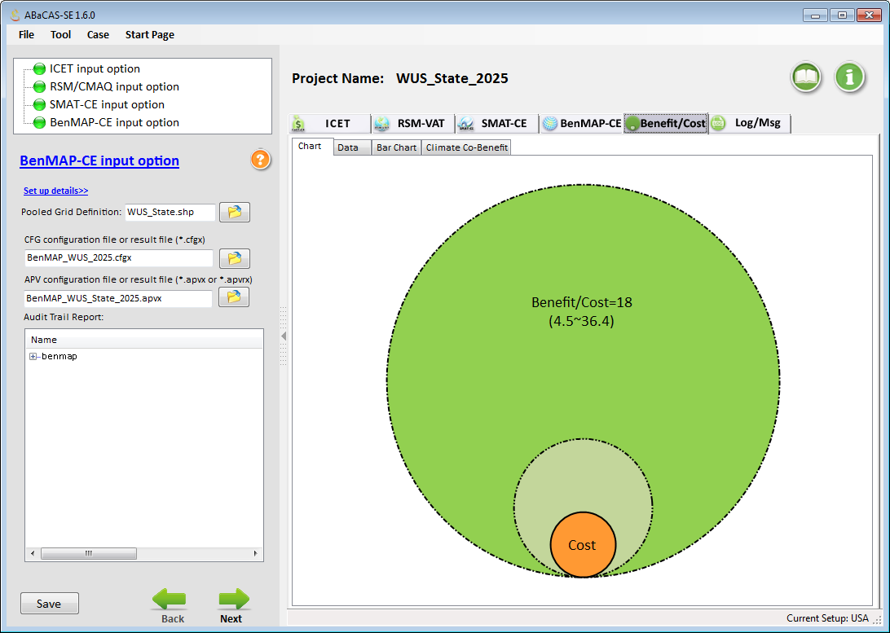
Western U.S. Case Study (ABaCAS-SE)
CMAQ (no-RSM)
(PI: UNC-IE)
SMAT-CE
BenMAP-CE
Benefit/Cost
Benefit/Cost =~ 18

Slide 14
“ABaCAS-OE”:
Optimized Edition (2019 Prototype)
Developed for “Scientists” and “Policy Makers”
14

Slide 15


“ABaCAS-OE ” (2019)
(Optimized Edition”: under “ABaCAS 3.x”)
Attainment Goals
Pollutant A: PM2.5
attains 35 ug/m³ (annual)
Pollutant B: O3
attains 80 ppb (MDA8)
ABaCAS-OE
> 12 ug/m³ (non-attainment)
Attainment
Target
SMAT-CE
LE-CO
Control Cost
Optimizer
Optimized Control & Cost for Attaining AQ Goals
ICET
pf-RSM
Air Quality
Benefit
Control &
Cost Estimate
Health Benefit ($$)
BenMAP-CE
Optimized Control Strategy
Benefit/Cost = ~20
Benefit ($$)/Cost ($$)
Notes:
spatial field: A Spatial Field refers to air pollution estimates made at the center of each grid cell in a specified modeling domain. For example, MATS might calculate ozone design values for each grid cell in the modeling domain. Several types of Spatial Fields can be calculated for ozone and PM.
利用环境监测数据、模型数据（主要是CMAQ模拟的结果）作为模型输入，并利用优化的数理统计技术对大气复合污染状况进行模拟，实现对环境空气质量标准的达标评估。其中包括point estimate和spatial field estimate。

Slide 16
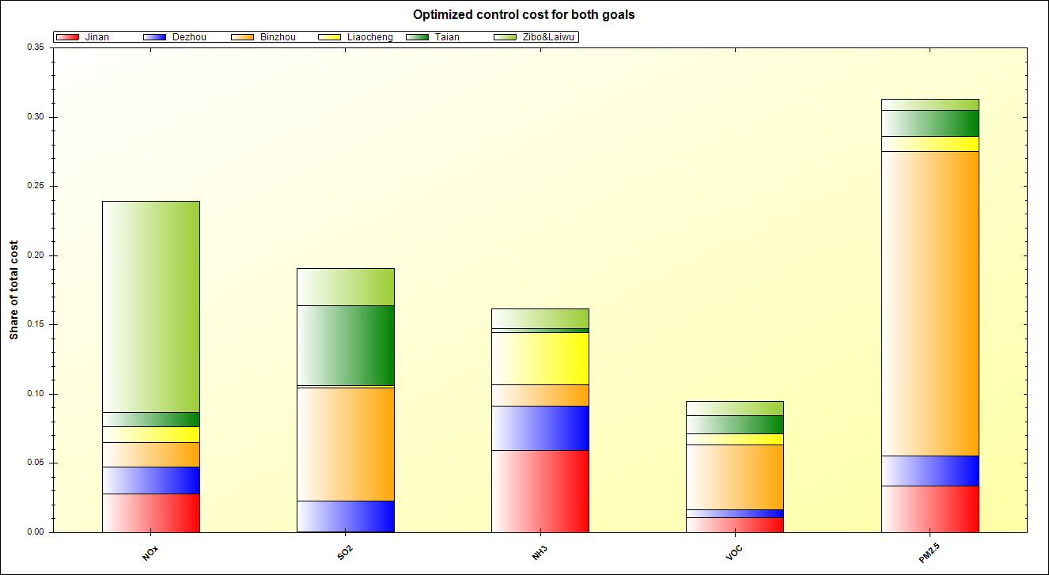
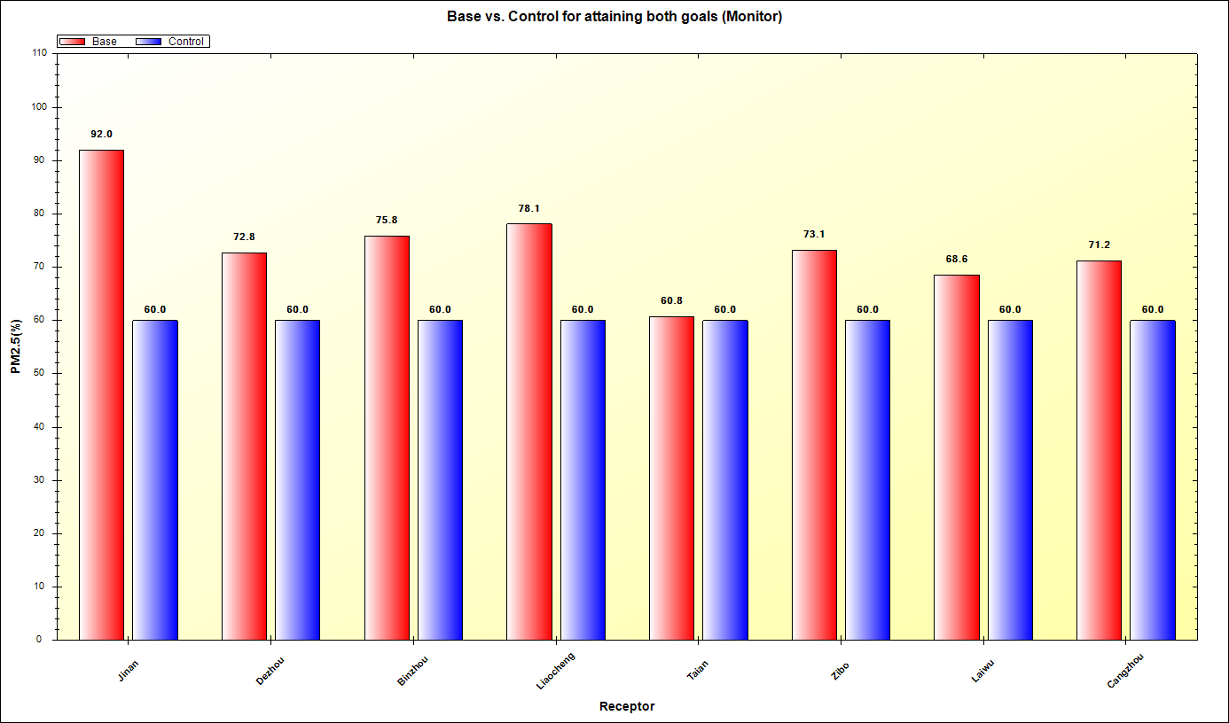
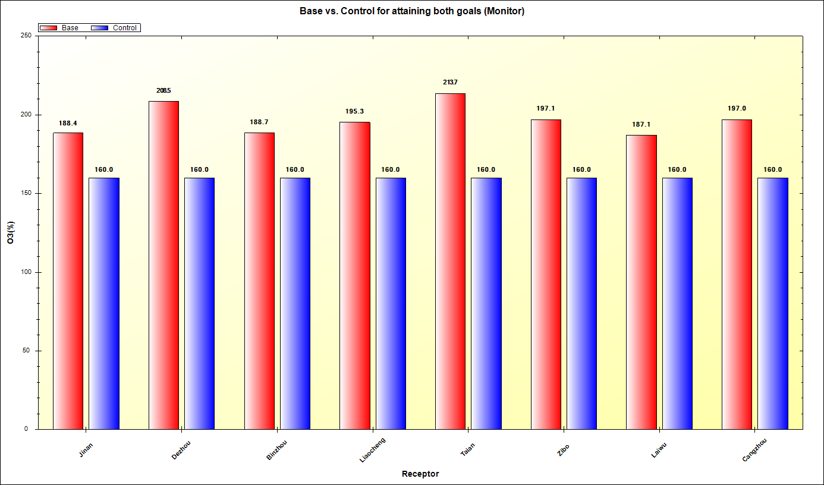
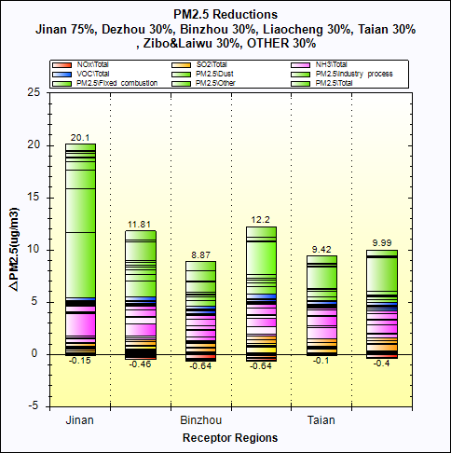
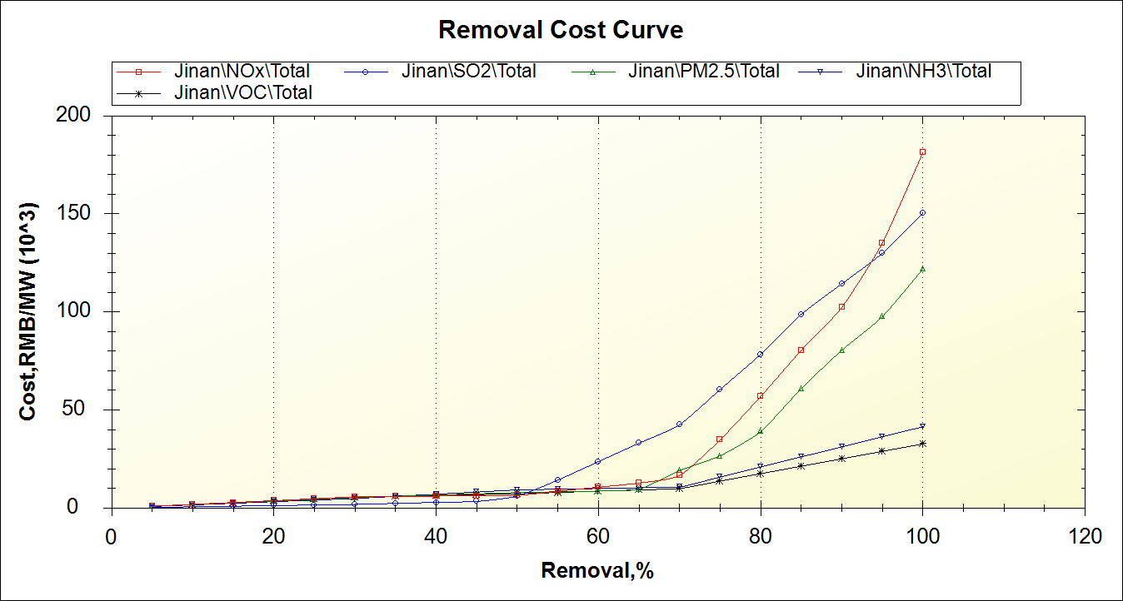
ABaCAS-OE: China Jinan “PM2.5 & O3” Case
SMAT-CE
Optimized Control Share & Reduction Share
PM2.5 Attainment Goal: 60 ug/m3
LE-CO
O3 Attainment Goal: 160 ug/m3 (~80 ppb)
RSM-VAT
ICET
Emissions Control
& Cost
AQ Reduction &
Source Contribution

Slide 17
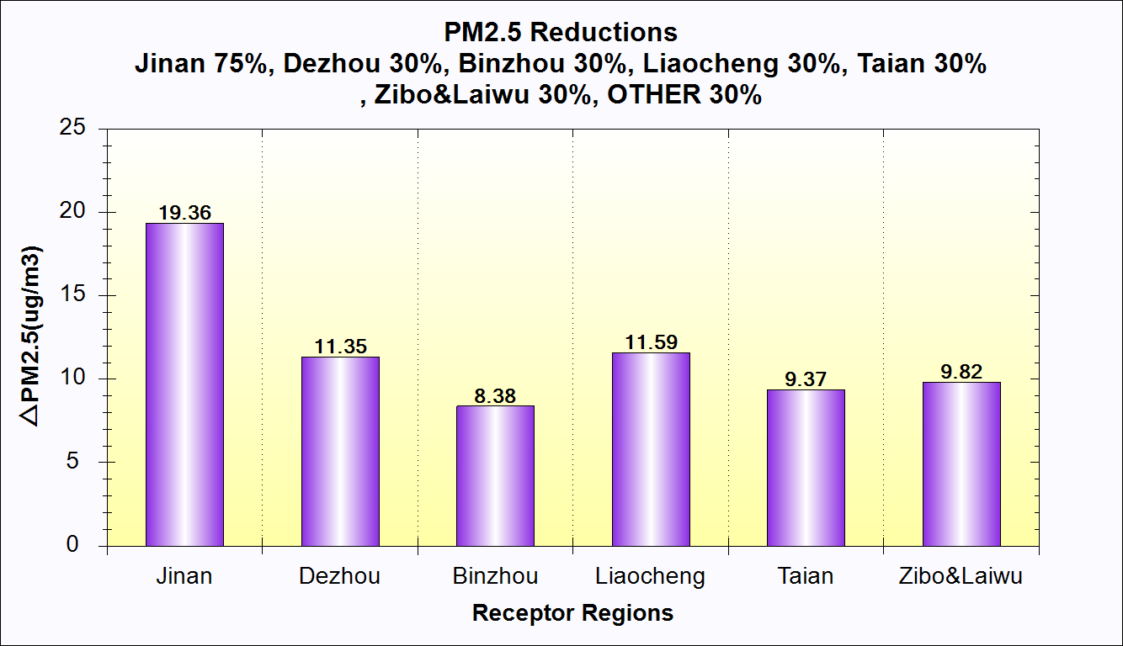
ABaCAS-OE: China Jinan “PM2.5 & O3” Case
SMAT-CE
LE-CO
Optimized Control Cost Share for both PM2.5 & O3
PM2.5 & O3
Attainment Goals
Primary PM2.5
NOx
SO2
NH3
VOC
ICET
RSM-VAT
Emission & Control Cost
Reduction & Source Contribution

Slide 18
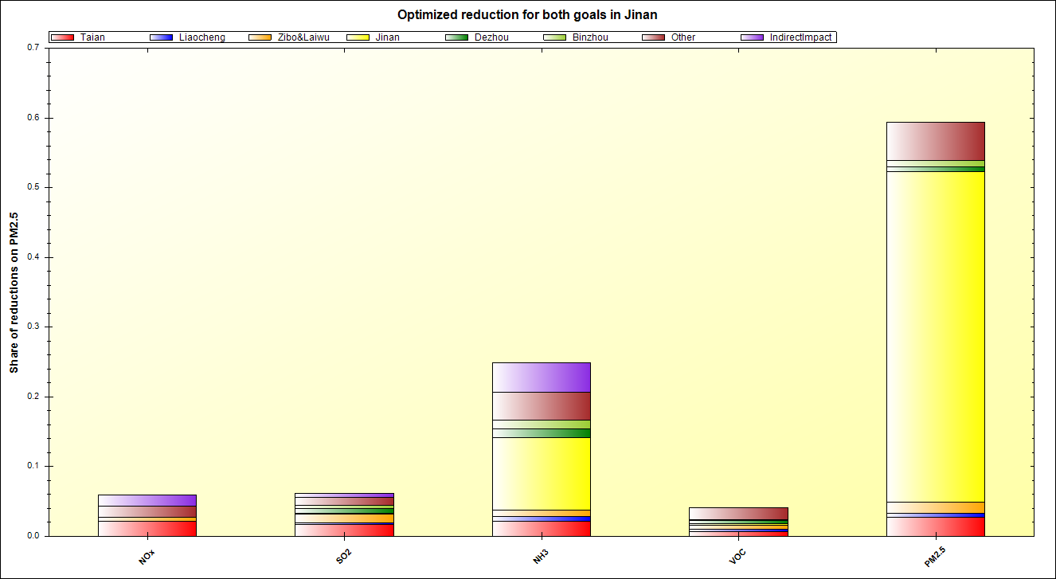
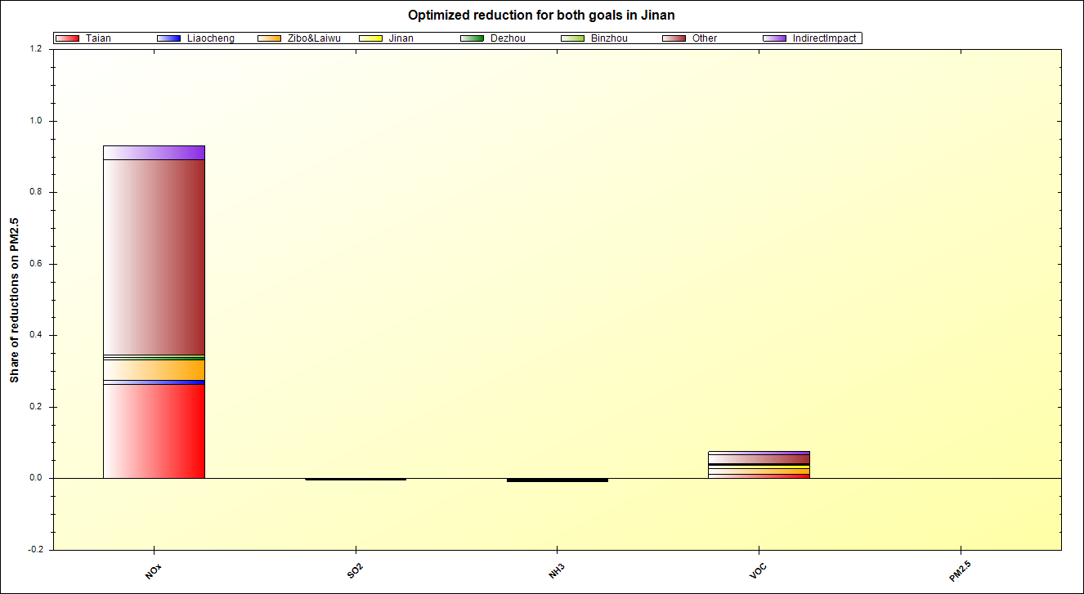
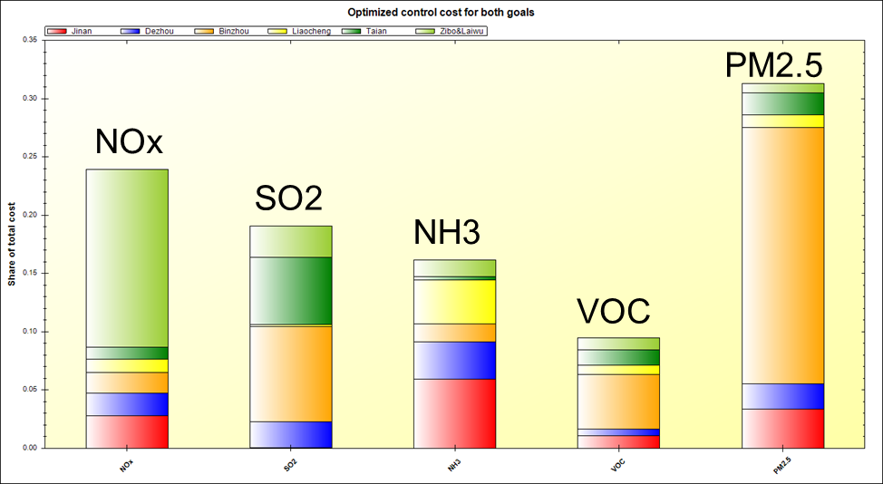
ABaCAS-OE: China Jinan “PM2.5 & O3” Case
SMAT-CE
PM2.5 & O3
Attainment Goals
LE-CO
PM2.5 Reduction Share
O3 Reduction Share
Primary PM2.5
NOx
NH3
VOC
NOx
SO2
VOC
SO2
NH3
P. PM2.5
Control Cost Share
for both PM2.5 & O3

Slide 19
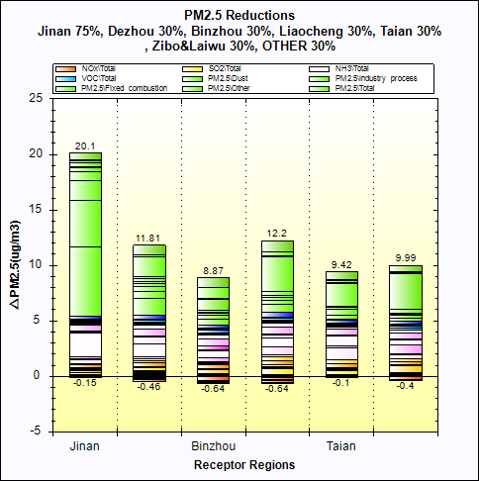
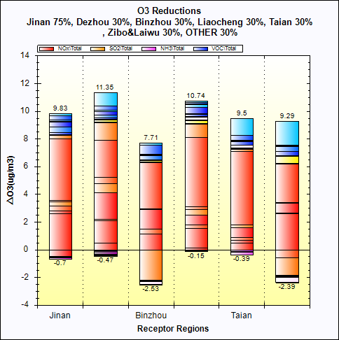
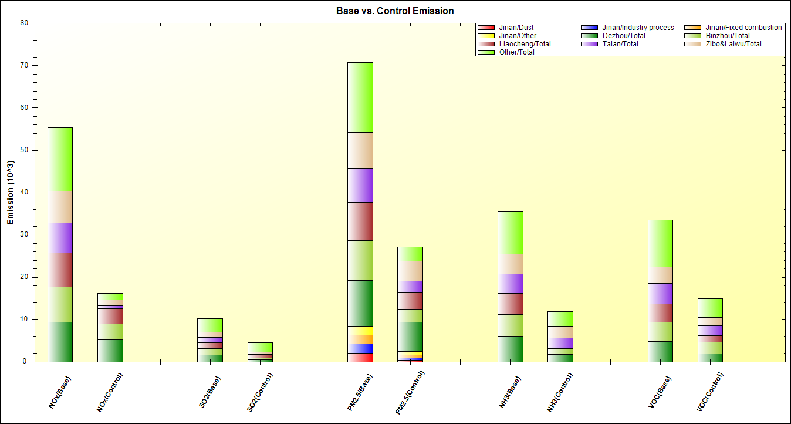
ABaCAS-OE: China Jinan “PM2.5 & O3” Case
PM2.5 & O3
Attainment Goals
SMAT-CE
LE-CO
ICET
RSM-VAT
Control Cost Curve
Emissions Reduction
(base vs. control)
PM2.5 Reduction &
Source Contribution
O3 Reduction &
Source Contribution

Slide 20
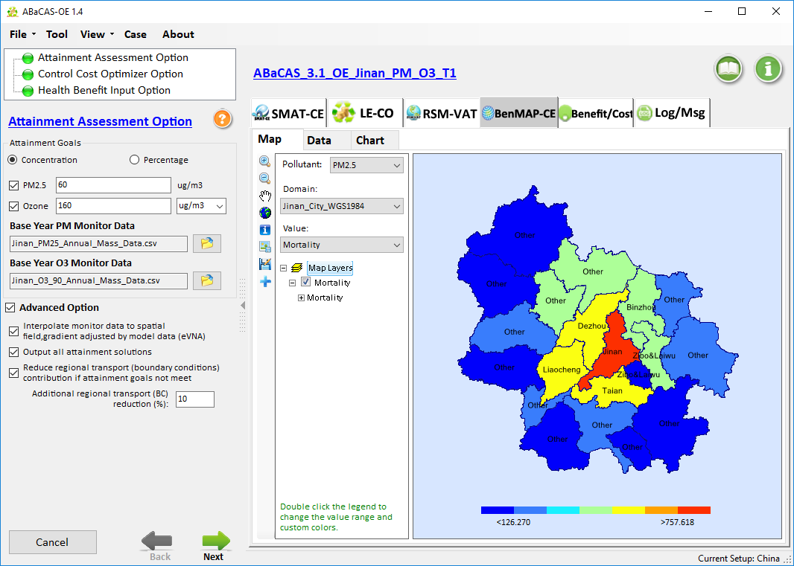

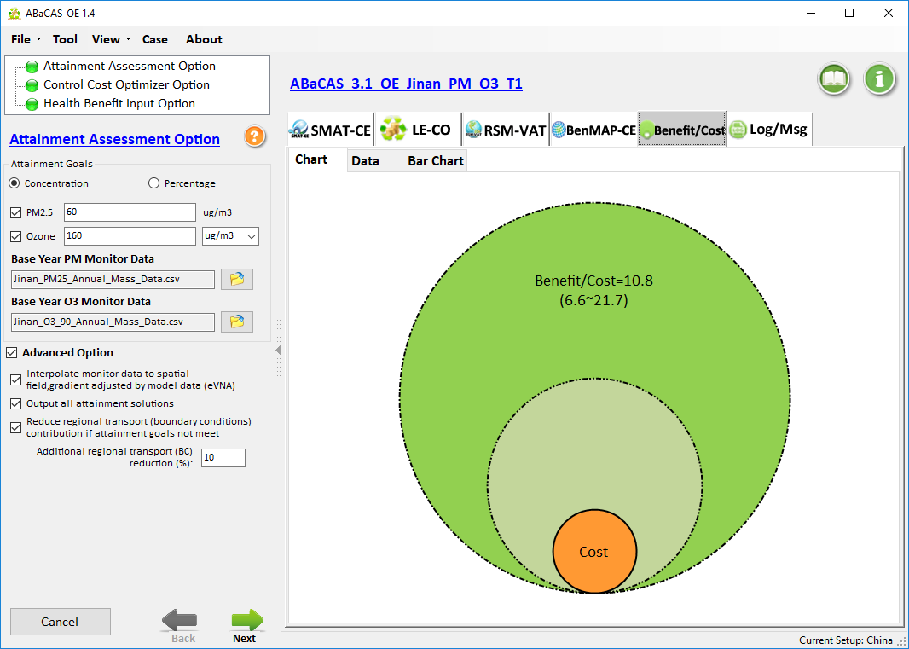
ABaCAS-OE: China Jinan “PM2.5 & O3” Case
PM2.5 & O3
Attainment Goals
SMAT-CE
LE-CO
ICET
RSM-VAT
BenMAP-CE
Benefit/Cost
Valuation
Benefit/Cost =~ 11
Mortality

Slide 21
“ABaCAS”: Air Benefit and Cost & Attainment Assessment System
Analytical Tools in “ABaCAS 3.x” (2018-2019)
New Analytical Tools: “Model-VAT” & Data Fusion Tool

Slide 22
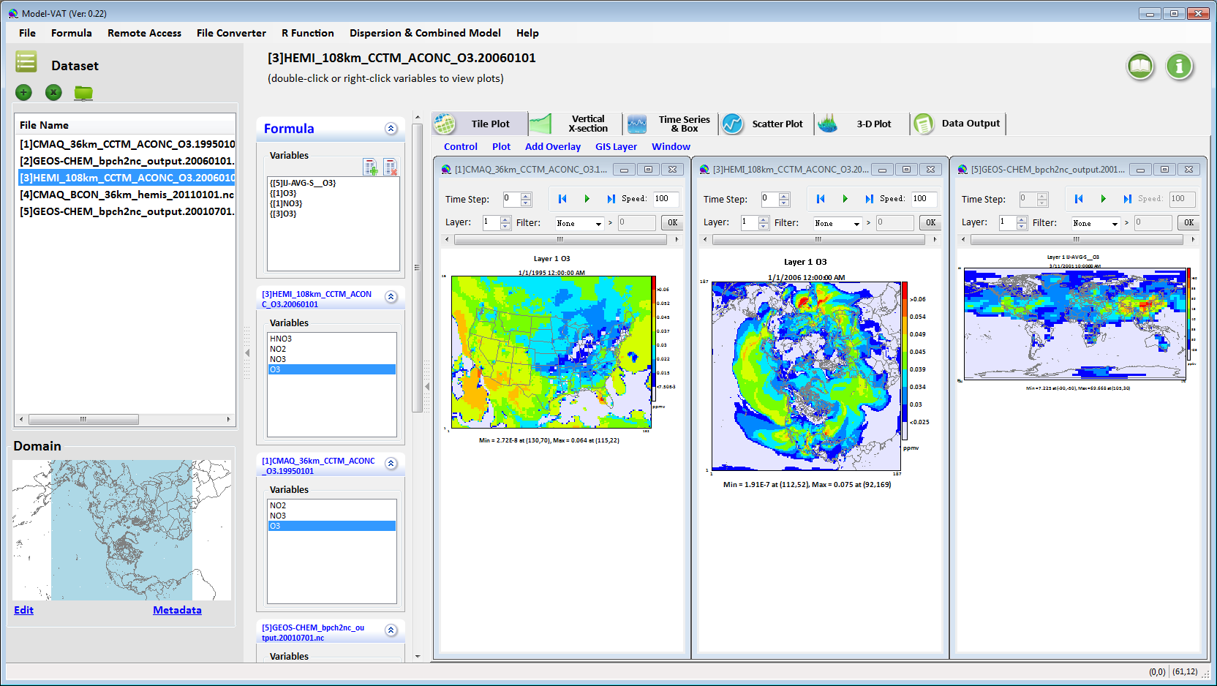
Model-VAT:
Multi-Scale Model Visualization & Analysis Tool
CMAQ/ CAMx
(regional)
GOES-Chem
(global)
H-CMAQ
(hemispheric)
(Easy Map Transformation)
User-Friendly V/A & Eval. Tool for Photochemical & Dispersion Models

Slide 23
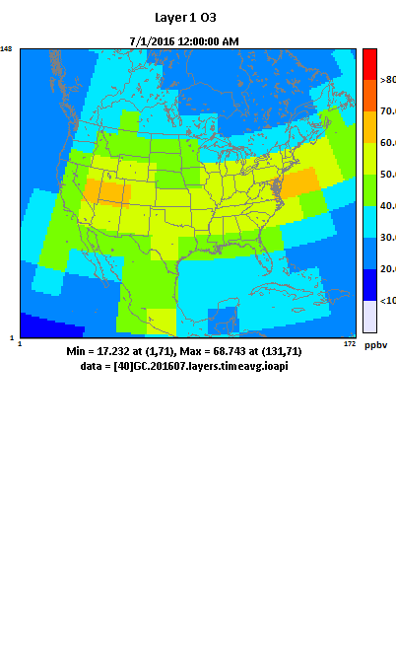
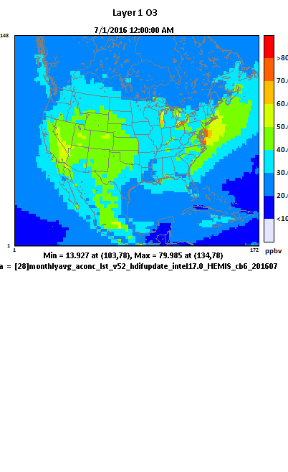
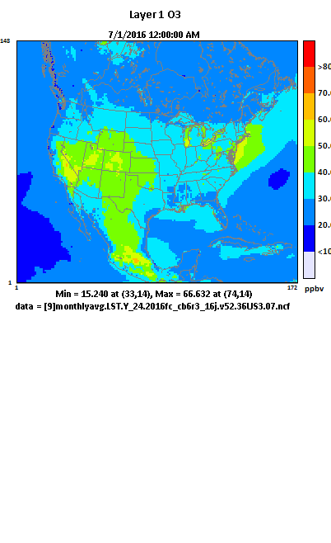



Model-VAT: Multi-Scale Model V/A Tool
GEOS-Chem (4ºx5º)
H-CMAQ (108km)
CMAQ (36-km)
O3 (July 2016)
PM2.5 (July 2016)

Slide 24









Model-VAT: Model Analysis & Evaluation
Link to “R”
Flexible
Data
Output
Remote File Access

Slide 25
“Data Fusion” Tool
(Fusing Model and Monitor and/or other data)
Inputs:
Model & Monitor or other data
(dispersion model, satellite data, LUR, etc.)
Spatial: grid & non-grid (census)
Temporal: annual/monthly/daily
Techniques:
eVNA, VNA,
Downscaler, etc.
Data
Fusion
Open-Source & User-Friendly
Cross-Validation
(QA, Multi-fold, Leave-one-out, etc)
Method Development, Evaluation & Research
Regulatory Assessment
(PM & O3 RIA, REA)
BenMAP-CE
Health Studies
SMAT-CE
Attainment Test
Notes:
In a simple team, DFT. An important last step of regulatory modeling and other assessment

Slide 26

“Data Fusion” Tool: Application in China PRD
(Fusing Model and Monitor data)
Model Data
Fused Data
Health Benefits
Monitor Data
Li et. al., 2019, J. of Environ. Management
Jim KELLY (next talk): “Data Fusion Tool application for PM2.5 spatial fields in USA”

Slide 27
“ABaCAS 4.x”: Work Plan (2019-2020)
  “FAST-CE”: Flexible AQ Scenario Tool - CE
  A user-friendly and open AQ assessment tool for source contribution analysis/visualization/evaluation
  Allow to adjust AQ surface and provide scenario analysis for source contribution assessment methods such as “OSAT/PSAT/APCA/ISAM, DDM, and RSM”
  RSM-VAT:
    Update pf-RSM w/ differential method & add i-RSM
    GUI re-design and upgrade
  Model-VAT: add “Model Evaluation” module
  Data Fusion Tool: add advanced DF methods & dataset

Slide 28
FAST-CE: “Flexible Air Quality Scenario Tool – Community Edition”(2019-2020)
Emission control factors, etc.
Input parameters
Multiple tracer species
Emission Inventory
(regions, pollutants, sectors, etc.)
Photochemical model (CMAQ/CAMx)
Photochemical model (CAMx/CMAQ)
Sensitivity coefficients
Math. & Chemical approximation
Math. approximation
Chemical approximation
Response Surface Modeling
Source/Receptor Sensitivity Modeling
Source Apportionment Modeling
RSM
DDM
OSAT/PSAT/APCA & ISAM
Dynamic control
strategies
FAST-CE
Source Contribution Analysis
(SA/RSM/DDM)
Assessment of health & economic benefit and attainment benefit
International cost estimate (ICET)
Attainment assessment tool (SMAT-CE)
Health benefit tool
(BenMAP-CE)
Least cost strategies (LE-CO)
Optimized Cost/Benefit Control Strategies

Slide 29
New RSM Development:“pf-RSM”&“i-RSM”
Region A
Pollutant A (PM)
Pollutant A (PM)
Air
Air
Air
Pollutant A (PM)
pollutant
pollutant
Region B
Pollutant B (O3)
Pollutant B (O3)
Pollutant B (O3)
•
Chemistry
RSM w/
Temporal
Polynomial
Functions
•
Transport
•
Indirect
Real-time pollutant responses
to emissions change
Real-time pollutant responses
Multi-pollutant responses
Single scenario
to multi-region sources
based on polynomial functions
Region A
Emis./Reg. A
Emissions
Emissions
Change
Region B
Emis./Reg. B
Region C
Emis./Reg. C
AQM
RSM
ERSM
Pf-RSM
Air Quality Model
(CMAQ, CAMx, etc.)
U.S.EPA
Response Surface
Model
U.S.EPA
Multi-Region
Extended RSM
Tsinghua U.
RSM w/
Polynomial Functions
Tsinghua U./SCUT

Slide 30
“pf-RSM” Methodology
Polynomial Functions
Chemistry:
Degree of
Non-linearity
Chemistry:
Term of
Interactions
Model:
Only 3rd step involved in training samples (i.e., model runs), and thus significantly reduces
# of model runs required for accuracy
“pf-RSM”: Response Surface Model based on Polynomial Functions
(Temporal & multi-region RSM)
Xing et. al., 2018,
Atmos. Chem. & Phys.
2nd next talk by Prof. Jia Xing

Slide 31
Machine Learning “i-RSM”
“i-RSM”: “Indicator-based CNN pf-RSM”
Use
pre-defined
“Indicators”
for
PM2.5 (18)
& O3 (16)
to predict
nonlinearities
of species
and their interactions
# of model runs needed for maintaining RSM accuracy in predicting control responses for each selected study region
Traditional RSM | pf-RSM | i-RSM
>100s | 20~30 | 2
Xing et. al., 2019, in preparation

Slide 32

“ABaCAS” Website (www.abacas-dss.com)
Everything you need is here! “abacas-dss.com”

Slide 33

www.ABaCAS-dss.com
THANK YOU!
Carey Jang, U.S. EPA, Jang.carey@epa.gov

Slide 34


2018 ABaCAS/CMAS Conference/Training Workshop (Beijing, 5/21-23)
2019 ABaCAS Conference/Training Workshop (Hangzhou, 5/19-22)

Slide 35
RSM: real-time estimate of air quality responses
Response Surface Model (RSM)
——a meta-model built upon multi-“Brute Force” model simulations, to explore the response relationship between emission changes and air quality responses
Ambient Concentration
Sensitivity (e.g., DDM)
“real atmosphere”
RSM
Source Apportionment (e.g., ISAM)
0
1
Emission ratio
base

Slide 36
FAST-CE: Flexible Air quality Scenario Tool - Community Ed.）
2019-2020 work plan
Emission Inventory
(regions, pollutants, sectors, BCs, etc.)
Emission rates, BCs/ICs, etc.
Input parameters
Grouped by pollutants, source categories and source regions
Multiple tracer species
DDM
OSAT/PSAT & ISAM
Photochemical
model (CMAQ/CAMx)
Math. approximation
Source/Receptor Sensitivity Modeling
Source Apportionment Modeling
Chemical Approximation
Photochemical
model (CMAQ/CAMx)
(Sensitivity coefficients)
Response Surface Modeling
Math. & Statistical approximation
RSM
FAST-CE response surface
Dynamic
control strategies
Source Apportionment (RSM/DDM//OSAT&PSAT)
Performance Evaluation for Source Contribution Analysis Methodologies
Notes:
Flexible Air quality Scenario Tool – Community Edition:
Integrate source-receptor relationships generated by photochemical transport models applied with instrumented techniques including SA methods.
Provide a fast turnaround for benefits estimation where time does not allow for the application of a specific control strategy to be modeled with a photochemical transport model.

Slide 37
New direction: i-RSM with Machine Learning
Air pollution
Air pollution
Air pollution
pollution 1
pollution 1
How to further reduce the number of cases required in RSM?
pollution 2
pollution 2
Chemistry
Transport
Indirect
Full range responses to multiregional sources
Multiple pollutant responses to multiregional sources with well-solved indirect effects
A series polynomial functions to explicitly represent the nonlinear response
Specific scenarios
Full range responses
Emission
Emission
Emission C
Emission C
NH₃
POA
NO_{x}
Emission B
Emission B
VOC
SO₂
Emission A
Emission A
CTM
RSM
ERSMv1.0
ERSMv2.0
pf-RSM
i-RSM
Xing et al., ACP, 2011
Zhao et al., GMD, 2015
Xing et al., ES&T, 2017
Xing et al., ACP, 2018
Wang et al., ES&T, 2011
Zhao et al., ACP, 2017

Slide 38
Overview of the RSM evolution
Air pollution
Air pollution
Air pollution
pollution 1
pollution 1
pollution 2
pollution 2
Chemistry
Transport
Indirect
A series polynomial functions to explicitly represent the nonlinear response
A pathway to reduce the number of cases required in RSM
Full range responses to multiregional sources
Multiple pollutant responses to multiregional sources with well-solved indirect effects
Specific scenarios
Full range responses
Emission
Emission
Emission C
Emission C
NH₃
POA
NO_{x}
Emission B
Emission B
VOC
SO₂
Emission A
Emission A
CTM
RSM
ERSMv1.0
ERSMv2.0
pf-RSM
Xing et al., ACP, 2011
Zhao et al., GMD, 2015
Xing et al., ES&T, 2017
Xing et al., ACP, 2018
Wang et al., ES&T, 2011
Zhao et al., ACP, 2017

Slide 39



IAMs need fast prediction of air quality response to pollution
Challenge of Air Pollution Control
An integrated assessment model system (ABaCAS)
Complex emissions of sectors
SMAT
RSM
ABaCAS
CoST
BenMAP
Complex atmospheric processes

Slide 40

Design of RSM with polynomial functions
$$∆Conc=\sum_{i=1}^{n}{X_{i}∙{\left(E_{NOx}\right)}^{a_{i}}∙{\left(E_{SO2}\right)}^{b_{i}}∙{\left(E_{NH3}\right)}^{c_{i}}∙{\left(E_{VOCs}\right)}^{d_{i}}∙{\left(E_{POA}\right)}^{e_{i}}}$$
15 coefficients of polynomial terms can be derived from 20~40 samples
O₃
PM_{2.5}
1st
1st
2nd
1st
POA
NO_{x}
3rd
1st
VOC
2nd
1st
4th
SO₂
NH₃
2nd
3rd
5th
3rd
High order for NOx and VOC
Linear behavior for SO₂ and POA

Slide 41

Design of RSM with polynomial functions (pf-RSM)
Original training samples
Ozone response
the prior knowledge was characterized as a series polynomial functions
Fewer samples->high efficiency (60% reduction in the sample number)
Easier investigation on the nonlinearity (e.g., peak value, derivative)
Regression-based
RSM (Traditional)
VOC
regression
VOC
NO_{x}
NO_{x}
Fewer samples
Prior knowledge
fitting
Fitting-based RSM
(pf-RSM)
VOC
VOC
$$Conc=\sum_{i=1}^{n}{X_{i}∙{\left(E_{NOx}\right)}^{a_{i}}∙{\left(E_{VOCs}\right)}^{b_{i}}}$$
NO_{x}
NO_{x}
(Xing J. et al. ACP, 2018)

Slide 42





Validation of pf-RSM prediction
Baseline
ΔCase1 (moderate control)
ΔCase2 (strict control)
PM_{2.5} (monthly averages in January 2014, unit: µg m⁻³)
CMAQ
pf-RSM
E_{NOx}, E_{SO2}, E_{NH3}, E_{VOCs} and E_{POA}
case1 : -49%, -45%, -20%, -64%, -20%
case2 : -76%, -79%, -81%, -83%, -73%

Slide 43





Validation of pf-RSM prediction
Baseline
ΔCase1 (moderate control)
ΔCase2 (strict control)
O₃ (monthly averages of daily 1-hour maxima in July 2014, unit: ppb)
CMAQ
pf-RSM
E_{NOx}, E_{SO2}, E_{NH3}, E_{VOCs} and E_{POA}
case1 : -49%, -45%, -20%, -64%, -20%
case2 : -76%, -79%, -81%, -83%, -73%

Slide 44

“GCAM-ABaCAS”: Conceptual Framework
Integrated Climate-AQ Benefit/cost Assessment
ABaCAS
(CPP, Paris Agreement, etc.)
Climate/AQ Policies
Input Data
Air Pollutant
Emissions
Reduction
RSM/CMAQ
SMAT-CE
ICET
BenMAP-CE
Control cost
AQ Benefit
Attainment Benefit
Health/Econ. Benefit
GCAM
Output Data
GHG
Emissions
Reduction
Radiative Forcing & Global mean temp
Global Change
Assessment Model
Climate benefit/Cost
assessment
AQ benefit/Cost
assessment
Social Cost of Carbon
Climate & AQ co-benefit/cost Assessment
Development Plan for 2019-2020, PI: Prof. Jia Xing, Tsinghua Univ.

Slide 45
2019 ABaCAS Conference Presentations
5/21 (Mon.):
Dale EVARTS: “Role of ABaCAS- Air Quality and Climate”
Carey JANG (USEPA): “ABaCAS Recent Development”
Shuxiao WANG (Tsinghua U.): “ABaCAS Applications in China”
Jim KELLY: “Data Fusion Tool for PM2.5 spatial fields”
Joshua FU (U. of TN): “Least Cost in ABaCAS-Taiwan”
Yun ZHU (S. China U. of Tech) : “pf-RSM” with differential method
5/22 (Tue):
Junghun WOO (Konkuk U.) : “RSM” application in Korean “GUIDE”
Hsin-Chi LAI (CJCU Taiwan): “ABaCAS-Taiwan Development”
Savitri GARIVAIT (KMUTT): “BenMAP-CE application in Thailand”

Slide 46
2018-2019 ABaCAS Papers/Publications
“pf-RSM”: “Quantification of the enhanced effectiveness of NOx control from simultaneous reductions of VOC and NH3 for reducing air pollution in the Beijing–Tianjin–Hebei region, China”, Xing, et al., 2018, Atm. Chem. & Phys.
“LE-CO”: “Least-cost control strategy optimization for air quality attainment: A case study of PM_{2.5} and O₃ in China’s Beijing–Tianjin–Hebei region”, Xing, et al., submitted to J. of Environ. Management
“i-RSM”: “An efficient way in quantifying the nonlinear response of air pollution to emission changes with the indicator-based response surface model ”, Xing, et al., in preparation
“DFT”: “Projecting PM_{2.5} Spatial Fields to Correspond to Just Meeting National Ambient Air Quality Standards”, Kelly, et al., 2019, Atmospheric Environ.
“DFT & BenMAP-CE”: “Health Benefit Assessment of PM_{2.5} Reduction in Pearl River Delta region of China using a Model-Monitor Data Fusion Approach”, Li, et al., 2019, J. of Environ. Management
BenMAP-CE”: “The Environmental Benefits Mapping and Analysis Program-Community Edition (BenMAP-CE): A tool to estimate the health and economic benefits of reducing air pollution”, Jason et al., 2018 Environ. Modelling & Software

Slide 47

Source Contribution Analysis for Policy Assessment
Transport rules or Transport SIPS:
  Assess “significant contribution” of sources in upwind states to downwind states
NAAQS Area designations:
  Provide analysis for States to assess impacts from boundaries
Exceptional events demonstrations:
  Assess impacts of special events such as fire
Inform control strategy development:
  O3, PM2.5, Reg haze SIPs & RIAs
Single source Impact assessments:
  PSD/NSR permitting
Sector impact assessments:
  EGU, Transportation, Industrial Boiler, etc.
Characterizing international contribution:
  179b demonstrations
U.S. EPA Source apportionment modeling for assessing source contributions to PM2.5 & O3 from emissions
Local Contribution
Ozone (ppb)
Upwind States
International
47
Natural
Ozone Source Contribution
(example, not to scale)

Slide 48
“ABaCAS-OE” (2018-2019)
  “ABaCAS-OE”: Optimized Edition
  For developing optimized (least cost) control strategies
    “pf-RSM”: New-generation RSM w/ polynomial functions
      Significantly reduce # of model runs and increase accuracy of RSM predictions
      Provide multi-pollutant (e.g., PM2.5 & O3) and temporal (e.g., daily) RSM results
    “LE-CO”: LEast COst control strategy optimizer tool
      Link with “ICET” & “pf-RSM” to calculate optimized emissions control & cost for attaining AQ goals

Slide 49
FAST-CE development (2019-2020)
Source Contribution/Response Assessment
Assessment of “Contribution” of sources/pollutants
  Source Apportionment Modeling (Chemical approximation)
    CAMx/OSAT & PSAT, CMAQ/TSSA, CMAQ/ISAM, etc.
  Source/Receptor Sensitivity Modeling (Math. approximation)
    Decoupled Direct Method (DDM), Adjoint method, etc.
Assessment of “Response” (control efficacy) of source emissions reduction
  Zero-Out (Brute Force) Modeling
  Response Surface Modeling (RSM) (Stat./Math. approximation)
    Provide “real-time” AQ response of emissions control
    Previous USA applications: REMSAD (PM2.5):2008, CAMx(O3):2009, CMAQ (EGU PM2.5): 2011
    Evolving into Extended RSM (ERSM):2015, Polynomial functions RSM (pf-RSM): 2018

Slide 50





2019 ABaCAS Training Workshop Agenda (5/20/2019)
Time | 5/20 (Mon) | Lead
09:00 - 09:40 AM | ABaCAS Overview and Recent Development | Carey JANG (U.S.EPA)
09:40 - 10:20 AM | ABaCAS Applications in China | Shuxiao WANG & Jia XING, (Tsinghua Univ.)
10:20 - 10:30 AM | Break and Prepare for ABaCAS demo | Yun ZHU & Shichen LONG (SCUT)
10:30 - 12:00 PM | ABaCAS-SE & -OE China Cases Demo/Hands-on | Yun ZHU & Shichen LONG (SCUT), Carey JANG (U.S.EPA)
12:00 - 1:15 PM | Lunch break/discussion
1:15 - 2:00 PM | BenMAP-CE: Health & Economic Benefit Assessment - Overview & Demo/Hands-on | Jiandong WANG (Max Planck Inst. for Chem.)
2:00 - 2:45 PM | SMAT-CE: AQ Attainment Assessment - Overview & Demo/Hands-on | Yun ZHU & Shichen LONG (South China Univ. of Technology)
2:45 - 3:00 PM | Break/Discussion
3:00 - 4:30 PM | RSM-VAT: Real-time AQ Response to Emissions Control - Overview & Demo/Hands-on | Yun ZHU & Shichen LONG (SCUT)
4:00 - 4:45 PM | Model-VAT: Visualization & Analysis Tool and Data Fusion Tool (DFT): Demo/Hands-on | Yun ZHU & Shichen LONG (SCUT)
4:45 - 5:15 PM | Discussion & Q/A of ABaCAS System and Tools | All

Slide 51

“ABaCAS” Project Team

Slide 52
LE-CO: Least-Cost Control Strategy Optimizer
Target
Optimize
Attainment
LEast
-
COst
Emissions
control cost
goals
control strategy
optimization
LE-CO
Response surface
International
cost
model (RSM)
estimate tool (ICET)
pf-RSM
ICET
Real-time AQ responses
Marginal Cost Curves
Control effectiveness
Control strategies
SMAT-CE
Optimized/cost-efficient strategy to meet attainment goals
Xing et. al., 2019, Submitted to JEM

Slide 53

China PM_{2.5} Attainment Goals
National Control Plan Goals
(大气国十条: 2013 - 2017)
2013 Annual Avg.
BTH
YRD
PRD
Others
A Major Success:
From 2013 to 2017, Beijing PM2.5 (annual avg.) dropped from ~90 to ~58 μg/m³; PRD is already in attainment
Non-Attainment cities dropped from >95% to ~66%
PM2.5: BTH (Beijing) the worst, YRD (Shanghaiai) median, and PRD (Guangzhou) better.

Slide 54

AQ Improvements in China’s Key Regions
PM2.5 has been significantly improved from 2013 to 2017,
But still exceeded the NAAQS grade II (35 µg/m³) except PRD region
It is also important to further reduce the PM2.5 pollution
How about Ozone?
PM_{2.5} concentrations
JJJ YRD PRD Beijing
PM_{2.5} reduction ratio, %
BTH
YRD
PRD
Others

Slide 55

ABaCAS Applications in China
Beijing-Tianjin-Hebei
China
2013- RSM, SMAT
2015- BenMAP-CE
2017- pf-ERSM, ICET, LECO
2010- RSM
2016- BenMAP-CE, SMAT
2017~2018- pf-ERSM, ICET, LECO, ABaCAS-OE
2019- Optimized pf-ERSM, FAST-CE, NEXUS
Beijing
Yangtze-River-Delta
Jinan
2012- ICET, RSM, SMAT, BenMAP-CE
2017- pf-ERSM, LECO
2018- ABaCAS-OE
Chengdu
Shanghai
Hangzhou
Guangzhou
Foshan
Shenzhen
Pearl-River-Delta
2013-2015 SMAT
2016- ICET, RSM, BenMAP-CE
2017-2018- pf-ERSM, LECO, ABaCAS-OE
ABaCAS has served as a key AQ management & assessment tool for air pollution cost/benefit and attainment assessment in China
Notes:
补充四川

