Slide 1



Appraisal of real-time bioaerosol detection techniques and classification algorithms
Ian Crawford, David Topping, Martin Gallagher
Simon Ruske & Virginia Foot
International Aerosol Modeling Algorithms Conference 2019
UC Davis
i.crawford@manchester.ac.uk
0000-0003-4433-7310

Slide 2
Abstract
Primary biological aerosol particles (PBAP) are ubiquitous in the atmosphere and have significant impacts on plant, animal and human health. They also may play an important role in cloud-aerosol interactions through ice nucleation processes, thus quantifying PBAP emissions is critical for understanding their impact in a changing climate. Despite this need, accurately classifying and quantifying atmospheric PBAP remains a significant technical challenge, limiting their inclusion in climate and health models.
Emerging commercial real-time ultraviolet light induced fluorescence instrumentation offers high spatiotemporal resolution compared to traditional offline bioaerosol detection techniques, however, PBAP classification with these methods requires a careful and considered approach to data processing to produce high quality outputs.
Here we present and evaluate a variety of different data processing approaches, including supervised and unsupervised machine learning methodologies. We appraise the current state of technological outputs and provide potential end-users with a road map of future development, focusing on data product quality.
Notes:
BULLET POINTS!

Slide 3
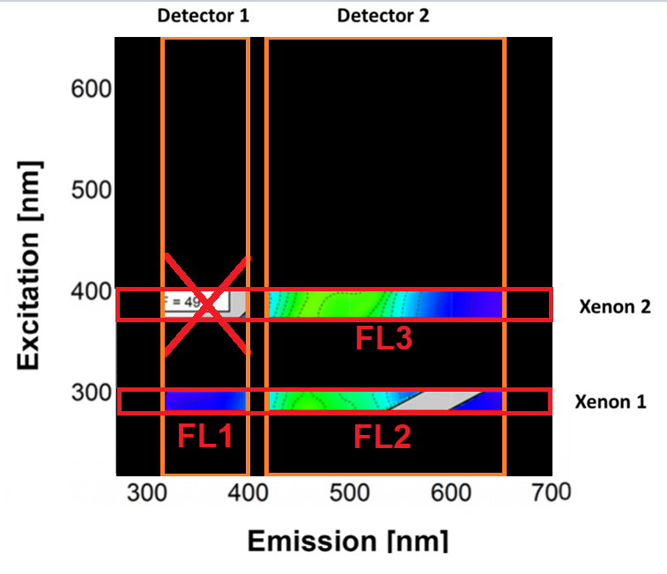
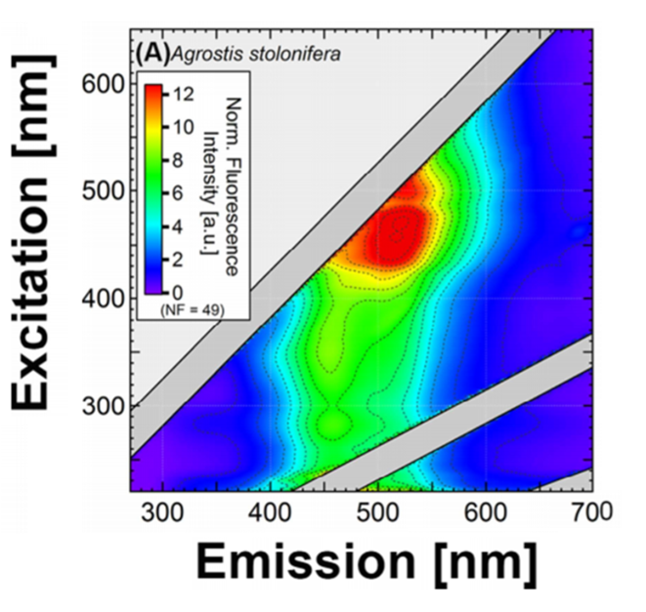
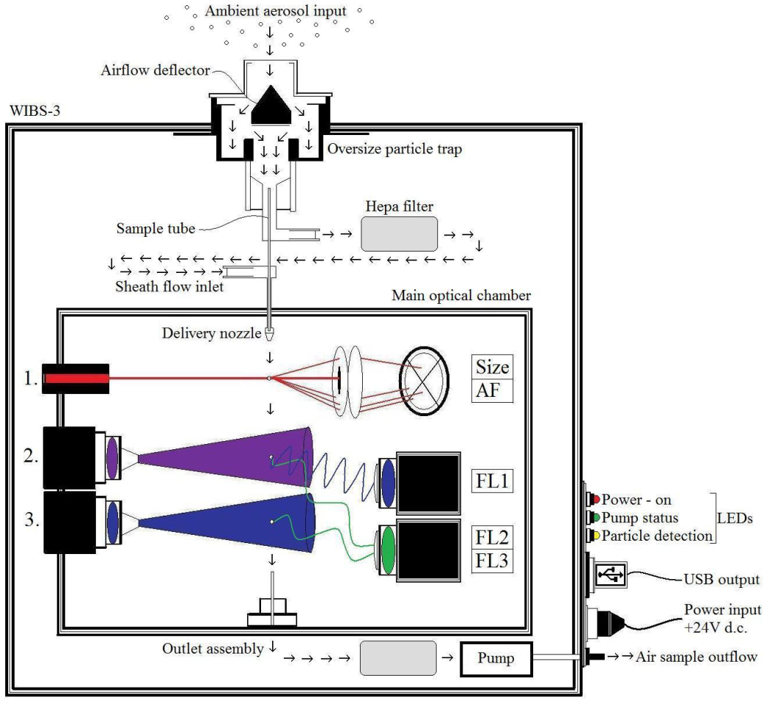
UV-LIF
Pohlker et al. 2012

Slide 4
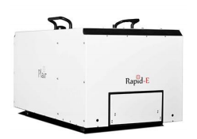
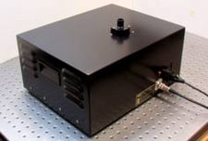
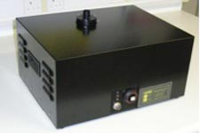
Spectrometers
PLAIR Rapid-E
32 channels
Excitation: 337 nm
32 detection bands: 350-800 nm
4 FL ifetime decay bands
Sizing: 0.5-100 µm
Shape: time resolved scattering
WIBS
3 channels
Excitation 280/370 nm
2 detection bands
310-400/420-650nm
Sizing: 0.8 – 20 µm
Shape: quadrant detector
MBS
8 channels
Excitation 280nm
8 detection bands
310 – 638 nm
Sizing: 0.8 – 20 µm
Shape: dual CMOS array
DMT SIBS
28 channels
Excitation 285/370 nm
16 detection bands: 300-720 nm
Sizing: 0.5-30 µm
Shape: quadrant detector
Increasing Complexity & Specificity

Slide 5
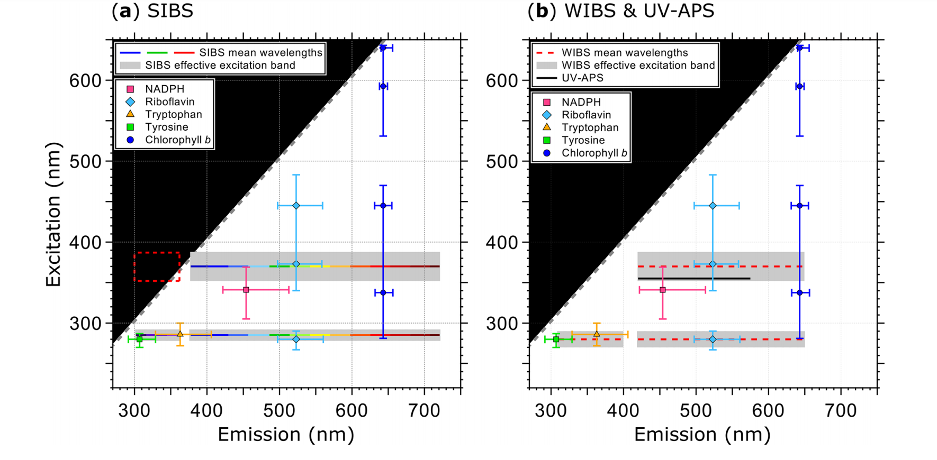
Könemann et al. 2019

Slide 6
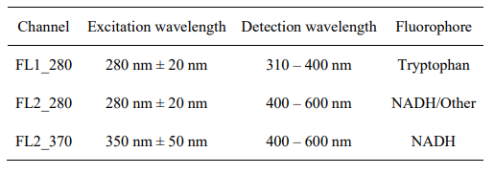
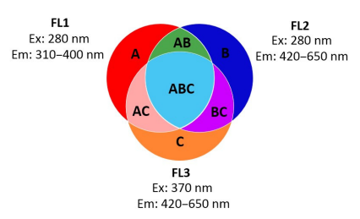
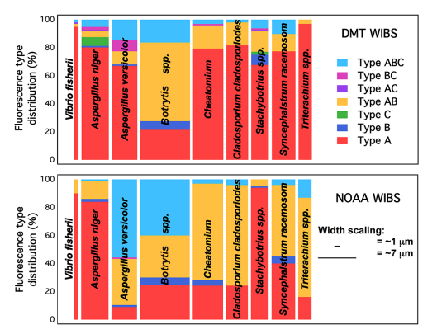
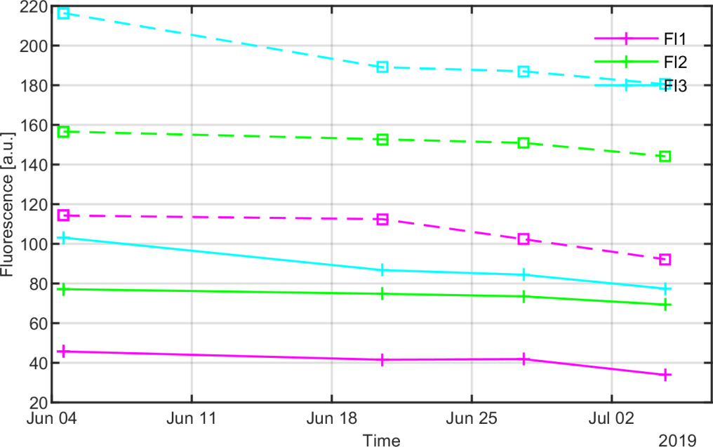
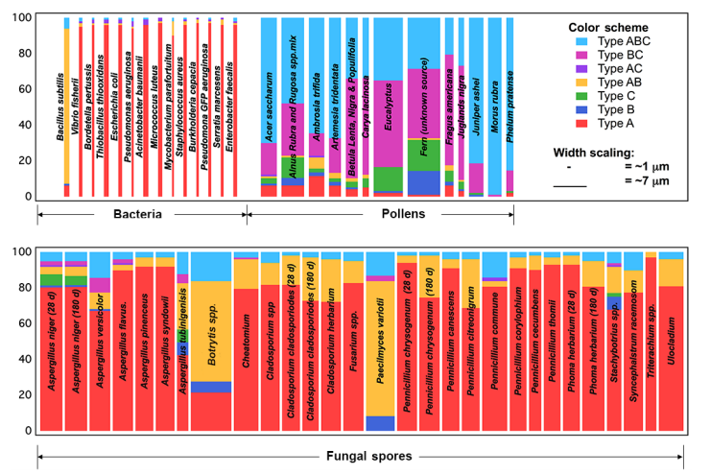
Historic Analysis Methods
Savage et al., 2013
Hernandez et a., 2016

Slide 7
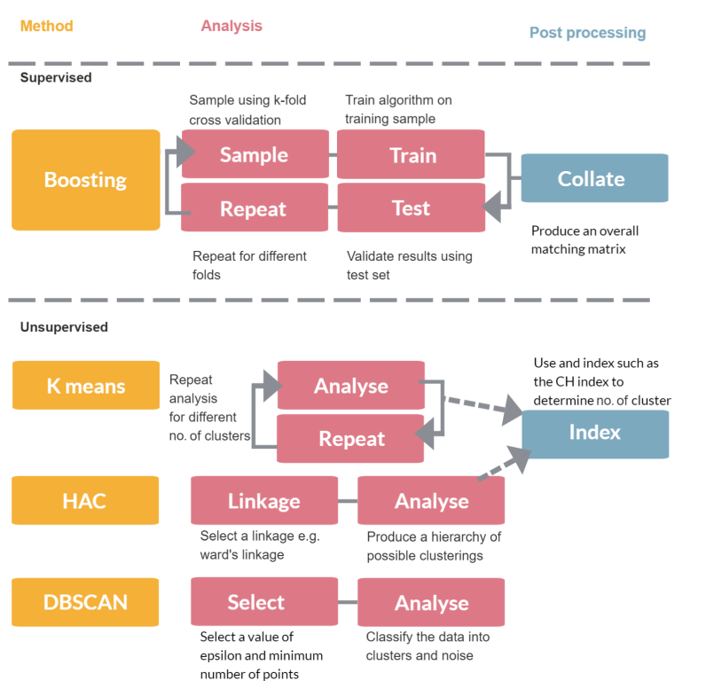
Current Analysis Methods
SLOW
FAST
Dimensionality
Reduction
Regression
Unsupervised
Machine
Learning
Supervised
Hierarchical
Agglomerative
Clustering
Gradient
Boosting
Clustering
SVM
Classification
Gaussian
Mixture
K-Means
Density Based
Spectral Clustering
and Noise
Artificial
Neural
networks
Decision
trees
Fuzzy
C-Means
K-nearest
neighbour
Ruske et al., 2018

Slide 8
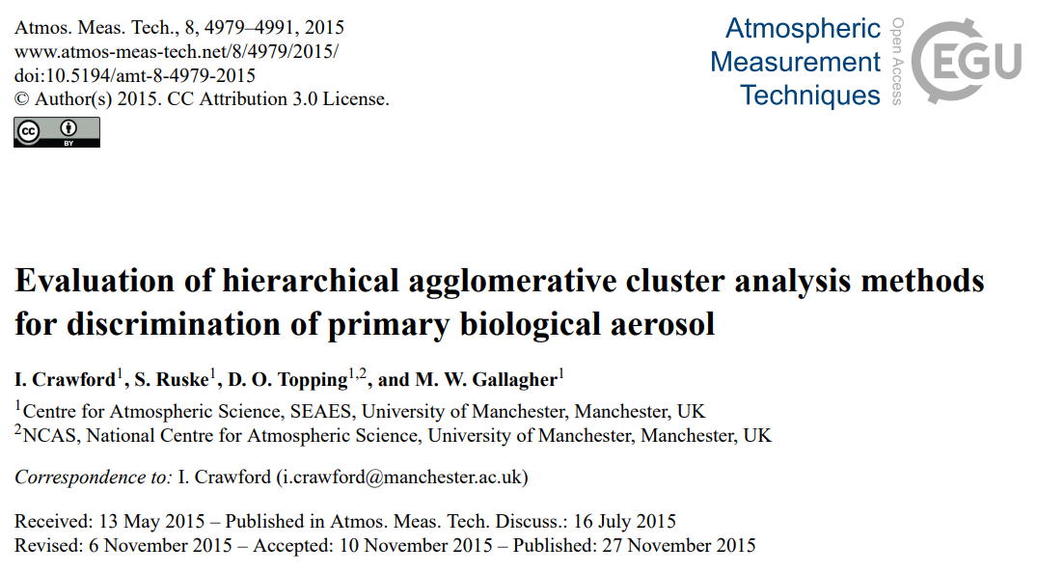
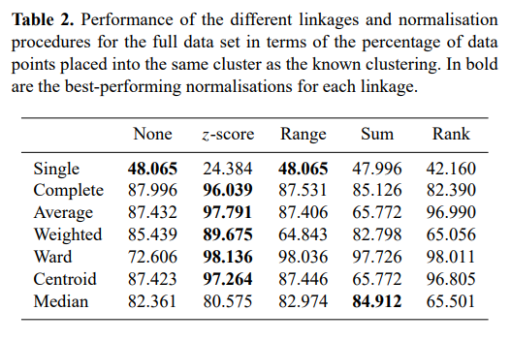
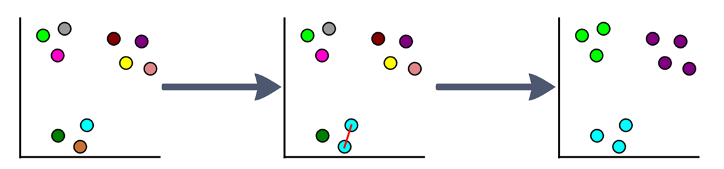
Hierarchical Agglomerative Clustering
Groups similar data points into clusters
No a priori information needed but highly sensitive to pre-processing
Need to choose best solution – e.g., Calinski–Harabasz index

Slide 9
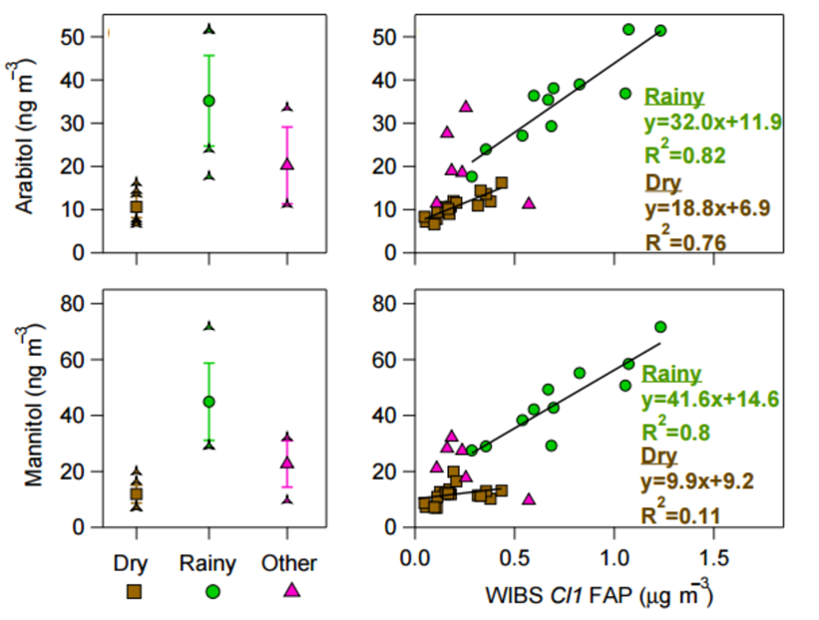
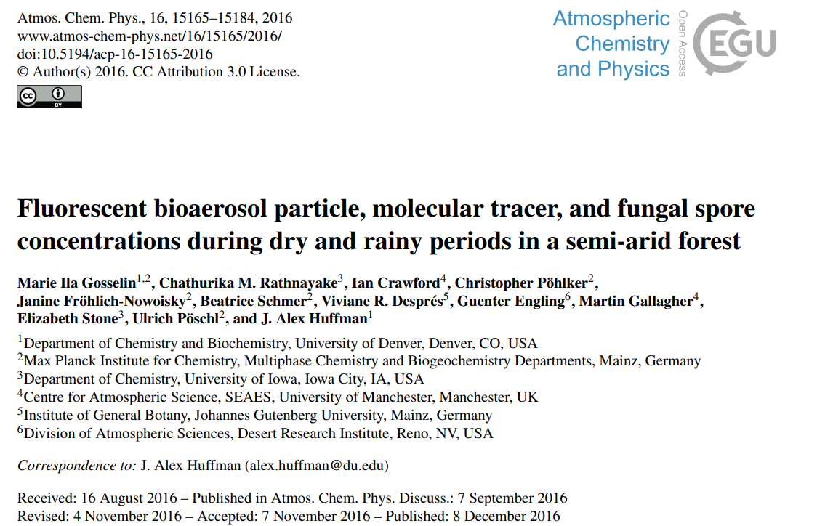
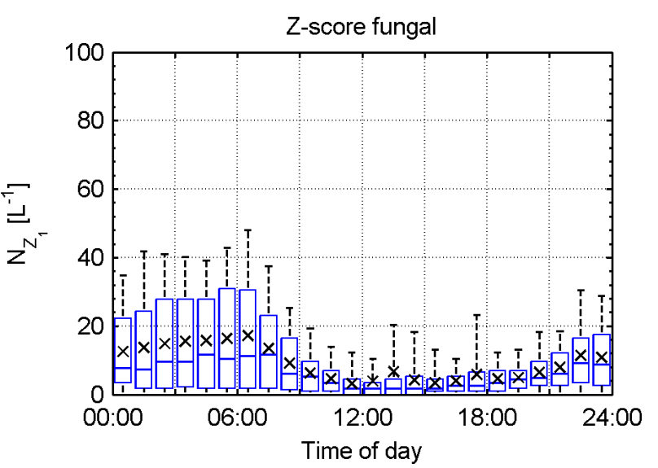
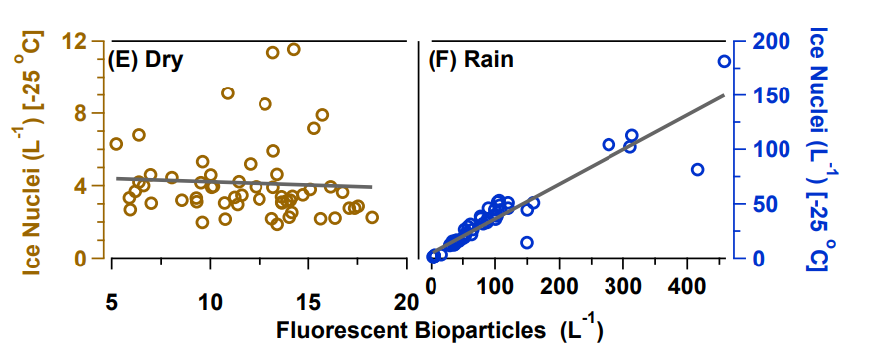
Huffman et al., 2013

Slide 10
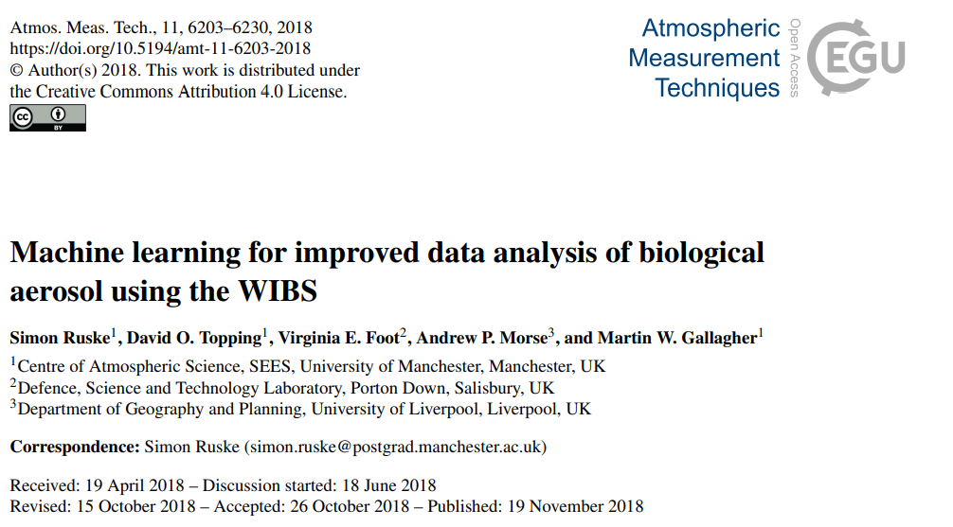

Density Based Spectral Clustering and Noise
Groups similar data points into clusters parametrically
Define neighbourhood radius and minimum radial population
Intrinsically calculated optimal solution
Particles may be left unclassified
New promising method – requires validation for ambient sampling

Slide 11
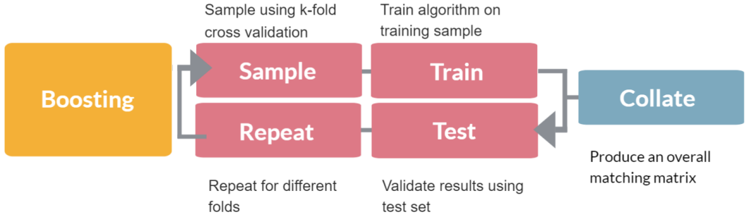
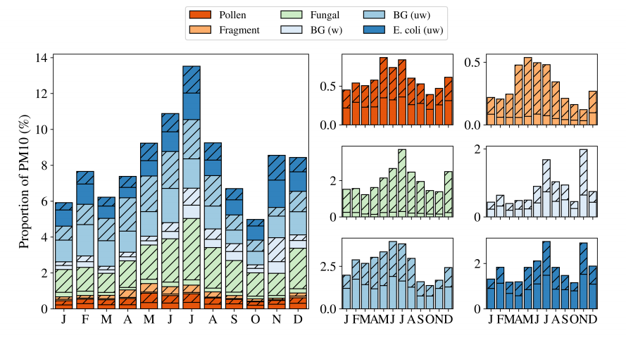
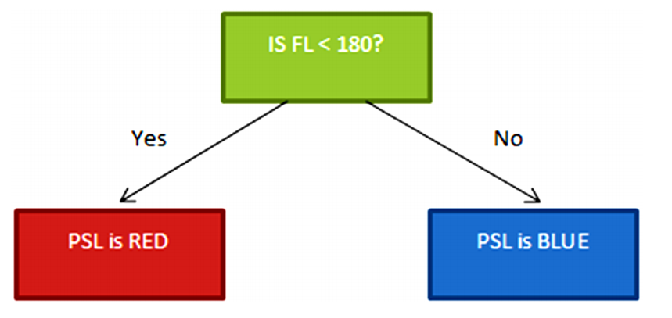
Decision tree – Gradient Boosting
MBS - London
Fit one tree to data
Evaluate where performing well
Fit second tree where model performs poorly
Repeat and add trees

Slide 12
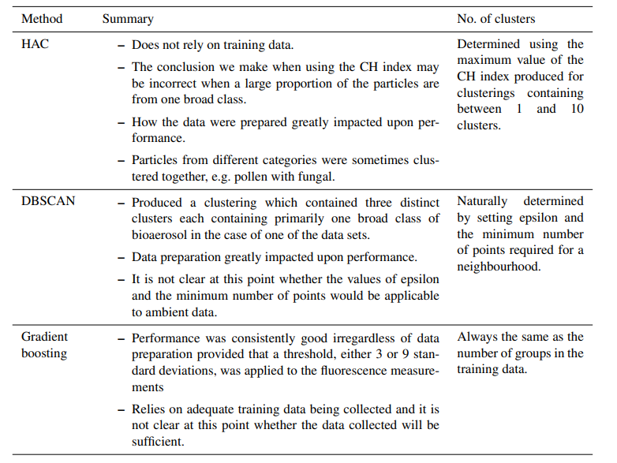
Algorithm summary

Slide 13
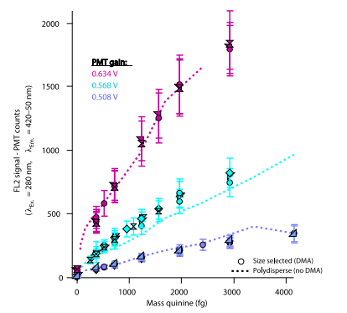
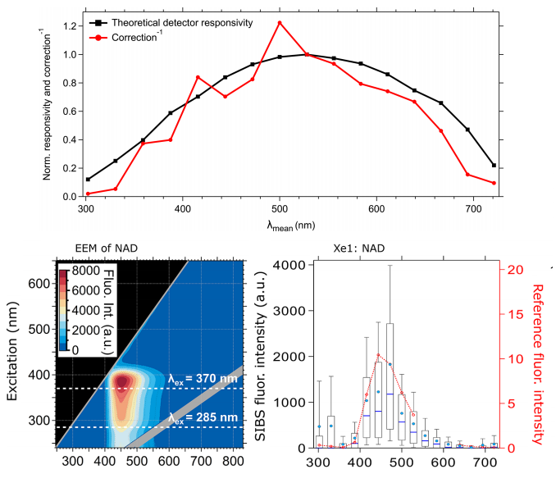
Challenges - Calibration
Könemann et al. 2019
Robinson et al., 2017
Need suitable fluorescent
calibration standards
Need calibration methods
for multichannel detectors

Slide 14
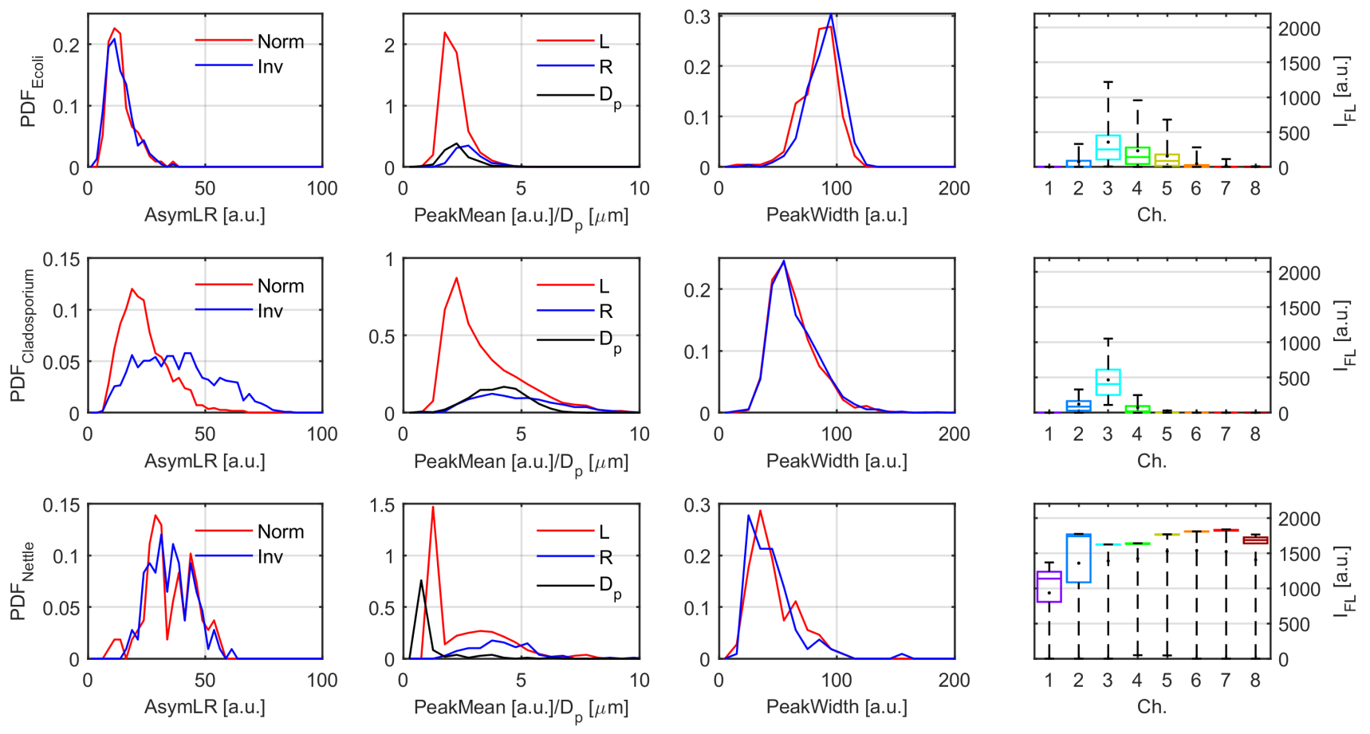
Challenges – Reference Data
Bacteria
Fungal
Pollen
Need a much larger reference database for training
Effect of processing and mixing uncharacterised

Slide 15
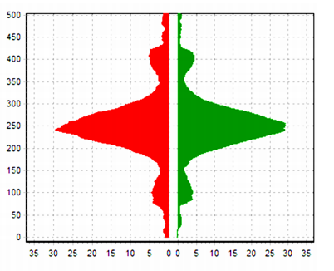
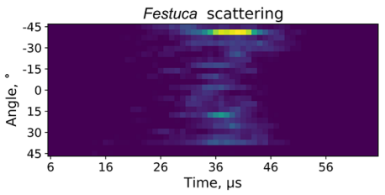
Challenges – Improving Spectrometers
MBS CMOS
RAPID-E

Slide 16
