Slide 1

The State of Acidity in the Atmosphere:
Particles and Clouds
The views expressed in this presentation are those of the authors and do not necessarily reflect the views or policies of the U.S. EPA.
Havala O. T. Pye and Collaborators
EPA RTP
Office of Research and Development
Center for Environmental Measurement and Modeling
4 December 2019
International Aerosol Modeling Algorithms Conference, Davis, CA

Slide 2
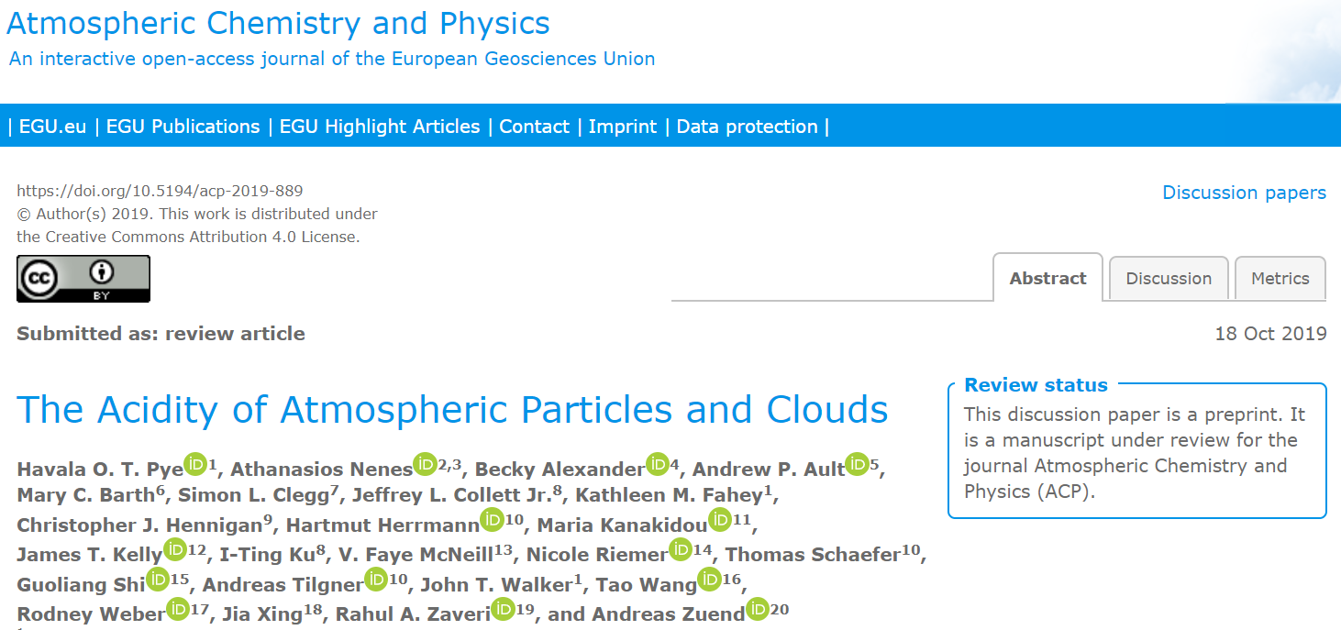
Notes:
My talk today is based a paper currently in review on ACPD about the acidity of atmospheric particles and clouds. I will only have time to cover a fraction of the material, so I encourage you to see the paper for additional information. The supporting information also contains a wealth of information that could be useful for model evaluation.

Slide 3










A Team Effort with Section Leads
John Walker and Jim Kelly (EPA) Importance of pH
Faye McNeill (Columbia)
Chemical Kinetics and pH
Andreas Zuend (McGill)
Definition of pH
Chris Hennigan (UMBC)
Proxies of pH
Athanasios Nenes (EPFL) Aerosol pH Box Model Intercomparison
Havala Pye (EPA)
Regional-Global Model Predictions of pH
Maria Kanakidou (Crete) and
Athanasios Nenes (EPFL) Observed Aerosol pH
Jeff Collett (CSU)
Observed Cloud pH
Rahul Zaveri (PNNL)
Aerosol pH Heterogeneity
Notes:
This review has been a large collaborative effort involving representatives from 9 countries and 8 states. The work was managed through a series of sections and the 10 people shown here served as section leads. John Walker and Jim Kelly provided a connection to policy endpoints and the importance of pH. Andi Zuend led the definition of pH. Faye McNeill contributed to this review and is also coordinating a companion paper to be submitted to ACP on the role of chemical kinetics in influencing pH. Chris Hennigan coordinated the section on proxies of pH. Thanos Nenes coordinated the box model intercomparison. In collaboration with Maria Kanakidou, he also synthesized observed aerosol pH values. Jeff synthesized cloud pH values. Rahul Zaveri emphasize the role of particle size, mass transfer, and composition in affecting heterogeneity, and I coordinate the regional to global chemical transport model section.

Slide 4














The Team
Contributions across multiple sections:
Becky Alexander (University of Washington)
Andrew Ault (University of Michigan)
Mary Barth (NCAR)
Simon Clegg (University of East Anglia)
Kathleen M. Fahey (EPA)
Hartmut Herrmann (TROPOS)
I-Ting Ku (Colorado State University)
Nicole Riemer (UIUC)
Thomas Schaefer (TROPOS)
Guoliang Shi (Nankai University)
Andreas Tilgner (TROPOS)
Tao Wang (Hong Kong Polytechnic University)
Rodney Weber (Georgia Institute of Technology)
Jia Xing (Tsinghua University)
Notes:
The team also included a number of individuals who contributed across multiple sections including…

Slide 5
Motivation
Acidity is an important property of ambient condensed phases
Acidity affects endpoints of interest
  Human health
  Deposition
  Climate
Literature estimates of aerosol acidity have become more common
  What are current aerosol acidity estimates?
  Are there indicators of pH that can be leveraged when pH itself is not available?
  Is our conceptual picture of acidity relatively complete?
Notes:
Our review was motivated by several factors. First, we recognized that acidity was an important property of ambient condensed phases (particles and clouds) with implications for endpoints including human health, deposition, and climate. In addition, the number of studies reporting estimates of fine aerosol pH has increased in recent years. We wanted to provide a resource to the community that brought together current estimate of acidity, highlighted the central role of pH over other indicators of pH, and synthesized how well we as a community understand pH. As part of that, we wanted to understand if there were any major issues or if our conceptual picture is relatively complete. We do think there is a wealth of information available now, but data is limited in space and time.

Slide 6
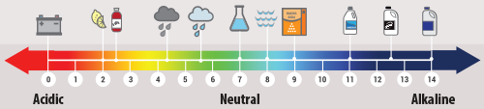
The Big Picture
pH provides a formal definition of acidity
Aerosol acidity is estimated with models
Acidic fine particles are ubiquitous
Clouds are less acidic than particles
As anthropogenic combustion emissions are controlled:
  Clouds tend to become less acidic
  Fine aerosol acidity can remain relatively constant
Image: epa.gov
Notes:
So today, we will discuss pH as a formal definition of acidity. You will see that aerosol acidity is rarely measured but is commonly estimated with models. We will show that acidic fine particles are ubiquitous across environments. Clouds, with their relatively higher water content are also acidic (meaning pH<7), but less so than particles. We will also discuss some of the important differences between clouds and particles. Specifically, the two media respond differently to changes in anthropogenic emissions of SOx and NOx. Clouds tend to become less acidic and fine aerosols can remain at a relatively constant pH despite changes in emissions.
=======================
Figure:Battery acid,Lemon juice,Soda,Acid rain 4.3,Clean rain 5.6,Seawater 8.1,Baking soda 9,Ammonia,Bleach,Liquid drain cleaner

Slide 7
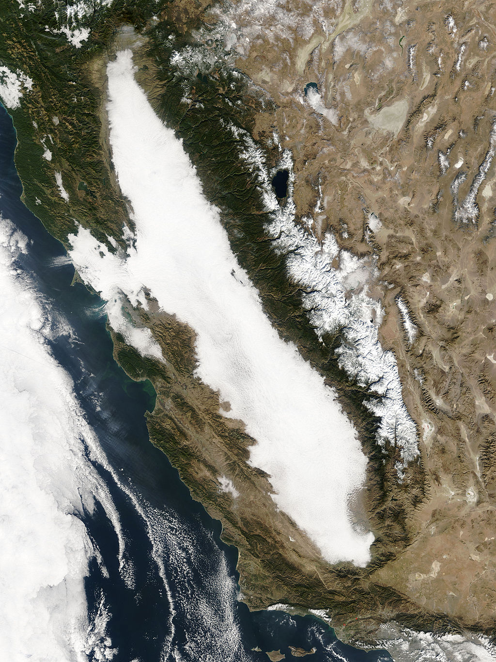


Outline
Central Valley Fog pH ~ 6
Smoke in San Francisco
Wildfire smoke pH~2-4
Importance of pH
Definition of pH and
The Algorithms
Proxies of pH
Chemistry and Heterogeneity
Observations
CTM Predictions
CalNex (LA Basin) Fine particle pH ~ 2-3
Condensed-phase media in California
Images: SF Chronicle, NASA, Soufi on Wikipedia
Notes:
==============================
https://www.sfchronicle.com/california-wildfires/article/What-will-wildfire-smoke-do-to-my-health-Long-13399961.php#photo-16515335
https://commons.wikimedia.org/wiki/File:Los_Angeles_Skyline.jpg
Tule Fog in CA Central Valley, 2005; image via NASA Terra Satellite

Slide 8
Introduction to and Importance of pH

Slide 9
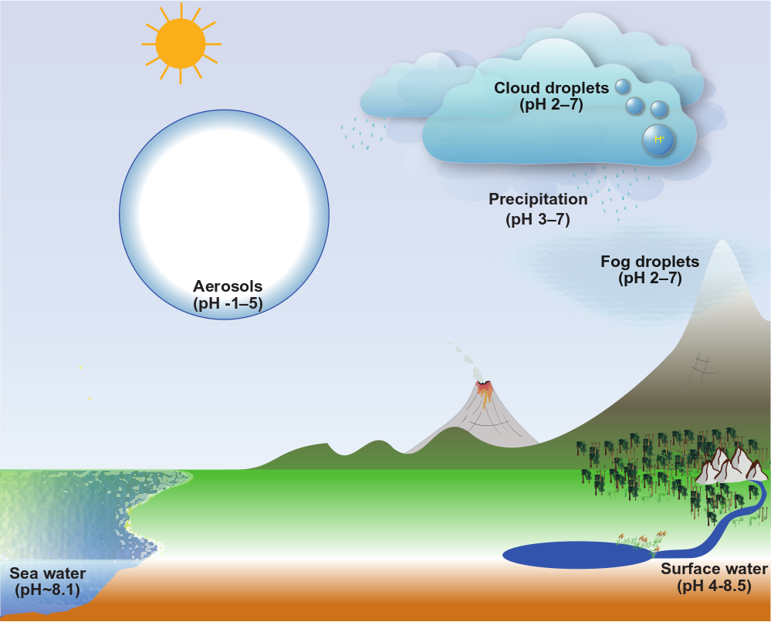
Suspended condensed phases are acidic
Notes:
The pH of various environmental media have been measured or estimated. Compared to surface waters, sea water, and precipitation, particles and clouds are more acidic.

Slide 10
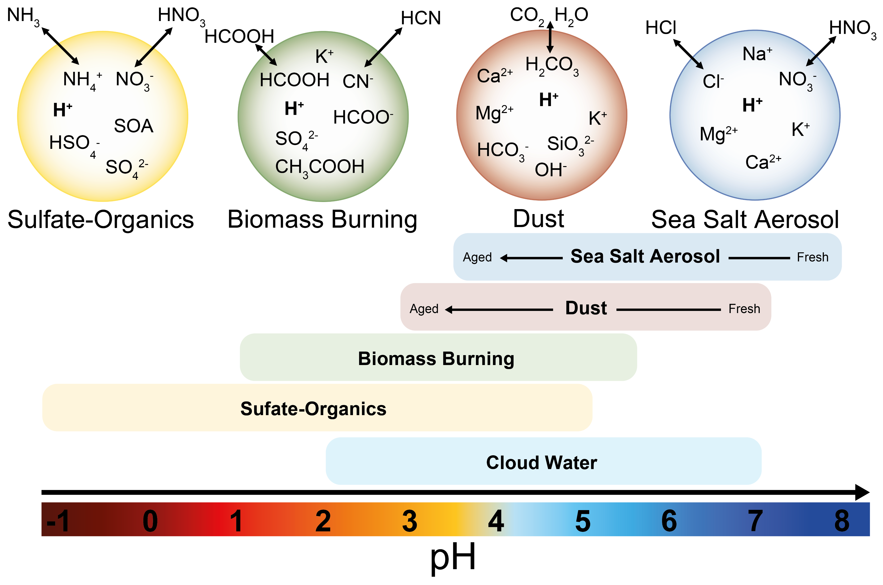
Fine particles are quite acidic
Notes:
Fine aerosols can have a wide range of pH from below 0 to around 5. This variability is driven by a number of factors including temperature, RH, and atmospheric composition.
Some emissions such as SO₂ act to increase acidity and sulfate-organic dominated particles tend to have pH from -1 to as high as 5.
Some species such as ammonia, amines, and non-volatile cations act to reduce acidity. Biomass burning, dust, and sea spray aerosols tend to have higher pH as a result of nonvolatile cations such as calcium, potassium, magnesium, and sodium.
Sea water has a pH of 8.1 and sea spray emissions are initially at a high pH. Sea spray aerosols will rapidly dehydrate and acids will partition into the particle. Initially the dissolved acids will titrate the carbonate alkalinity in the sea salt, but eventually the particles will become acidified compared to their initial emitted form. Generally, within 15 minutes, sea spray aerosols are acidified.
Dust is also more alkaline upon emission and is chemically processed to lower pHs of 3-5. Given the atmospheric lifetime of particles, dust and sea spray dominated environments tend to have measured or estimated pHs on the order of 4-5.

Slide 11
Clouds have more water and are less acidic
Notes:
Cloud droplets (including fogs) are slightly less acidic than fine particles, but still acidic. Just like particles, cloud pH is influenced by the composition of emissions. Precipitation provides a connection between clouds and the surface. Clean rain is around pH 5.6 as dictated by carbon dioxide. However, the pH of rain could be higher if significant alkaline emissions (dust, NH3) are present. Cloud pH has been observed as high as a pH of 7.

Slide 12
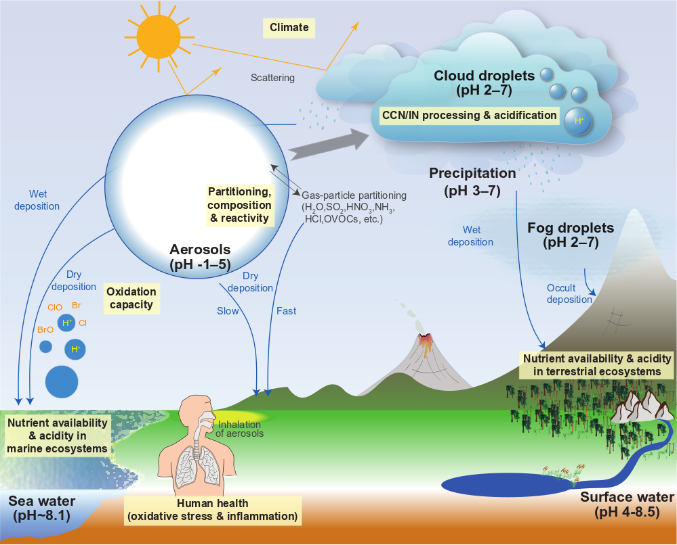
Acidity influences multiple endpoints
Effects of pH on deposition lead to ecosystem, biogeochemistry, water quality, and carbon cycle impacts. Effects are via
Direct acid deposition
Solubilization of trace nutrients
Partitioning and transport of nitrogen
pH affects human health by determining PM_{2.5} mass and composition via:
Acid-catalyzed reactions
Gas-particle partitioning
Solubilization of metals
pH has implications for climate and other endpoints
Notes:
Direct and indirect effects of pH on deposition lead to ecosystem, biogeochemistry, water quality, and carbon cycle impacts.
Direct acid deposition can cause: Leaching of cations from foliage and soils, Altered stomatal function, Changes in leaf wax structure, and Mobilization of aluminum in soil with implications for water quality
Acidity can increase the solubility and bioavailable of trace nutrients (phosphorus, iron, copper) leading to phytoplankton blooms
pH-dependent gas-particle partitioning has implications for atmospheric lifetime and transport of N (reduced and oxidized)
pH affects human health by determining PM_{2.5} mass and composition.
PM_{2.5} mass affected by: gas-particle partitioning of pH-dependent species (e.g. nitrate, ammonia) and acid catalyzed reactions
Aerosol pH has been linked to third-hand smoke exposure by promoting distribution in the indoor environment (De Carlo et al., 2018)
pH-dependent solubilization of metals (e.g. Fe) is linked to the oxidative potential of particles (Poschl and Shiraiwa, 2015) and has been further linked to cardiovascular endpoints (Fang et al., 2017)
pH has implications for climate and other endpoints.
pH influences water uptake of particles modulating visibility and the aerosol direct effect, Cloud pH has been linked to the amount and speciation of aerosol upon evaporation with radiative effects (Turnock et al., 2019)
pH affects brown carbon formation and modifies the active sites on ice nuclei (IN), particularly dust
Acid-base chemistry has a role in new particle formation and growth with implications for aerosol size and CCN abundance
pH has implications for halogen chemistry and oxidation capacity of troposphere

Slide 13
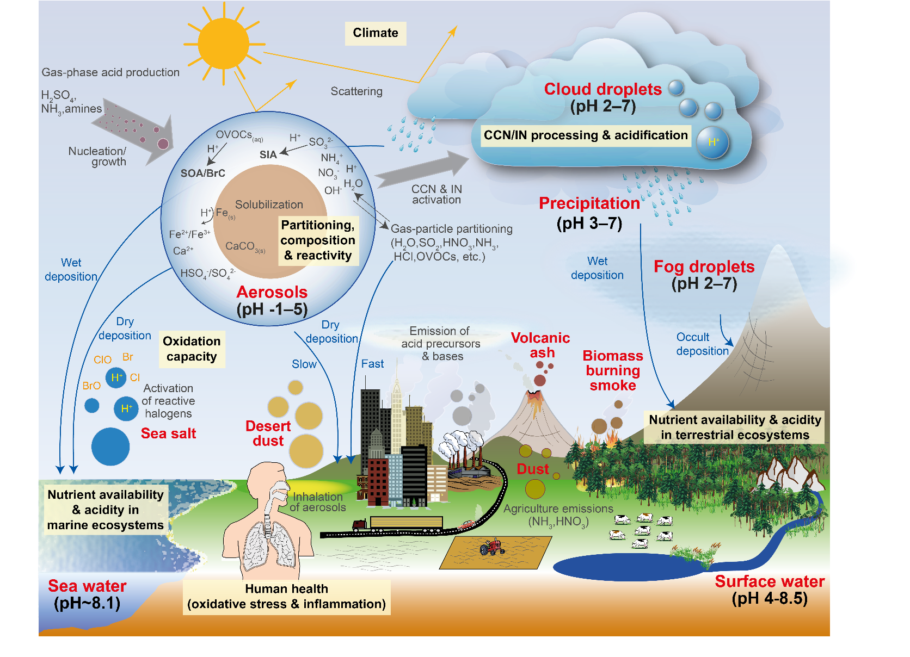
Acidity influenced by multiple processes
Emissions
Sea spray
Dust
Biomass burning aerosol
Anthropogenic PM (including metals)
Precursor gases
Chemistry
Gas-phase production of acids/bases
Condensed-phase reactions
Partitioning
Semivolatile acids/bases
Removal/conversion
Deposition
CCN/IN activation
Notes:
Acidity itself is influenced by multiple processes including direct emissions of particles and precursor gases, chemistry leading to production of acids and bases as well as condensed-phase reactions, and partitioning of semivolatile species.
Cloud processing can result in changes in particle composition and particles can also activate as CCN or IN.

Slide 14
Definition of pH

Slide 15
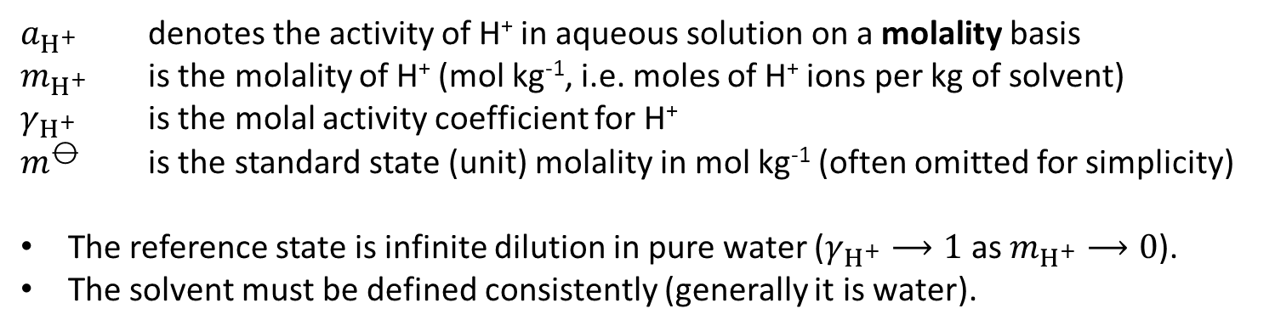
pH defines acidity
According to the International Union of Pure and Applied Chemistry (IUPAC):
$$\text{pH}={−log}_{10}\left(a_{H^{+}}\right)={−log}_{10}\left(\frac{m_{H^{+}}}{m^{⦵}} γ_{H^{+}}\right)={−log}_{10}\left(m_{H^{+}}γ_{H^{+}}\right)$$
$a_{H^{+}}$ denotes the activity of H⁺ in aqueous solution on a molality basis
$m_{H^{+}}$ is the molality of H⁺ (mol kg⁻¹, i.e. moles of H⁺ ions per kg of solvent)
$γ_{H^{+}}$ is the molal activity coefficient for H⁺
$m^{⦵}$ is the standard state (unit) molality in mol kg⁻¹ (often omitted for simplicity)
The reference state is infinite dilution in pure water ($γ_{H^{+}}⟶1$ as $m_{H^{+}}⟶0$).
The solvent must be defined consistently (generally it is water).
Notes:
We formally defined pH according to the IUPAC definition based on the molality scale. Thus the activity and activity coefficient, gamma, are defined on the molality scale with a reference state of infinite dilution in pure water. A standard state molality is needed to create a dimensionless quantity, but we can omit that for simplicity. The solvent should be defined consistently across the molality and activity coefficient and is generally water, however, organic species could be included in the solvent. Whatever is chosen, the definition should be carried through all quantities consistently.
pH is only defined for liquid particles (highly viscous or solid particles do not have a unique pH value as viscous particles may have significant gradients in concentration and solid particles lack water)
The IUPAC definition is notational only and we will discuss what that means for measurements and models.

Slide 16
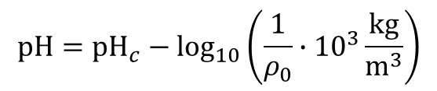

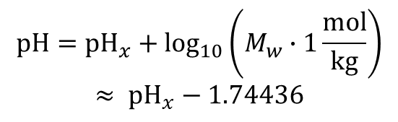
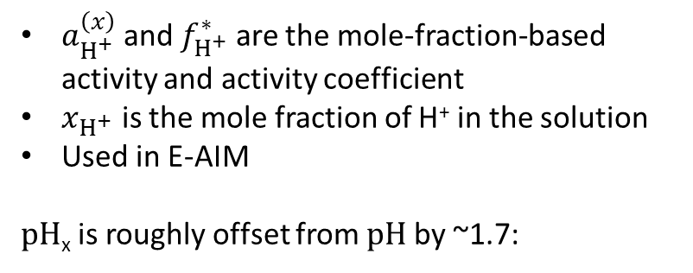

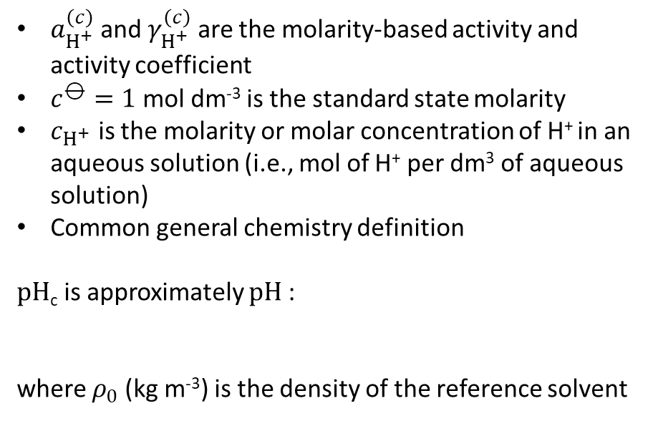
pH can be defined on other concentration scales
Molarity-based pH
Mole-fraction-based pH
$${pH}_{c}={−log}_{10}\left(a_{H^{+}}^{\left(c\right)}\right)={−log}_{10}\left(\frac{c_{H^{+}}}{c^{⦵}} γ_{H^{+}}^{\left(c\right)}\right)$$
$${pH}_{x}={−log}_{10}\left(a_{H^{+}}^{\left(x\right)}\right)={−log}_{10}\left(x_{H^{+}}^{}f_{H^{+}}^{∗}\right)$$
$a_{H^{+}}^{\left(c\right)}$ and $γ_{H^{+}}^{\left(c\right)}$ are the molarity-based activity and activity coefficient
$c^{⦵}=1$ mol dm⁻³ is the standard state molarity
$c_{H^{+}}$ is the molarity or molar concentration of H⁺ in an aqueous solution (i.e., mol of H⁺ per dm³ of aqueous solution)
Common general chemistry definition
pH_{c} is approximately pH :
where $ρ_{0}$ (kg m⁻³) is the density of the reference solvent
$a_{H^{+}}^{\left(x\right)}$ and $f_{H^{+}}^{∗}$ are the mole-fraction-based activity and activity coefficient
$x_{H^{+}}$ is the mole fraction of H⁺ in the solution
Used in E-AIM
pH_{x} is roughly offset from pH by ~1.7:
$$pH={pH}_{x}+\log_{10}\left(M_{w}∙1\frac{\text{mol}}{\text{kg}}\right)$$
$$≈ {pH}_{x}−1.74436$$
$$pH={pH}_{c}−\log_{10}\left(\frac{1}{ρ_{0}}∙{10}^{3}\frac{\text{kg}}{{\text{m}}^{3}}\right)$$
Reference state: infinite dilution in pure water
Notes:
pH can be defined on other concentration scales. The most common general chemistry approach is to use a molarity-based activity and activity coefficient, denoted with a superscript (c). A standard state is needed to create the dimensionless activity. The relationship between pHc and pH can be determined via equivalence of chemical potentials and indicates that pHC is approximately the same as pH. The two differ by the density of the reference solvent, usually water, which is a function of temperature for example.
The E-AIM model uses a mole-fraction basis for pH. Thus the activity and activity coefficient are mole-fraction based. The resulting pHX is not equivalent to pH, but is higher than pH by about 1.7 units.

Slide 17

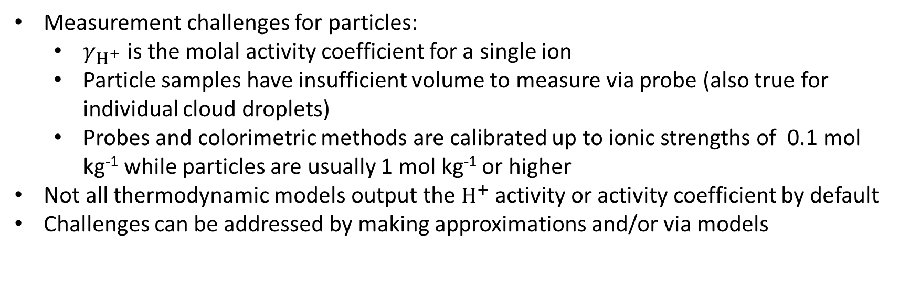
The definition of pH presents challenges
$$\text{pH}={−log}_{10}\left(a_{H^{+}}\right)={−log}_{10}\left(m_{H^{+}}γ_{H^{+}}\right)$$
Measurement challenges for particles:
  $γ_{H^{+}}$is the molal activity coefficient for a single ion
  Particle samples have insufficient volume to measure via probe (also true for individual cloud droplets)
  Probes and colorimetric methods are calibrated up to ionic strengths of 0.1 mol kg⁻¹ while particles are usually 1 mol kg⁻¹ or higher
Not all thermodynamic models output the $H^{+}$ activity or activity coefficient by default
Challenges can be addressed by making approximations and/or via models
Notes:
As I mentioned, the IUPAC Definition is notational only. This leads to both measurement and modeling challenges.
experimentally any electrolyte solution contains both cations and anions
True for individual cloud droplets which is why bulk measurements are made

Slide 18

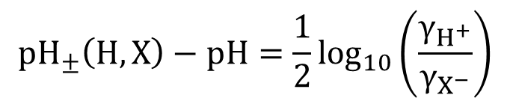
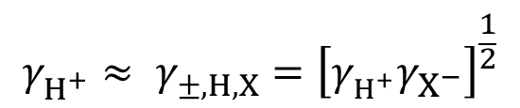

pH can be approximated
Approximations are based on the formal IUPAC definition
An activity coefficient of 1 results in free H⁺:
A mean molal ion activity coefficient could also be used:
with bias equal to:
$${pH}_{F}={−log}_{10}\left(m_{H^{+}}\right)$$
$$γ_{H^{+}}^{}≈ γ_{±,H,X}^{}={\left[γ_{H^{+}}^{}γ_{X^{−}}^{}\right]}^{\frac{1}{2}}$$
$${pH}_{±}\left(H,X\right)={−log}_{10}\left( m_{H^{+}}γ_{±,HX}^{}\right)$$
$${pH}_{±}\left(H,X\right)−pH=\frac{1}{2}\log_{10}\left(\frac{γ_{H^{+}}}{γ_{X^{−}}}\right)$$
Notes:
Free H+ calculation with gamma=1 is only appropriate for highly dilute systems (near 100% RH).
pH+- bias likely to be minimized under ideal conditions (gamma=1) or when the deviation in gamma for H+ and the anion are similar

Slide 19
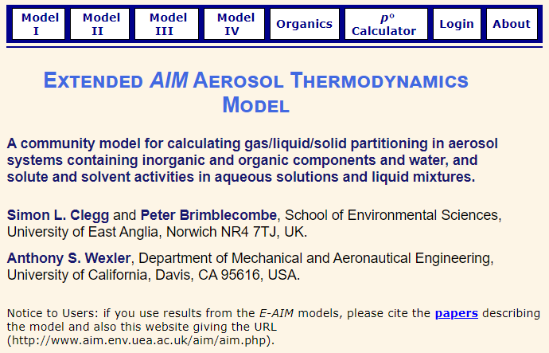

Aerosol pH is generally modeled
Two models can predict equilibrium pH :
Extended Aerosol Inorganic Model (E-AIM)
  Developed by Simon Clegg et al.
  Most accurate inorganic thermodynamic model
Aerosol Inorganic-Organic Mixtures Functional groups Activity Coefficient gas-liquid equilibrium (AIOMFAC-GLE) model
  Developed by Andi Zuend et al.
  Considers organic and inorganic component interactions
  AIOMFAC itself predicts activity coefficients

Slide 20
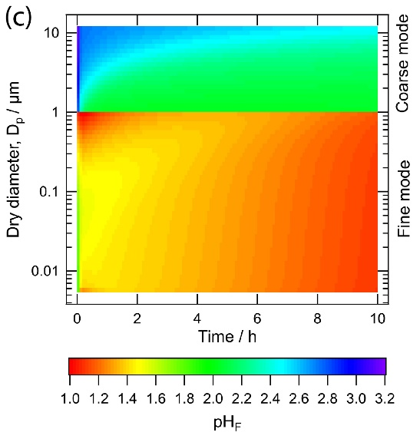
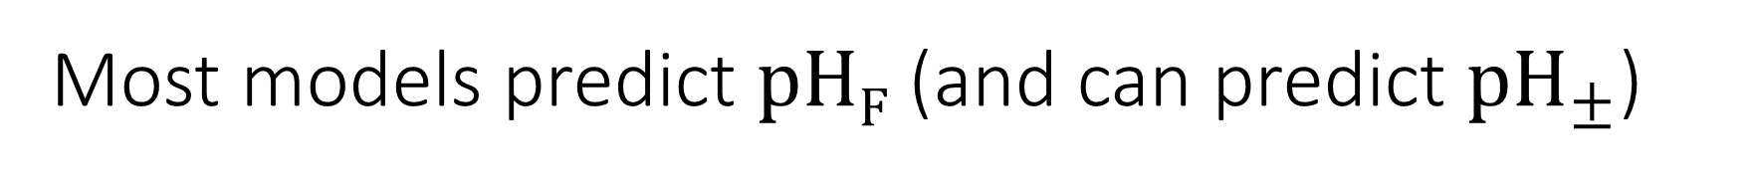
Most models predict pH_{F} (and can predict ${pH}_{±}$)
Evolution of pH_{F} predicted by MOSAIC for a population of particles
Model for Simulating Aerosol Interactions and Chemistry (MOSAIC) (Rahul Zaveri et al.) considers aerosol thermodynamics along with mass transport
  Small particles equilibrate quickly (< 1 hour in most cases)
  Large accumulation-mode particles can have equilibration timescales on the order of hours
  Coarse mode particles can still show heterogeneity after 10 hours
ISORROPIA II (Athanasios Nenes et al.) is computationally efficient and the most widely used inorganic partitioning model in CTMs
Other models are available (EQUISOLV II, GFEMN, UHAERO, SCAPE, EQSAM, …)
Recommended approach for input (e.g. Hennigan et al. 2015 ACP): total gas + aerosol composition
Notes:
Example on right is a calculation by MOSAIC with 60 size bins. The fine model is ammonium sulfate and coarse mode is NaCl. The initial distribution is exposure to sulfuric, nitric, and hydrochloric acid as well as ammonia and allowed to evolve. The fine mode rapidly absorbs the gases, but still takes quite a while to become relatively uniform in pH. The coarse mode is slower to adjust and is still not uniform after 10 hours

Slide 21
The Aerosol
Modeling Algorithms
Notes:
Box model calculations for idealized and ambient scenarios were used to understand the differences between pH and its approximations. We considered AIOMFAC-GLE, E-AIM, ISORROPIA, MOSAIC, and EQUISOLV II.

Slide 22
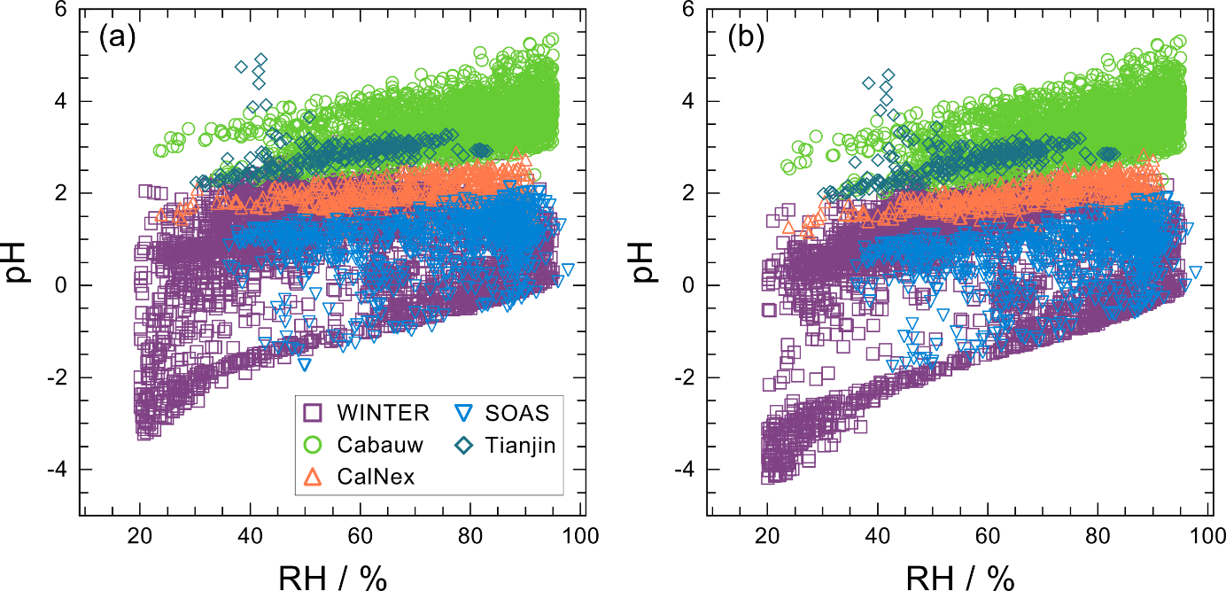
Field data spans a range of pH
E-AIM Predictions of pH (all data)
Study | Reference | Time | T (K) | Total SO₄²⁻ (μg m⁻³) | Total NH_{x} (μg m⁻³) | Total NO₃ (μg m⁻³)
Tianjin, China | Shi et al., 2019 | Summer 2015 | 302 | 21 | 38 | 18
CalNex, CA, US | Guo et al., 2017 | Summer 2010 | 291 | 2.9 | 3.4 | 10
Cabauw, Netherlands | Guo et al., 2018 | ~2012 | 282 | 1.9 | 9.3 | 4.1
WINTER Eastern US | Guo et al., 2016 | Winter 2015 | 271 | 1.0 | 0.53 | 2.1
SOAS, AL, US | Guo et al., 2015 | Summer 2013 | 298 | 1.8 | 0.78 | 0.12
Notes:
SOAS and WINTER were the most acidic campaigns with pH below 2. Some very low pH values were predicted for WINTER corresponding to measurement aloft at low temperature and RH.
CalNex experienced intermediate pH close to 2 as a result of high ammonia and NVC.
Tianjin and Cabauw have the highest ammonia and the highest pH with values between 2 and 5.

Slide 23
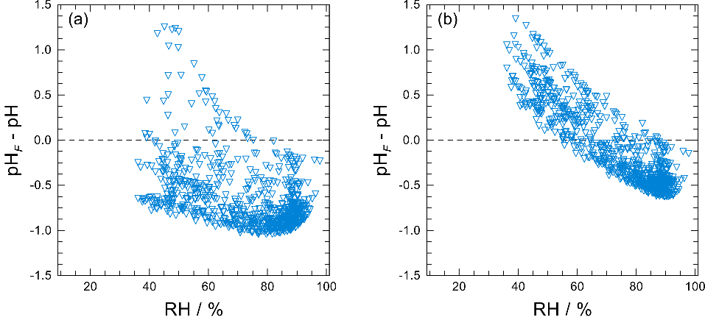
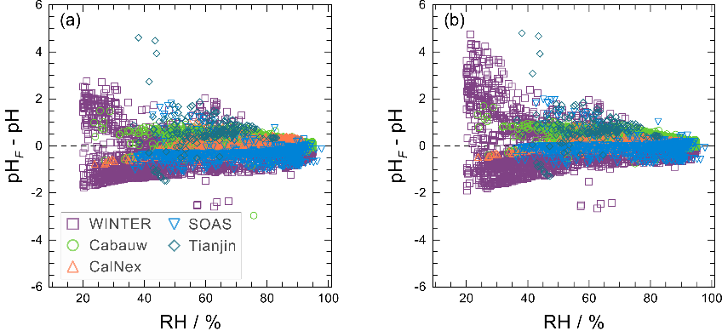
pH_{F} and pH generally within 1 unit
All Data
pH_{F} (ISORROPIA) –
pH (AIOMFAC-GLE)
SOAS Only
pH_{F} – pH (both AIOMFAC-GLE)
SOAS Only
pH_{F} – pH (both E-AIM)
All Data
pH_{F} (ISORROPIA) – pH (E-AIM)
Models predicting pH (AIOMFAC-GLE, E-AIM) are in good agreement with each other
Best agreement at high RH (dilute) with spread increasing to > 2 pH units as RH decreases
Model-model differences due to: liquid water content, degree of bisulfate dissociation, gas-particle partitioning, and activity coefficient approach
Notes:
Over a wide variety of atmospheric conditions, pHF and pH agree within one unit.
Within an internally consistent framework such as AIOMFAC or E-AIM, pH_{F} deviates from pH by up to 1 unit and usually by much less.
pHF-pH comparison using the same model for both roughly consistent with the SOAS data here, but the WINTER bias can be up to 2 or even 3 units at low RH.
When comparing across frameworks, pHF (from ISORROPIA) agrees with pH estimated from AIOMFAC-GLE or E-AIM within 1 unit for high RH (above 60%). At intermediate and lower RH

Slide 24
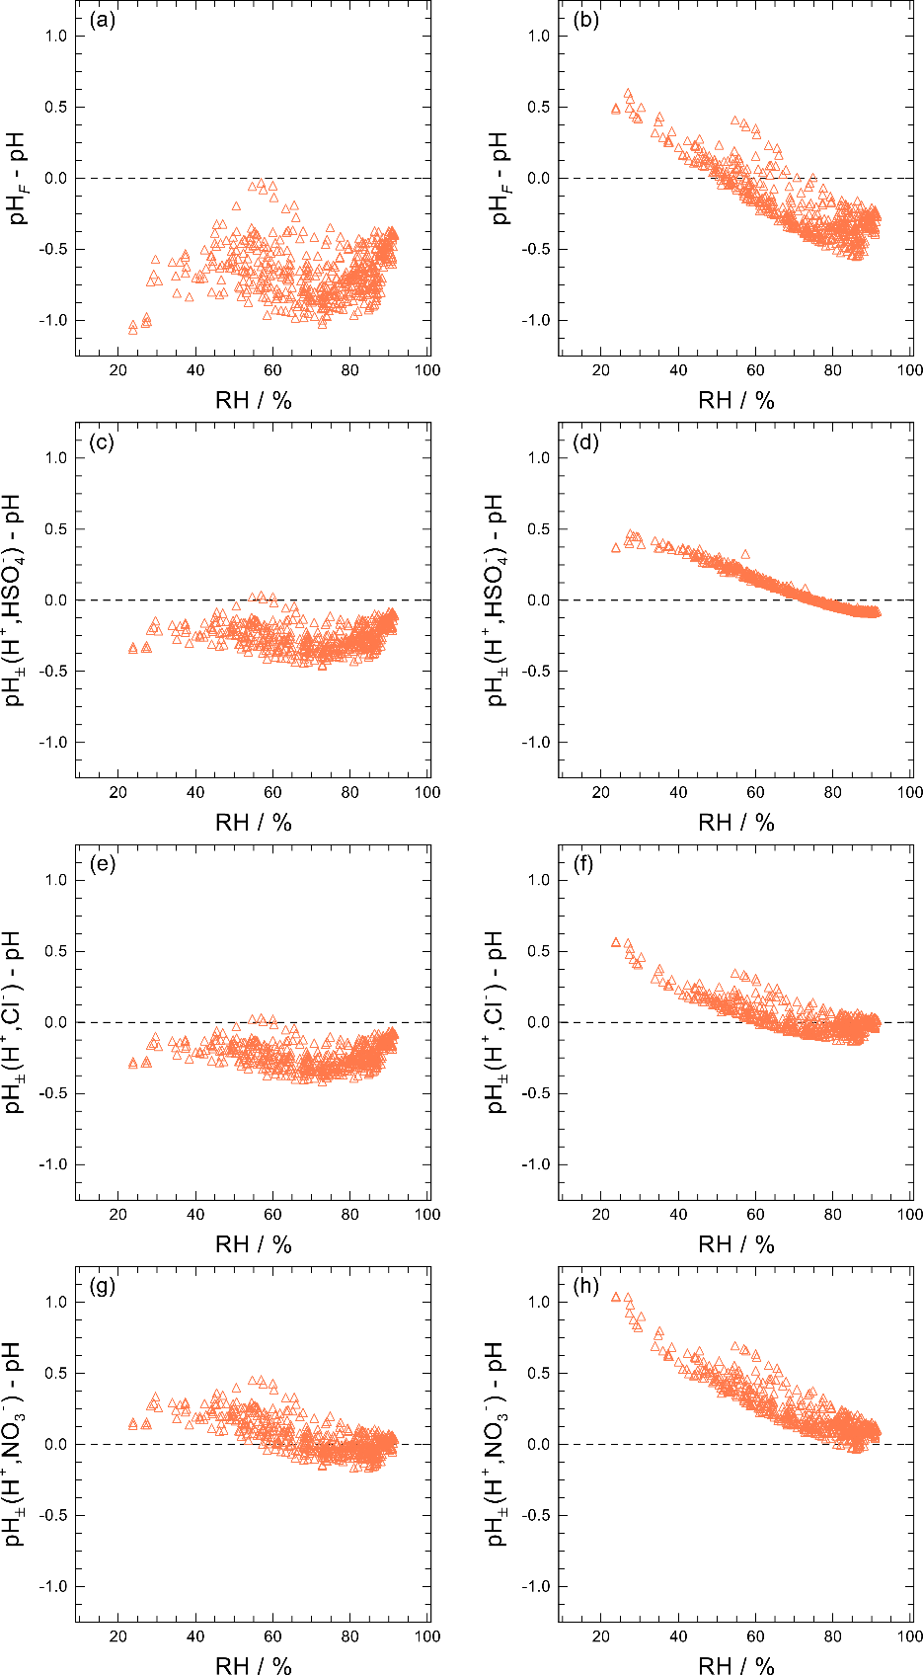
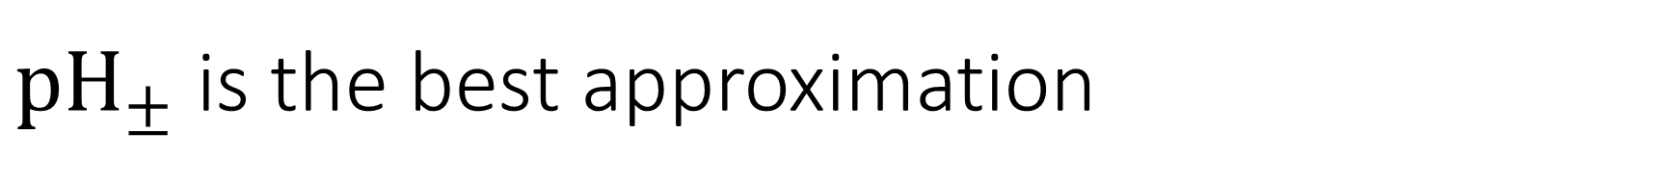
${pH}_{±}$ is the best approximation
AIOMFAC-GLE
AIOMFAC-GLE
pH_{F} – pH
pH± (H⁺, Cl⁻) – pH
E-AIM
E-AIM
AIOMFAC-GLE
AIOMFAC-GLE
pH± (H⁺, HSO₄⁻) – pH
pH± (H⁺, NO₃⁻) – pH
E-AIM
E-AIM
Semi-quantitatively captures the increase in γ due to decreasing RH
pH± (H⁺, Cl⁻) is best approximation overall
  pH± (H⁺, NO₃⁻) is best approximation for AIOMFAC-GLE; degraded compared to pH_{F} for E-AIM
  pH± generally reduces scatter (less error compared to pH) but can have higher mean bias in the case of E-AIM
Plots for CalNex data only
Notes:
For AIOMFAC-GLE both H,NO3 and H,Cl are good ion pairs for approximating pH. Both show reduced RMSE and MB compared to pHF for the combined dataset.

Slide 25
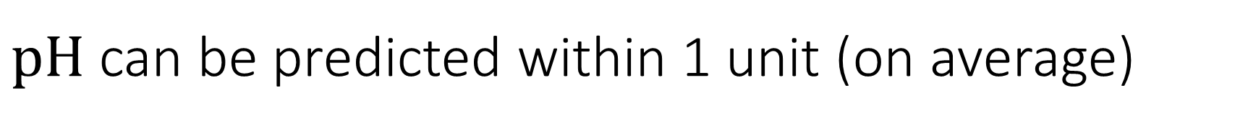
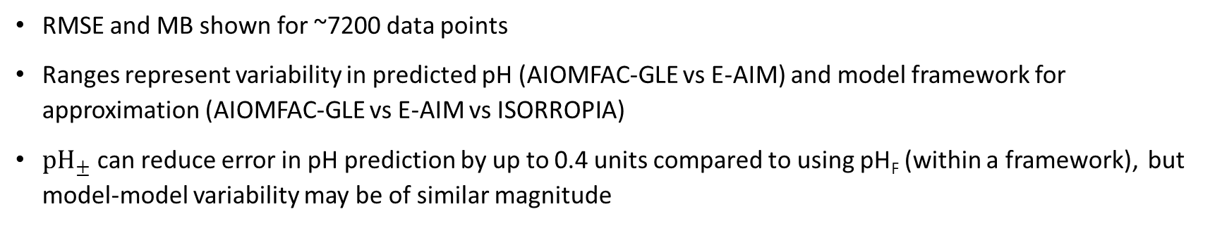
$pH$can be predicted within 1 unit (on average)
 | RMSE compared to pH | MB compared to pH
pH_{F} | 0.452 to 0.611 | -0.544 to 0.123
pH± (H⁺, Cl⁻) | 0.230 to 0.527 | -0.200 to 0.331
RMSE and MB shown for ~7200 data points
Ranges represent variability in predicted pH (AIOMFAC-GLE vs E-AIM) and model framework for approximation (AIOMFAC-GLE vs E-AIM vs ISORROPIA)
${pH}_{±}$ can reduce error in pH prediction by up to 0.4 units compared to using pH_{F} (within a framework), but model-model variability may be of similar magnitude
Notes:
highest RMSE in pH+- occur for E-AIM (pH)-ISORROPIA (pH+-)

Slide 26
Proxies of pH

Slide 27
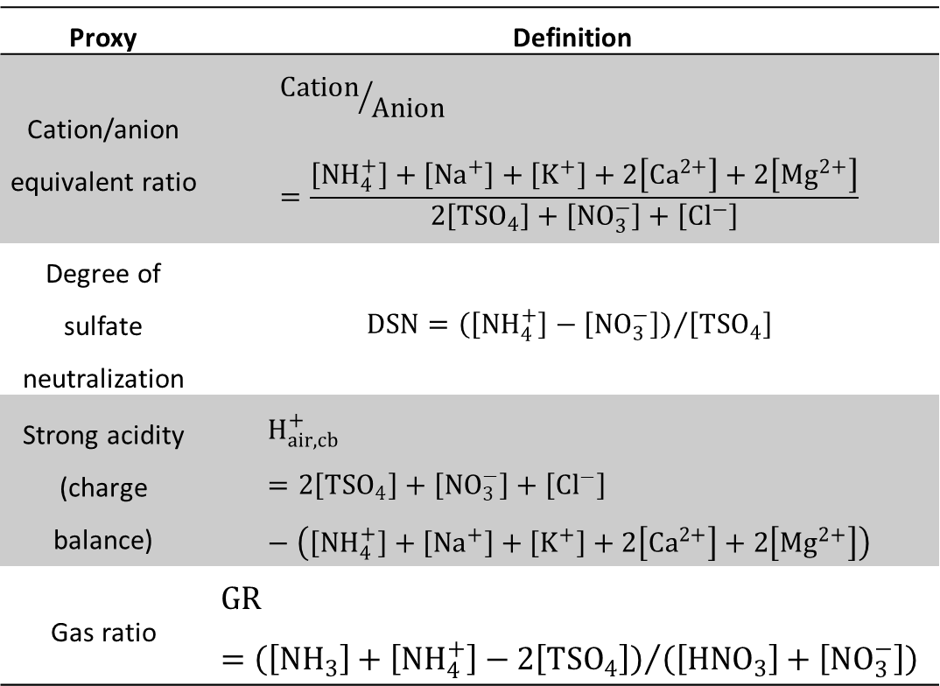
Proxies are indirectly linked to pH
Developed due to lack of direct pH measurements
Used to infer pH (e.g. acidic vs basic particles) or to infer properties related to acidity (e.g. PM sensitivity to NH_{x} vs NO₃)
Have provided qualitative information that has advanced atmospheric science
Common types of proxy bases:
  Electroneutrality
    Charge balance
    Molar ratio
    Degree of neutralization
  Semivolatile partitioning
  Gas ratio
Proxy | Definition
Cation/anion equivalent ratio | $${Cation}/{Anion}=\frac{\left[{NH}_{4}^{+}\right]+\left[{Na}^{+}\right]+\left[K^{+}\right]+2\left[{Ca}^{2+}\right]+2\left[{Mg}^{2+}\right]}{2\left[{TSO}_{4}\right]+\left[{NO}_{3}^{−}\right]+\left[{Cl}^{−}\right]}$$
Degree of sulfate neutralization | $$DSN={\left(\left[{NH}_{4}^{+}\right]−\left[{NO}_{3}^{−}\right]\right)}/{\left[{TSO}_{4}\right]}$$
Strong acidity (charge balance) | $$H_{air,cb}^{+}=2\left[{TSO}_{4}\right]+\left[{NO}_{3}^{−}\right]+\left[{Cl}^{−}\right]−\left(\left[{NH}_{4}^{+}\right]+\left[{Na}^{+}\right]+\left[K^{+}\right]+2\left[{Ca}^{2+}\right]+2\left[{Mg}^{2+}\right]\right)$$
Gas ratio | $$GR={\left(\left[{NH}_{3}\right]+\left[{NH}_{4}^{+}\right]−2\left[{TSO}_{4}\right]\right)}/{\left(\left[{HNO}_{3}\right]+\left[{NO}_{3}^{−}\right]\right)}$$
Notes:
Definition of proxy expanded to include quantities that may have an endpoint other than pH in mind, but are fundamentally related to pH and thus have pH built into their interpretation.
Proxies have provided qualitative information (for example, that isoprene aerosol was linked with H+ air) that resulted in further analysis that advanced the field

Slide 28
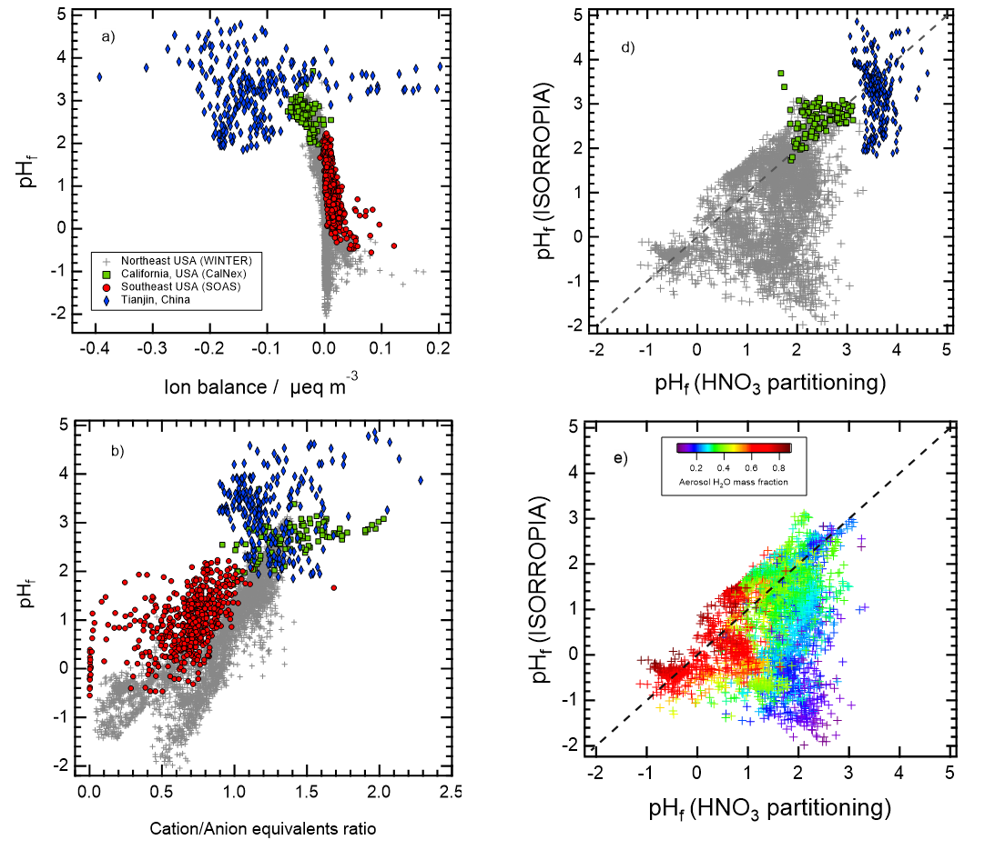
Proxies subject to measurement error
Electroneutrality-based proxies limited by
  Sensitivity to limitations in precision and accuracy of measurements
  Lack of aerosol water
  Lack of treatment of non-ideality
  Use of an extensive property as an indicator of an intensive one
Negative ion balance or molar ratio > 1 (excess cations) does not mean basic aerosol
pH_{F}
pH_{F}
Notes:
Challenges associated with measurement precision are the same reason why aerosol-only inputs to thermodynamic models are not recommended
Error in measured species concentration can propagate to error in proxy
H⁺ is generally a minor aerosol-phase species so measurements of major species (sulfate, nitrate, ammonium, NVC) are not precise enough even if measured concentrations are high
The same reason why aerosol-only inputs to thermodynamic models are not recommended
Negative ion balance or molar ratio > 1 (excess cations) incorrectly implies basic aerosol

Slide 29
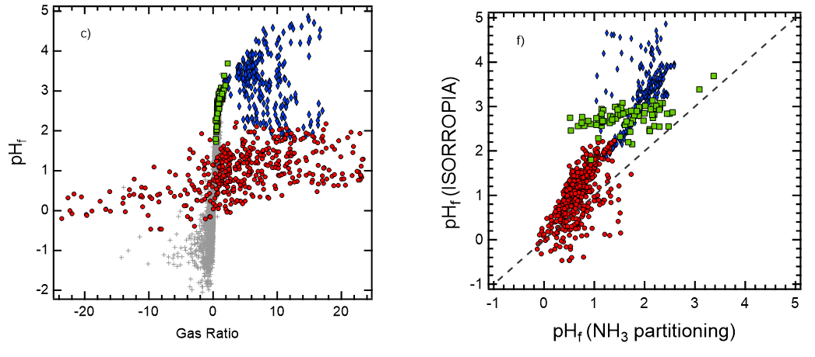
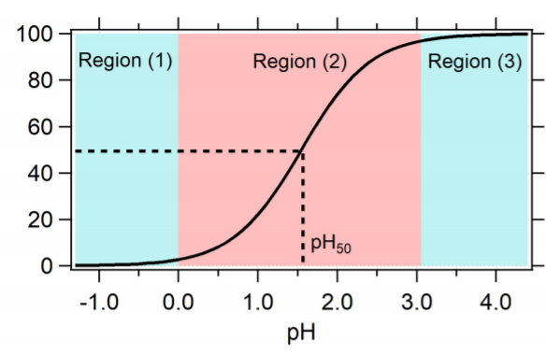
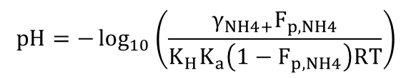
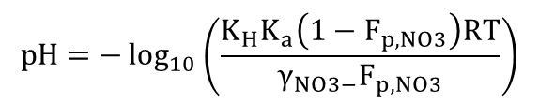
Fraction of species in particle (F_{p}) is related to pH
F_{p,NO3}
low aerosol water
pH_{F}
pH_{F}
Guo et al., 2018 ACP
pH_{F} (HNO₃ partitioning)
pH_{F} (NH₃ partitioning)
$$pH=−\log_{10}\left(\frac{K_{H}K_{a}\left(1−F_{p,NO3}\right)RT}{γ_{NO3−}F_{p,NO3}}\right)$$
$$pH=−\log_{10}\left(\frac{γ_{NH4+}F_{p,NH4}}{K_{H}K_{a}\left(1−F_{p,NH4}\right)RT}\right)$$
Not a true replacement for pH
Requires aerosol liquid water abundance (to convert Henry’s Law coefficients to K_{H})
Requires same measurements/inputs as thermodynamic model calculation (gas + aerosol)
Notes:
pH in equations reduce to pHF when activity coefficients of 1 are assumed

Slide 30
PM sensitivity analysis could benefit from pH
PM mass is influenced by pH
GR has been used to understand how reductions in sulfate affect PM
  some sigmoidal relationship with pH
  correlated with pH_{F} in some environments
Since pH is implicitly part of how emissions affect PM, pH should be explicitly considered
pH can be a useful way to evaluate CTM PM sensitivity
pH_{F}

Slide 31
Chemical Kinetics, Heterogeneity, and pH

Slide 32
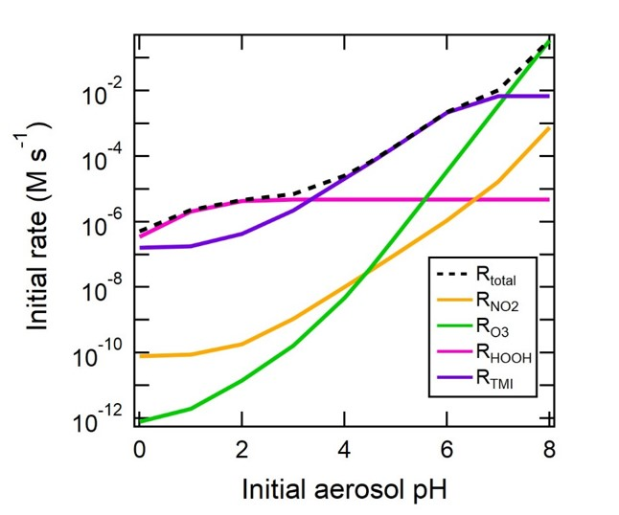
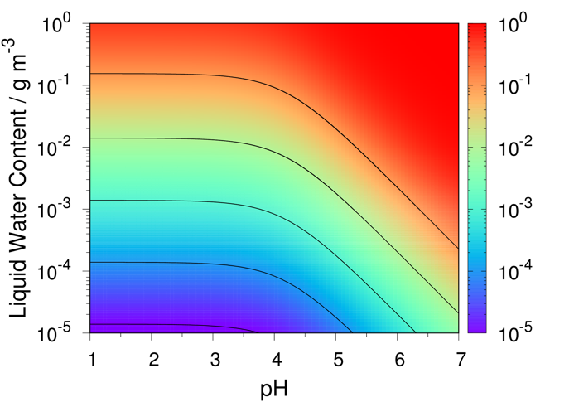
Chemical reactions in aqueous phases affect pH
Rates of in-particle sulfate production
(Beijing haze conditions)
Fraction of benzoic acid dissolved in aqueous phase (vs gas phase)
Effects of kinetics on pH: S(IV)→S(VI) oxidation, buffering (e.g. quenching of sulfate production), organosulfate formation and sequestering of H⁺
Effects of pH on kinetics: solubilization, reaction rates
Companion paper in preparation: Tilgner et al. with V. Faye McNeill coordinating
Notes:
Most of pH discussion thus far has focused on equilibrium

Slide 33
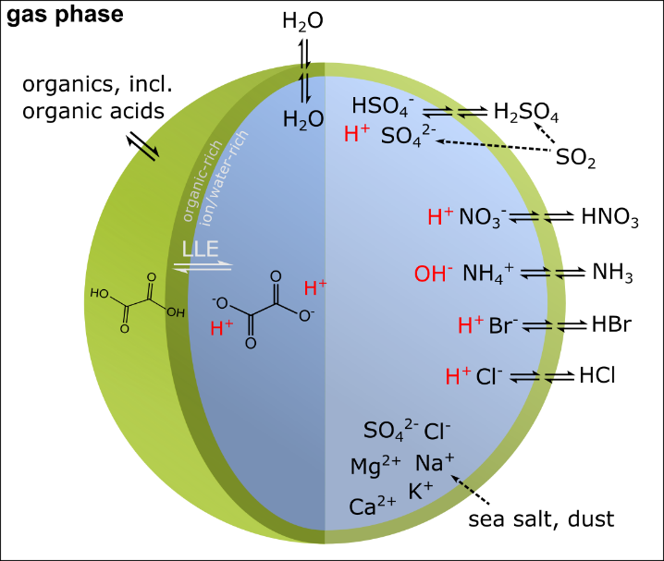
pH can be heterogenous across a population
Particle size, mass transfer limitations, and composition (mixing state) play a role
Presence of organic species could influence pH
  By modifying activity coefficient of H⁺
  By perturbing gas-particle partitioning of semivolatile components
  Via dissociation of organic acids (or association with amines)
Evidence for small changes in pH due to organics (tenths of pH units)
More work needed
Notes:
Size-coarse from sea salt and dust, higher pH PM1-2.5 is transition regime
Organic-inorganic interactions acan have an impact on mutual solubility and phase transitions with mutual solubility increasing towards higher solubility.
Few tenths pH effects for dissociated organic acids and non-ideality effects published.
Heterogeneity also occurs in the cloud system but we usually only measure a bulk property

Slide 34
Observations of aerosol pH
Notes:
Aerosol pH not typically measured due to small sample volumes and high ionic strengths. In addition, measurements would have to maintain equilibrium with the gas phase.
Generally, Estimates of fine particle pH are derived from models fed with observational constraints.

Slide 35
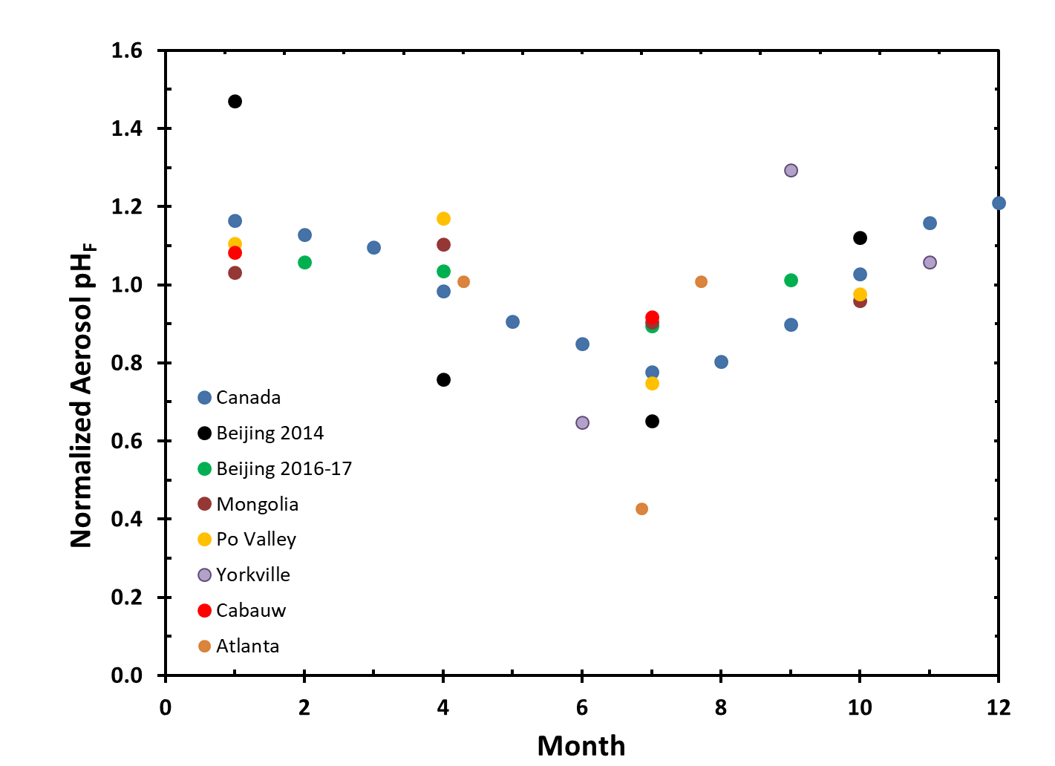
Particles are more acidic in summer than winter
normalized to annual average at location
Notes:
Summer experiences higher T (less ALWC) and more sulfate production
Low T and high RH in winter facilitate liquid water while summer conditions facilitate productions of sulfate
Annual pHF swings of 0.6 to 2.3

Slide 36
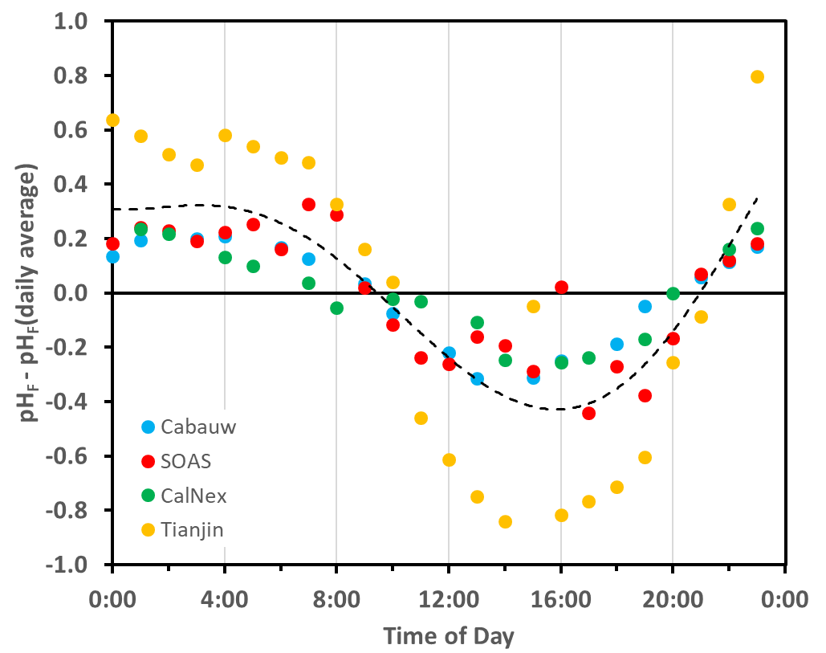
Particles are more acidic during day than night
Notes:
Diurnal changes in temperature and RH influence pH as well.
Urban heat island effect can also be seen in pH

Slide 37
Fine particles are acidic
pH_{F}
Data available in ACPD SI and will be posted in tables at doi:10.23719/1504059
Notes:
The eastern US is one of the most acidic locations with pHF near 1.
Higher pH in locations with intense agricultural emissions and/or larger particles
Relatively high pH in mainland China near Beijing. Values still acidic but can be between 4 and 6. Southeast Asia experiences higher acidity-variability in sources of alkalinity.

Slide 38
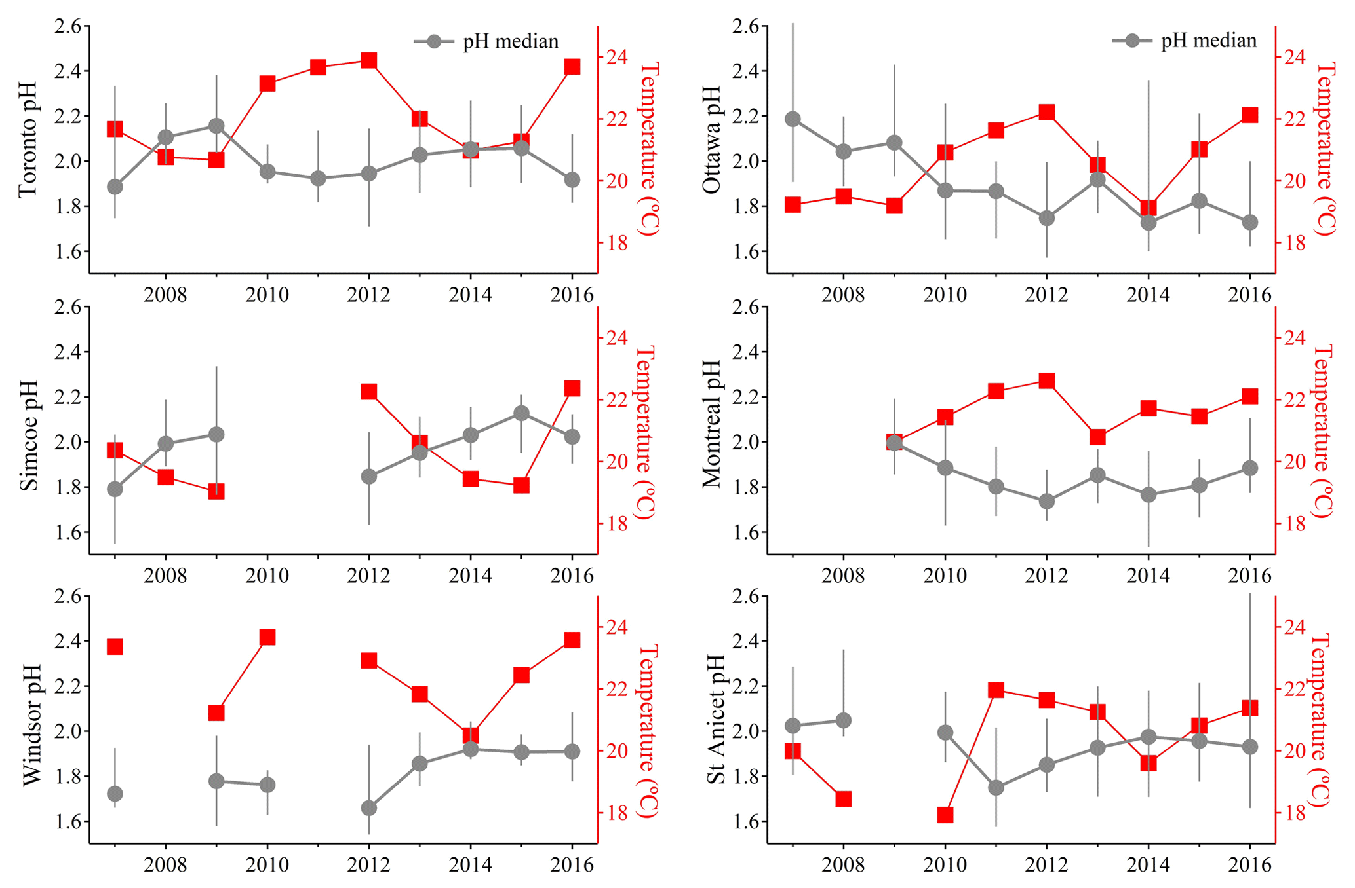
Fine aerosol pH relatively constant
Variability in summer pH in Canada driven by meteorology (Tao and Murphy 2019 ACP)
Notes:
Variability in summer pH driven by meteorology (Tao and Murphy 2019 ACP)

Slide 39
Observations of cloud pH

Slide 40
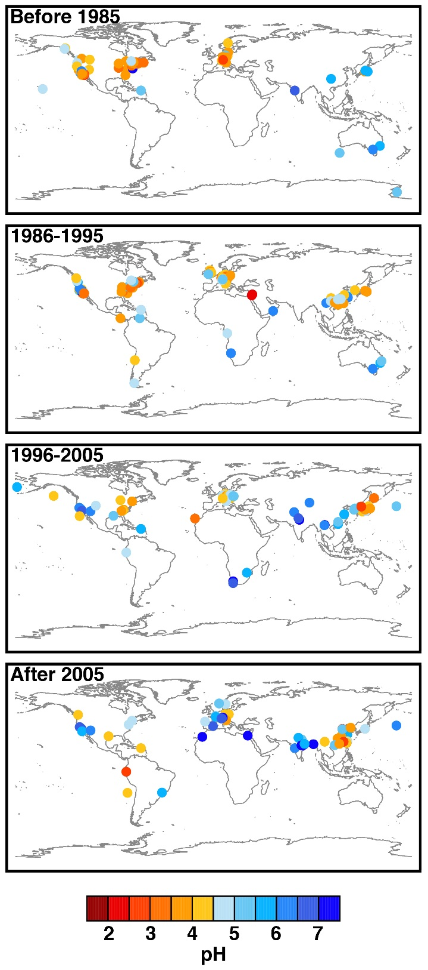
Clouds are acidic-but less so than particles
Data available in ACPD SI and will be posted in tables at doi:10.23719/1504059

Slide 41
Cloud pH has been changing
0.56 pH unit increase per decade
Europe only

Slide 42
Regional-global model predictions of pH

Slide 43
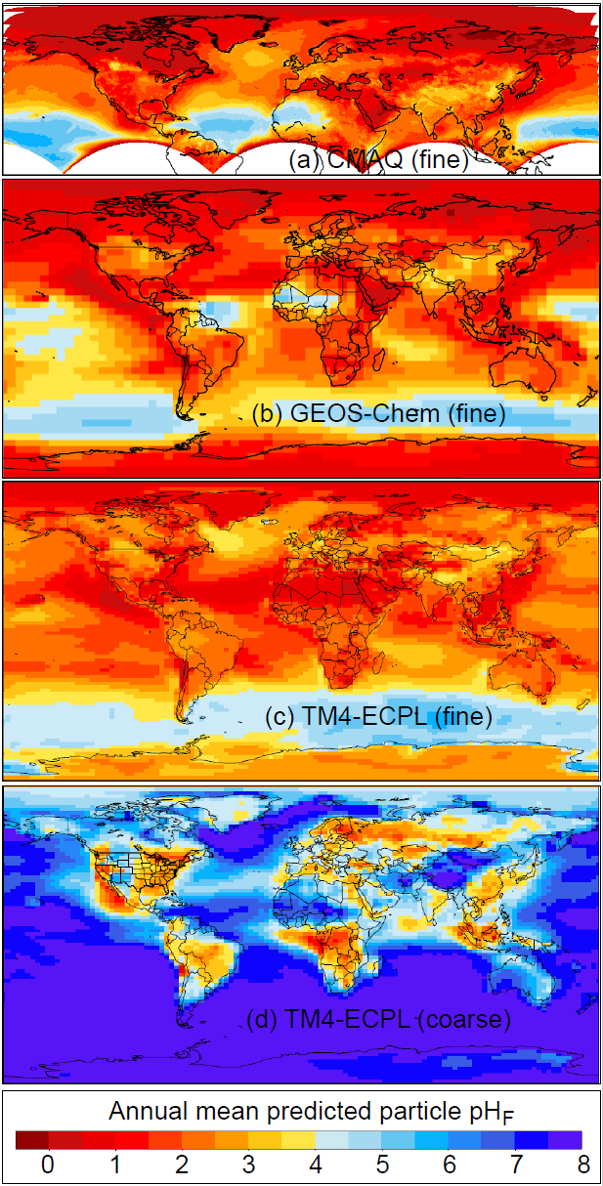
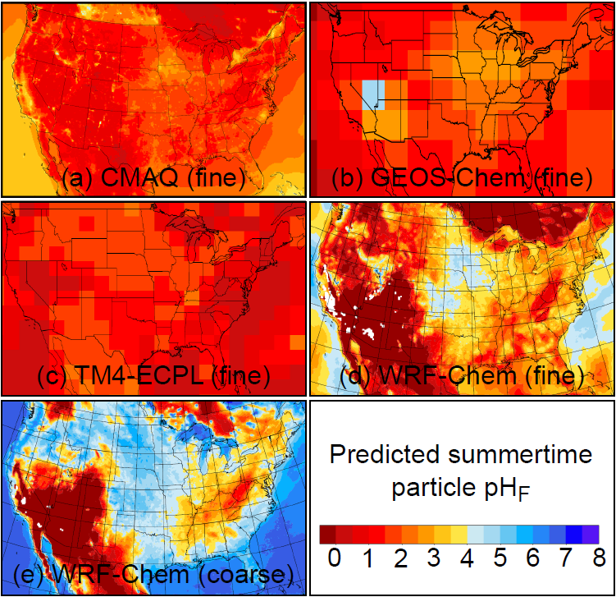
Inputs to thermodynamic models drive diversity for PM_{2.5}
Notes:
Several models use same thermodynamics. For example, CMAQ, GEOS-Chem, and TM4-ECPL use ISORROPIA.
WRF-Chem here uses MOSAIC
Even with the same thermodynamics, models can differ by up to 5 units in pH. This can be seen over the Sahara where models make different assumptions about the mixing state of NVC

Slide 44
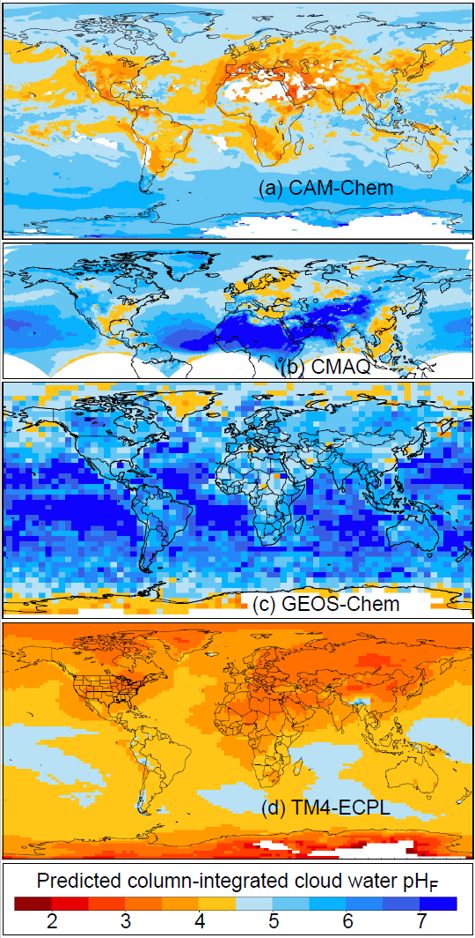
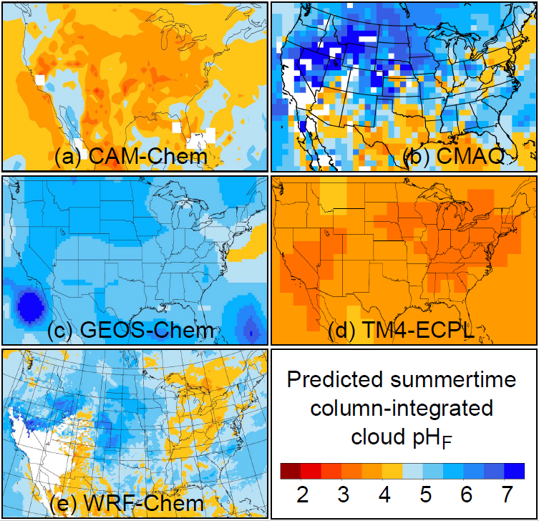
Cloud pH estimates show considerable diversity

Slide 45
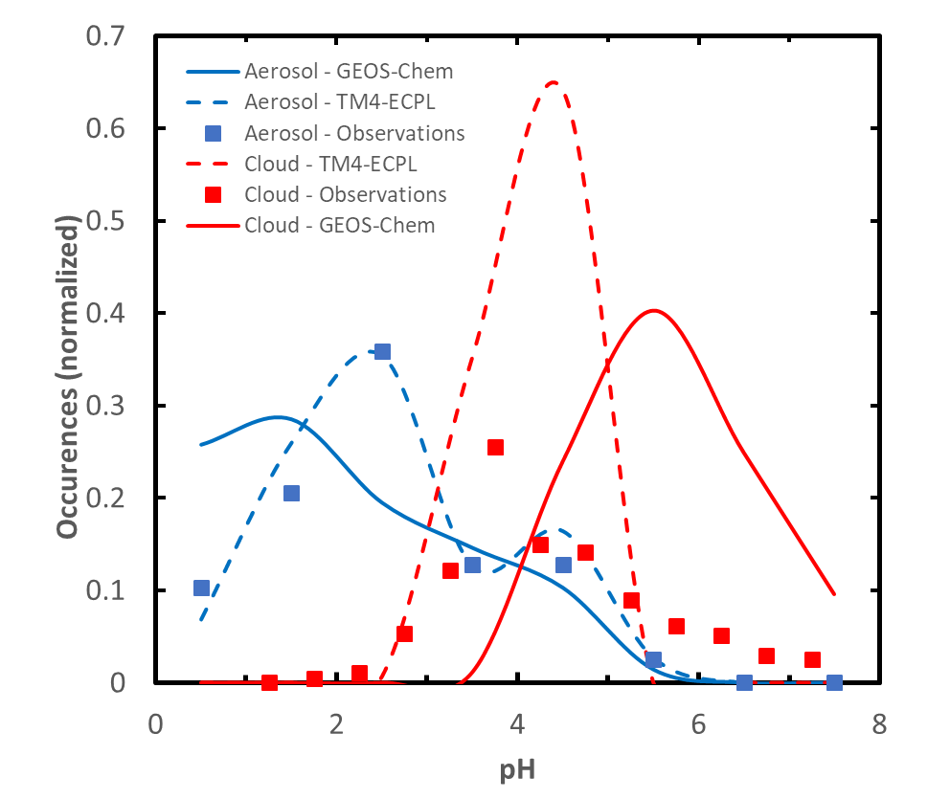
Features of the global distribution of pH are captured by models
…but discrepancies also exist

Slide 46
In conclusion

Slide 47
The Big Picture
Aerosol acidity is generally estimated with models
  Limited spatial and temporal coverage of estimates
Acidic fine particles (pH -1 to 5) are ubiquitous
  pH variability driven by source composition, chemistry, and meteorology
Clouds are less acidic than particles (pH 2 to 7)
  More condensed water than particles
  Can be measured as a bulk property
As anthropogenic emissions (e.g. SO_{x}, NO_{x}) are controlled
  Clouds tend to become less acidic as they integrate gas+particle composition
  Fine aerosol acidity can remain relatively constant due to semivolatile nature of acids and bases

Slide 49
EXTRA
49

Slide 50


Slide 51
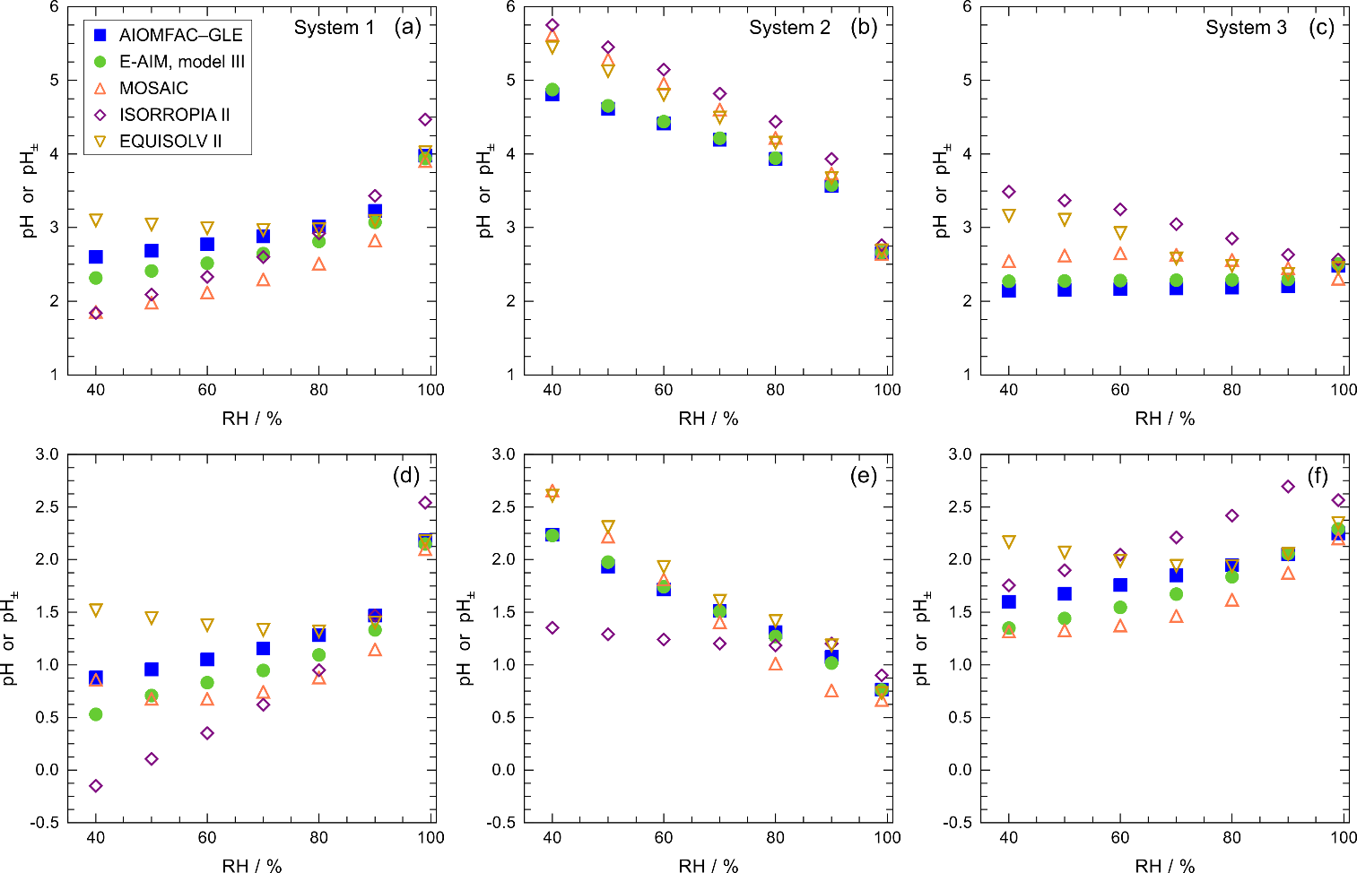
Box model agreement is a function of RH
Moderately acidic sulfate-rich system
Highly acidic sulfate-rich system
Models predicting pH (AIOMFAC-GLE, E-AIM) are in good agreement (within 0.4 pH units)
Best agreement at high RH (dilute) with spread increasing to > 1 pH unit as RH decreases
Model differences due to differences in: liquid water content, degree of bisulfate dissociation, gas-particle partitioning, and activity coefficient approach

Slide 52
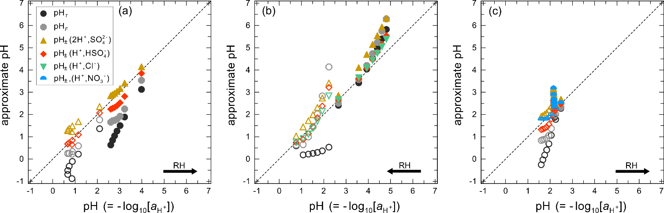
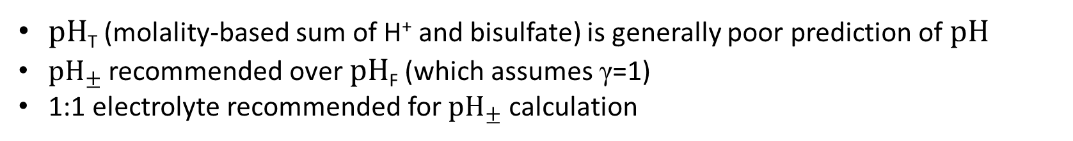
pH approximations vary in accuracy
Sulfate-rich system
Sea-salt like system
Nitrate-rich system
pH_{T} (molality-based sum of H⁺ and bisulfate) is generally poor prediction of pH
${pH}_{±}$ recommended over pH_{F} (which assumes γ=1)
1:1 electrolyte recommended for ${pH}_{±}$ calculation
All calculations by AIOMFAC-GLE

Slide 53
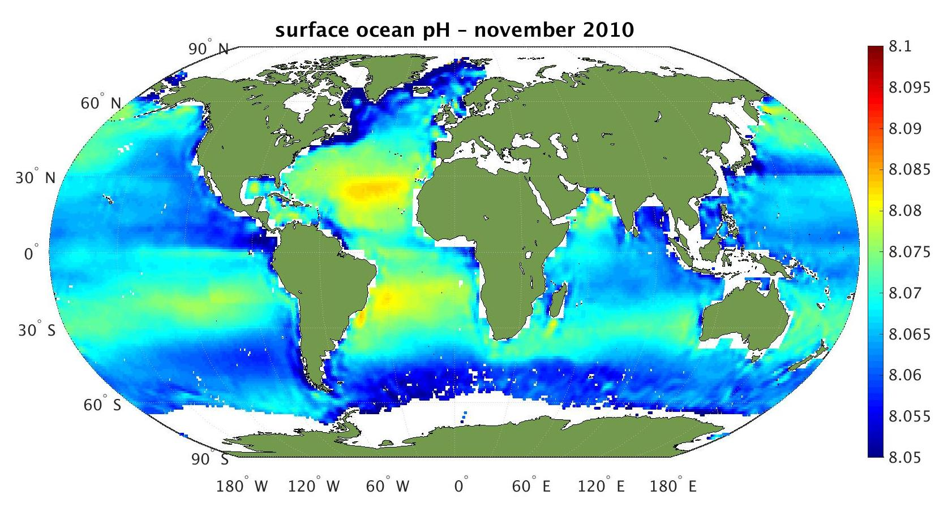
Suspended condensed phases are acidic
Image: esa.int
Notes:
The pH of sea water is fairly well established at a value of 8.1 which is slightly alkaline. While there is some variability, values are constrained to a fairly narrow band that has been trending towards higher acidity as a result on increased atmospheric CO2 levels. The relatively high pH value of sea water means emissions of sea spray aerosol also tend to have high pH. Sea spray aerosols will rapidly dehydrate and acids will partition into the particle. Initially the dissolved acids will titrate the carbonate alkalinity in the sea salt, but eventually the particles will become acidified compared to their initial emitted form. Generally, within 15 minutes, sea spray aerosols are acidified.

Slide 54
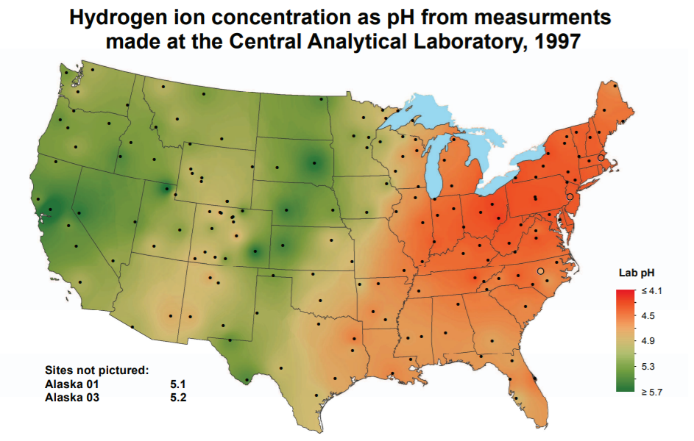
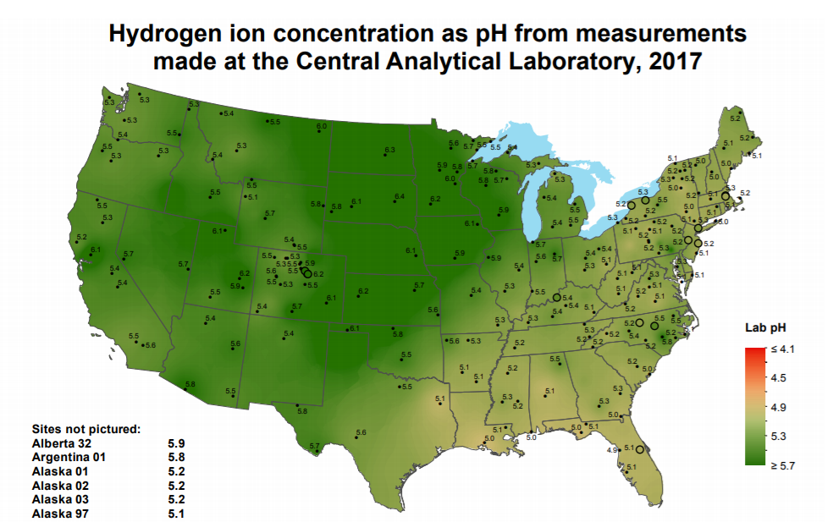
Suspended condensed phases are acidic
pH of precipitation (1997)
pH of precipitation (2017)
Image: NADP NTN
Notes:
We would be remis not to talk about the connection of particles and clouds to acid rain.
The pH of precipitation is variable with lower values corresponding to acid rain. Clean rain is around pH 5.6 as dictated by carbon dioxide. However, the pH of rain could be higher if significant alkaline emissions (dust, NH3) are present. As precipitation tends to integrate atmospheric composition, the pH of precipitation has changed significantly as emissions have been controlled in the US. Emission controls designed to reduce acid rain in the US have had implications for the acidity of other condensed media, particularly cloud droplets as clouds are upstream of precipitation.
https://www3.epa.gov/acidrain/education/site_students/phscale.html

Slide 55
Acidity influences multiple endpoints
Reduce words
Direct and indirect effects of pH on deposition lead to ecosystem, biogeochemistry, water quality, and carbon cycle impacts.
Direct acid deposition can cause
  Leaching of cations from foliage and soils
  Altered stomatal function
  Changes in leaf wax structure
  Mobilization of aluminum in soil
Acidity can increase the solubility and bioavailable of trace nutrients (phosphorus, iron, copper) leading to phytoplankton blooms
pH-dependent gas-particle partitioning has implications for atmospheric lifetime and transport of N (reduced and oxidized)
Notes:
The acidity of particles and cloud droplets influences multiple endpoints of interest.
Read bullets
…since gas phase species such as nitric acid and ammonia have higher deposition velocities than their aerosol-phase counterparts.
==================
We have already hinted at the fact that upon emission, sea spray aerosols are rapidly processed to higher acidity. This has implications for halogen chemistry and the oxidation capacity of the atmosphere.
Aluminum mobilization has implications for water quality
Increased solubility and bioavailability of trace nutrients can lead to promotion of phytoplankton blooms and have implications for ocean biogeochemistry and the carbon cycle.

Slide 56
Acidity influences multiple endpoints
Reduce words
pH affects human health by determining PM_{2.5} mass and composition.
PM_{2.5} mass affected by
  gas-particle partitioning of pH-dependent species (e.g. nitrate, ammonia)
  Acid catalyzed reactions (e.g. isoprene epoxydiols)
pH affects solubility and gas-particle partitioning of acids with potential health implications (e.g. PFAS)
Aerosol pH has been linked to third-hand smoke exposure (De Carlo et al., 2018)
pH-dependent solubilization of metals (e.g. Fe) is linked to the oxidative potential of particles (Poschl and Shiraiwa, 2015)
Recent work has further linked solubilization of metals to cardiovascular endpoints (Fang et al., 2017)

Slide 57
Acidity influences multiple endpoints
Reduce words
pH has implications for climate and other endpoints.
pH influences water uptake of particles modulating visibility and the aerosol direct effect
Cloud pH has been linked to the amount and speciation of aerosol upon evaporation with radiative effects (Turnock et al., 2019)
pH affects brown carbon formation
Acidity modifies the active sites on ice nuclei (IN)
Acid-base chemistry has a role in new particle formation and growth with implications for aerosol size and CCN abundance
pH has implications for halogen chemistry and oxidation capacity of troposphere

